Slide 1

Memory Management in ESX
Samuel Zhang，BJ Storage FVT team

Slide 2

Agenda
Memory virtualization
Memory Reclamation
Memory Sharing
Memory Management

Slide 3
Memory virtualization
Traditional Address Spaces
0
4GB
Process Virtual Address Space
Background Process
Operating System
Background Process
Operating System
0
4GB
Current Process
Operating System
Virtual
Address Space
MMU
0
4GB
RAM
Frame
Buffer
Devices
ROM
Physical
Address Space
Notes:
TLB: Translation look-aside Buffer

Slide 4
Memory virtualization
Memory Management Unit (MMU)
  Page table: Virtual Address to Physical Address translation
    Woks in fixed page size (typically 4kB)
    Page protection
  Translation Look-aside Buffer (TLB)
    Cache virtual address to physical address translation for performance
  Control Register (CR3)
    Page table location
Notes:
TLB: Translation look-aside Buffer

Slide 5
Memory virtualization
Traditional Address Translation
Virtual Address
TLB
Physical Address
1
5
2
6
4
CR3
Operating System’s
Page Fault Handler
Process
Page Table
3
Notes:
Work flow when there is a TLB miss
There is a miss in the TLB. The hardware will walk the current process’s page table to find the mapping.
One of two things can happen:
The required mapping is found in the page table and placed in the TLB. The instruction is restarted and all proceeds normally. Note that in this case the hardware does all the work.
The required mapping is not present. An page fault exception is generated by the hardware and trapped into the operating system. The OS will do what it does to figure out the correct mapping.
The new translation is put into the current process’s page table.
The OS resume’s execution at the faulting instruction. Now the hardware TLB refill mechanism will work.
The hardware put the new mapping in the TLB and life goes on.

Slide 6
Memory virtualization
Virtualized Address Spaces
0
4GB
Current Guest Process
Guest OS
Virtual
Address Spaces (VPN)
0
4GB
Virtual RAM
Virtual
Frame
Buffer
Virtual
Devices
Virtual
ROM
Physical
Address Spaces (PPN)
PhysMap (pmap)
0
4GB
RAM
Devices
Frame
Buffer
ROM
Machine
Address Space (MPN)
Guest maps Virtual Address to Physical Address
VMM maps Physical Address to Machines Address
Notes:
Shadow page table which means it’s invisible to Guest

Slide 7
Memory virtualization
Virtualized Address Spaces
0
4GB
Current Guest Process
Guest OS
Virtual
Address Spaces (VPN)
Shadow page table
0
4GB
Virtual RAM
Virtual
Frame
Buffer
Virtual
Devices
Virtual
ROM
Physical
Address Spaces (PPN)
0
4GB
RAM
Devices
Frame
Buffer
ROM
Machine
Address Space (MPN)
Hardware TLB must have VPN to MPN translation
Notes:
Shadow page table which means it’s invisible to Guest

Slide 8
Memory virtualization
Virtualized Address Translation
Virtual Address
TLB
Machine Address
6
1
7
2
8
Real CR3
5
Shadow
Page Table
Guest
Page Table
4
PMap
3
A
Notes:
Work flow when there is a TLB miss
There is a miss in the TLB. The hardware will walk the shadow page table to find the mapping. The page table structure will probably be more complicated than I’m showing here.
One of two things can happen:
The required mapping is found in the page table and placed in the TLB. The instruction is restarted and all proceeds normally. Note that in this case the hardware does all the work.
The required mapping is not present. An page fault exception is generated by the hardware and trapped into the VMM. The VMM needs to translate the virtual address to a machine address. It starts by walking the guest’s page table to determine the virtual to physical mapping. Note that the layout of the guest page table will be determined by the hardware being virtualized.
Note: Once the VMM tries to find the guest mapping one of two things can happen:
The guest mapping is not present. In this case the guest expects a page fault exception. So the VMM must generate an exception on the virtual cpu state and resume executing on the first instruction of the guest exception handler. This is called a true page fault because the hardware page fault results in a guest visible page fault.
If the guest mapping is present then the VMM must translate the physical page to a machine page. This is called a hidden page fault because the hardware fault is a fault that would not have occurred in non-virtualized system. In order to translate the physical page to machine page the VMM must look in PMap data structure that maps physical pages to machine pages. (A) The VMM might have perform further processing if there is no machine page backing the physical page or in other special circumstances.
The virtual to machine translation is complete. The new translation is put into the shadow page table.
The VMM restarts the guest instruction that faulted. Now the hardware TLB refill mechanism will work.
The hardware put the new mapping in the TLB and life goes on.

Slide 9
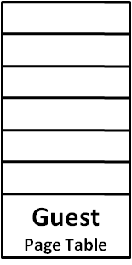
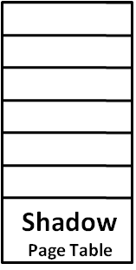
Memory virtualization
Shadow Page Tables
Guest Write
Virtual CR3
Real CR3
VMM Write
Notes:
Any write to Guest page table and virtual CR3 traced.

Slide 10
Agenda
Memory virtualization
Memory Reclamation
Memory Sharing
Memory Management

Slide 11
Memory Reclamation
  Demand Paging
  Ballooning
Notes:
Any write to Guest page table and virtual CR3 traced.

Slide 12
Memory Reclamation
Demand Paging
  Page out machine memory owned by VM to physical disk
  Operation transparent to Guest VM
  Induce double paging problem. So ESX use a randomized page replacement policy to choose candidate pages
  Dramatically downgrade VM’s performance.
Notes:
Any write to Guest page table and virtual CR3 traced.

Slide 13
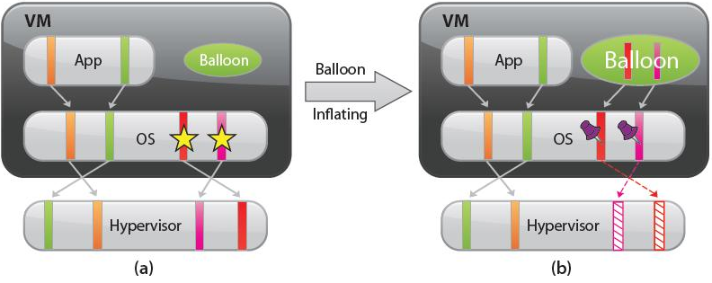
Memory Reclamation
Ballooning
  Balloon driver applies/releases memory in Guest if needed
  Balloon driver tolds ESX allocated PPNs via a private channel
  ESX invalids those PPNs in pmap and de-allocates corresponding MPNs
  Any attempt to access PPNs allocated to Balloon driver will generate a fault that will be handled by ESX
Notes:
Any write to Guest page table and virtual CR3 traced.

Slide 14
Memory Reclamation
Ballooning
Limitations:
  Balloon driver may be uninstalled, disabled, unaviable when Guest OS is booting.
  Unable to reclaim memory quickly enough
  Upper memory allocation size bounds may be imposed by guest OS limitations
Notes:
Any write to Guest page table and virtual CR3 traced.

Slide 15
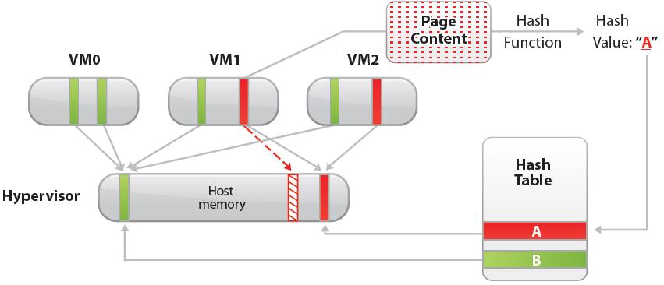
Memory Sharing
  Content-Based Page Sharing
  Using a fast, high-quality hash function to calculate hash value of a candidate page
  The hash value is used to index into a global hash table (containing other scanned pages)
  Full content comparison of two pages if they have same hash value
  If comparison succeed, PMap is re-directed to that MPN
  The shared pages are marked as COW

Slide 16
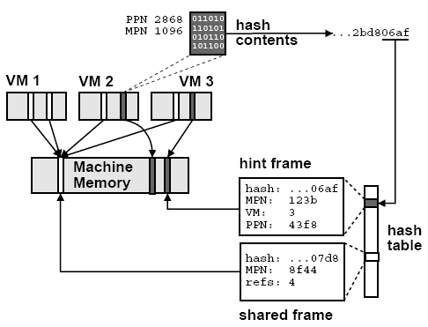
Memory Sharing
  Content-Based Page Sharing
  Hash table contains 2 kinds of entry: shared frame, hint frame
  Shared frame: 1. Hash value, 2. MPN, 3. Reference count, 4. Link for hash chaining
  Hint frame: …, 5. VM ID, 6. PPN
Notes:
Comparison failed PPN is marked as a hint frame, if other scanned pages match with it, then it’s change to shared frame;
if it’s hash value if changed, then it’s removed from the hash table

Slide 17
Agenda
Memory virtualization
Memory Reclamation
Memory Sharing
Memory Management

Slide 18
Memory Management
  Share-Based Allocation
  Reclaiming idle memory
  Measuring idle memory

Slide 19
Memory Management
  Share-Based Allocation
  A VM is entitled to consume resources proportional to its share allocation
  Shares-per-page ratio is used to distribute memory resource among VMs
  Memory is pulled from VMs which have a relatively lower shares-per-page ratio to those which has a relatively higher
  Limitation: Do not incorporate any information about active memory usage

Slide 20

Memory Management
  Reclaiming idle memory
  Idle memory tax: Charge a VM more for an idle page then for one it is actively using.
  Tax rate specifies the maximum fraction of idle pages that may be reclaimed from a VM
  S: share, P: total memory pages occupied,
  f: fraction of active memory
  , t is the idle memory tax rate
  Default t=75% for ESX, which means most idle memory will be reclaimed

Slide 21
Memory Management
  Measuring idle memory
  Statistical sampling approach
  Each VM is sampled independently using a configurable sampling period defined in units of VM execution time.
  A small number n of VM’s physical pages are selected randomly
  Each sampled page is tracked by invalidating any cached PPN->MPN mappings, count totally touched pages t
  Statistical estimate of active memory fraction f = t / n
  By default, ESX samples 100 pages for every 30s
  Result are soomthed both for stablity and agility

Slide 22
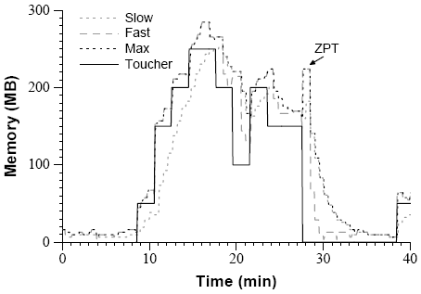
Memory Management
  Measuring idle memory

Slide 23
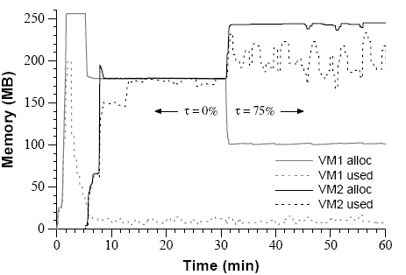
Memory Management
  Measuring idle memory

Slide 24
That’s All. Thanks!

