Slide 1
Hardware-assisted Virtualization
15-612 Operating System Practicum
Carnegie Mellon University
Pratik Shah (pcshah)
Rohan Patil (rspatil)

Slide 2
Agenda
Introduction to VT-x
CPU virtualization with VT-x
VMX
VMX Transitions
Virtual Machine Control Structure (VMCS)
MMU Virtualization with VT-x
Virtual Processor IDentifier (VPID)
Sidebar: Virtualizing memory in software
Nested / Extended Page Tables (EPT)
References
Q & A

Slide 3
VT-x
Intel Vanderpool Technology, referred to as VT-x, represents Intel’s virtualization technology on the x86 platform.

Slide 4
VT-x : Motivation
To solve the problem that the x86 instructions architecture cannot be virtualized.
Simplify VMM software by closing virtualization holes by design.
Ring Compression
Non-trapping instructions
Excessive trapping
Eliminate need for software virtualization (i.e paravirtualization, binary translation).

Slide 5
CPU Virtualization with VT-x

Slide 6
VMX
Virtual Machine Extensions define processor-level support for virtual machines on the x86 platform by a new form of operation called VMX operation.
Kinds of VMX operation:
root: VMM runs in VMX root operation
non-root: Guest runs in VMX non-root operation
Eliminate de-privileging of Ring for guest OS.

Slide 7
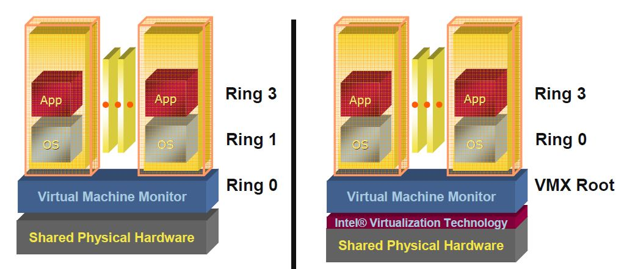
Pre VT-x Post VT-x
VMM ring de-privileging of guest OS | VMM executes in VMX root-mode
Guest OS aware its not at Ring 0 | Guest OS de-privileging eliminated
 | Guest OS runs directly on hardware
Source: [2]

Slide 8
VMX Transitions
Transitions between VMX root operation and VMX non-root operation.
Kinds of VMX transitions:
VM Entry: Transitions into VMX non-root operation.
VM Exit: Transitions from VMX non-root operation to VMX root operation.
Registers and address space swapped in one atomic operation.

Slide 9
VMX Transitions
VM 1
VM 2
VM n
VMX Non-Root Operation
Ring 3
Ring 3
Ring 3
Ring 0
Ring 0
Ring 0
VM Entry
VMCS 1
VMCS 2
VMCS n
VM Exit
VMX Root Operation
Ring 3
Ring 0
vmlaunch / vmresume

Slide 10
VMCS: VM Control Structure
Data structure to manage VMX non-root operation and VMX transitions.
Specifies guest OS state.
Configured by VMM.
Controls when VM exits occur.

Slide 11
VMCS: VM Control Structure
The VMCS consists of six logical groups:
Guest-state area: Processor state saved into the guest-state area on VM exits and loaded on VM entries.
Host-state area: Processor state loaded from the host-state area on VM exits.
VM-execution control fields: Fields controlling processor operation in VMX non-root operation.
VM-exit control fields: Fields that control VM exits.
VM-entry control fields: Fields that control VM entries.
VM-exit information fields: Read-only fields to receive information on VM exits describing the cause and the nature of the VM exit.

Slide 12
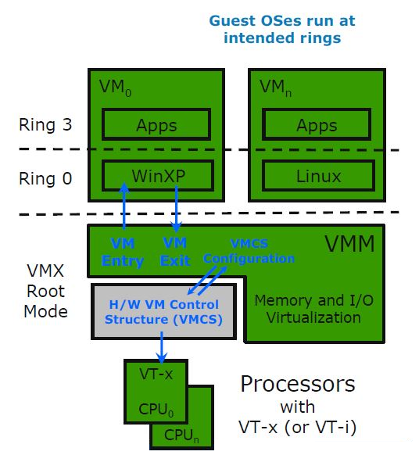
CPU Virtualization with VT-x
Source: [2]

Slide 13
MMU Virtualization with VT-x

Slide 14
VPID: Motivation
First generation VT-x forces TLB flush on each VMX transition.
Performance loss on all VM exits.
Performance loss on most VM entries
Guest page tables not modified always
Better VMM software control of TLB flushes is beneficial.

Slide 15
VPID: Virtual Processor Identifier
16-bit virtual-processor-ID field in the VMCS.
Cached linear translations tagged with VPID value.
No flush of TLBs on VM entry or VM exit if VPID active.
TLB entries of different virtual machines can all co-exist in the TLB.

Slide 16
Virtualizing Memory in Software
Three abstractions of memory:
0
4GB
Current Guest Process
Guest OS
Virtual
Address Spaces
0
4GB
Virtual RAM
Virtual
Frame
Buffer
Virtual
Devices
Virtual
ROM
Physical
Address Spaces
0
4GB
RAM
Devices
Frame
Buffer
ROM
Machine
Address Space
Source: [6]

Slide 17
Shadow Page Tables
VMM maintains shadow page tables that map guest-virtual pages directly to machine pages.
Guest modifications to V->P tables synced to VMM V->M shadow page tables.
Guest OS page tables marked as read-only.
Modifications of page tables by guest OS -> trapped to VMM.
Shadow page tables synced to the guest OS tables

Slide 18
Set CR3 by guest OS (1)
Guest
Page Table
Guest
Page Table
Guest
Page Table
Virtual CR3
Real CR3
Shadow
Page Table
Shadow
Page Table
Shadow
Page Table
Source: [6]

Slide 19
Set CR3 by guest OS (2)
Guest
Page Table
Guest
Page Table
Guest
Page Table
Virtual CR3
Real CR3
Shadow
Page Table
Shadow
Page Table
Shadow
Page Table
Source: [6]

Slide 20
Drawbacks: Shadow Page Tables
Maintaining consistency between guest page tables and shadow page tables leads to an overhead: VMM traps
Loss of performance due to TLB flush on every “world-switch”.
Memory overhead due to shadow copying of guest page tables.

Slide 21
Nested / Extended Page Tables
Extended page-table mechanism (EPT) used to support the virtualization of physical memory.
Translates the guest-physical addresses used in VMX non-root operation.
Guest-physical addresses are translated by traversing a set of EPT paging structures to produce physical addresses that are used to access memory.

Slide 22
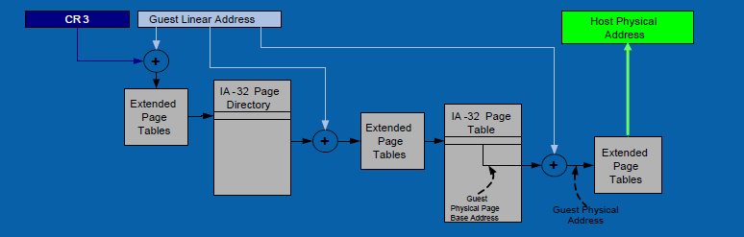
Nested / Extended Page Tables
Source: [2]

Slide 23
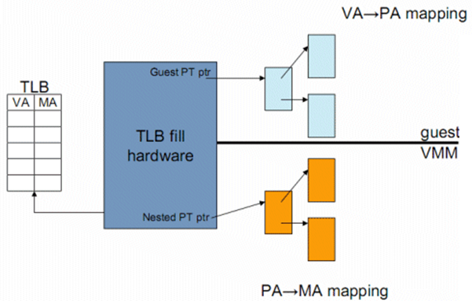
Nested / Extended Page Tables
Source: [4]

Slide 24
Advantages: EPT
Simplified VMM design.
Guest page table modifications need not be trapped, hence VM exits reduced.
Reduced memory footprint compared to shadow page table algorithms.

Slide 25
Disadvantages: EPT
TLB miss is very costly since guest-physical address to machine address needs an extra EPT walk for each stage of guest-virtual address translation.

Slide 26
References
Intel 64 and IA-32 Architectures Software Developer’s Manual (Volume 3C, Part 3) http://download.intel.com/products/processor/manual/326019.pdf
Intel Virtualization Technology Processor Virtualization Extensions and Intel Trusted execution Technology repo.meh.or.id/Todo/virtualization.pdf
Intel Virtualization Technology Primer by Rich Uhlig software.intel.com/file/26677
Hardware Virtualization blogs by Johan De Gelas at AnandTech http://www.anandtech.com/show/2480/9 http://www.anandtech.com/show/2480/10
Performance Evaluation of Intel EPT Hardware Assist http://www.vmware.com/pdf/Perf_ESX_Intel-EPT-eval.pdf
Memory Virtualization by Scott Devine, VMware Labs labs.vmware.com/download/46/‎

Slide 27

Questions

Slide 28
Thank You

