Slide 1

UNH InterOperability Lab
SCSI Commands Overview

Slide 2
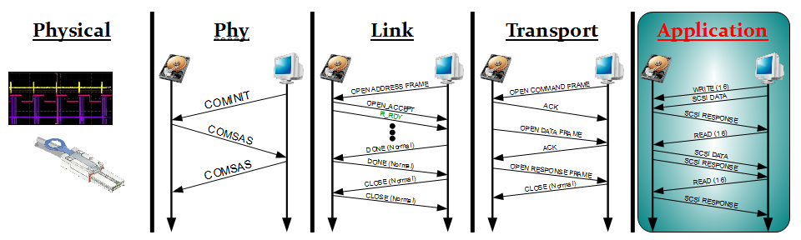

Slide 3

Presentation Topics
Command Summary
Select Command Explanations
Additional Sense Codes and Qualifiers

Slide 4
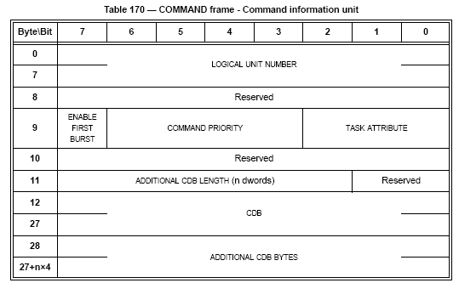
CDB
Command Data Block
  Commands are defined with CDBs
    Each command has its own CDB
  CDBs defined by various SCSI Standards
  Fixed and variable length variations
  In SAS:
    Encapsulated in a
    command frame

Slide 5
SCSI Command Sets
SPC-4
  SCSI Primary Commands Version 4
  Commands universal to all device types
SBC-3
  SCSI Block Command Version 3
  Commands specific to block devices (hard disks)
SSC-2
  SCSI Streaming Commands Version 2
  Commands specific to streaming devices (tape drives)
MMC-4
  SCSI Multi Media Commands Version 4
  Commands specific to multimedia devices (CD/DVD)

Slide 6
Common SCSI Commands in SAS
Read Commands
  READ (6) (SSC and SBC)*
  READ (10) (SBC)
  READ (12) (SBC)
  READ (16) (SBC)
  READ (32) (SBC)
*Different field definitions, same CDB Length

Slide 7
Command SCSI Commands in SAS
Write Commands
  WRITE (6) (SSC and SBC)*
  WRITE (10) (SBC)
  WRITE (12) (SBC)
  WRITE (16) (SBC)
  WRITE (32) (SBC)
*Different Field Definitions, same CDB Length

Slide 8
Diagnostic and Initialization Commands
READ BUFFER (SPC)
WRITE BUFFER (SPC)
INQUIRY (SPC)
TEST UNIT READY (SPC)
MODE SENSE (SPC)
MODE SELECT (SPC)
LOG SENSE (SPC)
LOG SELECT (SPC)
READ ATTRIUBUTE (SPC)
REPORT LUNS (SPC)

Slide 9
Block Specific Commands
READ CAPACITY
VERIFY
WRITE AND VERIFY
READ LONG
WRITE LONG
Many more…

Slide 10
Streaming Specific Commands
LOAD UNLOAD
LOCATE (16)
PREVENT ALLOW MEDIUM REMOVAL
READ BLOCK LIMITS
READ POSITION
REWIND
SET CAPACITY
SPACE (16)

Slide 11
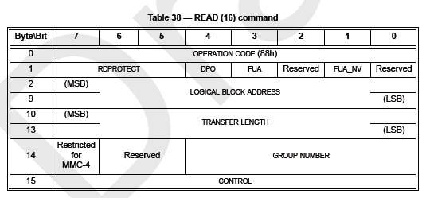
READ (16) Command
OP Code: 88h Specifies the command
RD Protect: Various settings regarding the write protection checking

Slide 12
READ (16) Command
DPO – Disable Page Out Bit
  Used to optimize caching onboard the target device
  Set to 1 tells the target that data at this Logical Block Address is not likely to be accessed again in the near future and that the target can remove it from its local cache

Slide 13
READ (16) Command
FUA and FUA_NV – Force Unit Access (Non-Volatile)
  Used to override the targets internal caching and force it to access the media

Slide 14
READ (16) Command
Logical Block Address (LBA)
  The address on the medium that the initiator would like to read
  Internally, the target converts the LBA to a (Cylinder, Sector, Head) address – Transparent to the computer system and user

Slide 15
READ (16) Command
Transfer Length
  Specifies the length in contiguous logical units to be transferred in this command
  Logical unit is typically 512-bytes (1 Block)

Slide 16
READ (16) Command
Restricted for MMC-4
  Used for the MMC-4 Version of this command

Slide 17
READ (16) Command
Group Number
  Used to collect performance statistics of different groups of commands
  Application A’s performance vs. Applications B’s performance

Slide 18
READ (16) Command
Control
  Standard SCSI Control Bytes
  Defined in SAM-4
  Has a consistently defined meaning across all commands\
  Found only on fixed-length CDB commands

Slide 19
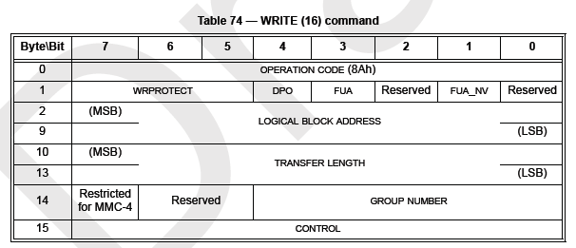
WRITE (16) Command
OP Code: 8Ah Specifies the command
WD Protect: Various settings regarding the write protection checking

Slide 20
WRITE (16) Command
DPO – Disable Page Out Bit
  Used to optimize caching onboard the target device
  Set to 1 tells the target that data at this Logical Block Address is not likely to be accessed again in the near future and that the target can remove it from its local cache

Slide 21
WRITE (16) Command
FUA and FUA_NV – Force Unit Access (Non-Volatile)
  Used to override the targets internal caching and force it to access the media

Slide 22
WRITE (16) Command
Logical Block Address (LBA)
  The address on the medium that the initiator would like to read
  Internally, the target converts the LBA to a (Cylinder, Sector, Head) address – Transparent to the computer system and user

Slide 23
WRITE (16) Command
Transfer Length
  Specifies the length in contiguous logical units to be transferred in this command
  Logical unit is typically 512-bytes (1 Block)

Slide 24
WRITE (16) Command
Restricted for MMC-4
  Used for the MMC-4 Version of this command

Slide 25
WRITE (16) Command
Group Number
  Used to collect performance statistics of different groups of commands
  Application A’s performance vs. Applications B’s performance

Slide 26
WRITE (16) Command
Control
  Standard SCSI Control Bytes
  Defined in SAM-4
  Has a consistently defined meaning across all commands\
  Found only on fixed-length CDB commands

Slide 27
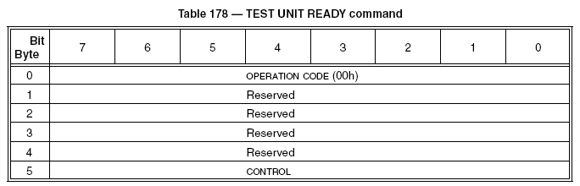
TEST UNIT READY Command
OP Code: 00h Specifies the command
Control Bits are typically zero
  Defined in SAM-4
Result: 6 Byte CDB consisting of entirely 0s

Slide 28
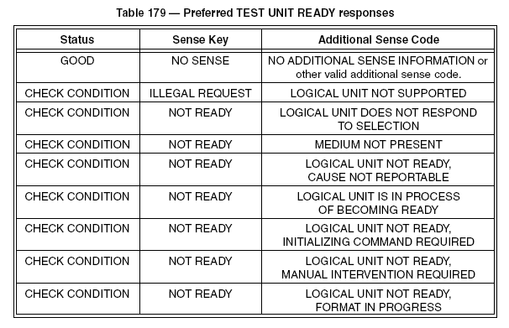
TEST UNIT READY Command
Also:
CHECK CONDITION – NOT READY – POWER ON OCCURED

Slide 29
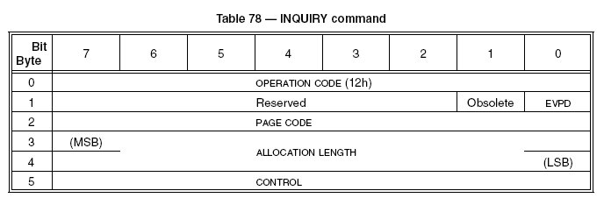
INQUIRY Command
OP Code: 12h Specifies the Command
EVPD: Enable Vital Product Data
  Set to zero, the device returns standard inquiry data
  Set to one, enables the page code field

Slide 30
INQUIRY Command
Page Code: Specifies the page code to return. Pages are defined in SAM-4, SPC-4, and technology specific standards
Allocation Length specifies the length of inquiry data the initiator is prepared to accept in bytes

Slide 31
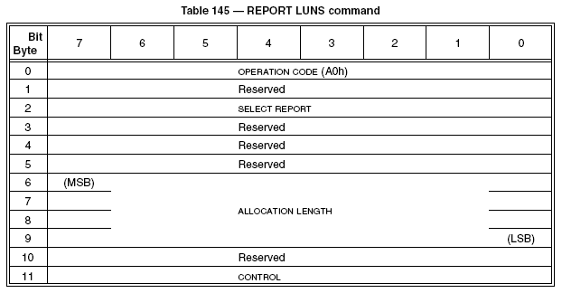
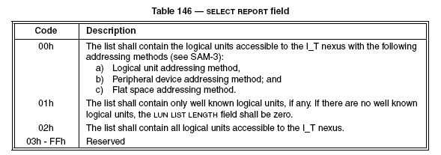
REPORT LUNS Command
OP Code: A0h Specifies the command
Select Report:

Slide 32
REPORT LUNS Command
Allocation Length should be at least 16 bytes
If the allocation length is insufficient to report all the LUNs on the device, the device shall report only what it is able to report

Slide 33
Additional Sense Codes
Values returned in a Response Frame (SAS) in the event that a command could not be completed
So many possible problems that a qualifier is used to expand the pool of possible returns

Slide 34
Additional Sense Codes Examples
ASC: 0x00 ASCQ: 0x06
  I/O Process Terminated
ASC: 0x04 ASCQ: 0x11
  Logical Unit Not Ready, Notify (Enable Spinup) Required
ASC: 0x4B ASCQ: 0x03
  ACK/NAK Timeout

