Slide 1
Hardware-Assisted Virtualization
Jim Mattson

Slide 2
HV: AMD-V and Intel VT-x
“Trap and emulate” virtualization for the x86 architecture
De-privileged guest execution mode orthogonal to protection rings
No ring compression in the guest
Hypervisor and guest have independent address spaces
Hypervisor intercepts selected guest events
Hypervisor
Guest Kernel
Ring 0
Ring 1
Ring 2
Guest User
Ring 3

Slide 3
Guest Execution State
VMCB/VMCS:
  RIP, RSP, RFLAGS
  Descriptor cache
  Most/all control registers
  Some debug registers
  Several MSRs
  Execution controls
  VM-exit information
Hardware:
  Most GPRs
  FPU state
Not true guest state
  Still need a VCPU structure

Slide 4
VM-Entry
Save host state (AMD-V only)
Validate guest state
Load guest state into CPU
Establish intercepts
Inject IDT vectoring event (optional)
Continue in guest mode
400 – 600 cycles

Slide 5
Guest Mode Operation
VMCB/VMCS execution controls specify intercepted events:
  Privileged/sensitive instructions
    Specific I/O ports
    Specific MSRs
  Physical interrupts
  Hardware exceptions
  Task switch
  CPU shutdown/triple-fault
  Local APIC page accesses (VT-x only)
Some instruction behavior is modified
MMU may be virtualized (nested paging)

Slide 6
VM-Exit
Save guest state to VMCB/VMCS
Record VM-Exit information in VMCB/VMCS
Load host state
  AMD-V loads state saved at VM-Entry
  VT-x loads some pre-defined state & some state from VMCS
Clear intercepts
Resume hypervisor execution
400+ cycles

Slide 7
Privileged & Sensitive Instruction Intercepts
AMD-V and VT-x
CLTS | CPUID | HLT | IN(S) | INVD
INVLPG | LGDT | LIDT | LLDT | LTR
LMSW | MONITOR | MOV-CR | MOV-DR | MWAIT
OUT(S) | PAUSE | RDMSR | RDPMC | RDTSC(P)
RSM | SGDT | SIDT | SLDT | STR
WBINVD | WRMSR
AMD-V only
CLGI | ICEBP | INT n | INVLPGA | IRET
POPF | PUSHF | SKINIT | STGI | VMLOAD
VMMCALL | VMRUN | VMSAVE
VT-x only
GETSEC | INVEPT | INVVPID | VMCALL | VMCLEAR
VMLAUNCH | VMPTRLD | VMPTRST | VMREAD | VMRESUME
VMWRITE | VMXOFF | VMXON | XSETBV

Slide 8
Interrupt Virtualization
Guest RFLAGS.IF can be virtualized
  PUSHF/POPF/CLI/STI typically not intercepted
  “Interrupt window” exiting (VT-x)
Guest CR8 can be virtualized
  MOV-CR8 often not intercepted
  TPR threshold (VT-x)
Local APIC page can be virtualized (VT-x)
  Non-TPR accesses must be intercepted
Hypervisor can inject virtual interrupts
  vAPIC IRQ description and VINTR intercept (AMD-V)

Slide 9
Local APIC Virtualization
VMCS specifies APIC access address and virtual APIC page
Reads from TPR fetch virtual TPR value
Writes to TPR update virtual TPR value
  Trap-style intercept *after* update if below TPR threshold
Accesses to other local APIC registers are intercepted
Only matters for 32-bit Windows XP
Hardware not as good as adaptive BT
  VT-x without local APIC virtualization: 1000+ cycles
  VT-x with local APIC virtualization: 500-600 cycles
  Adaptive Binary Translation: 2-3 cycles

Slide 10
Modified Instruction Behavior
RDTSC/RDTSCP
  Can be configured to add a fixed 64-bit offset to the hardware TSC
MOV-from-CR0/SMSW (VT-x)
  CR0 read shadow and guest/host mask
MOV-from-CR4 (VT-x)
  CR4 read shadow and guest/host mask
RDMSR/WRMSR (VT-x)
  Esoteric

Slide 11
Shadow Paging
Hypervisor manages hardware page tables
Guest CR3 in the VMCB/VMCS holds shadow root MPN
  MOV-to-CR3 and MOV-from-CR3 must be intercepted
  INVLPG intercepted (to sync shadow PT with guest PT)
  #PF intercepted (for hidden #PF)
#PF is the most prevalent intercept (~90%)
  Traces (primarily MMU)
  Code-backed pages (MMIO)
#PF intercept an order of magnitude more expensive than #PF

Slide 12
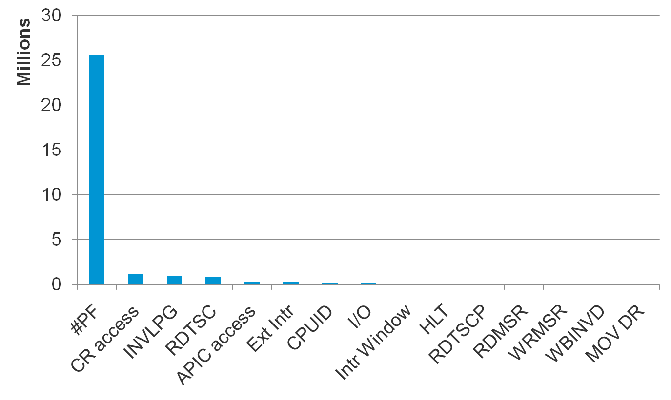
Intercept Distribution with Shadow Paging

Slide 13
Nested Paging
Hypervisor provides PPN->MPN mapping
  AMD-V/RVI uses standard x86 page table structure
  VT-x/EPT uses a new 4-level “extended page table” structure
Guest manages its own page tables with LPN->PPN mappings
Guest CR3 in the VMCB/VMCS holds true guest CR3 value
Hardware automatically performs PPN->MPN lookups
#PF, MOV-CR3, INVLPG not intercepted
New event: Nested Page Fault / EPT Violation
  Nested page table permissions used for traces & code-backed pages.
TLB misses much more expensive

Slide 14
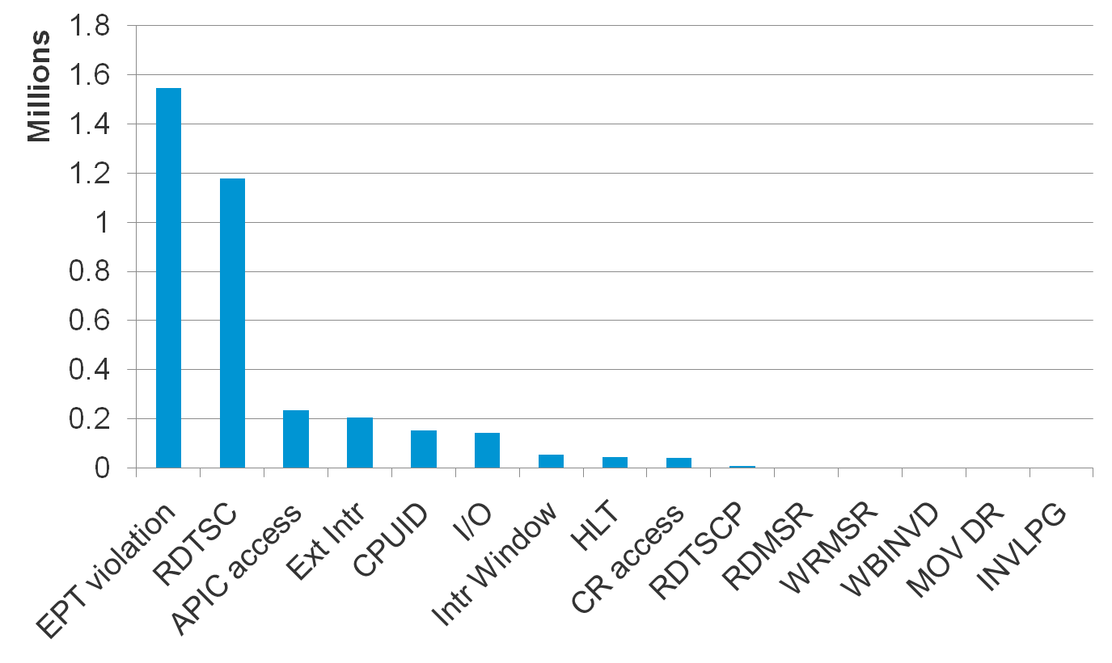
Intercept Distribution with Nested Paging

Slide 15
Complete Nested Page Table Walk
CR3
PPN->MPN
L4
L3
L2
L1
DATA
LPN -> PPN

Slide 16
TLB Tagging
ASID (AMD-V) or VPID (VT-x)
  Hypervisor uses ASID/VPID 0
  VMCB/VMCS specifies guest ASID/VPID
  No need for TLB flush on VM-Entry/VM-Exit
INVVPID (VT-x)
  Hypervisor can flush guest TLB entries without losing its own
Flush-on-VM-Entry (AMD-V)
  Flushes entire TLB
  Rotate through available ASIDs to emulate guest TLB flush

Slide 17
VM-Exit Handler
Interrupted IDT-vectoring
  Uncommon and hard to get right
  Interpret
Instructions not in need of decoding, exception intercepts
  VMCB/VMCS VM-Exit information fully specifies instruction semantics
  Option 1: Emulate and resume guest with VM-Entry
  Option 2: HVSimulate
  Option 3: Interpret
Instructions in need of decoding
  Option 1: HVSimulate
  Option 2: Interpret
Physical interrupts
  No direct guest involvement

Slide 18
HVSimulate
Checkcode-style translations
  Avoid traces due to the high latency of a VM-exit/VM-entry round-trip
Clusters of VM-exiting instructions
  Translations that span multiple VM-exiting instructions save VM-exits
  Delicate cost/benefit tradeoffs
Pattern-matching
  Memzero
  Mempoison
Great area for future development
  Better loop handling
  Chaining

Slide 19
GPhys
Guest physical address space mapped into monitor’s virtual address space
  AMD-V/RVI: Reuse NPT tables from L3 down
  VT-x/EPT: Need x86 page tables that replicate EPT page tables
Used by HVSimulate and MMU for walking guest page tables
Non-traced GPhys mappings replace GBus

Slide 20
A Sample HVSimulate Translation
0xf000:0xe37e | 0f22c0 MOVCR %cr0,%eax
PUSH %rbx
CMP -0x1718aa2(%rip),$0xffff ; VMCB.cs.limit
JNZ 1f
CMP -0x1718aaa(%rip),$0xf0000 ; VMCB.cs.base
1: JNZ HVSim_BailBaseLimit
MOV %rax,$0x80000fe37e ; GPhys address
<OP> CMP (rax),$0x220f
JNZ 2f
CMP 0x2(rax),$0xc0
2: JNZ HVSim_BailCoherency
XOR %edi,%edi
MOV %rsi,-0x16be852(%rip) ; VRAX
CALL Priv_SupervisoryMoveToCR
MOV %edi,$0x3; instruction length
MOV %rsi,%rax
JMP HVResumeProgressOrFault

Slide 21
Execution Mode
HW_VIRT
  GPR state is live in the VCPU
  CR state may be stale in the VCPU
  Descriptor state is live in the VMCB/VMCS or hardware
  Monitor IDT can’t use IST (AMD-V only)
  Software MMU may be dormant (nested paging)
  Emulation is write-through to the VMCB/VMCS
BIN_TRANS
  All guest state is live in the VCPU/DT
  Software MMU is active
Transitions are costly

Slide 22
Special Situations
Limited real-address mode support
  Use BT on unsupported systems
  Always use BT for SMM
  Monitor Base Mode
Limited non-paged protected mode support
  Use SPT (identity mappings) on unsupported systems
Limited NMI blocking support
  InterpStep through NMI handlers on unsupported systems
Limited IGNNE support
  InterpStep until virtualized IGNNE line goes low
Descriptor cache constraints
  InterpStep through protected mode transitions as necessary

