Slide 1
MonitorU: Timekeeping
Garrett Smith

Slide 2

Outline
Application requirements
Timekeeping fundamentals
Guest descheduling
TimeTracker internals
Sample graphs

Slide 3
Potential time related application requirements
Prompt response to outside events
  E.g. Responding to an incoming database query
Prompt wakeup from a timeout
  E.g. Waking up to display the next frame of video
Accuracy of current reported time of day
  E.g. Time stamping a transaction

Slide 4
Approaches to timekeeping in x86 OSs
1. Tick counting
  Program a periodic timer interrupt and count the number of timer interrupts to track time
    Each interrupt is referred to as a “tick”
  Used by all versions of Windows and older Linux kernels
2. Tickless
  Read a hardware timer register to determine the amount of time that has elapsed
  Ideal way to implement timekeeping when running in a VM
  Used by newer Linux kernels, Solaris 10, others

Slide 5
PC timer hardware
Timer interrupt sources
  These generate periodic or one-shot interrupts
    Programmable Interval Timer (PIT)
    CMOS Real Time Clock (RTC)
    Local Advanced Programmable Interrupt Controller (APIC) timer
Timer counters
  Device register returns a value that increases at a constant rate
    Time Stamp Counter (TSC)
    ACPI Power Management Timer (PM Timer)

Slide 6
Emulation of virtual timer devices in a VM
VMware implements virtual timer devices for VMs
Hypervisor delivers timer interrupts to the VM
Timer devices and interrupts are kept in sync
If a timer interrupt is late all counters are held back
  This results in a notional time that virtual hardware presents to the Guest OS which is called “apparent time”
Hypervisor tracks how far apparent time is behind real time
  Catches up by delivering timer interrupts faster than real time

Slide 7
Tick counting drawbacks (part 1)
Guest advances time with each interrupt handled
  Descheduling can cause apparent time to fall behind real time
  Interrupt handler must run to completion for each timer interrupt
    Cannot instantaneously advance time!
Real time
Apparent time
VM is descheduled
Behind

Slide 8
Apparent time versus real time
Desched
Desched
Desched
Real Time (seconds)
Amount apparent time falls behind real time (seconds)

Slide 9
Tick counting drawbacks (part 2)
Interrupt controller may merge timer interrupts
  Only one or two pending interrupts can be tracked
  If the OS disables interrupts for a long period of time interrupts will be lost and the OS’s notion of time will fall behind
    This is referred to as losing ticks
  This is a problem on physical hardware
  Also a problem in a virtual machine
  Hypervisor tries to delay an interrupt if it would otherwise be lost

Slide 10
Tick counting drawbacks (part 3) - Linux specific
Tick counting Linux kernels try to detect lost ticks
  Uses the TSC or the PM Timer to measure time elapsed since the previous interrupt
  If a lost tick is detected, that lost time is added back in to the OS’s notion of time
  Referred to as “lost tick compensation”
  False positives causes time in the VM to run fast
    Manifests more readily in a VM due to variability in interrupt delivery
  Many Linux kernels affected
    See VMware timekeeping whitepaper and best practices

Slide 11
Tickless timekeeping
Ideal for running in a Virtual Machine
  Apparent time can always match real time
  Also ideal for physical hardware
    Allows for lower power utilization and extended battery life
Linux tickless timekeeping kernel availability
  Linux timekeeping became tickless with “clocksource” system
    RHEL 6, SLES 11, Modern Ubuntu (8.04 and later)
  SLES 10 SP2 & RHEL 5.4 timekeeping patches from VMware
  VMI enabled Linux kernels
Solaris 10 and others also use tickless timekeeping

Slide 12
Taking advantage of tickless timekeeping
Hypervisor has to assume that Guest OS is counting interrupts unless it knows otherwise
  ESX 4.0 and have “lazy” APIC timers
    Tickless linux kernels use one-shot APIC timers.
    We don’t keep APIC timers in sync with other time sources
      Just fire them in real time
      Solaris 8 & 9 only OSs that count APIC timer interrupts.
  Paravirtualization hints can be used to inform the hypervisor
    Requires ESX 3.5 or later with …
    SLES 10 SP2 64-bit, RHEL 5.4
    VMI enabled kernels (available for 32-bit only)

Slide 13
Effects of guest descheduling on timekeeping
What is “Guest descheduling”
  Anything that blocks the guest from running
  VMM world may be running, but not executing guest code
Can cause apparent time to fall behind real time
  Tickless kernel timekeeping is not affected by descheduling
Guest descheduling can appear as timekeeping error
  Example scenario:
    Application calls gettimeofday()
    OS reads time from virtual hardware and gets exact time
    VM is descheduled and another VM runs for some time
    VM is rescheduled
    OS returns result of gettimeofday()
    Application uses result of gettimeofday() which is now inaccurate
  Descheduling defines a lower bound on timekeeping error
    The same considerations apply to processes in traditional OS

Slide 14
Sources of guest descheduling
CPU overcommitment
  Usually not a big problem
Memory overcommitment
  VMKernel swapping causes vcpu to block waiting to swap in page.
  Page sharing / balooning not a problem.
VCPU thread blocking on I/O.
VCPU thread blocking on locks (lock holder may be doing I/O).

Slide 15
TimeTracker
Module that orchestrates advancement of apparent time for the virtual timer devices.
TimeTracker_ApparentTime() aka TT_AT provides the current apparent time.
TimeTracker_Set() requests one-shot or periodic callbacks in apparent time.

Slide 16
TimeTracker building blocks (part 1)
PTSC (Pseudo TSC) provides a counter that runs at the host’s TSC frequency.
  Mostly hides host TSC issues.
  May go backwards small amounts between PCPUS.
MonTimer (previously MonitorPoll) provides a one shot, real time callbacks.
  On ESX driven by one shot Local APIC timers.
    Very accurate when VM is running.
  On Hosted driven by increasing host timer interrupt rate.
    Fast clock thread IPIs target PCPUs.
    Much less accurate
  Fired via MonitorActions.

Slide 17
TimeTracker building blocks (part 2)
VCPUProgress (known as virtual time in the vmx) provides a measurement of how much guest code has been executed.
  Ideally would be non-halted cycles that the guest executes
  In BT it is measured by reading host TSC when entering the TC/DE and again when exiting and adding the difference to the VCPUProgress counter.
  In HV it is left running when handling fast HV exits.
    Stopped when processing actions and in BackToHost.
  VCPUProgress only makes sense for relative measurements on one vcpu.
    Absolute measurements and comparison between vcpus meaningless.
  Advances at 100% while guest is halted.

Slide 18
Apparent time advancement
Apparent time advances at 100% between virtual timer interrupts.
  Exception: if we would have gone past the next timer interrupt advance 1/8th of the way from the last value read to the next timer interrupt.
When a virtual timer interrupt is raised apparent time is advanced to the time that timer interrupt corresponds to.
  May advance up to ½ way to the next interrupt if we are behind.
Longer term time advancement is controlled by when we schedule the virtual timer interrupts in real time.

Slide 19
Scheduling timer interrupts
Our goal is to schedule the virtual timer interrupt for the point in real time it corresponds to.
  Apparent = RealToApparent(PTSC_Get()) + apparentOffset
May be forced to push interrupt further out for several reasons
  To avoid dropping the interrupt
  To prevent time from advancing too rapidly
  To avoid hitting GOS assertions about time advancement
    If Vista and later see time advance by more than 3 seconds with a vcpu processing zero timer interrupts they BSOD with STOP 0x101.

Slide 20
Avoiding lost ticks
Two parts
  Decide when to schedule with MonTimer
  In MonTimer callback if conditions aren’t met, reschedule instead of firing TimeTracker client callback.
    After 64 retries, give up and fire the client callback anyway.
Space interrupts from the same device by 50us of VCPU progress.
  If VCPU is halted we can ignore VCPUProgress constraint.
Look at the IRR bit of the vector that the interrupt was last sent to.

Slide 21
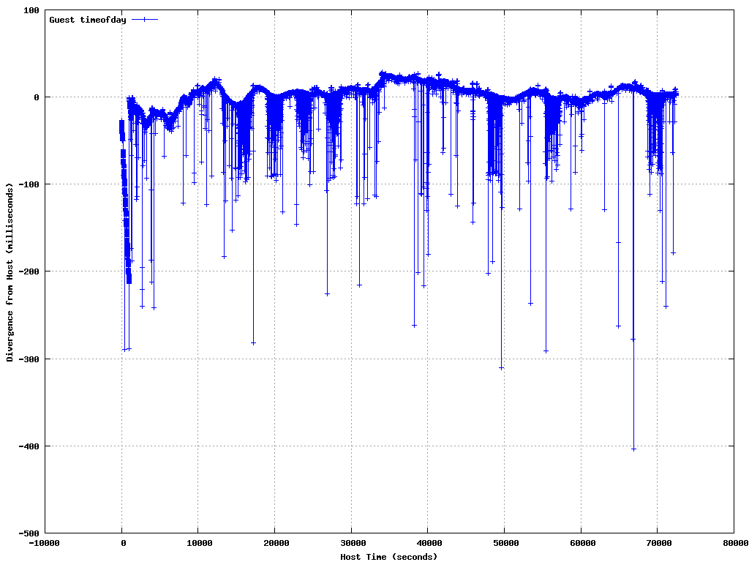
Accuracy of RHEL 4.7 32bit

Slide 22
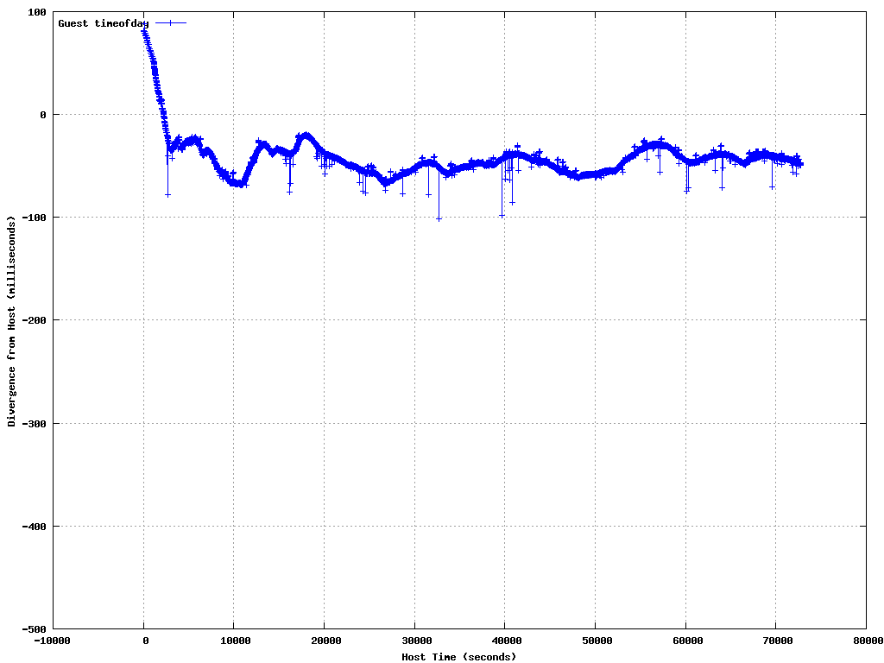
Accuracy of SLES 10 SP2 64bit

Slide 23
References
Timekeeping in VMware Virtual Machines
  aka Timekeeping Whitepaper
  http://www.vmware.com/pdf/vmware_timekeeping.pdf
Linux Timekeeping Best practices KB
  http://kb.vmware.com/kb/1006427

