Slide 1
Deep Dive on vISL
Feb 19, 2013

Slide 2
What we will cover
High-Level Objectives
Architecture of the Framework
Use Case Summary
CIS Deployment/Upgrade in More Detail

Slide 3
High-Level Objectives
Full Software Lifecycle Management
Install->patch->upgrade->removal
Support all Virtual Infrastructure Software products
ESXi, tools, virt hw, VC, VCD, NGC, vShield, SRM, View, etc
3rd party VI related components (e.g., N1K, PowerPath, Device Firmware, etc.)
Augments, does not replace existing OS level package formats (MSI, RPM, VIB, etc.)
Ensure compatibility across multi-tier related apps
E.g., upgrading one component shouldn’t break others
Greatly simplify customer experience
~3-5 clicks to patch your datacenter (with defaults for novice users)
Complex tasks still possible, but through gradual discovery of advanced capabilities

Slide 4
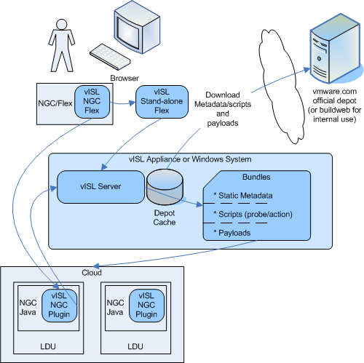
10,000’ View

Slide 5
Framework Architecture
Other API
Consumers
(ex: VCM, ...)
NGC
UI Extension
Detached UI Front-end
PowerCLI
Snapin*
XML-RPC over HTTPS
Front Desk
API
Helpers
Datacenter
State
Manager
Resolver
Plan
Engine
Script
Engine
Depot
Manager
Search
Engine
Persistence

Slide 6
New packaging format - Bundles
Does not require repackaging existing payloads - just a very thin wrapper
e.g., Typical VIB wrapped bundle only ~90 lines of machine generated json
Encodes the "smarts" for a given feature, and/or utilities for other bundles to call
Contents:
Static Metadata
Example: This feature version X is compatible with version Y of other feature
Scripts - business logic that understands the feature
Probes
Find the already deployed versions of this feature in the datacenter
Defines what’s important to understand compatibility relationships
Actions
Implements the logic for deploy, upgrade, patch of the feature, or generic utilities that other bundles can call
URL Reference to Payloads
Agnostic to type - ex: MSI, RPM, VIB, OVF, Firmware blob, etc.

Slide 7
Bundles for 2014
ESX
VA
Framework
Autodeploy
CIS
Windows
CIS
Appliance
ESXi
Tools
Cisco
N1K
vISL
VMX
VDS

Slide 8
A Better Depot
Contains Bundles
New layout based on xhtml instead of proprietary XML schema
Browsable for advanced users - find what you want and cherry pick
Users can easily mirror/replicate using wget, rsync, or other standard tools
Payloads can exist elsewhere (e.g., another depot in another format)
Depot Management within vISL itself
vISL always fetches all the metadata (it's small, and important)
Can proxy content through vISL, with tunable cache
Export offline bundles of subset of software
Aggregates depots

Slide 9
A New Publishing Mechanism
Web-based access, controlled by RM
Integrates with buildweb
Uses a vISL instance to aggregate software to publish
Signs the bundles
Supports publishing to an internal depot for QE/EE to consume

Slide 10
Use cases
Plan-of-record for 2014
VUM equivalent
ESXi patching and upgrade
Tools and virtual hardware upgrade
Cisco N1K VEM deployment (working with vDS and Cisco)
New
CIS deployment
CIS upgrade
ESXi deployment using Auto Deploy (can support more)
Future
Device Firmware (#1 customer ask)
Detection of compatibility problems with other VMware management software when deploying/upgrading any CIS component (e.g., SRM)
Deployment/upgrade of such software (e.g., SRM, View)

Slide 11
CIS Bundle Deep Dive
Probing
Installation
Major Upgrade
Patching
Facilitate ESX Upgrade/Patching

Slide 12
CIS Bundle: Probing
Uses pyvmomi (aka, python VMODL lib) to discover VC 5.0 and up
Supports Windows and VCVA
Discovers:
Inventory Hierarchy (datacenters, folders, clusters)
Hosts
VMs
VDS
Registered Extensions
VC components installed on multiple systems

Slide 13
CIS Bundle: Installation
2014 Appliance
Validate ESXi host(s) meets minimum requirements
OVF Deploy, tune resources, and we can’t use OVF properties (insecure, etc.)
Pass in user settings for firstboot scripts to access
Monitor firstboot scripts progress (run automatically)
e.g., CM registration, Cert generation, service handshakes, DB initialization
2014 Windows:
Validate Windows system(s) meets minimum requirements
Upload MSIs to the Windows system
Install MSIs
Kick off firstboot scripts, monitor their progress (same scripts as appliance)
Split LDU (aka, multi-system LDU)
Deploy same bits to multiple systems
Pass in data file designating which services to run where
“Match Maker” – introduce components to each other so they establish trust

Slide 14
CIS Bundle: Installation – common misconceptions
Firstboot scripts != vISL
Scripts responsible for bootstrapping each component the first time
They’re a part of the core CIS product
Owned by the component teams
Written in a language the component teams are comfortable with (Not MSI)
Common between Appliance and Windows
vISL CIS Bundle just runs/monitors them
MSI != vISL
Most generated automatically by the VC build using WiX
CIS approach for 2014 was to unify appliance/win model: MSI ~= RPM ~= ZIP
Goal was this would make it easier for teams to control their own destiny
Design choice was completely independent of the vISL architecture
All that vISL needs is an MSI that can run headless (“smart” MSIs can do this)
We built a prototype VC 5.0 installation bundle to prove it

Slide 15
CIS Bundle: Major Upgrade
Migration based upgrade
CIS Product choice, not a “vISL requirement”
vISL supports both in-place and migration based upgrades
vISL Enables a much more user-friendly migration model
CIS is radically different than pre-2014 VC (Common services, CloudVM, etc.)
Sequence:
Discover/probe the old system
Perform pre-upgrade checks
Extract configuration/state from old system into intermediary form
VC DB exception: supports DB in-place data transformation
Deploy new system (~identical to installation flow)
Apply configuration/state to new system
Verify new system

Slide 16
CIS Bundle: Patching
CIS Design choices:
What gets patched the most? JRE, openssl, etc.
~Every component impacted, no need for “live patching” of running system
Unify Appliance/Windows models
RPM “patch model” is full package replacement, with more granular packages
Applied same pattern to windows (No MSPs, but more, finer granularity packages)
Only replace the packages that actually change (minimize download/churn)
Flow:
Shutdown all services in target LDU (aka, LDU maintenance mode)
Including split LDUs – all services across all systems in the LDU
Calculate delta RPM/MSI list from bundle manifest
Download and stage only the updated RPMs/MSIs
Upgrade the packages
Reboot if metadata specifies it
Exit maintenance mode

Slide 17
CIS Bundle: Facilitating ESXi Upgrade/Patching
DRS Integration for zero workload down-time
Ask DRS for sub-set of hosts that can be put into maintenance mode
Put designated hosts in MM, upgrade, then exit MM
Loop until all the hosts in the cluster have been upgraded
Implementation not as simple as just “pushing a button”
DPM – doesn’t understand, has to be turned off temporarily
HA – very conservative, admission control must be suspended
FT – very narrow version compatibility, must be suspended
Workaround Bugs:
VC quirks when hosts reboot with a new version (e.g., doesn’t always reconnect)
Hostd quirks (e.g., drops vmotion nic)

Slide 18
Covering the full suite – Example: SRM
vISL was designed with products like SRM in mind
The following diagrams illustrate some of the complexity involved in managing installation and upgrade of a product like SRM.
Today, customers rely heavily on documentation and/or PSO for these sorts of deployments.
(Each arrow on the following diagrams is a component relationship which has version compatibility we have to track and manage. HBR and array based replication are typically not combined, but both have to be modeled and understood.)

Slide 19
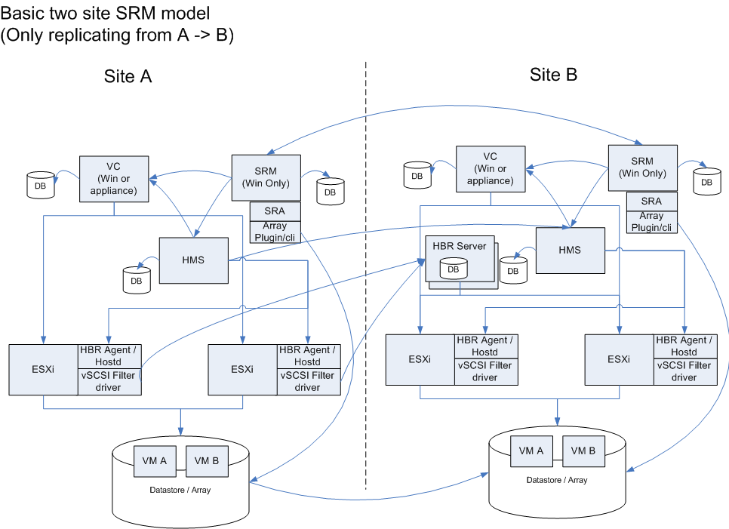
Suite Example: SRM

Slide 20
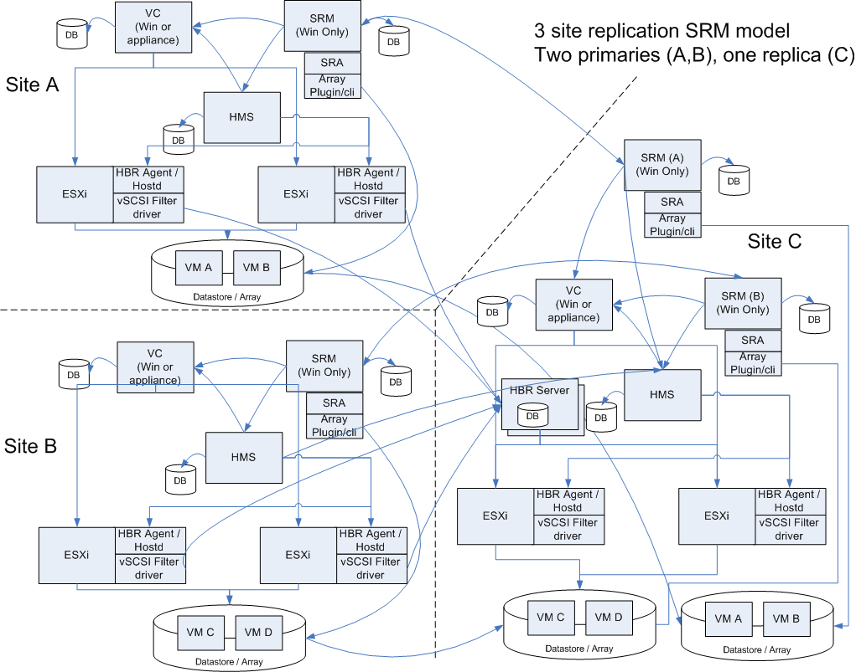
Suite Example: SRM

