Slide 1
Big Data, Hadoop and Virtualization November 13, 2012 Luke Lu, (lukelu@vmware.com, llu@apache.org)

Slide 2
Who am I
3??321
Sr. staff engineer, big data
First Hadoop committer @VMware
Past
Architect, BigInsights dev @IBM
Principal engineer, Hadoop dev @Yahoo
Principal architect, Hypertable dev @Zvents
Founder/chief architect, social search @Wink
Sr. engineer, MLX (spam classification) dev @Proofpoint
Software engineer, web crawling, index & search dev @Inktomi
Software engineer, HPC/MPI reservoir simulator dev @Landmark Graphics

Slide 3
Agenda
Big Data and Hadoop
Definitions
Industry Trends
Hadoop as the Big Data Platform
Overview
Hadoop 1.0 (Current Stable)
Hadoop 2.0 (“Near” Future)
Notable Distributions
Hadoop and Virtualization
Challenges
Opportunities
Hadoop Virtualization Extensions

Slide 4
Big Data and Hadoop
“Big Data” according to Gartner: “high-volume, -velocity and -variety information assets that demand cost-effective, innovative forms of information processing for enhanced insight and decision making.”
Notes:
March 7, 2012 – International Data Corporation (IDC) today released a worldwide Big Data technology and services forecast showing the market is expected to grow from $3.2 billion in 2010 to $16.9 billion in 2015. This represents a compound annual growth rate (CAGR) of 40% or about 7 times that of the overall information and communications technology (ICT) market.
Volume: Enterprises are awash with ever-growing data of all types, easily amassing terabytes—even petabytes—of information.
Turn 12 terabytes of Tweets created each day into improved product sentiment analysis
Convert 350 billion annual meter readings to better predict power consumption
Velocity: Sometimes 2 minutes is too late. For time-sensitive processes such as catching fraud, big data must be used as it streams into your enterprise in order to maximize its value.
Scrutinize 5 million trade events created each day to identify potential fraud
Analyze 500 million daily call detail records in real-time to predict customer churn faster
Variety: Big data is any type of data - structured and unstructured data such as text, sensor data, audio, video, click streams, log files and more. New insights are found when analyzing these data types together.
Monitor 100’s of live video feeds from surveillance cameras to target points of interest
Exploit the 80% data growth in images, video and documents to improve customer satisfaction
Veracity: 1 in 3 business leaders don’t trust the information they use to make decisions. How can you act upon information if you don’t trust it? Establishing trust in big data presents a huge challenge as the variety and number of sources grows.
Big data is more than simply a matter of size; it is an opportunity to find insights in new and emerging types of data and content, to make your business more agile, and to answer questions that were previously considered beyond your reach.

Slide 5
Hadoop as the Big Data Platform
Grew out of the necessity to process big data cheaply
Commodity hardware
Fault tolerance
Parallel to the earlier Google stack
“Hadoop” nowadays often refers to the whole stack
Initially HDFSand MapReduce (Hadoop core)
Growing enterprise features
GUI
SQL
Monitoring
Configuration management
Security
Hadoop Stack | Google Stack
HDFS | GFS
MapReduce | MapReduce
HBase | BigTable
Zookeeper | Chubby
Pig, Hive, Impala, Giraph, Storm ... | Sawzall, Dremel, Pregel, Percolator...
Notes:
Serengeti, ambari

Slide 6
Joy of (Commodity) Hardware at Scale
Typical first year of a new Google cluster
Excepts from Jeff Dean's LADIS 2009 Keynote
1 PDU failure
20 rack failures
3 router failures
1000 individual machine failures
Thousands of hard drive failures
Slow disks, bad memory, misconfigured/flaky machines
Wild dogs, sharks, horses and hunters disrupt fibers

Slide 7
Fault Tolerance
“Hardware eventually fails; Software eventually works.”
— Michael H. Hartung (retired IBM Fellow)

Slide 8
The General Problem

Slide 9
Hadoop: HDFS
Fault-tolerant, high throughput, distributed and replicated storage
Runs on top of existing file system (ext3/4, XFS etc.)
Designed for throughput; optimized for scanning large files
Single global namespace (initially with a single NameNode)
Uses blocks to store a file or parts of a file.
Block #1
CRC32 #1
File
Block #2
CRC32 #2
Block #3
CRC32 #3

Slide 10
Hadoop: HDFS: Blocks
Fixed size except for last block
Easy to calculate the number of blocks
A file can be larger than any single disk in the cluster
64 MB (default), 128MB (recommended); Compare with 4KB-64KB in typical file systems
Blocks are files on underlying file systems
With corresponding checksum files
Default: CRC32 for each 512 bytes
CRCs are end-to-end: computed in client buffer (unlike GFS)
Checksums are critical for large storage systems (> 2PB)
Blocks are replicated to multiple nodes
Tolerates some node failures without data loss
Increases MapReduce throughput
Any replica can be used as an input to a task, taking advantage of data locality
Notes:
According ZFS blurbs: a modern hard disk devotes a large portion of its capacity to error detection data. Many errors occur during normal usage, but are corrected by the disk's internal software, and thus are not visible to the host software. A tiny fraction of errors are not corrected. For example, a modern Enterprise SAS disk specification estimates this fraction to be one uncorrected error in every 10¹⁶ bits, or approximately one in every 1.2 PB.
According to Jeff Deans SOCC 2010 keynote: Google’s BigTable catches 1 corruption in every 5.4PB compacted via CRC.

Slide 11
Hadoop: HDFS: Architecture

Slide 12
Hadoop: MapReduce
Fault-tolerant, high throughput, distributed computing
Taking advantage of data locality: bringing computation to data
High throughput without expensive network and storage hardware
MapReduce concepts via a simple example
Count words that matches certain patterns

Slide 13
Hadoop: MapReduce: System Work Flow

Slide 14
Hadoop: MapReduce: Architecture

Slide 15
Hadoop: MapReduce: Software Framework
Users supply map and reduce functions
Map transforms data into key value pairs
Reduce aggregates data based on keys
The functions are invoked by the framework
The framework takes care of the rest
Map and reduce functions are supposed to be idempotent
Fault tolerance is essentially retries with replicated data
The framework schedules map tasks with data locality preference: local (to physical node) then same rack then random
Speculative executions to work-around slow nodes to improve overall job execution time

Slide 16
Hadoop: Security
Authentication
Bootstrapped with Kerberos
Mutual authentication between services (NN, JT, TT)
Work underway to allow pluggable external authentication
Sustained by an internal token framework
Delegation token for accessing NameNode and JobTracker
Prevent DDoS of KDC when thousands of tasks launch
Control over credential renewal
Limit scope of damage in case of breach
Block access token for accessing DataNode
Light-weight, short lived capability tokens to access data blocks
Job token for accessing TaskTracker
Per job capability tokens for tasks to update status on TaskTracker
Secure shuffle over HTTP with HMAC-SHA1
Authorization
Unix (BSD) style file/directory permission for HDFS
Job ACLs for MapReduce
Notes:
Hadoop security is challenging because regular firewall solutions don’t apply: client needs to access every data node and tasktracker in the cluster.

Slide 17
Hadoop: Security: Communication Paths

Slide 18
Hadoop 2.0
Built-in NameNode HA (HDFS-1623, 3077)
NameNode HA was not critical for batch workloads
Assisted HA via external HA manager was adequate for many cases
Becomes critical for HBase deployment
Federated NameNodes for even larger clusters
A new sub-project/component for Hadoop core
YARN (Yet Another Resource Negotiator or YARN Application Resource Negotiator)
Refactored out of JobTracker as a generic container scheduler
Support work load besides batch oriented MapReduce via per application ApplicationMaster
MPI, BSP
Stream processing (ESP, CEP)
Wire protocol compatibility
Protocol-buffer based
Multiple language (other than Java) support
Notes:
Assisted HA (cold restart of NN with shared storage for edit logs) is often adequate for cluster up to 100 nodes.
ESP = enterprise stream processing
CEP = complex event processing

Slide 19
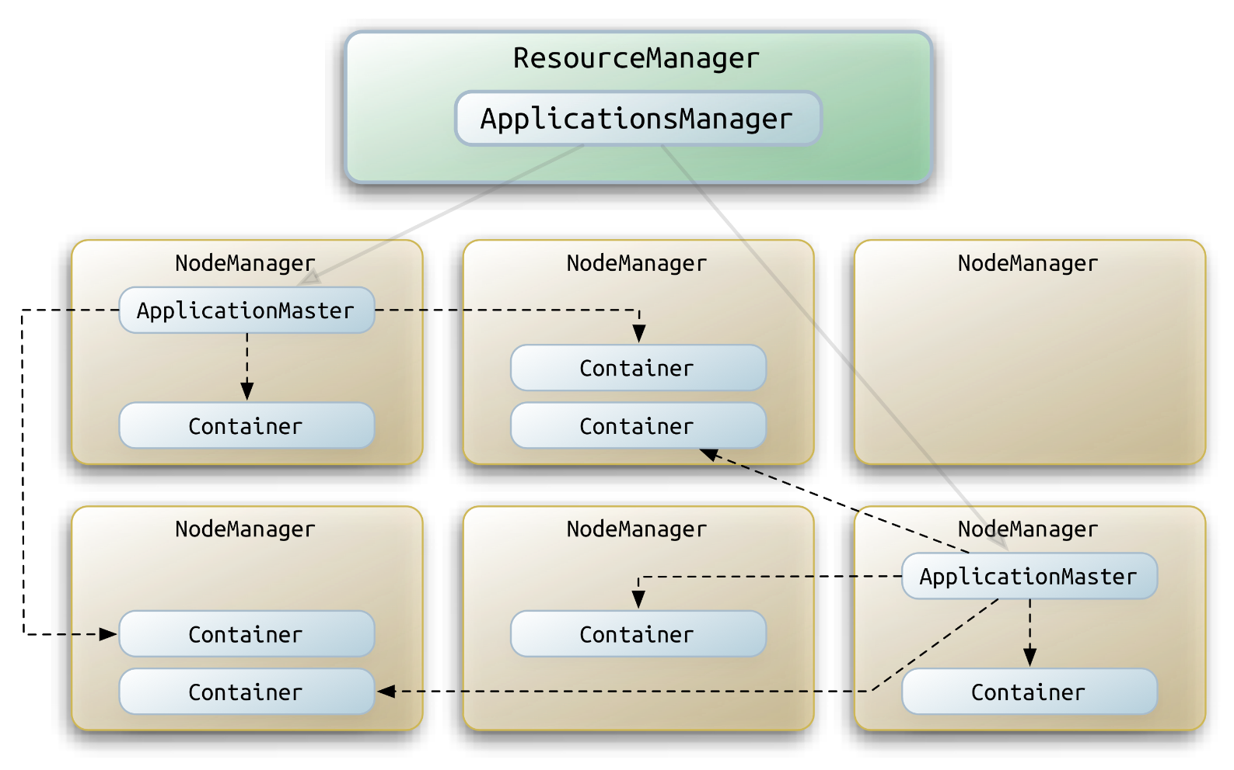
Hadoop 2.0: YARN
Notes:
Application specific resource logic (e.g. locality) goes into ApplicationMaster
Corona: cluster manager == resource manager, corona job tracker == application master.

Slide 20
Hadoop: Notable Distributions
Apache Hadoop 1.x
Based on Yahoo Hadoop 0.20.203; 1.0 is essentially renamed 0.20.205
Apache Hadoop 0.23.x, 2+
Federated HDFS (v2) + MRv2 based on YARN
IBM BigInsights 1.4, 2.0 (full stack including HBase etc.)
Based on Apache Hadoop 1.x with patches for IBM JDK
Cloudera CDH3 (ditto)
Based on Apache Hadoop 0.20.2 with patches from Apache Hadoop 1.x
Cloudera CDH4 (ditto)
Federated HDFS (v2) + MRv1 based on CDH3
MapR M3, M5, M7 (ditto)
Proprietary DFS and JobTracker with no SPOF and no security either
Facebook Hadoop-20
HDFS (NN Avatar HA) + Corona (MRv2 with no security)
Notes:
Comment on hadoop core differences with details on other components elided. E.g. BI has extensive analytics apps etc.
Corona uses thrift based rpc vs protobuf based rpc

Slide 21
Hadoop and Virtualization: Challenges
Performance overhead
~10% typical cited virtualization overhead
Task VM start up time higher than JVM
Storage in virtual hard drives may cause a lot of seeking, even if it appears to be sequential access to the VM.
Need better IO scheduling in vSAN/VMFS; e.g., vSAN SSD bypass etc.
Data redundancy/reliability
A physical host failure can take down multiple VMs
Data loss can occur if these VMs belong to the same HDFS cluster
Direct attached storage (DAS) deployment relatively uncommon
Most deployments rely on SAN
Need better storage layer to manage DAS
More sophisticated policies to ensure IO isolation between VMs
Need API for data locality information
Notes:
Based on recent conversation with Sonic et al. a simple client configured vSAN SSD bypass is (will be?) implemented.

Slide 22
Hadoop and Virtualization: Opportunities
Unified resource management
Better resource utilization through sharing
Better resource isolation
Can run tasks in different OS
Simplify non-MapReduce security via per user/job VLAN
Assume we can define virtual networks fast enough via SDN
Multiple types/versions of clusters
Simplify scale testing
Streamline multi-department/tenant deployment/upgrade
Better support for preemptive task scheduling
Built-in support for task suspend, resume and vMotion!
Preempt long running tasks no longer too wasteful
Particularly relevant for non-MapReduce workloads
Notes:
Note, I specifically didn’t mention “better” security. As VM increases attack surface area in general. Most notable example is the recent side-channel (instruction cache timing) attack to steal private key from colocated VM.

Slide 23
Hadoop Virtualization Extensions (HVE)
Developed by VMware Bejing
JIRA: HADOOP-8468
Modifies Hadoop Common, HDFS and MapReduce
Partially committed
Address data reliability issues in virtualized Hadoop clusters
Physical host aware block placement
Optimize task scheduling for better performance
Physical host aware task scheduling

Slide 24
Hadoop HDFS Replication Recap
1
2
3
DFS Client

Slide 25
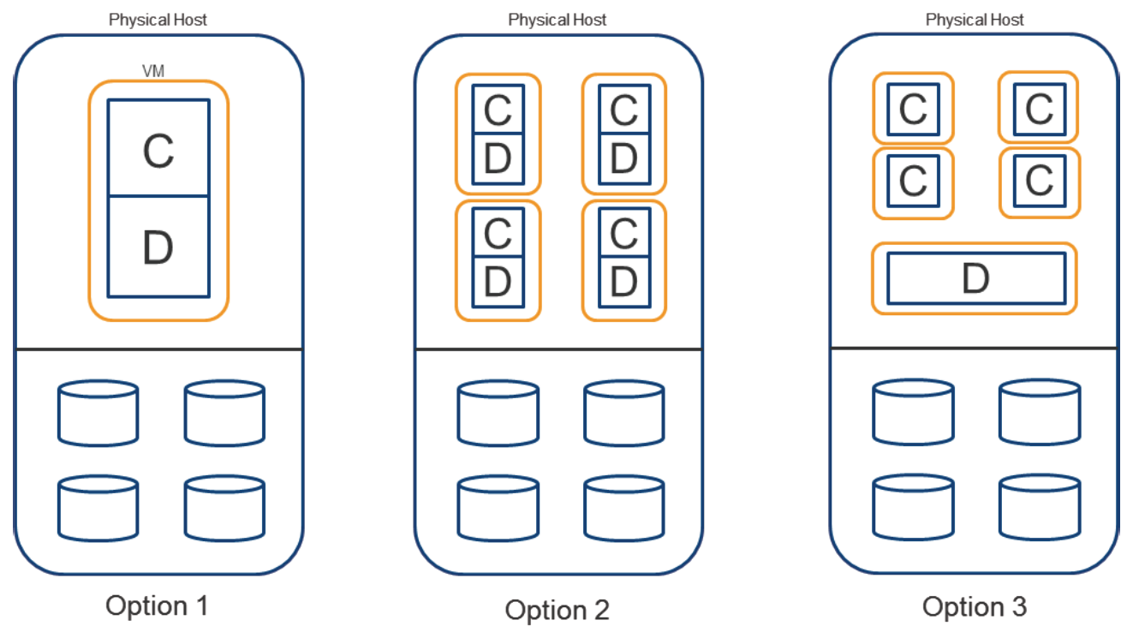
Virtualized Hadoop Configurations
Notes:
C == compute/task VM
D == data VM

Slide 26
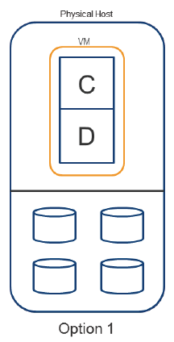
Virtualized Hadoop: Option 1
Single virtual machine running both compute and data processes on the physical host
Does not require changes to Hadoop topology algorithms
Underutilize the virtualized infrastructure
Unless more than one logical Hadoop cluster are deployed.

Slide 27
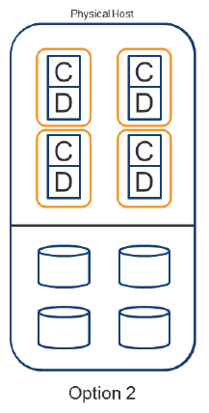
Virtualized Hadoop: Option 2
Multiple VMs, each running both compute and data processes
DFS processes taking a subset of the locally attached disks
Underutilize storage due to fixed device partitioning

Slide 28
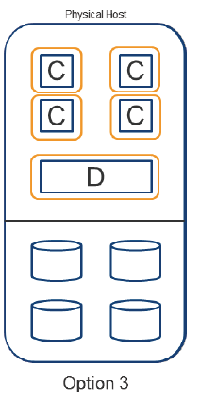
Virtualized Hadoop: Option 3
Multiple compute VMs communicating with a data VM
Elastic because compute VMs can be added/removed easily
Still maintains data locality
Need optimization for inter VM communication for performance

Slide 29
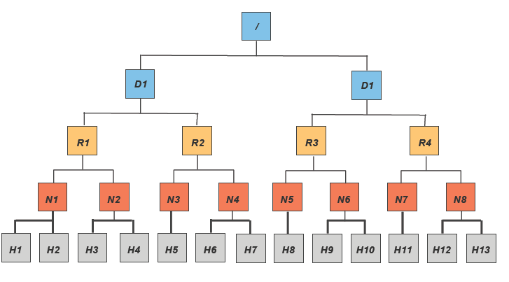
HVE: Proposal: Topology
Notes:
Extra layer between racks and (logical) nodes/hosts.

Slide 30
HVE: Proposal: Node Group
An extra locality failure group in the topology: node group
Represent the hypervisor layer (physical host)
VMs in the same group run on the same physical host
Communication between VMs in the same group (physical host) should be faster than cross hosts
SDP over VMCI
VMs in the same group (physical host) have the same failure zone for a given hardware failure
Modify Hadoop to take advantage of the new topology
Patch for trunk (YARN) ready, partially committed
Patch for branch-1 under review

Slide 31
HVE: Future: Breathing Elephant (aka Option 4)
Make Hadoop VM itself elastic
DRS as the resource authority
Memory ballooning coordinated with Hadoop scheduler
Finer grain of elasticity
Need to experiment with ballooning rate and limits to avoid guest freak out
Disable/enable portion of guest VCPUs/cores?
How does ESX respond to disabled guest VCPU/cores?
Does the ESX automagically assign CPU slices to the remaining cores?
Does the existing VM CPU share mechanism work as expected (the remaining cores run at full speed instead of fraction of full clock rate)?
Complementary to all previous options
Enable hybrid approaches to achieve best performance, isolation and elasticity tradeoffs

Slide 32
More Resources
http://www-01.ibm.com/software/data/bigdata/
http://hadoop.apache.org/
http://wiki.apache.org/hadoop/Virtual%20Hadoop

