Slide 1
Virtual DMA remapping

Slide 2
Virtual DMA Remapping
DMA re-mapping overview
Why virtualize it
DMA in a VM
Monitor/VMX changes
VMKernel changes
Performance
FW changes
Guest driver changes

Slide 3
DMA re-mapping overview
PCI device accesses to physical addresses are translated through page tables
  Bus/Device/Function (BDF) is used to map a device to a set of device page tables
  Device page tables translate PA to PA and indicate R/W permission
  Faults are raised on un-translated/illegal accesses
    DMA is treated the same as to non-existent memory
    Asynchronous and difficult to recover from
Relevant examples include Intel VT-D and AMD IOMMU
  Both include Interrupt re-mapping as well (not covered here)

Slide 4
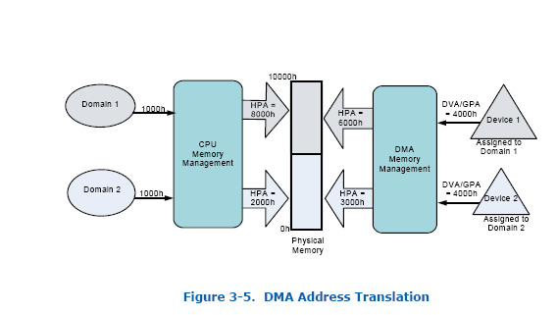
DMA re-mapping overview

Slide 5
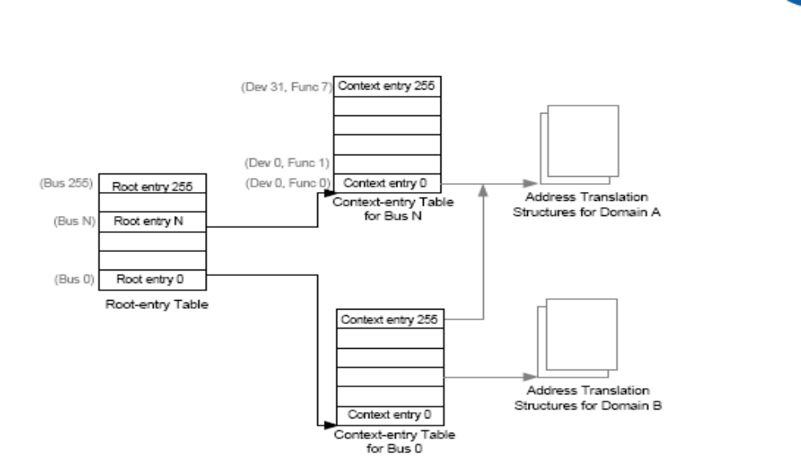
DMA re-mapping overview

Slide 6
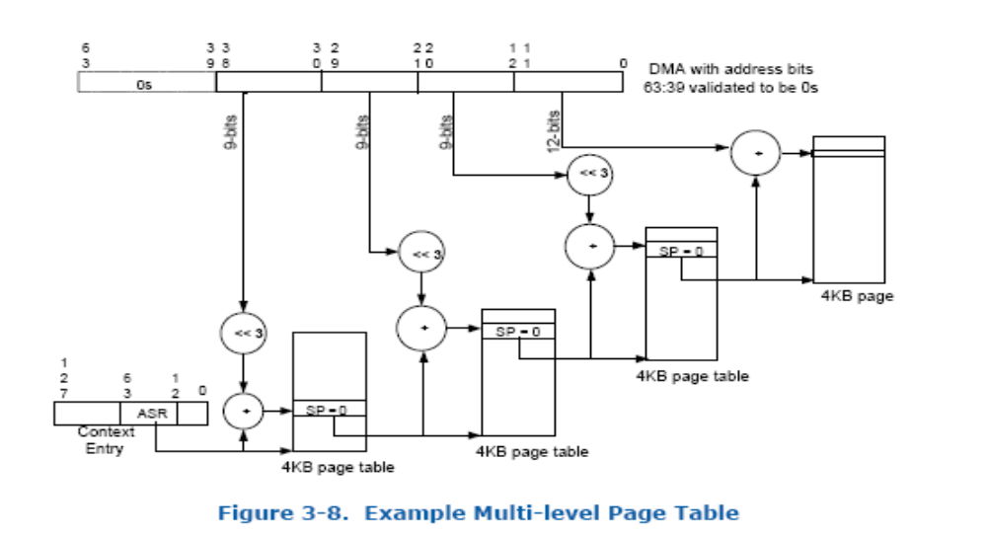
DMA re-mapping overview

Slide 7
Why should we virtualize it?
Virtualize PCI passthru
  IOMMU is uned by PCI passthru to remap guest PPNs to the backing host MPNs
  Makes testing PCI passthru much easier
Support x2APIC
  Windows/Linux won’t use x2APIC without VT-D interrupt remapping
    Interrupt re-mapping already implemented
    Exposed through ACPI DMAR table
      Some versions of Linux try to use VT-D DMA remapping if a DMAR table is present
      Failures are not graceful

Slide 8
DMA in a VM
On hosted most devices go through PhysMem_Get and friends
  Some in VMM some in VMX
    DMAs may cross page boundaries
    VMM has 2 page limit – VMX has no limit
  Some use PPN_2_BPN_Device / BusMem_DevicePinPage
  Some cache mappings – USB physCache
On ESX many virtual devices DMA in the VMKernel
  Most use P2MCache
  Some use VmMemPin_GetPhysMemRange

Slide 9
Monitor/VMX changes
IOMMU needs to know the initiating BDF in order to perform translation
  BDFs are not fixed – BIOS assigns bridge numbers during boot
    In theory Guest OS could re-program the bus numbers
  Solution:
    PCI_RegisterDevice APIs return a pciHandle which maps to a B/D/F
    PCI_SetBusNumber() updates the B/D/F table when bus numbers change

Slide 10
Monitor/VMX changes
PhysMem_Get APIs need to know the pciHandle.
  Needed for PCI devices but not all callers
    Some code in bora/device/misc (Backdoor, SMBIOS, ACPI) should bypass DMAR
    Some code in bora/vmx (vmioplugin, hgfsVmci ) should *not* bypass DMAR
Proposed solutions:
  Introduce new PhysMem_GetDevice APIs for PCI devices
    Can’t be exclusive to or restricted to bora/devices
    Involves adding 8 more entrypoints
  Make all existing PhysMem_Get APIs take a pciHandle
    Non PCI device callers have to pass an excempt PCI handle to bypass DMAR
    Harder for devices to misuse or abuse

Slide 11
Monitor/VMX changes
PhysMem_Get APIs need to handle page crossing differently
  Mainmem is mapped contiguously in the VMX
  PhysMem_Get returns a single pointer for a given PA range
  Guest may program IOMMU to re-map a PA range to non-consectuive PPNs
    VMX needs to use PhysMem_GetPPNList to map discontiguous PPNs to a single pointer
      Can be done transparently to callers!
    VMM has to KSeg in any 2 PPNs - easy

Slide 12
Monitor/VMX changes
Devices need to be less sloppy
  No pre-fetching
  Request read or write permission more strictly
  Vast majority of devices are OK
Need to invalidate the PhysCache when the guest invalidates IOTLBs
  trivial

Slide 13
Monitor/VMX changes
VVTD needs to walk BDF -> root tables and PA -> PA tables
  Page table walker code can easily be shared between VMM an VMX
    Not as easy to share with VMKernel but not much code to duplicate
Currently no plans to add an AMD IOMMU backend
  Should be easy once devices and PhysMem are modifed to support VVTD
  Would make testing VMKernel MD IOMMU driver easier

Slide 14
VMKernel changes
VMKernel P2M cache needs a lot of work
  Current APIs doesn’t know read or write
  Get APIs need to take PCI handle
    Easily accessible from shared area
  Release APIs also need to take the PCI handle
    Should be re-written to use tokens like PhysMem to support buggy or malicious guests that change the mapping with an in-flight DMA
  May need mechanism to invalidate pointers obtained with P2MCache_Get APIs
  VmMemPin_GetPhysMemRange called directly by some devices
    needs to know the PCI Handle

Slide 15
Performance optimizations
Need to walk up to 8 tables per DMA
  2 for mapping BDF to device page tables
  Between 2 (30 bit GAW) and 6 (64-bit GAW) for PA -> PA remapping
IOMMUs slow down DMAs in both physical machines and VMs
  HW implements a context cache for caching BDF to page table mappings
  HW implements an IOTLB for caching effective translations
  Implementing a virtual IOTLB should be easy

Slide 16
FW changes
FW changes needed for supporting VVTD are already done
  FW has a DMAR table
  FW resets VVTD HW during boot
New ACPI tables would need to be added to support an AMD IOMMU

Slide 17
Guest driver changes
On Linux well behaved drivers use the pci_map APIs to translate virtual addresses to physical addresses for DMA
  Some drivers, vmxnet3, may not comply 100%
    Causes faults
  Easy to fix but means modifying guest code
  Drivers for ‘real’ virtual devices are likely OK

Slide 18
Next steps
Most of the VMM/VMX code is already written/tested
Very little VMKernel code has been changed
Performance enhancements / IOTLB not yet implemented

Slide 19
Questions
????

