Slide 1
Cloning Live VMs Instantly

Slide 2
Value Proposition
Instant provisioning of ready VMs
Linux VMs in ~700ms
Windows VMs in ~4.5s
Ongoing work to reduce these times even further
Instant provisioning of Applications
Start application and then clone VM
Application instantly available on the new VM
Massive Scale-out with little overhead
60 Linux VMs instantiated in ~7.5s
Scales with #cores
Memory Consolidation
If many VMs share common applications
Launch common applications then clone

Slide 3
Use Cases
View/VDI
Rapid Provisioning of Windows VMs
Instant Application provisioning/Application publishing
E.g., Pre-launch Office applications in the parent then clone
Reduce memory requirements by facilitating page sharing
Big Data
Enable high elasticity and true multi-tenancy
Light-weight containers for multiple tenants with QoS guarantees
Reduce/Remove the need for hot spares
Cloud Foundry
Rapid rolling patch upgrades
Elastic management of VMs (esp. Windows – for linux they use containers)
Reduces need for hot spares in vCHS environments
Nimbus
Rapid provisioning of ESX VMs
And potentially many others…(e.g., Build team, ESX Cloud, VCD-sp, faster App-level HA, etc.)

Slide 4
Outline
Background: Fast VM instantiation without vSphere changes
vSphere Enhancements for Fast VM Instantiation
Performance Evaluation
Example Use Cases

Slide 5
Optimizing Regular VM Power-On
Using CBRC
OS Image in memory
Removes disk overhead and improves scalability
vSphere related overheads
VMX_PowerOn, Monitor start, Devices, Logging, SCSI vs. IDE disks, etc.
Adds ~1-1.5s overhead
VC/hostd
Adds couple of seconds of overhead
VC 5.5: ~1.25s without DRS and ~2s with DRS
ESX 5: hostd overhead ~0.4s
Latency/first power-on of a batch for scale-out applications

Slide 6
More Optimizations
OS-specific overheads
Customized linux kernel
remove drivers for unwanted devices
Remove initrd (loading all modules vs. only when needed)
Reduce size of boot image (ext4 journaling)
Grub (2 vs. 1)
Remove/Disable init scripts
Lots of help from Monitor and Platform Infrastructure teams
Especially Garrett, Ole, Jeffrey, and Petr

Slide 7
Optimizing VM Boot Time
*Work with Tariq

Slide 8
vSphere Enhancements for Fast VM Instantiation

Slide 9
Goals
Fast instantiation of “ready” VMs with minimal resource overheads
Ready VMs => ready to use immediately (e.g., post boot)
Resources include CPU, Memory, and Disk
Mainly target scale-out and instantiation latency sensitive applications
Support all OSes/versions (minimal/no changes to the guest OS)
Minimal changes to ESX
Unlike previous invasive approaches
Without creating a new ESX stack
Optimize critical path of VM Instantiation
Keep only essential operations in the critical path
E.g., pre-register VMs, break large pages, etc.

Slide 10
Enable vSphere Platform to “Fork” VMs
Low latency to reach “ready” state
~0.7s to power on
More room for optimization
Removes overhead of boot
Not necessary to have “thin” VMs
Minimal CPU overhead
Enables page sharing of common application infrastructure
“Fork” after starting common applications
Minimal, isolated code changes in vSphere stack
Coding mostly done/documented
Mostly OS independent
Customization of VMs is OS dependent

Slide 11
VMFork Architecture
Splits work into preparation (expensive) and fork (cheap) paths
Preparation phase:
Boot parent VM, launch any applications, bring libraries into memory, etc
Freeze parent VM state as a powered-on template
Break large pages, hash and mark all memory COW
Pre-create and register any number of desired child VM config files with hostd
Fork phase:
Power on child VM
Child inherits parent VM’s memory state (COW), device state (checkpoint), disk state (delta disk)
Guest customization in guest gives child a unique identity

Slide 12
How to Fork?
Power-on parent VM and get it to the desired state for forking
Execute “vmfork-begin” inside the parent
The parent is quiesced at this point
Use linked-clone API to create as many children as desired
Change vmx file of children to include:
parentID, new identity (mac/ip address, hostname)
Set boot vmdk in children as non-persistent
Separate persistent data disks
Customize each child soon as it powers on
E.g., In parent: vmware-rpctool “vmfork-begin 101” ; customizeFork.sh
101 here refers to user assigned fork group id
Children should have migrate.VMForkGroup = 101 in their vmx file
customizeFork.sh picks up the identity information from the vmx file

Slide 13
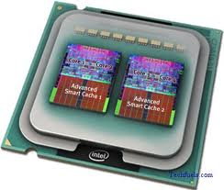
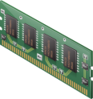




Technology: (1) “Linked Clone” of Memory
Parent VM
VMFork
VMFork
Child1 VM
Child2 VM
Same CPU Configuration
COW Memory Clone
Linked Clone to create Delta Disks

Slide 14
Technology: (2) Attributing Unique Identity to Children VMs
Occurs as the last operation of power-on of child VM
Leverage identity information in VM configuration file (.vmx)
Use in-guest commands for customization
Linux
IP/MAC addresses: ifconfig
Unique DNS name for the VM: hostname
Windows
IP address: Relying on DHCP
MAC address: WMI commands and registry settings
Domain name: Registry settings
Joining a domain
License management

Slide 15
Changes to vSphere Platform
vmKernel
Added Fast-Suspend-Resume like technology to enable copy-on-write memory clones
Leveraged pluggable migration architecture to add a new clone migration type
Minimal code changes were needed (few hundred lines)
Fully isolated from rest of the code
Vmx
Plumbing to invoke the new migration type
New vmware-rpctool command (vmfork-begin)
Glue to perform refork using reset
Minimal code changes (couple hundred lines)
Overall: < 1000 LOC in ESX-side changes

Slide 16
Desired Changes in vSphere
VC
Management story for powered on parent template and children VMs
APIs to create children, promote to first-class VMs, etc.
Hostd
Reject operation on powered-on parent templates
Ability to power-off parent
isParent(), isChild() properties

Slide 17
Performance Evaluation

Slide 18
Performance Evaluation: VM Instantiation Time
> 10X faster than typical Linux VMs
~4X faster than heavily optimized “thin” linux VM
VM doesn’t have to be thin/skimmed down in our case
Consumes ~¼ CPU resources

Slide 19
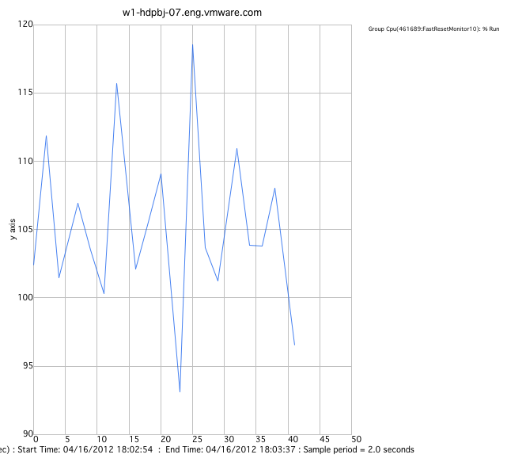
CPU Overhead (2.9GHz)
 | vmgid | name | pgid | pname | size | vsmps | usedsec
Opt Regular VM | 7238168 | vm.2423425 | 4 | user | 10 | 8 | 2.724
Forked VM | 7239009 | vm.2503877 | 4 | user | 10 | 8 | 0.695
Sched-stats output
Infinite Reset VM
~1 core 100% utilized during reset (in both cases)

Slide 20
Performance Evaluation: Efficient Scaling
Once created and registered, time for VM to be “ready” scales well
60 VMs can be forked in ~7.5s (using 12 cores)
Scales with #cores
Time computed from first entry to vmware.log to last fully functional VM
Doesn’t include VC/hostd initial latency

Slide 21
Overhead of COW-breaking
Expt: 10GB written in a standalone VM vs. forked VM
Unmapped/New pages – no overhead
Mapped pages (in parent)
COW-break cost: 350ms/GB
Linux
Consumed boot memory: ~350MB
Memory COW-broken by forked VM: ~200MB
Overhead = ~70ms
Windows
All guest memory zeroed at boot
Expect negligible overhead due to COW-breaking

Slide 22
Example Use caseS

Slide 23
Big Data
Make Big Data workloads highly elastic
VMs can be “ready” or “killed” almost instantaneously
Reaffirms our physical consolidation story
Fewer hot spares required for compute VMs
Less resources “wasted”
Reduced CPU overhead of VM instantiation
Reset = Refork
Fosters multi-tenancy
Preload JVM and potentially JITed code before forking

Slide 24
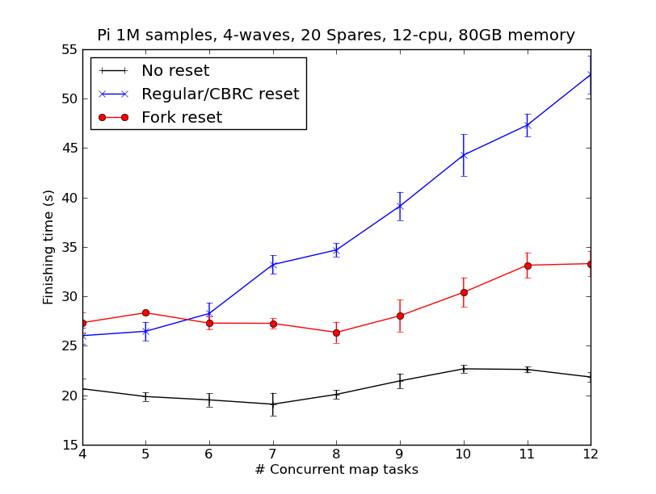
Preliminary Results
Instantiate Compute VMs to execute Map/Reduce Tasks on-demand
Map-Reduce applications run faster due to little CPU overhead (no booting)
Live VM cloning reduces the need for hot spares
Notes:
We conducted some preliminary experiments to evaluate the overhead of using lightweight VMs/resets
This graph shows the importance of needing hot spares. We ran a simple pi Hadoop job for these purposes.
The x axis shows different scenarios – a. VMs are always powered on and never reset b. We reset after every task, but we do not maintain a hot spare pool c. We keep around enough hot spares. Y axis shows the execution time – lower is better.
Results show that without hot spares results are significantly worse, but having enough hot spares could get us the same level of performance as not resetting VMs.
But hot spares come at a cost – especially memory overhead
X axis shows the number of hot spares and Y axis shows execution time – so lower is better again.
The blue line shows the performance using heavily optimized regular linux VMs and red line shows results using Ruyiscale
We won’t get into the details here, but note that using Ruyiscale reduces the need to have hot spares – using 0 hot spares gets the same level of performance as having as many as 9 or 10 regular VMs
Using a couple of hot spares in RuyiScale we can get even better performance than having any number of hot spares!
This is because RuyiScale enables instantiating VMs in well under 1s and up to 60 VMs in less than 8s…Imagine the possibilities with this technology!
This is a good leeway into some of the vSphere innovations we are pushing through Mumakil

Slide 25
VDI Case Study
View Desktop Provisioning
Need to provision 1000s of VMs
Multiple reboots and guest customization are the main bottleneck
Using VMFork
Fast provisioning of View VMs with no reboots
Currently ~4.5s to fork a Win 7 VM
App publishing -> the next big push in VDI
Instantiation latency sensitive
Fork upon login
Boot-storm issues
Eliminated by VMFork
Limited CPU and memory overheads

Slide 26
Competitive Landscape
GridCentric/Citrix
Citrix funded Snowflock-based startup
Virtual Memory Streaming integrates with hypervisors (Xen and KVM) and OpenStack
Redhat
OpenShift: Auto-scaling PaaS
Gears: SELinux-based Containers + cgroups
Docker
Open source light-weight portable containers (using LXC, etc.)
HyperV
Remote Desktop Services (RDS)
vSphere enables OS agnostic, version-independent, performance and security-isolated containers
We want vSphere to be the manager of all resources, not individual OSes

Slide 27
Discussion
VM as a light-weight container
VMFork brings us closer than ever
VMs provide better security, performance, and configuration isolation
VMs can use Resource Pools, DRS, VC etc. for better QoS, etc.
Changes potentially needed in other layers of the VMware stack
Boot vs. VMFork
Latency and CPU overhead
Boot failures
No need for CBRC
Customer-specific templates
Large vs. Small pages
When to break COW sharing with parent
Allowing sharing of large pages

Slide 28
Summary
Live VM cloning is a compelling technology
Fundamental enabling technology for cloud computing
Potential to help multiple use cases
Code mostly complete in vmkernel and vmx
Potential minor tweaks based on feedback from appropriate groups
Continue optimizations to make it even faster
Initial results show it’s a great fit for Big Data and VDI
Linux VMs instantiated in ~0.7s and windows VMs in ~4.5s
60 Linux VMs in ~7.5s
Major differentiating technology
Compared to existing solutions (e.g., OS-specific, less isolated, etc.)
References
wiki.eng.vmware.com/RuyiScale
Live VM Cloning (RADIO ‘12)
RuyiScale (RADIO ‘13)

Slide 29
Glimpse into the future: RuyiScale
Big Data Services
Cloud Foundry
Services
Virtual Desktop
Services
RuyiScale Compute Fabric
Tenant 5
VM Template Hierarchy
Miscellaneous VM
Templates
Hadoop
1.03
Ubuntu
Linux
Win7
spawn

