Slide 1
Virtual Machine on ESXi Performance Troubleshooting Introduction
Hill Zhao( hillzhao@vmware.com )
May 21, 2013

Slide 2
What’s a performance problem sound like …
Customer Complain:
“My VM is running slow and I do not know what to do”
“My VM is slow on one host but fast on another”
“My application performance drops dramatically on VM comparing with on physical machine”
In one word “Slow”
In our words “Throughput” and “Latency”

Slide 3
Performance Matrix
Functions Layers | CPU | Memory | Networking | Storage
Application
GuestOS (& Tools)
VMX/VMM
VMKernel
Hardware
Methodology
Symptom Analysis Tools Root Cause Tuning Solutions

Slide 4
Agenda
VMKernel Architecture
Virtual Machine Monitor(VMM) Architecture
Performance Troubleshooting

Slide 5
VMKernel Architecture
Guest OS
VMX
hostd‏
vcpu0
vmx
VMM0
VMM1
VM
VM
vcpu0
vcpu1
vcpu1
mks
UserWorld
host
Linux Syscall
UWVMKCall
VMK_Call
VSCSI
VLance
/proc
User
VMKernel
VMXNET
VSI
World
AddrSpace
Boot
Semaphore
Dump/Debug
SPLock
Helper
VMotion
MachineMem
FSS
TCP/IP
MemMap
Resource
Management
(CPU/Mem)
NFSc
VMFS5
RDM
Net
BH/ Interrupts
Storage
VMKLinux
3com
e1000
tg3
emulex
aicXXX
mptscsi
qlaXXX

Slide 6
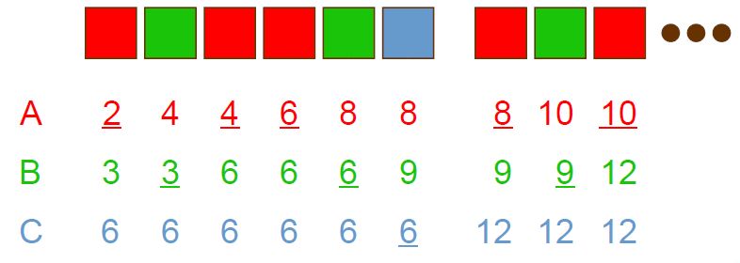
CPU-Scheduler
Virtual Time Algorithms
Associate virtual clock with each VM
Ticks at rate inversely proportional to VM shares
Allocation: select VM with minimum virtual time
Example: 3 VMs A, B, C with 3 : 2 : 1 share ratio

Slide 7
Co-Scheduling SMP VMs
Run all VCPUs of VM concurrently
May be required for correctness
Synchronous execution improves performance
Single vtime, stride for multi-VCPU VM
Co-schedule
One VCPU scheduled by local processor
Map remaining VCPUs to remotely-preemptible processors
Send IPIs to force remote reschedules
Remote scheduler switches to specified VCPU
Co-deschedule
Set timeout when local VCPU blocks
If still blocked, change remote VCPU states, send IPIs

Slide 8
Memory
Reclamation Mechanisms
Ballooning
Demand Paging
Sharing
Transparent Page Sharing
Content-Based Page Sharing
Allocation
Share-Based Allocation
Reclaiming Idle Memory
Dynamic Reallocation

Slide 9
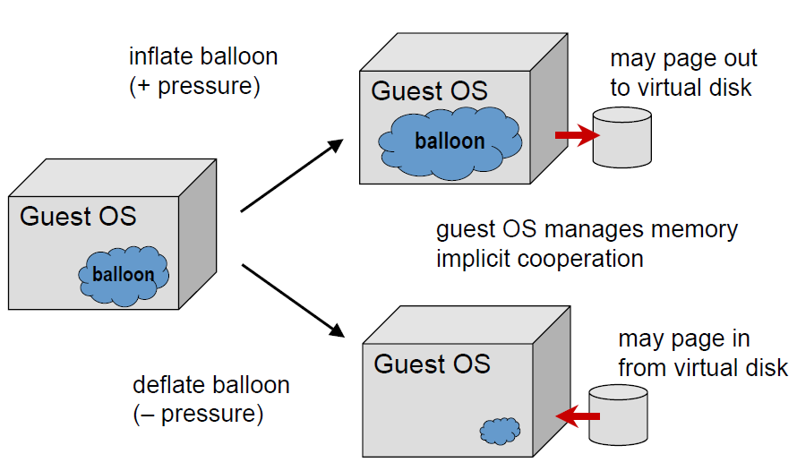
Memory---Ballooning
Balloon Kernel Driver
Pinned PPNs

Slide 10
Demand Paging
Swap
One swap file per VM
vmx.config
Memsize=256
Sched.mem.minsize=256
Sched.swap.enable=False
sched.swap.dir=”/vmfs/vmfs0”
sched.swap.file=”win2k.swap”
hypervisor transparently pages out PPNs, paged in on demand.
Problems
Choice which VM ? Choice which pages?
Double paging problem.
physical disk( vswap )-> physical mem -> virtual mem->virtual disk -> physical disk
Performance
Zip swap

Slide 11
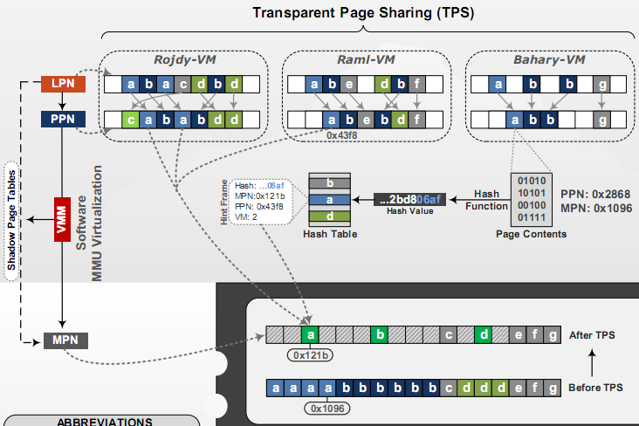
Content-based page sharing
Hypervisor identifies identical PPNs based on content, maps to same MPN copy-on-write.
Monitor randomly selects a set of guest pages.
Platform computes a 64 bit hash of each.

Slide 12
Memory State
Sharing
Reclamation
State | Policy | Describe
High 6% | Sharing | free memory is sufficient and no reclamation is performed
Soft 4% | Balloon | the system reclaims memory using ballooning, and resorts to paging only in cases where ballooning is not possible
Hard 2% | Swap | the system relies on paging to forcibly reclaim memory
Low 1% | Swap and Block | the system continues to reclaim memory via paging, and additionally blocks the execution of all VMs that are above their target allocations.

Slide 13
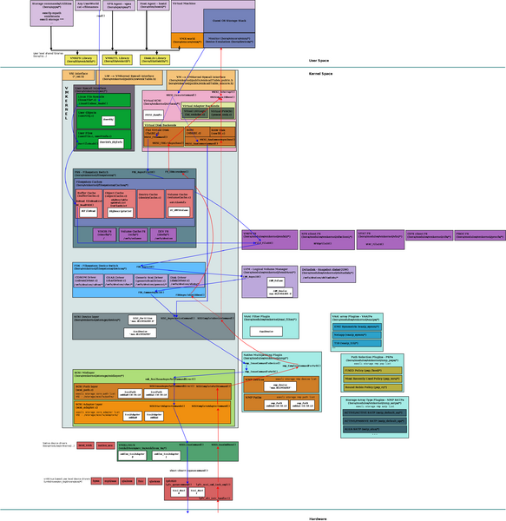
Storage
https://wiki.eng.vmware.com/File:Storage-Stack-Overview.png

Slide 14
Storage Stack
Application
Guest OS
vmm
vSCSI
FSS
VMFS
VMFS
NFS Client
PSA
PSA
Network
Driver
swiSCSI
Driver
FC
Network
NFS
Driver

Slide 15
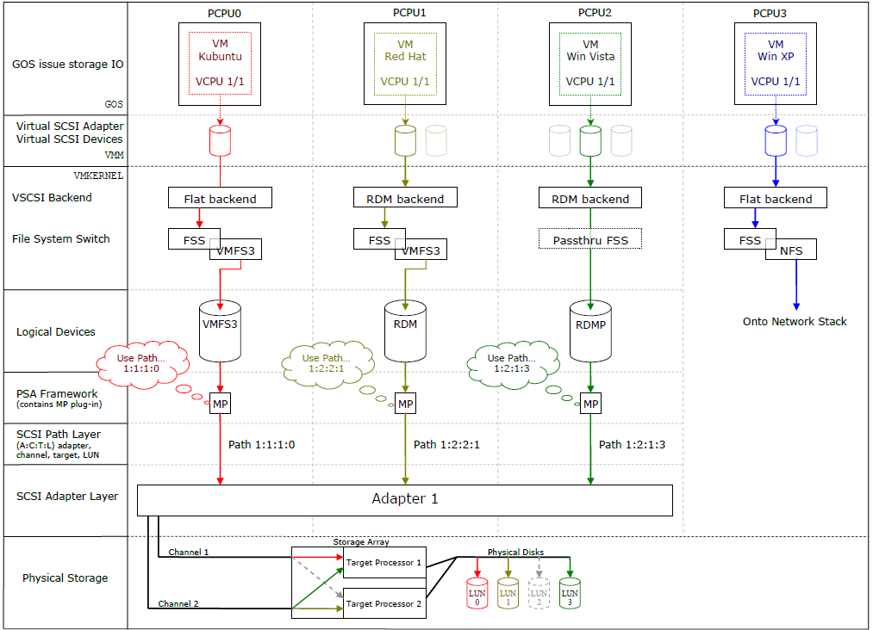
Storage Flow Overview
This diagram is an overview of the whole storage IO process and it highlights the general idea from the GOS to physical storage. Please refer to this diagram when reading the descriptions.

Slide 16
Storage Statistic
Application start
Application
Guest OS
vmm
Application end
Perfmon start
Perfmon end
Virtual disk start
vSCSI
Virtual disk end
FSS
VMFS
Command start
Device start
Device end
Device
MPP
Path start
Path end
Path
Adapter start
Adapter end
Adapter
Driver start
Driver end
vmklinux
Driver
From Devaki’s slides

Slide 17
Storage Latency Breakdown: EMC CX4-480 (FC Cached LUN)
1 OIO, 1 KB Read
8.7 K IOPS
App
Total latency: 119 µs
Guest start
Guest end
RHEL5 Guest OS
Guest/VMM: 30 µs
VMM
Virtual SCSI start
VSCSI
Virtual SCSI end
Core Storage Stack
VMKernel: 43 µs
vmklinux
Driver
SCSI I/O start
SCSI I/O Completion
Storage access: 46 µs
Notes:
Total latency is measured in the guest I/O benchmark program (IOblazer)
Guest/VMM latency represents time spent in Guest/VMM for issuing and completing I/Os.
VMKernel latency represents time spent in VMkernel for issuing and completing I/Os (VSCSI+ PSA + vmkernel device driver).
Storage access latency is time spent in FC SAN disk array controller. (measured in EMC Navispher Analyzer)

Slide 18
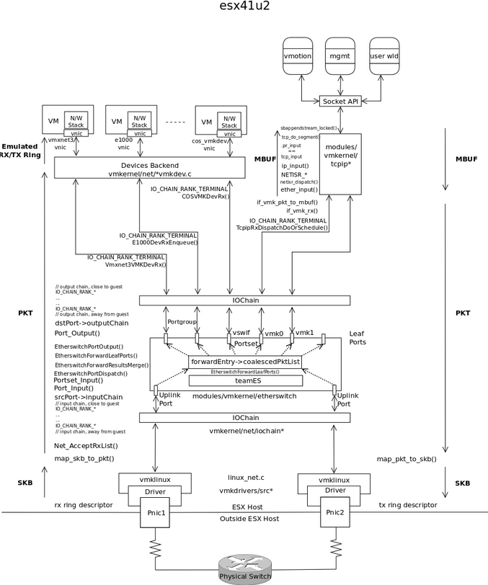
Networking Stack
https://wiki.eng.vmware.com/wiki/images/1/10/TopLevelRX.png

Slide 19
Networking Stack
VC / UI Extension
VC / SDK
External Control Plane
ESX
ESX
ESX
ESX
Port state
and event
DVswitch
VNIC
VNIC
VNIC
IO vswitches
IO filters
port
port
port
Ethernet Forwarding
NIC teaming
port
port
IO filters
HW driver
HW driver

Slide 20
Networking Stack
Application
Guest OS
Network Stack
vNIC (vmxnet3)
Socket API
vNIC Backend
TCP/IP Stack
IOChain
vSwitch
Port Sets
IOChain
UPLink
vmkLinux Driver
pNIC
pNIC

Slide 21
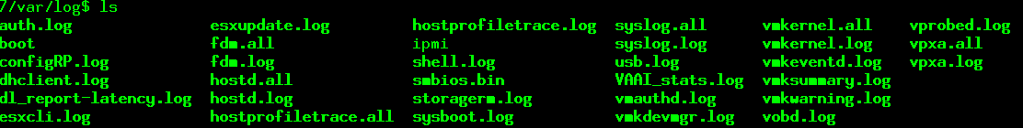
Debugging System Logs
Most logs are located under /var/log directory.
Error & Failed & Warning Message
LOG levels
vsish –e set /system/loglevels/FSS 5

Slide 22
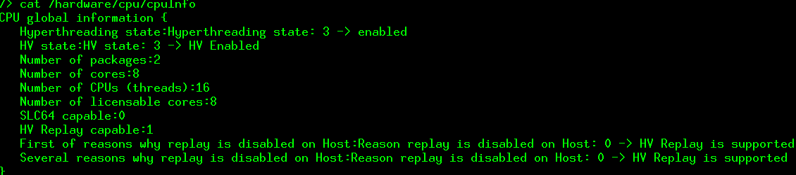
VMKernel Debugging --- VSI
VMkernel sysinfo (VSI) for device and kernel management
Similar to /proc, but much more structured
Not a public interface – exposed only via higher layers (vmkctl, etc)
Set/get operations supporting multiple instances
Interface checksum for binary compatibility between tools/kernel
VMkernel modules can have separate name spaces for vendor specific sysinfo configuration
vsish

Slide 23
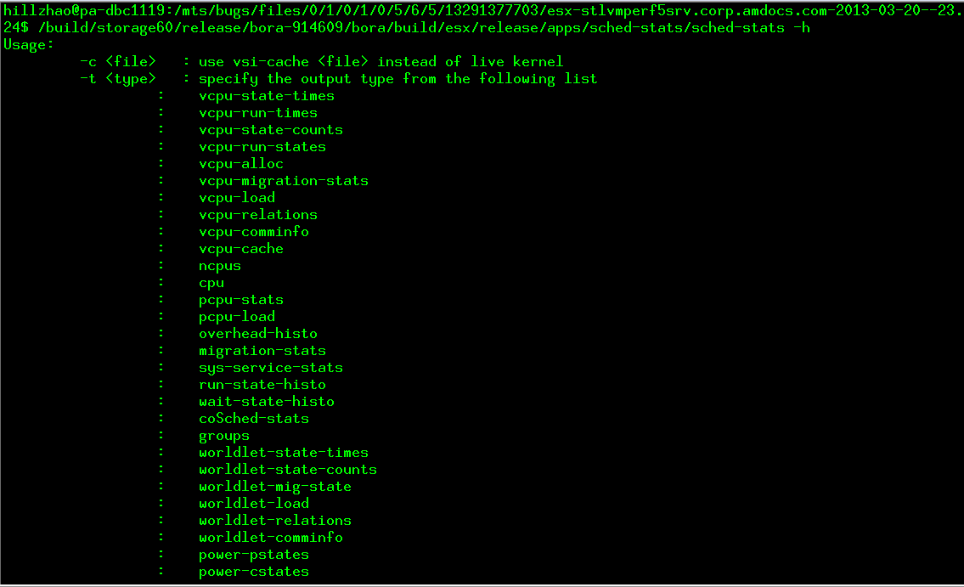
Sched-stats

Slide 24
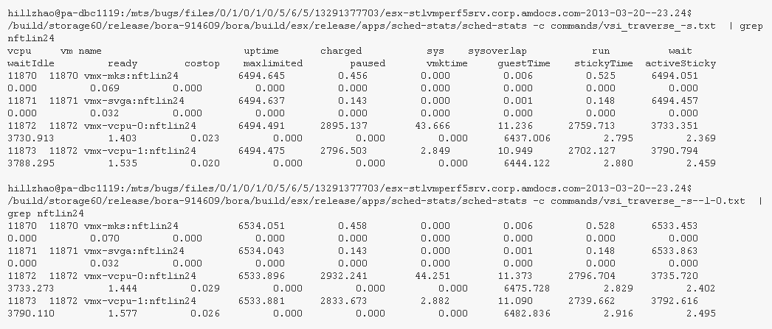
VMM Debugging
Sched-stats
sched-stats is a powerful tool to investigate scheduling related statistics. sched-stats can either analyze a live kernel or a vsicache dump. The data collected from sched-stats is used extensively for debugging CpuSched related problem as well as performance tuning.
Notes:
https://wiki.eng.vmware.com/CpuSched/Sched-stats

Slide 25
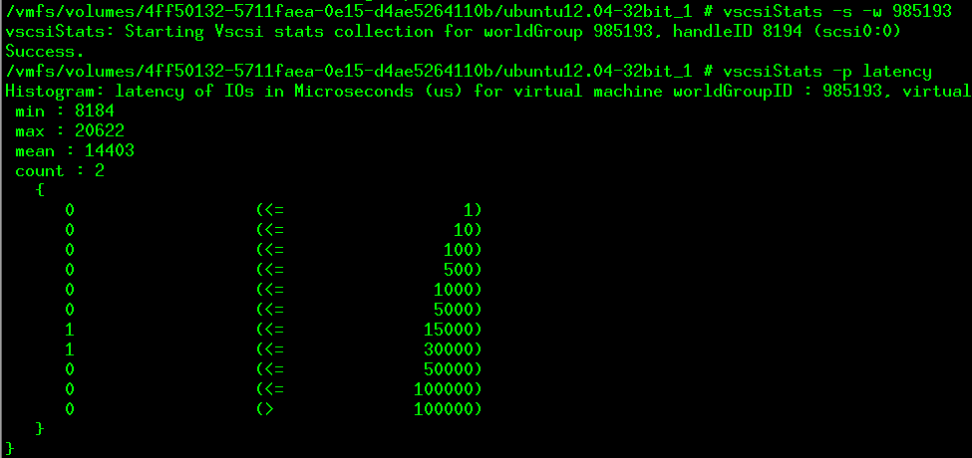
vscsistats
ioLength
Latency
IO seekDistance
Notes:
http://communities.vmware.com/docs/DOC-10095

Slide 26
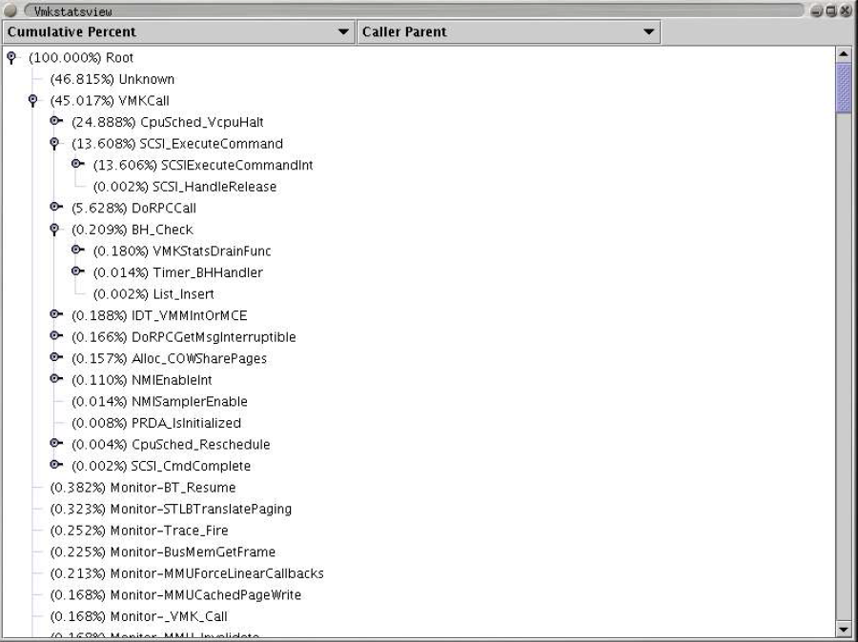
VMKernel Debugging--- VMKstats
Set up performance counters to trigger NMIs
NMI handler records information for each sample
EIP, Stack, PCPU, WorldID, Eflags
Data collection and storage
Notes:
How it works
Vmkstats uses the hardware performance counters to periodically sample the vmkernel. The counters can be set to "overflow" after counting a certain number of events (e.g. 250000 cycles). Upon overflowing, the counter fires a non-maskable interrupt (NMI). Vmkstats handles the interrupt. It records the stack-trace and eip at the time of the NMI into a per-cpu buffer. This buffer is periodically drained by BH_Check. It is important that the nmis do not happen too frequently, because otherwise this per-cpu buffer cannot be drained fast enough. Running with high sample rates that cause over 5% overhead from the NMI handler is not recommended.
The out-of-order/superscalar execution of a modern x86 cpu make it hard to pinpoint the exact instruction that caused the counter to overflow, but for function-level profiling, the accuracy is very good. Note that you probably want to use an OPT build, to avoid performance problems caused by OBJ debugging code.

Slide 27
VMKernel Debugging --- VProbe
ESX
Script
Load
Output
Data
Guest
Guest
emt
emmett
compiler
vprobe (CLI)
VMX
VMM
VMX
VMM
vp
vp
VP
VP
(hostd)
User
vp
Kernel
VProbes module
VProbes
device
VP
Probe
fires
Data buffer
data

Slide 28
VMKernel Debugging --- VProbe
PR 574187 – vprobe use case
Boot time of ESXi increases with no. of cores/socket
Narrowed down to a single command taking ~ 1 sec to complete
echo "Hello World" | cut -c1-126 > /dev/klog
Had a reliable repro.
Suspected a syscall. Standard userworld linux syscalls
strace : wait() syscall took 1 sec to return.
Cores/socket | Boot Times
2 | 01:24.619
4 | 02:57.390
6 | 05:02.846
8 | 05:10.071
10 | 05:15.974
12 | 05:16.695

Slide 29
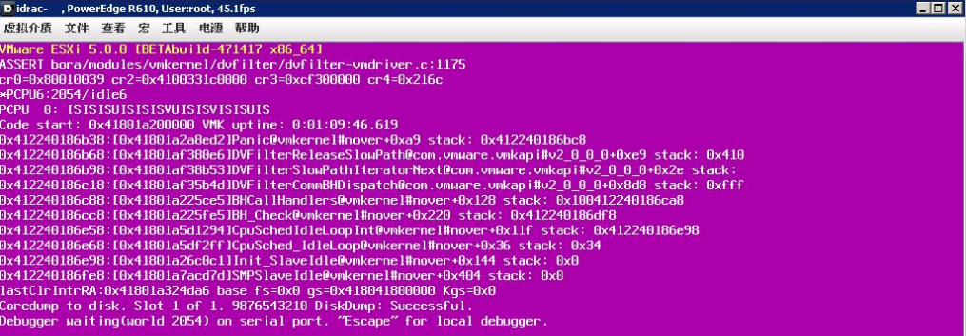
VMKernel Debugging ---PSOD
debugzilla.py vmkernel-zdump.1

Slide 30
Agenda
VMKernel Architecture
Virtual Machine Monitor(VMM) Architecture
Performance Troubleshooting

Slide 31
Classical Instruction Virtualization Trap-and-emulate
Nonvirtualized (“native”) system
OS runs in privileged mode
OS “owns” the hardware
Application code has less privilege
Virtualized
VMM most privileged (for isolation)
Classical “ring compression” or “de-privileging”
Run guest OS kernel in Ring 1
Privileged instructions trap; emulated by VMM
System call
Exceptions
Privileged resource, (IOAPIC)
But: does not work for x86 (lack of traps)
PUSHF/POPF
Apps
Ring 3
OS
Ring 0
Apps
Ring 3
Guest OS
Ring 1
VMM
Ring 0

Slide 32
BT Mechanics
GuestOS
input
basic block
BT
translator
translated
basic block
Guest View
system call, interrupt
return from system call
CPL3
CPL0
CPL3
CPL0
CPL3
Application code
Kernel code
Application code
Kernel code
Application code
Translation cache
time
Reality
“Direct Execution”
Guest application code running directly on hardware
Run translated code
modest overhead
Virtualization specific events
Hidden page faults
Trace faults
Backmap related activity
Emulating TSC
...
Near native speed
account for most of the overheads

Slide 33
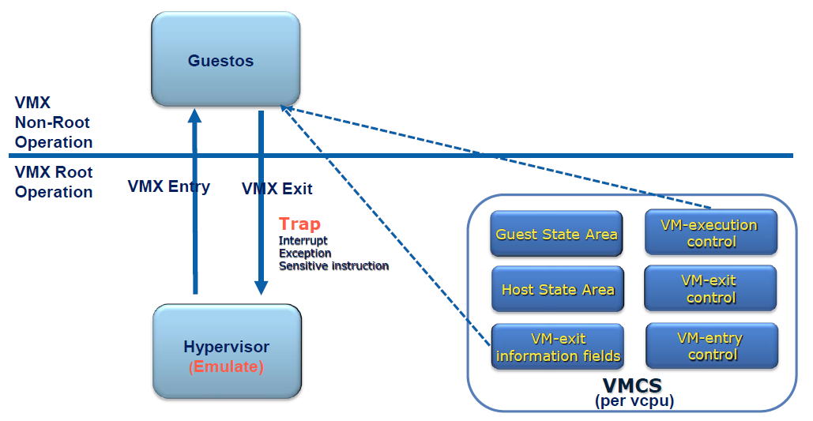
Hardware Virtualization (HV)
Hardware-defined structure, VMCB/VMCS contains
Guest state
Control bits that define conditions for exit
Exit on IN, OUT, CPUID, ...
Exit on write to control register CR3
Exit on page fault, pending interrupt, ...
VMM uses control bits to “confine” and observe guest
Apps
Ring 3
Guest mode
Guest OS
Ring 0
VM
exit
VM
enter
Root mode
VMM

Slide 34
Qualitative Comparison of BT and VT-x/AMD-V
BT loses on:
system calls (getppid)
translator overheads
path lengthening
indirect control flow
BT wins on:
page table updates (adaptation)
memory-mapped I/O (adapt.)
IN/OUT instructions
no traps for priv. instructions
VT-x/AMD-V loses on:
exits (costlier than “callouts”)
no adaptation (cannot elim. exits)
page table updates (forkwait)
memory-mapped I/O
IN/OUT instructions
VT-x/AMD-V wins on:
system calls
almost all code runs “directly”
 | BT | VT | NPT
sum | 95% | 95% | 95%
getppid | 25% | 95% | 95%
forkwait | 15% | 5% | 85%
memsweep | 85% | 85% | 40%
Notes:
Before we move on to the next part of the talk, which is about memory virtualization, let me just make one more quick observation here, related to In/out. As you can see, the hardware assist’s higher exit times will have an impact on I/O performance. This is especially true for I/O devices that carry a high rate of traffic in small chunks (i.e., networking).
In fact, choosing a suitable network device is a good way to help alleviate some of these overheads since some devices/driver combinations require that the device be touched fewer times per packet transmitted. For example, a networking device that supports TSO or large packets may be more suitable for deployment in virtual environments. We have also optimized our “paravirtualized” vmxnet device to require as few touches per packet as possible. So if your VM is running with hardware assist, it is better to use vmxnet than e1000.

Slide 35
Memory Native Virtual Memory
Process 1
Process 2
0 4GB
0 4GB
Virtual Memory
VA
Physical Memory
PA
Applications see contiguous virtual address space, not physical memory
OS defines VA -> PA mapping
Usually at 4 KB granularity
Mappings are stored in page tables
HW memory management unit (MMU)
Page table walker
TLB (translation look-aside buffer)
TLB
VA→PA mapping
VA
PA
%cr3
. . .
TLB fill
hardware

Slide 36
Virtualizing Virtual Memory Shadow Page Tables
VM 1
VM 2
Process 1
Process 2
Process 1
Process 2
Virtual Memory
VA
Physical Memory
PA
Machine Memory
MA
VMM builds “shadow page tables” to accelerate the mappings
Shadow directly maps VA -> MA
Can avoid doing two levels of translation on every access
TLB caches VA->MA mapping
Leverage hardware walker for TLB fills (walking shadows)
When guest changes VA -> PA, the VMM updates shadow page tables

Slide 37
NPT (Nested Page Table)
MMU composes VA->PA and PA->MA mappings on the fly at TLB fill time
TLB Miss
Large Page
VA→PA mapping
TLB fill
hardware
Guest PT ptr
. . .
TLB
VA
MA
guest
VMM
Nested PT ptr
PA→MA mapping

Slide 38
SPECjbb
Evaluates server side Java performance
TLB miss intensive workload
Little MMU activity
NPT is significantly slower than BT
Back of envelope
TLB miss rate = 3.1M/s
BT: 3.1M X 30 = 93M out of 1600M is okay
NPT: 3.1 X 100 = 310M out of 1600M is high
But this is not the end for SPECjbb!
9965 ops per sec
guest code
(direct or translated)
8979 ops per sec
6387 ops per sec
With NPT monitor
With BT monitor
overheads
Native (Unvirtualized case)
With BT monitor
With NPT monitor

Slide 39
Performance Tests Results
Apache compile
MMU heavy, TLB moderate
NPT improves it very much
Shell counting
MMU obese
NPT improves it beyond wildest dreams
SPECjbb
MMU light, TLB heavy
NPT hurts if it does not use large pages
NPT, BT nearly equal if it uses large pages
Citrix (faster on NPT by 16%)
Lots of context switches
One of the best use case for NPT
Database workloads(slower on NPT by 2-14%)
Oracle
MSSQL Server
Networking(slower on NPT by 10-20%)
Netperf
Why are they slower?
Possible reason is high vmm<-> vmk transition rate. gtlb is flushed when returning to vmm.

Slide 40
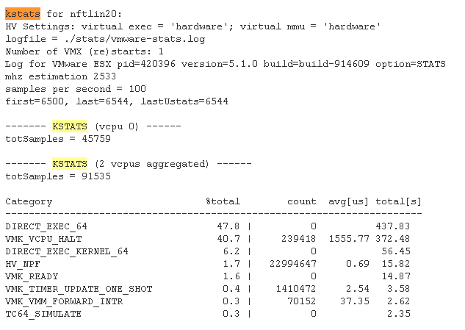
Debugging --- Kstats
Mechanism of profiling the monitor
https://wiki.eng.vmware.com/Performance/Automation/kstats
https://wiki.eng.vmware.com/USTATS

Slide 41
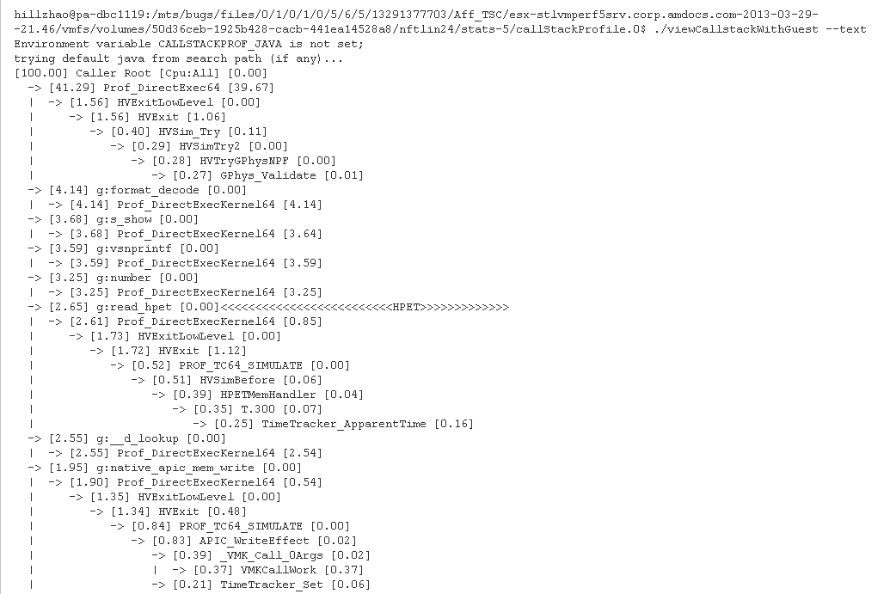
Debugging --- CallstackProfiling
Monitor callstack path profiling
https://wiki.eng.vmware.com/CallstackProfiling

Slide 42
Debugging VProbe Anatomy
[from Keith’s 2007 Techtalk]
Script
Vp compiler
VPQ
Output
VMX
VProbe TC
VMM
printf, logaggr,
aggr samples…
getguest, …
Data
Int3/BP handler
VMM
Runtime
Control
Static Probes
Notes:
You might be curious how this hooey works? Glossing over many details, VProbes is yet another facility split across VMX and the VMM. In rough caricature, the user provides a script in a very simple language (simpler than the one I’m demoing with, in fact), and the VMX compiles it into the vprobes translation cache. The VMX asynchronously notifies the VMM of the probes it’s enabled and the VMX sets up debugging hardware for dynamic probes, and the bitmasks for static probes, to ensure it catches execution at the right point. When we fire a probe, we branch into the vprobe translation cache and execute the user’s handler (whose safety is guaranteed at the language level). We might call out into VMM-supplied routines in the course of computing for the probe, e.g., to read guest memory. Finally, we might produce output: either an explicit output statement, like printf, or implicit output caused by overflowing the local buffer of aggregate samples. These forms of output are placed in a multiple-producer, single consumer queue called the VPQ. When a VMM sees the queue approach a high water mark, it makes a call to the VMX to asynchronously drain it.

Slide 43
VMM Debugging Vstrace
Vstrace Command
vstrace -tracevmkcall VMK_COW_HINT_UPDATES [-displaystats -i 2 –ignorezeros]
Internal Processing
…
int tracevmkcall()
{
return (curcallnum == 17);
}
VMKERNEL:VMKCall
{
curcallnum = (int) ARG0;
if (tracevmkcall()) {
printf("VMKC>|%d|%d|%d|\n"
, PCPU
, WORLDID
, curcallnum
);
}
}
…
Vprobe Script
Vprobe Output
VMKC>|3|8698|17|
VMKC<|3|8698|17|0|
VStrace Stack
PCPU
World
Call
Return Value
VStrace Output, Statistics
3 8698 VMK_COW_HINT_UPDATES() = VMK_OK
=== Statistics Snapshot 1 (interval = 2000 ms) ===
VMKCall_Name Calls/sec AvgLat/Call MinLat MaxLat TotalLat/sec AvgUsed/Call MinUsed MaxUsed TotalUsed/sec
(cycles) (cycles) (cycles) (cycles) (cycles) (cycles) (cycles) (cycles)
VMK_COW_HINT_UPDATES 7.500 10899 9293 14554 81744 10899 9293 14554 81744
World_Switches/sec: 457.500

Slide 44
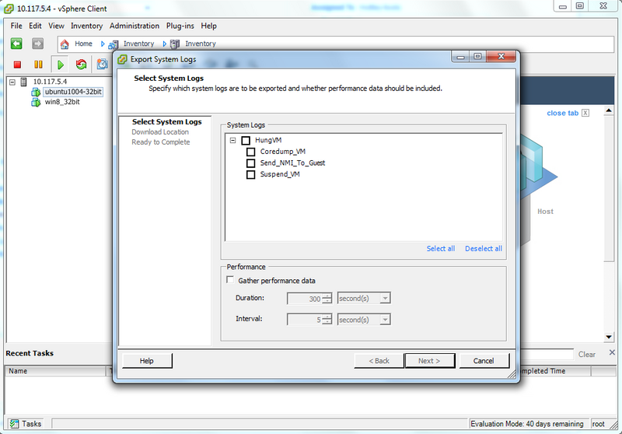
Debugging --- Collect Dump
ESXi 4.1
vm-support -x # list running vms
vm-support -Z <vmid>
ESXi 5.0 and later
vm-support --performance --manifests="HungVM:Coredump_VM HungVM:Suspend_VM Virt:Snapshots" --groups="Fault Hardware Logs Network Storage System Userworld Virtual" --vm=/vmfs/volumes/4ff50132-5711faea-0e15-d4ae5264110b/win-2k3-32-sp2/win-2k3-32-sp2.vmx
KB http://kb.vmware.com/kb/2005715

Slide 45
GuestOS memory dump (Crash/Hang)
Transfer VM memory into Coredump
vmss2core –N6 rhel_6.vmss
vmss2core –W win_2k8.vmss
Windows
windbg
http://windbg.info/doc/1-common-cmds.html
Linux
crash
http://people.redhat.com/anderson/crash_whitepaper/
X86
bin/crash --machdep phys_base=0x200000 vmlinux vmss.core
X64
bin/crash vmlinux vmss.core

Slide 46
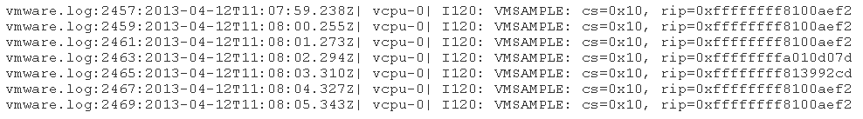
Debugging --- GuestOS Instruction Sample
Enable them at power-on time with "monitor_control.enable_vmsample = 1" in .vmx
Or at run-time with `vmdumper -l`;`vmdumper <wid> samples_on`. They will appear in vmware.log for each VCPU.

Slide 47
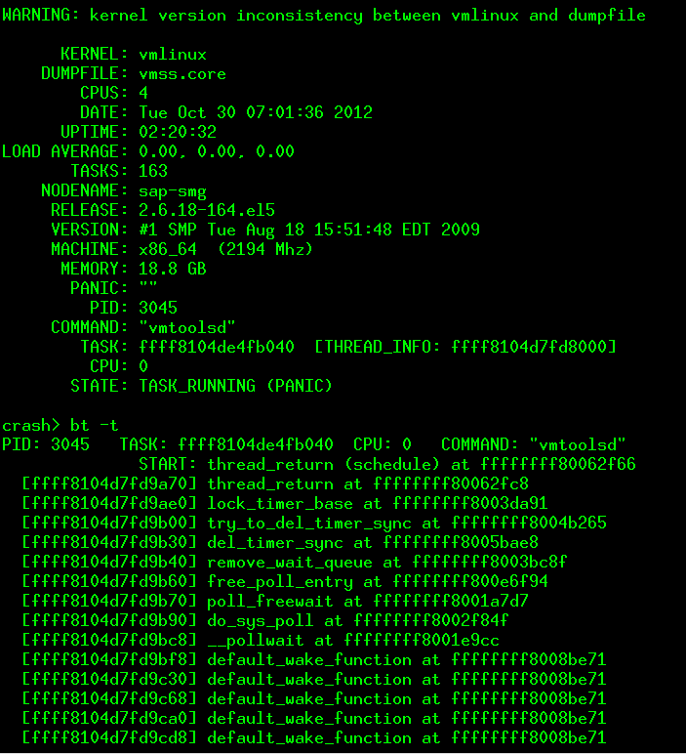
Linux Coredump

Slide 48
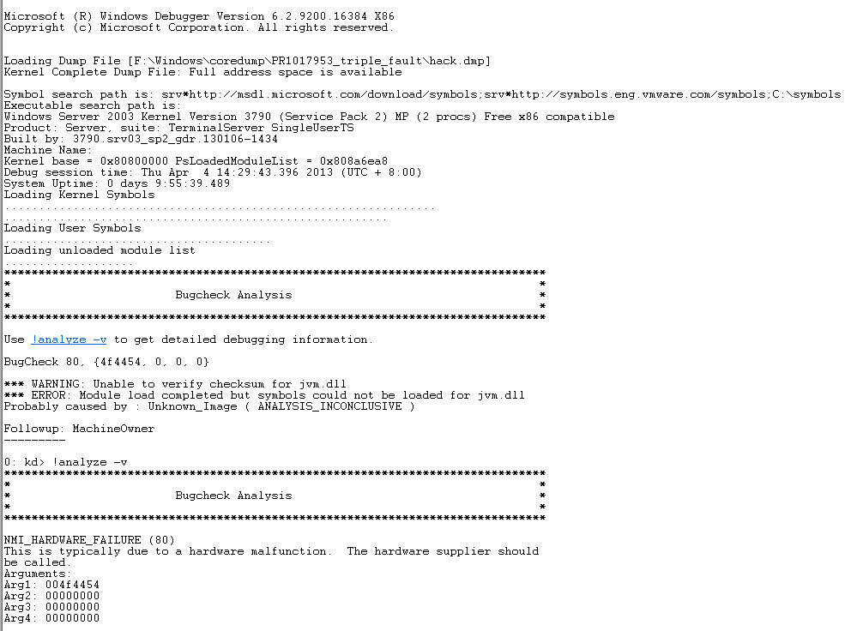
Window Coredump

Slide 49
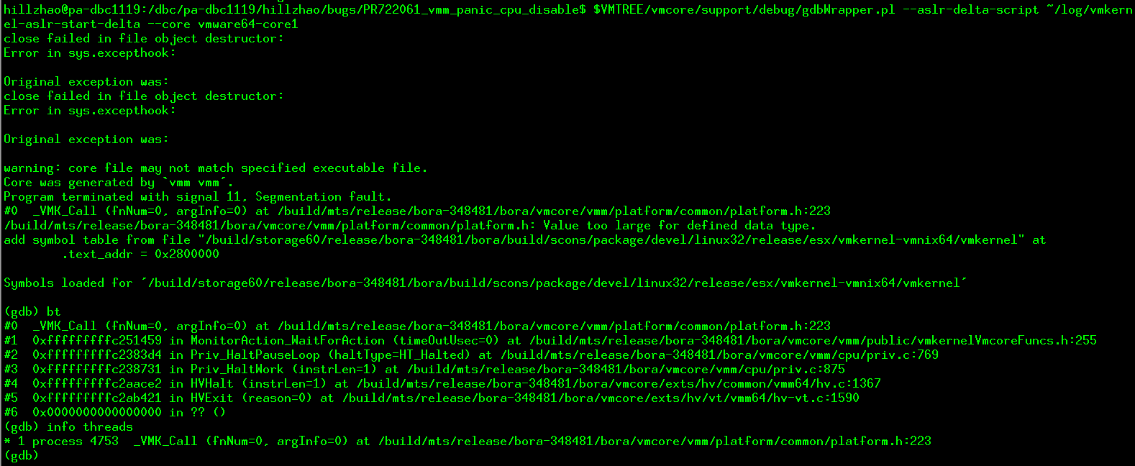
Monitor Dump

Slide 50
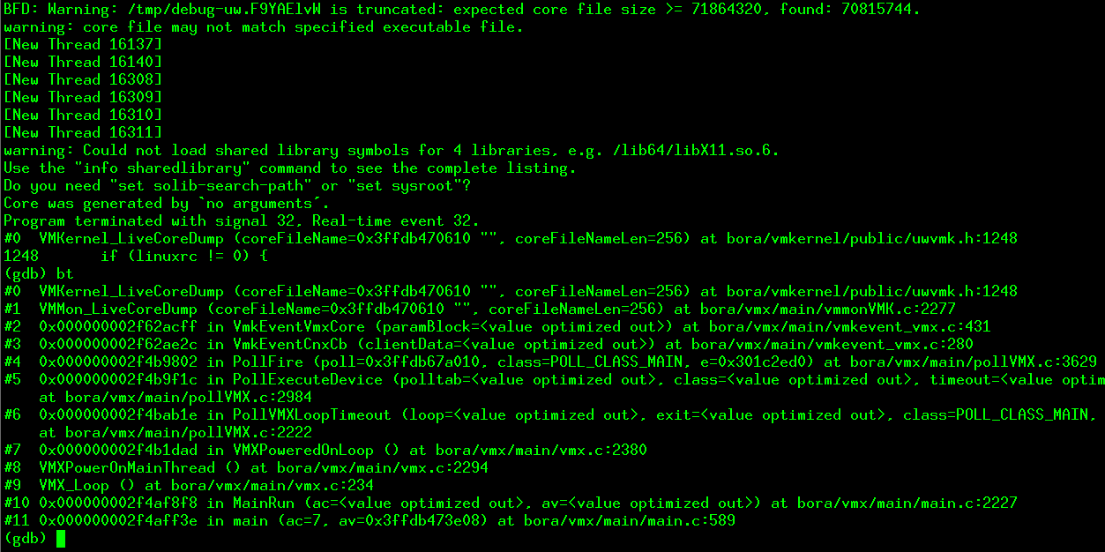
VMX Coredump

Slide 51
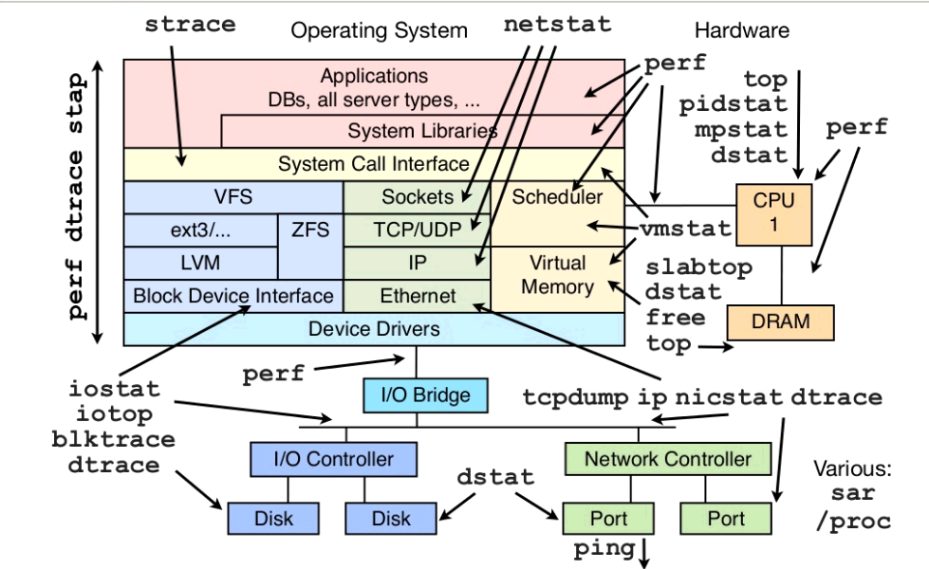
Linux Stack and Tools

Slide 52
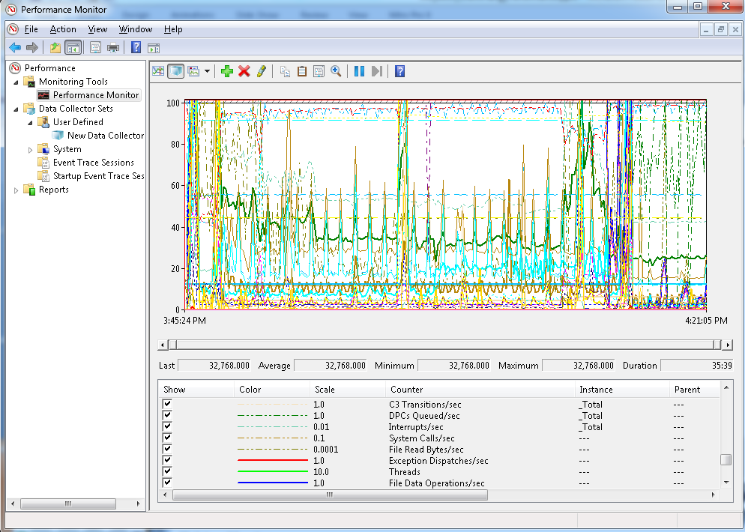
Perfmon

Slide 53
Agenda
VMKernel Architecture
Virtual Machine Monitor(VMM) Architecture
Performance Troubleshooting

Slide 54
Performance Matrix
Functions Layers | CPU | Memory | Networking | Storage
Application
GuestOS (& Tools) | top perf | free vmstat | netstat systemtap | iostat perfmon
VMX/VMM | Kstats + vProbe + Coredump +vmware.log vStrace
VMKernel | esxtop + vmkstats + PSOD + sched-stats +vProbe +vscsistats
Hardware
Methodology
Symptom Analysis Tools Root Cause Tuning Solutions

Slide 55
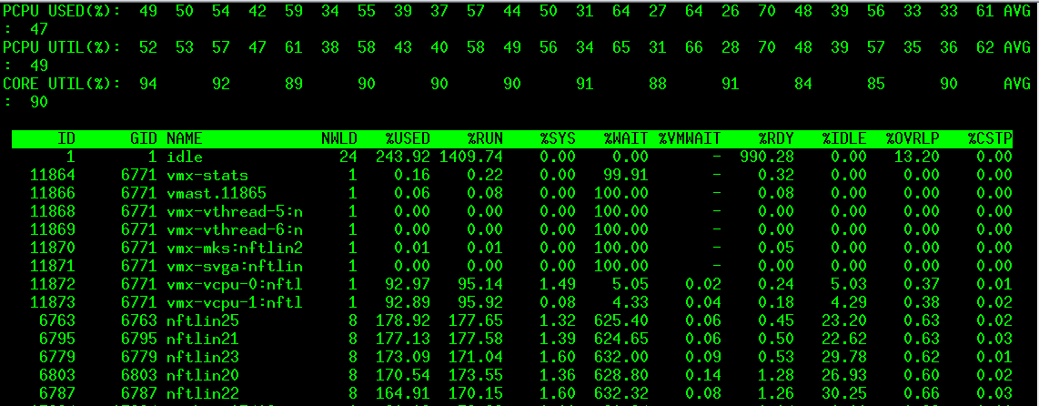
Host CPU
PCPU Usage
Notes:
Q: What does it mean if PCPU UTIL% is high?
Hyper-threading
>100%, check %RDY
Affinity, only one PCPU high
Q: What is the difference between "PCPU UTIL(%)" and "CORE UTIL(%)"?
Q: What is the difference between "PCPU UTIL(%)" and "PCPU USED(%)"?
If PCU_UTIL == CORE_UTIL
Then like
(1) PCPU 0: +++++----- (UTIL: %50 / USED: %50)
PCPU 1: -----+++++ (UTIL: %50 / USED: %50)
First see pcpu util, which can be 100%, that means it’s every busy(other use the unit, it try to use other unit), and then see used with util ratio, and then core_util with pcpu_util ratio
+++++++---
---+++++++
pCPU usage + hyperthreading + UTIL difference.
Solution:
Reduce VM + DRS + efficient VM (large pages + time sensitive+ more memory)

Slide 56
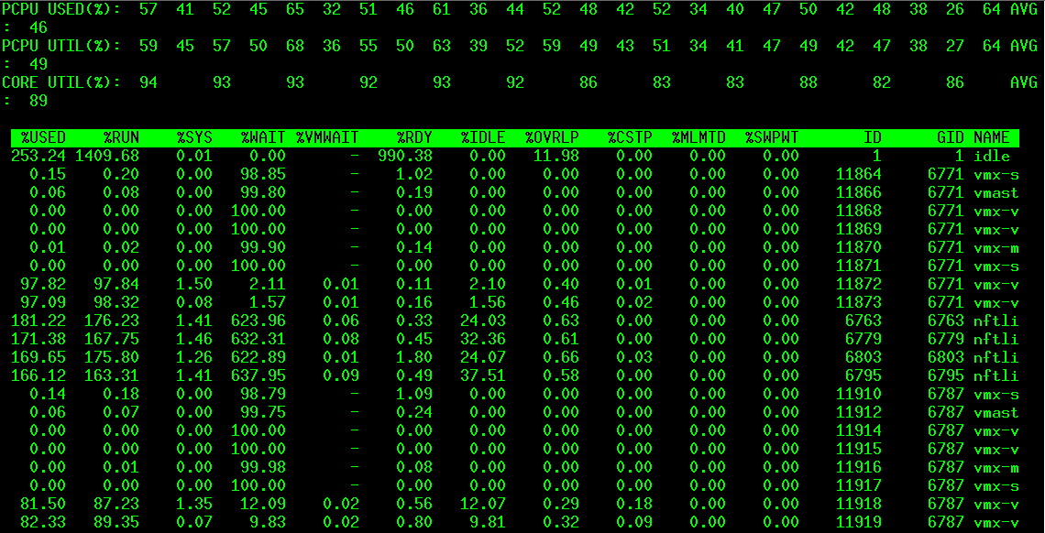
vCPU
Notes:
%RDY - %MLMTD > 20%
+Q: How do I know CPU resource is under contention?+
+A: %RDY is a main indicator. But, it is not sufficient by itself.+
%USED = %RUN + %SYS - %OVRLP
+Q: For an SMP VM, why does VCPU 0 have higher CPU usage than others?+
VCPU with high %CSTP is "stopped" from executing so that another VCPU in the same virtual machine could be run to "catch-up".
+Q: How do I know the VCPU world is waiting for I/O events?+
+A: %WAIT - %IDLE
+Q: How do I know the VM group is waiting for I/O events?+
USED + RDY +CSTP + WAIT + vSMP
Solution:
Add VCPU + Migrate VM + Balance Workload + APP affinity + Remove vCPU + Tuning APP (single Thread or Pinned)

Slide 57
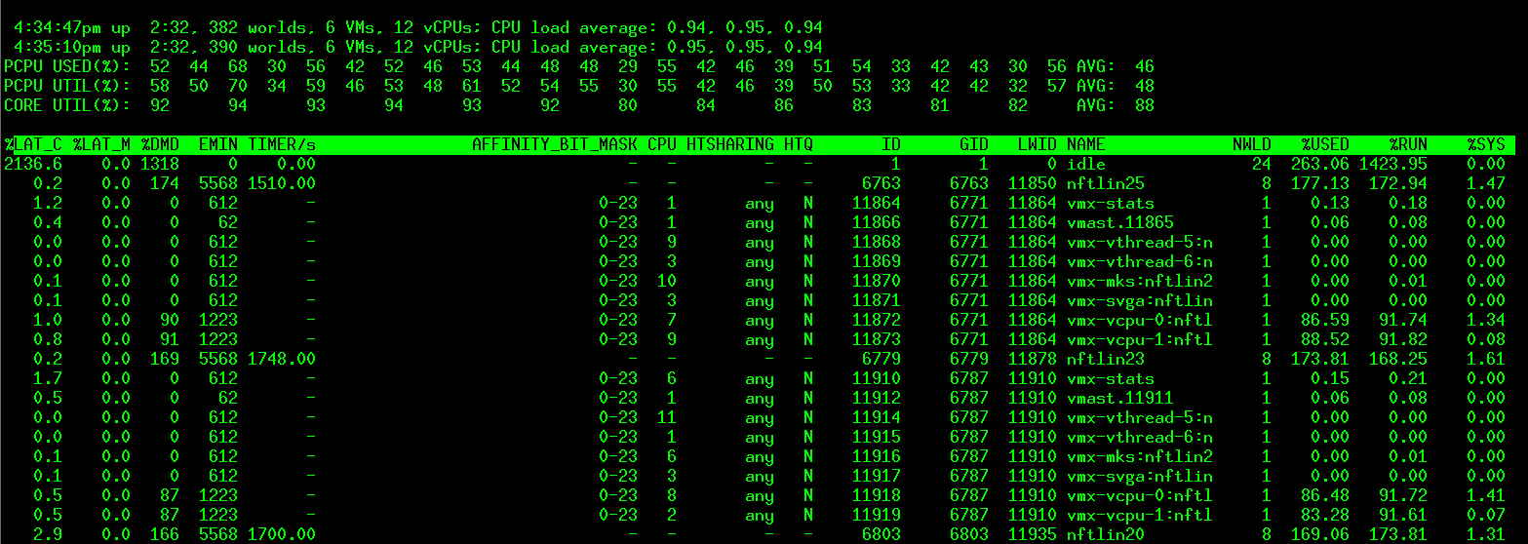
vCPU
Notes:
.It %LAT_C
The percentage of time the Resource Pool/World was ready to run but was not
scheduled to run because of cpu resource contention.
.It %LAT_M
The percentage of time the Resource Pool/World was ready to run but was not
scheduled to run because of memory resource contention.
It %DMD
the CPU demand in percentage. It represents the average active CPU load in the past 1 minute.
+ vSMP

Slide 58
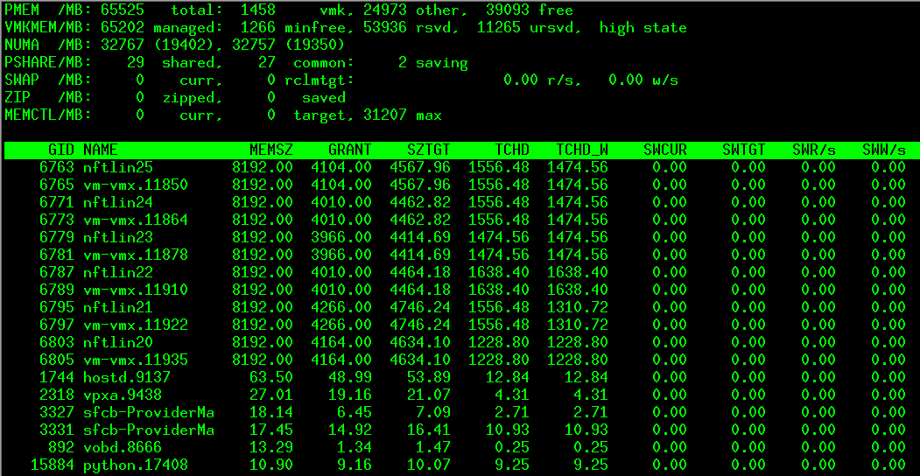
Memory--- Host
Notes:
"state" : the free memory state. Possible values are high, soft, hard and low. The memory "state" is "high", if the free memory is greater than or equal to 6% of "total" - "cos". If is "soft" at 4%, "hard" at 2%, and "low" at 1%. So, high implies that the machine memory is not under any pressure and low implies that the machine memory is under pressure
Ursvd < rsvd or ursvd is small , memory limit possible
NUMA balance
State + NUMA(VM memory size > NUMA node) + SWAP + Balloon
Solution:
Enable Ballon (if swap large) + Reserve memory + Tuning APP + add Physical Memory + DRS

Slide 59
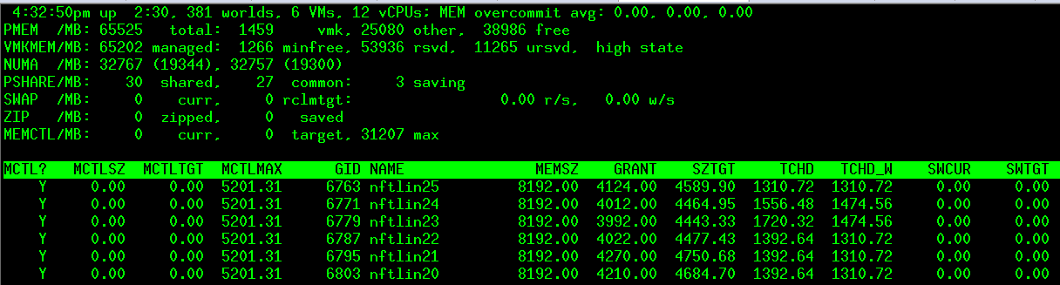
Memory--- VM
Notes:
"MEMSZ" = "GRANT" + "MCTLSZ" + "SWCUR" + "never touched“
Q: How is "TCHD" used?
A: "TCHD" is a working set estimate, which indicates how actively the VM is using its memory
"MCTLSZ" (MB)
The amount of guest physical memory reclaimed by balloon driver.
"SWCUR" (MB)
Current swap usage.
For a VM, it is the current amount of guest physical memory swapped out to the backing store. Note that it is the VMKernel swapping not the guest OS swapping.
It is the sum of swap slots used in the vswp file or system swap, and migration swap.
: Why is it possible for "MCTLTGT" to be less than "MCTLSZ" for a long time?
A: If "MCTLTGT" is less than "MCTLSZ", VMKernel allows the balloon to deflate. But, balloon deflation happens lazily until the VM requests new memory. So, it is possible for "MCTLTGT" to be less than "MCTLSZ" for a long time, when the VM is not requesting new memory.
Q: What does it mean if "SWCUR" of my VM is high?
A: It means the VM's guest physical memory is not resident in machine memory, but on disk. If those memory will not be used in the near future, it is not an issue. Otherwise, those memory will be swapped in for guest's use. In that case, you will see some swap-in activities via "SWR/s", which may hurt the VM's performance.
Q: What does it mean if SWR/s is high?
A: It is very bad for VM's performance. Because swap-in is synchronous, the VM needs to wait until the requested pages are read into machine memory. This happens when VMKernel swapped out the VM's memory before and the VM needs them now. Please refer to "SWW/s".
Ballon + SWAP(read +Write per second)

Slide 60
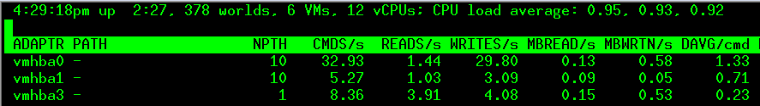
Storage--- Throughput
Adapter Counter
1M IOPS
Notes:
For performance analysis purposes, an IO request from an application in a virtual machine traverses through multiple levels of queues, each associated with a resource, in the guest OS, the VMkernel and the physical storage.
. (Note that physical storage could be an FC- or IP- SAN or disk array.)
http://en.wikipedia.org/wiki/IOPS
IOPS * transferbytespersec = byterpersecond
https://wiki.eng.vmware.com/Performance/1M_IOPS
CMDS/s 36729
RD/s == 72366
MBRD/s MBWR/s
35.33
IOPS + Queue depth relation
Vscsistats: IO size, sequencial, + seek distance
Iometer: isolate problem
Cause: IO Size + IO arrive-rate + Locality + vMotion ( separte vmknic) + disk Share + snapshot (long find)
Solution:
Add Storage capacity + Add Q depth + PVSCSI (hv)+ vendor (LUN number, RAID level, cache of array) + SCSI (hardware + software)
+ overloaded (abort number) + Move some VM to other Disk (pre-exist VMFS for VM sharing, same time sequencial request to ) + merge snapshot
https://wiki.eng.vmware.com/NativeFastPathSSD/ESXStorageStackLatencyProfiling
• I/O arrival-rate: A given configuration of a storage device will have a maximum rate at which it can handle specific mixes of I/O requests. rate, they may need to be queued in buffers along the I/O path. This queuing can add to the overall response-time. When bursts of requests exceed this
• I/O Size: The transmission rate of storage interconnects, and the speed at which an I/O can be read from or written to disk, are fixed quantities. As a result, large I/O operations will naturally take longer to complete. A response-time that is slow for small transfers may be expected for larger operations.
• I/O Locality: Successive I/O requests to data that is stored sequentially on disk can be completed more quickly than those that are spread randomly. In addition, read requests to sequential data are more likely to be completed out of high-speed caches in the disks or arrays.
• Disk Shares: Represents the relative importance of a VM when accessing a shared datastore. During periods of I/O congestion, VMs with higher shares are given proportionally higher percentage of access to the shared datastore. This typically results in higher I/O throughput and lower latency for the VMs with higher shares.
• Limit – IOPs: Represents the maximum number of I/O requests a VM is allowed to issue per second.
• Congestion Threshold (Advanced Option): Upper limit for the datastore-wide normalized I/O latency beyond which a shared VMFS datastore is determined to be congested

Slide 61
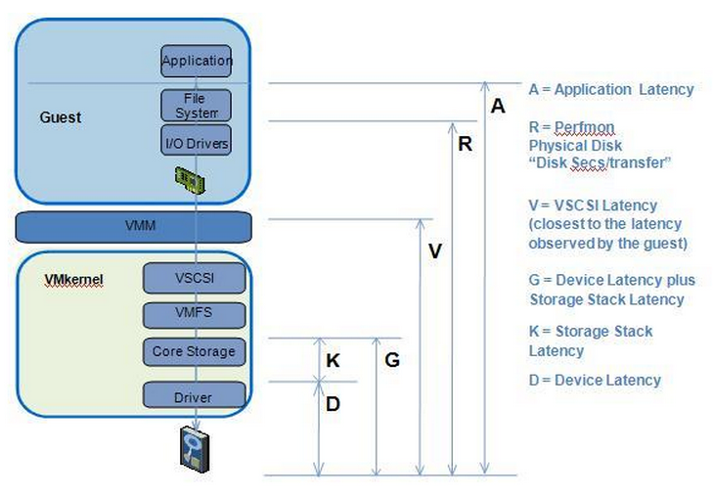
Storage --- Latency

Slide 62
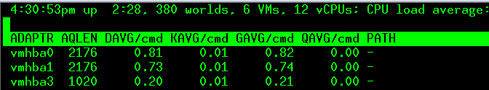

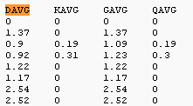
Storage --- Latency
1M IOPS
Notes:
只要IO延迟在20ms内，IO性能对于应用程序来说都是可以接受的，但是如果大于20ms
，
Q: What is the relationship between GAVG, KAVG and DAVG?
A: GAVG = KAVG + DAVG
The KAVG value should be very small in comparison to the DAVG value and should be close to zero.
DAVG (milliseconds)
This is the latency seen at the device driver level. It includes the roundtrip time between the HBA and the storage.
Davg = ((issueTime + queueTime) - layerTime) / (commands)
QAVG
The average queue latency. QAVG is part of KAVG
Response time is the sum of the time spent in queues in the storage stack
If QAVG is high, another line of investigation is to examine the queue depths at each level in the storage stack.
Latency: how to compute?
GAVG + KAVG + DAVG + QAVG + AQLEN
QAVG: kernel issue
DAVG : hardware , arrary + FC + RAID level

Slide 63
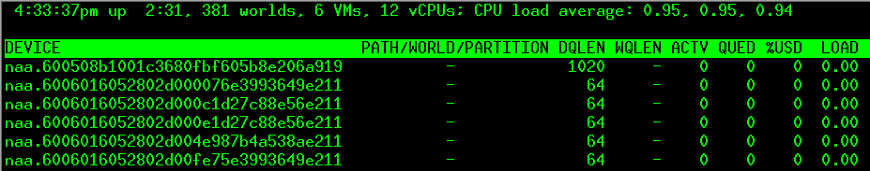
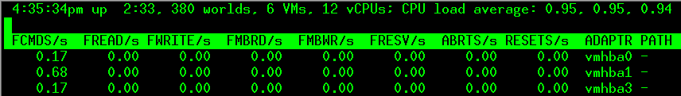
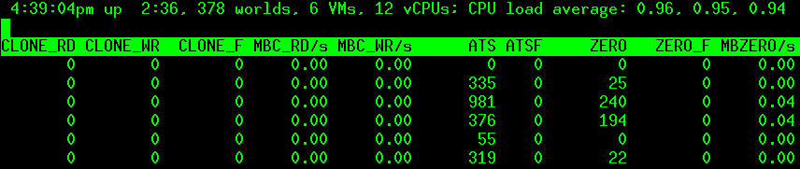
Storage --- Queue Depth
Error Statics
Notes:
QUED
The number of commands in the VMKernel that are currently queued. This statistic is only applicable to worlds and LUNs.
sustained high value for the QUED counter signals a storage bottleneck which may be alleviated by increasing the queue depth. Check that LOAD &lt; 1 after increasing the queue depth. This should also be accompanied by improved performance in terms of increased cmd/s.
%USD = ACTV / QLEN * 100%
公式：IOPS=(队列深度）X(IO延迟）
Queue depth 增加，一个IO的延时增加，但是IOPS增加了，平均的延时相对减少了。
控制器向存储设备发起的指令，不是一条条发送的，而是一批批的发送，存储目标设备批量执行IO
SSD 随机4KB读取下 IOPS 范围在5000~8000附近
他们使用一块365GB Fusion ioDrive2固态硬盘就创造了9608000 IOPS的随机性能，逼近千万大关。
.5K , Read 100%, Random 100%
Total IOPS = 1107131.02
MB/sec = 540.58
CPU util: 90.5% of 16 cores
LOAD
The ratio of the sum of VMKernel active commands and VMKernel queued commands to the queue depth. This statistic is only applicable to worlds and LUNs.
ABRTS/s
The number of commands aborted per second.
ZERO
The number of the ZERO_BLOCKS commands successfully completed
When a virtual disk is created, depends on the VMDK type, any data remaining on the physical disk or LUN can be zeroed out during creation of the virtual disk or zeroed out at a later time during virtual machine read and write operations.
ATS
Then number of ATS (Atomic test and set) commands successfully completed.
The ATS operation atomically compares an on-disk sector to a given buffer, and, if the two are identical, writes new data into the on-disk sector. The ATS primitive obviates the need for SCSI reservations for the purpose of disk-locking.
Qdepeth & IOPS relation (Throughtput and latency): SSD example.
Qdepth: memge Ios together to issue, performance good.
QUED: can not process well
Abort + Reset + ATS( disk lock) + zero(thin/thick)

Slide 64
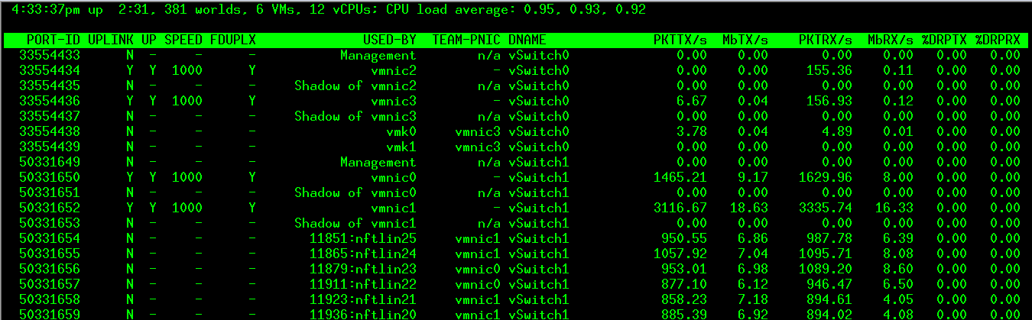
Networking
Notes:
vmsupport-net-analyzer.py 914609 vsi_traverse_-s.txt vsi_traverse_-s--l-0.txt net-dvs_-l.txt > ./hill_net_analyzer.txt
DROP counter RX/TX
Client status (broadcast packets)
Solution:
guestOS Stack tuning(poll or interupt) + pNIC hardware accelerate + dest buffer size + increase cpu resource + add uplinks + move VM to others + vmotion
All solution:
Use latest tools

Slide 65
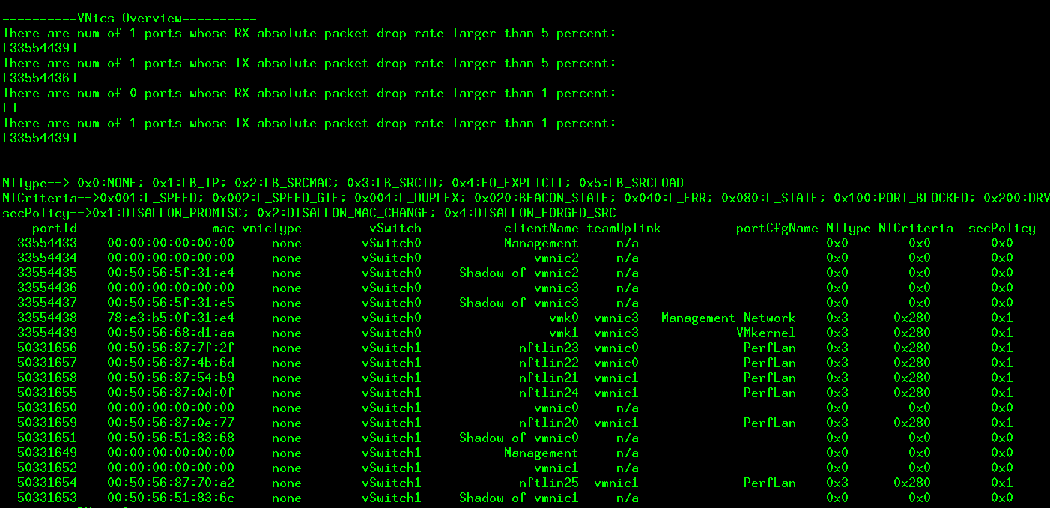
Vmsupport-net-analyzer

Slide 66
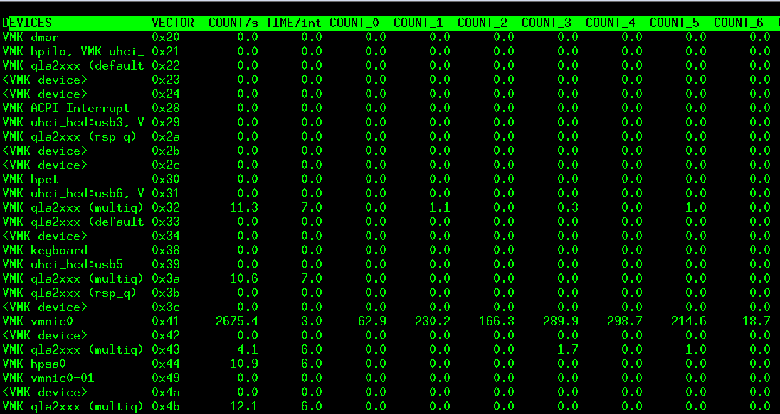
Interrupt
Notes:
High io interrupt + timekeeping +

Slide 67
Oprofile
modprobe oprofile timer=1 opcontrol --init opcontrol --vmlinux=/usr/lib/debug/boot/vmlinux-3.2.0-23-generic opcontrol --reset java -agentpath:/usr/local/lib/oprofile/libjvmti_oprofile.so oprofed_java_app opcontrol –start //in another console, dump the oprofiling opcontrol --dump opcontrol –stop opcontrol --shutdown opcontrol –deinit
opreport -o report.txt opreport --image-path /lib/modules/<kernelversion>/kernel --symbols -o report-symbols.txt .

Slide 68
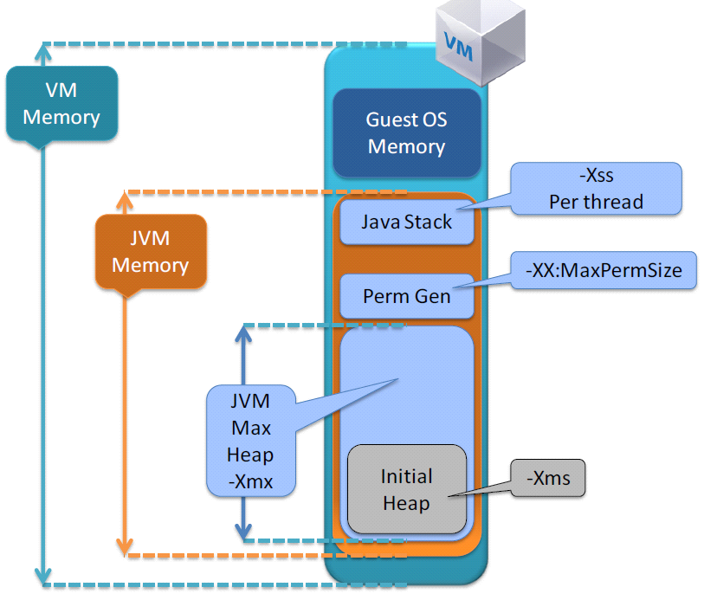
Performance --- Java
vCPU numbers for Virtual Machine
VM sizing and VM-to-JVM ratio through a performance load test
VM vCPU CPU overcommit
VM vCPU. Do not oversubscribe to CPU cycles that you do not really need
Virtual Machine Memory Size
VM Memory (needed) = guest OS memory + JVM Memory
JVM Memory = JVM Max Heap
(-Xmx value) + Perm Gen (-XX:MaxPermSize) + NumberOfConcurrentThreads * (-Xss)
Notes:
Timekeeping Best Practices(http://kb.vmware.com/kb/1006427)
Java Best Practices (http://www.vmware.com/resources/techresources/1087)

Slide 69
Java
Memory
VM memory sizing
Set memory reservation for virtual machine memory needs
Use large memory pages
Set the -XX:+UseLargePages
Timekeeping
Use NTP source
-XX:+ForceTimeHighResolution.
Latency-sensitive best practices
Use ESX/ESXi host cluster
HA & DRS
Affinity rules
Notes:
ESXtop
http://communities.vmware.com/docs/DOC-11812

Slide 70
Thanks & Q/A

