Slide 1
Tool introduction - Cybertron
11 Jun 2015
CPD Platform Team

Slide 2

What’s Cybertron?
A Linux vmcore analyzer
Based on open source project retrace server
Output with Bugzilla, Redhat KB search result
Online terminal for crash command
http://cybertron.eng.vmware.com

Slide 3
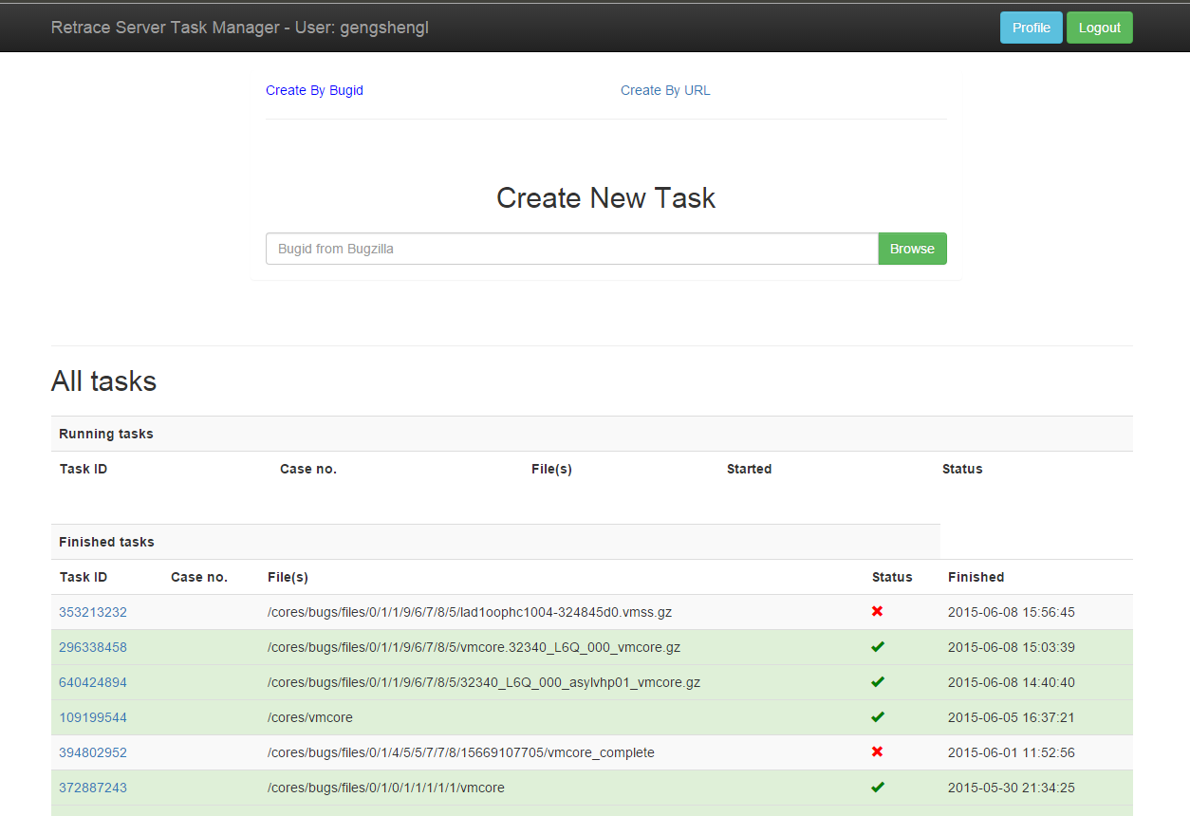
UI

Slide 4
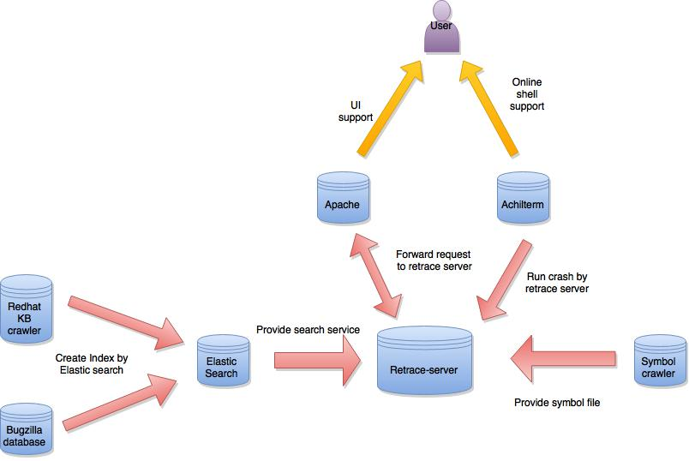
Architecture of Cybertron

Slide 5

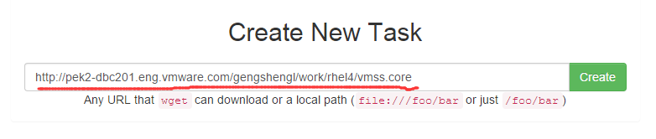
Input of Cybertron
Bugzilla ID
Vmcore ULR

Slide 6
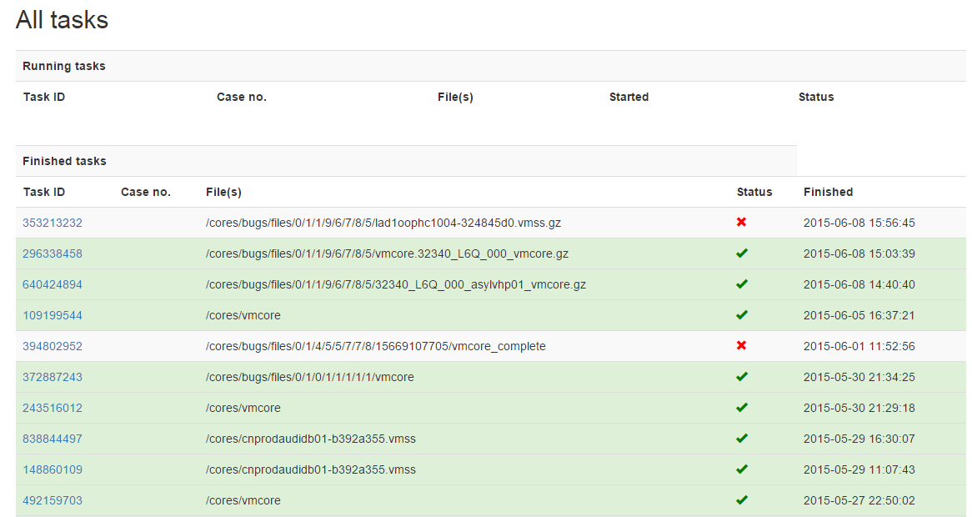
Task List

Slide 7
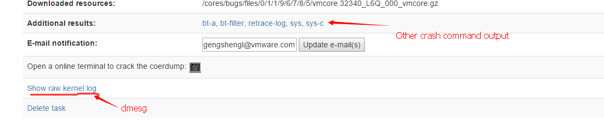
Output: dmesg and other command

Slide 8
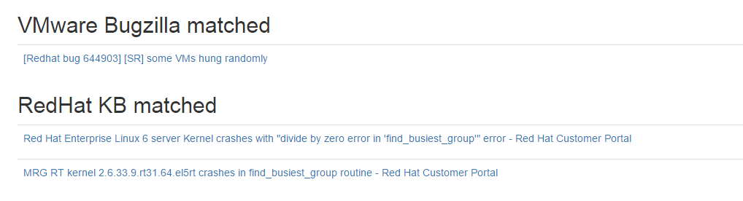
Output：Bugizlla and Redhat KB

Slide 9

Online shell for crash

Slide 10
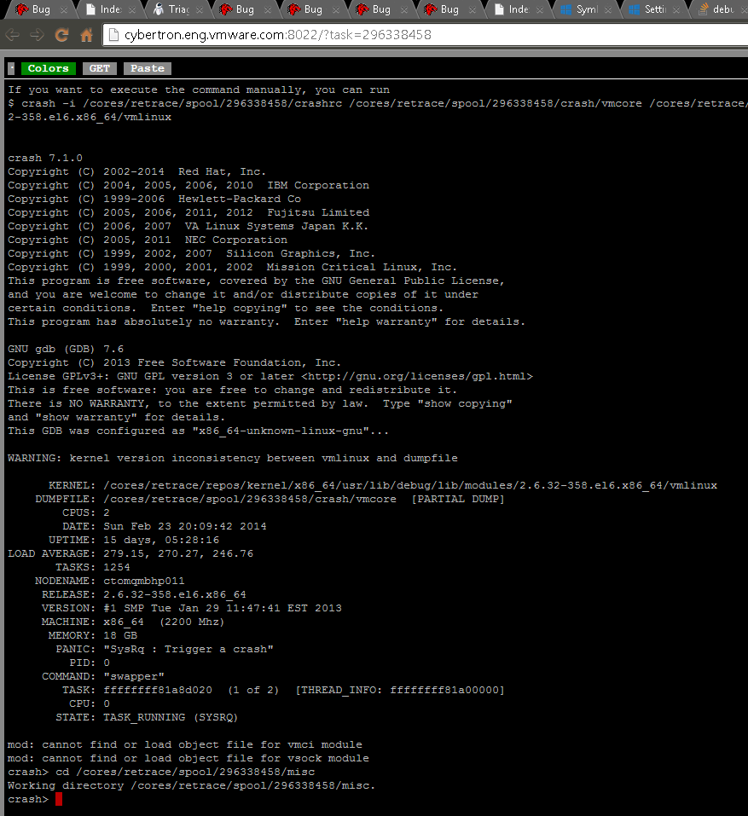

Slide 11
Developers
Zhuqing Zeng(Intern)
Gengsheng Liu

Slide 12

Q&A

