Slide 1

|Coverage, an overview|
Stuart Easson
1

Slide 2


Key points
What is coverage?
How do we do it?
What is the cost?
What does it do?
Why do we want it?
How do we use it?
What's left to do?
2

Slide 3
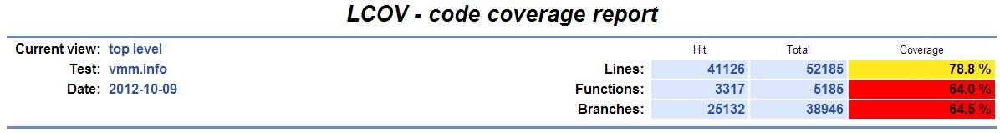
What is 'coverage'?
Generating coverage is the process of instrumenting the build of a product so that its execution generates statistics which show whether and how many times all the instrumented code paths were executed. There are additional constructor function calls to initialize the counters and destructors that harvest the ultimate values and write them to disk.
In general gathering coverage data means generating a special build, then executing the code in as wide a range of scenarios as possible.
'Good' coverage results rely on whomever is using the coverage enabled build to execute appropriate workloads to touch as much of the code as possible. Once all test cases have been completed, a report is prepared from the gathered statistics.
Spoiler (we do OK with our basic test cases)
There are 150+ functions that are included but not reachable.
3

Slide 4
How do we do it?
Generating a coverage enabled build of the monitor in the WS product, is easy. The makefiles we use have been augmented to pass the proper command-line options to GCC, and the correct constructor and destructors are already in place. We run a coverage enabled build thus:
make GCOV_VMM=1 ARCH=x64 OBJDIR=release
and with frobos, like so:
...frobos-run legacymode -j 4 -passthru "coverage.enabled=true"
All build types should work, but the run-time linker is experiencing difficulties that make release and opt builds the only options at the moment.
I have a collection of helper scripts to reduce some of the sources of user error:
init-samples :- generate a baseline for all source files, helps get the numerator correct (Broken!).
add-samples :- harvest sample data and store it to a particular dataset.
combine-samples :- Merge and add datasets.
finalize :- Generate the HTML output from a particular dataset.
4

Slide 5
What's the cost?
A coverage build has additional code emitted to increment counters for each possible code path, and after running a workload these counters are written to disk for later analysis.
This makes things a lot bigger:
[64] text bss rodata data
vmm: 854740(+296k) 378024(+277k) 188044(+75k) 451476(+18k)
hv-none: 336(+256) 184(+180) 964(+960) 872(+744)
hv-svm: 140664(+47k) 121001(+43k) 13384(+12k) 4552(+968)
hv-vt: 167552(+59k) 131680(+53k) 14684(+12k) 4520(+972)
mmu-hwmmu: 45708(+15k) 33896(+24k) 9812(+9k) 5289(+1896)
mmu-nohv: 82556(+29k) 38440(+28k) 9996(+9k) 7337(+1896)
and sometimes a little slower (legacymode + longmode):
GCOV_VMM=1 GCOV_VMM undefined
|Duration: 0h:29m:23s| |Duration: 0h:32m:17s|
|Tests run: 2279| |Tests run: 2279|
|Passes: 1923| |Passes: 1923|
Skipped Tests: 356 Skipped Tests: 356
Test Failures: 0 Test Failures: 0
5

Slide 6
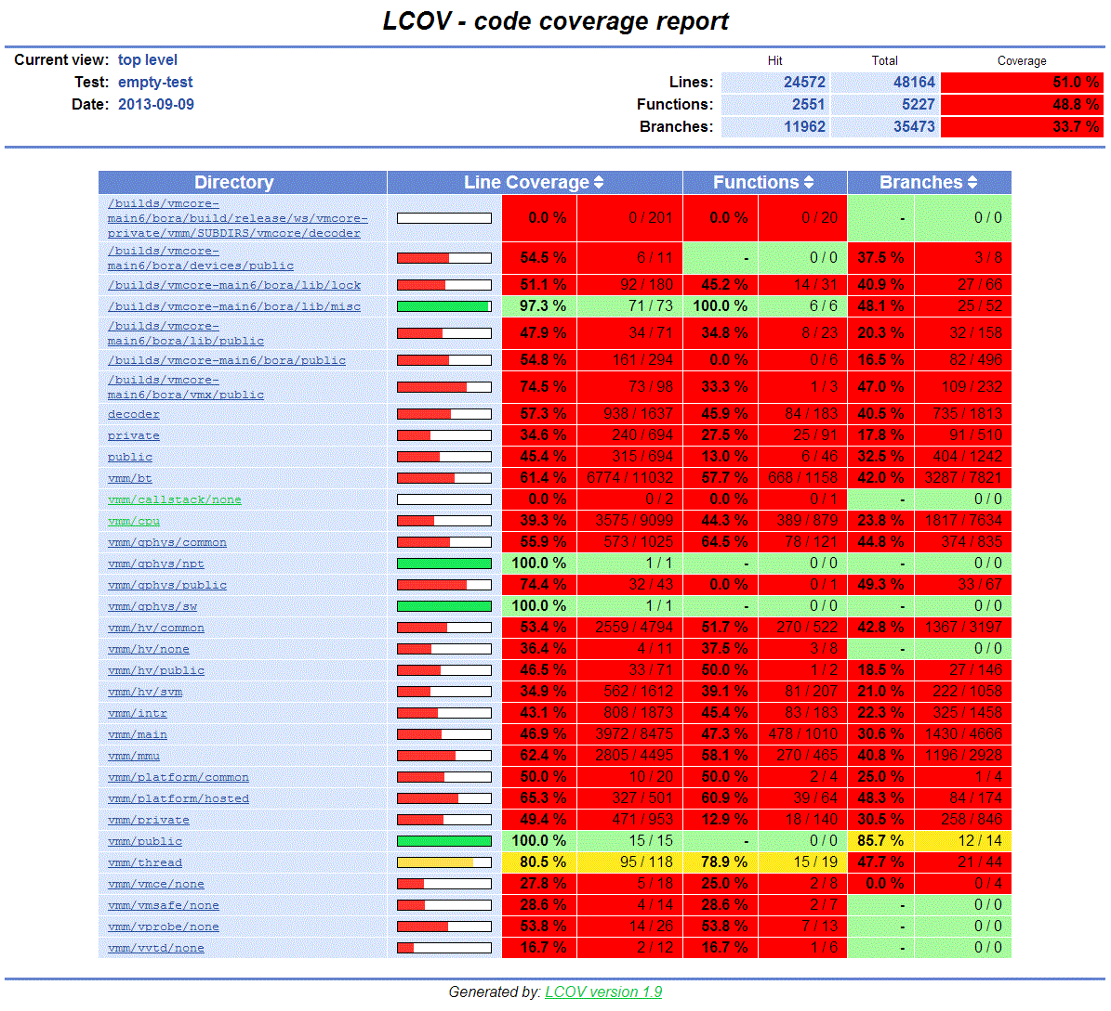
What does it do?
After running a workload (the frobos empty test) and analyzing the data files we get HTML output:
6

Slide 7
Why do we want it?
The data collected from coverage runs allows us to know which parts of our code have been executed, which is good - right?
Not as useful as it sounds: the fact that lines of a function have been executed in one context make it impossible to know if the same lines were appropriately executed in any other.
The better job we do factoring code the less we can infer about code paths.
The real win: Coverage allows us to clearly see which parts of our code have not been executed ... with a few caveats:
The process of inlining function calls can 'leave' complete bodies of functions. These cannot be reached, i.e. they are a false reading of no-coverage (see next slide).
The 'baseline' pass by which the full set of sources that contain lines and functions expected to be reachable by executing the program seems broken by our runtime linking.
7

Slide 8
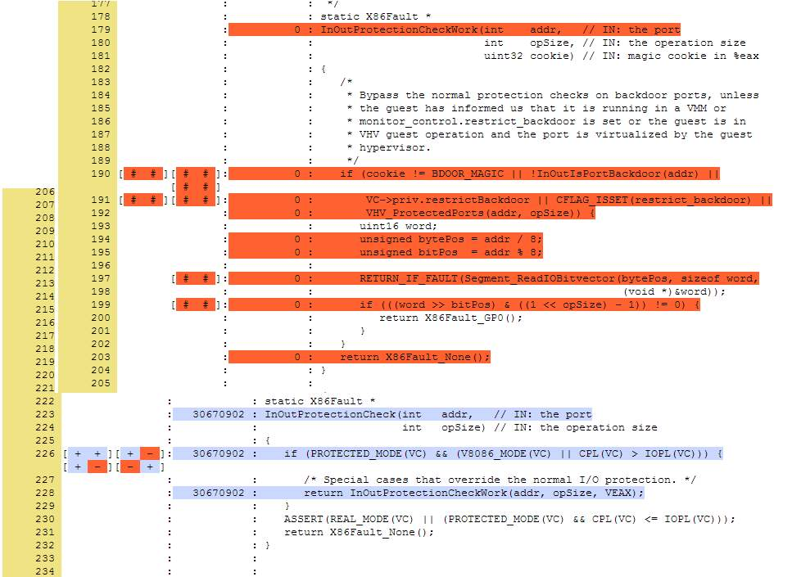
A function that can never be hit
8

Slide 9
How do we use it?
Since we now have a good idea which lines of code are not executed, we know where we need test cases...
A surprising amount of code is not designed to be executed in normal operation, deep error checking can be very hard to 'reach', or in release build types not present. A thorough, expensive analysis of paths and guest state will be needed to reach the deeper cases. We probably need to run coverage builds for a release and obj builds.
We can only gain coverage for the set of errors that do not inhibit the 'normal' shutdown of the VMX.
We need a lot of very similar test cases run on an ever widening array of architectures. For instance a lot of the not hit cases in stateloggermonitor.c are those functions and branches which cater to architecturally specific 'features.'
9

Slide 10
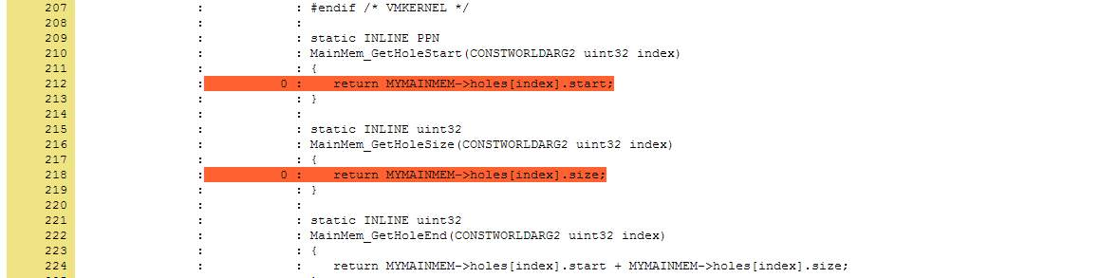
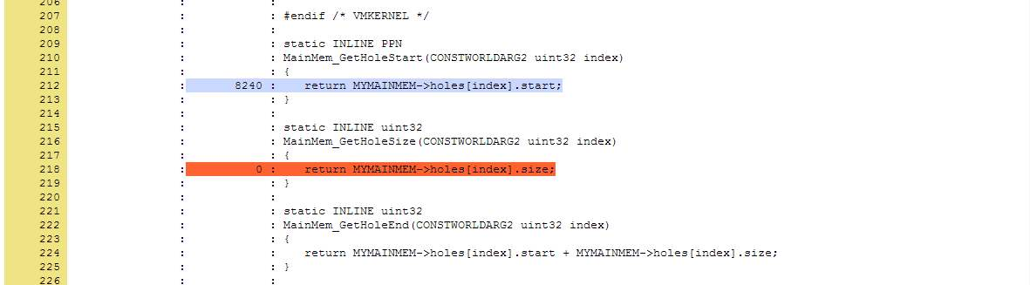
Lets zoom in to line / function level...
The frobos empty test misses MainMem_GetHoleStart
While running "all" the frobos tests hits it 8240 times:
10

Slide 11
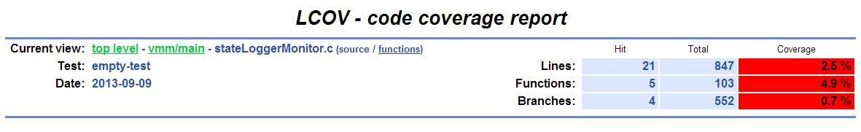
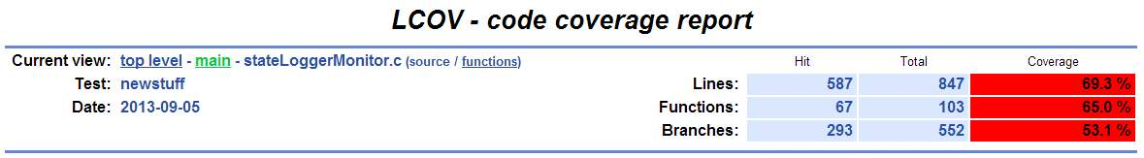
...and a file level example
frobos empty test:
frobos empty test with -replay
11

Slide 12
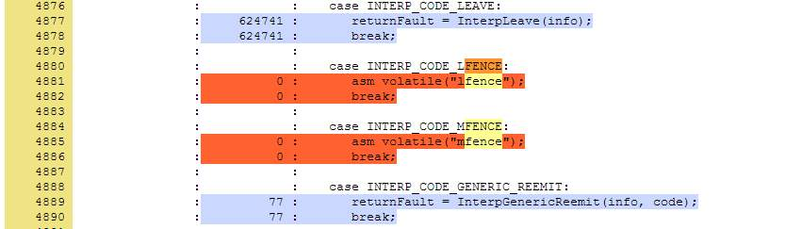
What's left to do (1 of 2)?
'Fix' issues with build process so all paths are represented in the same form for all build types: merging of results from opt and release builds will sometimes yield twice as many source lines for some files, lcov does not recognise the files are in fact the same.
Add intermediate processing step(s) to identify and prune the dataset so orphaned function bodies and the like are not included.
Using the coverage maps as a guide, add additional test cases to test previously missed functions, lines and branches. e.g. While preparing I learned that we have no direct tests in FrobOS for mfence, lfence and sfence running in the interpreter.
12

Slide 13
What's left to do (2 of 2)?
Coordinate the instrumentation for more of the product on a feature basis:
vProbes is currently not covered end to end, some of the code is in the VMX.
mainmem.h is covered by GCOV_VMM=1, while mainmem.c is not.
...?
Finally, automate the process of gathering coverage data. I have an Intel Sandybridge and an AMD Piledriver allocated for running workloads to gather coverage data. I plan on running a continuous process for gathering and publishing on a 24hr schedule, allowing for all of our immediate workloads to be included (frobos, frobos-replay, vprobes, autoinstalls, etc).
13

Slide 14
Coverage analysis, reality
Pull source trees for a WS and an ESX build;
I use 2 appropriate clients sync'ed to same change number.
Generate an ESX build with largest possible memory reservations
update local.sc to generate an OBJ build.
execute "scons -gcov_vmm=1 " - the build generally fails, but we don't need to run it, we just want the programmatically generated public/vmm-overheads.h
copy the file to the correct spot in the WS source tree, then build an OPT build with coverage enabled: make GCOV_VMM=1 OBJDIR=opt
Collect some coverage data
Run workload with the config file option "coverage.enabled=TRUE"
Check bora/build/obj/ws/vmcore-private/... for SUBDIRS/*.gcda
Run lcov to collect and pre-process data, storing intermediate results to a named file.
If more workloads goto 1
Aggregate coverages runs into a final data file.
Run genhtml to create presentation of data with all line counts etc.
14

Slide 15
Coverage analysis, an overview
Generate gcov instrumented build;
The maintainers of the coverage project recommend using a relatively unoptimized build; Apparently inlining defeats some benefits of coverage analysis.
Performance can be severely impacted, so timing sensitive workloads might not be a good fit.
Each basic block adds approx. 4 bytes to the data for the module and 8 bytes of code. Anecdotal comments suggest C++ expands enormously if heavily templated.
Run instrumented build with carefully chosen workload
Post-process coverage data
Examine coverage information
If coverage not yet good enough, choose a better/other workload, then goto step2 otherwise
Declare victory, collect accolades.
15

