Slide 1
Host USB
Gengsheng Liu
CPD-Platform Team

Slide 2
Agenda
The Introduction of USB
  Basic Terms
  USB Spec
  Topology
  Data flow
  Descriptor
VMware Virtual USB
  Architecture
  Device connect / disconnect
Logging & Trouble Shooting
  Logs
  Tools

Slide 3
Basic Terms
Host Controller （HC）
Hub & Root Hub
Port
Endpoint (EP0)
Pipe
Function
Device Address (Default Address 0)
Frame
Packet

Slide 4
USB Spec
USB 1.1 (UHCI, OHCI)
    Low Speed (1.5MB/s), Full Speed (12Mbps)
USB 2.0 (EHCI)
    Low Speed , Full Speed, High Speed (480Mbps)
USB 3.0 (xHCI)
    Compatible with 2.0, Super Speed (5Gbps, 10bps)
USB OTG
Host
Device
Device
Device

Slide 5
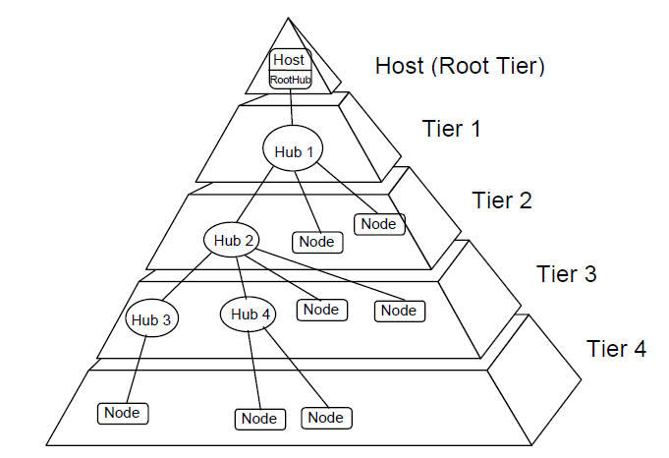
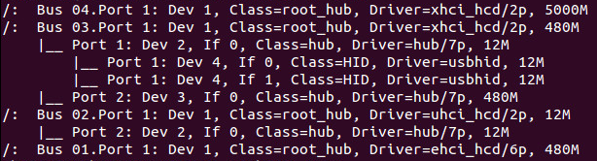
Physical USB Topology
PCI Bus

Slide 6
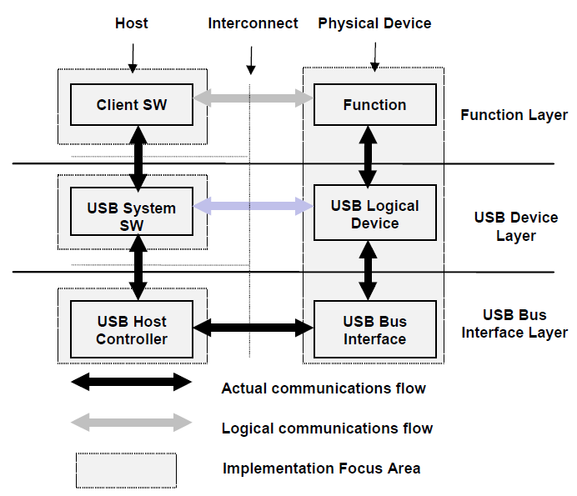
USB Data Flow Model

Slide 7
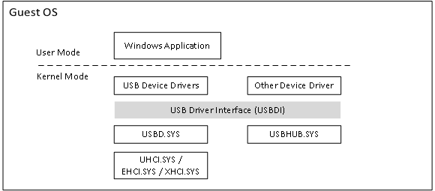
Windows USB Driver System

Slide 8
Data Flow Type
    Control Transfers
      Init & Configure USB device
      Special data structure
Bulk Transfers
      Large amounts of data, the data is sequential.
      No latency requirement
Interrupt Transfers
      Small data package， low latency
Isochronous Transfers
      Isochronous data is continuous and real-time
      bandwidth required
      No ERROR Detection

Slide 9
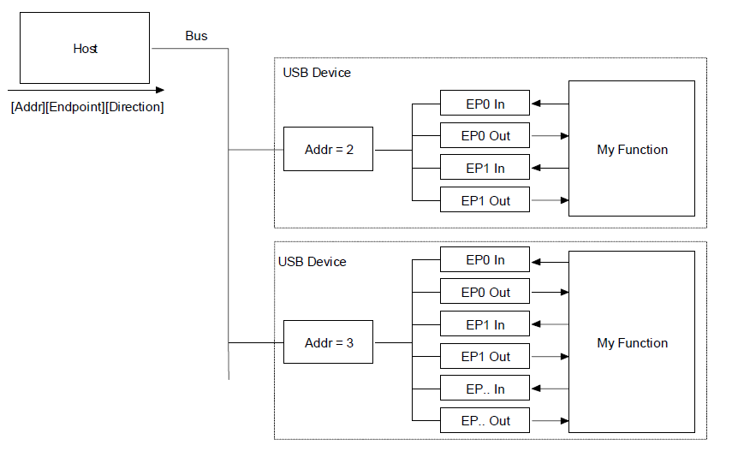
Singe Packet Transfer
Packet

Slide 10
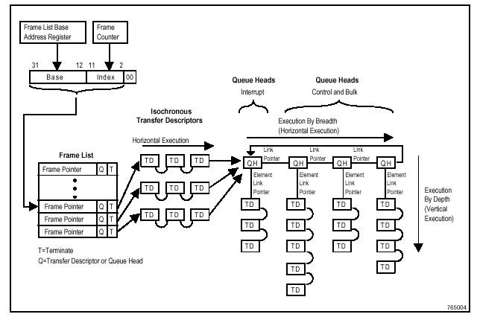
Multi-Packet Transfer

Slide 11
Descriptor
    Definition
      A descriptor is a data structure with a defined format.
      USB devices report their attributes using descriptors.
Descriptor Type
      Device Descriptor
        Describe general information about a USB device.
        Length, Class, subclass, vender ID, product ID, Number of Configurations
      Configuration Descriptor
        Describe information about a specific device configuration.
        Length, Config characteristics (Self-Power, Remote Wakeup), MaxPower, Number of Interface

Slide 12
Descriptor
Descriptor Type (Continue)
      Interface Descriptor
        Describe a specific interface within a configuration
        Length, Interface Class & Subclass, Number of Endpoint
      Endpoint Descriptor
        Length, Transfer Type (Control, Isochronous , Interrupt, Bulk), Endpoint Address, Max Packet Size

Slide 13
Descriptor Relationship
Only one == >
Device Descriptor
Only One active configuration, determined at device init
Configuration 0
Configuration 1
Driver object
Interface 0
Interface 1
Interface 2
EP1
EP2
EP3
EP4
EP5
EP0 belongs to every Interface

Slide 14
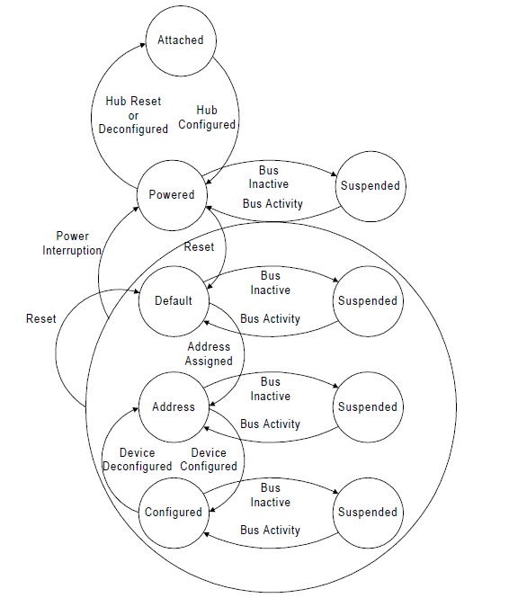
Device State Diagram

Slide 15
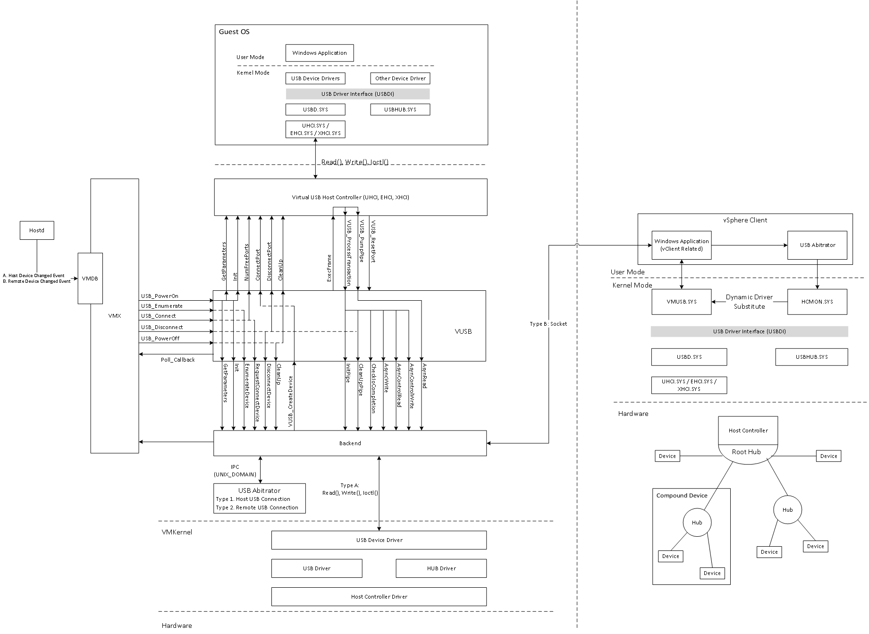
VMware USB Architecture

Slide 16
Logs
    vmware.log
      VUSB Poweron, Init, USBIO, Device connect & disconnect
Arbitrator log
      Record the connection / disconnection between VM and Devices
Hcmon log
      Dynamic driver substitute
      Filter & Change special Control Message
Hostd log
      Record the USB device change event.
https://wiki.eng.vmware.com/USBBugGuidelines

Slide 17
Tools
    lsusb
      -t: Dump the physical USB device hierarchy as a tree
      -v: show USB device’s descriptors
  Usbview.exe
      The same as lsusb, but on Windows
Virtual USB Analyzer
      http://vusb-analyzer.sourceforge.net/tutorial.html
USB wireshark
      http://esec-lab.sogeti.com/post/2011/04/06/Sniffing-USB-traffic-with-VMWare

Slide 18
Q & A
Thanks

