Slide 1
VMware USB Stack Overview
Subtitle
Dyno Fu (hfu@vmware.com)
Apr 8, 2015

Slide 2
USB – Hosted (VMware Workstation on Windows)
Subtitle text is Arial 18 pt
vmware-hostd.exe
vmware-vmx.exe
vmware.exe
usblib
usblib
usblib
vmware-usbarbitrator64.exe
usblib
ioctl
Hcmon.sys
vmusb.sys
Notes:
Vmware-usbarb-2488.log
2014-09-10T15:56:44.927-07:00| vthread-5| I120: USBArb: Num instances:2, user:SYSTEM client:vmware-hostd.exe
2014-09-10T15:56:44.927-07:00| vthread-5| I120: USBArb: Client 8564 connected (version: 6)
2014-09-10T15:56:53.596-07:00| vthread-5| I120: USBArb: Num instances:3, user:hfu client:vmware.exe
2014-09-10T15:56:53.596-07:00| vthread-5| I120: USBArb: Client 8768 connected (version: 6)
2014-09-10T15:57:55.332-07:00| vthread-5| I120: USBArb: Num instances:4, user:hfu client:vmware-vmx-debug.exe
2014-09-10T15:57:55.332-07:00| vthread-5| I120: USBArb: Client 7712 connected (version: 6)

Slide 3
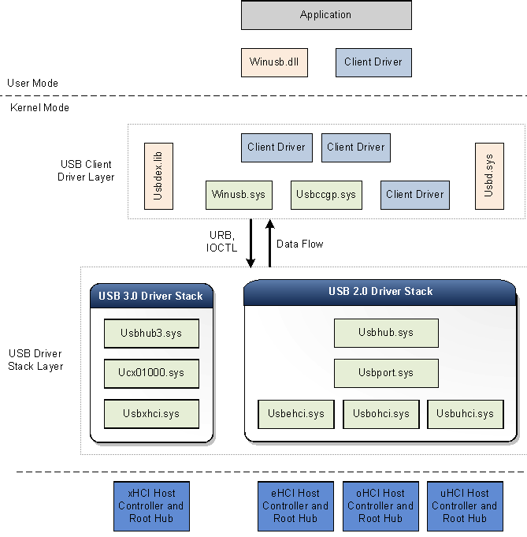
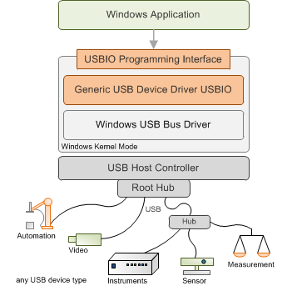
Windows USB Stack
vmusb.sys
Notes:
https://msdn.microsoft.com/en-us/library/windows/hardware/hh406256(v=vs.85).aspx
http://www.thesycon.de/eng/usbio.shtml
http://blogs.msdn.com/b/usbcoreblog/archive/2009/10/31/how-does-usb-stack-enumerate-a-device.aspx http://blogs.msdn.com/b/usbcoreblog/archive/2013/04/11/usb-2-1-2-0-1-1-device-enumeration-changes-in-windows-8.aspx

Slide 4
USB – ESX (VIClient, NGC)
vmware-hostd.exe
vmware-vmx.exe
usblib
usblib
usblib
usblib
vmware-usbarbitrator64.exe
remoteDeviceConnect
Linux USB Stack
vmklinux

Slide 5
USB – View – Client Side
Subtitle text is Arial 18 pt
Vmware-view-usbd.exe
usblib
vmware-usbarbitrator64.exe
usblib
ioctl
Hcmon.sys
vmusb.sys

Slide 6
USB – View – Remote Side
Subtitle text is Arial 18 pt
Vmware-view-usbd.exe
PCoIP
vmwvhub.sys

Slide 7
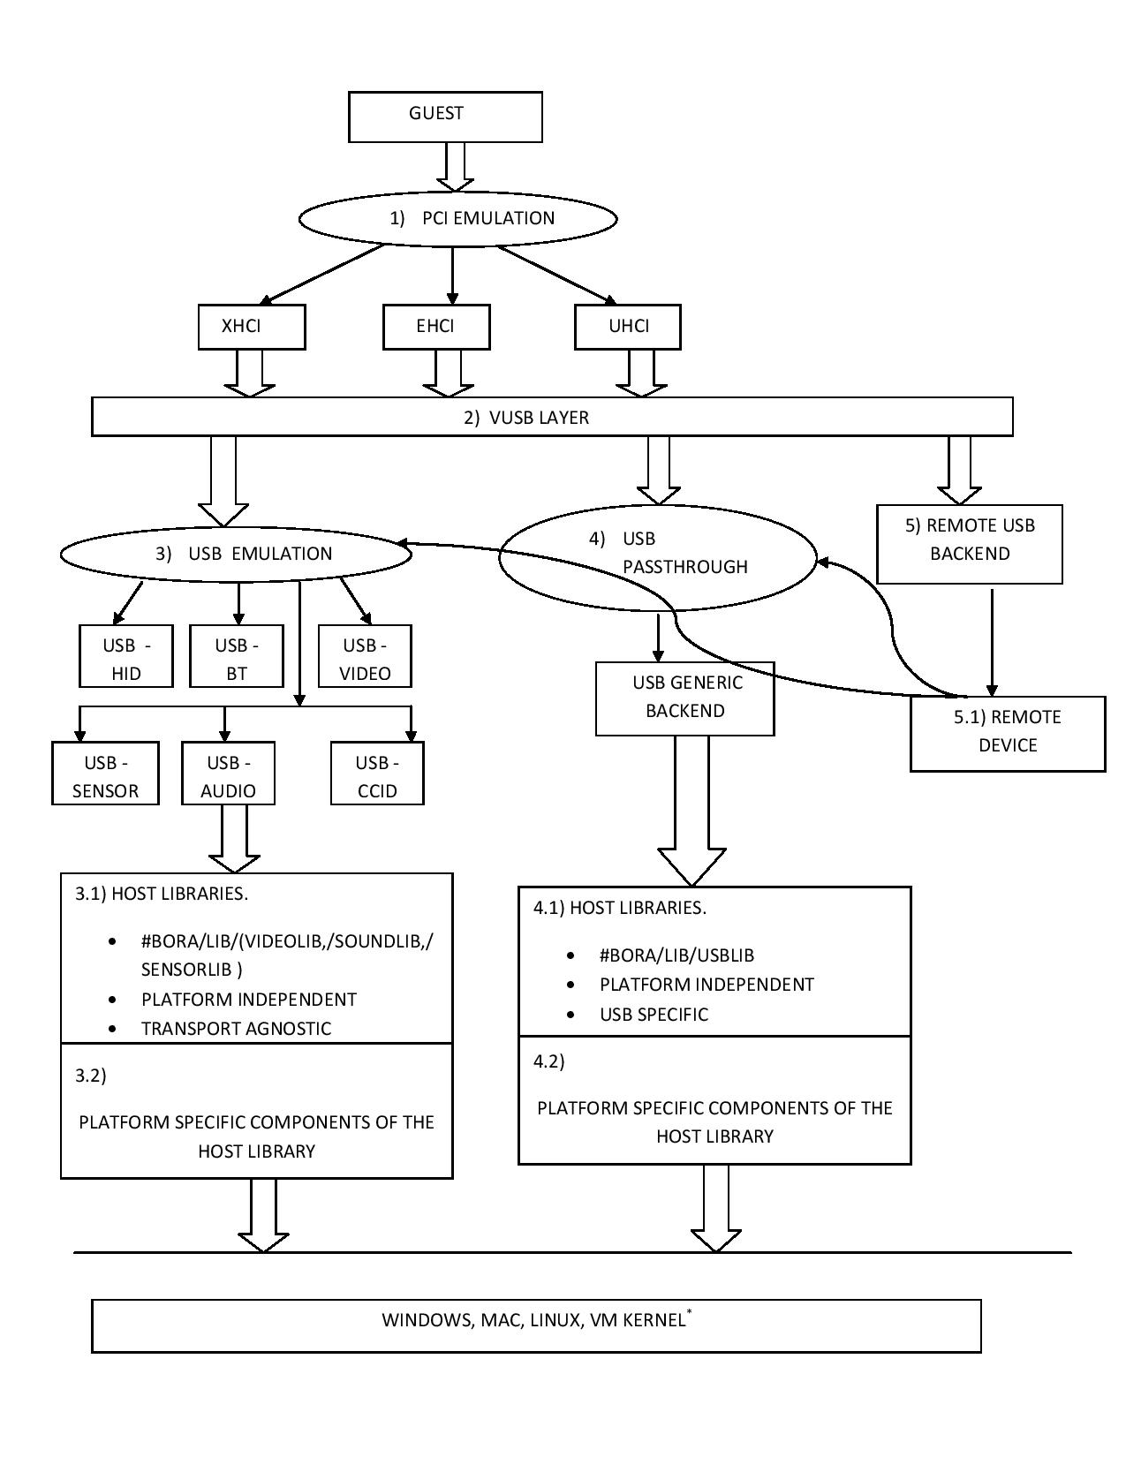

Slide 8
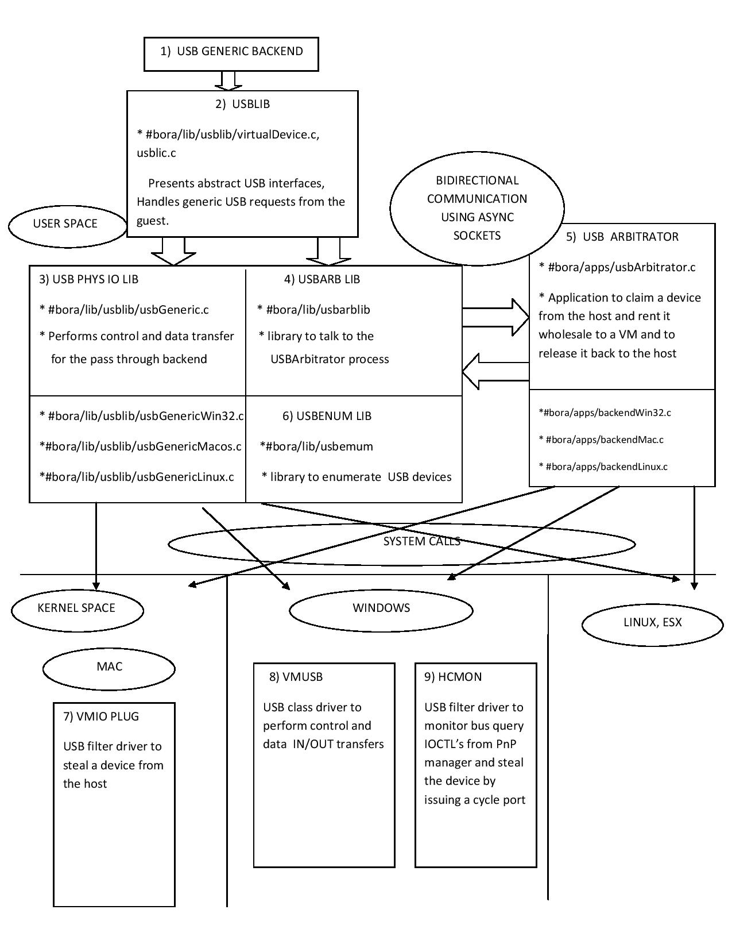
Notes:
https://wiki.eng.vmware.com/USB/archOverview

Slide 9
Tools
Subtitle text is Arial 18 pt
USBTreeView (Enumeration)
TraceView (hcmon.sys, vmwvhub.sys, Windows PnP)
vusb-analyzer (USB Protocol)
Notes:
https://wiki.eng.vmware.com/BeatTheBugKBs#USB
http://www.uwe-sieber.de/usbtreeview_e.html
http://vusb-analyzer.sourceforge.net/tutorial.html

Slide 10
Log
vmware.log
VUSB Poweron, Init, USBIO, Device connect & disconnect
Arbitrator.log
Record the connection / disconnection between VM and Devices
Hcmon.log
Dynamic driver substitute
Filter & Change special Control Message
Hostd.log
Record the USB device change event.
Notes:
https://wiki.eng.vmware.com/USBBugGuidelines
From Shanpei’s CPD-USBArch.ppt

Slide 11
https://wiki.eng.vmware.com/BeatTheBugKBs/Useful_KBs#USB
https://wiki.eng.vmware.com/BeatTheBugKBs#USB

Slide 12
Thank You
Dyno Fu (hfu@vmware.com)

