Slide 1
Cast_variant
Select a single “canonical” representation of a variant’s effects from the list of all possible effects provided by VEP.
Identify a variant’s position in uniprot and get an idea of any annotations at that position.
Identify any PDB structures that are currently available that cover that variant
Identify any SWISSMODEL that covers that variant
Provide a simple set of initial structure-based features for the variant such as surface area, secondary structure, and distance to complex members (ligands, other proteins, etc) when available.

Slide 2
Setting up cast_variant
Dependencies:
python2.7
Pandas (pandas)
Biopython (bio)
Numpy (numpy)
xml

Slide 3
Dataset workflow for cast_variants
Find the pre-aligned PDB structures using the SIFTs alignment databases
ENSEMBL Fasta sequences
PDB Structures
SASA, SS, closest ligand, etc.
Align transcript sequence to uniprot sequence
Assign variant to a transcript, preferably one listed as canonical in uniprot. Or use the transcript provided by user
Uniprot hub:
FASTA sequences for canonical and isoforms
Positional annotations
Out
SASA, SS, closest ligand, etc. + template identity, complex state, structure isoform
Refseq fasta sequences
Uniprot is a central repository for proteins. It contains sequences for isoforms, protein function, protein domains, mutagenesis or known variant information, binding sites, etc. etc.
SWISSMODELS
Look through the INDEX of downloaded SWISSMODELs to find one that matches the uniprot provided and align.
Calculate structure-based descriptors for all structures if –d flag set

Slide 4
Required datasets
1) SIFTS: (ftp://ftp.ebi.ac.uk/pub/databases/msd/sifts/split_xml)
https://www.ebi.ac.uk/pdbe/docs/sifts/
“Structure Integration with Function, Taxonomy and Sequence (SIFTS) is a project in the PDBe-KB resource for residue-level mapping between UniProt and PDB entries.”
cast_variant:
SIFTS pre-aligns every PDB structure to the corresponding uniprot entry and is updated regularly. All PDB-uniprot alignments appear in individual xml files that are accessed as needed by cast_variant.
To quickly identify any SIFTS alignments for a given uniprot, the file pdb_chain_uniprot.tsv.gz is downloaded
This summarizes all SIFTS alignments. For a given uniprot, cast_variant looks in the pickled version of this to see if there are any aligned PDB structures, gets the alignment from the XML file, and reports the aligned position if it covers the variant

Slide 5
Required datasets
2) SWISSMODEL (https://swissmodel.expasy.org/)
This is an automated pipeline service for modeling protein structures.
It looks at all known protein structures and identifies known structures with an amino-acid sequence that is similar to a given transcript. Then, it uses that known structure to replace all amino acids with those aligned to the given transcript, and uses some limited movement to accommodate these AA’s into the existing structure and relieve some energetic clashes. This “comparative modeling” strategy relies on the assumption that similar protein sequences lead to similar folds and that using a known protein with a similar sequence, we can get a pretty good idea of what our protein looks like and only minor adjustments diverge it from the known structure.
The known structure is called the “template” and can be the same protein in a different species, a similar protein in the same family, or a completely different protein that happens to have a highly similar sequence. Additionally, many modeling pipelines will model the same protein as the template. Often, PDB structures are missing short fragments of a protein for experimental reasons and comparative modeling can take the existing structure and attempt to fill in those residues. In these cases, the template sequence identity is 100%
The further the sequences differ, the less likely the proteins are to fold into similar structures, therefore, people generally will not use any structure templates that are not at least 30% sequence similar to their transcript of interest.
SWISSMODEL pipeline iterates through all uniprot isoforms, automatically finds protein structures with a similar sequence, and performs the comparative modeling process. These models are downloaded in bulk to be used.
cast_variant:
SWISSMODEL database provides an INDEX file that maps all uniprot isoforms to the location of the corresponding model file. This INDEX is processed and used by cast_variant. First, cast_variant looks at the particular isoform being considered, either based on user assignment or during VEP processing. Then, it looks to see if there is a SWISSMODEL particularly for that isoform. If so, it uses that model. If not, it uses all SWISSMODELs for the given uniprot. Typically, this does not matter but in some cases it might so in cases where multiple isoforms exist, one should look at their sequences on uniprot to get an idea of potential differences and also look at the different structures. In most cases, the structures will be extremely similar anyway.

Slide 6
Other models
Currently, cast_variant only supports SWISSMODEL structures. This was because cast_variant is uniprot-centric and SWISSMODEL is as well.
There are other automated pipelines such as MODBASE that use slightly different approaches to align sequences and select templates as well as performing the minor adjustments during the modeling. No pipeline is consistently “the best” and often the modeled structures look very similar. MODBASE was not used because it is transcript-centric but could easily be added in the future.

Slide 7
Required datasets
3) Ensembl sequences (https://useast.ensembl.org/info/data/ftp/index.html)
Contains all transcript and protein sequences found in the human proteome as defined by ensembl
In some cases, these sequences can differ slightly from Refseq and typically both datasets are queried but only one transcript is used if it is found in both. cast_variant uses ensembl sequences preferentially.
Transcript sequences are identified by “ENST###” and proteins by “ENSP###” These are almost always identical. Initial set-up processes the main transcript set so finding sequences is faster during runtime.

Slide 8
Required datasets
3) Refseq sequences (https://www.ncbi.nlm.nih.gov/refseq/about/)
Contains all transcript and protein sequences found in the human proteome as defined by NCBI
Transcript sequences are identified by “NM###” and proteins by “NP###” These are almost always identical. Initial set-up processes the main transcript set so finding sequences is faster during runtime.
Refseq also contains some predicted transcripts that are typically designated with XM### or XP###.

Slide 9
Refseq vs ENSEMBL
There is no “best” sequence database for the human proteome.
There are different avenues of annotation and quality control that lead to slight differences between the Refseq and ENSEMBL databases.
For most cases, only one database is necessary and cast_variant uses ensembl transcript sequences preferentially. However, in some cases, uniprot has selected a Refseq transcript as its canonical sequence. In this case, the Refseq is used.
Although slight, the differences in these transcript definitions can matter when examining genes and variants. To better understand the Refseq/ENSEMBL headache, there are several publications that compare results from either study:
https://bmcgenomics.biomedcentral.com/articles/10.1186/s12864-015-1308-8
https://www.ncbi.nlm.nih.gov/pmc/articles/PMC4062061/

Slide 10
Required datasets
4a) Uniprot sequences
Uniprot is a collection of all known proteins and much of what is known about these proteins. It contains many residue-specific annotations such as where binding sites are, where pathogenic variants are, what is known about the protein’s function, binding partners, and much more.
Uniprot collects sequences from both ensembl and Refseq and often defines multiple isoforms from different transcript sequences. Note that when uniprot determines two isoforms of the same gene perform fundamentally different functions, they may split that gene into two individual uniprot entries. This can lead to rare cases where one variant affects multiple uniprots.
cast_variant is uniprot-centric because SIFTS and SWISSMODEL allow easy mapping to structures directly. Additionally, the large collection of residue-specific annotations rely on uniprot’s definition of the protein sequence.

Slide 11
The uniprot canonical sequence
Just as Refseq and ensembl can disagree at the level of the isoform, uniprot has its own “canonical” protein sequence through which it attaches all the residue-level annotations. Therefore, an ‘disulfide bond’ affecting Cys201 in the transcript sequence, may be annotated on uniprot as Cys200 because the first residue of the transcript is a initiator methionine.
In many cases, the canonical sequence matches a specific ensembl or Refseq sequence. cast_variant uses these assignments to select a single variant representation from VEP when possible.
Because the uniprot canonical sequence may differ from the transcript sequence selected by the user, it is necessary to align the two sequences at the start.
Note that the SIFTS alignments are relative the uniprot “canonical” sequence. Therefore, it is best to update SIFTS+Uniprot at the same time in case the canonical sequence changes (rare but possible).
For more information on how uniprot defines its canonical sequence:
https://www.uniprot.org/help/canonical_and_isoforms

Slide 12
Required datasets
4b) uniprot canonical-isoform and secondary identifier mappings
In addition to the multiple isoforms at a given uniprot, each of which may match a different transcript, uniprot continues to change, defining new entries and retiring old ones. In some datasets (VEP, for example), an old or “secondary” uniprot ID will be used. In this case, these libraries can be used to match this old ID to the newest, currently used uniprot ID.

Slide 13
Required datasets
4c) Uniprot XML (uniprot_sprot.xml.gz)
As mentioned in 4a, uniprot contains many residue-specific annotations that may be useful especially in cases when the variant is not covered by any structures. These annotations are often used as clues to the effect of a given variant and if any are scored True, the user should look at the uniprot entry directly and follow any attached publications which may reveal important information about their variant.
It is important to note that many annotations are predicted based on well established motifs and other methods and therefore, there may not be a reference but uniprot will indicate it was ‘predicted’
Because the set of annotations is extremely large, initial processing generates a library of annotations for quick lookup during runtime. To parse this large file into the desired data, the processing script requires a significant amount of time but only needs to be performed any time a new uniprot XML is downloaded.

Slide 14
Required application
DSSP (version 2.0.4 provided in repository; newer versions and information https://swift.cmbi.umcn.nl/gv/dssp/)
Used to identify secondary structure and solvent accessible surface area of all residues in a given protein structure.
DSSP is used through Biopython which reports surface area as a relative surface area and not the absolute surface area. This is common practice. For more information:
https://biopython.org/DIST/docs/api/Bio.PDB.DSSP%27-module.html

Slide 15
The setup process
Follow instructions in downloading_datasets.txt in datasets/
Update the config.sys file to match the paths selected.
Go through the remaining processing steps in downloading_datasets.txt that conform the downloaded datasets to that which is expected by cast_variant and also runtime speedup processing steps such as prepare_uniprot_features.py which parses that large uniprot XML to create a library of annotations and pickle_sequences.py which parses all the downloaded fasta libraries and creates a dictionary for quick lookup during runtime.

Slide 16
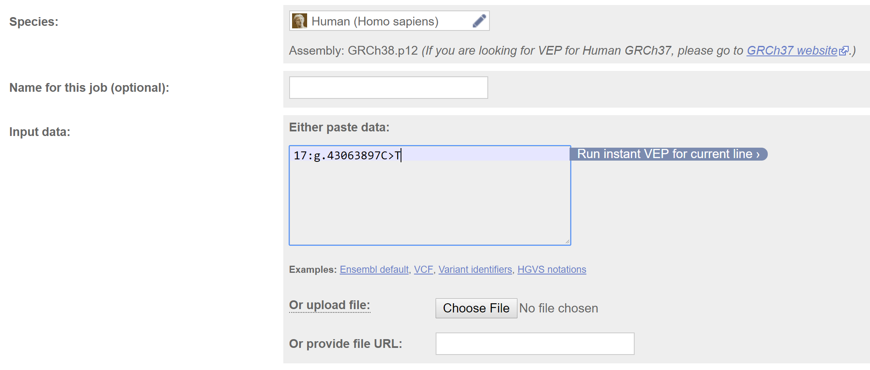
The cast_variant workflow
Your variant: rs978862398
Using Variant Effect Predictor to generate input for cast_variant:
https://useast.ensembl.org/Tools/VEP

Slide 17
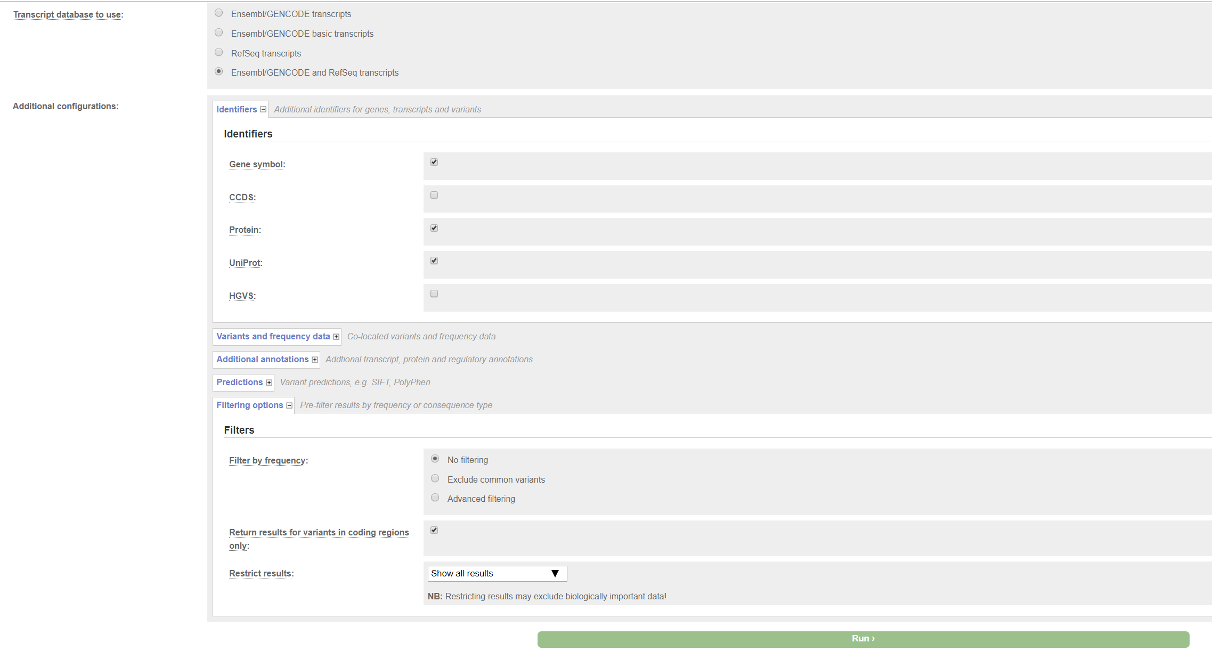
Adjust VEP settings before running
cast_variant is best if it can identify the canonical transcript defined in uniprot . This may be a Refseq sequence so allowing VEP to report ENSEMBL and Refseq may be useful in cases where the ENSEMBL transcript is not the canonical in uniprot.
cast_variant attempts to identify the corresponding uniprot entry itself. However, if it is unable to do that, supplying these columns are necessary to identify the corresponding uniprot entry.
Any non-coding variants are immediately filtered anyway

Slide 18
Running VEP
VEP will use current genome reference and databases containing known gene coordinates, etc to translate your genomic change into a corresponding protein change.
VEP takes several styles of input, examples are shown by clicking buttons underneath the input box.
cast_variant assumes will not do this prediction as VEP is very good and fast for this step and the online interface is highly recommended. Large variant sets, however, should be broken up into sets of 1000 or so. Those can be submitted in parallel.

Slide 19
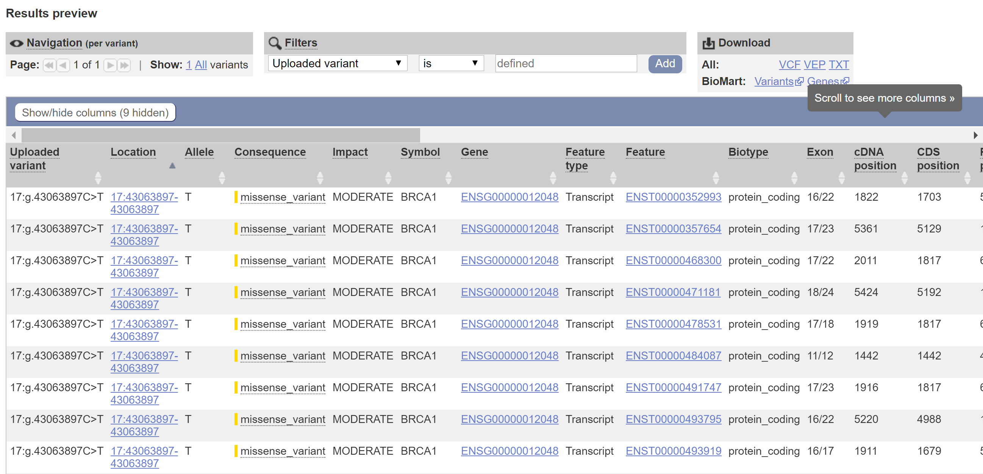
VEP Output
Save the TXT file for input to cast_variant, which expects the delimited format of this file.
VEP will predict all potential consequences based on sequence coordinate databases.
Many times there are identical codon positions or amino acid changes as these are slightly different sequences predicted within or across databases.
Cast_variant will select one representation of each variant based on that which most closely matches uniprot.

Slide 20
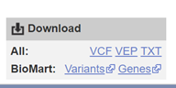
Run cast_variant
Tells cast_variant you are providing raw VEP output (not needed anymore, should detect automatically, but if not, try using this flag)
Saved as
./cast_variant.py Example_VEP.txt –d all -v
This run:
Process raw VEP input:
For each unique variant, a single representation* is selected and assigned a uniprot ID. This selection is based on using current uniprot ID’s and the uniprot-defined canonical sequence whenever possible.
Save processed VEP:
A file with the extension vep_selected is created. This can be used in future runs in place of the raw VEP TXT file to skip the VEP processing step.
Align transcript to uniprot sequence
Search for PDB’s connected to that uniprot that cover variant position
Search for SWISSMODELs connected to that uniprot and isoform (when possible) that cover variant position
Calculate accessible surface area and secondary structure for variant in any structure
Identify any nearby ligands, DNA, RNA, or other proteins in the structure within a cutoff
Identify any uniprot annotations at the variant position and score as True/False
Due to –d all flag
*In rare cases, a variant may impact multiple unique uniprots, in these cases, one representation per unique uniprot is kept.

Slide 21
Running VEP
helpers/artifacts.ls defines ligand IDs in PDB structures that are potential crystallization artifacts and are not considered for ligand-distance descriptors
Loaded artifacts: 112 ligands, and 0 protein-protein interfaces
1 unique coding variants loaded
selecting unique variants
YES: ENST
1 unique variants with uniprot assignment selected
1 Selected vars written to standard varfile example_VEP.vep_selected
1 variants processed
loading necessary datasets
loaded 452402 transcript sequences
loaded 20417 uniprots
loaded 46267 sifts uniprots
loaded 17411 swissmodel uniprots
Casting variants across 1 transcripts
Casting ENST00000357654 variants
Loading preprocessed uniprot features
Loaded 839479 total residues with uniprot features
HTTP Error 404: Not Found
Complete: 1 transcripts successfully aligned
Progression of VEP processing by priority, not important
Can be used for future runs with same variants to skip previous lines
Loads the pickled transcripts generated from
ensembl and refseq fasta downloaded during setup
Loads pickled uniprot sequences downloaded during setup
Loads pickled sifts table of predefined PDB-uniprot alignments downloaded during setup
Loads pickled SWISSMODEL lookup table downloaded and generated during setup
For identifying uniprot annotations at variant position from –d all flag from library generated during setup
Error explained next slide

Slide 22
HTTP Error 404: Not Found
In some cases, the variant will fall on a structure that fails to load for a variety of reasons.
In this case, the variant fell on a very large EM structure (6G2I). Because cast_variant retrieves PDBs through URL, and the online database RCSB PDB does not store large structures as PDBs, it is unable to download this structure.
When a structure fails to load, processing will continue and you can go back and look at those structures manually or see why they failed afterwards.

Slide 23
Examining output
Check for issues first (.skipped and .failures files)
For a variety of reasons, variants may be skipped or something fails when processing them. In these cases, the run continues but they are recorded in one of two ways (in this case, all variants ran successfully so these were not generated)
This is a stop-gain. Currently, VEP only processes single position missense variants.
Expand has not been tested, but is designed to treat every residue affected by a single large variant like this one as individual variants
A_skipped_example.skipped
stop_gained ENST00000272895 1664 L/* ENSP00000272895 Q86UK0 Q86UK0-1 ABCA12:c.5000T>A expand not set
A_failure_example.failures
2 Failed during initial sequence alignments because in one case the transcript sequence was not found in the database and in the other the uniprot sequence was not found.
NP_005507.3 P13747 no transcript seq found for NP_005507.3
ENST00000479692 K7ENC6 no unp seq found for K7ENC6
cENST00000335496 Q7Z572 worker: sifts_lookup failed: no sifts entry for Q7Z572
No PDB for Q7Z572, but some output still generated. This is a common failure when a protein has not been crystallized yet.
Variant(s) will still appear in output but will not have any PDB entries.

Slide 24
Examining output – columns 1/2
example_VEP.variants
This is the main output for all processed variants. Tab delimited columns:
transcript - transcript ID supplied/selected during VEP processing
Uniprot – uniprot provided or assigned during VEP processing
Isoform – uniprots may be defined with multiple isoforms which may arise from alternative splicing, etc. SWISSMODELs are generated for each (in most cases) isoform and structures may differ slightly.
transcript_identity – The identity of the uniprot sequence to the transcript sequence (should be very close to 100%)
transcript_position – supplied position in selected transcript
uniprot_position – position in the aligned uniprot sequence that can be used to examine annotations on the uniprot website in cases where uniprot position number is different than transcript number.
structure_position – position in the structure
icode – sometimes experimentors use insertion codes to indicate residues artificially inserted or to keep numbering consistent. These are important when working with raw PDB files, look at external documentation if you have an icode and want to work with the PDB file itself.
transcript_aa – amino acid at provided position
uniprot_aa – amino acid at aligned uniprot position
structure_aa – amino acid at aligned structure sequence
ref_aa – reference amino acid
alt_aa – variant amino acid

Slide 25
Columns 2/2
4. structure_identity – identity of structure to uniprot sequence, not really useful
5. template_identity - identity of template used to generate SWISSMODEL to uniprot sequence. Very important as it can affect model quality. Generally,, anything below 30% should be ignored as the model quality may be too low.
6. Structure – name of the structure (4 character PDBID or swissmodel file)
7. Chain – identifier within a structure for the particular protein being considered. In multiple protein structures, each protein gets an individual chain. Even if it’s a homodimer, each copy of the same protein in the structure gets its own chain. In some cases, you may see a structure show up multiple times for the same variant but with a different chain ID. This is because the variant is covered by multiple chains in the same structure. Many times the structures of those chains are the same, but it is up to the user to determine whether they need to consider every chain a variant hits within a structure or just one.
8. structure_isoform – As mentioned, each uniprot may have different isoforms and SWISSMODEL attempts to make a structure for each. Therefore, this column only matters for SWISSMODELs and indicates which isoform of the uniprot is being modeled.
9. complex_state – SWISSMODEL uses transcripts from other known structures as templates. Sometimes these structures have multiple proteins in a complex. When a protein is in a complex, it can change conformation. So, this is a warning that the SWISSMODEL template is based on a conformation in a complex which may differ from it by itself.
10. Varcode – provided or assigned unique variant ID key
https://pdb101.rcsb.org/learn/guide-to-understanding-pdb-data/dealing-with-coordinates
https://www.uniprot.org/help/canonical_and_isoforms
chr:position:alt_nucleotide

Slide 26
Descriptor columns: generated with –d flag only
11. SS – secondary structure at position of variant in structure
12. SASA_complex - solvent accessible surface area of variant residue in structure. If structure is a complex of multiple chains, this is the surface area within the complex.
13. SASA_self – solvent accessible surface area of residue in the chain in isolation. Variants at protein-protein interfaces in a complex, for example, will have a very low SASA_complex, but once taken out of the complex it is surface exposed and SASA_self is higher. In non-complex structures, these should be identical.
14. closest_ligand_distance – ligand ID of the closest ligand in the structure (if there is any ligands in the structure)
15. ligands_within_5A - List of all ligand ID’s within 5A of variant
16. closest_nucleotide_distance
17. closest_nucleotide_type – DNA vs RNA
18. closest_chain_distance – In structures containing multiple chains (ex complexes), the distance to the closest chain. This will be low for example when the variant is at a protein-protein interface but high when it is on the opposite side of the protein.
19. chains_within_5A
20. cleaved - uniprot annotated as a residue cleaved during protein processing (T/F)
21. sorting - uniprot annotation that residue is part of a sorting motif (T/F)
22. Membrane – uniprot annotation that residue is within the membrane (T/F)
23. binding region – uniprot annotation that residue is within a binding region (binding regions are larger, more general, and/or less precise than binding sites) (T/F)
24. Motif – uniprot annotation that variant is part of a defined motif (T/F)
25. binding site – uniprot annotation that variant participates in binding site (generally higher resolution info than binding region) (T/F)
26. Ptm – uniprot annotation that variant is on residue that undergoes post-translational modification (phosphorylation, glycosylation, etc) (T/F)
27. Covalent – uniprot annotation that variant residue participates in a covalent bond (disulfide bonds are the most common) (T/F)

Slide 27
Overall Output Format
For each variant, there are three potential different kinds of rows. To keep columns consistent, there are times that a column is not applicable to the given row type.
For any column that does not have a value, to keep column types constant, -999 is used for float columns and ? is used for text columns.
Row types:
Uniprot – Output for every variant whether or not it has protein coverage. Useful for identifying uniprot position and annotations when no structure is found. Structure-dependent columns (SASA, ligands_within_5A, etc) are not applicable so placeholders are used.
PDB – Output for every chain in every RCSB PDB that the variant is covered by
SWISSMODEL – output for every SWISSMODEL that variant is covered by

Slide 28
Example output: First data line
This is the first type of output row, the uniprot output
Sequence identifiers
Sequence Positions
Sequence AA’s
ENST00000357654 P38398 P38398-1 1.0 1710 1710 1710 G G -
G E 100.0 100.0 Uniprot - P38398-1 Uniprot 17:43063897-43063897:T
? -999 -999 -999 ? -999 ? -999 ? False False False False False False False False
Identities are all 100% because there are no structures or templates for uniprot lines
Indicates it’s a Uniprot data row so there is no structure name or chain
ref_aa
alt_aa
No complex state since not structure
Unique variant ID
chr:pos:alt
Placeholders used for all structure-dependent features since this is the uniprot data row and not a structure
This variant position does not have any relevant annotations on uniprot (all False). When any of these are True, it is useful to go directly to uniprot and examine the annotations assigned to this uniprot position to see if any information can be quickly gathered.

Slide 29
Second line – PDB data row
Same identifiers
ENST00000357654 P38398 P38398-1 1.0 1710 1710 1710 G G G
G E 1.0 100.0 1jnx X PDB PDB 17:43063897-
43063897:T T 0.405 0.405 25.03 None -999.0 ? -999.0 ?
False False False False False False False False
https://www.rcsb.org/structure/1jnx
PDBID
Chain
Only applicable to models
SS is coded as T (see next slide for DSSP codes)
SASA is the same in complex or isolated (structure in this case is not a complex
Nearest ligand is 25 A away
There are no ligands within 5A
There are no nucleotides or other chains in this structure so placeholders are used
For column consistency, the uniprot annotation columns as with the identifiers are repeated for all data rows

Slide 30
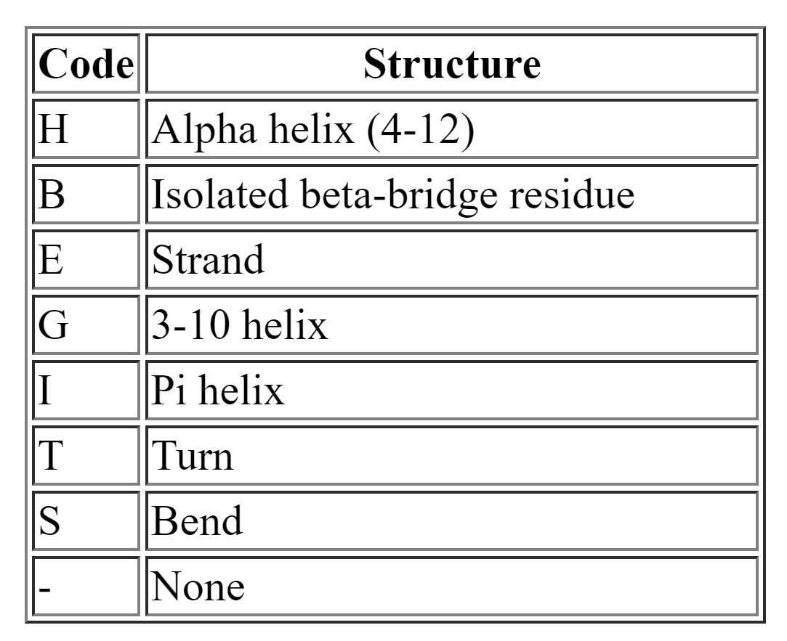
DSSP codes

Slide 31
Last line – SWISSMODEL line
ENST00000357654 P38398 P38398-1 1.0 1710 1710 1710 G G G
G E 100.0 100.00 /dors/capra_lab/data/swissmodel/2018-07-23/SWISS-
MODEL_Repository/P3/83/98/swissmodel/1646_1859_4y18.1.A_5b4ed068c4494f26dcaa3793.pdb A
P38398-1 monomer 17:43063897-43063897:T T 0.25 0.25 -999.0 ? -999.0 ? -999.0 ? False False False False False False False False
Template is 100% similar to modeled sequence. In many cases, SWISSMODEL will use a PDB of the same protein to model the protein when there already is a PDB. This can be useful to fill in missing residues absent from the PDB but is generally very similar to the PDB and can be ignored.
Full path to model file
In model, residue is slightly more buried than the PDB. Model may be inaccurate or PDB may be missing portions that would otherwise bury the residue more
Model is specific for -1 isomer
Template is in monomer state
Model has no ligands, nucleotides, or other chains, so placeholders used

Slide 32
Other output files
example_VEP.alignments = contains entire sequence alignments to examine any gaps, etc. that may be important to future analysis.
- This file can be very large and you may not be interested in it, so use –a to suppress creation of this file
example_VEP.completed = simple file that logs every variant that has been run. Used automatically to continue where program left off if it does not complete for some reason
- suppress the continuation to start entire variant list over with –c

Slide 33
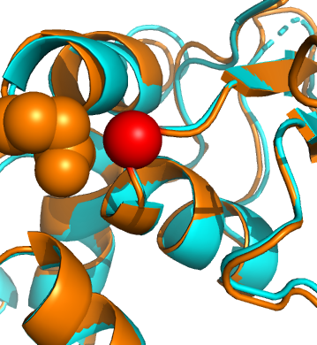
Model vs PDB
Often the PDB is preferred over a model since it has a higher resolution and confident.
In some cases, especially when identity is extremely high, a model can be preferred.
In the example, the model had slightly lower surface area than the PDB.
Examining the position of the variant (red sphere) within the PDB (cyan) and model (orange) reveals that the PDB file does not contain side chain residues aside from CB for Q1756. However, when the model fills in these side chain residues (orange spheres), the surface area of the variant slightly decreases. Therefore, in this case, the calculated surface area of the model is potentially more accurate because it is more complete than the PDB.

Slide 34
Using custom local models
When you want to cast to local models not found in SWISSMODEL, use the –l flag with a file containing a list of structure files.
Ex:
./cast_variant.py myvars.tab –l mystructs.tab
Format of the list of structure files (must be tab delimited):
TRANSCRIPT_ID1 MODEL_FILE1.pdb(full path)
TRANSCRIPT_ID1 MODEL_FILE2.pdb(full path)
TRANSCRIPT_ID2 MODEL_FILE3.pdb(full path)
This list can contain any number of transcripts and model files. Variants are provided exactly the same, and the transcript column is used to match the model files. This will run variants normally but after casting to SWISSMODELs it will cast to any additional local custom models that you listed with a matching transcript.

Slide 35
Adding custom sequences
Potentially in cases where models are used, you may want to use a custom sequence the model is based on. Therefore, you can add custom sequences to the transcript or uniprot datasets.
This must be done after running pickle_sequences.py
In datasets, run:
./add_custom_sequences.py your_seqs.fasta destination.pickle
Your sequence file can contain any number of fasta’s as long as they have a header line in the format:
> Custom identifier
Note: If that identifier is already found in whatever destination you supplied, it will, by default overwrite that entry and tell you. If you don’t want to add sequences if the ID is already there, add a 1 as the third argument of the command line.

Slide 36
Untested features
Expand variants (-e)
The major consequence encountered will be missense variants. However, there may be instances in which a large portion of the protein is lost due to early stops, inframe deletions, and frameshifts. In these cases, it can be assumed in most cases that every residue downstream of the mutation is affected, thereby generating a list of individual variant positions. Setting this flag will accept these large variants and expand them to cover all downstream residues. However, it hasn’t been tested and may not yet work.
2. Parallel processing (-n #)
Uses python multiple instance pool to process individual uniprots in parallel. This hasn’t been tested but should work, maybe, who knows.

Slide 37
A final note on uniprots
It’s not necessary to have a uniprot in the uniprot column of the variant file. Things like -, ?, None, etc. are also automatically flagged as missing.
In the case of missing uniprots, cast_variant will attempt to assign a uniprot based on the transcript ID.

Slide 38
Future directions
Add modbase
Add more structure-specific features
Add bioassembly integration to filter out protein-protein interaction crystallization artifacts in the same way ligands are filtered.

