Slide 1
Characterizing Biological Networks Using Subgraph Counting and Enumeration
George Slota Kamesh Madduri
madduri@cse.psu.edu
Computer Science and Engineering
The Pennsylvania State University
SIAM PP14
February 20, 2014

Slide 2
# of speakers mentioning BFS
# of speakers mentioning
protein interaction networks
4 out of 5 (including me)
3 out of 5

Slide 3
Acknowledgments
NSF ACI award 1253881
NSF XSEDE allocation TG-CCR13006
Siva Rajamanickam, Sandia
Current and past organizers of parallel graph analysis minisymposia at SIAM PP

Slide 4

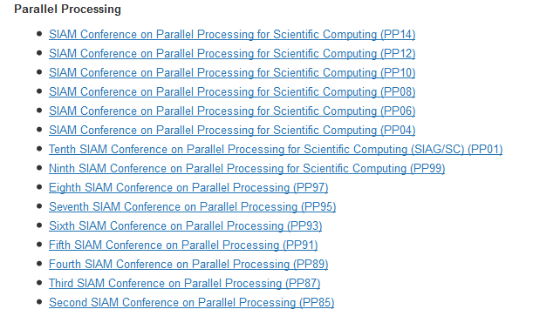

Slide 5
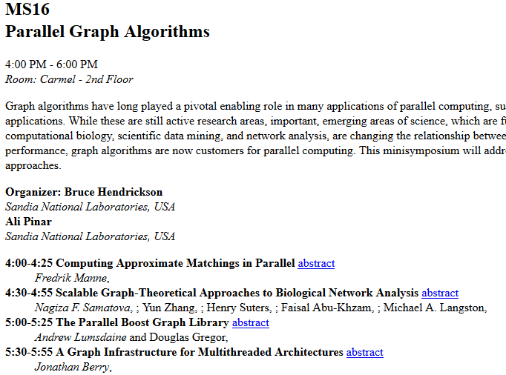
SIAM PP06

Slide 6
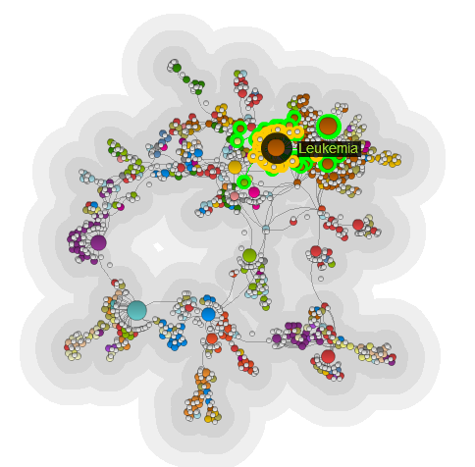
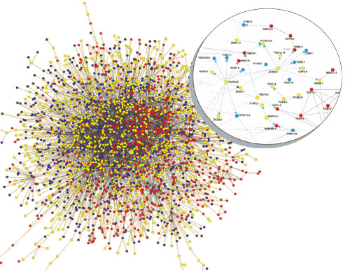
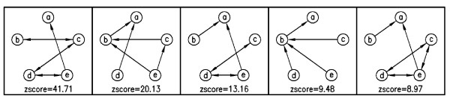
Network motifs in protein interaction networks (PINs) and gene-disease networks
C Elegans PIN
Diseasome
DisGeNET
Signaling pathways in PINs
Two high-scoring pathways from human PIN
SHC1
Grb2
EGFR
PTPN1
INSR
Irs1
EGFR
SH3KBP1
CBL
Grb2
GRB2
SOS1
SHC1

Slide 7
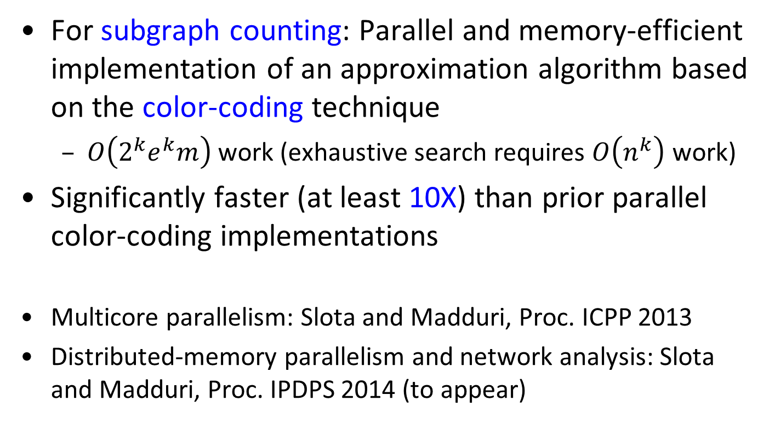
Our new parallel approach: FASCIA
For subgraph counting: Parallel and memory-efficient implementation of an approximation algorithm based on the color-coding technique
  $O\left({2^{k}e}^{k}m\right)$ work (exhaustive search requires $O\left(n^{k}\right)$ work)
Significantly faster (at least 10X) than prior parallel color-coding implementations
Multicore parallelism: Slota and Madduri, Proc. ICPP 2013
Distributed-memory parallelism and network analysis: Slota and Madduri, Proc. IPDPS 2014 (to appear)

Slide 8
FASCIA features
Get approximate counts of tree-structured templates
Determine network motifs
Comparative network analysis using
  Graphlet frequency distances (GFD)
  Graphlet degree distributions (GDD)
  Graphlet degree signatures (GDS)
Cluster networks into categories
New: simple modifications to find signaling pathways in protein interaction networks (PINs)

Slide 9
This talk: FASCIA applied to PIN analysis and comparative network analysis
The dynamic programming scheme and shared-memory parallelism
FASCIA and approximate counting for finding motifs in protein interaction networks
Comparative network analysis
Parallel performance results

Slide 10
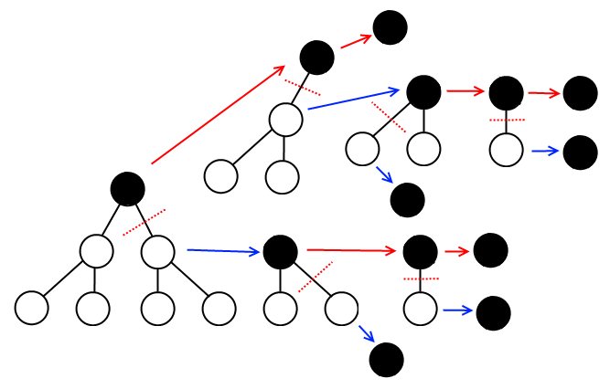
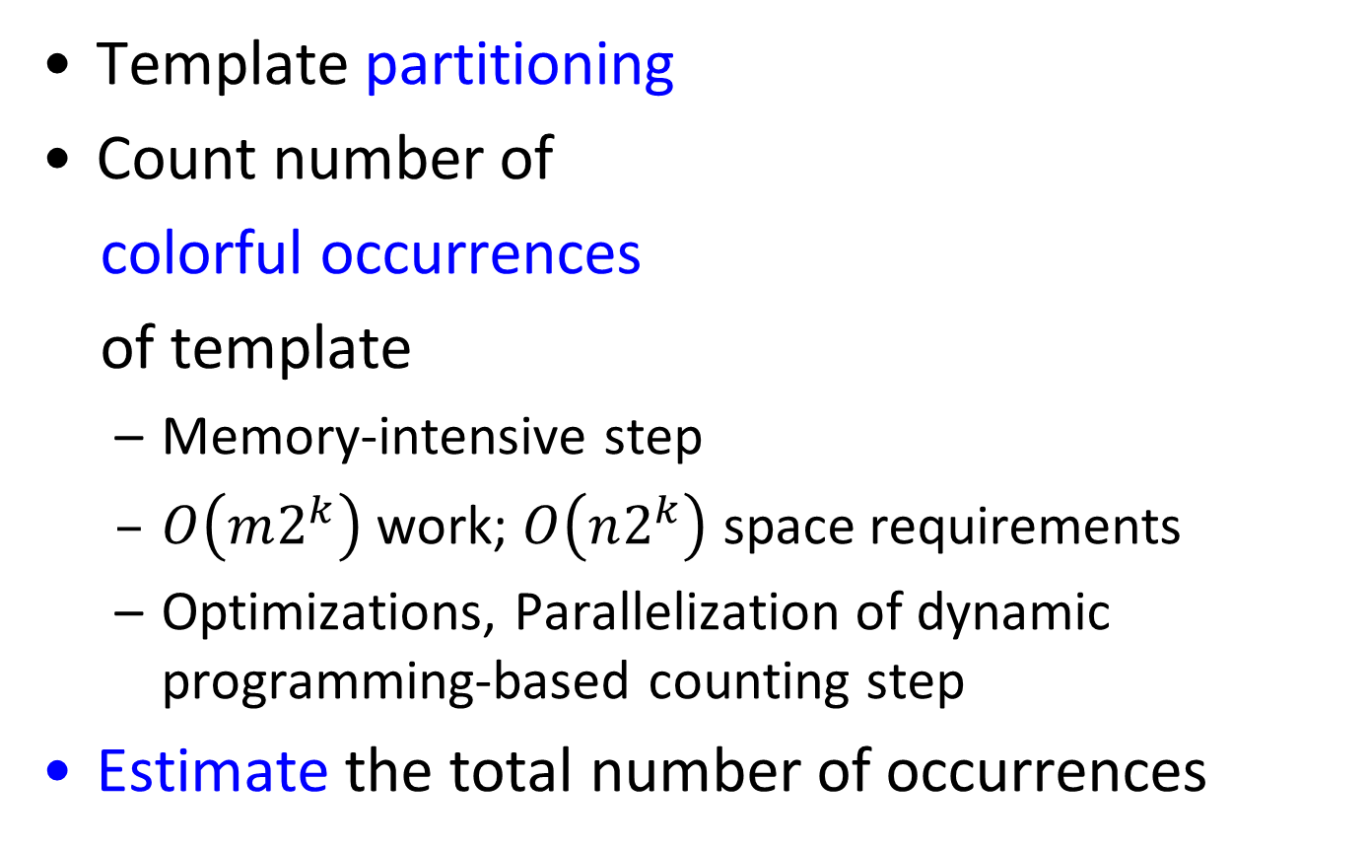
FASCIA Algorithm and Parallelization Overview
Template partitioning
Count number of
colorful occurrences
of template
  Memory-intensive step
  $O\left(m2^{k}\right)$ work; $O\left(n2^{k}\right)$ space requirements
  Optimizations, Parallelization of dynamic programming-based counting step
Estimate the total number of occurrences

Slide 11
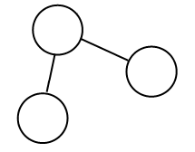
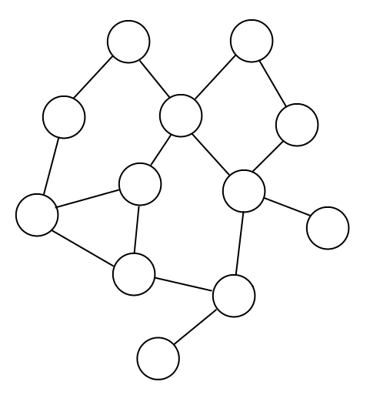
Color-coding approximation strategy
Alon et al., 1995: approximate counting of tree-like non-induced subgraphs
Template
Larger graph
k = 3
n = 12, m = 15

Slide 12
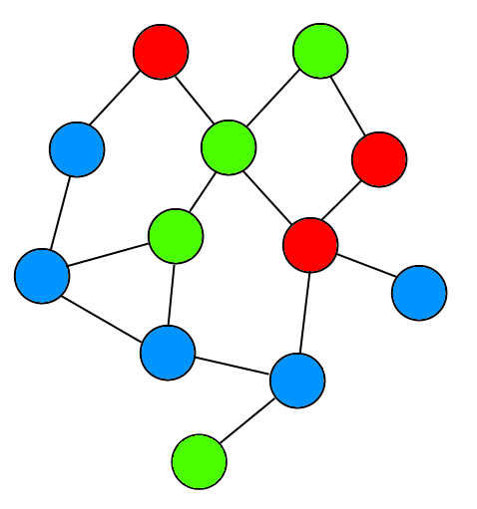
Color-coding approximation strategy
Template
Randomly “color” vertices of graph
k = 3

Slide 13
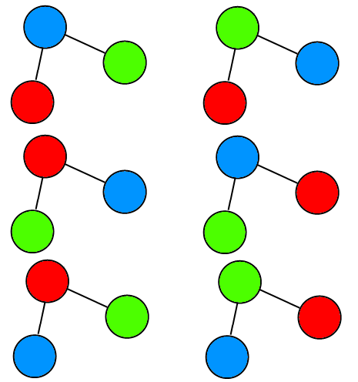
Color-coding approximation strategy
Possible colorful embeddings

Slide 14
Color-coding approximation strategy
Identify colorful embeddings
Possible colorful embeddings

Slide 15
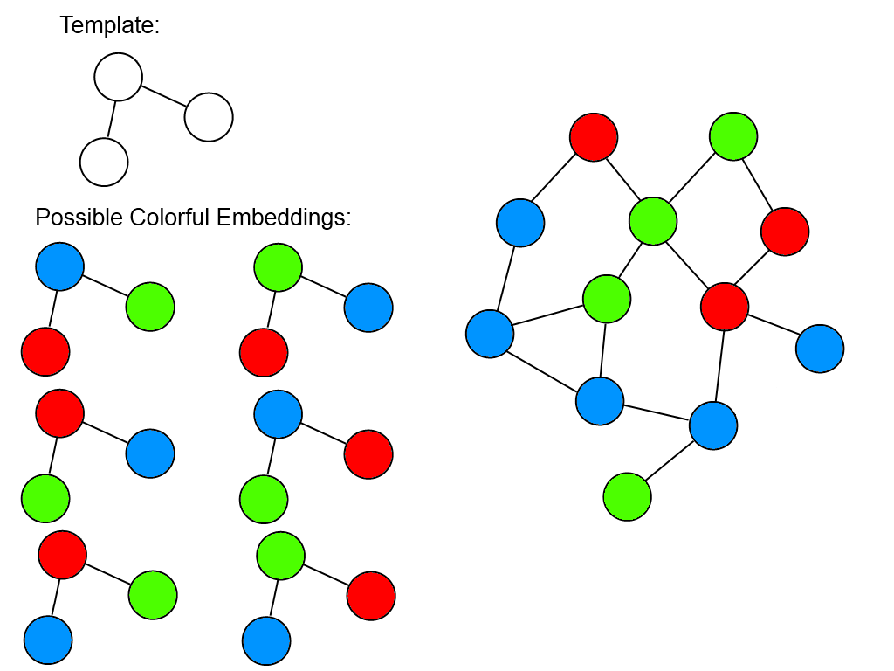
Color-coding approximation strategy
Cnt_{colorful} = 3, Probability of colorful embedding = 3!/3³
Perform multiple (~ e^{k}) coloring iterations
Each iteration requires O(m2^{k}) work

Slide 16
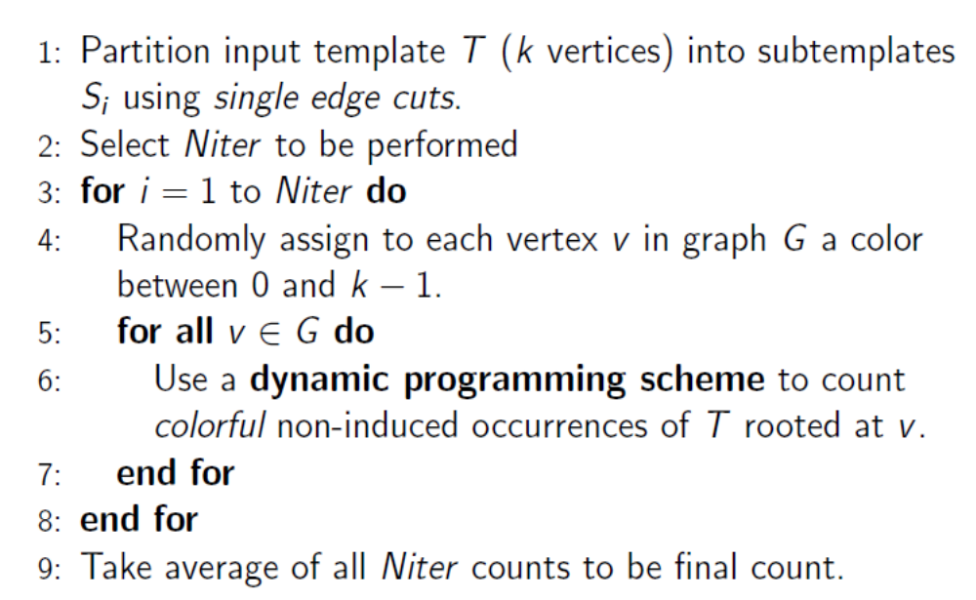
FASCIA Algorithm

Slide 17
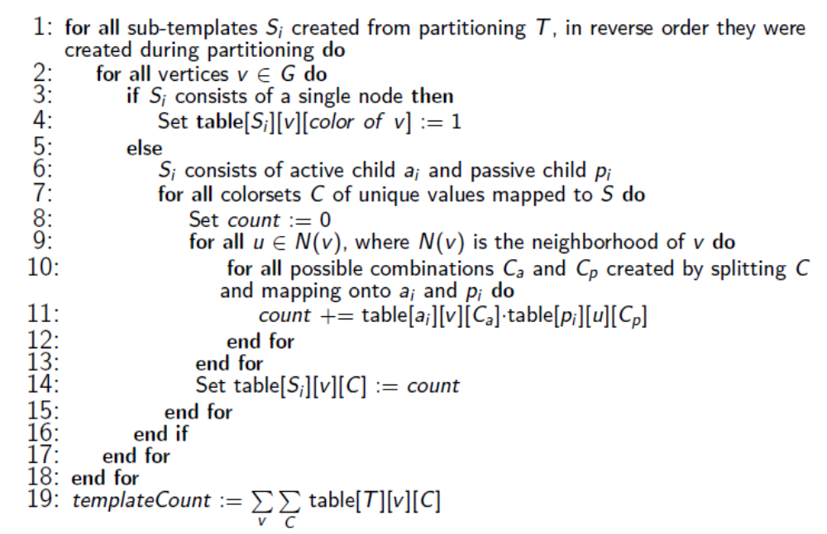
Counting step

Slide 18
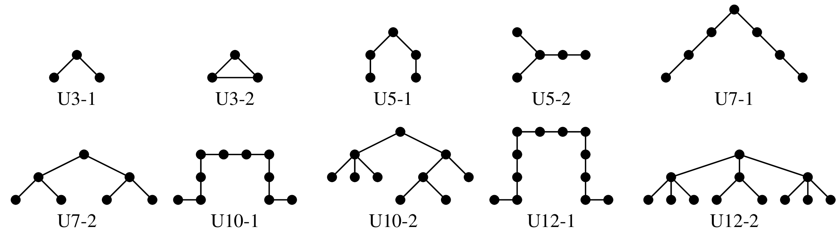
Test network families, example templates
Network type | # of networks | # of edges in largest network
PINs | 8 | 22 K
Web crawls | 4 | 3.9 M
Social networks | 6 | 5.4 M
Road | 5 | 2.8 M
Collaboration | 6 | 1.05 M
Large soc. net (Orkut) | 1 | 117 M
Large synth. urban pop. (Portland!) | 1 | 31 M

Slide 19
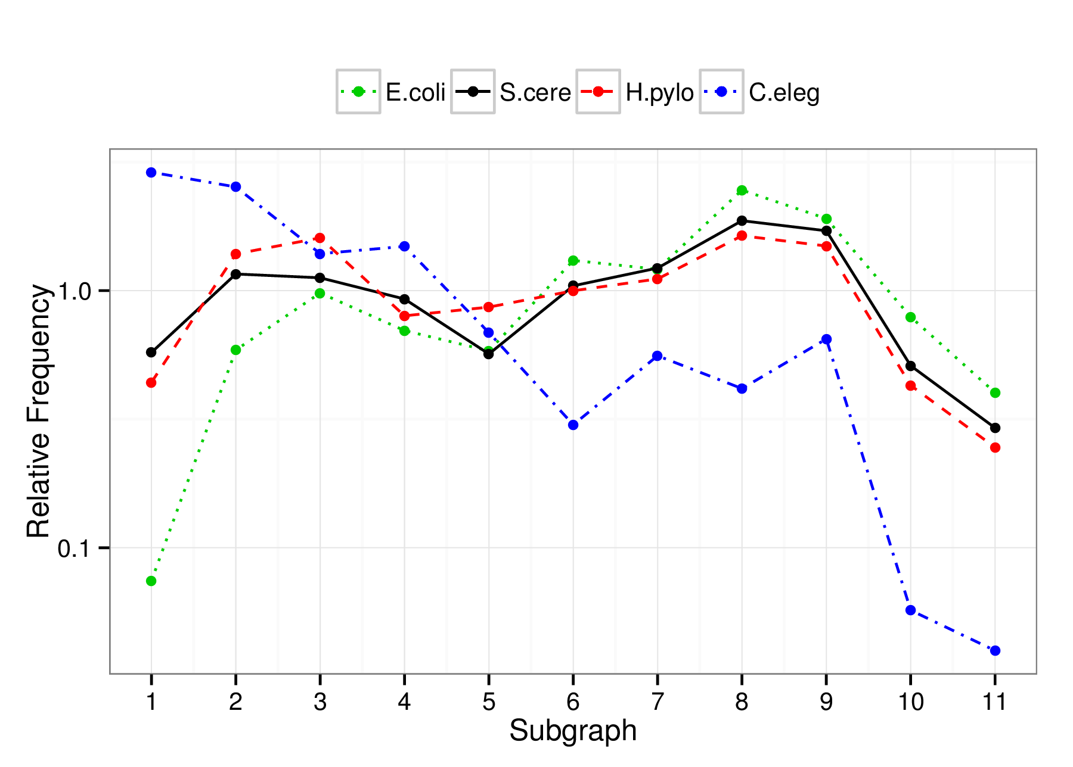
Motifs: frequently-occurring subgraphs of certain size and structure
E. Coli
S. Cerevisiae
H. Pylori
C. Elegans

Slide 20
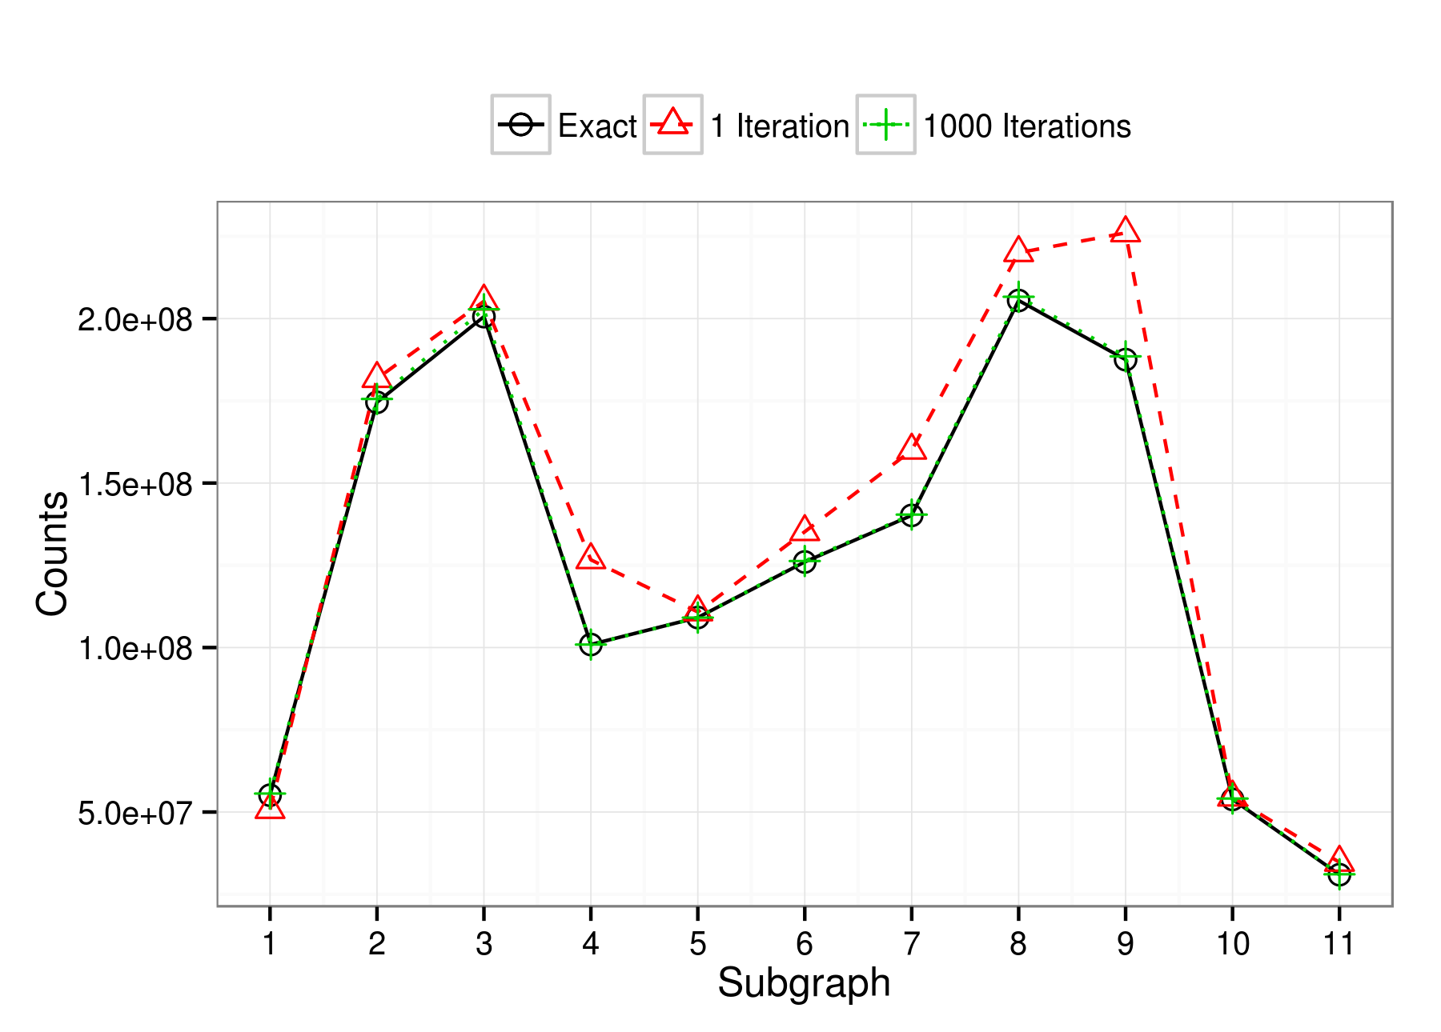
Error
H. Pylori, Subgraphs of size 7

Slide 21
Error
H. Pylori, Subgraphs of size 7

Slide 22
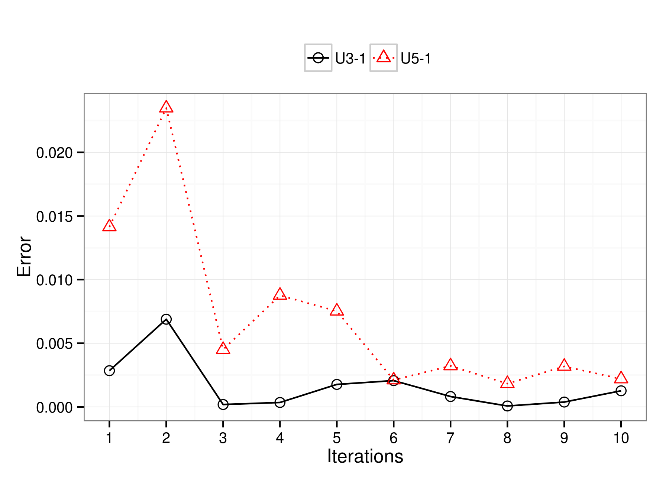
Error
Enron email network

Slide 23
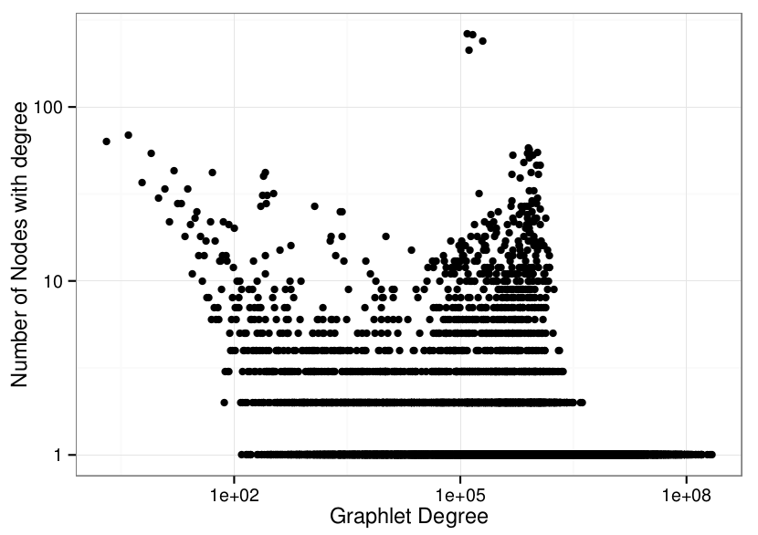
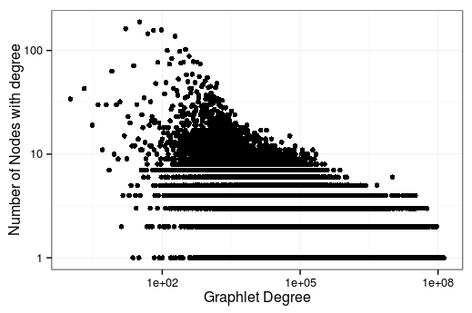
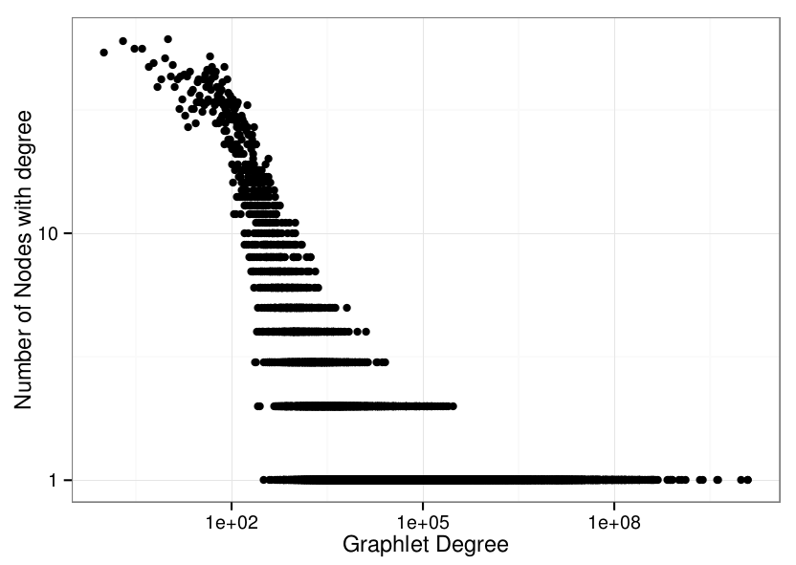
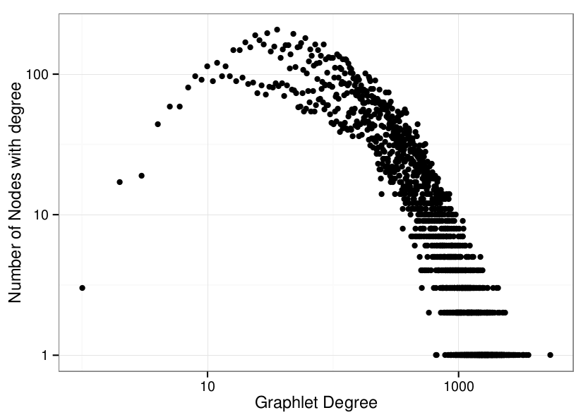
Graphlet degree distributions
Enron
Portland
Slashdot
G(n,p) random

Slide 24
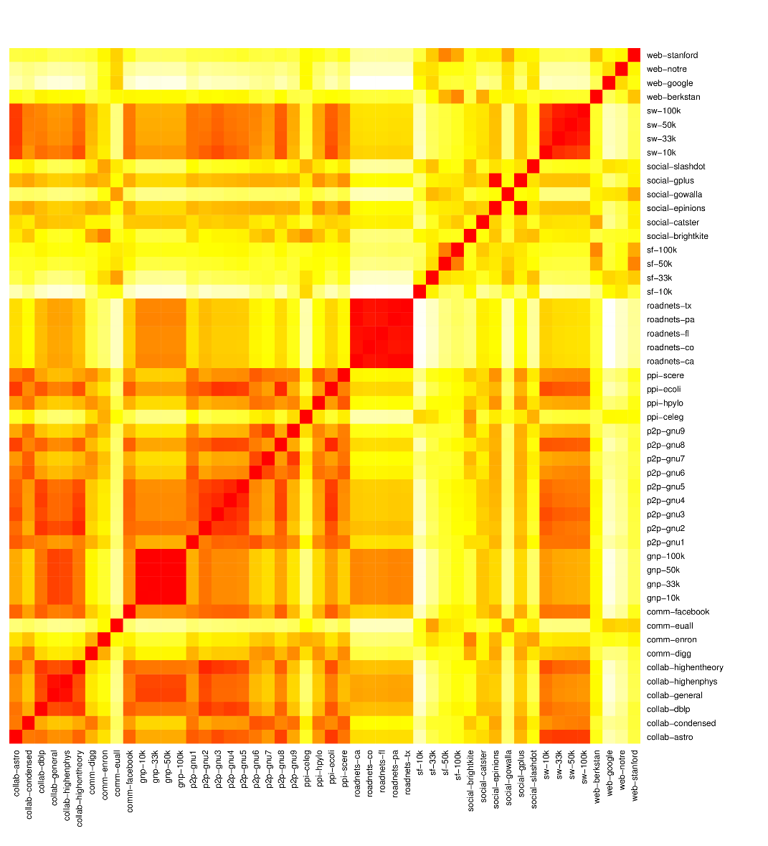
Graphlet frequency distribution agreement scores heatmap
Road networks
PINs
P2P
Collaboration
networks

Slide 25
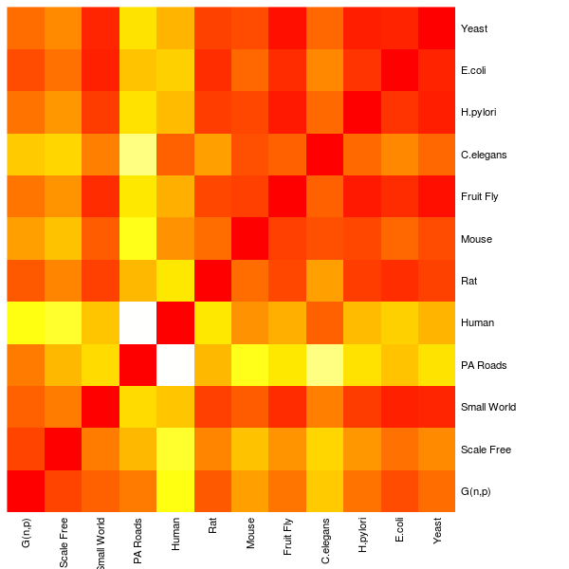
How similar are PINs to each other?

Slide 26
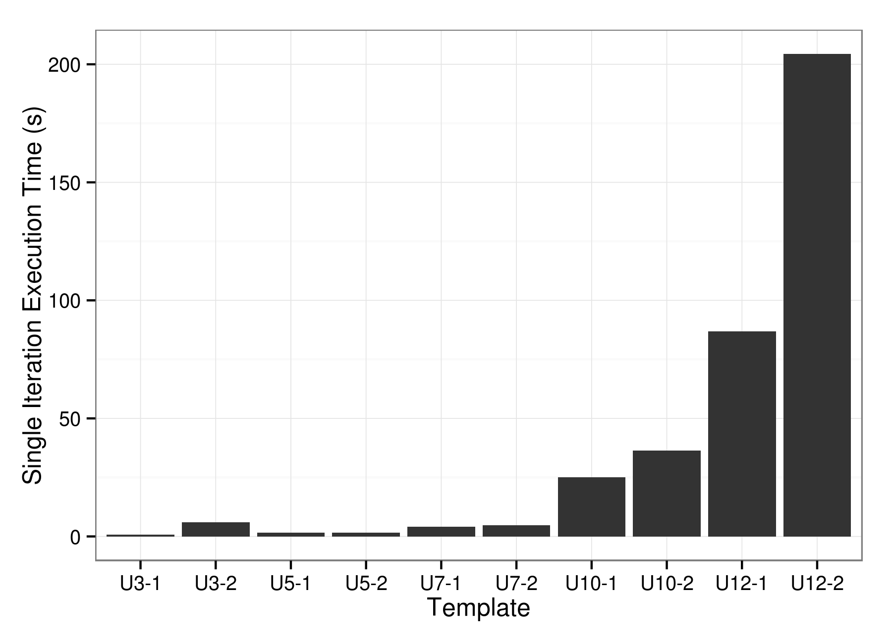
Execution times for various template sizes
Portland network (31M edges)
Single node performance (Intel Sandy Bridge server, 16 cores)

Slide 27
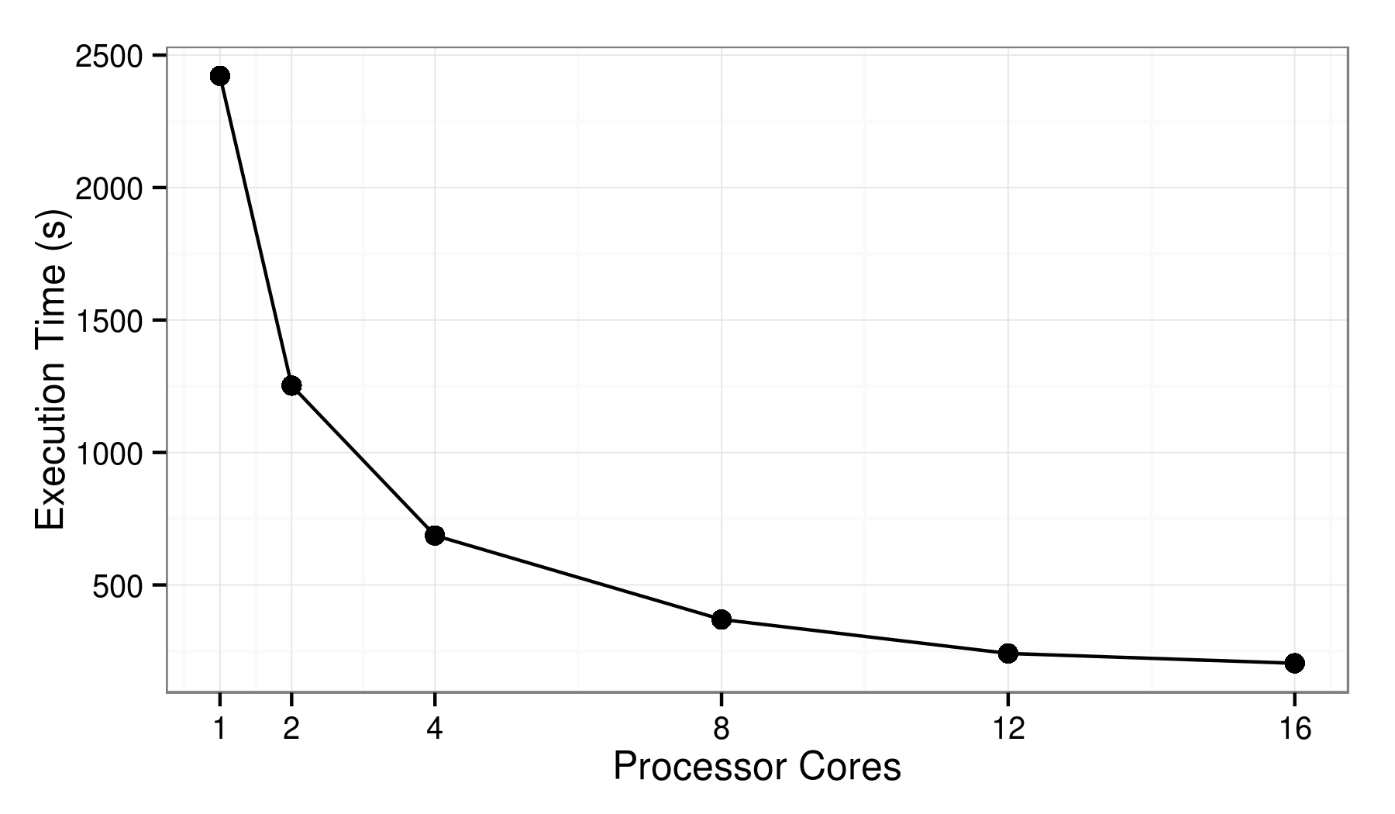
Shared-memory strong scaling
Portland network (31M edges), U12-2 template
Single node performance (Intel Sandy Bridge server, 16 cores)
1 color-coding iteration
11.8x speedup

Slide 28
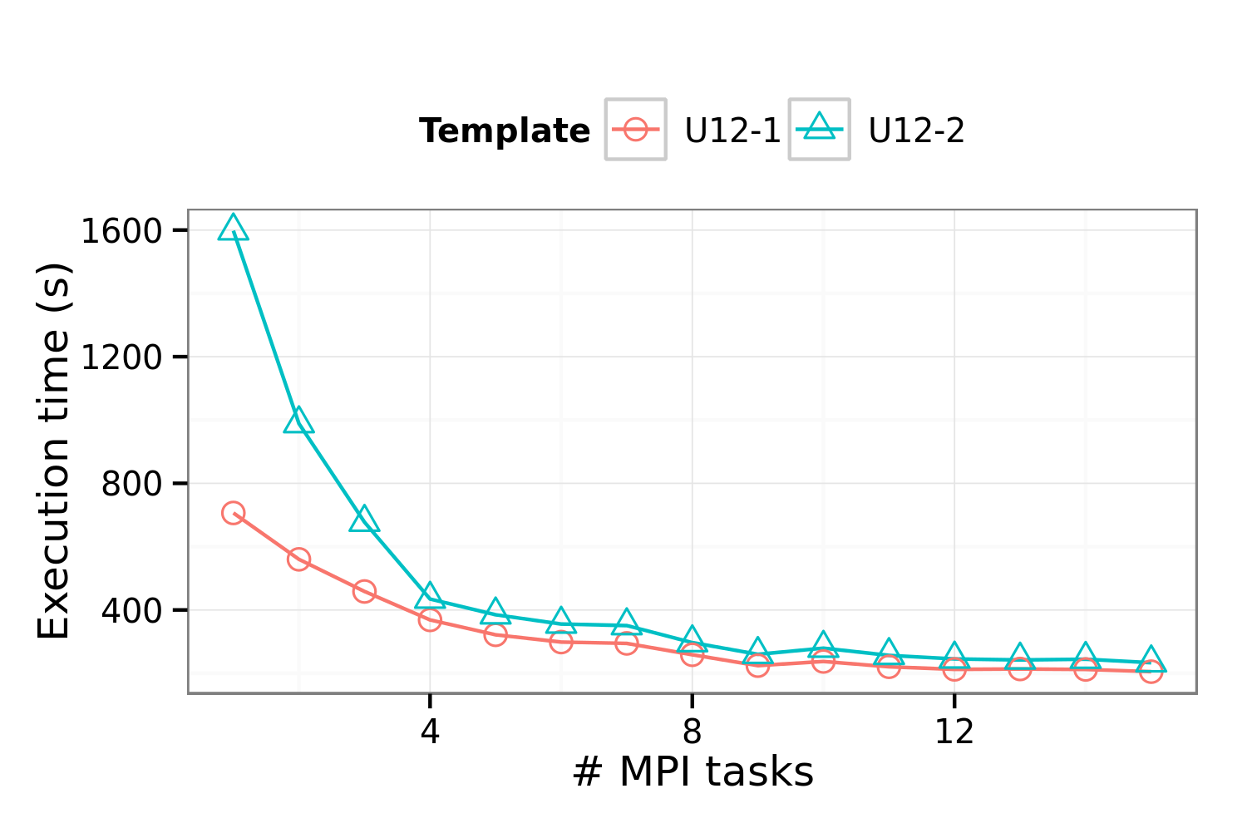
Multi-node strong scaling
Orkut network (117M edges)
Performance on an Intel Sandy Bridge cluster (1-15 nodes)
6.8x speedup
for U12-2

Slide 29
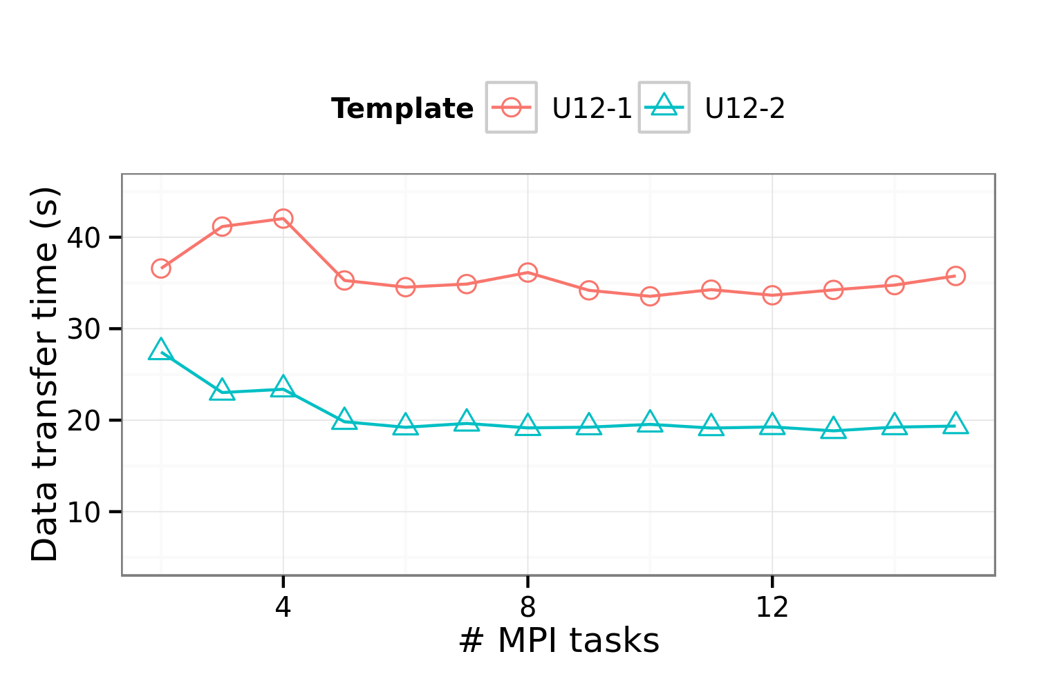
Multi-node strong scaling (communication time)
Orkut network (117M edges)
Performance on an Intel Sandy Bridge cluster (1-15 nodes)
No scaling:
Comm Volume
proportional
to # of MPI tasks!

Slide 30
FASCIA Summary and Current Work
FASCIA: Color-coding parallel implementation applied to count subgraphs
Current work: FastPath, color-coding applied to enumerate simple short paths
FASCIA performance optimization
  Graph coarsening
  Reduce memory utilization
  Fix the (computation) load imbalance at high concurrencies with better graph partitioning
  Hide inter-node communication, non-blocking collectives
Source code: Will be up at fascia-psu.sourceforge.net
  Immediate access: contact me or George Slota (gms5016@psu.edu)

Slide 31
Thank you!
Questions?
madduri@cse.psu.edu
http://www.cse.psu.edu/~madduri

Slide 32
Backup slides

Slide 33
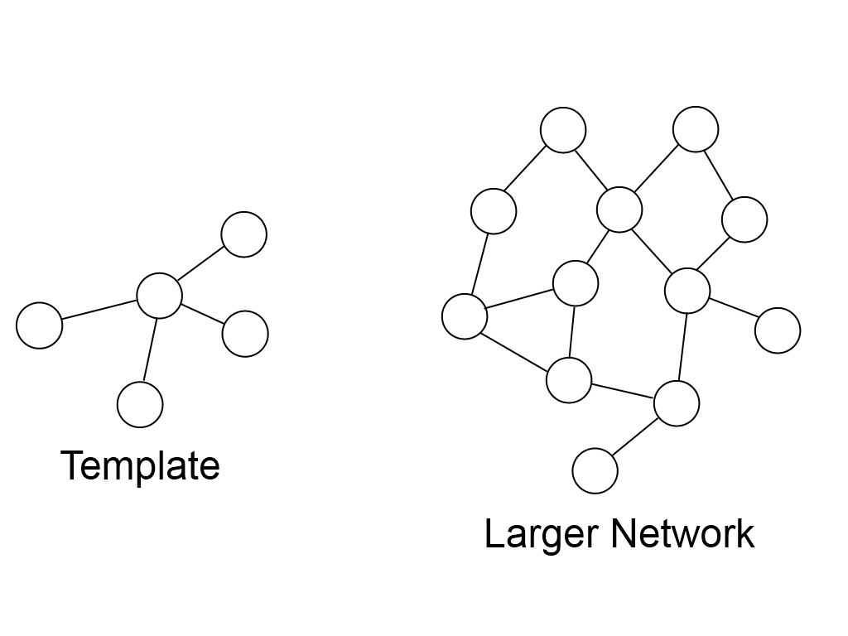
Subgraph counting

Slide 34
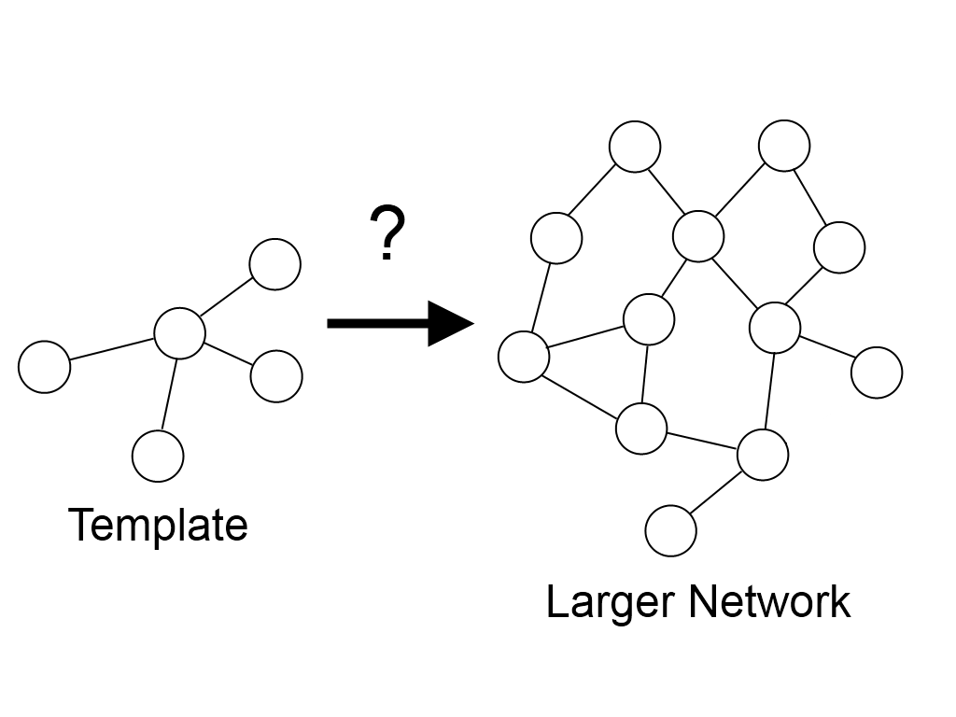
Subgraph counting

Slide 35
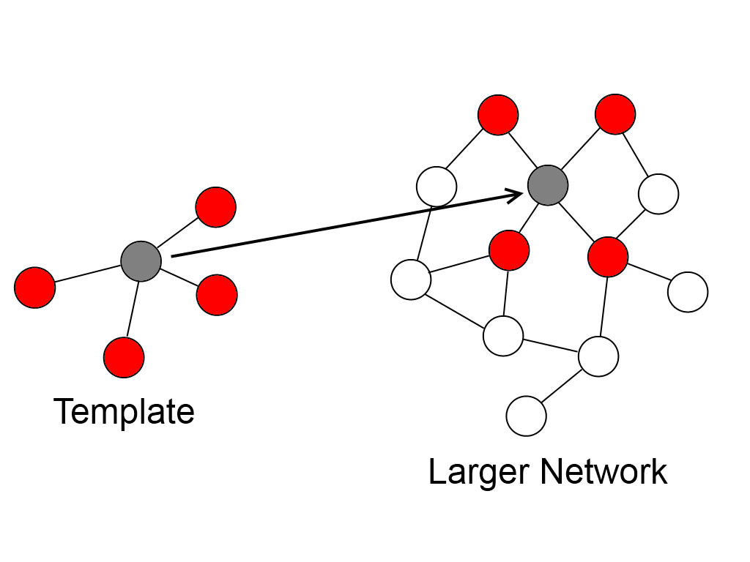
Subgraph counting

Slide 36
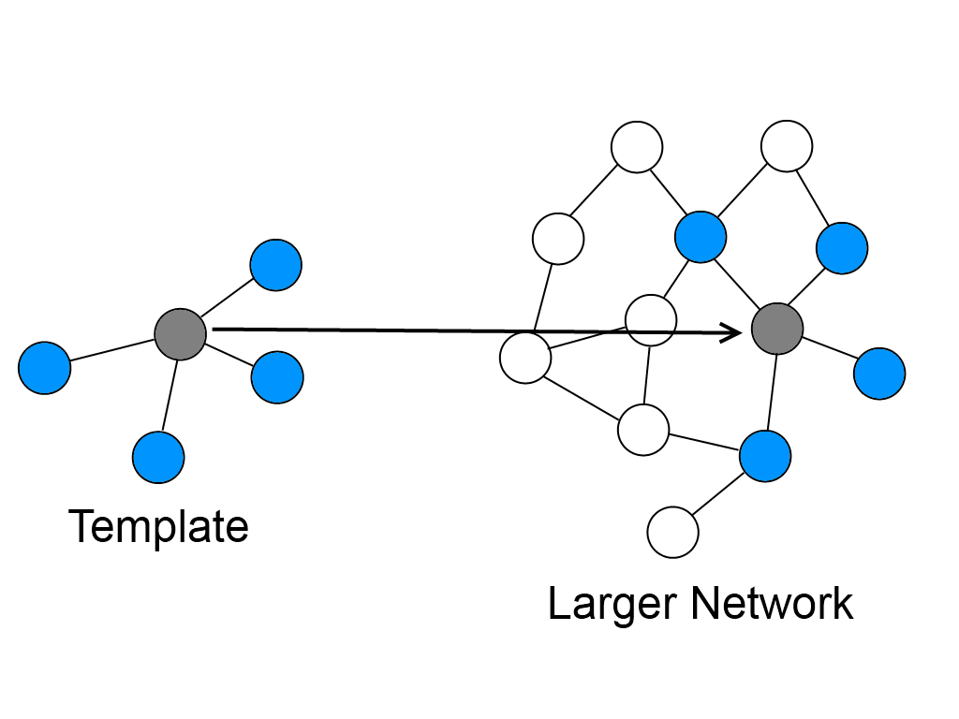
Subgraph counting

Slide 37
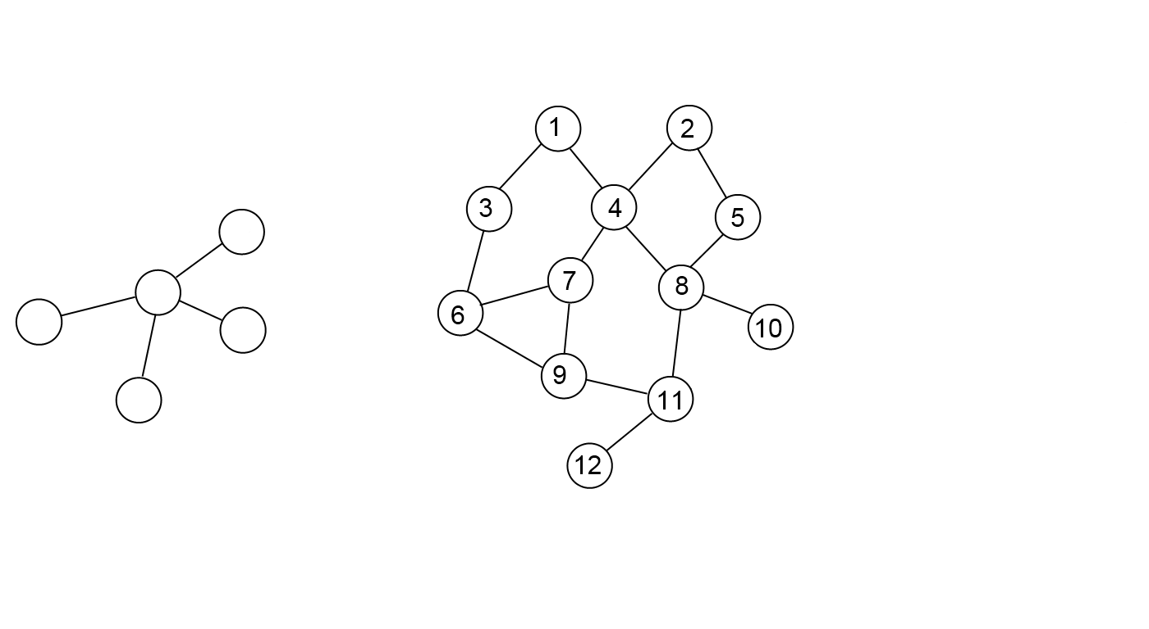
Subgraph enumeration

Slide 38
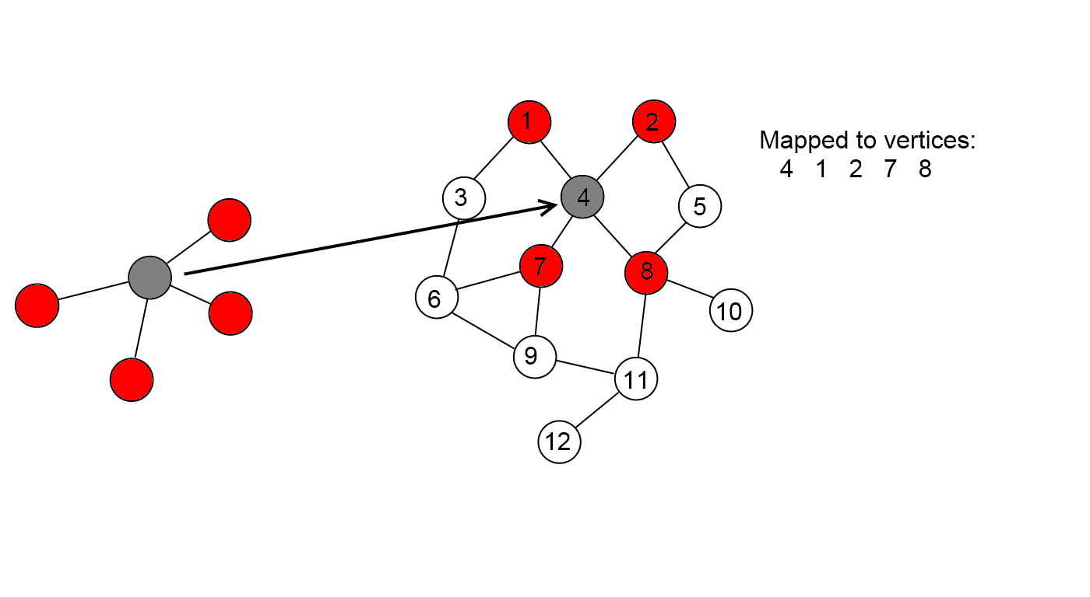
Subgraph enumeration

Slide 39
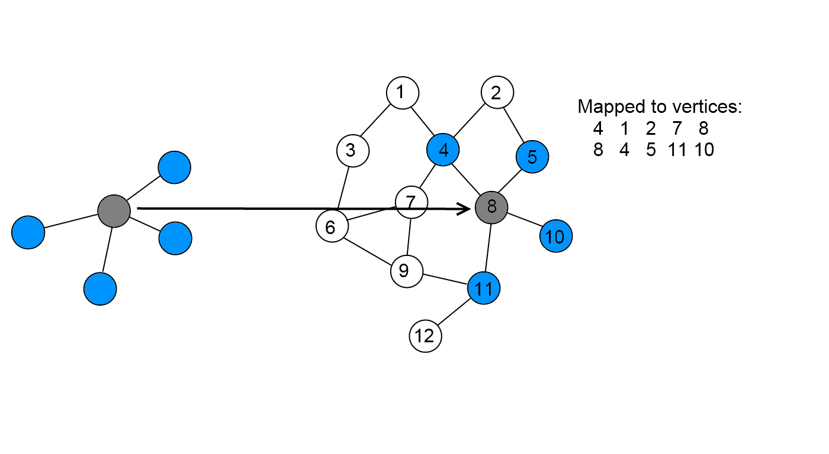
Subgraph enumeration

Slide 40
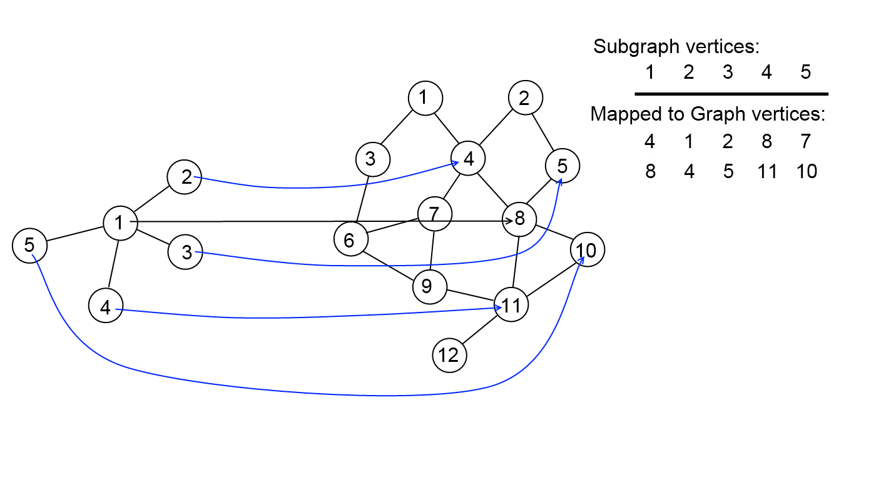
Subgraph enumeration

Slide 41
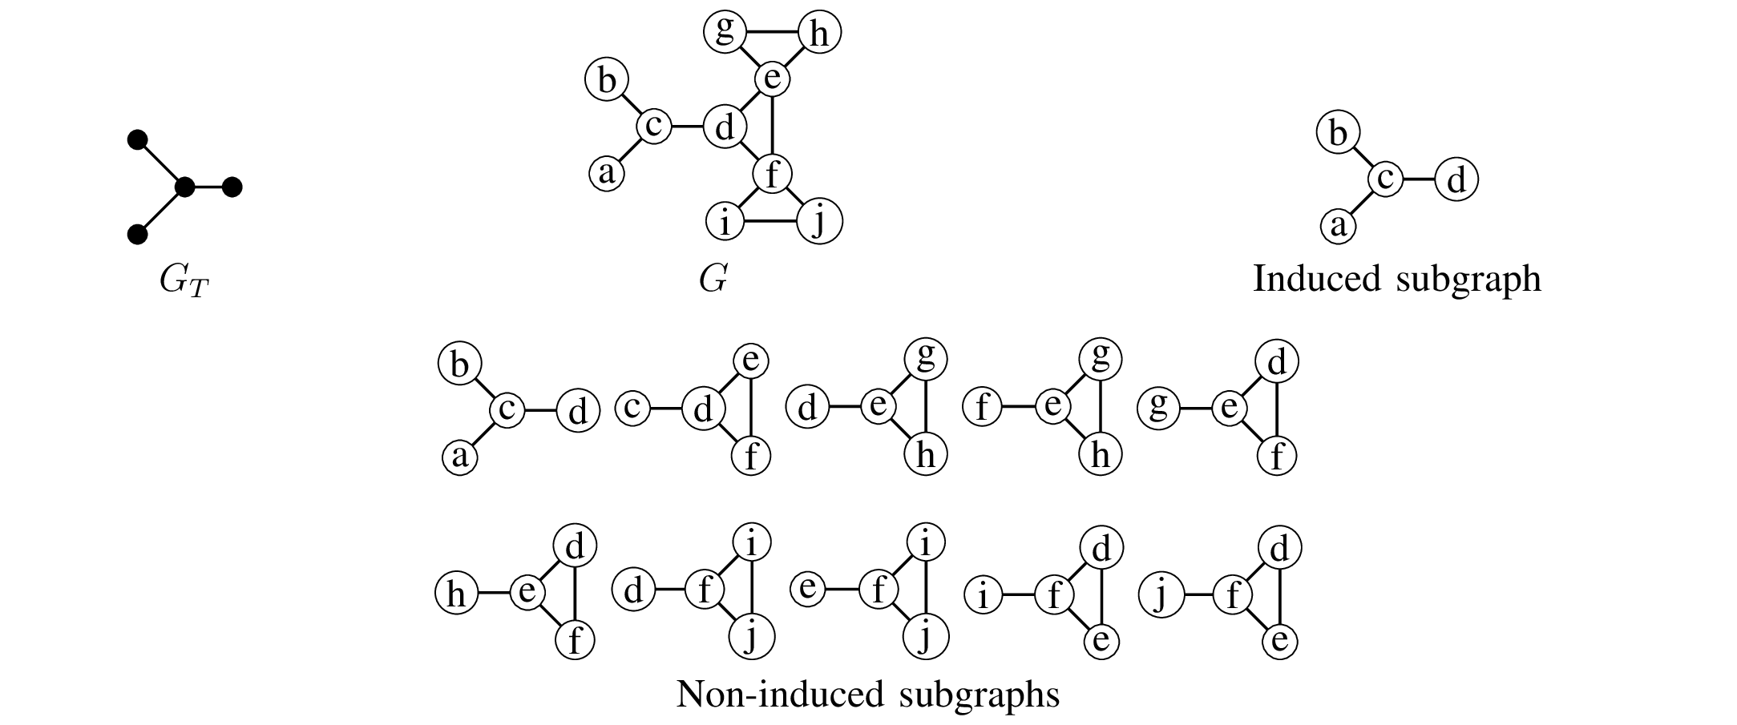
Induced vs. Non-induced subgraphs

Slide 42
Motivation: Why fast algorithms for subgraph counting?
Important in bioinformatics, chemoinformatics, social network analysis, communication network analysis, etc.
Forms basis of more complex analysis
  Motif finding
  Graphlet frequency distance (GFD)
  Graphlet degree distributions (GDD)
  Graphlet degree signatures (GDS)
Exact counting and enumeration on large networks is very compute-intensive, O(n^{k}) work complexity for naïve algorithm

Slide 43
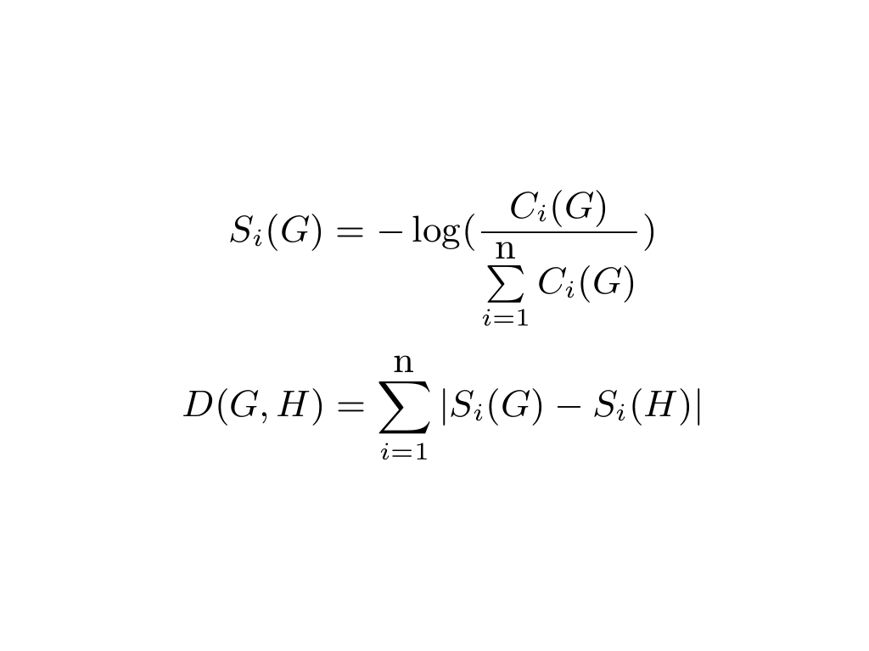
GFD
Numerically compare occurrence frequency to other networks

