Slide 1
A Parallel Graph Algorithm for Detecting Mesh Singularities in Distributed Memory Ice Sheet Simulations
Ian Bogle¹ Karen Devine² Mauro Perego² Sivasankaran Rajamanickam² George Slota¹
¹Rensselaer Polytechnic Institute Troy, NY
²Sandia National Labs Albuquerque, NM
SAND2019-9113 C

Slide 2
Goal: Efficiently Detect Problematic Mesh Features
Ice sheet simulations fail to converge due to features like hinged peninsulas and icebergs in meshes
Previous solutions either did not find all classes of features or were not able to be run at each step of the simulation
New algorithm that detects all problematic features
Distributed memory implementation provides good strong scaling and weak scaling up to 4096 nodes
Detection takes at most 0.4% of a simulation step’s runtime
46,000x faster than previously used preprocessing on highest resolution meshes

Slide 3
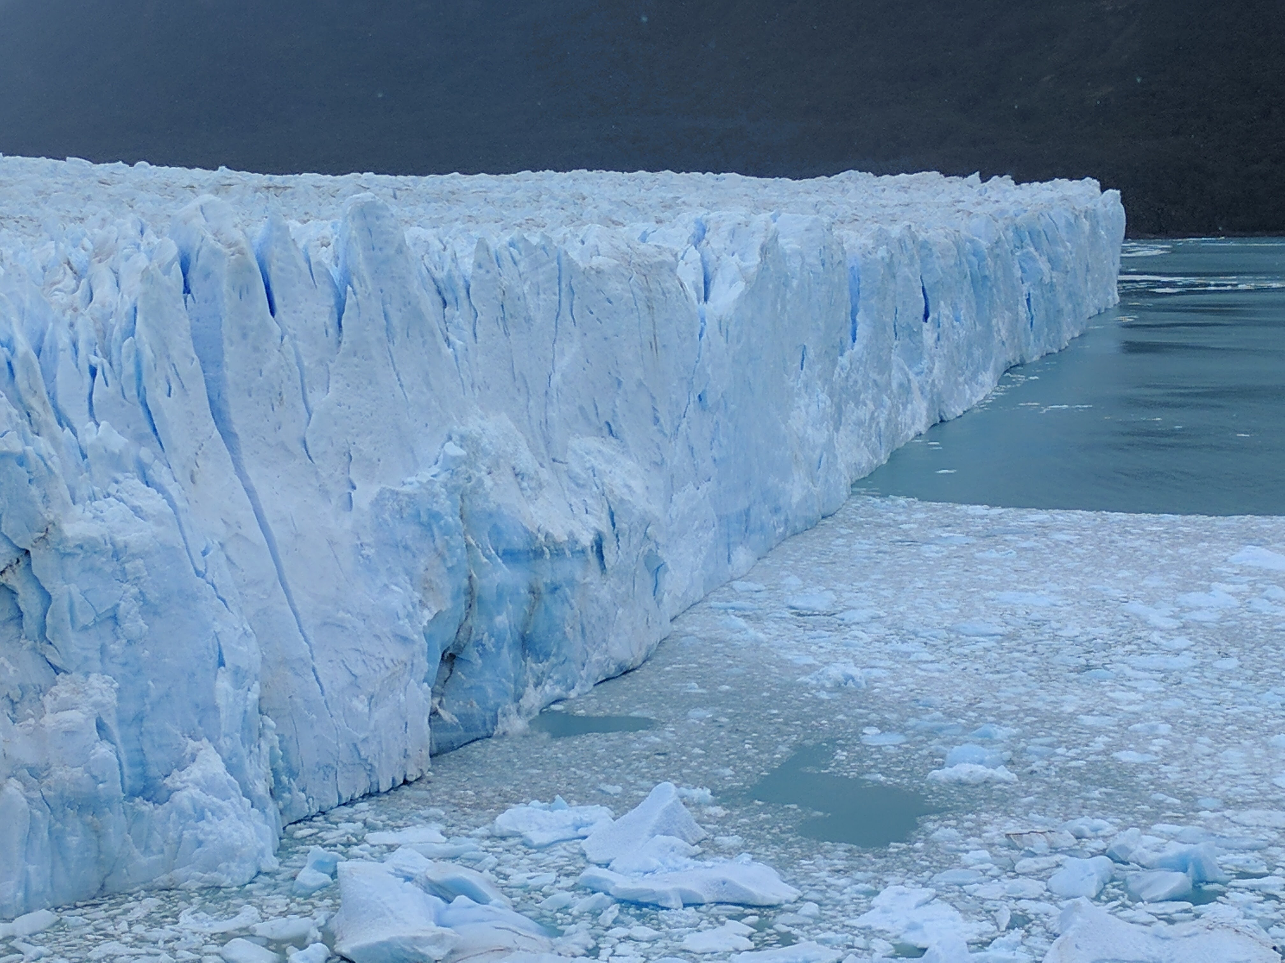
Ice Sheet Simulations are Used to Predict Sea Level Rise
Sea Level Rise (SLR) is something everyone is worried about
The largest contributor to SLR is the melting of the ice sheets in Antarctica and Greenland
To accurately predict SLR we need to accurately model ice sheets

Slide 4
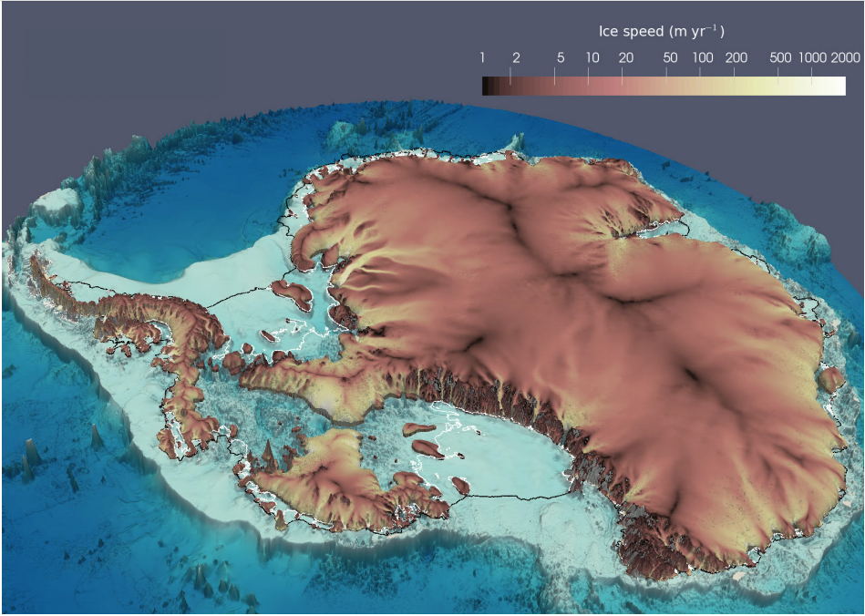
MALI is an Unstructured Mesh Finite Element Land Ice Simulator
We use the 2D mesh that MALI extrudes for simulations
Our work aims to increase convergence of the simulations
Interested in the velocity solving component of MALI
Courtesy of Matt Hoffman (LANL)

Slide 5
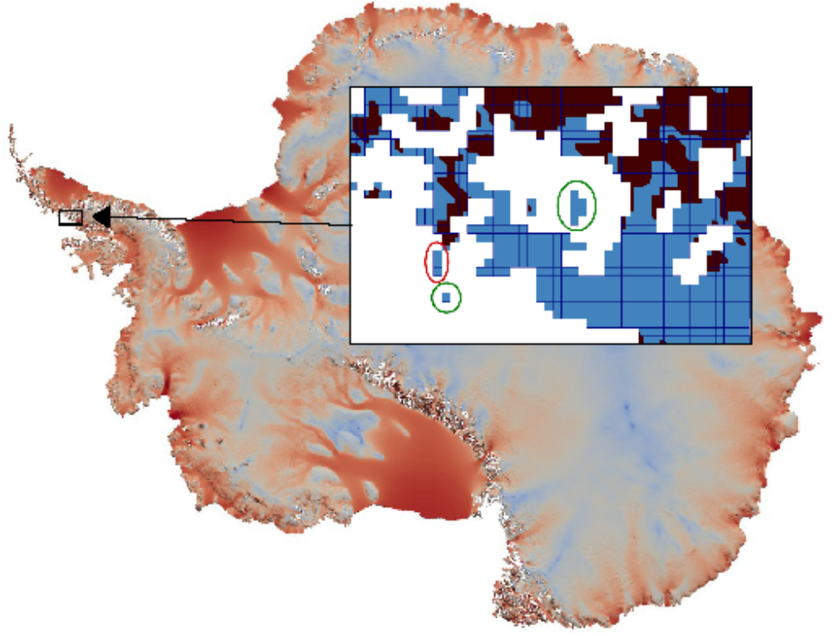
Mesh Singularities are Parts of the Mesh That Can Rotate or Translate
Icebergs
Floating Peninsulas
(Floating Hinges)
Any part of the mesh that can freely rotate or translate makes the velocity solution not unique
Blue ice is floating
Brown ice is on the ground

Slide 6
Mesh Singularities Have at Most One Connection to the Ground
These two vertices allow for two unique connections to ground.
Only one unique connection to ground exists, it is through this vertex.
There are no Mesh Singularities
These are Mesh Singularities
Vertex that is floating in the water
Vertex that is touching the ground

Slide 7
Mesh Singularities Cause Headaches for Scientists Running Simulations
Mesh Singularities cause convergence problems for solvers
Mesh Singularities are difficult to detect
Mesh Singularities can form during simulation

Slide 8
Detecting/Removing Mesh Singularities is the Most Efficient Approach
Tuminaro et. al. 2016 shows this
  Proposes a “quick fix” to find both icebergs and floating peninsulas
  Implemented in a serial matlab code
Zou et. al. detect icebergs only, and on a structured mesh
Harrison et. al. 2015 detects icebergs in 3D meshes
A well-studied graph problem, Biconnectivity, relates to this problem
  Work-optimal serial algorithm by Hopcroft and Tarjan 1973
  Shared-memory parallel algorithm by Tarjan and Vishkin 1985
  Two shared-memory algorithms by Slota et. al. 2014
  A more recent shared-memory algorithm by Chaitanya et. al. 2016

Slide 9
Converting the Mesh into a Graph Loses Useful Information
Meshes have vertices, edges, and elements
Graphs have only vertices and edges
Easy to spot holes in the ice
Difficult to tell where ice is

Slide 10
Detecting Mesh Singularities is Related to Biconnectivity in Graphs
Biconnected Components of a graph remain connected if any single vertex is removed.
Articulation Points are vertices that disconnect the graph if removed.
This would not solve our problem completely

Slide 11
Application Provides a Mesh and Grounding Information
Legend
Floating
Touching Ground

Slide 12
We Identify Parts of the Mesh with No Mesh Singularities
Legend
Mesh Singularity
Not Mesh Singularity

Slide 13
Our Approach Propagates Grounding Information Through the Mesh
Propagating the initial grounding carefully should reveal Mesh Singularities
We have access to useful information from the application apart from the graph representation of the Ice Sheet.
Our approach has two steps:
  Find Potential Articulation Points
  Propagate Grounding Information
Note: Examples show quad meshes, but the approach works with triangular meshes as well.

Slide 14
Step 1: Find Potential Articulation Points
Application identifies boundary edges at interfaces between ice and water

Slide 15
Step 1: Find Potential Articulation Points
This is the only actual Articulation Point
Vertices with more than two incident red edges are Potential Articulation Points

Slide 16
Step 2: Propagate Grounding Information
Legend
Start with grounding given from the application
Floating
Initially Grounded
1 Path to Ground
2 Paths to Ground
P
Potential Articulation Point
P
P
P

Slide 17
Step 2: Propagate Grounding Information
Legend
Initially grounded vertices have one path to ground
Floating
Initially Grounded
1 Path to Ground
2 Paths to Ground
P
Potential Articulation Point
P
P
P

Slide 18
Step 2: Propagate Grounding Information
Legend
Propagate only from vertices that have changed color
Floating
Initially Grounded
1 Path to Ground
2 Paths to Ground
P
Potential Articulation Point
P
P
P

Slide 19
Step 2: Propagate Grounding Information
Legend
Stop the propagation at the Potential Articulation Points
Floating
Initially Grounded
1 Path to Ground
2 Paths to Ground
P
Potential Articulation Point
P
P
P

Slide 20
Step 2: Propagate Grounding Information
Legend
Floating
Initially Grounded
1 Path to Ground
2 Paths to Ground
P
Potential Articulation Point
P
P
P
These two Potential Articulation Points allow for two paths to ground

Slide 21
Final Result of Our Algorithm
Legend
Keep all vertices with two unique paths to the ground
Floating
Initially Grounded
1 Path to Ground
2 Paths to Ground
P
Potential Articulation Point
P
P
P
The yellow vertices only have one unique path through this vertex
These green vertices have two unique paths through both Potential Articulation Points

Slide 22
Our Algorithm is Provably Correct and Efficient
We prove that every vertex we label has the correct number of paths
We prove that every vertex that has a certain number of paths gets labeled correctly
We show linear expected work complexity O(|E|)
  |E| is the number of edges
We show linear expected parallel time O(d) on O(|E|) processors
  d is the graph diameter
The full proofs are available in the paper

Slide 23
Experimental Setup
Testing Systems:
  Amos – 5 rack Blue Gene/Q housed at RPI, with 5k nodes, 80k cores and 80TB RAM
  Edison – NERSC’s Cray XC30 Supercomputer
We used a simple block partitioning for our inputs
We used real quad meshes of the Antarctic Ice Sheet from the ProSPect project, and generated synthetic quad meshes.

Slide 24
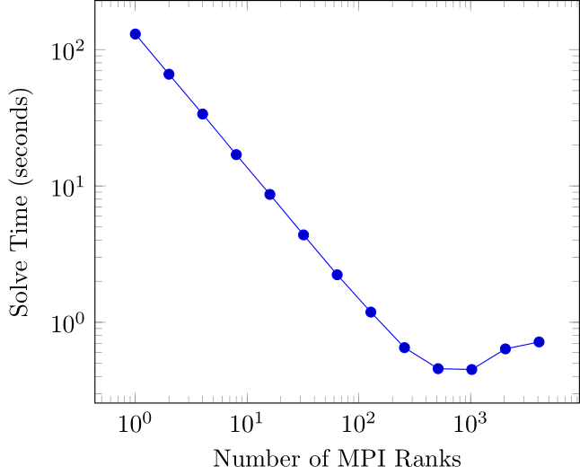
Near-Linear Strong Scaling on Real Ice Sheet Meshes
1km real mesh
13.5 million vertices
13.4 million elements
Ran on up to 4096 nodes
  One MPI rank per node

Slide 25
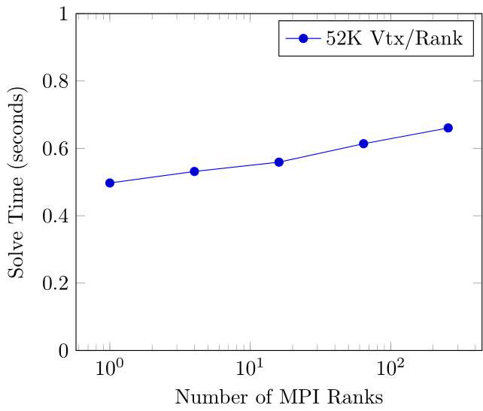
Good Weak Scaling on Real Ice Sheet Meshes
Mesh | Vertices | Elements | Ranks
16km (real) | 52,465 | 51,087 | 1
8km (real) | 210,170 | 206,436 | 4
4km (real) | 841,346 | 831,173 | 16
2km (real) | 3,368,275 | 3,341,449 | 64
1km (real) | 13,479,076 | 13,413,766 | 256

Slide 26
How We Generated Synthetic Ice Sheets
Add initial grounding
Start with a square Central Ice Mass
Add features that have two paths to the Central Ice
Mesh Singularities can be of arbitrary length
Add some Mesh Singularities

Slide 27
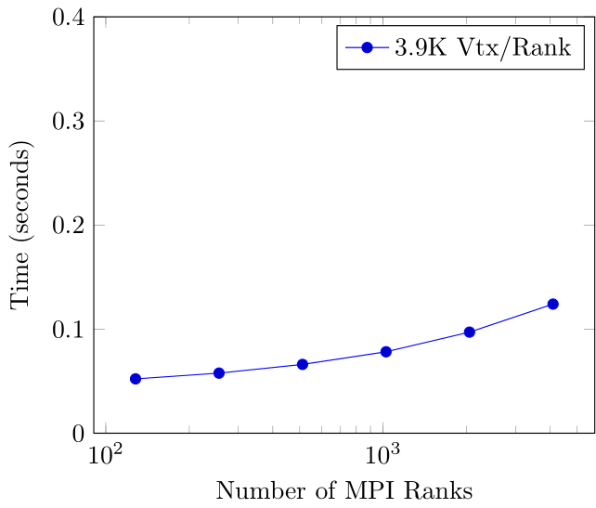
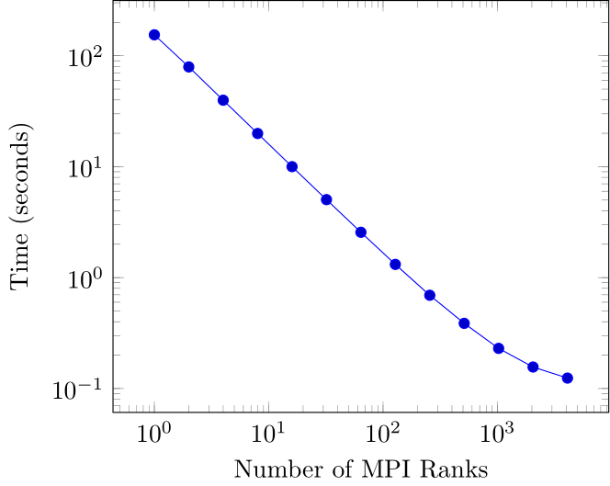
Similar Scaling Shows Synthetic Meshes are Realistic
Synthetic Weak Scaling
Synthetic Strong Scaling (16.2 Million Vtx)

Slide 28
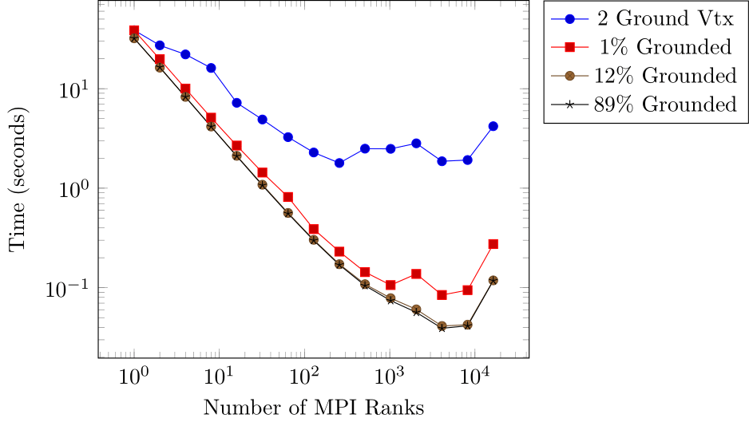
Algorithm Performance is Robust w.r.t. Number of Grounded Vertices
Vary the percentage of initially grounded vertices
Real meshes have 89% of vertices initially grounded

Slide 29
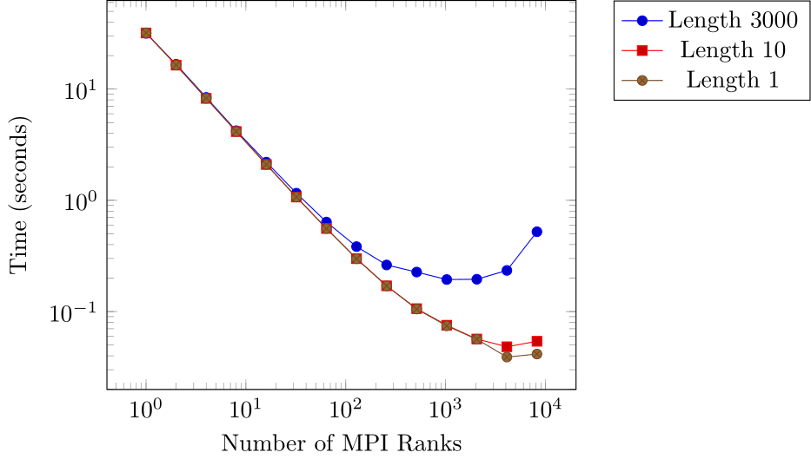
Algorithm Performance is Robust w.r.t. Length of Mesh Singularities
Chain multiple floating peninsulas together
Real meshes have at most four floating peninsulas chained together

Slide 30
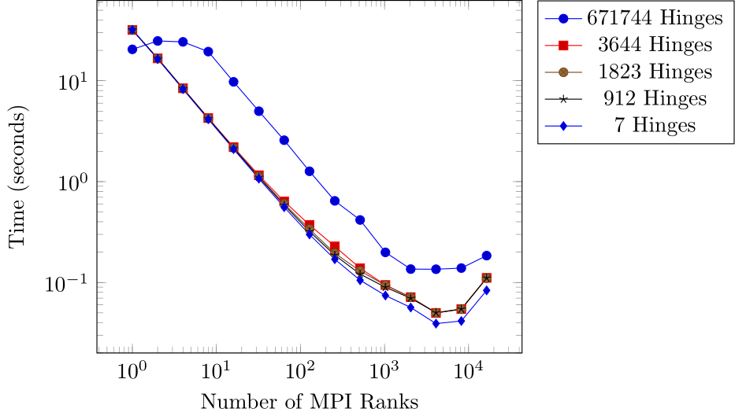
Algorithm Performance is Robust w.r.t. Number of Floating Peninsulas
Real meshes have between 7 and 912 mesh singularities
Increasing amount of mesh singularities changes runtime, not scalability

Slide 31
Our Algorithm Scales Well for Realistic Inputs
Near-linear strong scaling and good weak scaling on real inputs
Tolerates wide variations in mesh characteristics

Slide 32
Our Algorithm’s Runtime is Negligible w.r.t. Simulation Runtime
Our algorithm uses at most 0.4% of a simulation step’s runtime
Low cost relative to application enables dynamic use as mesh evolves
Mesh | Elements | Distributed Runtime (MPI Ranks) | Percentage of Simulation Step Runtime
16km (real) | 51,087 | 0.0176s (6) | 0.19%
8km (real) | 206,436 | 0.0217s (24) | 0.158%
4km (real) | 831,173 | 0.0414s (96) | 0.287%
2km (real) | 3,341,449 | 0.0407s (384) | 0.314%
1km (real) | 13,413,766 | 0.0561s (1536) | 0.412%

Slide 33
New Capability Significantly Benefits Ice Sheet Applications
Avoid expensive pre-processing of mesh
“Serial Matlab Runtime” is Tuminaro et. al.’s quick fix (2016)
  Running in serial on a workstation with an Intel Xeon Gold 6146 CPU @ 3.2GHz
“Distributed” is our approach running on NERSC’s Cray XC30 Supercomputer
Mesh | Distributed Runtime (MPI Ranks) | Serial Matlab Runtime | Speedup
16km (real) | 0.0176s (6) | 1.04s | 59x
8km (real) | 0.0217s (24) | 5.65s | 260x
4km (real) | 0.0414s (96) | 34.6s | 835x
2km (real) | 0.0407s (384) | 245s | 6019x
1km (real) | 0.0561s (1536) | 2630s | 46880x

Slide 34
Conclusions and Future Work
New algorithm for finding mesh singularities
  Hinged peninsulas and icebergs in ice sheet meshes
Enables convergence of iterative solvers in ice sheet simulations
Demonstrates good scaling on real and synthetic meshes
Efficient parallel implementation uses at most 0.4% of the runtime of a single simulation step
Removes need for expensive mesh preprocessing by application
Investigating generalization to efficient distributed-memory biconnected component detection
Contact Me: boglei@rpi.edu

Slide 35




This work was supported in part by the U.S. Department of Energy, Oﬃce of Science, Oﬃce of Advanced Scientiﬁc Computing Research, Scientiﬁc Discovery through Advanced Computing (SciDAC) program through the FASTMath Institute under Contract No. DE-AC02-05CH11231 at Rensselaer Polytechnic Institute and Sandia National Laboratories and through the SciDAC ProSPect project at Sandia National Laboratories. Sandia National Laboratories is a multimission laboratory managed and operated by National Technology and Engineering Solutions of Sandia, LLC., a wholly owned subsidiary of Honeywell International, Inc., for the U.S. Department of Energy’s National Nuclear Security Administration under contract DE-NA-0003525.

Slide 36
Conclusions and Future Work
New algorithm for finding mesh singularities
  Hinged peninsulas and icebergs in ice sheet meshes
Enables convergence of iterative solvers in ice sheet simulations
Demonstrates good scaling on real and synthetic meshes
Efficient parallel implementation uses at most 0.4% of the runtime of a single simulation step
Removes need for expensive mesh preprocessing by application
Investigating generalization to efficient distributed-memory biconnected component detection
Contact Me: boglei@rpi.edu

