Slide 1


Explicit Ordering Refinement for Accelerating Irregular Graph Analysis
Michael Mandulak¹ Ruochen Hu¹ George M. Slota¹
¹Rensselaer Polytechnic Institute
IEEE HPEC 2022- Graph Analytics & Network Science
20 September 2022

Slide 2
Graph Ordering Problem
Motivation
Goal: Improve Analysis Measures using Refinement
▶ Analysis runtime
▶ Analysis cache efficiency
Why?
▶ Faster graph analysis – growing network sizes.
▶ Memory access pattern concerns on HPC systems.
Focus:
▶ Improve vertex locality for improved memory access patterns.
▶ NP-hard – heuristic and approximation solutions.
▶ Experimental study – is optimization viable?

Slide 3
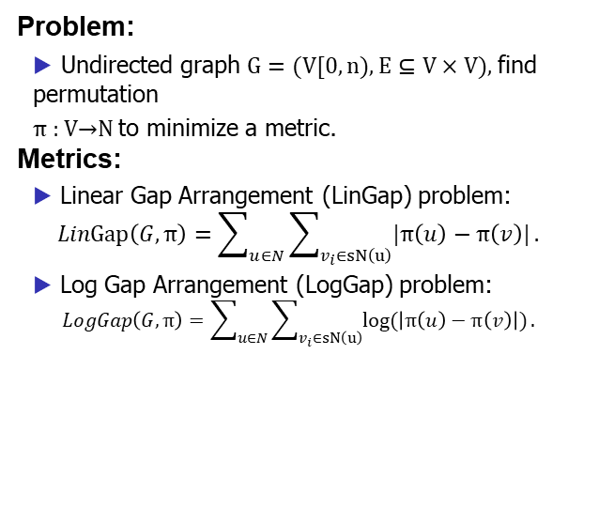
Graph Ordering Problem
Background
Problem:
▶ Undirected graph $G=(V[0,n),E⊆V×V)\text{, }$find permutation
$\text{π}\text{ : }\text{V}\text{→}\text{N}$to minimize a metric.
Metrics:
▶ Linear Gap Arrangement (LinGap) problem:
$$LinGap\left(G,π\right)=\sum_{u∈N}{\sum_{v_{i}∈sN\left(u\right)}^{ }{|π\left(u\right)−π\left(v\right)|}}.$$
▶ Log Gap Arrangement (LogGap) problem:
$$LogGap\left(G,π\right)=\sum_{u∈N}{\sum_{v_{i}∈sN\left(u\right)}^{ }{log⁡(\left|π\left(u\right)−π\left(v\right)\right|)}}.$$

Slide 4
Experimental Study
Considerations:
▶ What analysis algorithms can we test with?
▶ What ordering methods can we compare with?
▶ How do our metrics relate to analysis measures?
▶ How should we refine?

Slide 5
Analysis Algorithms
Memory Access
Focus: Vertex-centric approaches with CPU-based shared memory parallelism.
PageRank
▶ Sparse matrix-vector multiplication.
▶ Compressed Sparse Row locality.
Louvain
▶ Coarsening through edge density.
▶ Ordering dependent within neighborhoods.
Multistep
▶ Traversal and propagation connectivity.
▶ BFS-based vertex access.

Slide 6
Ordering Methods
Natural Ordering
Rabbit
▶ Community generation and mapping to cache-hierarchies.
▶ Optimizes for cache efficiency.
Layered Label Propagation (LLP)
▶ Community detection through label propagation.
▶ Considers global distribution of labels.
▶ Optimizes for compression.
Shingle
▶ Order by neighborhood commonalities.
▶ Optimizes for compression.

Slide 7
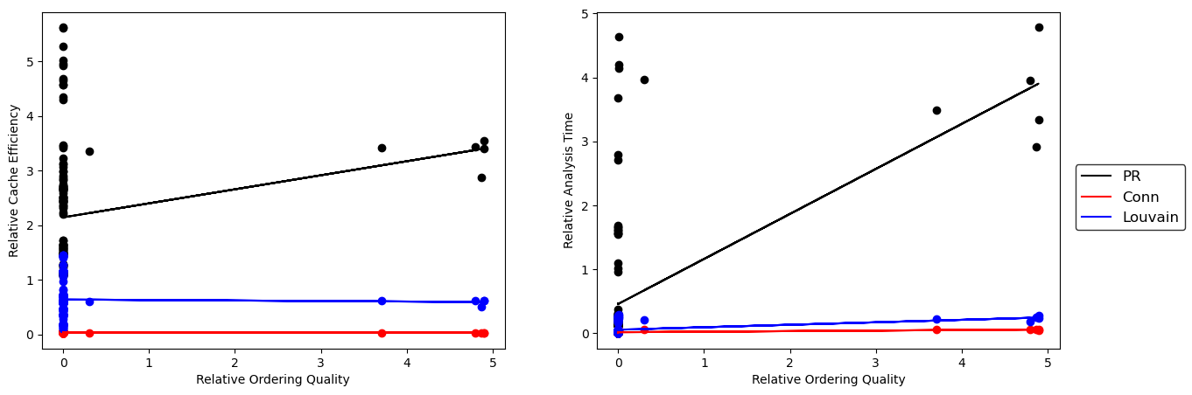
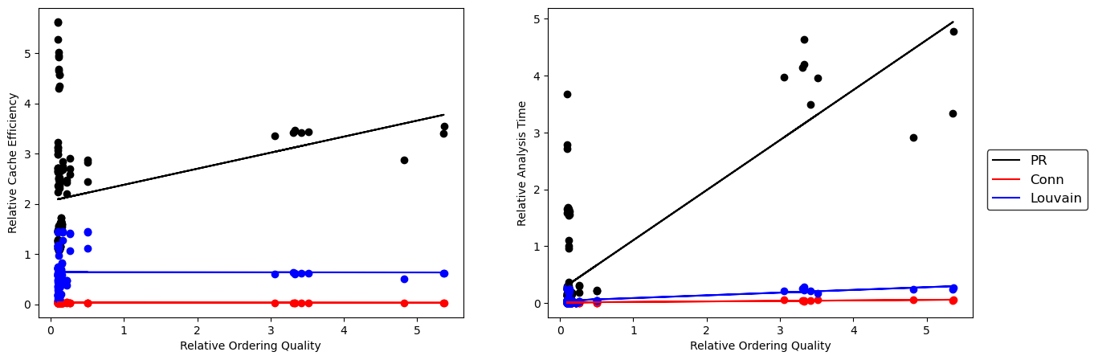
Metric Correlation
LinGap (Top) & LogGap (Bottom)

Slide 8
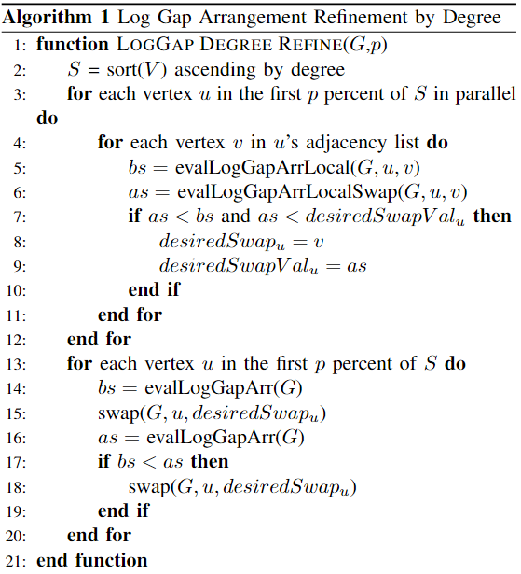
Refinement Method
Algorithm

Slide 9
Results Collection
Considerations:
▶ What graphs to test on?
▶ How much refinement should we conduct?
▶ What observations can be drawn from results?
▶ How are these results to be used?

Slide 10
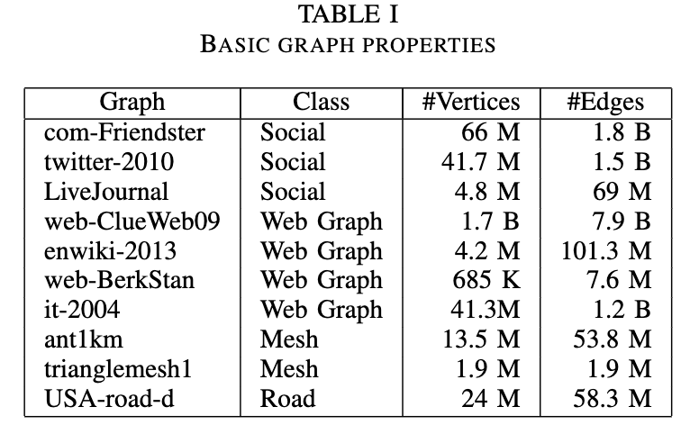
Experimentation
Data: Diverse classes and sizes
▶ SNAP, DIMACS, WebGraph
Collection:
▶ Ten runs per analysis algorithm per initial ordering per refinement method.
▶ Tens of thousands range of vertices to refine (experimentation).
Architecture:
▶ AMD system – 2TB DDR4 RAM.
▶ Cache per core: 4MiB L1, 64 MiB L2, 256MiB shared L3 per socket.

Slide 11
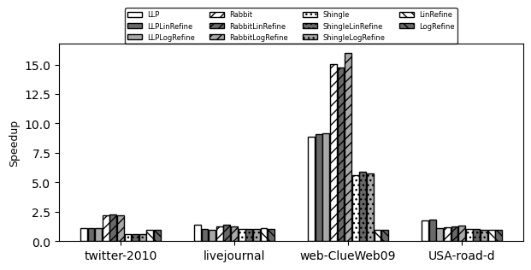
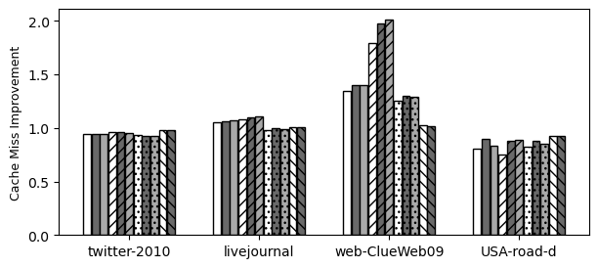
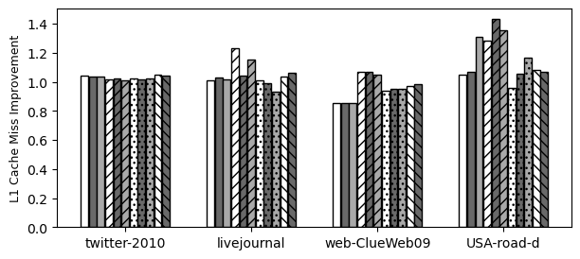
Results
PageRank

Slide 12
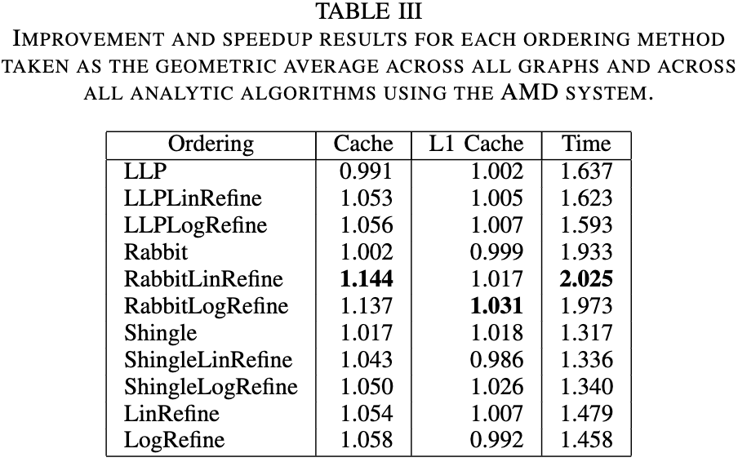
Results Summary
Observations:
▶ High impact from an initial Rabbit ordering.
▶ Experimental results show promise using baseline methods.
▶ Improvement trends upon algorithm-generated orderings with refinement.

Slide 13
Contributions
▶ Experimental study into the explicit refinement of vertex orderings.
▶ LinGap and LogGap metrics show promising correlations with PageRank analysis measures.
▶ Metrics improve in spikes throughout refinement.
▶ Refinement is most effective on an initial Rabbit ordering.
▶ Optimization shows promising improvements to heuristic methods given improved refinement methods.

Slide 14
Future Works
Refinement Testing
▶ More diverse analysis algorithms – not TLAV / graph classes.
Improved Refinement
▶ Explicit refinement on subgraphs.
▶ Alternate partitioning/spectral/multi-level methods for refinement.
Optimization
▶ Apply linear and non-linear solver models to adjacency lists for our metrics.
▶ Apply to subgraphs for easily distributed computing?
Metrics
▶ Single metric that is memory access pattern-agnostic?

Slide 15
Acknowledgement & Contact
Acknowledgement
▶ This work is supported by the National Science Foundation under Grant No. 2047821.
Contact
▶ Michael Mandulak: mandum@rpi.edu
▶ George Slota: slotag@rpi.edu

