Slide 1


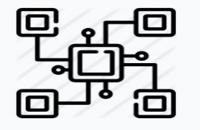
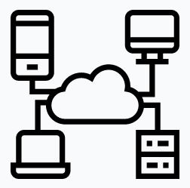
Why do we need Docker in Test Automation
Problem Statement
Test automation has two major challenges such as initial configuration challenges and Execution & orchestration challenges which consume significant effort, time and cost .Identifying a solution to resolve these challenge will reduce cost and improve efficiency.
Challenges in Test Automation
1. Configuration challenges
when we begin a new automation project, we spend significant time configuring our automation environment (tools, IDE’s , driver binary vs selenium version) and fixing associated issues as they surface.
2. Execution and orchestration challenges
Below are the three ways of performing test execution and orchestration in test automation along with the challenge
Local execution has the challenge that you cannot scale the amount of executable browsers; furthermore, only browsers supported by your operating system are available.
Grid - we can execute tests in parallel on multiple machines, but the maintenance of the machines, drivers and browsers will take you a lot of time and effort.
Cloud services – we can resolve the challenges in 1,2 using cloud services .However, they are costly and the location of the cloud provider’s servers impacts the execution speed of your tests.

Slide 2
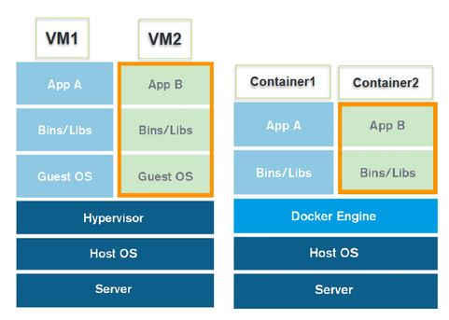
How to resolve the challenges mentioned in problem statement
Docker technology
Docker is an open source software
Allows us to package applications in a container
Containers are like a VM.
However, they have a very important difference – a container shares the system kernel with others
How to resolve the challenges mentioned in problem statement
1. Configuration challenge:
With Docker technology, we just need to build a file that configures an environment that normally works issue free” – avoiding the time spent in configuration and problem solving.

Slide 3

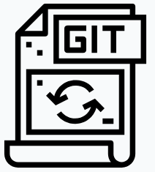


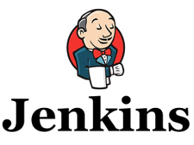


How to resolve the challenges mentioned in problem statement (cont..)
2. Execution and orchestration challenges
Steps:
Automation Tester commits his code to git /svn repositories
Initiate the Jenkins container and configure the below jobs
Job-1 :
Pull the source code from repositories and build it
Create Docker image form the source code
Push the source code to Docker hub
Job-2:
Pull the Docker image from Docker hub
Initiate the docker-yaml file which will run the selenium hub, node and source code containers.
Achieve the test results
Scale down the resources
Push the code
Poll repository
>………
……..
………
Create Image
Push to Docker Hub
Docker Hub
Jenkins Pipe line
Jenkins Server
Pull the image
Archive the test results and scale down the infrastructure
Complete the execution
Run the image by creating containers

Slide 4
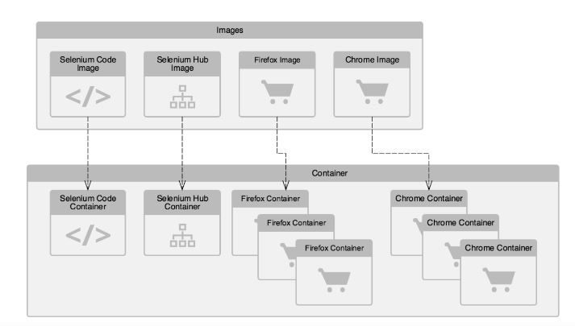
How to resolve the challenges mentioned in problem statement (cont..)
Pictorial representation of the working model
Images
Images are downloaded from the Docker hub
Selenium code (Automation code) is fetched from the repository and build and Image of the Selenium code is created using Docker file through Jenkins job
Images
Docker containers are created using Docker-compose file through Jenkins job
Automation script is executed and results are archived
Once execution is completed , infrastructure is scaled down automatically

Slide 5
Thank you!

