Slide 1


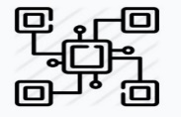

Docker in Test Automation
Problem Statement
Test automation has two major challenges such as initial configuration challenges and Execution & orchestration challenges which consume significant effort, time and cost .Identifying a solution to resolve these challenge will reduce cost and improve efficiency.
Challenges in Test Automation
Configuration challenges
when we begin a new automation project, we spend significant time configuring our automation environment (tools, IDE’s , driver binary vs selenium version) and fixing associated issues as they surface.
Execution and orchestration challenges
Local execution has the challenge that you cannot scale the amount of executable browsers; furthermore, only browsers supported by your operating system are available
Grid - we can execute tests in parallel on multiple machines, but the maintenance of the machines, drivers and browsers will take you a lot of time and effort
Cloud services – we can resolve the challenges in 1,2 using cloud services .However, they are costly and the location of the cloud provider’s servers impacts the execution speed of your tests

Slide 2
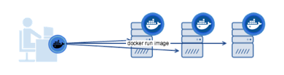
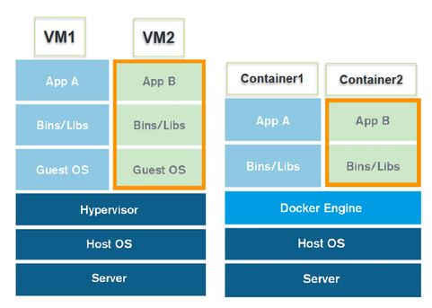
Docker in Test Automation
What is Docker ?
Docker is a tool designed to make it easier to create, deploy, and run applications by using containers
Docker container is an open source software development platform. Its main benefit is to package applications in “containers,” allowing them to be portable among any system running the Linux operating system (OS)
Container is a fast, neat capsule containing your application
Docker Hub is a cloud-based registry service which allows you to link to code repositories, build your images and test them, stores manually pushed images, and links to Docker Cloud so you can deploy images to your hosts
Docker can get more applications running on the same hardware than other technologies; it makes it easy for developers to quickly create ready-to-run container applications

Slide 3

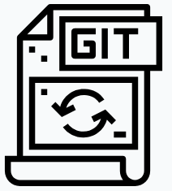


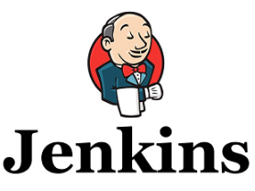
Docker in Test Automation
How does it work ?
Steps:
Automation Tester commits his code to git /svn repositories
Initiate the Jenkins container and configure the below jobs
Job-1 :
Pull the source code from repositories and build it
Create Docker image form the source code
Push the source code to Docker hub
Job-2:
Pull the Docker image from Docker hub
Initiate the docker-yaml file which will run the selenium hub, node and source code containers.
Achieve the test results
Scale down the resources
Push the code
Poll repository
>………
……..
………
Create Image
Push to Docker Hub
Docker Hub
Jenkins Pipe line
Jenkins Server
Pull the image
Archive the test results and scale down the infrastructure
Complete the execution
Run the image by creating containers

Slide 4
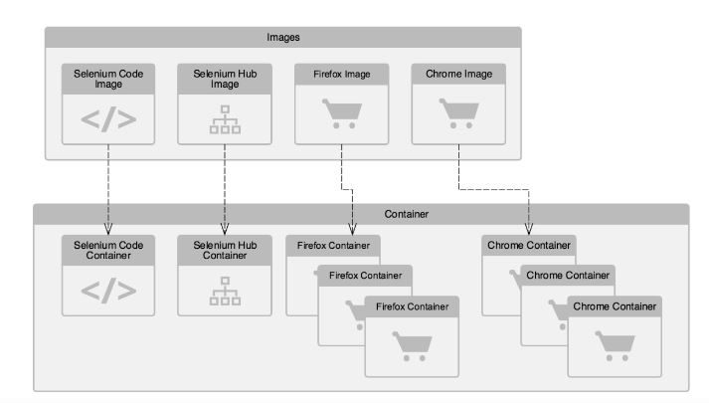
Docker in Test Automation
Pictorial representation of the working model
Images
Images are downloaded from the Docker hub
Selenium code (Automation code) is fetched from the repository and build and Image of the Selenium code is created using Docker file through Jenkins job
Containers
Docker containers are created using Docker-compose file through Jenkins job
Automation script is executed and results are archived
Once execution is completed , infrastructure is scaled down automatically

Slide 5
Thank you!

