Slide 1
SLA Assignment

Slide 2
SLA Assignment
Assignment Goal : Forecast daily ward occupancy Load
Models used in this assignment:
Here's a short explanation of the models used and why they are suitable for this problem:
Prophet: This is a time series forecasting model developed by Facebook. It's designed for time series data that has strong seasonal effects and holidays. In this problem, ward occupancy data likely exhibits daily, weekly, and potentially yearly seasonality, making Prophet a suitable choice for capturing these patterns. It also handles missing data and outliers well.
Random Forest: This is an ensemble learning method that builds multiple decision trees and merges their predictions to get a more accurate and stable forecast. It can capture non-linear relationships between the features (like lag occupancy and time-based features) and the target variable (occupancy). It's suitable here because we've engineered features that represent past occupancy and temporal patterns, which Random Forest can leverage.
XGBoost: This is another powerful gradient boosting algorithm that is an improvement over traditional gradient boosting. It's known for its speed and performance in various machine learning tasks, including regression. Similar to Random Forest, it can model complex relationships between the engineered features and occupancy. Its boosting approach often leads to higher accuracy compared to Random Forest, making it a good candidate for this forecasting problem.
Both Random Forest and XGBoost are suitable because they can utilize the engineered features (lagged occupancy, day of week, month) to predict future occupancy, treating it as a regression problem based on historical patterns and temporal information.

Slide 3
SLA Assignment
Planning:
Planning:
Mount Google Drive and Install Libraries: Access dataset from Google Drive and install necessary libraries.
Load and Demo the Dataset: Load transfers.csv and perform basic exploration.
Exploratory Data Analysis (EDA): Analyze transfers table for data quality, feature selection, and cleaning needs.
Aggregate Daily Ward Occupancy: Calculate daily occupancy from transfer data.
Time Series Forecasting with Prophet: Build and evaluate a Prophet model for forecasting.
Feature Engineering for Machine Learning Models: Create time-based and lag features.
Random Forest Model: Train, evaluate, and interpret a Random Forest model.
XGBoost Model: Train, evaluate, and interpret an XGBoost model.
Tables used: transfers.csv
Columns Used (from transfers):
ROW_ID, SUBJECT_ID, HADM_ID, ICUSTAY_ID: Identifiers.
PREV_CAREUNIT, CURR_CAREUNIT: Used for tracking care unit changes.
INTIME, OUTTIME: Used for calculating duration and creating occupancy events.
DBSOURCE, EVENTTYPE, PREV_WARDID, CURR_WARDID, LOS: Available for potential analysis but not explicitly used in the current code.

Slide 4
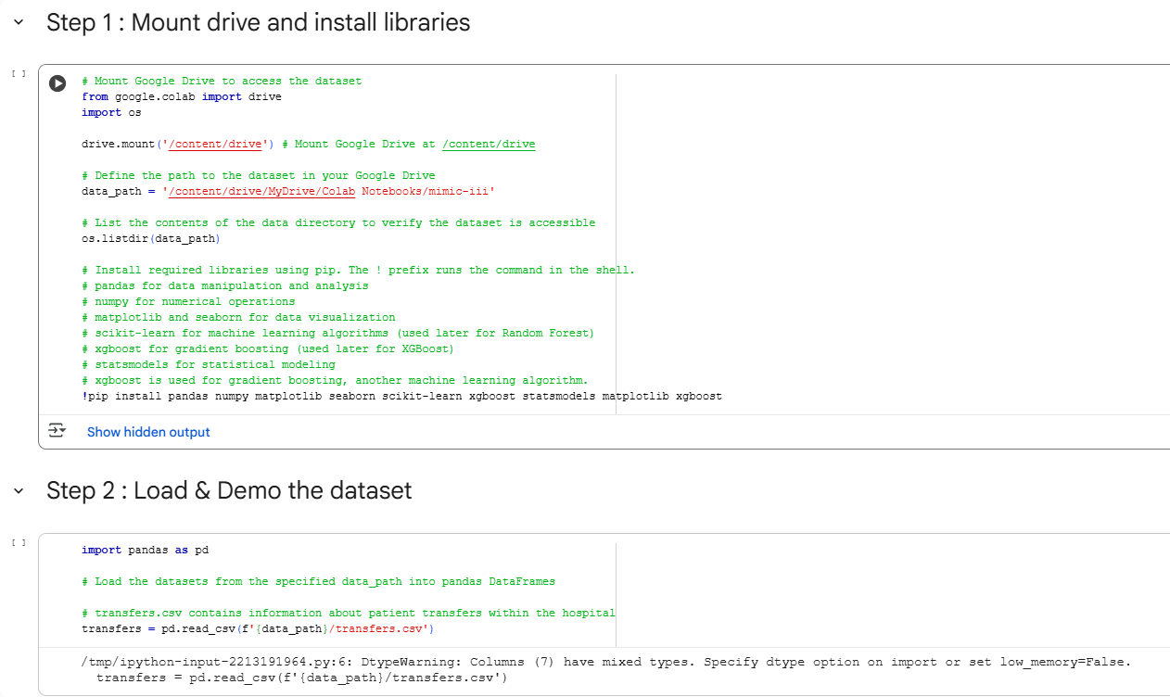
SLA Assignment
Prerequisite:
Refer the Python code and Data set: Obtain the necessary Python code and dataset from the specified GitHub Project. Git URL : https://github.com/gsmanivel/sla-assignment
Place the Python code and dataset in Google Drive: Ensure the downloaded files are stored in your Google Drive.
Update the dataset path: Accurately update the data_path variable in the code to point to the location of the dataset in your Google Drive.
Run every step: Execute each code cell sequentially to ensure the notebook runs as expected.
1. Mount Google Drive to access the dataset
Mount Google Drive at /content/drive
Define the path to the dataset in your Google Drive
Install required libraries using pip
Outcome:
At this stage, the drive should be mounted & dataset should be loaded

Slide 5
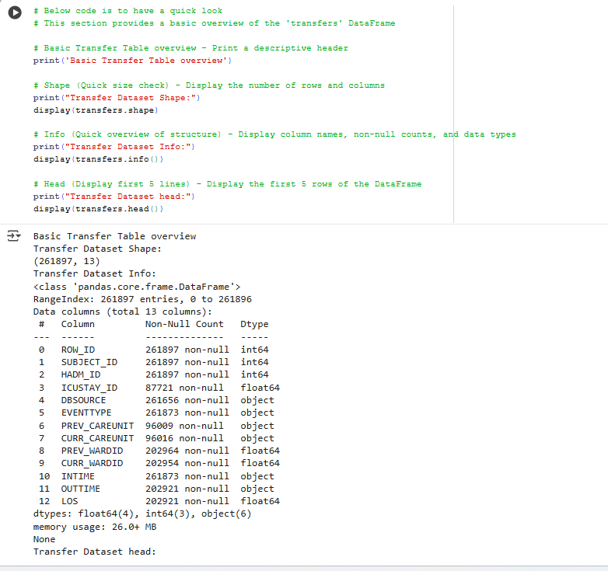
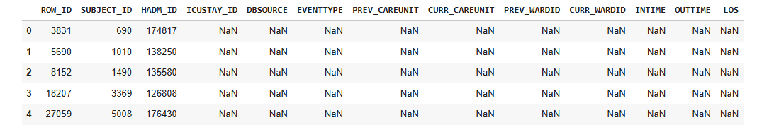
SLA Assignment
2. Dataset Overview
Step-by-Step Breakdown:
Header Print: Clearly labels the section for readability.
Shape Check: Displays the number of rows and columns to assess dataset size.
Info Summary: Reveals column names, data types, and missing values to identify potential data quality issues.
Head Preview: Shows the first few rows to get a sense of the actual data values and formats.
Why It’s Useful:
Helps in validating data ingestion.
Aids in identifying data types for preprocessing.
Useful for spot-checking anomalies or unexpected values early.
Best Practices Highlighted:
Using display() ensures better formatting in notebooks (e.g., Jupyter).
Keeping the overview concise and readable improves collaboration and debugging.

Slide 6
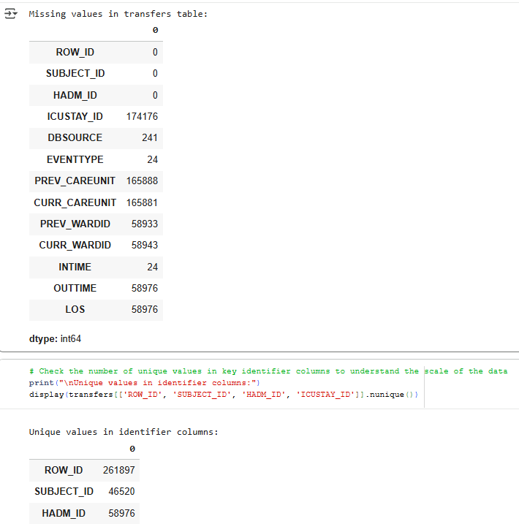
SLA Assignment
Step 3: Exploratory Data Analysis (transfers table)
Below are the key outcomes and benefits of performing this EDA:
Understand Data Quality: Identify missing values, inconsistencies, and potential errors in the datasets. This step is crucial for knowing which columns require cleaning or imputation before further analysis or modeling.
Feature Selection: Get an initial sense of which features (columns) might be most relevant for the task at hand (e.g., predicting hospital occupancy). Visualizations and summary statistics can highlight important variables.
Identify Areas for Data Cleaning: Based on the data quality assessment, determine specific steps needed to handle missing data (e.g., imputation, dropping rows/columns) or correct incorrect data formats or values.
Insights for Modeling: Discover patterns, trends, and distributions within the data through visualizations. For time-series data like ward occupancy, visual patterns (e.g., seasonality, skewness) can guide feature engineering (e.g., adding lag features, rolling statistics) and model selection.

Slide 7
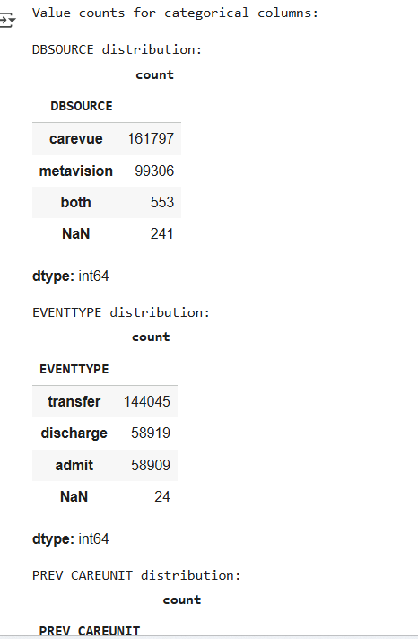
SLA Assignment
Step 3: Exploratory Data Analysis (transfers table) (Cont.)
It helps us understand how key categorical fields are distributed in the transfer dataset. It’s a way to profile the data and spot patterns or irregularities.
What It Analyzes:
DBSOURCE: Identifies the source systems contributing data.
EVENTTYPE: Shows the types of transfer events recorded.
PREV_CAREUNIT: Indicates the care unit a patient was transferred from.
CURR_CAREUNIT: Indicates the care unit a patient was transferred to.
Why It’s Important:
Helps us understand operational flow within the care units.
Reveals dominant sources and event types, which may influence system design or reporting.
Identifies imbalances or missing values that could affect analysis or decision-making.

Slide 8
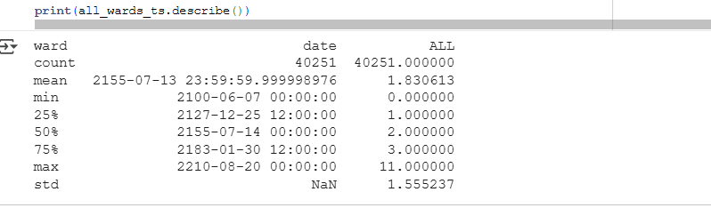
SLA Assignment
Step 4: Aggregate Daily Ward Occupancy Across All Wards
In this step, I aggregate transfer data to calculate daily ward occupancy using an event-based approach:
Converts INTIME and OUTTIME to datetime objects.
Drops rows with missing critical occupancy information.
Calculates the duration of stay.
Creates 'arrival' (+1 occupancy) and 'departure' (-1 occupancy) events.
Combines and sorts all events chronologically.
Calculates the cumulative sum of occupancy changes for each ward.
Resamples the data to a daily frequency, taking the last observation of the day and forward-filling missing days.
Renames the final DataFrame to ward_ts.
This process transforms raw transfer data into a daily time series of ward occupancy.
Finally describing the all_wards data frame.
Note: Why I aggregate all wards together ?
This project is to Forecast daily ward occupancy Load. Hence, I am aggregating all the wards data together.

Slide 9
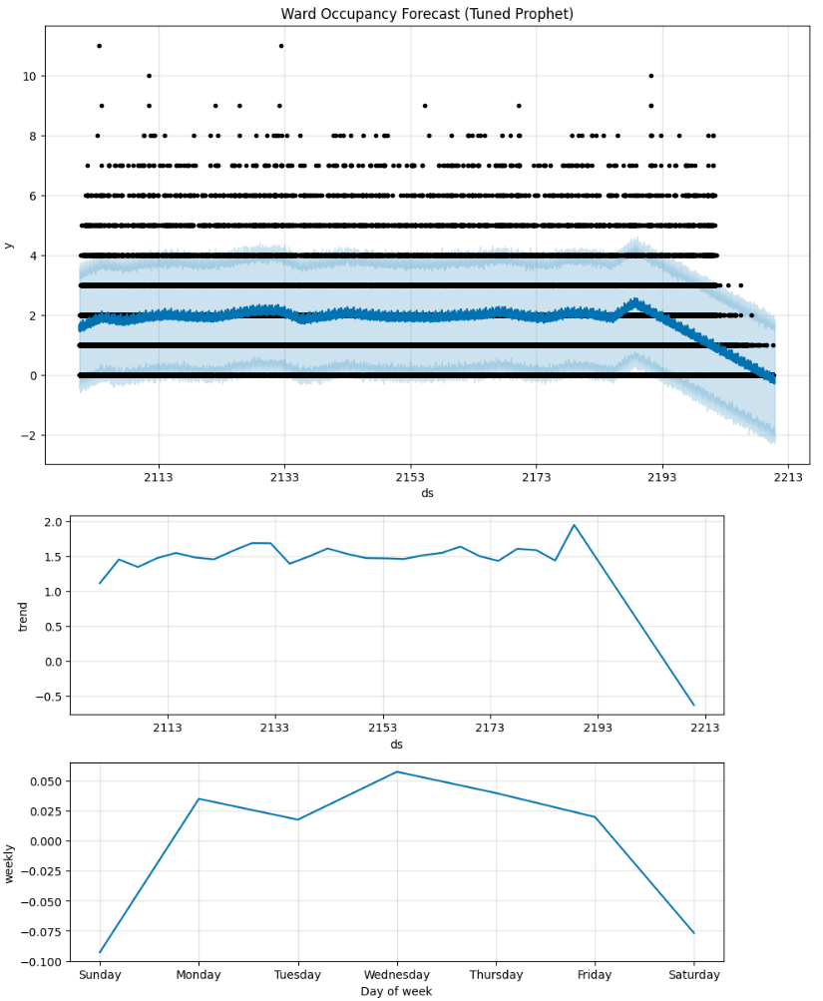
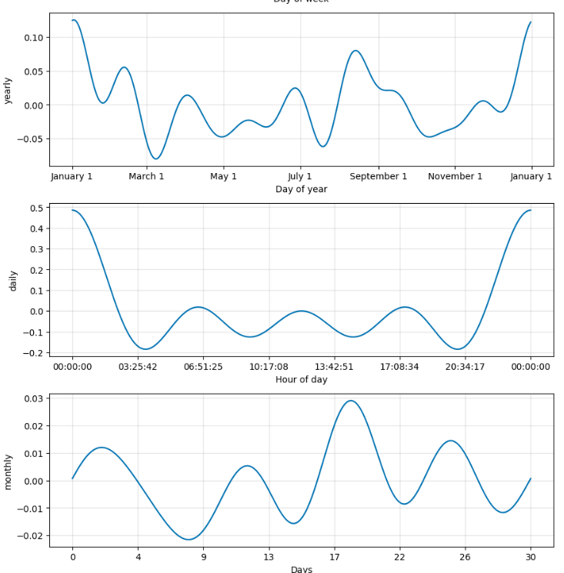
SLA Assignment
Step 5: Time Series Forecasting with Prophet
Based on the nature of ward occupancy data and how Prophet models time series, here's a description of the expected patterns in the two lines (historical/actual and forecasted/predicted) in each diagram:
Ward Occupancy Forecast Plot (Historical Data vs. Forecast):
Black dots: Historical all ward occupancy data points.
Blue line: Prophet’s predicted trend for all ward occupancy
Light blue shaded area: Uncertainty interval for the forecast.
The forecast extends beyond the historical data, showing a relatively stable trend with slight fluctuations.
No strong upward or downward trend detected; occupancy remains mostly low.
Prophet Model Components Plots: These plots show how different time-based factors contribute to the overall forecast. Each plot will typically show a single line representing the estimated impact of that component over time:
Trend Component: Shows a mild increase followed by a slight decline toward the end of the forecast horizon. Indicates overall all ward occupancy is fairly stable over time.
Yearly Seasonality: This line illustrates the typical pattern that repeats every year. Peaks around July and dips around January, indicating possible seasonal hospital load (summer higher, winter lower).
Weekly Seasonality: This line shows the typical pattern that repeats every week. For ward occupancy, you might see consistent peaks and troughs corresponding to specific days of the week. Occupancy tends to be higher on Monday and Tuesday, then gradually decreases toward Saturday.Suggests weekday patterns in MICU admissions.
Additional Seasonal Components: Monthly and daily cycles show oscillations, but no extreme variations. Confirms that all ward occupancy has some periodic behavior but remains generally low
Summary:
all ward occupancy is low and stable, with occasional spikes.
Prophet detected weekly and yearly seasonality, which can help in resource planning (e.g., staffing more on Mondays and in summer months).
Forecast uncertainty grows over time, which is expected for time-series models.

Slide 10
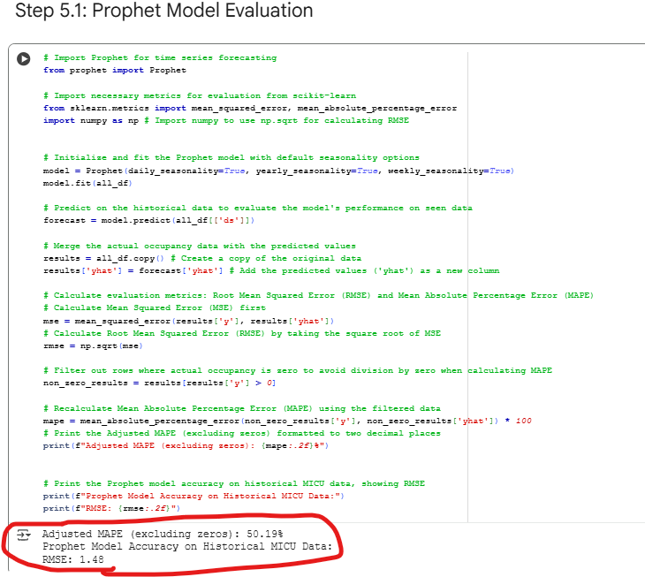
SLA Assignment
Step 5.1: Prophet Model Evaluation Summary
A Prophet model was trained on historical MICU occupancy data with daily, weekly, and yearly seasonality enabled. Predictions were made on the historical dataset to evaluate performance. Accuracy metrics were calculated:
RMSE (Root Mean Squared Error): Measures the absolute error.
RMSE: 1.48 - On average, Prophet’s predictions differ from actual MICU occupancy by about 1.5 patients.
MAPE (Mean Absolute Percentage Error): Adjusted to exclude zero occupancy days to avoid division by zero.
Adjusted MAPE (excluding zeros): 50.19% - Indicates percentage error is high because occupancy values are small (0–10), so even small absolute errors cause large percentage differences. What i feel is the data in transfers table needs more accurate data.

Slide 11
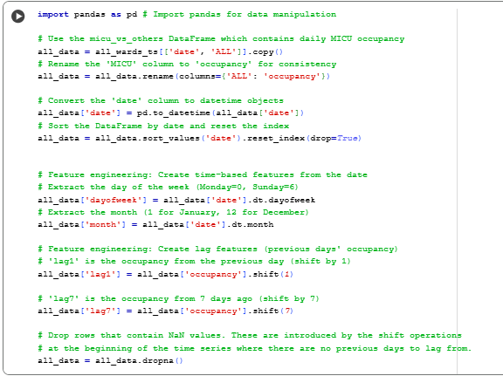
SLA Assignment
Step 6: Feature Engineering for Machine Learning Models
In this Step, Prepare the data for machine learning models (Random Forest Model) by creating time-based and lag features:
Selects 'date' and 'ALL' (renamed to 'occupancy') from all_wards_ts.
Converts 'date' to datetime and sorts the data.
Creates dayofweek and month features from the date.
Creates lag1 (previous day's occupancy) and lag7 (occupancy from 7 days ago) features using the .shift() method.
Removes rows with NaN values introduced by the lag features at the beginning of the time series.
These features provide temporal information and historical context for the models.

Slide 12
SLA Assignment
Step 7: Random Forest Model
Random Forest Model Code Explanation
In this step, we trains and evaluates a Random Forest Regressor model for ward occupancy forecasting:
Define Features and Target:
X: Contains the input features ('dayofweek', 'month', 'lag1', 'lag7').
y: Contains the target variable ('occupancy').
Split Data:
Divides the data into training (80%) and testing (20%) sets using train_test_split.
Initialize and Train Model:
Creates a RandomForestRegressor instance with 200 estimators.
Trains the model using the training data (X_train, y_train).
Predict and Evaluate:
Makes predictions on the test set (X_test).
Calculates the Root Mean Squared Error (RMSE) between the actual (y_test) and predicted (y_pred) values to assess model performance.

Slide 13
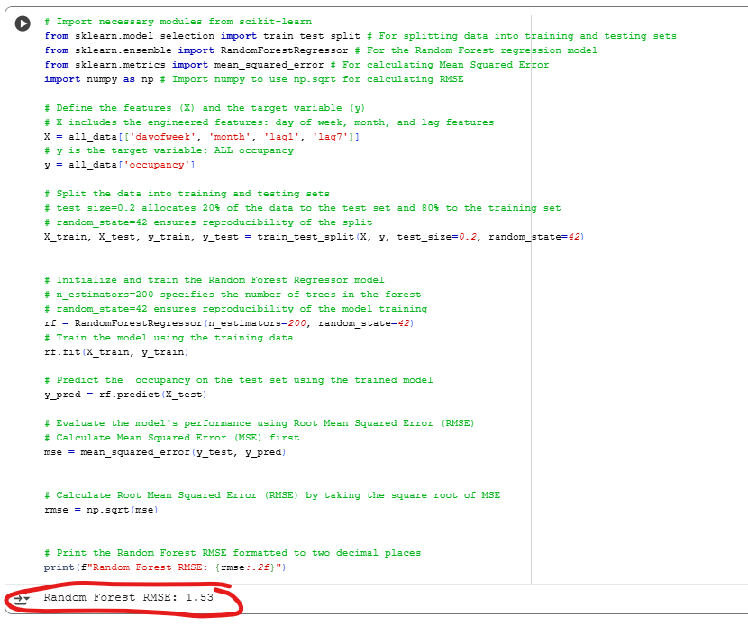
SLA Assignment
Step 7.1: Random Forest Model Training & Evaluation
The output Random Forest RMSE: 1.53 indicates the Root Mean Squared Error for the Random Forest model's predictions on the test set.
RMSE (Root Mean Squared Error): This is a common metric for evaluating regression models. It measures the average magnitude of the errors between the predicted values and the actual values.
Interpretation:
An RMSE of 1.53 means that, on average, the Random Forest model's predictions for daily ward occupancy differ from the actual occupancy by approximately 1.53 patients.
A lower RMSE indicates better model performance. You can compare this value to the RMSE obtained from other models (like Prophet and XGBoost) to determine which model provides a more accurate forecast for this specific problem.

Slide 14
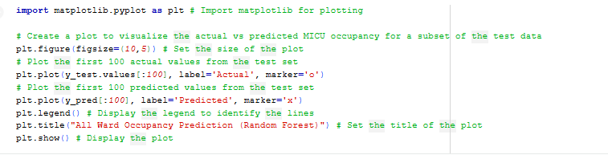
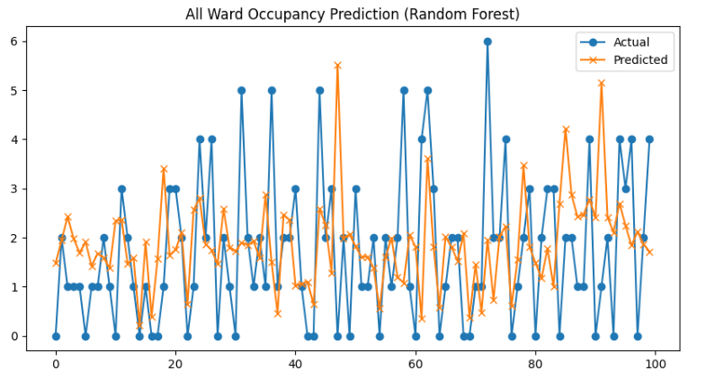
SLA Assignment
Step 7.2: Random Forest Model Output
The code generates a line plot to visualize the performance of the Random Forest model on a subset of the test data:
It plots the actual ward occupancy values (y_test) against the predicted values (y_pred) for the first 100 data points in the test set.
Markers ('o' for Actual, 'x' for Predicted) are used to distinguish the two lines.
A legend is included to identify the lines, and the plot is titled "MICU Occupancy Prediction (Random Forest)".
Interpretation:
The chart compares actual MICU occupancy (blue line with circles) vs predicted occupancy (orange line with crosses) for 100 test samples using Random Forest.
Actual values fluctuate sharply between 0 and 6 patients, showing high variability and frequent spikes.
Predicted values are smoother and generally stay between 0 and 5 patients, capturing some trends but missing extreme peaks.

Slide 15
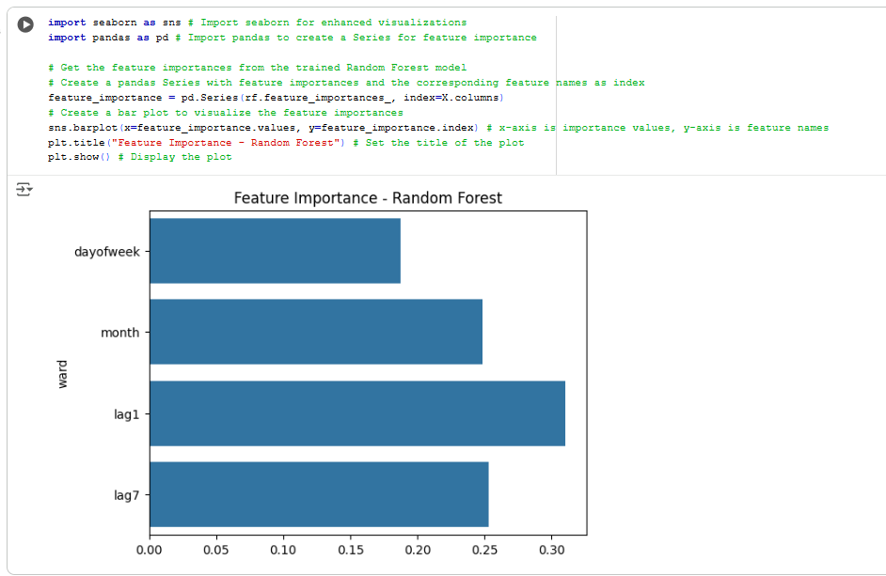
SLA Assignment
Step 7.3: Random Forest Model –Feature Importance
Tbar chart displays feature importance from the trained Random Forest model for MICU occupancy prediction.
Features analyzed:
lag1 (previous day occupancy)
lag7 (previous week occupancy)
month
Dayofweek
Interpretation of Feature Importance:
lag1 is the most important feature (~0.30), meaning yesterday’s occupancy strongly influences today’s occupancy.
lag7 is the second most important (~0.25), indicating weekly patterns matter.
month and dayofweek have similar importance (~0.20 each), showing seasonal and weekly trends also contribute but less than lag features.

Slide 16
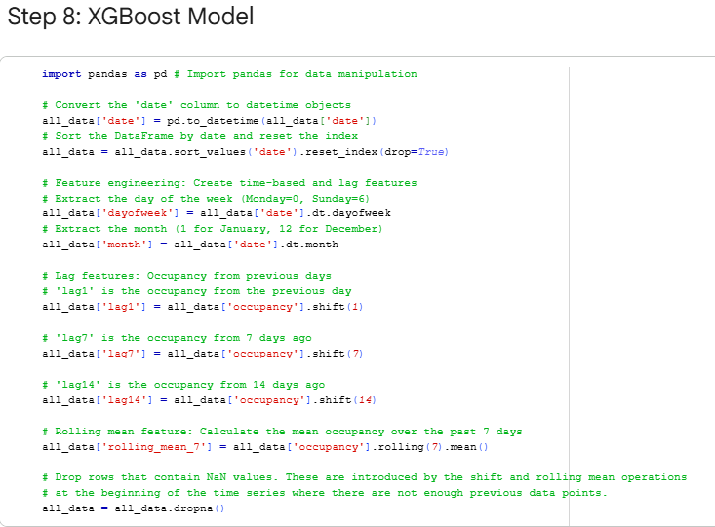
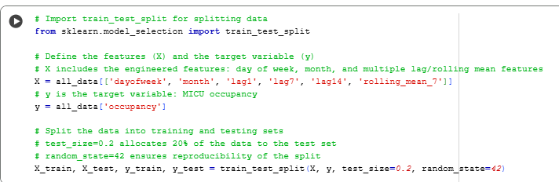
SLA Assignment
Step 8: Feature Engineering for XGBoost Model
In this step , I prepare the data for the XGBoost model by creating additional time-based and lag features:
Starts with the 'date' and 'occupancy' data.
Converts 'date' to datetime and sorts the data.
Creates dayofweek and month features.
Creates lag features: lag1, lag7, and lag14 (occupancy from the previous day, 7 days ago, and 14 days ago).
Creates a rolling_mean_7 feature, which is the average occupancy over the past 7 days.
Removes rows with NaN values introduced by the lag and rolling mean calculations.
These additional features provide more historical context and smoothed information for the XGBoost model.
Data Preparation
Define Features and Target:
X: Contains the input features, including the time-based features (dayofweek, month) and the engineered lag and rolling mean features (lag1, lag7, lag14, rolling_mean_7)
y: Contains the target variable, which is the daily 'occupancy'.
Split Data:
Uses train_test_split to divide the data into training (80%) and testing (20%) sets.
test_size=0.2 specifies that 20% of the data will be used for testing.
random_state=42 ensures that the split is reproducible.
This step is crucial for evaluating the model's performance on unseen data

Slide 17
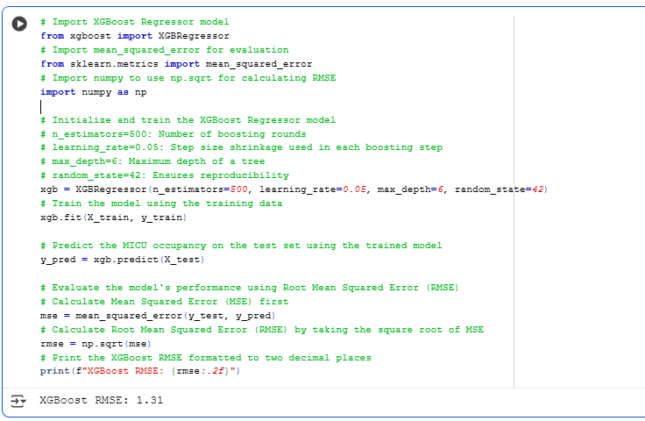
SLA Assignment
Step 8.1 XGBoost RMSE
In this step, we train an XGBoost Regressor model to predict ward occupancy.
Import Libraries:
Imports XGBRegressor, mean_squared_error, and numpy.
Initialize Model:
Sets up the XGBRegressor with hyperparameters like n_estimators, learning_rate, and max_depth.
Train Model:
Fits the model to the training data (X_train, y_train).
Predict:
Makes predictions on the test data (X_test).
Evaluate:
Calculates the Root Mean Squared Error (RMSE) between actual and predicted values.
Output:
The output XGBoost RMSE: 1.31 indicates that, on average, the model's predictions differ from actual occupancy by about 1.31 patients. A lower RMSE means better performance.

Slide 18
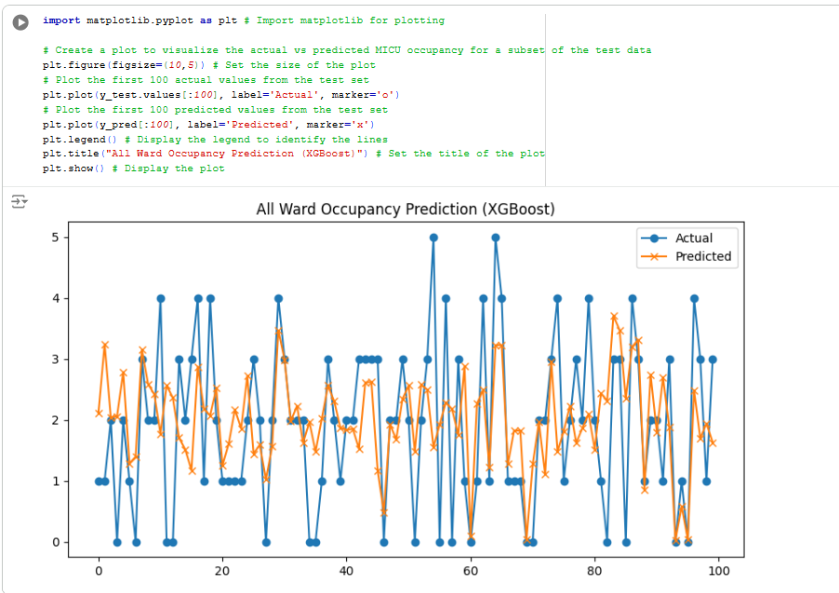
SLA Assignment
Step 8.2 XGBoost Prediction
In this step, we compare the actual all wards occupancy (blue line with circles) vs predicted occupancy (orange line with crosses) for 100 test samples using XGBoost.
Outcome:
Actual values fluctuate sharply between 0 and 5 patients, showing high variability and frequent spikes. Predicted values follow the general pattern more closely than Random Forest, capturing some peaks and dips, but still smoothing out extreme spikes.
Observations:
XGBoost performs better than Random Forest:
Predictions align more closely with actual values.
Captures short-term trends and some spikes better than Random Forest.
However, XGBoost still underestimates the highest peaks and overestimates some low points.
XGBoost is a strong candidate for wards occupancy prediction when using lag features and time-based features.
Further improvements could include such as Adding more lag features (lag14, lag30).

Slide 19
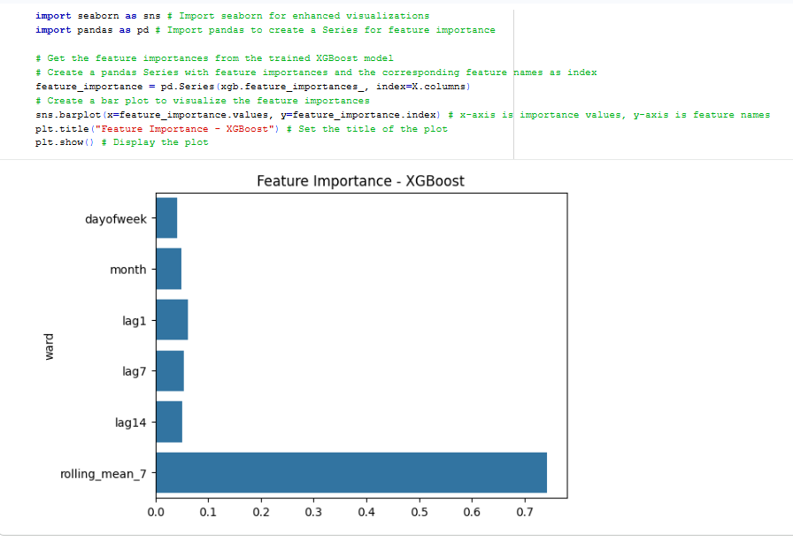
SLA Assignment
Step 8.3 XGBoost Feature Importance Analysis
The bar chart displays the importance of features used by the XGBoost model to predict MICU occupancy.
Key Findings:
rolling_mean_7 (7-day average occupancy) is the most important feature, indicating that recent average occupancy is the strongest predictor.
Lag features (lag1, lag7, lag14) and time-based features (dayofweek, month) have much lower importance.
Interpretation:
XGBoost heavily relies on the 7-day rolling mean, suggesting that short-term trends are more influential than specific past days or calendar patterns for predicting MICU occupancy.
Implication for Improvement:
Focus on incorporating more rolling statistics and potentially external factors for better accuracy.

Slide 20
thank you

