Slide 1
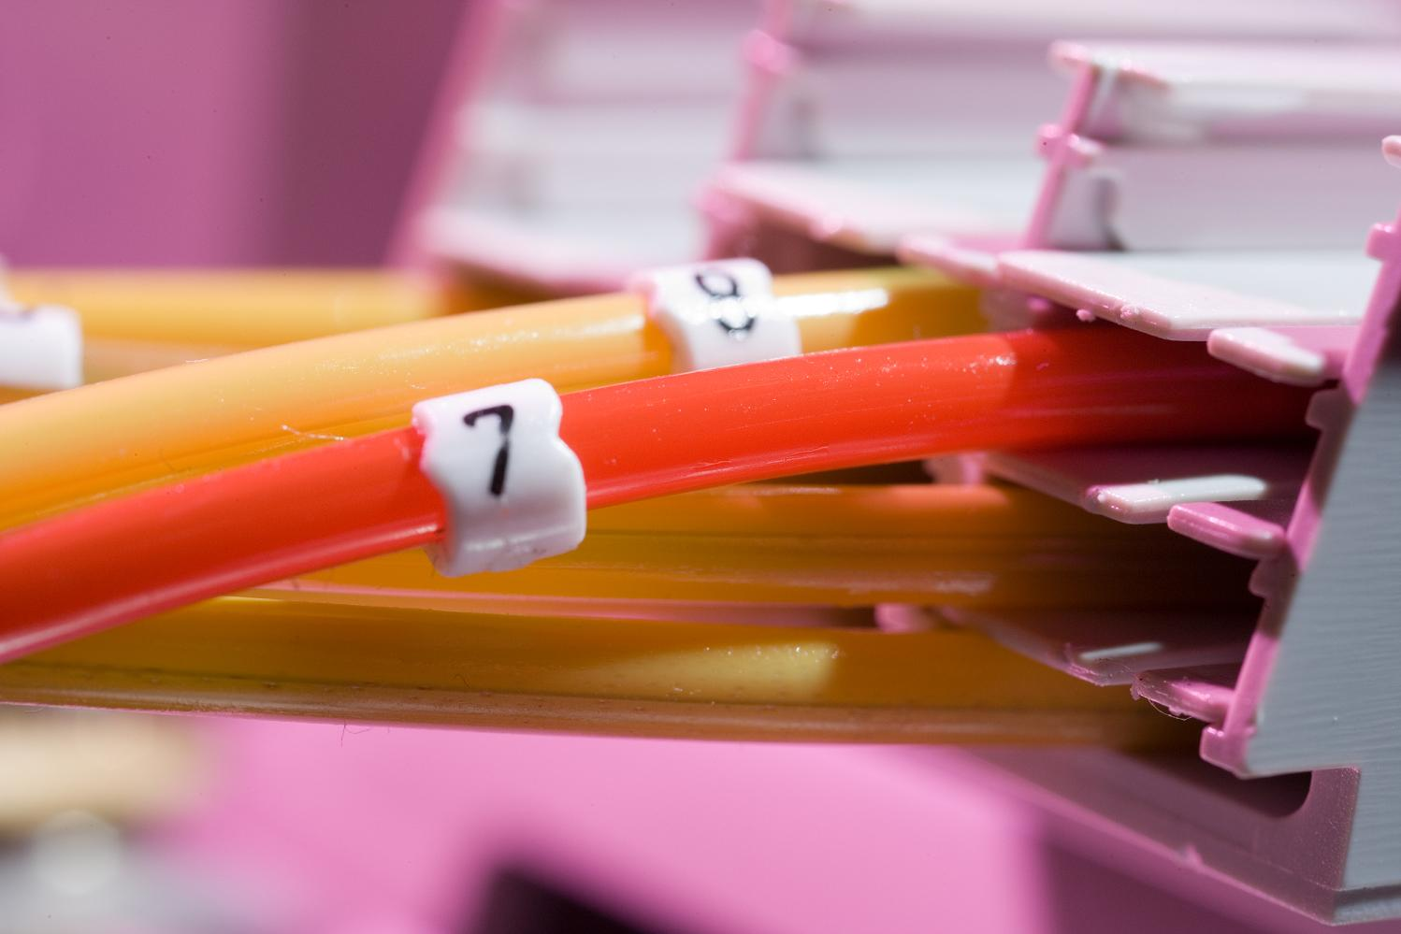
Energy Trade-offs among Content Delivery
Architectures.
Anja Feldmann, Andreas Gladisch, Mario Kind, Christoph Lange, Georgios Smaragdakis, Fritz-Joachim Westphal, Deutsche Telekom AG, Laboratories.

Slide 2

The big picture.
Source: Bill St. Arnaud - Technology and SME business opportunities in the green space through communications enabled applications (CEA)

Slide 3
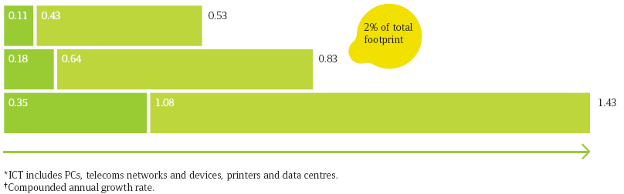



Components of sustainability are part of company strategies.
SMART2020 Report: Carbon footprint of ICT will double until 2020
Operators are adopting corporate responsibility principles
Luis Neves, Head of the Corporate Responsibility unit at Deutsche Telekom:
„We must meet the numerous demands made of CR in all respects,
with sustainable products, energy efficiency…”
“…we have set ourselves the goal of reducing our CO2 emissions by 20 percent by the year 2020.”
Source: Smart2020 Report; Deutsche Telekom AG Corporate Responsibility Report 2009

Slide 4
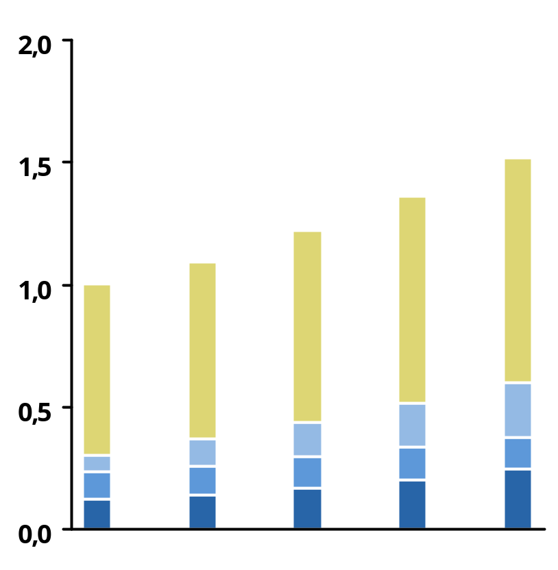
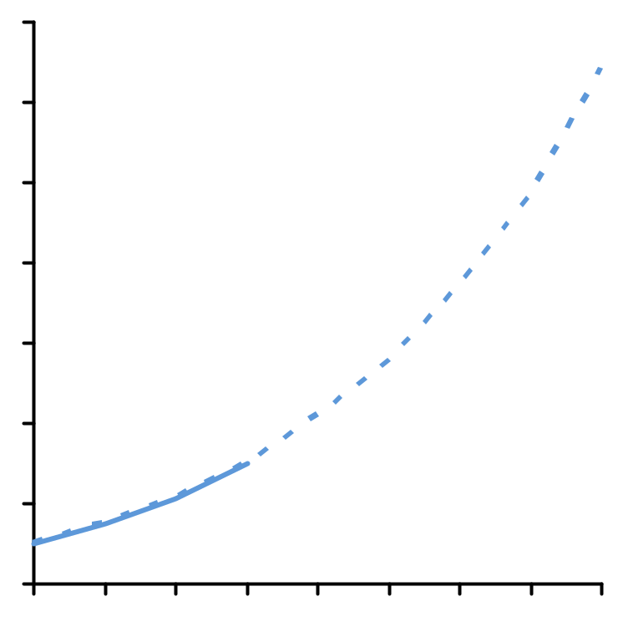
Energy consumption of broadband networks.
Traffic volume and energy consumption.
7
Growth of traffic volume…
…and growth of energy consumption
1.400%
home networks
data centre & applications
1.200%
mobile access & switching
fixed networks
1.000%
800%
600%
400%
200%
0%
2009
2010
2011
2012
2013
2014
2015
2016
2017
2009
2011
2013
2015
2017
Based on: Cisco Visual Networking Index – Forecast and Methodology, 2007–2012. 2008
Based on: C. Lange, A. Gladisch - Energy Efficiency Aspects in Telecommunication Networks, OFC/NFOEC 2009.

Slide 5
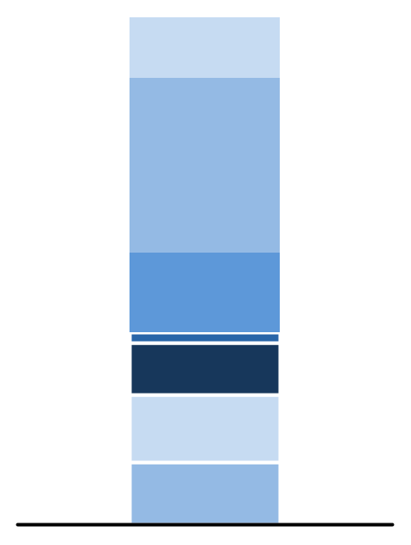
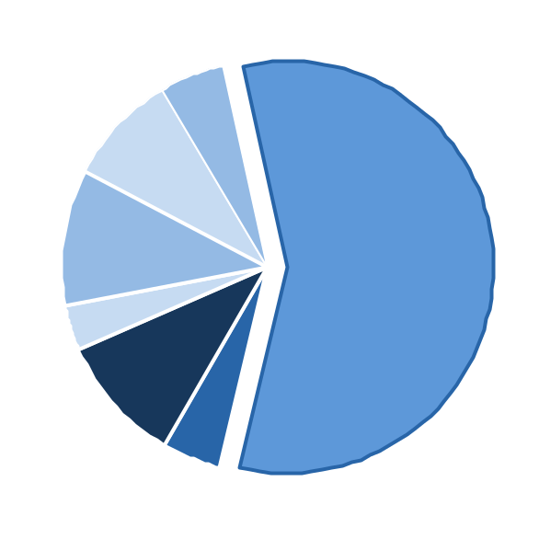
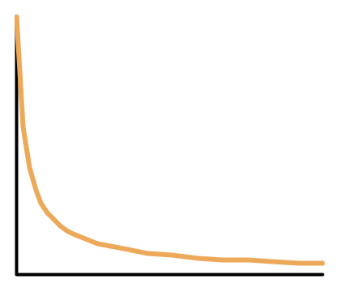
HTTP based content is the dominating traffic contribution in broadband networks.
Traffic characteristics of residential broadband networks
Request for delivery of content
  50% of HTTP traffic equal to 30% of overall traffic
  P2P + UseNet equal to 20%
Distribution of popularity or access frequency shows a Zipf distribution (ά = 0.8)
11,5 %
Image
eDonkey
BitTorrent
5,0
8,5
32,8 %
Video
unclassified
10,6
57,6
14,7 %
RAR file
well-known
3,6
2,2 %
audio
10,0
9,6 %
text
other DPD
4,8
12,7 %
unidentified
Downloads per time
NNTP
11,7 %
other
HTTP
G. Maier, A. Feldmann, V. Paxson, and M. Allman, “On dominant characteristics of residential broadband internet traffic,” in Proc. ACM Internet Measurement Conference, 2009.
Files sorted by Popularity

Slide 6
Principle options for optimisation of content distribution architecture: trade off between transport and storage.
Central storage of content, for resilience reasons at least one backup data centre
Optimal delivery
Low demand for storage
High demand transport
① Centralised Data Centre
Exact duplication of content to a number of data centres
High demand for storage
Medium demand for transport
② Distributed Data Centre
③ CDN
Managed distribution of content, mixture of two data centre types
Medium demand for storage
Medium demand for transport
④ P2P
Different variants exists
  Unmanaged
  Structured managed
  Unstructured managed
No demand for storage at operator
High demand for transport
Each variant has some advantages for content delivery.
Operators have to decide on their situation and strategy for the appropriate model.
Customer
Transport node
Storage

Slide 7
The principle content distribution architectures differ in few parameters only.
Access
Network
Core Net-
work Hops
Number of
Data Centre
Set-Top Box
DSLAM
Downstream
Storage
Downstream
1 x
12
1 + 1
① Centralised Data Centre
Downstream
Storage
Downstream
1 x
3
10
② Distributed Data Centre
Downstream
Storage
Downstream
1 x
12 / 3
1 + 1
Up to 12
③ CDN
Downstream
Upstream
Multistorage
Downstream
Upstream
2 x
3
④ P2P

Slide 8
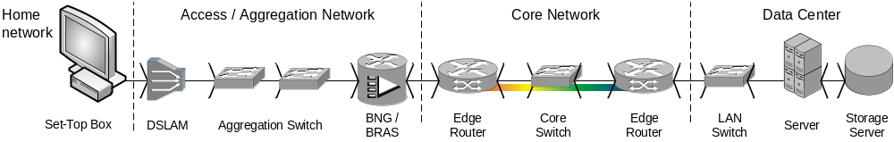
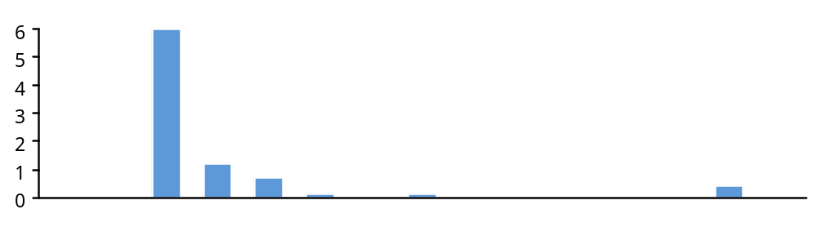
Energy consumption per bit: DSL and centralised data centre server are major contributors in content delivery chain.
0
ECb in цWs
ECb = Energy Consumption per bit
Storage
Up
Down
Up
Down
Aggr. Switch
BRAS
Edge Router
Core Router
OTN / WDM
Edge router
LAN Switch
Server
Storage
Set-Top Box
DSLAM
Notice: DSL is shown for 25/5 Mbit/s Down-/Upstream

Slide 9
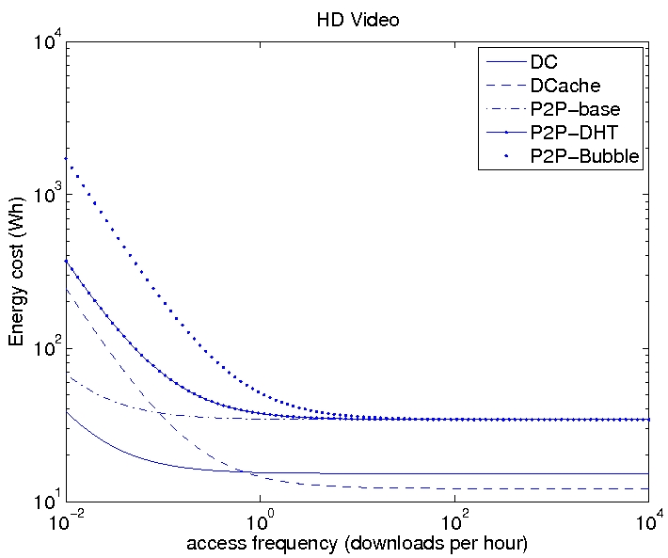
Single file download energy consumption:
Centralised or Distributed Data Centre are best for any access frequency.
④ P2P requires two times the energy (logarithmic scale!)
Depending on access frequency
  ① Centralised Data Centre is optimal for less than one download per hour
  ② Distributed Data Centre is optimal for more than one download per hour
  ③ CDN: “best of both worlds” ①
  and ②
Conclusions
④ P2P
① Centralised DC
③ CDN
② Distributed DC

Slide 10
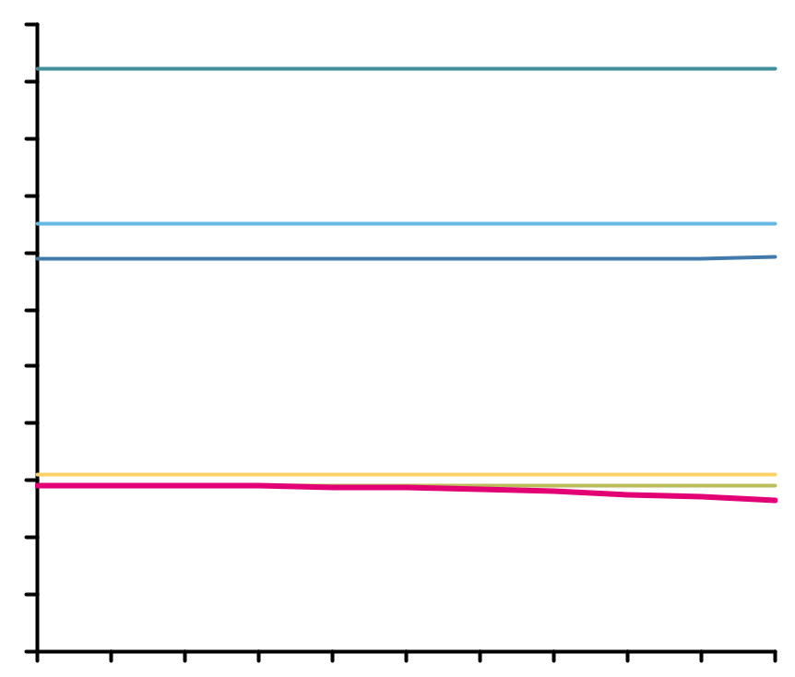
Total energy consumption:
Data centre options and CDN are very similar and more efficient as P2P.
e
Optimal strategy is mixture of storage and transport
  ③ CDN is the optimal distribution for total energy consumption
  ② Distributed Data Centre (DC) is close to CDN
  ① Centralised Data Centre is little less optimal than Distributed DC
④ P2P is at least more than two times
Increasing number of replicas require more energy
Overall delta depends not on popularity
in GWh
Conclusion
5.500
5.000
④ P2P Bubble
4.500
4.000
④ P2P DHT
3.500
④ P2P
3.000
2.500
2.000
② Distributed DC
1.500
① Centralised DC
1.000
③ CDN
500
Popularity
parameter
0
0
0.2
0.4
0.6
0.8
1

Slide 11
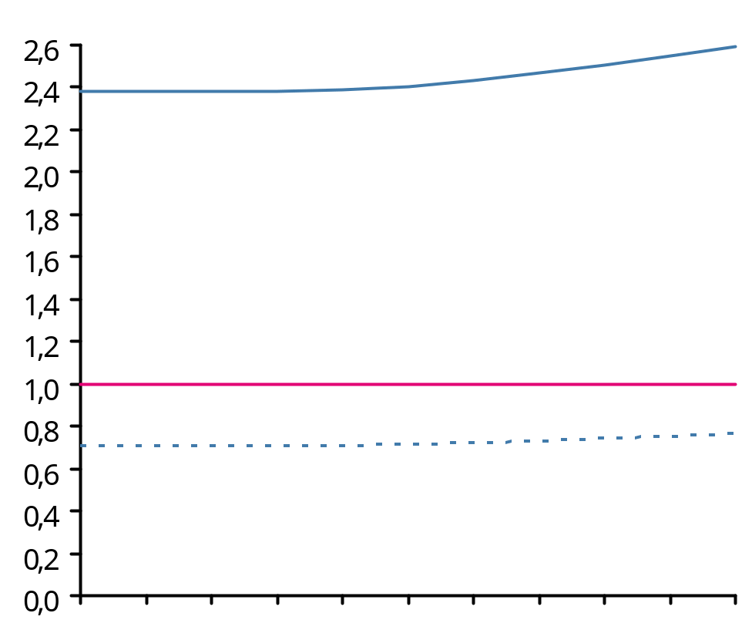
Impact analysis of set-top box energy consumption:
P2P approach is good for operators, but not preferable in terms of sustainability.
B
Normalised total energy consumption
④ P2P
-70%
③ CDN
-28%
④ P2P without STB
Popularity
parameter
0
0.2
0.4
0.6
0.8
1

Slide 12
Operators have different options to optimise energy consumption of content delivery architectures.
Summary of analysis
Popularity of content (access frequency) has a large impact on energy consumption
Difference in total energy consumption for Data Centre solutions and CDN is rather small and depends not on popularity
P2P is only preferable, if energy consumption of set-top boxes is neglected
Analysis is done assuming xDSL access technology, influence of other access technologies is for further study
Conclusion
Strategy to optimize energy consumption for content delivery is influenced by contribution from storage and transport and depends on access frequency
CDN is the optimal case for sustainable operators

Slide 13
Thank you for your attention. Questions?

