Slide 1

The Effect of Router Buffer Size on HighSpeed TCP Performance
Dhiman Barman
Joint work with Georgios Smaragdakis and Ibrahim Matta
Notes:
Today I am going to talk on this interesting topic, how Gigabit router (linecard speed and buffering)
affects HighSpeed TCP. How much utilization of such router can be achieved by HighSpeed TCP flows for different
speeds and buffer sizes. . This is a joint work with George Smaragdakis and our advisor Prof. Ibrahim Matta.

Slide 2
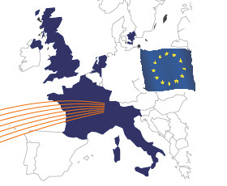

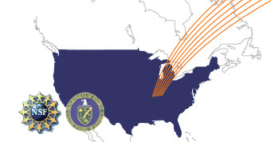


Applications
Transferring scientific data from Geneva to Chicago (dataTAG)
GRID Super Computing and Future Internet
Human Genome Project and Future Analysis Project
Notes:
One of the key drivers of High Speed Networking is the High Energy and Nuclear Physics community. Collaboration on a global
scale would not have been possible without outstanding network performance. Rapid data transfer at speeds of 1 to 10 Gbps and 100 Gbps in future, is a key enabler of the global collaboration. For example, physicists wanted to transfer huge amount of data from Geneva to Chicago. Continued advances in computing, communication, and storage technologies, combined with the development of national and global Grid systems and Projects like Human Genome Analysis Project, give us promising hope of providing the required capacities and an effective environment for science and computing. The main challenge we face is that the current congestion control algorithm does not scale to this regime. In other words, regular protocols cannot fully utilize the available bandwidth in short time.

Slide 3
TCP in High Speed Networks
Regular TCP is too slow in High Speed Networks
Throughput (Mbps) | RTT between Losses | Window size | Losses
1 | 5.5 | 8.3 | 0.02
10 | 55.5 | 83.3 | 0.002
100 | 555.5 | 833.3 | 0.0002
1000 | 5555.5=9 mins | 8333.3 | 0.00002
10000 | 55555.5=1.5h | 83333.3 | 0.000002
Packet size = 1500 bytes, RTT = 0.1s
A High Speed Protocol has to be:
- Scalable - Responsive - Stable - Intra protocol fair
Notes:
Regular TCP is not scalable and too slow to capture the Gigabit link bandwidth. As shown in the Table, under standard configuration, regular TCP will need around 1.5 hours to achieve average throughput of 10Gbps and the required loss rates should be less than 2 in 1 million packets which is almost impossible in present high speed links. If the packet loss rate requirement is not met, the regular TCP window will not attain the average throughput and such highspeed link will remain underutilized. That is the main reason why a new High Speed version of TCP has to be introduced.
Such a High Speed TCP should have four features – it should be scalable and efficient in utilizing the available bandwidth in Gigabit links. The protocol should be responsive and should quickly converge to equilibrium on changes. The stability of the protocol measures the smoothness of the window oscillations. At last but not least, we want High Speed protocols to remain fair among other High Speed flows of the same flavor.

Slide 4
High Speed Protocols
HighSpeed TCP
  First standardized HighSpeed TCP
  AIAD in log-scale
Scalable TCP
  MIMD in linear scale
BIC TCP
  Binary search for available bandwidth
FAST TCP
  Reacts to both packet loss and queueing delay
Notes:
Here we summarize recently proposed High Speed protocols. HighSpeed TCP has been fairly standardized and designed to scale to 10Gbps link. The window dynamics follows additive increase and additive decrease in log-scale. Scalable TCP can be viewed as MIMD Regular TCP. BIC TCP was designed to efficiently search for available bandwidth and grab it efficiently. In the search, the target available bandwidth is estimated and the window is updated fast when it is far away from the target. FAST TCP is the High Speed version of TCP Vegas and it reacts to both queueing delay and packet loss. The window dynamics is very aggressive when the queueing delay is zero.
Our focus is on HighSpeed TCP because we are mainly concerned with the scalability and utilization of the router. Analyzing the effect of router buffer size on the HighSpeed TCP will be the first step to analyze the effect on the others.

Slide 5
Motivation
All High Speed variants of TCP scale over Gigabit linespeed with rule-of-thumb buffer size
  Rule-of-thumb: Buffer Size = RTT * BW
  Ideal static transmission window
  – high utilization and minimal loss
Focus has been given to improve other High Speed TCP features.
Notes:
Until now scalability has been the main focus in the research on High Speed TCP. Presently researchers are interested in achieving better performance with respect to other desirable features of the High Speed TCP like fairness, stability and responsiveness.
On the other hand, a little attention has been given to the interaction between High Speed TCP and the router. Our contribution is to
investigate this interaction and moreover study how scalable a gigabit router can be and how buffer size affects the scalability of the High Speed protocols.

Slide 6
Our Contribution
We investigate:
Interaction between protocol and router buffer size and linespeed
Do we need to increase buffer size linearly with linespeed ?
How Router Buffer affects HighSpeed TCP behavior ?

Slide 7
Why Router Buffer is a concern
10Gb/s linecard
  Rule-of-thumb about 300Mbytes of buffer size
  Read and write 40 byte packet every 32ns
Memory technologies
  SRAM: fast, require more devices, expensive, energy consuming
  DRAM: slow, require less devices, cheap, less energy consuming
Problem gets severe
  At 40Gbps, 100Gbps, …
  In an all-optical router for a backbone network where buffer size is limited to 5-10 packets in delay lines
Notes:
Let us discuss why having a large buffer size is not an elegant router design concept.
Following the rule-to-thumb, the bottleneck router buffer size should be at least equal to the BDP. For example, for
10Gbps and 250ms of buffering, we need around 300Mbytes of memory and at this speed, only 32ns is available to read and write a packet header to memory. We can observe that as linecard speed increases we need larger and larger buffer size to meet the rule
Of thumb. Although the memory technology has been developed dramatically and memory has been become cheaper,
Other technological problems have come into place. There are mainly two types of memory technologies:
SRAM: is fast but more devices are required, it is expensive and consumes a lot of energy
DRAM: is slow, but less devices are needed and it is cheap.
Buffering becomes a more serious problem:
- in higher speeds of 40Gbps,100Gbps,…
- in all-optical networks where buffer is limited to 5-10 packets.

Slide 8
Joint Model of HighSpeed TCP and Router Buffer Size
Aggregated Throughput
Converged Utilization
Load
Loss
Compute Throughput as function of loss rate
Compute Loss rate as function of Throughput
Iterate to compute fixed-point
.
Notes:
After analyzing the behavior of single HighSpeed TCP flow, we extend our analysis for many flows
using Fixed Point Iteration to compute converged utilization from aggregated throughout connecting load and loss.
We used analytical model of both DropTail and RED.
Matta: simply say what models are these (i.e. main assumptions
on arrival and service)? M/M/1/K/FCFS or M[x]/M/1/RED

Slide 9
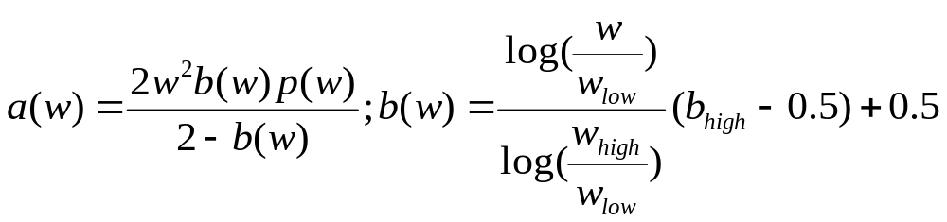
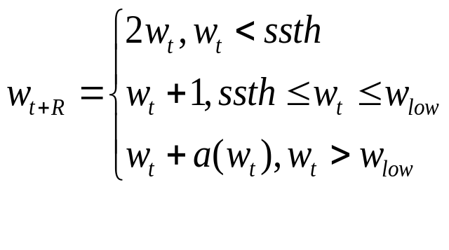
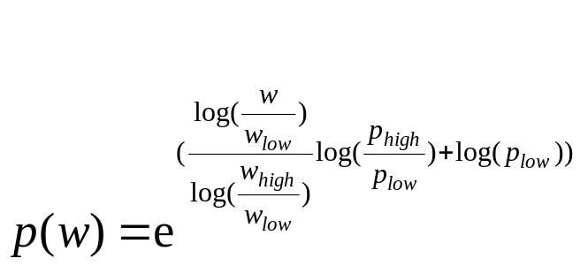
HighSpeed TCP Window Dynamics
W_{high}
W_{p}
HighSpeed TCP
W_{p}(1-b_{p})
W_{low}
Regular TCP
ssth
Notes:
In this figure, we present the window dynamics of a single flow is illustrated. There are regions of operations.
When the congestion window is less than w_low, the HighSpeed TCP behaves like regular TCP (blue region).
When the congestion window is greater than w_low, the HighSpeed TCP increases exponentially (given by factor a) and in case of loss, window is reduced by a factor 1-b. Here, both a and b are functions of current window size.
We derived the closed form expression for single TCP flow throughput as a function of w_low, p_low, p_high and RTT where p_low is the loss rate corresponding to w_low and p_high corresponds to w_high.
Matta: I suggest adding the window update
rules here. Need to *intuitively* explain
what’s interesting in the derived throughput
equation (that will possibly help understand
results later).

Slide 10
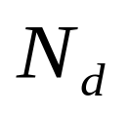


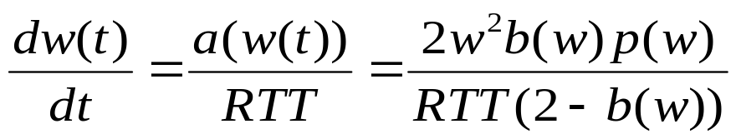
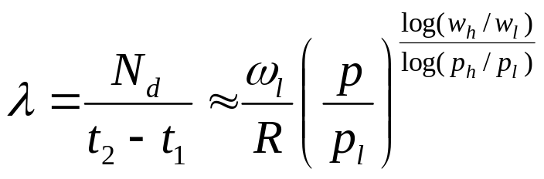
HighSpeed TCP Window Dynamics
W_{high}
W_{p}
HighSpeed TCP
W_{p}(1-b_{p})
W_{low}
ssth
Regular TCP
We derived Analytical Closed Form Expression for Throughput

Slide 11
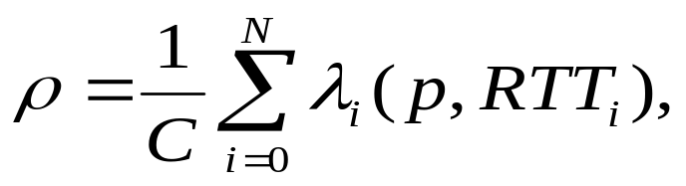
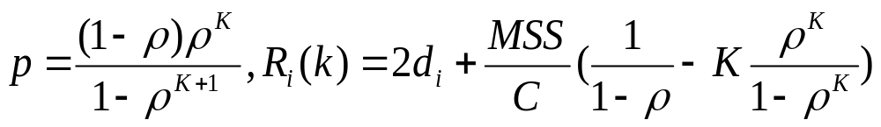
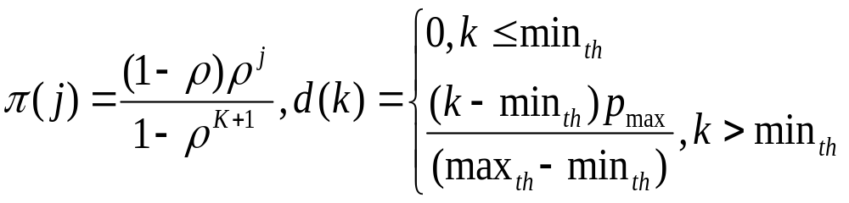
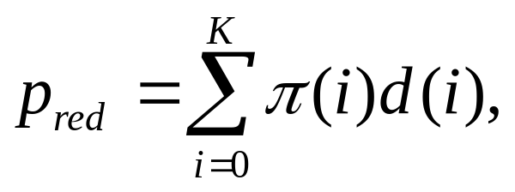
Analytical Loss Rate Derivation
Drop Tail [M/M/1/K/FCFS]
RED [M/M/1/K/RED]

Slide 12
Simulation Setup
Senders
.
.
.
Receivers
.
.
.
Gigabit Bottleneck
In traffic mix, long flows (elephants) dominate
buffer requirements
Buffer size varies as fraction of bandwidth-delay
product
Notes:
Here is the simulation setup. We assume that there is a single bottleneck and the traffic mix consists of only long-lived
flows using HighSpeed TCP. In order to create desynchronize the flows, we randomly start the flows at different times and we also randomly set the RTTs. We first run simulations using the rule-of-thumb (the buffer size is equal to the BDP) and then we reduce the buffer size up to 1% of the BDP.

Slide 13
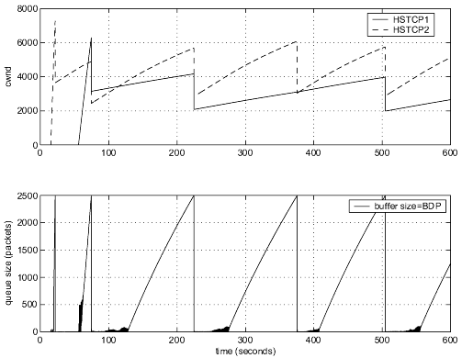
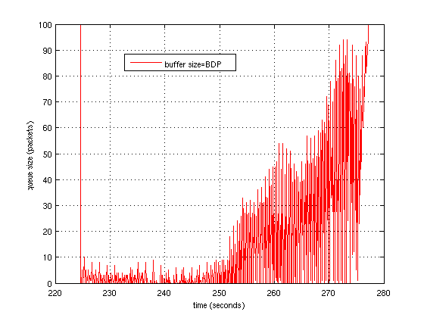
Rule-of-Thumb Buffer Sizing
High utilization is achieved for a single flow or synchronized flows
Notes:
In the first experiment we use the rule-of-thumb. The top figure illustrates the congestion window of two competing flows that are synchronized.
The bottom figure illustrates the queue size behavior. As you can see the queue size behaves like the aggregated window. This model captyres
The behavior of synchronized flows is equivalent to a single flow wind dynamics.
Matta: why does it make sense?
One sees underutilization?

Slide 14
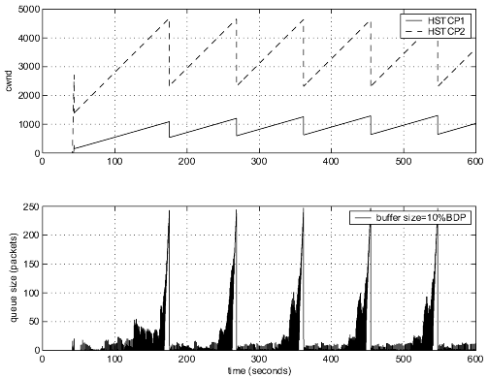
Reduced Buffer Sizing
Unfairness
Worse RTT fairness
Increased synchronization
High Utilization
Notes:
In this slide we reduced the buffer size to 10% of the BDP. The bottleneck router is more utilized, but we still see the effect of synchronization.
The observed unfairness between the two flows is due to synchronization and RTT differences.
Matta: but you don’t show improved “fairness”
for unsynchronized flows later on?

Slide 15
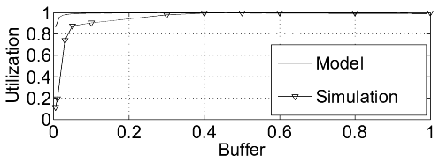
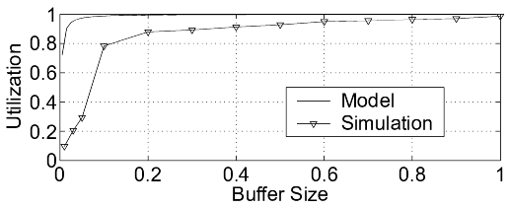
Reduced Buffer Size (DropTail)
1Gbps bottleneck
10 desynchronized flows
2.5 Gbps bottleneck
10 desynchronized flows
High Utilization even with small buffer size is due to aggregation
Notes:
In the slide we plot the utilization of the bottleneck buffer obtained from both our model and simulations.
There is a sharp knee when the buffer size is around 10% of the BDP, for different linespeeds (1Gbps,2.5 Gbps).
The knee corresponds to 90% of the utilization. We see that the analytical results overestimate the utilization,
The reason could be the underline poisson assumption and also the approximations made in the derivation of the
Closed form expressions.
Similar observations have been made in an independent contemporary where the authors explained it through
high aggregation. Under high Aggregation the aggregated window tends to follow the Gaussian distribution and
authors connected the required buffer size with the variance of the Gaussian distribution. Since the variance
Scales by 1/sqrt(l#long lived active connections).
Matta: why model overestimates?
How is your model/finding different from cited paper?
Have you actually measured the queue size distribution here?

Slide 16
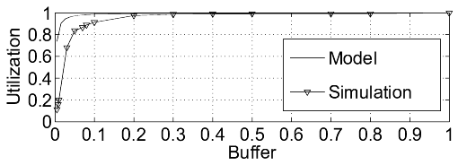
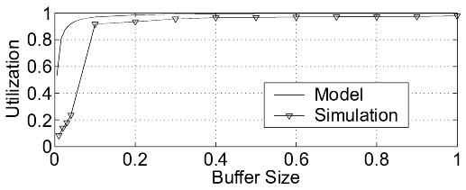
Reduced Buffer Size (RED)
1Gbps bottleneck
10 desynchronized flows
2.5 Gbps bottleneck
10 desynchronized flows
High Utilization is still achieved even with conservative behavior of RED.
Notes:
We change the queue management of our experiments, studying the behavior under RED. Similar conclusions are drawn,
although RED is more conservative.

Slide 17
Summary
Buffer size ≈ 10% of BDP suffices to maintain high Utilization > 90%
Under high aggregation the results are insensitive to
  Queue Management
  Router Linespeed
Small buffer size
  worsens fairness among flows (due to less delay variability)
  leads to synchronization (unlikely due to high aggregation and path diversity)
Notes:
In conclusion, we observed that the high utilization can be achieved at small buffer size contrary to rule of thumb suggests.
The utilization is insensitive to queue management policy and the router Linespeed.
The main problem is synchronization of flows in both small and large buffers. The only overhead
of small buffer size is the introduced unfairness only among synchronized flows,which can also
be caused by RTT differences.
Matta: “High aggregation” means how many flows here?
How do you model “unsychronization”? (do you simply mean
different RTTs?)
What “results” are insensitive? Do you mean utilization and fairness?
You should define your performance measures right after the setup.
You need to better organize the results and make your conclusions
there and NO need for a discussion section!

Slide 18
Future Work
Analytically quantify degree of aggregation for our results to hold
Improve model considering unsynchronized losses
Experiments with other HighSpeed TCP variants
  e.g., FAST TCP which reacts to both packet loss and queueing delay
Model the effect of router buffer size on other High Speed TCP features
  Stability, Responsiveness
Notes:
Our long term research agenda includes the validation of degree of aggregation needed to guarantee the efficacy of our results.
We are also working towards relaxing other assumptions such as synchronized loss model.
We also extending the work considering other version of High Speed protocols like FAST TCP. FAST
TCP is a high speed version of TCP Vegas reacting to packet loss and queueing delay.
We want to evaluate the effect of router buffer size on other protocol features like fairness,
Stability and responsiveness.
Matta: But you already claimed findings on “fairness” and
aggregation effects???

Slide 19
Thank you for your attention

