Slide 1
Mistreatment in Distributed Caching Groups: Causes and Implications
Nikolaos Laoutaris†‡, Georgios Smaragdakis†, Azer Bestavros†, ‡Ioannis Stavrakakis
†Boston University
‡University of Athens
INFOCOM 2006 - Barcelona

Slide 2
This work is about 2 things:
a new application - Distributed Selfish Caching (DSC)
  distributed caching of web/P2P content under selfish nodes
  we want to protect DSC against (1) isolationism (2) mistreatment (abuse) and do that in a non-stationary environment (non-fixed operating parameters)
and a new approach to handling local utility aware nodes – Self-preservation
  Main idea: “we can borrow concepts and connotations from Game Theory (GT), without using the theory itself”
  Main goal:“to design complex systems that include selfish agents without being constrained in a GT framework”
  An “engineering approach” to handling selfishness
Notes:
More fundamentally, this work is about a new methodology

Slide 3
A distributed replication/caching group
origin server
Applications
Content distribution
Shared memory
Network file systems
a collection of
n nodes
Ν objects
v_{j}
group
nodes storage used for
either replication or caching
each node
local client population
generates requests (preference profile over the N objects)
requests serviced by the “closest copy”
fixed amount of storage capacity
permanent
copies
temporary
copies
Notes:
For the purpose of our discussion, we will be using the following model of a distributed group which consists of a set of nodes. Attached to each node is a local client population that issues requests for objects drawn from an object universe according to some popularity profile (which can be different for different nodes).

Slide 4
Node selfishness brings a new perspective
the traditional approach:
  entire group under common control
  find replication/caching strategies to minimize the access cost of the entire group
but a selfish node:
  wants to minimize (or guarantee some level) the access cost of local users only
  better model for applications with:
    multiple/independent authorities
    e.g., P2P, distributed web-caching
Therefore, two new research questions:
  “object replication under selfish nodes?” (done, TPDS’06)
  “object caching under selfish nodes?” (topic of this talk)

Slide 5
Replication strategies – Brief review
At the two extremes:
  Socially Optimal (SO) replication (min access cost – entire group)
  Greedy Local (GL) replication (min access cost – unique isolated node)
Both have problems under selfish nodes:
  SO can lead to mistreatment phenomena
  GL leads to isolationism (uncooperative selection of objects that typically yields poor performance, both local and social)
DEFINITION: A node is being mistreated, if its participations in the group:
leads to a higher (local) access cost
than the minimum one it can guarantee for itself by operating on its own
Notes:
Let’s first review some of our previous results on replication
To reconcile between them, we have proposed the Equilibrium

Slide 6
Mistreatment under SO
an over-active node
1000 reqs/sec
5
6
7
8
10 reqs/sec
SO replicates the most popular objects locally
(smaller id-> greater popularity)
1
2
9
10
3
4
11
12
17
18
13
14
19
20
uses the storage capacity of all other nodes to replicate the next most popular ones
15
16
“We are being mistreated. Let’s abandon the group and follow GL”
(replicate objs 1,2,3,4)
group
these nodes end up replicating objects of low popularity
nodes go GL and the group disintegrates (everybody replicating 1,2,3,4 is ineffective…)
Notes:
Same situation can arise by introducing imbalance in some other dimension of the problem (storage capacities, preference vectors, etc.)

Slide 7
EQ replication: Our (pure Nash) equilibrium strategy for selfish replication (TPDS’06)
some nice properties of EQ replication:
  guarantees a local cost that is lower than GL, for all nodes
  therefore it precludes mistreatment
  also, good social cost in typical situations (e.g., under common preference)
  and finally, low communication requirements for implementation (can use Bloom filters)
all is done for a stationary group
  we assume everything to be fixed:# nodes, storage capacities, communication costs, object preference profiles
BUT…
Notes:
Implicit cooperation

Slide 8
Can we handle dynamic groups?
Classic approach: periodically re-compute EQ
  how often ???
  can we gather the necessary input??? (e.g., estimate the local popularity profiles)
Our new approach: fundamentally different in two ways:
  Application-wise: uses (on-line) caching instead of (off-line) replication to adaptively track group dynamics
  Methodologically:
    We emancipate from GT (we have used pure Nash as the means to get what we want. We DO NOT need to make it the objective)
    Instead, we propose an ad hoc “self-preservation” approach to avoid the aforementioned limitations of the classic approach and protect against uncooperativeness and mistreatment in a dynamic group
Notes:
So an immediate question is…

Slide 9
How can mistreatment occur under caching?
can occur due to state interaction
  cache contents can be affected by the so called “remote hits”
or due to a common caching scheme at all nodes
  nodes can have different characteristics (be non homogeneous)
    different capacities, distances to other nodes, etc.
  and thus a common parameterization of the caching protocol (caching behavior) cannot always perform well for all nodes
  examples coming next

Slide 10
1st case: State interaction
?
user request
miss
redirect
hit
v₁
v₂
if v₂ discriminates between local and remote hits:
  local (caching) state NOT AFFECTED
  requested object sent back to v₁
else, local state is affected, e.g.:
  LRU → bring the requested object to the top of the list
  LFU → increase the frequency count for this object
v₂’s storage can be “hijacked” → access cost increasing for local users

Slide 11
Some facts about state interaction
High request rate imbalance for mistreatment to appear
  not easy to do low rate (high potency) attacks (leech without being detected)
Caching more robust to mistreatment than replication
  mis. occurs “earlier” under replication (i.e., with smaller imbalance)
  stochastic nature of caching
LFU more robust to mistreatment than LRU
  the higher replacement “noise” of LRU makes it more vulnerable
Robustness disappears when operating in L2 caching mode
  proactively fetching objects for remote nodes
Notes:
I don’t have time to go into details on these

Slide 12
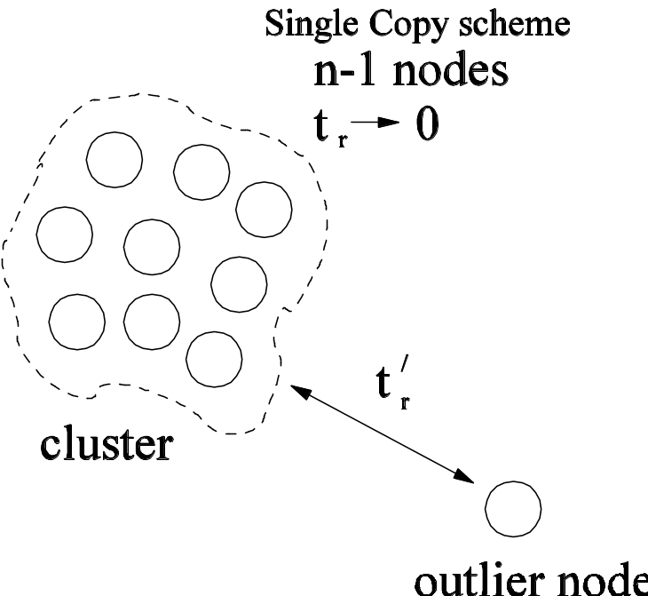
2nd case: Common caching scheme
Key idea: a common parametarization across all (dissimilar) nodes can mistreat some
Example: object admission control scheme in an “outlier” node
clustered nodes: want to avoid multiple copies of the same object
(ideally they would do HASH caching)
outlier: cannot fetch objects efficiently from the cluster (ideally it keeps copies of all incoming objects)
Either one gets mistreated if a common object admission scheme is applied

Slide 13
A general plan for self-preservation
Do not avoid cooperation
  be open to resource sharing (storage here)
  offer to help (send objects back)
Keep an open eye for mistreatment by monitoring your running utility (or cost)
React when necessary (protect your resources)
Requirements:
  be able to detect mistreatment (not trivial in an on-line distributed setting)
  have an anti-mistreatment device on the side
  be able to modulate the device depending on the (non-stationary) environment

Slide 14
Making it specific to DSC and the common scheme problem
Mistreatment detection => Use emulation
  Virtual cache emulating an alternative caching behavior
Anti-mistreatment dev. => Object admission control
  LRU(q): keep local copy with probability q if object exists in other node (q=1 if fetched from the origin server)
Modulating the device => Change q to adjust to current group settings
  e.g., the “outlier”: decreases q when getting closer to the cluster, increases it otherwise
  in this paper: “hard switch” approach between LRU(0) and LRU(1)
  in a forthcoming one: PID controller for a finer control of q
Can design a similar solution for the state interaction problem

Slide 15
Block diagram
holds objects identifiers
virtual cache
emulate LRU(1)
run LRU(0)
request stream
E.g.
switch when
crossing the threshold
cache
holds actual objects

Slide 16
Wrapping it up …
In a DSC setting we can:
  protect nodes from mistreatment
  without resorting to isolationism
  and do that under a dynamic setting
Our self-preservation based solution more flexible than our previous GT based approach:
  is on-line (no need for a priori knowledge or stationarity)
  is strongly distributed (runs only on local information):
    updating the local utility as requests get serviced
    modulation based on local “test for mistreatment” (e.g., emulated virtual cache)

Slide 17
Thank you
Q ?

