Slide 1
Distributed Placement of Service Facilities in Large-Scale Networks
IEEE INFOCOM 2007 – Anchorage
*Nikolaos Laoutaris
nlaout@eecs.harvard.edu
Postdoc Fellow
Harvard University
Joint work with:
Georgios Smaragdakis†, Konstantinos Oikonomou‡, Ioannis Stavrakakis§,
Azer Bestavros†
§U. Athens, ‡Ionian U., †Boston U.
* Sponsored under a Marie Curie Outgoing International Fellowship of the EU at Boston University and the University of Athens

Slide 2
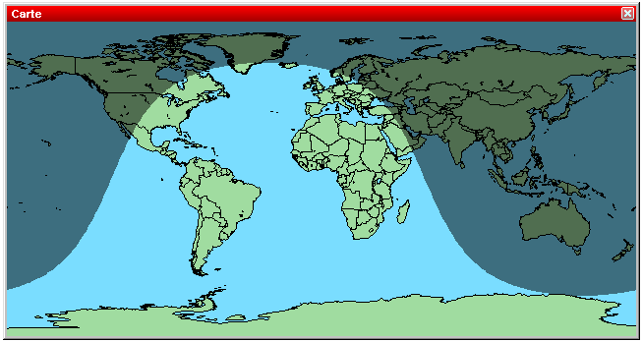

Where to install the service facility?
Distribution of software updates and patches (e.g., Windows Update)
Real time distribution of virus definition files
Fixed deployment
Dynamic deployment
  time-of-day effects
  flash crowds
Being able to adjust the number and the location of service facilities dynamically should be more economic than fixed over-provisioning…

Slide 3

A setting for dynamic service deployment
Generic
Service
Host
Service
Facility
Flash
Crowd
Notes:
-- different granularity from akamai (we don’t migrate with every request)

Slide 4
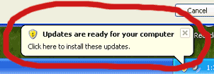
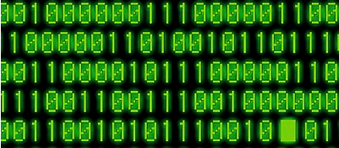

Let’s abstract the problem
We have:
  a network (let’s think AS-level granularity)
  a demand (# downloads from each AS)
We want:
  [the number of service facilities]
  their location
Theory has the solution
  Uncapacitated k-median
  Uncapacitated facility location
a request
a server
(software)
a really nice read

Slide 5
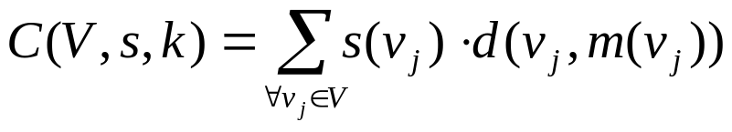
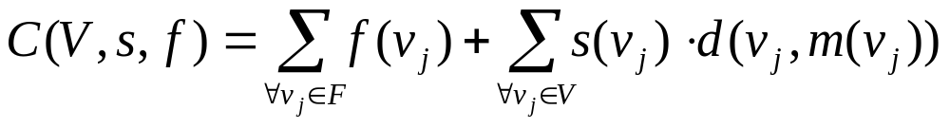
UKM and UFL
Uncapacited K-median (UKM): Given a set of points V with pair-wise distance function d and service demands s(v_{j}), ∀ v_{j} ∈V, select up to k points to act as medians (facilities) so as to minimize the service cost C(V,s,k):
where m(v_{j}) is the median that is closer to v_{j}.
Uncapacited Facility Location (UFL): Given a set of points V with pair-wise distance function d, service demands s(v_{j}), ∀ v_{j} ∈V, and facility costs f(v_{j}), ∀v_{j}∈V, select a subset of points F to act as facilities so as to minimize:

Slide 6
Centralized UKM and UFL:
Not very practical for Internet-scale applications
Limitations:
  need entire topology and demand information in one place
  one BIG computation
  no way for incremental re-optimization
We need distributed versions:
  using limited local topology/demand info
  employing multiple small computations
  keeping changes local
Previous work:
  Moscibroda & Wattenhofer (PODC’05)

Slide 7
Common framework for distributed UKM and UFL
Initialization: select an initial set of nodes to be the facilities
Iterative improvement: select an existing facility and “process” it using local information only
  change its location (in the case of UKM)
  change its location and/or merge it with other facilities or spawn additional copies of it (in the case of UFL)
  continue with the next facility in round-robin manner
Stopping condition: when “processing” yields no improvement for any facility

Slide 8
Processing a facility
“ring” nodes
const # facilities → 1-median in r-ball
var # facilities → UFL in r-ball
but there is a PROBLEM
  nodes outside the r-ball
  … are totally neglected
and a SOLUTION to it
  map ring demand on the “skin” of the r-ball
r-ball
(r=2)
r-ball
(r=1)
Notes:
-- each client shortest path to the facility
-- 2 or more copies in “duplication”
-- don’t want to know the topology of the ring and certainly not want to solve UKM in the ring
-- bad local minima
--loops

Slide 9
Intersecting r-balls merge into r-shapes
when 2 or more r-balls intersect we merge them
if J facilities in the r-shape
  J-median (const facilities)
  UFL (var facilities)
r-shape provides for a way to reduce the # facilities if needed
we put a restriction on the max-size of r-shapes
r-ball
r-shape
r-ball
Notes:
-- need merging otherwise # facilities would be strictly increasing

Slide 10
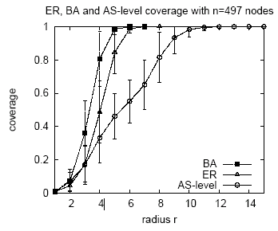
Selecting the radius r
Small radius:
+ limited local information for the r-balls (scalability)
− performance penalty (easier to run into bad local minima)
Since most networks are small-worlds → we keep r small (1≤r≤3)

Slide 11
Case Study: The AS-level Topology
497 peer AS’s in the core of the Internet (Subramanian et al. ’02)
load s(v_{j})= # AS’s with costumer-provider relationship to v_{j}
distance d(v_{i},v_{j})= # intermediate AS’s from v_{i}→v_{j}
centralized vs distributed
  UKM vs dUKM(r)
  UFL vs dUFL(r)
social cost and # iterations

Slide 12
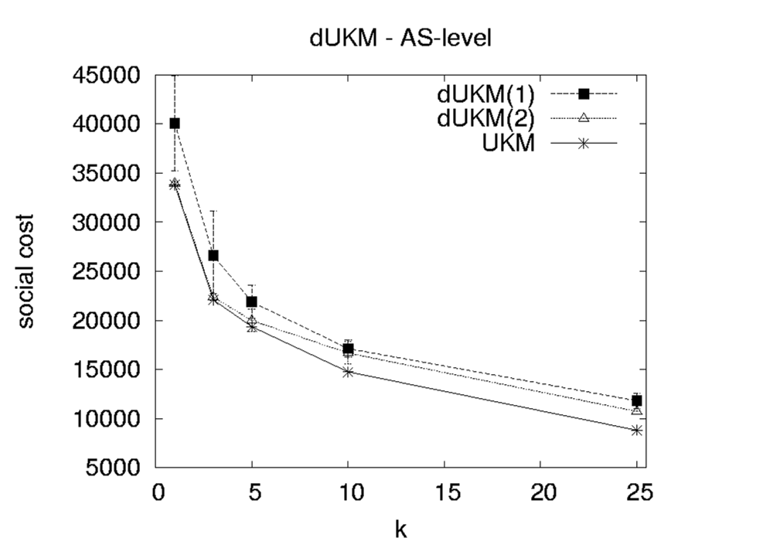
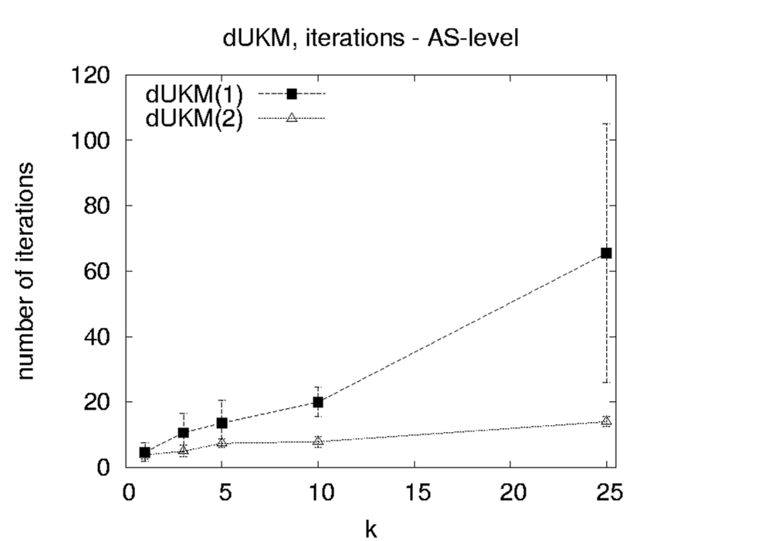
Placing k servers on the AS-level map
1% 3% 5%
#facilities: % of nodes
1% 3% 5%
#facilities: % of nodes

Slide 13

Selecting the right number of servers aka dUFL(r)
Need a model for f(v_{j}), the cost of placing a server at GSH v_{j}
  Uniform: all GSH’s charge the same
  Degree-based: proportional to the degree of v_{j}

Slide 14
Wrap up
Placement of service facility can be casted as a discrete location problem
Existing centralized solutions are not practical
Instead → multiple local re-optimizations
  exact info for a limited neighborhood of radius r
  approximate info for the surrounding “ring”
Good approximation (experimental) even for very small radius

Slide 15
Thank you
Q ?

