Slide 1
Implications of Selfish Neighbor Selection in Overlay Networks
IEEE INFOCOM 2007 – Anchorage, AK
*Nikolaos Laoutaris
nlaout@eecs.harvard.edu
Postdoc Fellow
Harvard University
Joint work with:
Georgios Smaragdakis, Azer Bestavros, John Byers
Boston University
* Sponsored under a Marie Curie Outgoing International Fellowship of the EU at Boston University and the University of Athens

Slide 2
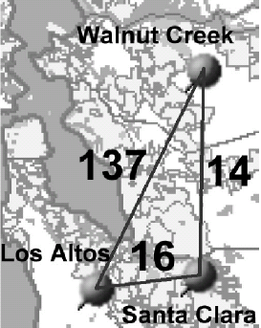


Neighbor Selection in Overlay Networks
O₂
overlay
node
Assumed overlay network model:
no predefined structure
nodes & weighted dirctd overlay links
  weight ~ physical dist.
shortest-path routing @ overlay
overlay
link
O₁
O₃
R₃
Neighbor selection: choose overlay nodes for the establishment of direct links
R₁
R₂
R₄
physical
link
Applications:
overlay routing nets (traffic)
unstructured P2P file sharing (queries)
physical node (e.g., end-systems, router or AS)
Notes:
-- we’re considering an overlay network without pre-defined structure
-- in which routing at the overlay layer is shortest-path
-- and links are directed and carry weights that relate to the underlying distance
-- since there’s no predefined structure, we have to devise neighbor selection policies to be able to fold new nodes in the network and also cope with changes in traffic and node participation

Slide 3
Key elements of our study of neighbor selection
  selfish nodes
    … select neighbors to optimize the connection quality of the local users
  bounded node out-degrees
    overlay routing ➔ overlay link-state O(nk) as opposed to O(n²)
    unstructured P2P ➔ many neighbors would flood the network (even with scoped flooding in place)
  directional links
    don’t want degree-based preferential attachment phenomena
Previous Network Creation Games more appropriate for physical telecom. networks
(Fabrikant et al., Chun et al., Alberts et al., Corbo & Parkes, Moscibroda et al.)
Notes:
-- we’re considering neighbor selection under a new setting
-- BOUNDED DEGREE: (1) LINK-STATE O-ROUTING PROTOCOL; (2) FLOODING

Slide 4
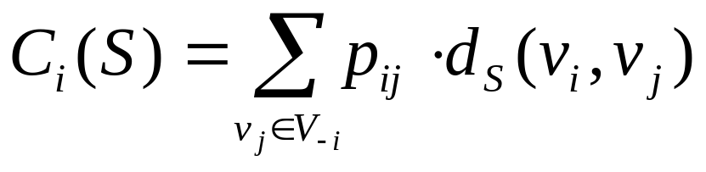
Here comes the selfish node
v_{i}’s preference for v_{j}
v_{i} wants to minimize:
w
over all s_{i}∈S_{i}
v_{i}
u
individual wiring
s_{i}={u,w}
G_{-i}=(V_{-i},S_{-i})
global wiring
S=S_{-i}+{s_{i}}
v_{i}’s residual wiring
v_{i}’s residual network
residual wiring
Notes:
-- imagine that a new node wants to connect to an existing network (we call it residual)
-- Pij IS TRAFFIC MATRIX FOR O-ROUTING OR REPUTATION FOR P2P
-- say again about SHORTEST PATH – SAY THA DELAY →(implicitly) BANDWIDTH

Slide 5
An initial set of questions we pose
What is the best way to connect to a given residual wiring?
How does it compare to empirical connection strategies?
Do pure Nash equilibrium wirings always exist ?
What about their structure and performance?
Notes:
Granted the previous description what the network is and what every node wants to do
-- when a new node joins or network conditions change

Slide 6
The Selfish Neighbor Selection (SNS) game
Players: the set of overlay nodes V={v₁,…,v_{n}}
Strategies: a strategy s_{i}∈S_{i} for node v_{i} amounts to a selection of direct outgoing overlay links (therefore |S_{i}|=(n-1 choose k_{i}))
Outcome: S={s₁,…,s_{n}} is the global wiring composed of the individual wirings s_{i}
Cost functions: C_{i}(S) the communication cost for v_{i} under the global wiring S, i.e.:
symmetric strategy sets
Notes:
-- to answer these questions we model the formation of such networks as a strategic game in normal form

Slide 7
What is a Best-Response wiring?
residual network
It is the optimal neighbor selection for the deciding node undr a given residual graph (utilizes fully the link structure of the residual graph)
  k-Random does not use any link information
  k-Closest uses only local information
Under uniform overlay link weights (hop-count distance):
  best-response wiring ⬄ asymmetric k-median on the reversed distance function of the residual graph G_{-i} :
Consequently:
  Best-response is NP-hard
  Const. factor approx for metric k-median don’t apply here
  O(1)-approx with O(logn) blow-up in # medians (Lin and Vitter,’92)
  Most likely the best we can do (Archer, 2000)
1
2
2
w
w
wrong
3
right
3
1
cheap
4
expensive
d(1,3)=2
u
u
since these
cost the same
d(3,1)=1
w,u can be
obtained from
2-median on
reversed distances
d₁₂<d₁₃<d₁₄
Notes:
-- a best response wiring for a node is JUST the selection of OPT neigh granted the residual graph
-- In this slide I’ll try to build some intuition on what a best response is and what it looks like
-- this is the key differentiating factor with the empiricals
-- BR gets u ur best neighbors by solving an optimization problemd
-- map the preference into the demand in the k-median formulation

Slide 8
Existence of pure Nash equilibria and performance
  uniform game → uniform preference, link budget (k), and link weights (1)
  Theorem: All (n,k)-uniform games have pure Nash equilibria.
  Theorem: There exist non-uniform games with no pure Nash equilibria.
    there exist asymmetric non-uniform games that have no pure Nash (we “implemented” on a graph the cost-structure of the matching-pennies game)
    there exists an equivalent symmetric non-uniform game for each one of them
  Theorem: Strong connectivity in O(n²) turns from any initial state.
  Lemma: In any stable graph for the (n, k)-uniform game, the cost of any node is at most 2 + 1/k + o(1) times the cost of any other node.
  Lemma: The diameter of any stable graph for an (n, k)-uniform game is
  O(sqrt(n log_{k}n)). [don’t know if it is tight]
  Theorem: For any k ≥ 2, no Abelian Cayley graph with degree k and n nodes is stable, for n ≥ c2^{k}, for a suitably large constant c.
Social Cost(ourEQ) < 2 * Social Cost(SO)
Notes:
-- a pure Nash equilibrium wiring is when nodes use BR WIRINGS CONCURRRENTY
-- PERFECT FAIRNESS NOT ATTAINABLE – DISRIBUTED IMPLEMENTATION

Slide 9
Performance under non-uniform overlay links (1/2)
residual network
control parameters:
overlay link weight model
  BRITE, PlanetLab, AS-level maps
link density
wiring policy of pre-existing nodes
  BR (residual=Nash)
  k-Closest (residual=greedy)
  k-Random (residual=random graph)
w
newcomer
u
performance metric:
newcomer’s normalized cost
  cost under empirical wiring X
  cost under BR wiring
What does BR wiring
buy for the newcomer?
Notes:
-- by combining 3 choices for the policy that the existing nodes have followed
-- SAY ABOUT STABLE THRU ILP IN THIS CASE
-- SAY ABOUT CHEATING IN P2P

Slide 10
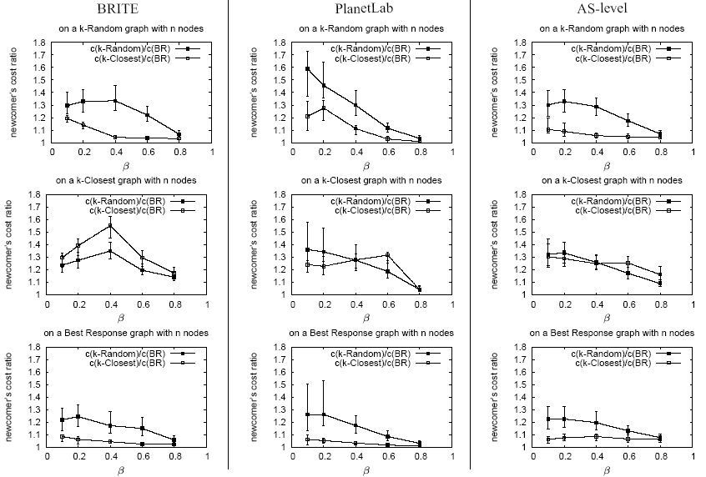
Connecting to a k-Random graph
k-Random/BR
k-Random/BR
k-Random/BR
k-Closest/BR
k-Closest/BR
k-Closest/BR
A “newcomer” connecting to k-Random graph with 50 nodes
k-Random/BR
k-Random/BR
k-Closest/BR
k-Random/BR
k-Closest/BR
k-Closest/BR
A “newcomer” connecting to BR graph with 50 nodes
A “newcomer” connecting to k-Closest graph with 50 nodes
k-Random/BR
k-Random/BR
k-Random/BR
k-Closest/BR
k-Closest/BR
k-Closest/BR
Notes:
In reality the benefits from BR are even bigger

Slide 11
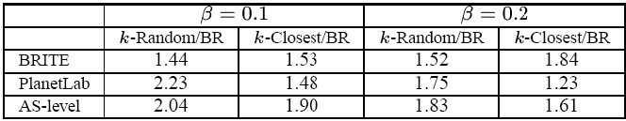
Performance under non-uniform overlay links (2/2)
Benefits for the social cost of the network:
  social cost = sum individual node costs
  SC(random graph)/SC(stable) and SC(closest graph)/SC(stable)
    under different link weight models
    and different link densities
stable graphs can half the social cost compared empirical graphs
nearly as good as socially OPT graphs

Slide 12
But can we use Best-Response in practice?
Candidate applications:
  Overlay routing (RON, QRON, Detour, OverQoS, SON, etc.)
  Unstructured P2P file sharing (KaZaA, Gnutella, etc.)
To give an answer, we have to examine:
  how natural is the mapping from the abstract SNS to the app?
  are the SNS pre-requisites in place?
    information to compute Best-Response: d_{ij} and d_{G-I}
    computational complexity
    shortest path routing on the weighted overlay graph
  true performance benefits (factoring-in node churn, dynamic delays, bandwidth, etc.)
Notes:
-- to answer it, we will examine specific applications
-- and for each one we will have to answer

Slide 13



EGOIST:
Our prototype overlay
routing system for
n7
n8
n3
n2
n1
n10
n4
n5
n9
Connecting a newcomer node v_{i}
bootstrap
listen to overlay link-state protocol to get d_{G-i}
get d_{ij}’s through active (ping) or passive measurmnt (Pyxida,pathChirp)
wire according to (hybrid) Best-Response
monitor and announce your links
n6
n11
50 nodes around the world using the infrastructure of
Notes:
FOR OVERLAY ROUTING OUR ANSWER IS ON THE POSITIVE SIDE
EGOIST for PROOF OF CONCEPT

Slide 14
The next step (ongoing actually)
an interesting application: n × n broadcasting
  n nodes, each broadcasting its own LARGE file
  e.g., scientific computing, distributed database sync, distributed anomaly/intrusion detection
our approach: swarming (BitTorrent like) on top of EGOIST
  EGOIST to construct a common overlay
  swarming to exchange chunks over it
many interesting questions:
  EGOIST-related: which formulation, how often to rewire?
  Swarming-related: multiple torrents fighting for bandwidth
    download / upload scheduling of chunks
    free-riding
  Can we beat n torrents, or n Bullets, or n Split-Streams ?????

Slide 15
Wrap up
neighbor selection with selfish nodes & bounded degrees
optimal neighbor selection vs empiricals
existence & performance of stable (pure Nash) graphs
Best Response ➔ performance benefits!!!
→ realizable in practice (on the next paper)
several applications that can be build on top of such an overlay

Slide 16
Thank you
more info at: http://csr.bu.edu/sns
Q ?

