Slide 1

Swarming on Optimized Graphs for n-way Broadcast
Georgios Smaragdakis
joint work with Nikolaos Laoutaris, Pietro Michiardi,
Azer Bestavros, John Byers, Mema Roussopoulos

Slide 2

P2P File Sharing Systems
Parallel Upload/ Download
- Swarming
Local Scheduling
- Local Rarest First
Peer Selection
- Choke/Unchoke
→Random Graphs
internet
Scalability
transit ISP
transit ISP
$
$$
$$
$$
access ISP
access ISP
access ISP
overlay node

Slide 3
A Closer Study
Flow Networks
- analysis of 1-way broadcast
[Massoulie et al., Infocom’07]
Max-Flow abstracts the behavior of Swarming
internet

Slide 4
Limitations
internet
Performance is tied to the topology
The topology is not optimized for Swarming!
Multiple Files

Slide 5
n-way Broadcast
internet
Synchronization
- Distributed Databases
- Backups
Batch Parallel Processing
- Distributed Anomaly Detection
- Cloud Computing
Performance

Slide 6
Preliminary Solutions
n co-existing swarms
(-) stress of physical links
(-) exchange of multiple chunks in parallel overpartitions
the uplink capacity [Tian et al., ICPP’06]
End-System multicast (mesh) [SplitStream, Bullet]
(-) Creates an overlay for each swarm
(-) No coordination among swarms
(-) Monitor overhead

Slide 7
Our Approach
Creation of Networks for Swarming!
Common Overlay
  - Joint optimization of the entire overlay
  - Amortization of monitor cost and available resources
Bounded degree
Bandwidth-Centric/Data-Agnostic
  - Improvement of the end-to-end performance
- local scheduling
Distributed Formation

Slide 8
Optimized Graphs for Swarming
Swarming is too complicated to be described with an analytic function
Max Flow -> abstracts the behavior of swarming
Creation of Optimized Graphs based on bandwidth from Max Flow
Performance of swarming over optimized graphs with simulation and PlanetLab

Slide 9
Reducing the Average Download Time
Objective: Minimize the average download time
Max-Sum:
Wiring strategy of node v_{i}:
max (sum (MaxFlow(v_{i}, v_{j})), for all v_{j}

Slide 10
Reducing the Download Time
Objective: Minimize the worst download time
Max-Min:
Wiring strategy of node v_{i}:
max (min (MaxFlow(v_{i}, v_{j})), for all v_{j}

Slide 11
Feasibility
Both Max-Sum and Max-Min are NP-hard
Max-Min:
Choose k
b₂
b₁
b₃
v_{j}
v_{i}
b₁ >> b₂ >> b₃
→ Reduction to the SET-COVER

Slide 12
Local Search
b₂
b₁
b₃
v_{j}
v_{i}
b₁ >> b₂ >> b₃
Wiring {s_{i}}, for the residual wiring S_{-i}

Slide 13
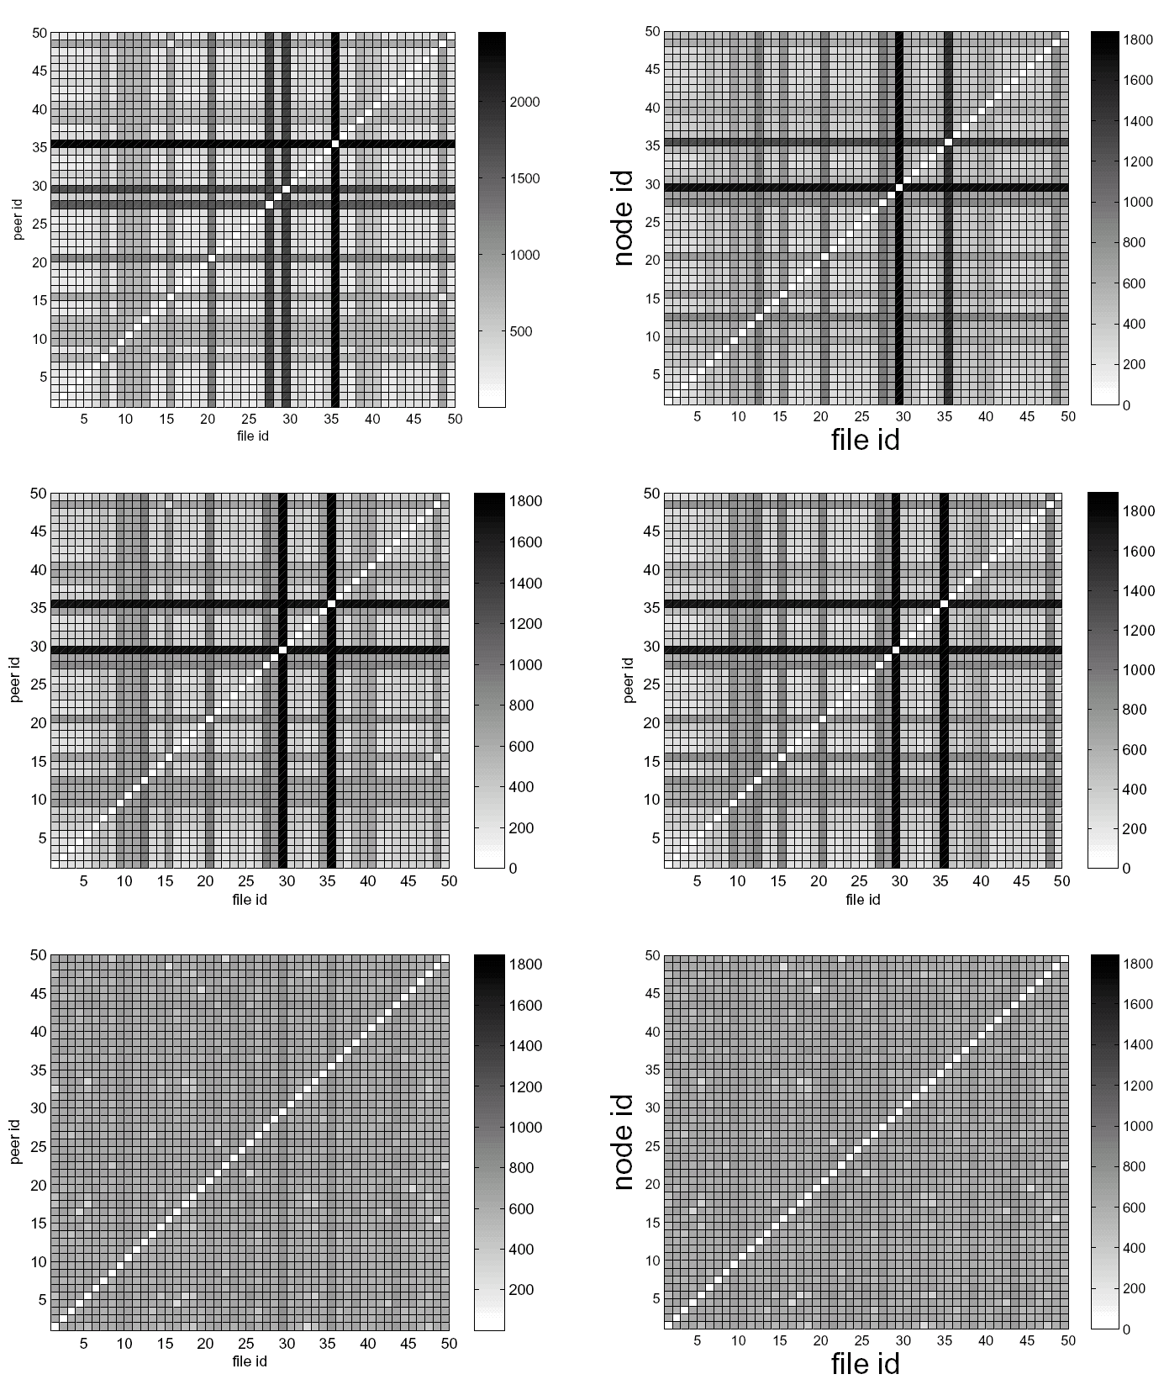

Performance Evaluation
Naive
Max-Sum
Max-Min
Node ID
Delivery Time
File ID
File ID
File ID
Flattens Distribution Time!
Guarantees Synchronization!
comparable average download time

Slide 14
Impact of Selfish Behavior
Upload-Selfishness
Selfish-FIFO
Most Replicated First:
- protect the uplink capacity
Selfish Fast nodes:
- no improvement of upload time
Selfish Slow nodes:
- significant improvement of upload time
- significant improvement of download time in all nodes

Slide 15
Wrap-up
Current file sharing systems are not designed for n-way broadcast.
Network Creation taking into consideration the end-to-end performance characteristics.
Swarming protocols for bulk file transfer perform better over optimized overlays
Such optimized overlays might boost other applications like network coding

Slide 16
Thank You! http://csr.bu.edu/sns

