Slide 1



“A Feedback Control Approach to Mitigating Mistreatment in Distributed Caching Groups”
Georgios Smaragdakis, Nikolaos Laoutaris, Azer Bestavros,
Ibrahim Matta and Ioannis Stavrakakis

Slide 2





Current Practice

Slide 3
More storage showing up
care about the local clients
a storage node

Slide 4
How to Manage the Additional Storage
Each storage node in isolation
- Typically leads to Poor Performance
In cooperation with other storage nodes
+ cooperation can improve individual and collective performance
- risk of losing control over own storage – others controlling and benefiting from it.
Mistreatment

Slide 5
Our Work in Perspective
Such concerns have been studied restricted to the object replication (using game theory)
[Laoutaris et. al. TPDS’06]
Mistreatment in Distributed Selfish Caching
[Laoutaris et. al. Infocom’06]
In this work: How to guarantee the best response

Slide 6
Causes of Mistreatment
Cause 1: Cache State Interactions due to cooperative servicing of requests
Cause 2: Adoption of a Common Scheme
1
2
3
4
t_{r}
O

Slide 7
Towards Mistreatment-Resilient
Network Design
Detection Mechanism
Mitigation Mechanism
(Adaptive Caching eg. LRU(q))
Control the Mitigation Mechanism
(how to tune q)

Slide 8
Detection Mechanism
Local
Requests
Real Cache
Virtual Cache

Slide 9
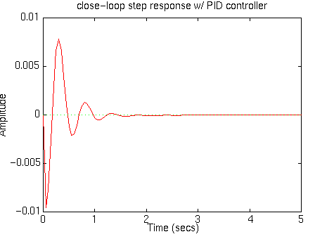
Mitigation and Control Mechanism
error
input
+
Target
Controller
Plant
output
-
PID controller:
input(t) ← input(t-1) + α_{c}·Δerror(t) + β_{c}·(Δerror(t)- Δerror(t-1))
Target
Value
Amplitude
Time

Slide 10
Our Approach
q₁
q₁<q₂
q₂
average
access cost
t_{r}

Slide 11
Adaptive vs. Static Caching
cost_{static} - cost_{adaptive}
max
min cost reduction (%) = 100
cost_{static}
max
cost_{static} = min (cost(LRU(q=0), LRU(q=1))

Slide 12
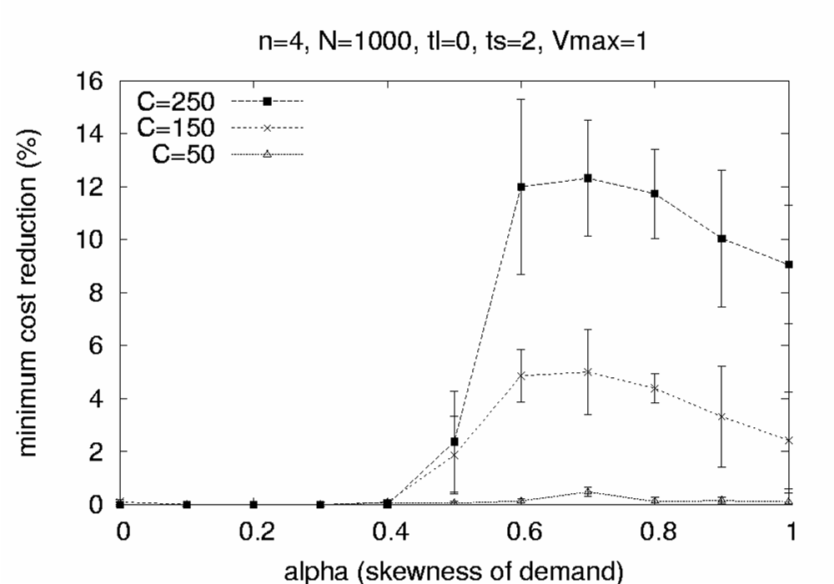
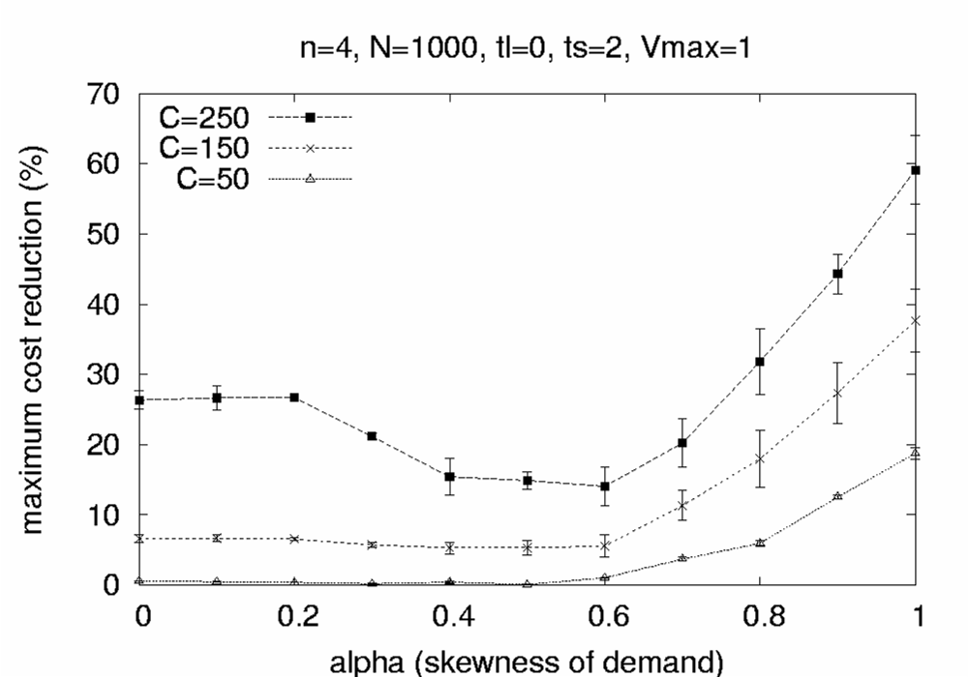
Simulation Results

Slide 13
Future Work
Other Coincidental types of Mistreatment
Adversarial Mistreatment

Slide 14
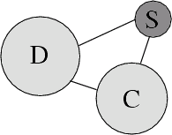
http://csr.bu.edu/dsc

Slide 16
Our Approach
q₁
q₁<q₂
Virtual Cache Cost
q₂
average
access cost
t_{r}
dist(tr)
dist’(t_{r})
If q ↑ and dist ↓ : you operate in the 1st region
If q ↑ and dist ↑ : you operate in the 2nd region
Δerror(t) = dist(t)- dist(t-1)
σ = sign(Δerror(t))

Slide 17
A Critical View to Cooperation in Networking Applications
Cooperation is not always beneficial for the individual node.
Cooperation may lead to mistreatment:
A node’s cost to perform a task is worse when the node participate in a group than when it operates in isolationism

Slide 18

Distributed Selfish Caching
Causes and
Implications
[Laoutaris et. al, Infocom 2006]
Mitigation
[Smaragdakis et. al, Networking 2006]

Slide 19
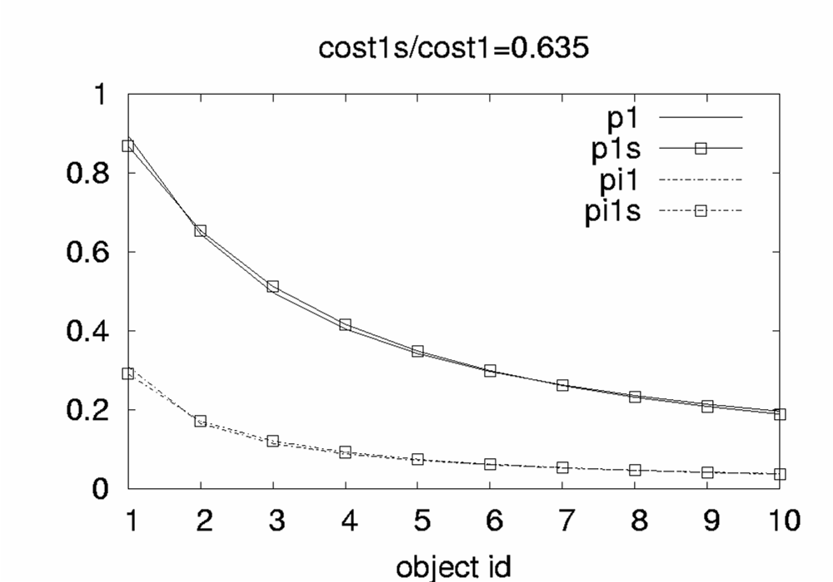
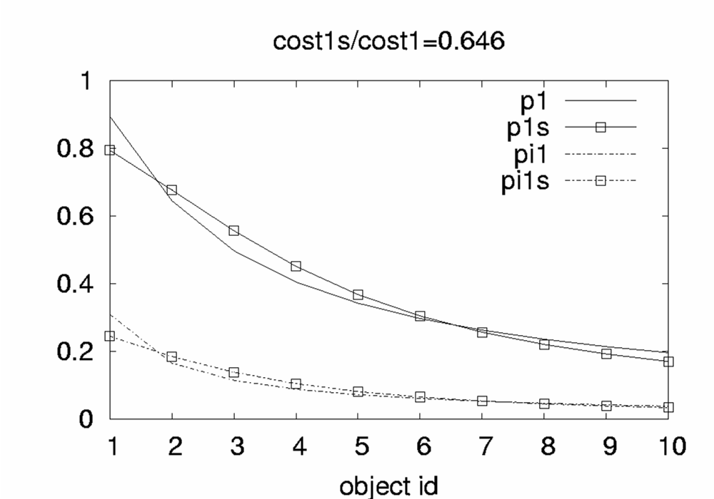
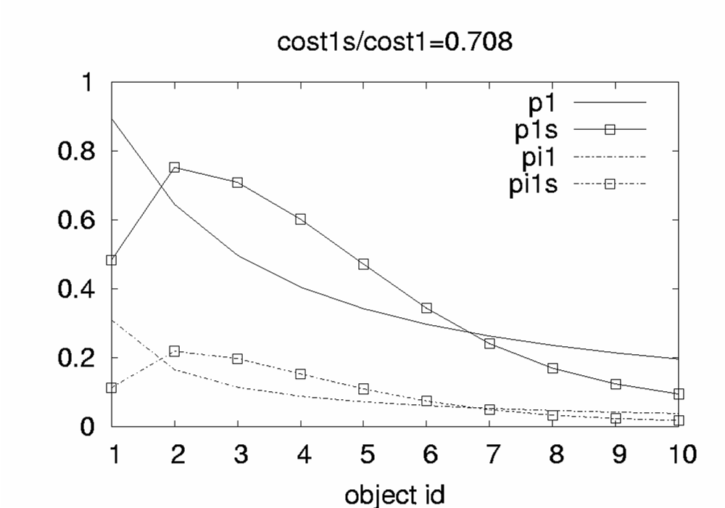
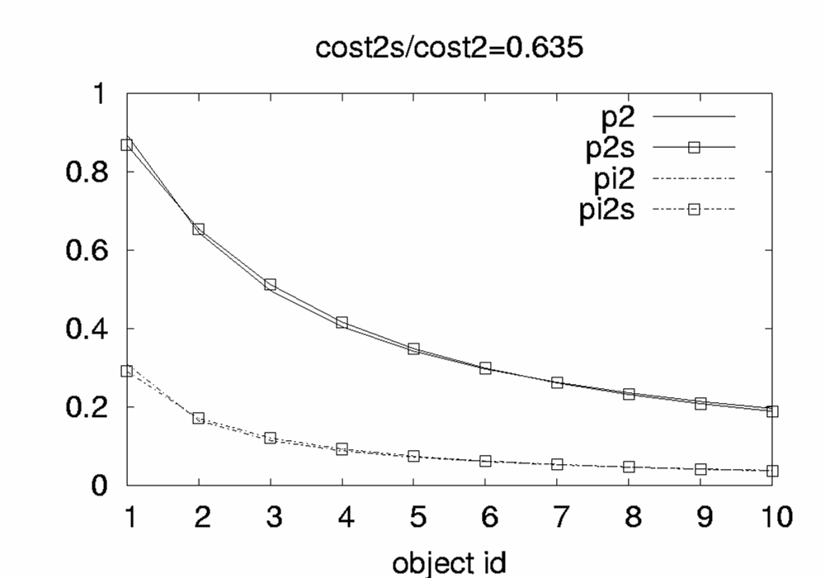
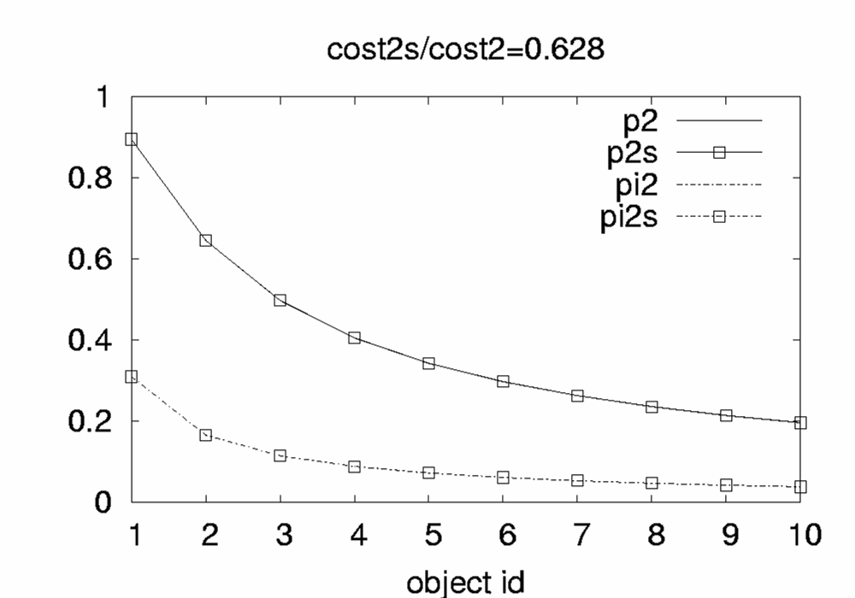
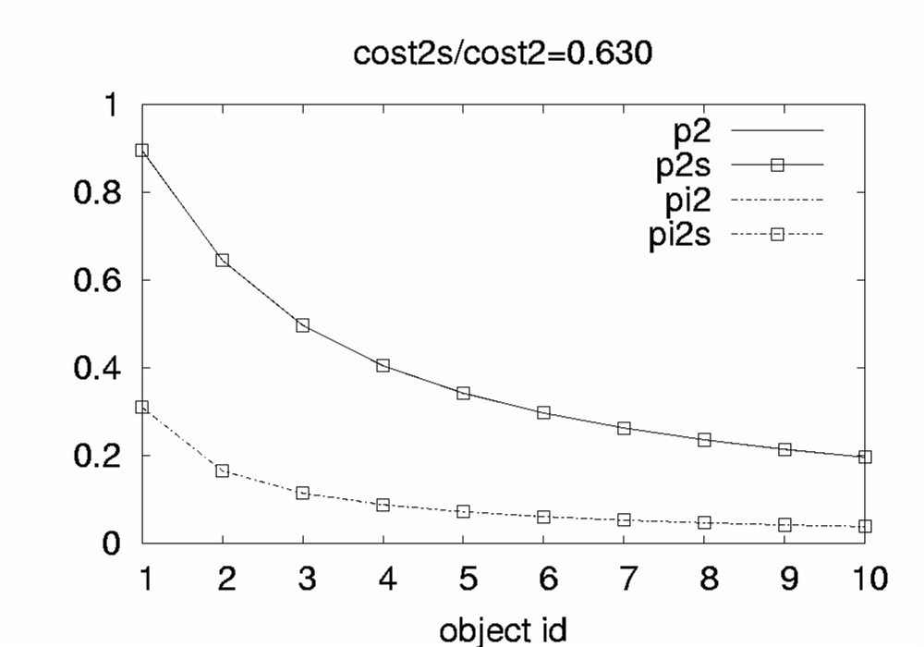
Mistreatment due to State Interaction
1
2
3
4
Node 1
Node 4

Slide 20
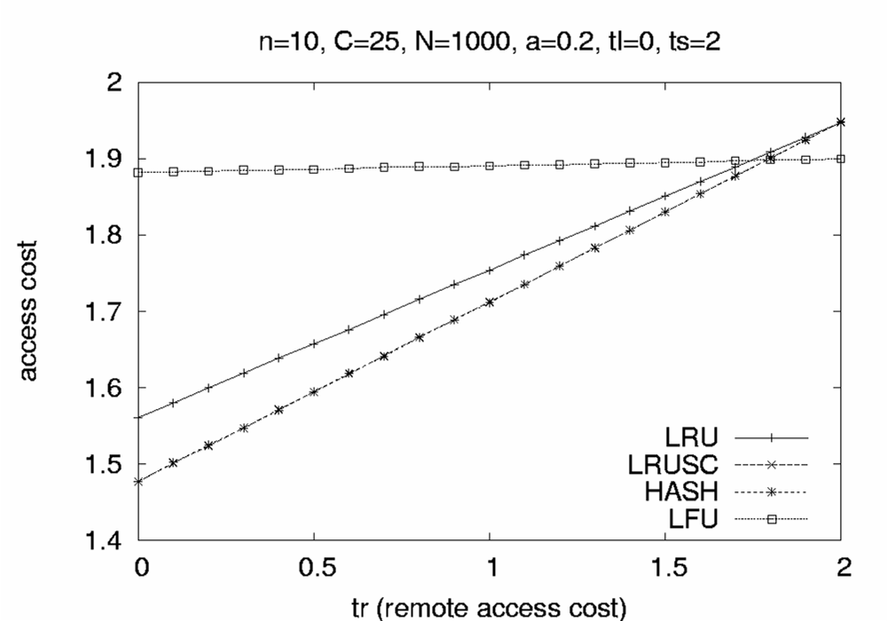
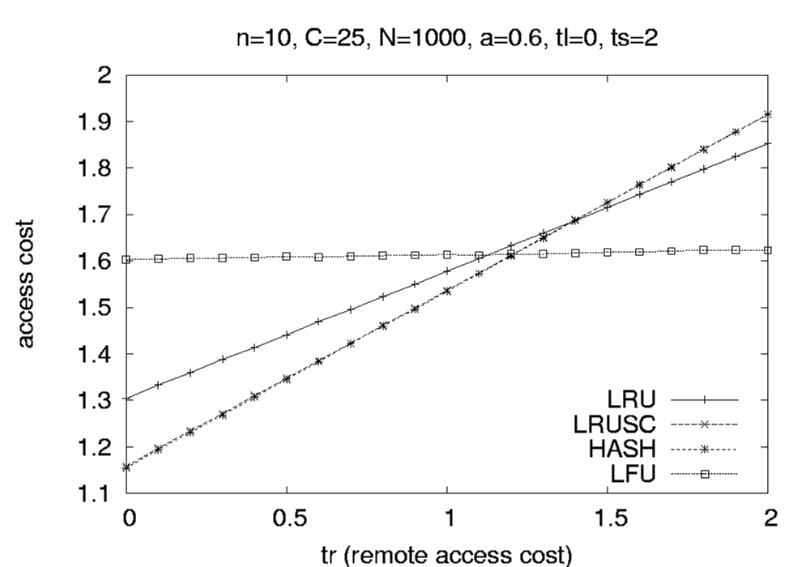
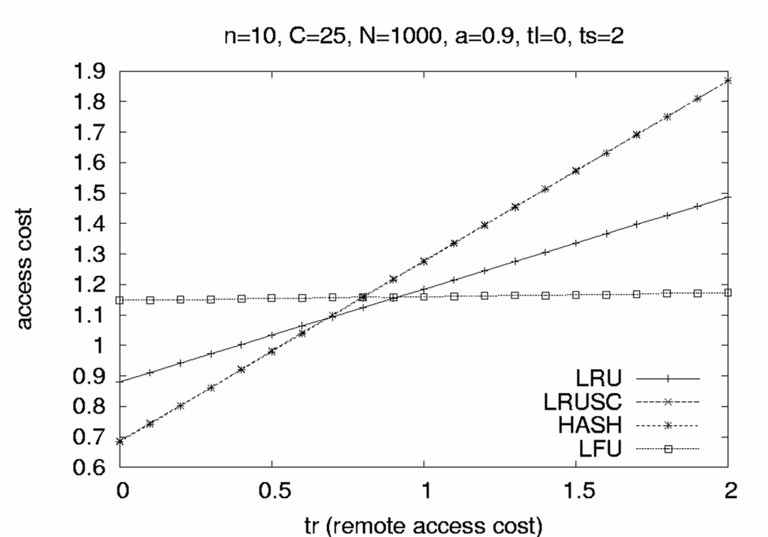
Mistreatment due to Common Scheme
t_{r}
O

Slide 21
The Algorithm
dist(t) = cost_{virtual}(t) - cost_{q}(t)
dist(t-1) = costvirtual(t-1) - cost_{q}(t-1)
Δerror(t) = dist(t)- dist(t-1)
σ = sign(Δerror(t))
if q(t-1)>q(t-2) then
q(t) ← q(t-1) + σ ·α_{c}·|Δerror(t)| + σ ·β_{c}·|Δerror(t)- Δerror(t-1)|
else
q(t) ← q(t-1) - σ ·α_{c}·|Δerror(t)| - σ ·β_{c}·|Δerror(t)- Δerror(t-1)|

Slide 22
In Practice
error
q
+
Target
Controller
Plant
output
-
PID controller:
q(t) ← q(t-1) + α_{c}·Δerror(t) + β_{c}·(Δerror(t)- Δerror(t-1))
- How do we determine the Target

