Slide 1



“A Feedback Control Approach to Mitigating Mistreatment in Distributed Caching Groups”
Georgios Smaragdakis, Nikolaos Laoutaris, Azer Bestavros,
Ibrahim Matta and Ioannis Stavrakakis
Notes:
Intoduction,
Joint Work with + affiliations

Slide 2





Current Practice
Notes:
- Our focus is on content networking applications – including web caching, Content Distribution Networks, and P2P applications,
were nodes cooperate using on-line caching algorithms, where the exposed resource is the storage of a node.
Currently these resources are provided by 3rd parties through SLA(Service Level Agreements) with the agents.
Under these scheme there is a central authority that determines how the resources are allocated.

Slide 3
More storage showing up
care about the local clients
a storage node
Notes:
- Our focus is on content networking applications – including web caching, Content Distribution Networks, and P2P applications,
were nodes cooperate using on-line caching algorithms, where the exposed resource is the storage of a node.
Currently these resources are provided by 3rd parties through SLA(Service Level Agreements) with the agents.
Under these scheme there is a central authority that determines how the resources are allocated.

Slide 4
How to Manage the Additional Storage
Each storage node in isolation
- Typically leads to Poor Performance
In cooperation with other storage nodes
+ cooperation can improve individual and collective performance
- risk of losing control over own storage – others controlling and benefiting from it.
Mistreatment
Notes:
Under this autonomic framework of service deployment,
Although cooperation generally may increases the amount of resources available to a community of nodes,
thus improving individual and collective performance
We identify that :
1. It might not be beneficial for individual nodes, so nodes do not have any incentive to participate in this network
2. Even worse - it allows for the appearance of potential mistreatment
problems through the exposition of one node’s resources to others.
A node is mistreated when its cost to perform a task is higher when it participates
In a group than that it can guarantees when it operates in isolationism/isolation.
A mistreted node lacks of any motivation to participate in the group, but it might be difficult
for an individual node to reveal such mistreatment.

Slide 5
Our Work in Perspective
Such concerns have been studied restricted to the object replication (using game theory)
[Laoutaris et. al. TPDS’06]
Mistreatment in Distributed Selfish Caching
[Laoutaris et. al. Infocom’06]
In this work: How to guarantee the best response
Notes:
- We study such concerns by considering a group of independent, rational (want to minimize their cost to performe a task)
and self-aware (do not have a complete view of the network but can measure its individual cost) nodes i.e. selfish nodes
- This study extends previous work on the off-line version of the problem, which was conducted under a game-theoretic
framework and was limited to object replacement.

Slide 6
Causes of Mistreatment
Cause 1: Cache State Interactions due to cooperative servicing of requests
Cause 2: Adoption of a Common Scheme
1
2
3
4
t_{r}
O
Notes:
In our seminal paper, we identified two causes of mistreatment namely,
Mistreatment due to Cache State Interactions, i.e. due to the cooperative servicing requests/cooperative service of requests
Mistreatment due to the Adoption of a Common Scheme for cache management policies.
We also analytical and experimentally studied the implications of such mistreatments. I would like
to illustrate an example and present the most important implications for both types of mistreatment.

Slide 7
Towards Mistreatment-Resilient
Network Design
Detection Mechanism
Mitigation Mechanism
(Adaptive Caching eg. LRU(q))
Control the Mitigation Mechanism
(how to tune q)
Notes:
Moving toward Mistreatment-Resilient Network Design,
- A Detection Mechanism is only the first requirement.
The second requirement is to ensure that a node has a mechanism to react
To mistreatment using adaptive caching schems
->In the context of SI, we can define the interaction parameter parameter ps where a remote hit
is allowed to effect the local state
->In the context of CS, we can define an reliance parameter q, ie, the probability that a node
Will search a object among the members of the group that particiaptes or not.
- In addition an on-line control scheme must be responsible to adapt the value of these parameters.

Slide 8
Detection Mechanism
Local
Requests
Real Cache
Virtual Cache
Notes:
It is now clear that when a node operates in a dynamic environment, it must be able to detect if
It is mistreated. Current protocols have not considered these concerns.
We provide an on-line test that allows every node to identify if it is mistreated
We introduce the notion of virtual cache.
Along with a real cache a node is equipped with a virtual cache that holds
the ids of the object of local requests. VC is used to emulate the cache
contents and the access cost different that the one currently imployed.
Thus VC can be used to emulate the threshold cost that the node can
guarantee for itself when working in isolation.
--------------------------------------------------------------------------
Hard switch, only ID, loose but on-line threshold

Slide 9
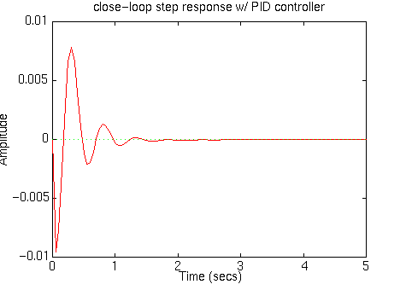
Mitigation and Control Mechanism
error
input
+
Target
Controller
Plant
output
-
PID controller:
input(t) ← input(t-1) + α_{c}·Δerror(t) + β_{c}·(Δerror(t)- Δerror(t-1))
Target
Value
Amplitude
Time
Notes:
Turning our attention on how to control these parameters, we can use results from control theory
Assuming that there is a desired Target value, the output of the system is compared
With this target, the error i.e the difference between Target and output is fetched as
Input to the controller that tunes the parameter of our interest of the system and this procedure continues.
The most refered contolled is the so called PID (Proportional Integral Differential) controller
where the input to the systems changes as follows.
This controller has very good properties. It guaranties that starting from any input, the
Output will eventually converge to the Target value with no oscillations

Slide 10
Our Approach
q₁
q₁<q₂
q₂
average
access cost
t_{r}
Notes:
To that end we develop a novel approach to tackle this problem
By setting the target/estimating the error adaptively.
Assuming q1<q2
We run more experiments and we observed the following behavior.
Our observations were consistent for any pair of q1,q2 and as the
Parametersof the network change
As you can see there is a switch point where it is preferable to
Use q1 instead of q2.
As common reference we use the virtual access cost which provides
An online threshold of mistreatment.
We diffine as distance the difference between VC and the avg access cost
That is observed by deploying the LRU(q) scheme.
If q increases and dist decr then the outlier operates in the 1st region
If q decreases and dist incr then the outlier operates in the 2nd region
We are now ready to define error as the difference of dist
And \sigma as the sign pf Derror to specify the region of operation given Dq
-----------------------------------------------------------------
VC cost independent of tr! But changes on line as a,C,n changes!
Common reference
Want to max the distance from VC
Similar solution for the State Interaction
(In TR offilne estimation of ->ac, bc (for the a,C,n) -> We Showed convergence
difficult to achieve the best values on-line but small values of ac, bc <1 sufficient.)

Slide 11
Adaptive vs. Static Caching
cost_{static} - cost_{adaptive}
max
min cost reduction (%) = 100
cost_{static}
max
cost_{static} = min (cost(LRU(q=0), LRU(q=1))
Notes:
To study the performance of our soultion
We define two performance metrics namely
The minimum cost reduction that is achieved when our adaptive scheme is deployed
As the fraction of the best adavtive scheme that can deployed – the cost of the adaptive
scheme normalized with the best static scheme
In the same function we can define the max cost reduction

Slide 12
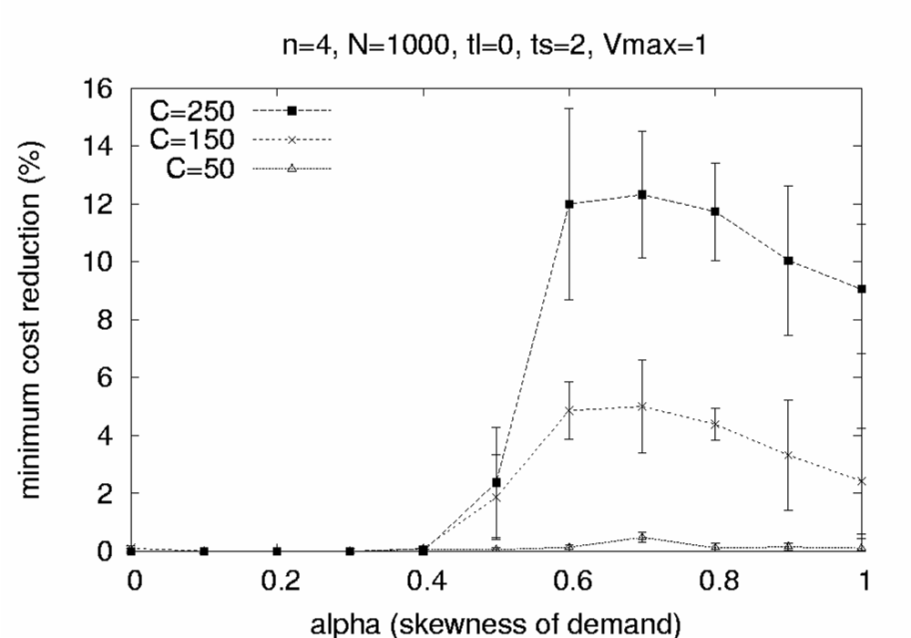
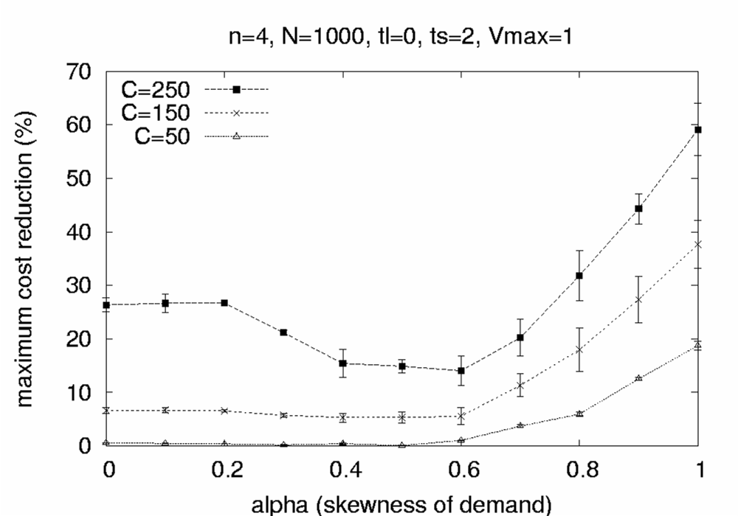
Simulation Results
Notes:
Assuming that there is an oracle that can provide the best caching scheme the min cost reduction
provide the lower bound of improvement. As you can see this depent of the cache size that a node
dedicate to the application and can reach up to 15% for large cache size.
To achieve the upper bound of improvement that can be gained, we
compare with the worst static scheme. The improvement can be up to
60% for settings were the demand is skewed and tha cashe size is arge

Slide 13
Future Work
Other Coincidental types of Mistreatment
Adversarial Mistreatment
Notes:
We believe that any online distributed resource management protocol can lead to mistreatment under certain circumstances
- Although we focus on the data plain, mistreatment can also appear in the control plane, eg. Route path storing, routing
Tables of group members, and to study mistreatment there is part of our agenda
Adversarial Mistreatment
We are also interested in studying the worse possible mistretament when the nodes
Act as adversarials and try to explore the characteristics of the network to achieve the worse
Possible mistreatment.

Slide 14
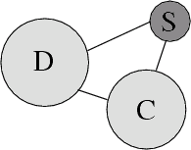
http://csr.bu.edu/dsc
Notes:
We maintain a research site in our cluster at BU, providing links to our publications and results. We are also in the process of releasing experimental code to the research community.
Thank you for your time.

Slide 16
Our Approach
q₁
q₁<q₂
Virtual Cache Cost
q₂
average
access cost
t_{r}
dist(tr)
dist’(t_{r})
If q ↑ and dist ↓ : you operate in the 1st region
If q ↑ and dist ↑ : you operate in the 2nd region
Δerror(t) = dist(t)- dist(t-1)
σ = sign(Δerror(t))
Notes:
To that end we develop a novel approach to tackle this problem
By setting the target/estimating the error adaptively.
Assuming q1<q2
We run more experiments and we observed the following behavior.
Our observations were consistent for any pair of q1,q2 and as the
Parametersof the network change
As you can see there is a switch point where it is preferable to
Use q1 instead of q2.
As common reference we use the virtual access cost which provides
An online threshold of mistreatment.
We diffine as distance the difference between VC and the avg access cost
That is observed by deploying the LRU(q) scheme.
If q increases and dist decr then the outlier operates in the 1st region
If q decreases and dist incr then the outlier operates in the 2nd region
We are now ready to define error as the difference of dist
And \sigma as the sign pf Derror to specify the region of operation given Dq
-----------------------------------------------------------------
VC cost independent of tr! But changes on line as a,C,n changes!
Common reference
Want to max the distance from VC
Similar solution for the State Interaction
(In TR offilne estimation of ->ac, bc (for the a,C,n) -> We Showed convergence
difficult to achieve the best values on-line but small values of ac, bc <1 sufficient.)

Slide 17
A Critical View to Cooperation in Networking Applications
Cooperation is not always beneficial for the individual node.
Cooperation may lead to mistreatment:
A node’s cost to perform a task is worse when the node participate in a group than when it operates in isolationism
Notes:
Under this autonomic framework of service deployment,
Although cooperation generally may increases the amount of resources available to a community of nodes,
thus improving individual and collective performance
We identify that :
1. It might not be beneficial for individual nodes, so nodes do not have any incentive to participate in this network
2. Even worse - it allows for the appearance of potential mistreatment
problems through the exposition of one node’s resources to others.
A node is mistreated when its cost to perform a task is higher when it participates
In a group than that it can guarantees when it operates in isolationism/isolation.
A mistreted node lacks of any motivation to participate in the group, but it might be difficult
for an individual node to reveal such mistreatment.

Slide 18

Distributed Selfish Caching
Causes and
Implications
[Laoutaris et. al, Infocom 2006]
Mitigation
[Smaragdakis et. al, Networking 2006]
Notes:
Under this framework we tackle what we call the “Distributed Selfish Caching” problem.
In particular, we identify and investigate causes of mistreatment and we explore the implications in distributed
Caching groups and,
We design novel, distributed mechanisms to mitigate mistreatment in distributed caching groups.
Before I continue describing our mistreatment mechanism, which is the focus of this paper, it is more natural
to spend a few minutes presenting our initial results on mistreatment in distributed caching groups in order
To make clear why such a mechanism must be part of the network design of current and emerging content
Networking applications.

Slide 19
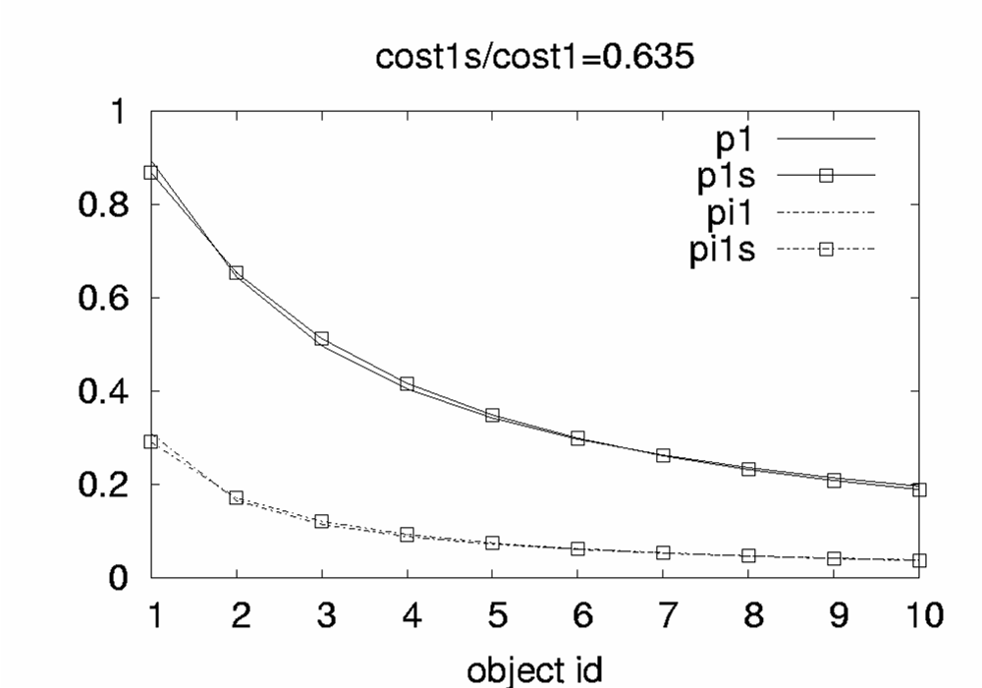
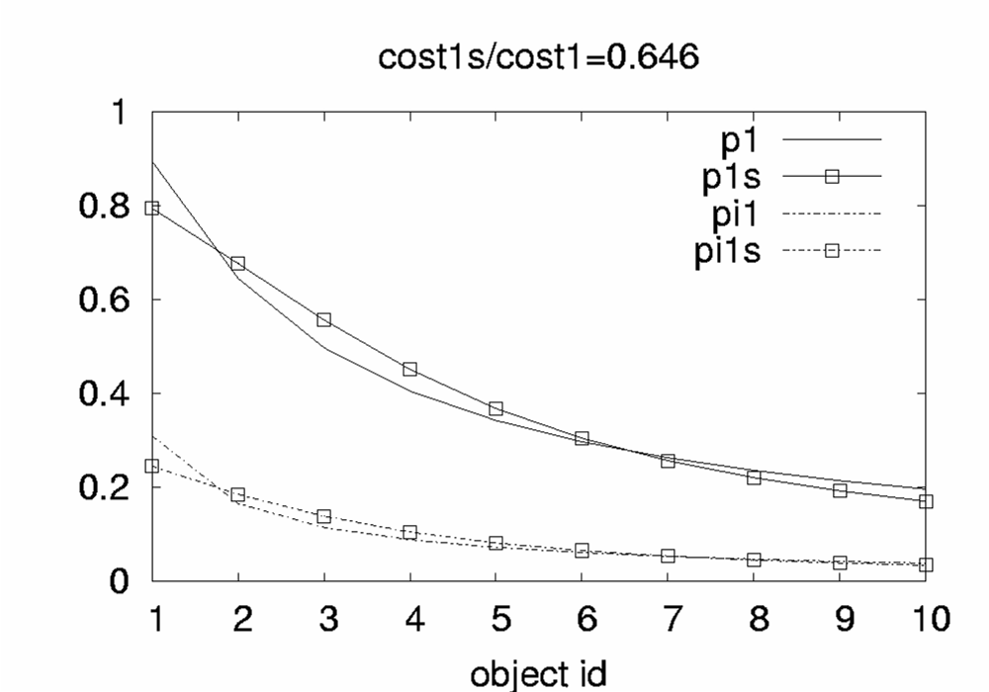
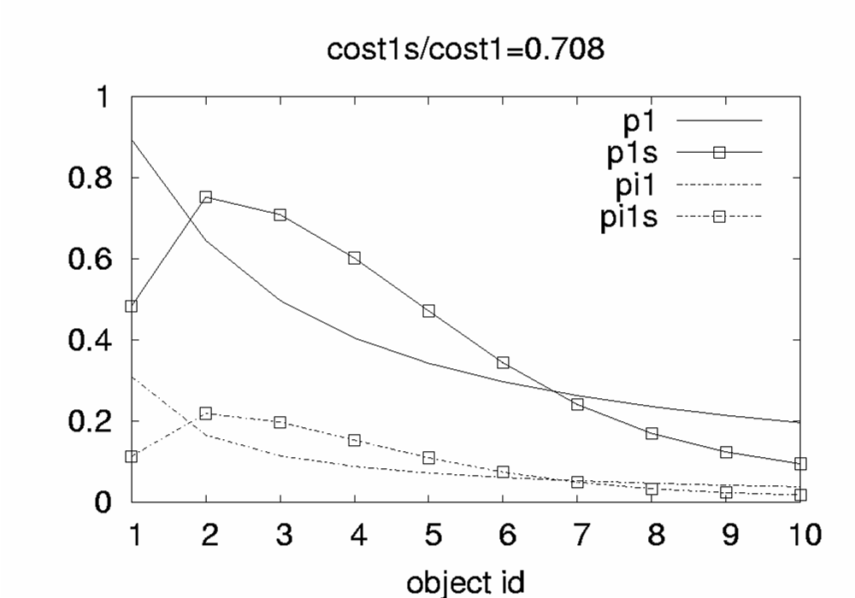
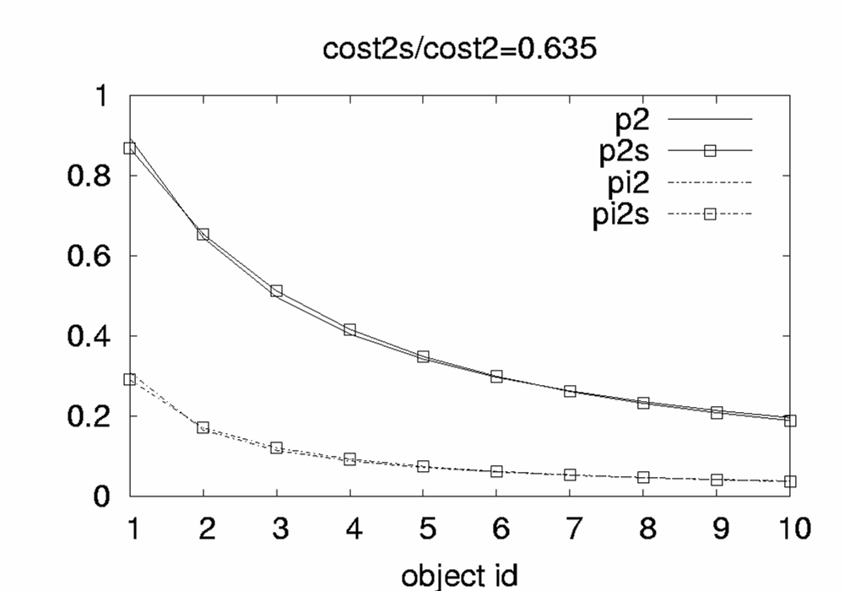
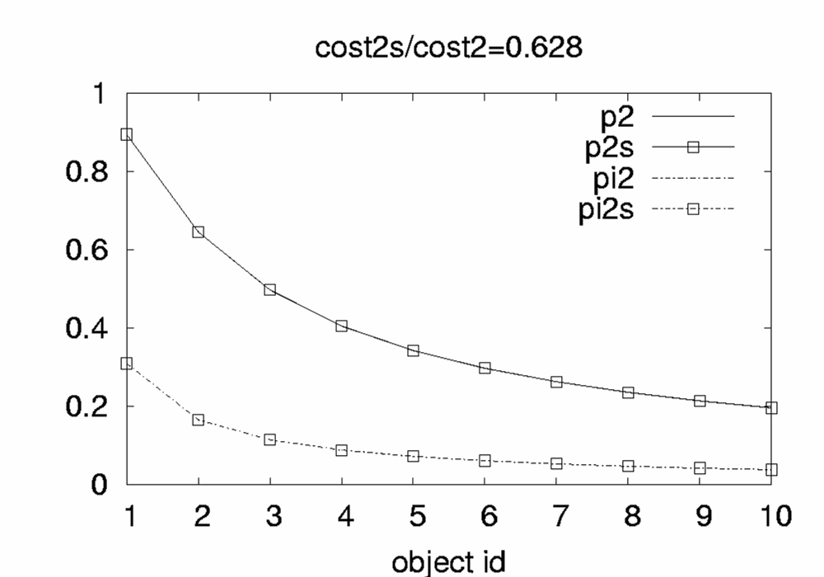
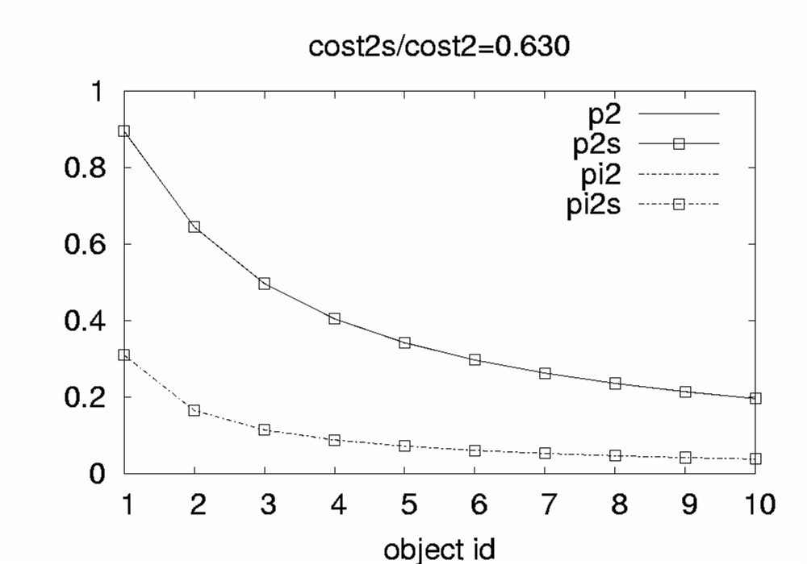
Mistreatment due to State Interaction
1
2
3
4
Node 1
Node 4
Notes:
Consider a simple network with 4 nodes. Were nodes 1-3 have fixed request rate,
Whereas the node 4 is overactive. We are interested in studying the
Effect of the miss stream of the overactive node, as its request rate increases
Compared w/ the fixed rate of the other nodes.
The graphs the demand (and the steady state vector) for nodes 1 and 4
Looking at the graphs, we see that the overactive is not affected by the miss streams of the other nodes,
But as the request rate increases both demand and the Steady state vector of node 1 deviate from that were
All the nodes have the same rate. Thus the cost of non-overactive nodes to serve their local
Demands increases rapidly.

Slide 20
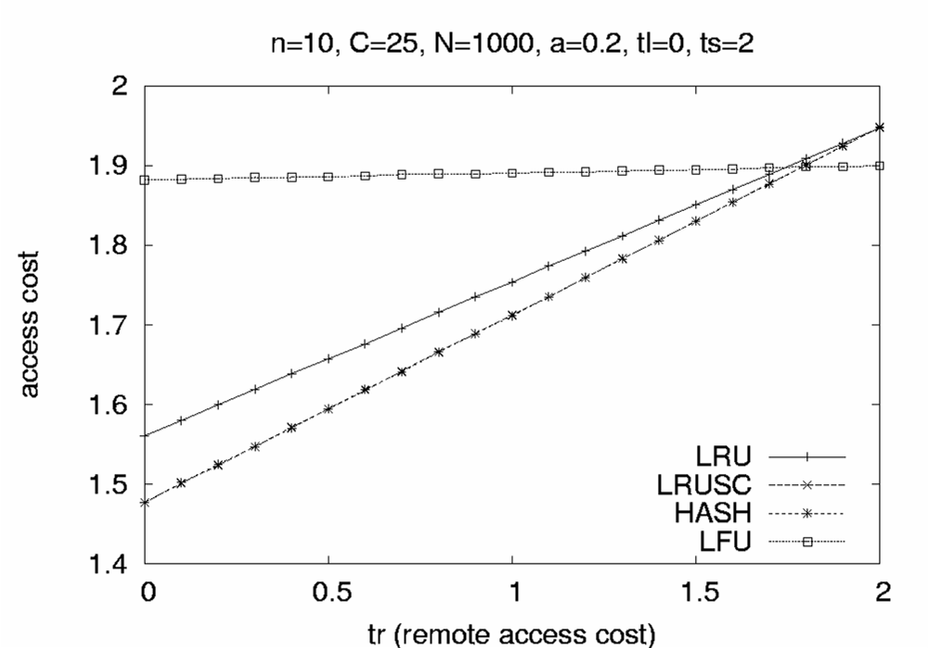
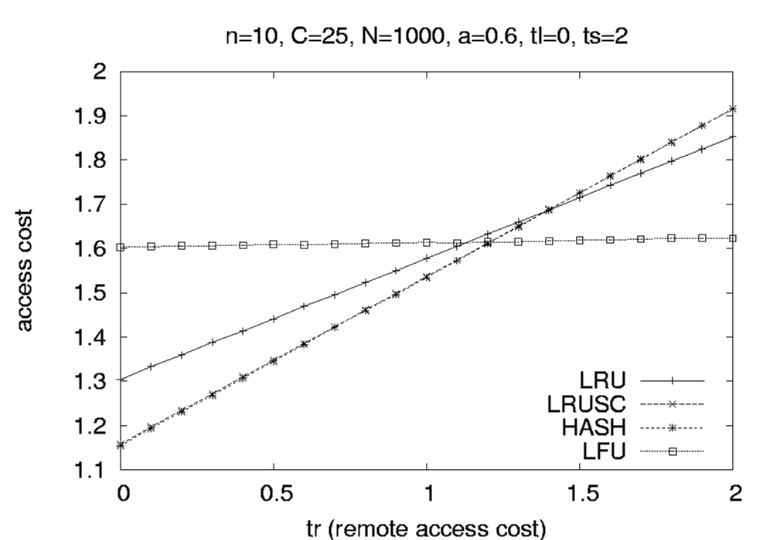
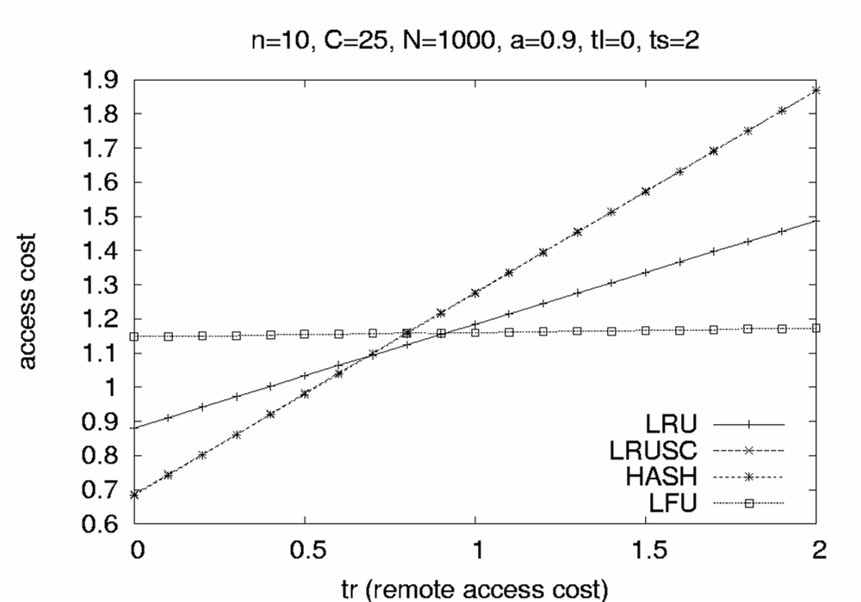
Mistreatment due to Common Scheme
t_{r}
O
Notes:
Now consider another scenario where the characteristics of one of the nodes (eg. The distance from all the other
Nodes) deviates from the average behavior. We call this node an outlier.
We consider Single Copy schemes that allow for the existence of up to one copy of each object in the group
And Multiple copy schemes that allow for the existence of multiple copies of one object at different nodes of the group.
The plots depict the average access cost of the group (social cost) – including outlier, for different values of tr
And demand skewness.:
- SC performs better when the distance/access cost between nodes is small
MC perform better when the access cost between node is high
To that end deployment of one scheme with the existence of an outlier can lead to mistreatment

Slide 21
The Algorithm
dist(t) = cost_{virtual}(t) - cost_{q}(t)
dist(t-1) = costvirtual(t-1) - cost_{q}(t-1)
Δerror(t) = dist(t)- dist(t-1)
σ = sign(Δerror(t))
if q(t-1)>q(t-2) then
q(t) ← q(t-1) + σ ·α_{c}·|Δerror(t)| + σ ·β_{c}·|Δerror(t)- Δerror(t-1)|
else
q(t) ← q(t-1) - σ ·α_{c}·|Δerror(t)| - σ ·β_{c}·|Δerror(t)- Δerror(t-1)|
Notes:
Here I Just to summarize our algorithm using Control Theory notation
As you can see it is very easy to embed such an algorithm to emerging applications
As only the values of a few variables is needed to be stored.

Slide 22
In Practice
error
q
+
Target
Controller
Plant
output
-
PID controller:
q(t) ← q(t-1) + α_{c}·Δerror(t) + β_{c}·(Δerror(t)- Δerror(t-1))
- How do we determine the Target
Notes:
It seems that is pretty straight forward to apply this framework in our framerork/
Unfortunatelly it turns out to be very difficult to determine the target value and as a result
To estimate the error.

