Slide 1


TCP Performance over UMTS Network
Technical University of Crete
Electronic & Computer Engineering Department
Diploma Thesis
by
Smaragdakis Georgios

Slide 2
OUTLINE
From Mobile Networks to UMTS Revolution
UMTS Radio Access Network
UMTS Core Network
TCP/IP
Simulation Parameters
NS2
Our Simulator
Results & Discussion
Conclusions & Future Work

Slide 3
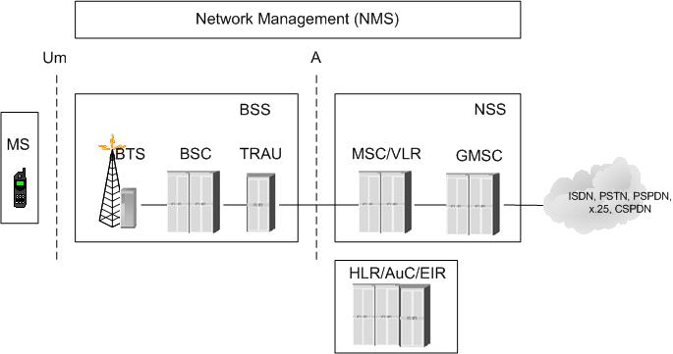
From Mobile Networks to UMTS Revolution (1/6)
GSM Network

Slide 4
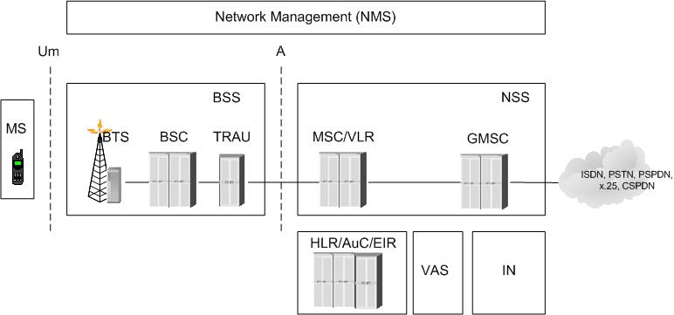
From Mobile Networks to UMTS Revolution (2/6)
VALUE ADDED Service Platform

Slide 5
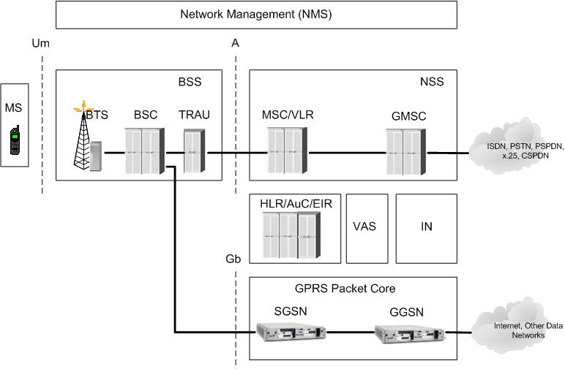
From Mobile Networks to UMTS Revolution (3/6)
GPRS Service

Slide 6
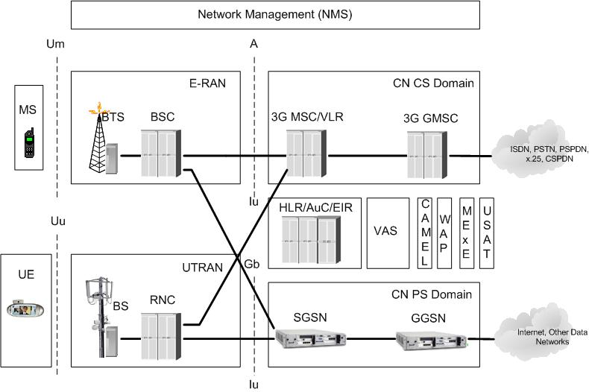
From Mobile Networks to UMTS Revolution (4/6)
3GPP R99 Network

Slide 7
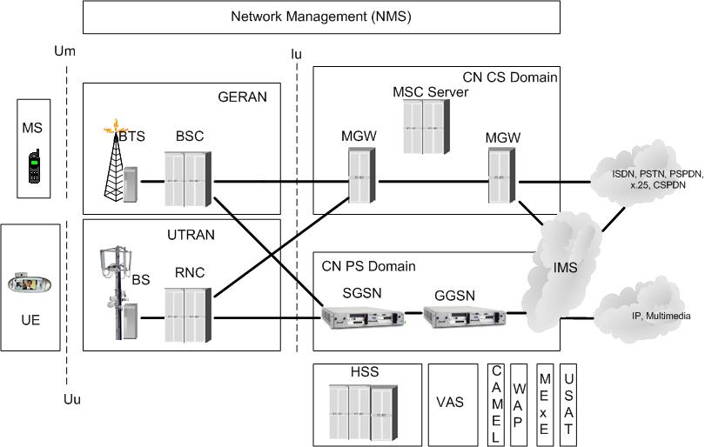
From Mobile Networks to UMTS Revolution (5/6)
3GPP R4 Network

Slide 8
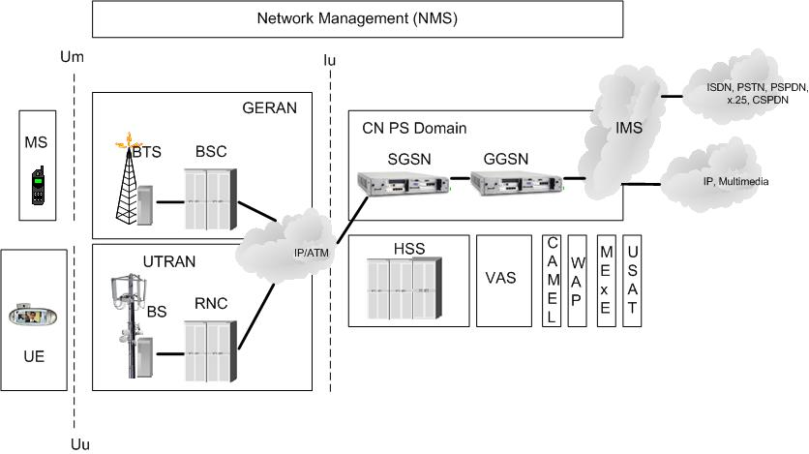
From Mobile Networks to UMTS Revolution (6/6)
3GPP R5 Network

Slide 9
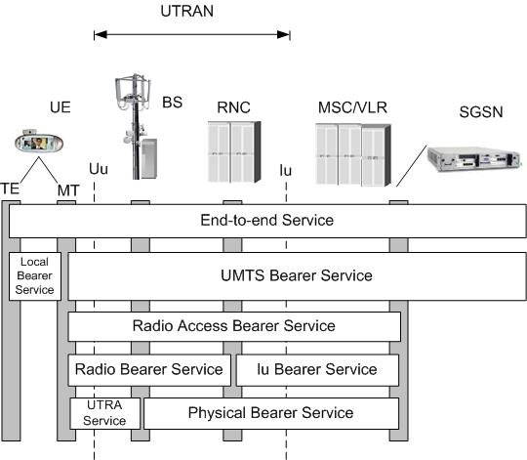
UMTS Radio Access Network (1/7)

Slide 10
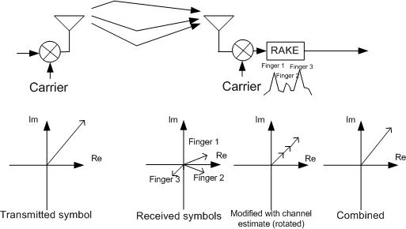
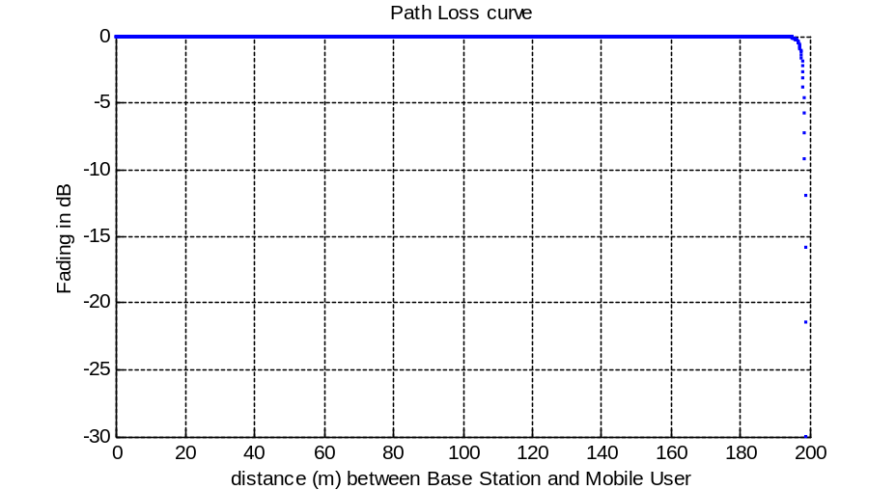
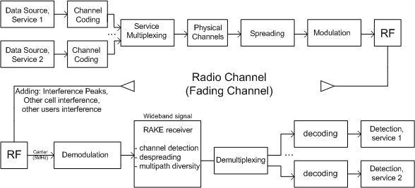
UMTS Radio Access Network (2/7)
Solution: RAKE receiver
LOSS due to:
Path Loss (distance)
WCDMA Transmission:
Shadowing
Doppler (movement)
Multipath Transmission

Slide 11
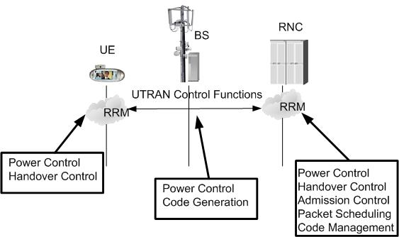
UMTS Radio Access Network (3/7)
Resource Management

Slide 12
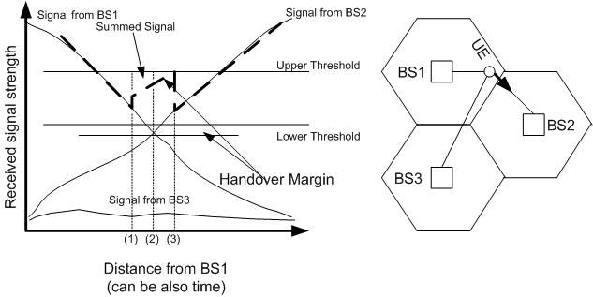
UMTS Radio Access Network (4/7)
Handover:
Softer where the User Equipment is connected to two sectors of the same Base Station simultaneously (no delays).
Soft where the User Equipment is connected to two sectors of different Base Stations simultaneously (no delays).
Hard where the User Equipment is connected to only one sector at the time.
Algorithm:

Slide 13
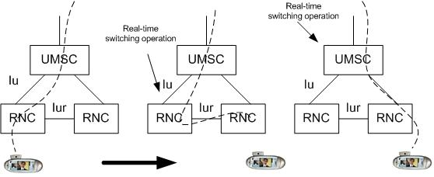
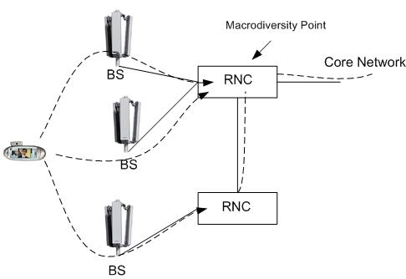
UMTS Radio Access Network (5/7)
RNC Changes:
Macrodiversity:

Slide 14
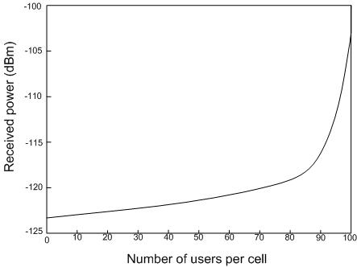
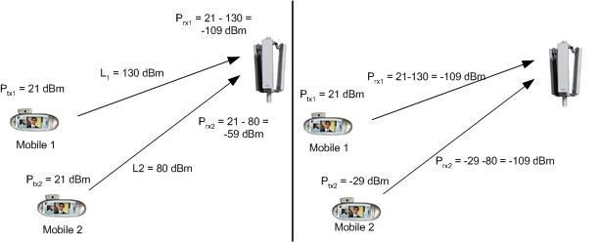
UMTS Radio Access Network (6/7)
Power Control :
WHY?
EXAMPLE

Slide 15
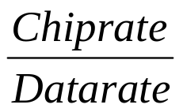
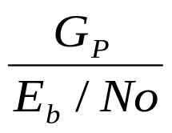
UMTS Radio Access Network (7/7)
Assumptions:
All the subscribers under the TRX coverage are equally distributed so that they have equal distances to the TRX antenna.
The power level they use is the same and thus the interference they cause is on the same level.
Subscribers under the TRX use the same base-band bit rate that is the same symbol rates.
Speading Factor : G_{P} =
Number of users/cell: X ≈

Slide 16
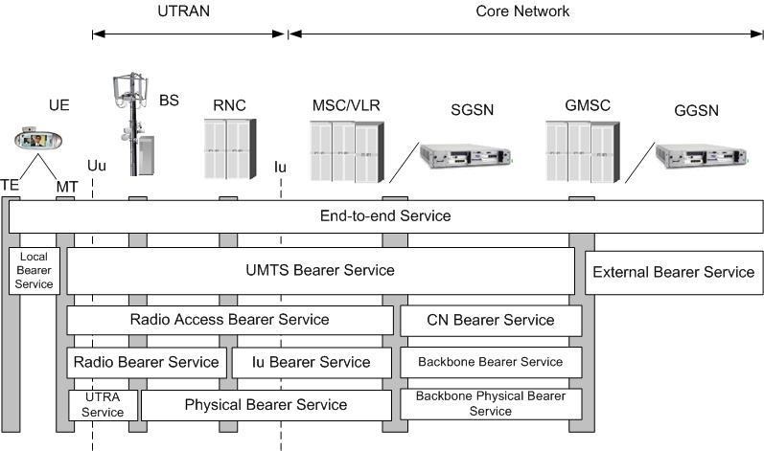
UMTS Core Network (1/2)

Slide 17
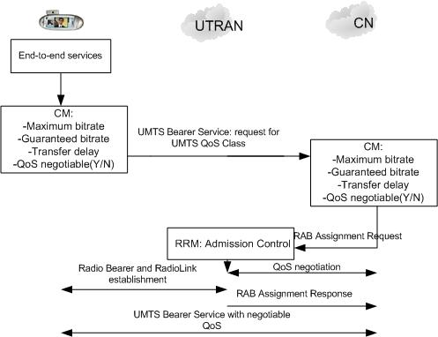
UMTS Core Network (2/2)
end-to-end Services

Slide 18
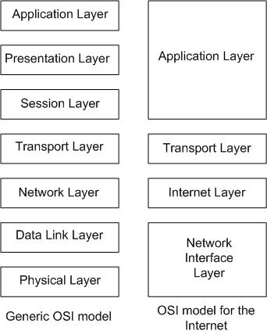
TCP/IP (1/12)
General OSI and OSI for the Internet

Slide 19
TCP/IP (2/12)
TRANSMISSION CONTROL PROTOCOL
TCP is point-to-point protocol. This means that there is always one sender and one receiver. It is reliable and in-order in byte stream. Multicasting is not possible with TCP as it is.
TCP is pipelined. This means that in TCP there is congestion window size is set.
In TCP there are send and receive buffers.
TCP uses full duplex data. There exists bi-directional data flow in the same connection. Moreover there is a Maximum Segment Size (MSS).
TCP is connection-oriented. There exist handshaking that is exchange of control messages, initiating sender and receiver state before data exchange.
At last but not least TCP is flow controlled, which means that sender will not overwhelm receiver.

Slide 20
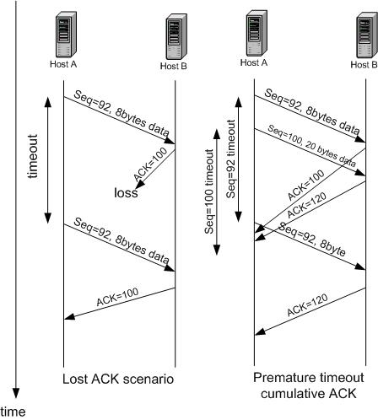
TCP/IP (3/12)
TCP Reliable data transfer and Retransmission

Slide 21
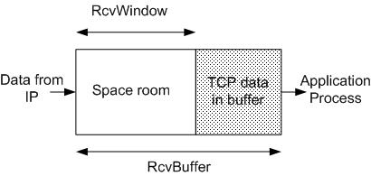
TCP/IP (4/12)
TCP Flow Control :
TCP Round Trip Time and Timeout :
EstimatedRTT = (1-x) · EstimatedRTT + x · SampleRTT
This average is an exponential weighted moving average. There is an influence of given sample decreases exponentially fast. A typical value for x is 0.125.
Timeout = EstimatedRTT + 4 · Deviation
Deviation = (1-x) · Deviation + x · | SampleRTT – EstimatedRTT |

Slide 22
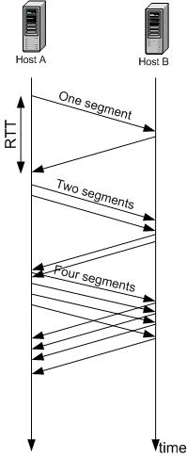
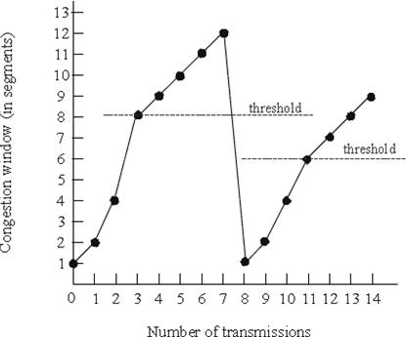
TCP/IP (5/12)
TCP Congestion Control:

Slide 23
TCP/IP (6/12)
TCP Tahoe:
TCP Tahoe is the oldest version of TCP
TCP Tahoe congestion algorithm includes Slow Start and Congestion Avoidance.
In order to overcome a loss event three timeouts have to be passed. This is its main drawback as when a segment is lost, the sender side of the application may have to wait a long period of time for the timeout. It implements an RTT-based estimation.

Slide 24
TCP/IP (7/12)
TCP Reno:
TCP Reno except from Slow Start and Congestion Avoidance includes also Fast Retransmit. In Fast retransmit mechanism, three duplicate acknowledgements carrying the same sequence number triggers a retransmission without waiting for the associated timeout event to occur. The window adjustment strategy for this early timeout is the same as for the regular timeout and Slow Start is applied.
The problem, however, is that the Slow Start is not always efficient, especially if the error was purely transient or random in nature and not persistent. In such a case the shrinkage of the congestion window is, in fact, unnecessary and renders the protocol unable to fully utilize the available bandwidth of the communication channel during the subsequent phase of window re-expansion.

Slide 25
TCP/IP (8/12)
TCP NewReno:
TCP NewReno introduces Fast Recovery in conjunction with Fast Retransmit. The idea behind Fast Retransmit is that an ACK is an indication of available channel bandwidth since a segment has been successfully delivered. This, in turn, implies that the congestion window should actually be incremented upon one ACK delivery. Then instead of entering Slow Start, the sender increases its current congestion window by the threshold number.
TCP NewReno’s Fast Recovery can be effective when there is only one segment drop from a window of data, given the fact that NewReno retransmits at most one dropped segment per RTT. The problem with the mechanism is that is not optimized for multiple packet drops form a single window, and this could negatively impact performance.

Slide 26
TCP/IP (9/12)
TCP Vegas:
TCP Vegas approaches the problem of congestion from another perspective. The basic idea is to detect congestion in the routers between source and destination before packet loss occurs and lower the rate linearly when this imminent packet loss is detected. The longer the round-trip times of the packets, the greater the congestion in the routers. Every two round trips delays the following quantity is computed:
ρ = (WindowSizeCurrent - WindowSizeOld) · (RTTCurrent-RTTOld)
If ρ>0 the window size is decreased by 1/8 . Else the window size is increased by one minimum segment size.
One problem that it does not seem to overcome is the path asymmetry. The sender makes decisions based on the RTT measurements, which, however, might not accurately indicate the congestion level of the forward path. Furthermore, packet drops caused by retransmission deficiencies or fading channels may trigger a Slow Start.

Slide 27
TCP/IP (10/12)
TCP SACK:
TCP Selective Acknowledgements (SACK) is a TCP enhancement which allows receivers to specify precisely which segments have been received even in the presence of packet loss. TCP SACK is an Internet Engineering Task Force (IETF) proposed standard which is implemented for most major operating systems.
SACK enables receiver to give more information to sender about received packets allowing sender to recover from multiple-packet losses faster and more efficiently. On the contrary TCP Reno and New-Reno can retransmit only one lost packet per round-trip time because they use cumulative acknowledgements.

Slide 28
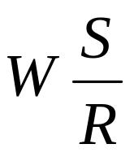
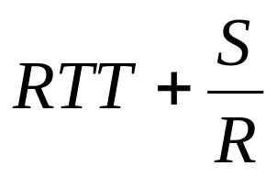
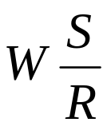
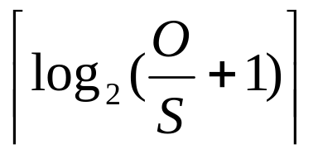
TCP/IP (11/12)
Latency:
If
>
Then Latency = 2 RTT + O/R
Else
Latency = 2RTT + O/R + (K-1) [S/R + RTT -
] ⁺
Where K =
Error adds Latency !

Slide 29
TCP/IP (12/12)
Discussion
Even today’s wired internet has so many problems that some people persist to call it the World Wide Wait. These problems will enlarge in the future Mobile Internet. Although TCP was introduced years ago on the wired internet it will continue to be THE transfer protocol. Its hard defensive behavior towards any kind of loss will be its weakest point over wireless and mobile networks. TCP can not infer if an error is due to traffic congestion or losses over a wireless link. Our approach to this problem is to find the proper version of TCP to each profile of application and user over the UMTS network. Notice that the UMTS network is implemented using TCP and end-to-end QoS.

Slide 30
Simulation Parameters (1/6)
NETWORK PARAMETERS
PARAMETER | VALUE
Number of cells | 7 (hexagonal)
Cell Side | 200m
Path loss propagation exponent β | 3.5
Path loss propagation parameter A | –30dB
Shadowing parameter σ | 4dB
Number of oscillators (Jakes) | 8
Number of multipath rays | 5
Noise | -132 dbW
Doppler frequency | 0,6,20,80 Hz
Chip rate | 3.84 Mcps
PC frequency | 1500 Hz
PC power range | 80dB
PC step | 0.5 dB
PC SIR objective | 2.5 to 3 dB
PC loop delay | 1,2,3,4,10
Maximum TX Power | -16 dBW
Packet length(MTU) | 1000 bytes

Slide 31
Simulation Parameters (2/6)
Users with 120 Kbps bit rate
Users with 240 Kbps bit rate
Spreading Factor = 32
Approximately 16 users per cell
(with one TRX per cell)
Approximately 110 users total
Approximately 330 users total
if there are 3 TRX per cell
Performance is declined rapidly if
total users > 160
RTT ≈ 120 msecs
(but can be increased)
Spreading Factor = 64
Approximately 8 users per cell
(with one TRX per cell)
Approximately 55 users total
Approximately 160 users total
if there are 3 TRX per cell
Performance is declined rapidly if
Total users > 100
RTT ≈ 80 msecs
(but can be increased)

Slide 32
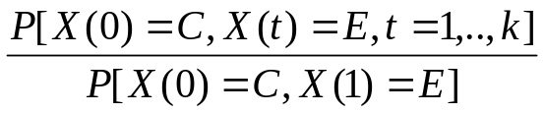

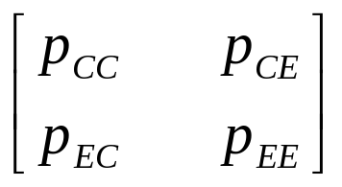
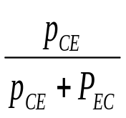
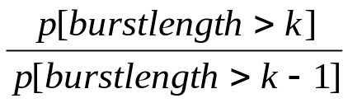
Simulation Parameters (3/6)
Error Statistics over UMTS (WCDMA) air interface
Let X(i) = E if the block I is in error (which occurs with probability Pe(i)) and C if it is correct.
For an ergodic process X(i) we have:
P[burst length k] = P[X(t)=E,t=2,…,k|X(0)=C,X(1)=E]
=
The above model can be described by a Two-State Markov error model as shown in the following Figure :
The model is fully characterized by its transition matrix:
P =
and
P(E) =
,
P[burst length>1] = P[E|E] = p_{EE}
,
P(E|E) = p_{EE} =

Slide 33

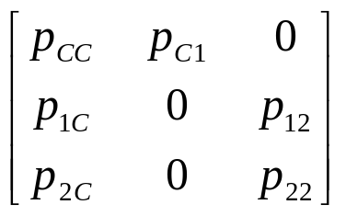
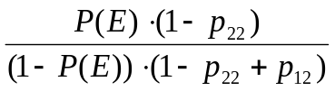
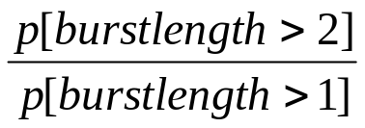
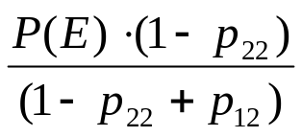
Simulation Parameters (4/6)
Error Statistics over UMTS (WCDMA) air interface
Simple as it is the two-state Markov Model does not capture all types of behavior. An obvious way to get
around this problem is use a multistate Markov Model. We therefore further restrict ourselves to a three-
state model such as the one shown in the next figure
Two error states are now present and the second of them, E2, can only be entered from the first, E1.
Also exiting E2 necessarily, leads to the Correct State (not to E1). The transmission matrix for such a
model is as follows:
Finally P(C)=P(E1)/p_{C1}
where
p_{C1}=
And P[E]=P[E1]+P[E2]=a₀
P =
P[burst length>1]=p₁₂= a₁
=p₂₂ = a₂
P(E1)=

Slide 34
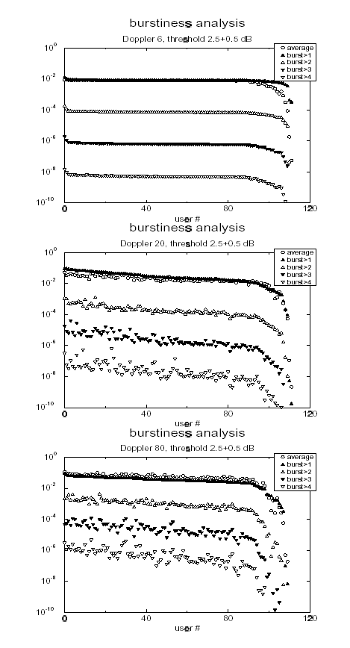
Simulation Parameters (5/6)
The results in the first plot, for slow fading, show that most users will see independent errors, since power control equalizes SIR so well that all randomness due to fading and interference is absorbed. Also, the fading randomness equalizes performance across most users, since all will essentially see the same average. This behavior resembles the behavior observed in the two-state Markov model.
As expected, as fading rate increases everything gets more mixed, but a similar qualitative trend can still be observed. Note that a positive burst correlation can be observed i.e. P[E|E] ≈ P[burst>1]>P[E] in most cases for values of the Doppler up to 20Hz. This indicates that the system tends to stay in the bad state i.e. errors tend to be clustered, which is intuitive pleasing since the channel has memory. This resembles to the behavior observed in the three-state Markov model.
On the other hand, for fast fading the opposite is observed, i.e. the system tends to escape from error states. This can be explained by noting that the power control tends to increase the transmitted power when an error is observed while at the same time the dynamics of the channel tend to make the channel exit quickly from bad conditions, so that right after an error the probability that a transmission is successful is higher than average. We refer to this case in which errors tend to occur isolated as the case of “anticorrelated” errors. This resemble the behavior observed in the two-state Markov model

Slide 35
Simulation Parameters (6/6)
TCP Improvements Proposed for 3G
Large Window Size (Sender and Receiver)
Increased Initial Window (Sender). The initial CWND must be
equal to min ( 4 MSS , max ( 2 MSS , 4380 bytes ))
Limited Transmit (Sender)
IP larger than Default:
576bytes (min IP compatible) < MTU < 1500bytes
Typical 1000 bytes (12/1000 bytes = only 1,2% overhead)
MTU Discovery (Sender and Intermediate Routers)
Explicit Congestion Notification activated (Sender, Receiver, Routers) for congestion avoidance.

Slide 36
NS 2 (1/2)
In order not to “reinvent the wheel”, as base for our simulations we use the widely used Network Simulator (NS) version 2 (2.1b9).
NS2 is THE Network Simulator, widely used from the network community, providing procedures for all versions of TCP and TCP applications.
It is an object-oriented, discrete event driven network simulator developed at Lawrence Laboratories - UC Berkely (maintained by Information System Institute-ISI) written in C++ and OTcl and running in the UNIX operating system.
All simulation results can be viewed by the Network Animator (NAM) which is a simulation display tool.

Slide 37
NS 2 (2/2)
How it works
Applications
Sink
Agent (TCP)
Agent (TCP)
Node 1
Node 2
By observing the intermediate nodes or edge nodes we can examine
the behavior of the network and applications. Statistics can also be taken

Slide 38
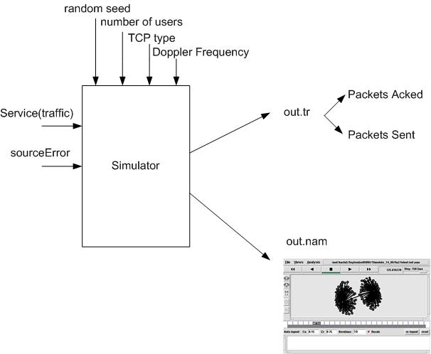
Our Simulator (1/5)
By monitoring the intermediate and edge nodes, NS provides specific output format. By using pattern recognition tools: awk and cat we can determine the number of packets sent and correctly acked end-to-end.
With NAM tool we can have a visible representation of topology and behavior of our simulations

Slide 39
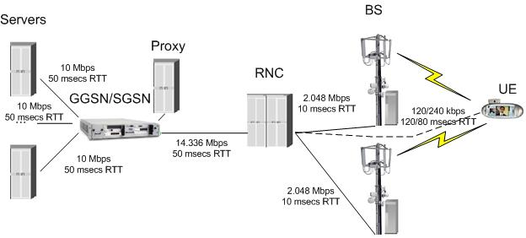
Our Simulator (2/5)
General Topology of our Simulations

Slide 40
Our Simulator (3/5)
More Specifications
We use three TCP Applications: FTP, Telnet and HTTP
FTP: Poisson Request adapted per user
Telnet: Poisson Request adapted per user
HTTP: HTTP/1.1 with Proxy functionalities
  Inter-page interval exponential (mean duration) 1 second
  Number of Page (mean duration) 4
  Inter object interval exponential (mean duration) 0.01 second
  Number of packets per object Pareto distributed shape 1.2 and scale 10

Slide 41
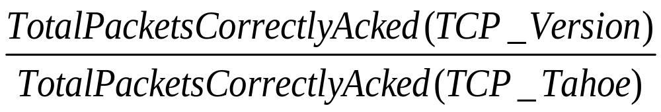
Our Simulator (4/5)
We examine TCP Performance, Energy Consumption and Application Efficiency for users with 120 and 240 kbps
for each version of TCP
for Doppler 6 , 20 and 80 Hz
Duration of simulation : 600 seconds
TCP Performance :

Slide 42
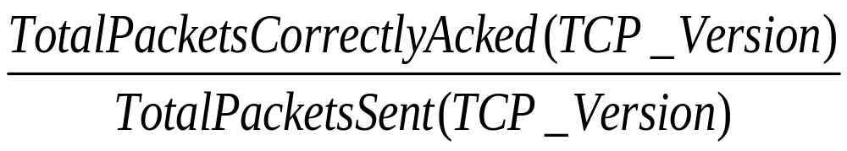
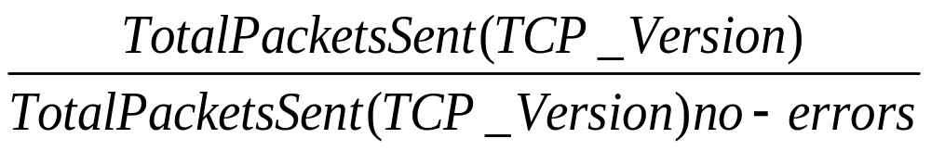
Our Simulator (5/5)
TCP Energy Consumption:
(or Resource Consumption
including Power(WCDMA),
CPU,RAM)
Efficiency of TCP Applications:
(literature has shown that this
factor is load independent)

Slide 43
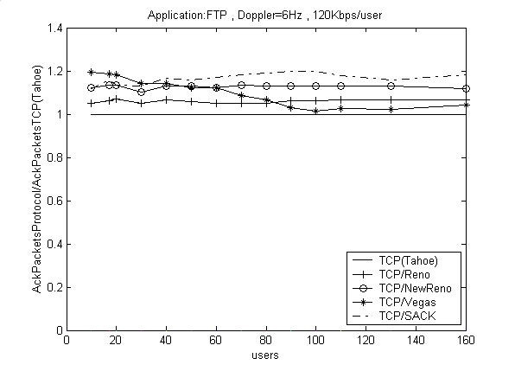
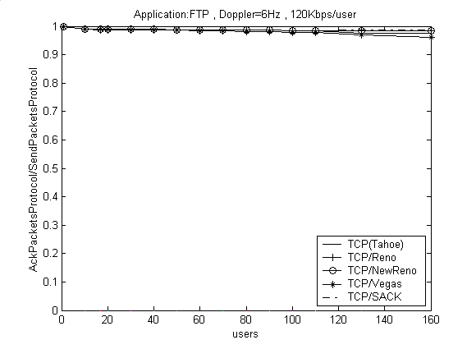
Results and Discussion (1/14)
TCP Vegas outperforms only when load is light
If number of users > 30
TCP SACK outperforms
And TCP New Reno follows
TCP SACK outperforms slightly
In all cases and especially as number
of users increases

Slide 44
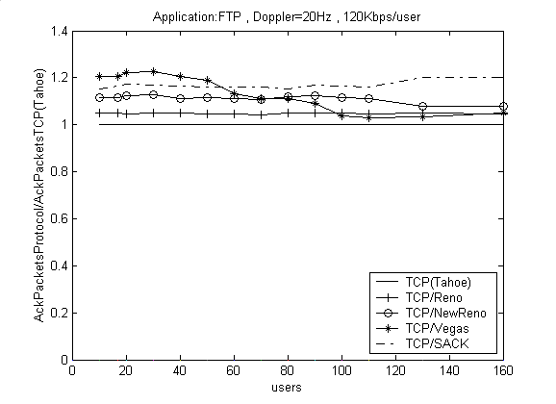
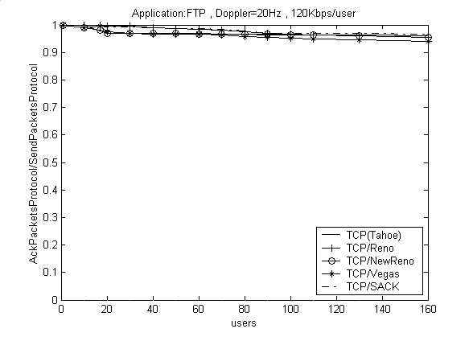
Results and Discussion (2/14)
TCP Vegas outperforms only when load is light
If number of users > 50
TCP SACK outperforms
And TCP New Reno follows
TCP SACK outperforms slightly
In all cases and especially as number
of users increases

Slide 45
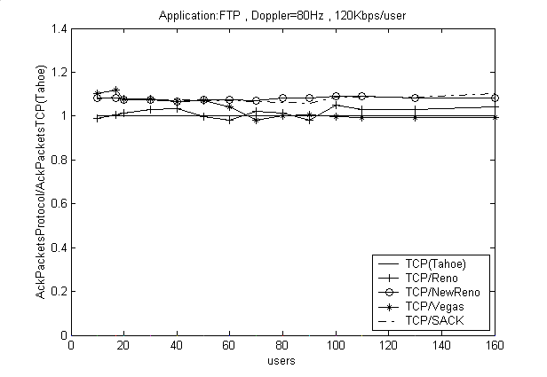
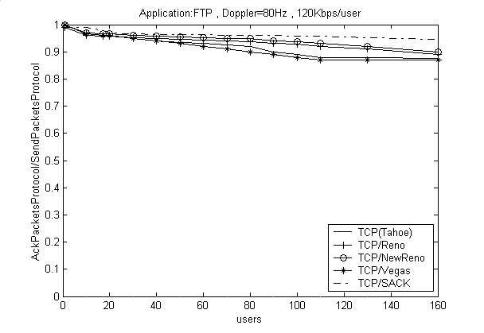
Results and Discussion (3/14)
TCP Vegas outperforms only when load is very light
If number of users > 20
TCP SACK and TCP New Reno
share the same performance
TCP SACK outperforms slightly
In all cases and especially as number
of users increases when the difference is obvious

Slide 46
Results and Discussion (4/14)
FTP Application
TCP Vegas outperforms when load is light
When the load is not very light TCP SACK outperforms TCP New Reno and all the other TCP versions follows
If Doppler is equal to 80Hz TCP New Reno share the same performance as TCP SACK
In all cases TCP SACK consumes less energy than any other TCP version

Slide 47
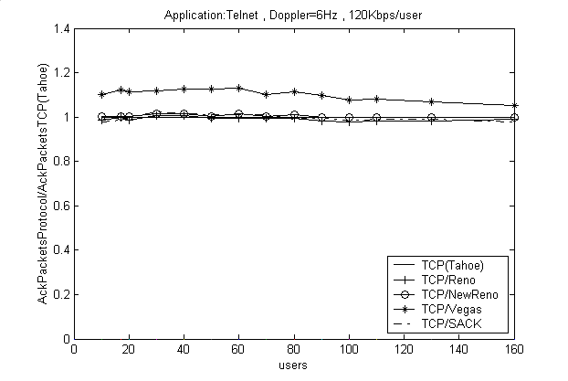

Results and Discussion (5/14)
TCP Vegas outperforms all TCP Versions
TCP SACK outperforms slightly
In all cases and especially as number
of users increases

Slide 48


Results and Discussion (6/14)
TCP Vegas outperforms all TCP Versions
TCP SACK outperforms slightly
In all cases and especially as number
of users increases

Slide 49


Results and Discussion (7/14)
TCP Vegas outperforms all TCP Versions
TCP SACK outperforms slightly
In all cases and especially as number
of users increases

Slide 50
Results and Discussion (8/14)
Telnet Application
TCP Vegas outperforms in all cases
In all cases TCP SACK consumes less energy than any other TCP version

Slide 51


Results and Discussion (9/14)
TCP HTTP outperforms and
TCP New Reno follows
TCP SACK outperforms in all cases and especially as number
of users increases

Slide 52


Results and Discussion (10/14)
TCP HTTP outperforms and
TCP New Reno follows
TCP SACK outperforms in all cases and especially as number
of users increases

Slide 53


Results and Discussion (11/14)
TCP HTTP outperforms and
TCP New Reno follows
TCP SACK outperforms in all cases and especially as number
of users increases

Slide 54
Results and Discussion (12/14)
HTTP Application
TCP SACK outperforms in all cases
In all cases TCP SACK consumes less energy than any other TCP version

Slide 55
Results and Discussion (13/14)
Statement for users with 240 Kbps bit rate
In the case of 240Kbps users we noticed the same behavior with 120Kbps link capacity in all applications and similar results about energy consumption have been observed. The only difference worth mentioning is that in the case of 240Kbps in HTTP application, TCP SACK still outperforms the others but to a smaller extend than before

Slide 56

Results and Discussion (14/14)
Application Efficiency

Slide 57
Conclusions & Future Work (1/3)
There is not a TCP Version that outperforms all the other in all
cases, however, TCP SACK outperforms all the other TCP
Version in Energy Consumption.
More than 75% of UMTS load will be HTTP load. In HTTP
Application TCP SACK outperforms all the other TCP Versions
Most of Operating Systems use only one type of TCP
UMTS must support TCP SACK (or TCP New Reno if
TCP SACK can not be used). If more TCP versions can be
used TCP Vegas will be suitable for special applications.

Slide 58
Conclusions & Future Work (2/3)
An IETF Draft published in August is in clear agreement with the results of our Thesis:
IETF Draft (draft-ietf-pilc-2.5g3g)
“TCP over 2.5G/3G SHOULD support SACK. In the absence of SACK feature, the TCP should use New Reno”

Slide 59
Conclusions & Future Work (3/3)
Future Work
Future Real Time Application Protocols will use TCP not only
for control data but also for information delivery. This protocols
can be used over UMTS. If the traffic of this TCP Application
can be modeled then we can select the best TCP version.

Slide 60
THE END
QUESTIONS if any… ☺
?
?
?

