Slide 1
















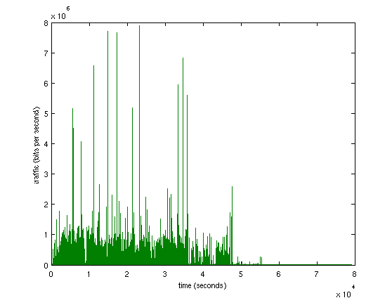
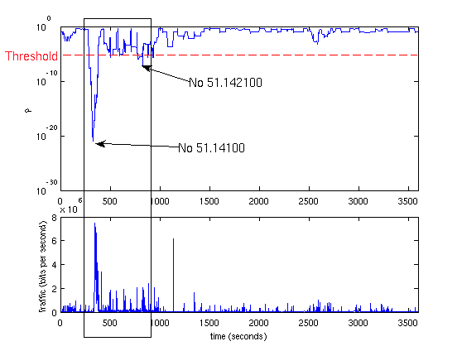


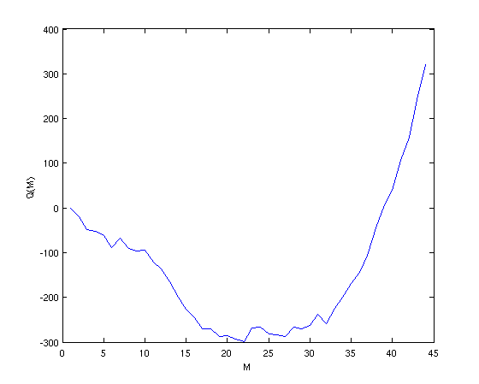

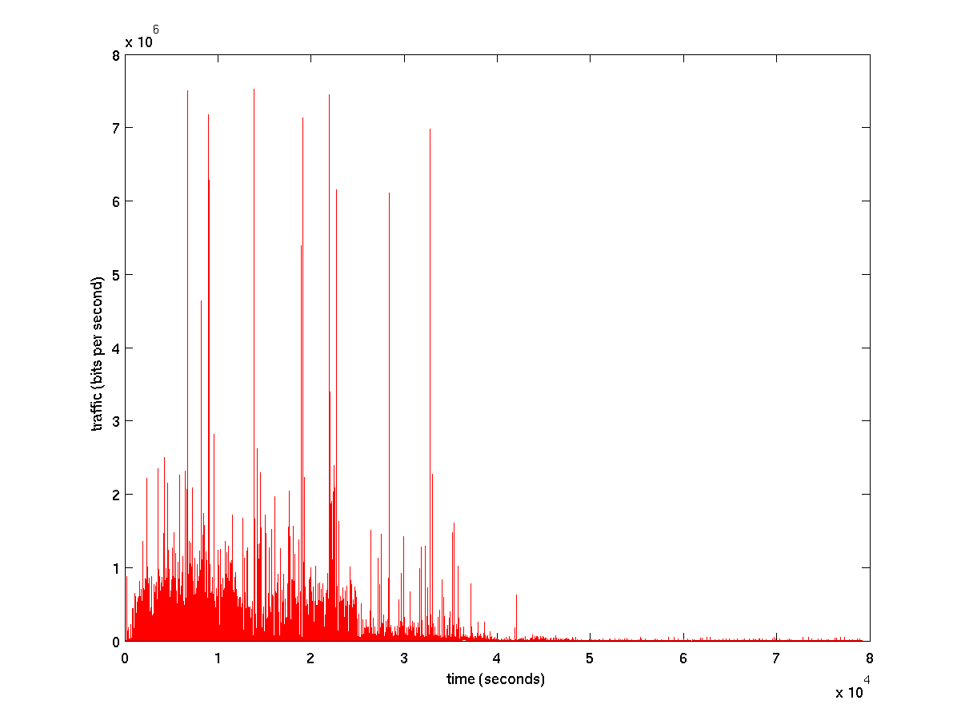


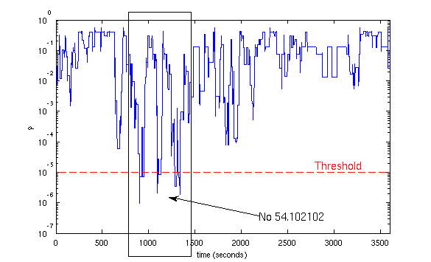
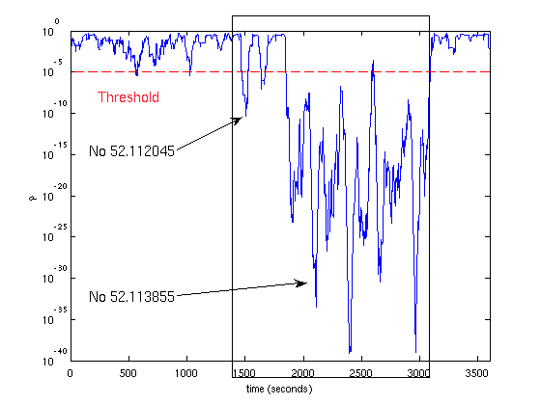

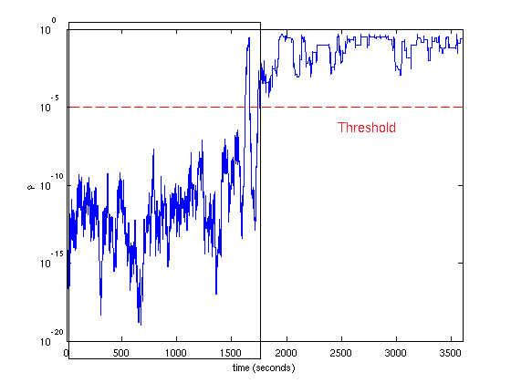
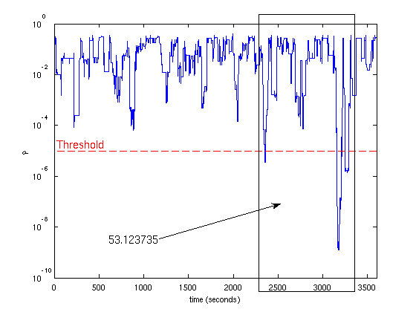
Statistical Traffic Anomaly Detection:
A Large Deviations Approach
Ioannis Ch. Paschalidis, Maria Konte, Georgios Smaragdakis – Boston University
Introduction
We introduce a traffic anomaly detection mechanism based on Large Deviations asymptotic results. We monitor the aggregated traffic at a border router of a local network during busy hours, where no anomalies have been observed. We model this traffic with disjoint Markov modulated processes estimating the optimal number of states using the Akaike's Information Criterion and we assume that this model is reliable for representing the traffic activity for this time interval of the day. Using the model as reference we rapidly identify anomalies in traces corresponding to the same time-of-day interval. To that end, we develop Large Deviations results to assign to each traffic sample a probability of being “consistent'' with the reference model. Our simulation results show that (even short-lived) anomalies are identified within a small number of observations. We have developed software to validate our technique by analyzing real traffic traces with time-stamped attacks.
Theoretical Background
Assume that the d-MMP has an irreducible underlying Markov chain with M states 1,2,…,M and transition probability matrix .Let denote the vector consisting of the rows of .
Let denote a sequence of states that the Markov chain visits with the initial state being
, and consider the empirical measures where is the indicator function for the subset
Let now denote the set of pairs of states that can appear in the sequence and denote by the standard - dimensional probability simplex, where denotes the cardinality of . For any , let
and be it’s marginals.
Whenever , let . We will be using the notation
. We say that a probability measure is shift invariant if both its marginals are identical. A large deviations result for is established in the next theorem:
Theorem
For every let =
where is the relative entropy, that is,
Then, for any set of probability vectors in ,
Where denotes the interior of . More intuitively, Theorem II.1 states that for a long trace
(i.e, large ) it’s empirical measure is “close to” with probability that behaves as
Advantages: 1. General, as it detects all types of anomalies
2. Prompt, as it can detect on line the anomalies within a small number of
observations.
3. Our threshold is independent of traffic volume moments.
Method Overview
Attack Detection
Reliable Model
Large Deviations Theory
Model Training
Training Traffic
Testing Traffic
DOS Attack
Anomaly Detection Algorithm
1) From an anomaly-free trace obtain a d-MMP with transition probability vector .
2) For each time let the trace of current traffic activity of
consecutive traffic measurements (in bits/sec). Compute its empirical measure
and let = , be the result.
3) Then, approximates the probability that the trace is drawn from the
d-MMP with transition probability vector . If is consistently low for some observed time interval (e.g., for 10 seconds), we conclude that the observed trace does not “appear coming” from the reliable model which indicates an anomaly.
Experimental Results
DATA Attack
U2R Attack
Performance Evaluation
Attack Category | Success Rate
Data | 100%
DoS | 89.50%
PROBE | 84.60%
R2L | 76.50%
U2R | 88%
Overall | 88%
Day | Attacks | Attacks Identified | False Alarms
Monday | 17 | 16 | 3
Tuesday | 21 | 17 | 1
Wednesday | 13 | 8 | 1
Thursday | 13 | 13 | 4
Friday | 19 | 19 | 2
Overall | 83 | 73 | 11*
* These false alarms may correspond to other types of traffic anomalies that we that are not described in the DARPA evaluation of attacks.
R2L Attack
PROBE Attack

