Slide 1




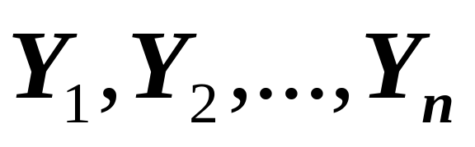
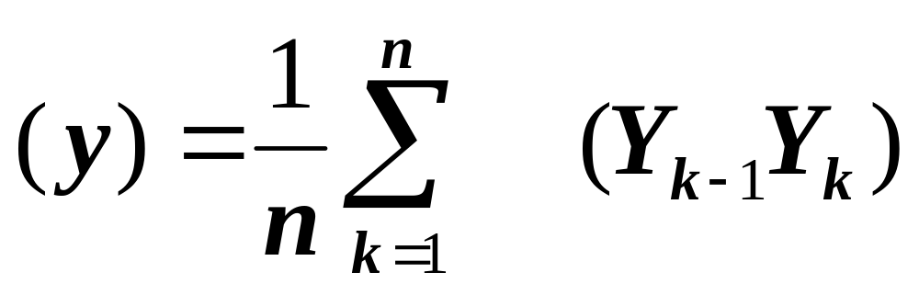


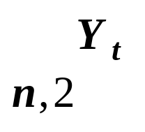


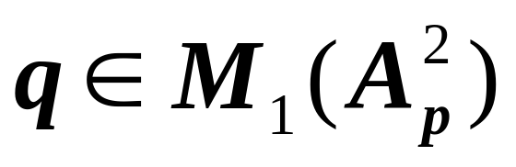
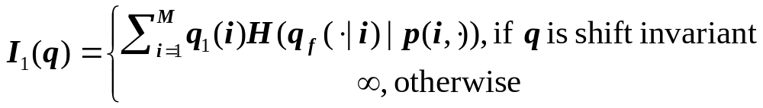





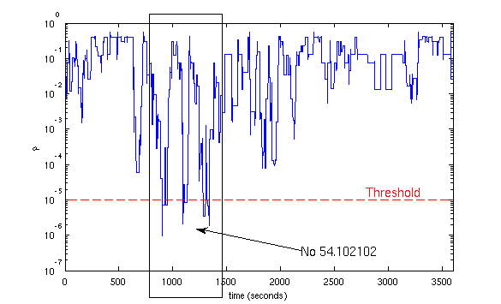
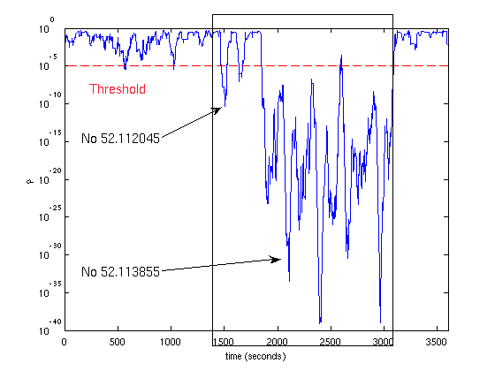
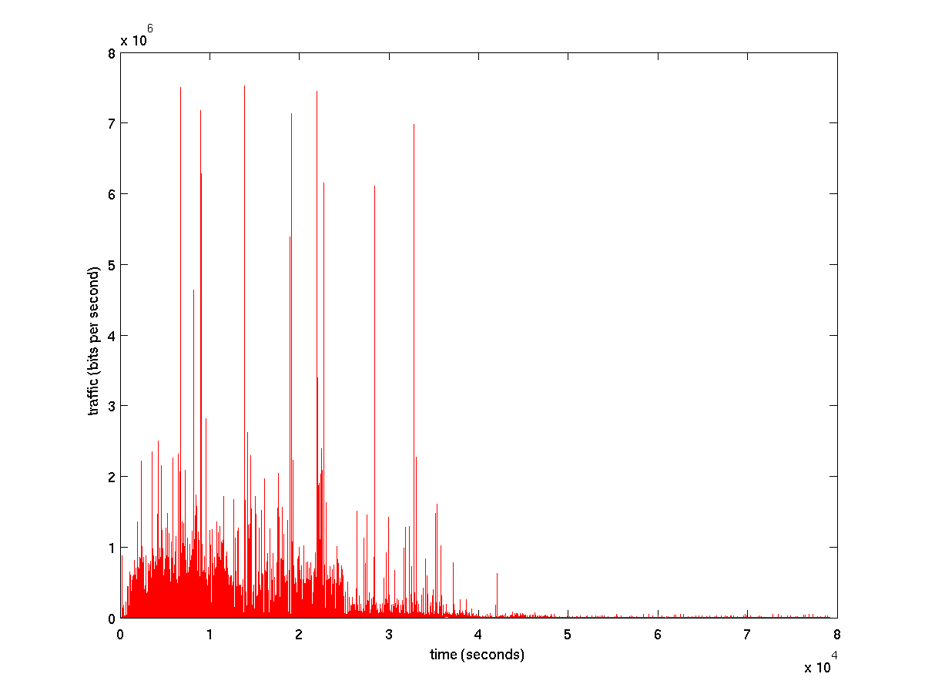
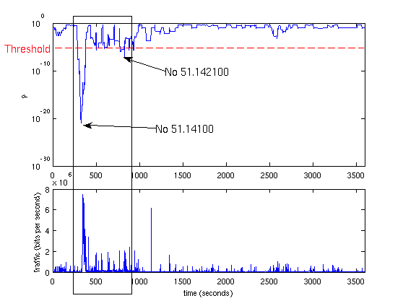
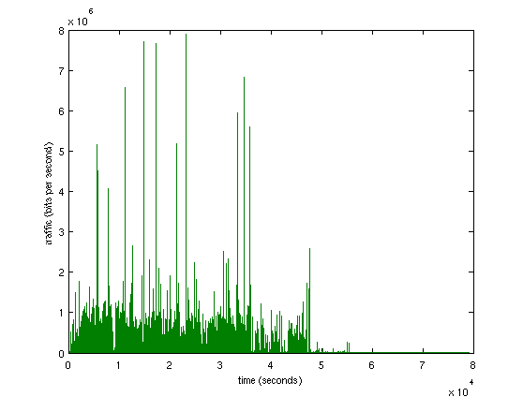

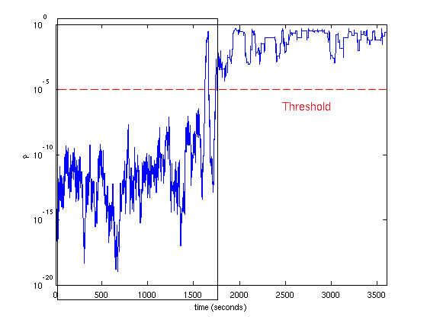
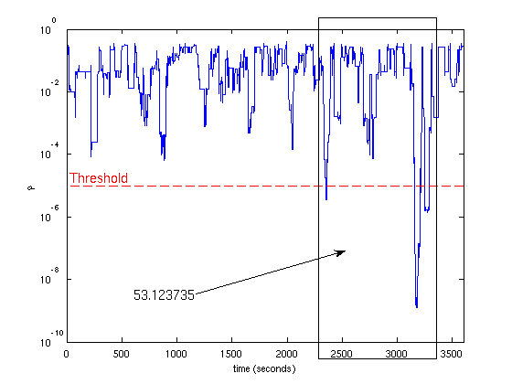
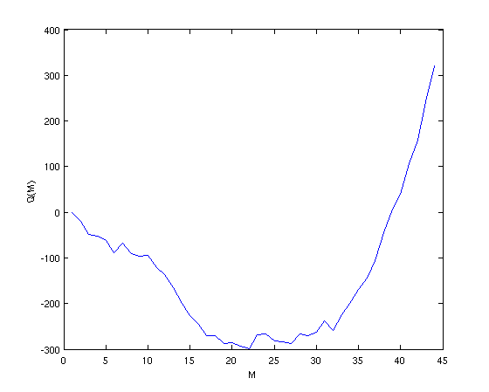
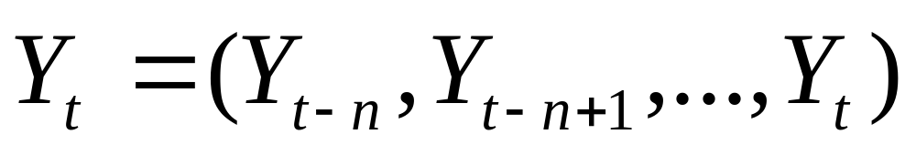


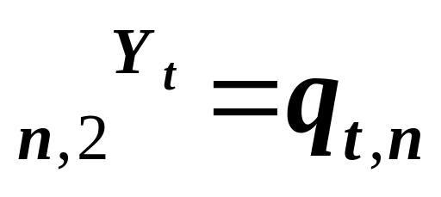
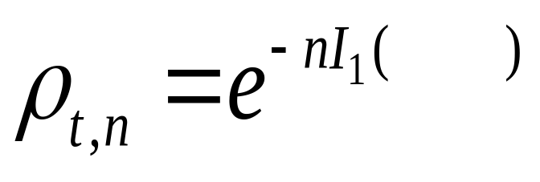


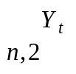

Statistical Traffic Anomaly Detection:
A Large Deviations Approach
Georgios Smaragdakis, Maria Konte, Ioannis Ch. Paschalidis – Boston University
Abstract
We introduce a traffic anomaly detection mechanism based on Large Deviations asymptotic results. We monitor the aggregated traffic at a border router of a local network during busy hours, where no anomalies have been observed. We model this traffic with disjoint Markov modulated processes estimating the optimal number of states using the Akaike's Information Criterion and we assume that this model is reliable for representing the traffic activity for this time interval of the day. Using the model as reference we rapidly identify anomalies in traces corresponding to the same time-of-day interval. To that end, we develop Large Deviations results to assign to each traffic sample a probability of being “consistent'' with the reference model. Our simulation results show that (even short-lived) anomalies are identified within a small number of observations. We have developed software to validate our technique by analyzing real traffic traces with time-stamped attacks.
Theoretical Background
Assume that the d-MMP has an irreducible underlying Markov chain with M states 1,2,…,M. Let denote a sequence of states that the Markov chain visits and consider the empirical
measures where is the indicator function for the subset
A large deviations result for is established in the next theorem:
Theorem
For every let
where is the relative entropy. More intuitively, Theorem states that for a long trace Y (i.e, large n ) it’s empirical measure is “close to” q with probability that behaves as
Advantages: 1. General, as it detects all types of anomalies
2. Prompt, as it can detect on line the anomalies within a small number of
observations.
3. Our threshold is Independent of traffic volume moments.
Experimental Results
Method Overview
Attack Detection
Experimental Setting
Testing Traffic
Model
Training
Reliable
Model
Large Deviations Theory
Training Traffic
DATA Attack
U2R Attack
DOS Attack
Markov Modulated Models
Akaike’s Information Criterion
1
2
…
K
K+1
…
Opt#
Training Traffic
Optimal # of States
R2L Attack
PROBE Attack
Anomaly Detection Algorithm
1) From an anomaly-free trace obtain a d-MMP with transition probability vector .
2) For each time t let the trace of current traffic activity of n
consecutive traffic measurements (in bits/sec). Compute its empirical measure
and let be the result (n is the size of a sliding window).
3) Then, approximates the probability that the trace is drawn from the
d-MMP with transition probability vector . If is consistently low for some observed time interval (e.g., for 10 seconds), we conclude that the observed trace does not “appear coming” from the reliable model which indicates an anomaly.
Performance Evaluation
Attack Category | Success Rate
Data | 100%
DoS | 89.50%
PROBE | 84.60%
R2L | 76.50%
U2R | 88%
Overall | 88%
Day | Attacks | Attacks Identified | False Alarms
Monday | 17 | 16 | 3
Tuesday | 21 | 17 | 1
Wednesday | 13 | 8 | 1
Thursday | 13 | 13 | 4
Friday | 19 | 19 | 2
Overall | 83 | 73 | 11*
* These false alarms may correspond to other types of traffic anomalies that are not described in the DARPA evaluation of attacks.

