Slide 1
A Large Deviations Approach to Statistical Traffic Anomaly Detection
Georgios Smaragdakis (gsmaragd@cs.bu.edu)
Joint Work with Yannis Paschalidis

Slide 2
Introduction (1)
Anomalies may manifest in several forms:
DoS attacks
High Traffic
Router misconfigurations
BGP policy modifications
Probing/Scanning
Compromises
Trojan horses/Worms
Network failures

Slide 3
Introduction (2)
Why analyze anomalies:
Operational/Monitoring reasons:
attacks, worms, congestion, resource utilization, etc
Network Planning

Slide 4
Introduction (3)
Limitations:
  Revising signature database
  Emerging cyber threats
  Latency in deployment
Current Approaches
Misuse detection / Signature based
  Known intrusion patterns
  Record patterns -> monitor event sequences
  -> report matched events
Statistical Anomaly detection
  Deviation from normal behavior
  Self-learned -> adapts to network
  Normal behavior profiles -> observe current activity -> report deviations

Slide 5
Introduction (4)
Key challenges:
Large data size
High Dimensionality [Lakhina et al]
Spatial/Temporal nature of the data
Fast Response

Slide 6
Overview of our Methodology (1)
Standard procedure:
Observe the past to capture normal behavior &
continuously monitor the system to detect deviations
Novelty:
Normal behavior characterization through:
(i) A model-based approach (d-MMP)
(ii) A model-free approach (method of types)
Employment of LD theory to assess deviations from normal behavior
Why LD?
Handles rare events & associated probabilities

Slide 7
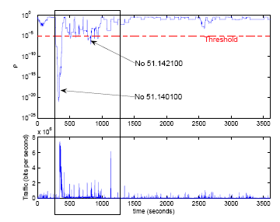
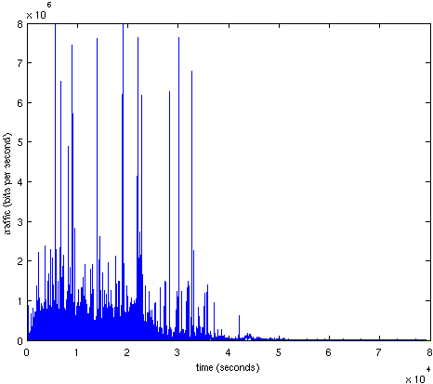
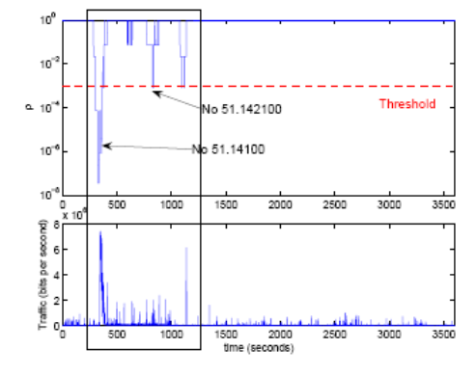

Overview Of our Methodology(2)
Model-based Approach
Model-based anomaly detection algorithm
Reference construction
…
…
d-MMP model
Training data
Anomaly detection
Testing data
Model-free Approach
Model-free
anomaly detection algorithm
Reference construction
Alphabet on the partial sums
Training data
Anomaly detection
Testing data

Slide 8
Note:
Traffic has diurnal variations
But for short time intervals (~ 1h), stationary model can be appropriate
A different model for different time of day intervals (morning, busy hours, overnight)
A Model-Based Approach (1)

Slide 9
A Model-Based Approach (2)
The d-MMP (HMM) is characterized by an
underlying Markov Chain.
Each state i=1,…,M is associated with an interval [r_{i-1},r_{i}]
Model parameters:
(i) The number of states
(ii) The range of values associated with every state
(iii) Estimation of state transition probabilities

Slide 10
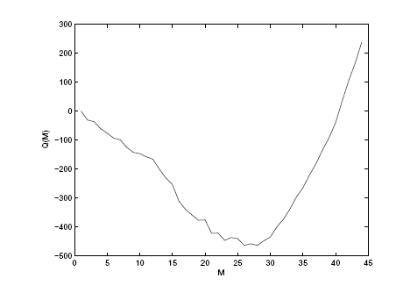
A Model-Based Approach (3)
Model parameters selection:
(i) Number of states
Akaikes Information Criterion (AIC):
L(): Log-likelihood of the model with respect to one realization
Advantage: Removal of bias to favor models with a large number of parameters.
(ii) Range of intervals: Initial selection of equally length intervals and then merge of the unobserved states.

Slide 11
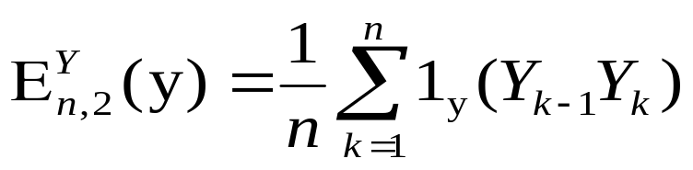
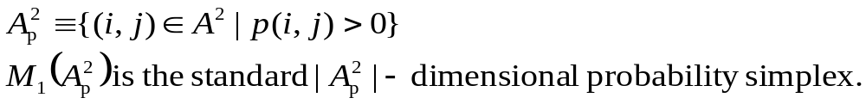
A Model-Based Approach (4)
Notation:
d-MMP: irreducible M-C with M states and transition probability vector p
Y: a sequence of states the M-C visits
Empirical measures:
The set of pairs that can appear in the sequence:

Slide 12
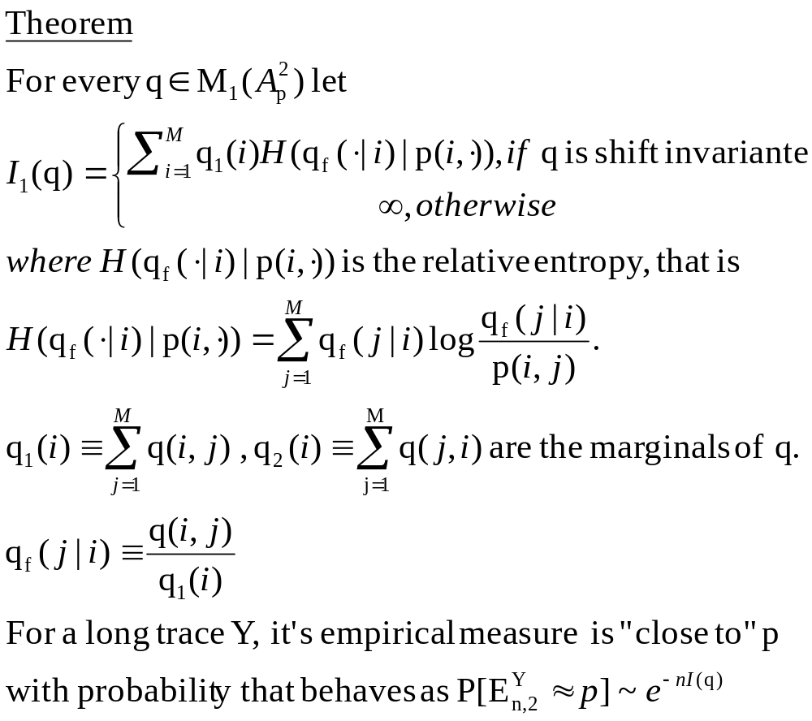
A Model-Based Approach (5)

Slide 13
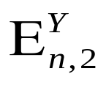

Model – Based Anomaly Detection Algorithm
From an anomaly free trace obtain a d-MMP with transition probability vector p.
For each time t let Y_{t}=(Y_{t-n+1}, … ,Y_{t}) the trace of current traffic activity. Compute it’s empirical measure
Then, approximates the probability that the trace Y_{t} is drawn from the d-MMP with transition probability vector p.

Slide 14
Model – Based Anomaly Detection Algorithm
From an anomaly free trace obtain a d-MMP with transition probability vector p.
For each time t let Y_{t}=(Y_{t-n+1}, … ,Y_{t}) the trace of current traffic activity. Compute it’s empirical measure
Then, approximates the probability that the trace Y_{t} is drawn from the d-MMP with transition probability vector p.

Slide 15
Model – Based Anomaly Detection Algorithm
From an anomaly free trace obtain a d-MMP with transition probability vector p.
For each time t let Y_{t}=(Y_{t-n+1}, … ,Y_{t}) the trace of current traffic activity. Compute it’s empirical measure
Then, approximates the probability that the trace Y_{t} is drawn from the d-MMP with transition probability vector p.

Slide 16
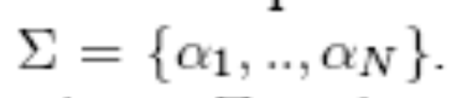

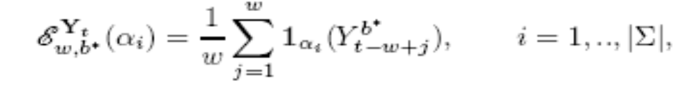
A Model – Free Approach (1)
X₁,…,X_{n} traffic activity (bits/sec)
Y^{b}_{t} partial sum over the time bucket containing
b* samples
Use of the previous technique for the alphabet construction
Map the partial sums to the alphabet
Notation:
the space of all probability measures on the
alphabet
the type
(empirical measure) of Y_{t}

Slide 17
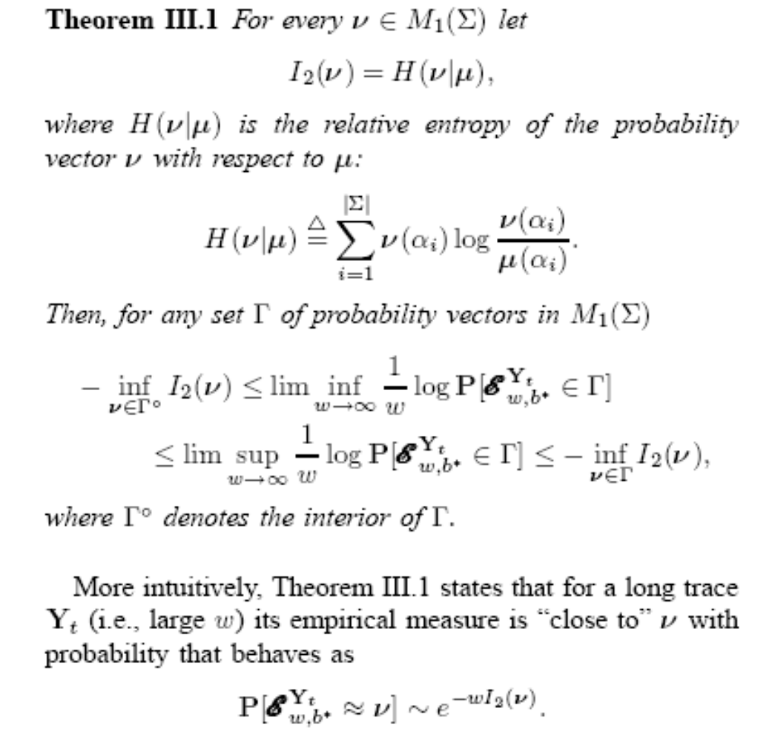
A Model – Free Approach (2) –
Sanov’s Theorem

Slide 18
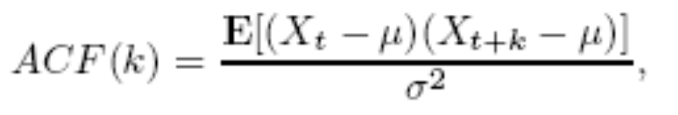
A Model – Free Approach (3)
Crucial assumption: Y^{b*}₁,…,Y^{b*}_{[b/n]} are i.i.d for
some appropriate bucket size b*.
Validation of the independence assumption:
Correlation between elements X1,…,Xn of traffic over short time scale (1 sec).
The ACF function is defined as
Long-Range Dependence if ACF(k) decays following a power law.
Short-Range Dependence if ACF(k) decays to 0 fast.

Slide 19
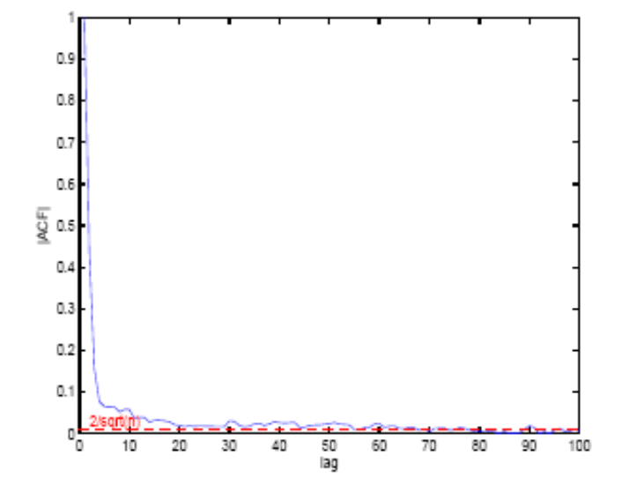
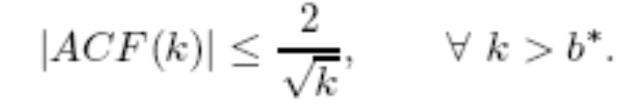
A Model – Free Approach (4)
Select the bucket size such that:
The bucket size cannot be selected for a long period of time due to diurnal variation.
For smaller time periods (10 hours) ACF reaches the bound of 20.
Performing external shuffling ACF is very close to 0.

Slide 20
A Model – Free Approach (5)
Validation of the identical distribution of
partial sums:
Given the sequence of the partial sums
Use of the Kolmogorov-Smirnov goodness of fit test on two subsequences: Start with the initial
Hypothesis H₀. The test outputs the limit distribution (of Dmax of the two CDFs) under the initial Hypothesis.

Slide 21


Model – free Anomaly Detection Algorithm
From an anomaly free trace obtain an alphabet
and the empirical measure (law) µ.
For each unit time t let Y_{t}=(Y^{b*}_{t-w+1},…,Y^{b*}_{t}) be the trace of the w most recent partial sums using a bucket size b*. Compute the empirical measure .
Then, approximates the probability that the trace Y_{t} is drawn from the probability law µ.

Slide 22
Model – free Anomaly Detection Algorithm
From an anomaly free trace obtain an alphabet
and the empirical measure (law) µ.
For each unit time t let Y_{t}=(Y^{b*}_{t-w+1},…,Y^{b*}_{t}) be the trace of the w most recent partial sums using a bucket size b*. Compute the empirical measure .
Then, approximates the probability that the trace Y_{t} is drawn from the probability law µ.

Slide 23
Model – free Anomaly Detection Algorithm
From an anomaly free trace obtain an alphabet
and the empirical measure (law) µ.
For each unit time t let Y_{t}=(Y^{b*}_{t-w+1},…,Y^{b*}_{t}) be the trace of the w most recent partial sums using a bucket size b*. Compute the empirical measure .
Then, approximates the probability that the trace Y_{t} is drawn from the probability law µ.

Slide 24


DATASET 1: 1999 DARPA Data Set
MIT Lincoln Laboratory
Inbound traffic at the border of a local network
Data gathered for 22 h/day
3 weeks of training
2 weeks of network based attacks in the midst of normal background data

Slide 25
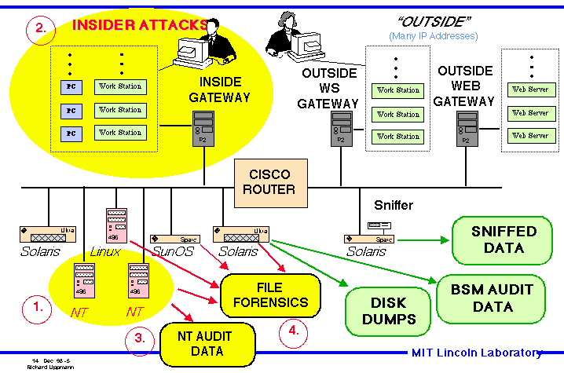
Simulation Network

Slide 26
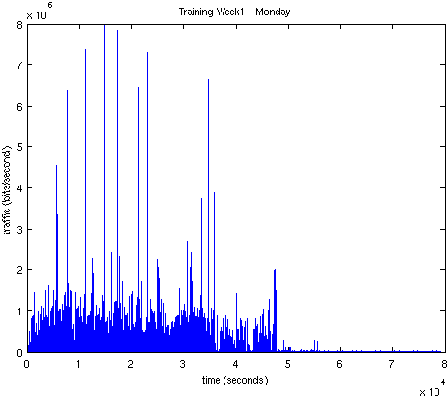
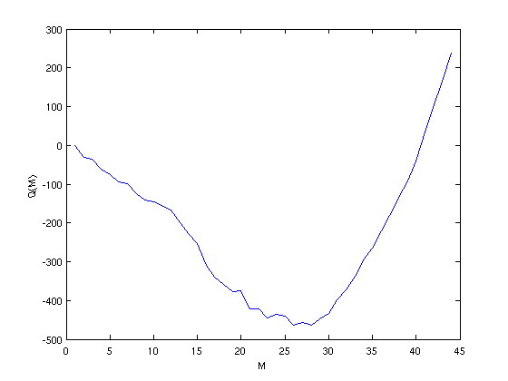
Simulations Results (1)
AIC yields 28 states
Anomaly free traffic
Monitored Traffic
Training period for the model:
36,000 sec (8:00 am – 6:00 pm)
Legitimate?

Slide 27
Type of Anomalies
DoS: unauthorized attempt to break down a host
DATA: Unauthorized modification of Data
PROBE: Unauthorized probing
R2L: Obtain user privileges without authorization
U2R: unauthorized access to local superuser

Slide 28
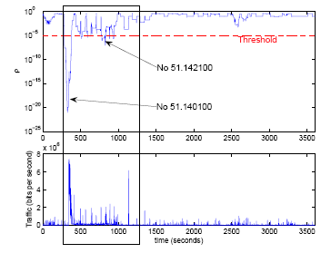
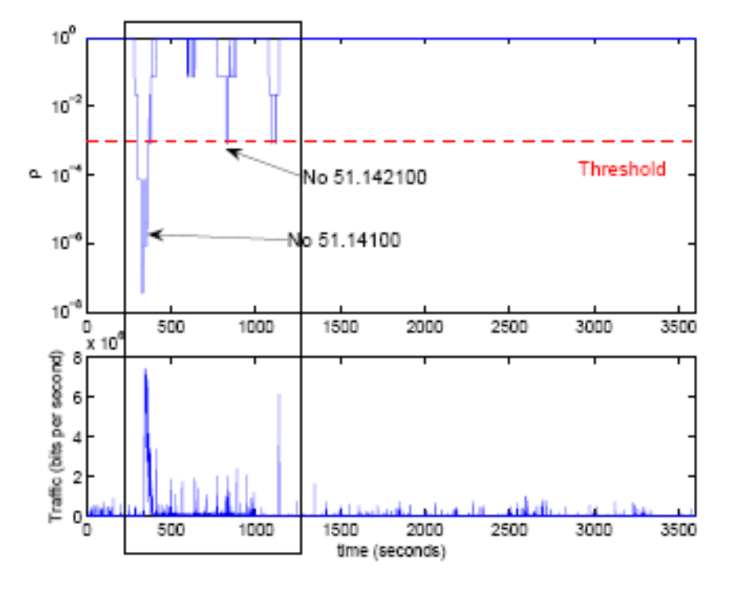
Simulation Results (2)
Model-based approach
Model-free approach
Monday, fifth week Inbound traffic (time-stamped attacks trace) 2:00 pm – 3:00 pm

Slide 29
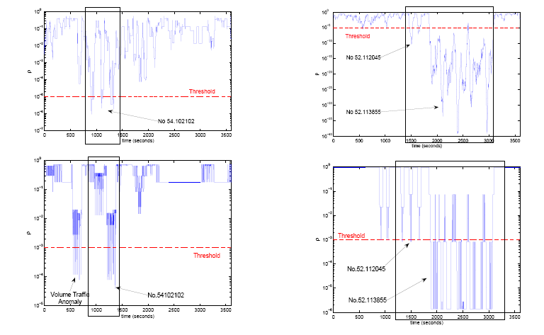
Simulation Results (3)
Data type detection
U2R detection

Slide 30
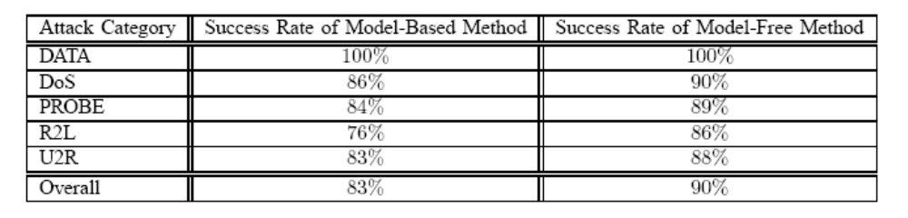
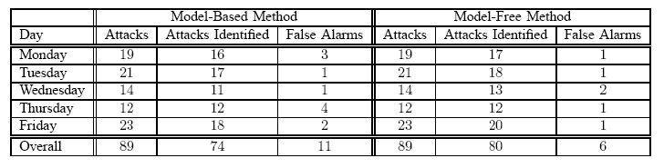
Performance Evaluation
Model based:
more responsive
more sensitive
Operates in shorter time scale
Model free:
Fewer false alarms
Detects more easily volume
anomalies

Slide 31
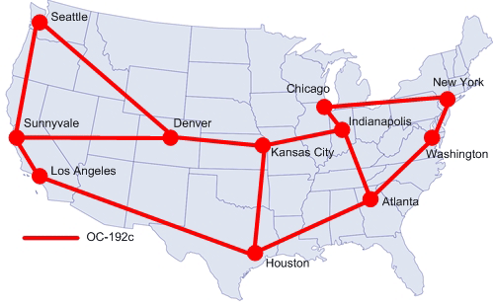
DATASET 2: The Abilene Network
(work in progress)

Slide 32
Data Traces:
Sampling in random 1% of packets entering the router (1 Week of Data)
Origin-Destination flows
  B(yte) representation
  P(acket) representation
  F(low) representation

Slide 33
Type of Anomalies
DoS: Distributed Denial of Service attack against a single victim
=> In P representation
SCAN:Scanning host for a vulnerable port (port scan) or scanning the network for a target port (network scan)
  => In F representation
ALPHA: Unusually high rate point to point byte transfer
=> In B representation

Slide 34
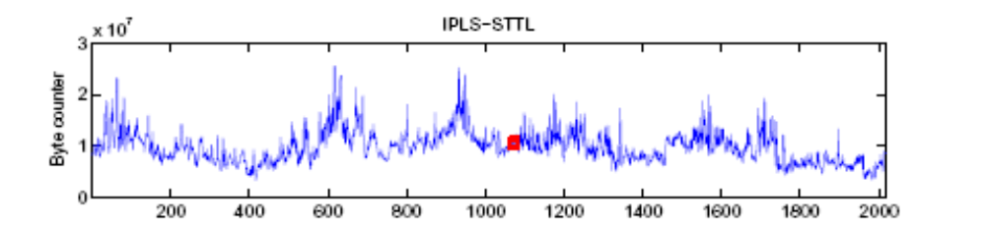
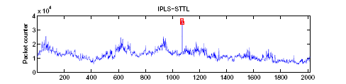
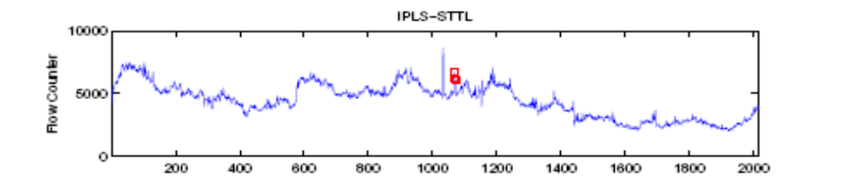
Preliminary results: Identifying a DoS Attack (1)

Slide 35
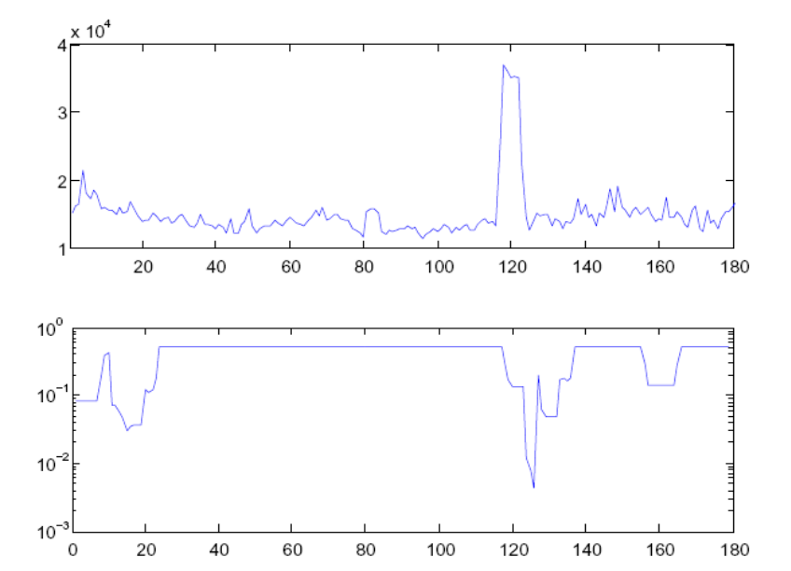
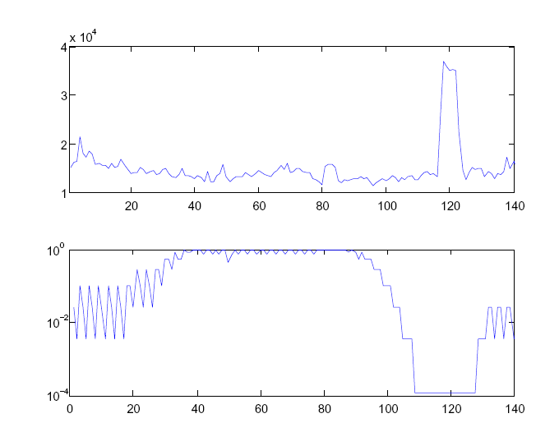
Preliminary results: Identifying a DoS Attack (2)
Model-Based Method
Model-Free Method

Slide 36
Key Features (1)
On-line method
Detection in short time scales (1 sec/
5 mins for netflow)
Detection of attacks that do not affect the volume traffic
A simple infrastructure is required – bit counter (single link) but advanced technologies like netflow can also be used (for the whole internet)

Slide 37
Key Features (2)
The reference trace can be updated periodically
Useful deviations can be detected even using a trainted reference trace
It is a general framework - not application specific traces or networks
Easily adapted to identify anomalies in any trace of system activity – e.g. access to various destination ports, IP source-destination addresses, system calls, etc.)

Slide 38
Possible Applications
Embeded in routers/interface card of every host in a local network or in PoPs
As a new component in Monitoring Systems

Slide 39
Thank you

Slide 40
Main References
Paschalidis, S. Vassilaras, “On the estimation of Bufferoverflow probabilities form measurments”, IEEE Transactions on Information Theory 2001.
Lakhina, M. Crovella, C. Diot, “Diagnosing Network-Wide Traffic Anomalies”, SIGCOMM 2004.

