Slide 1




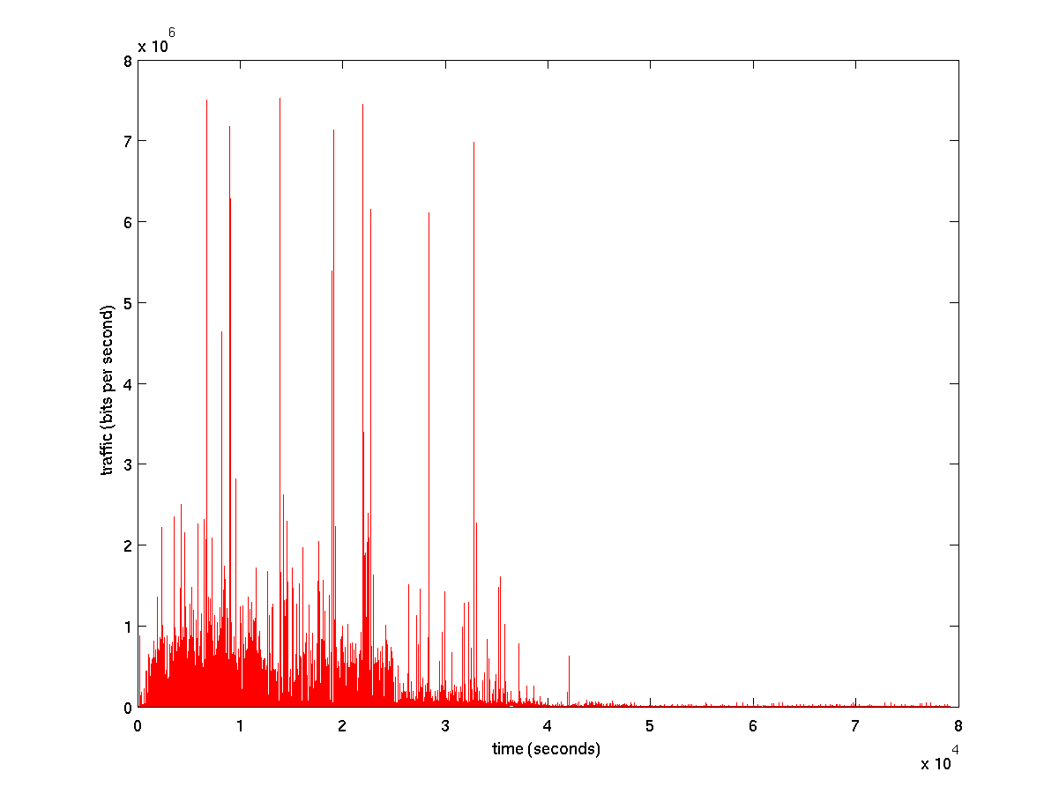

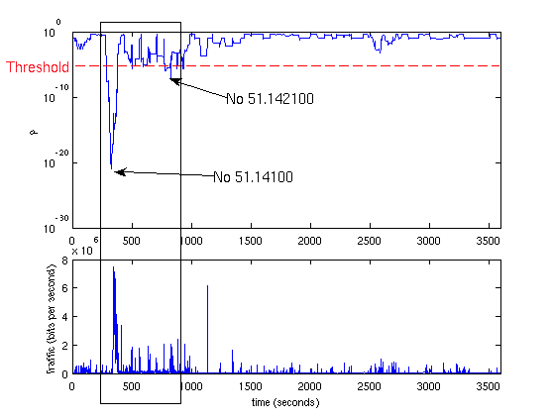
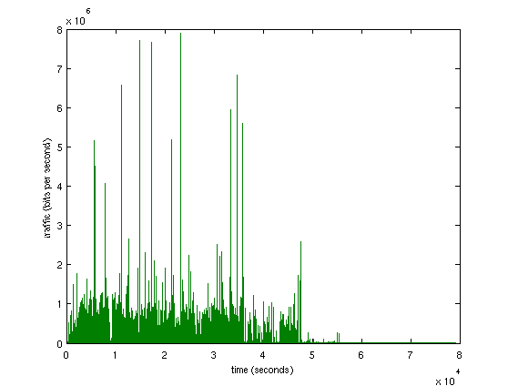
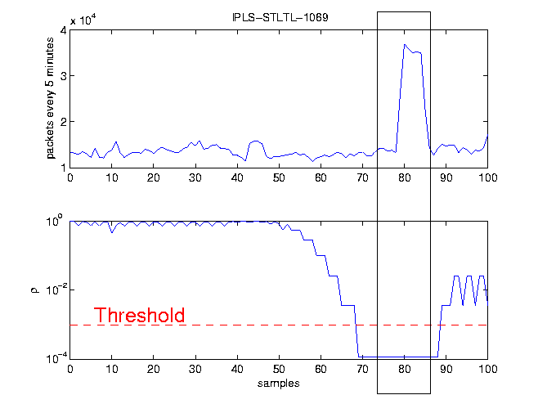
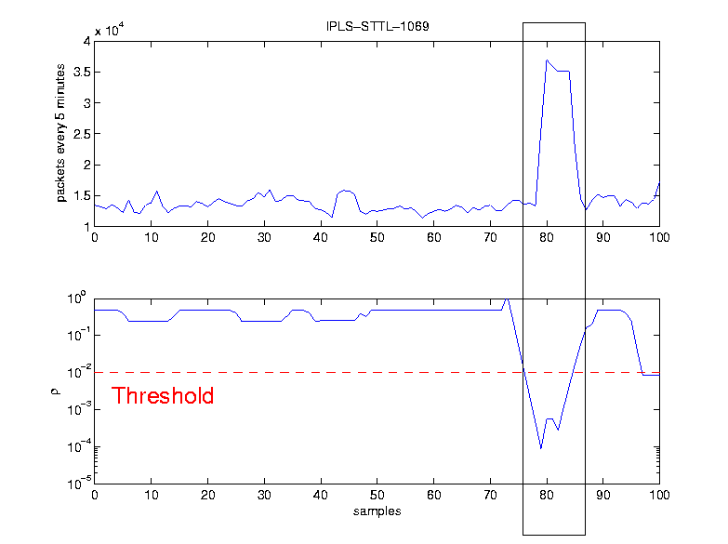
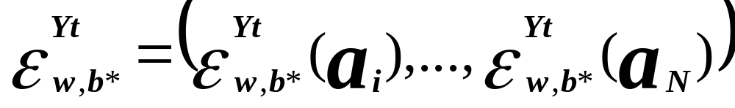
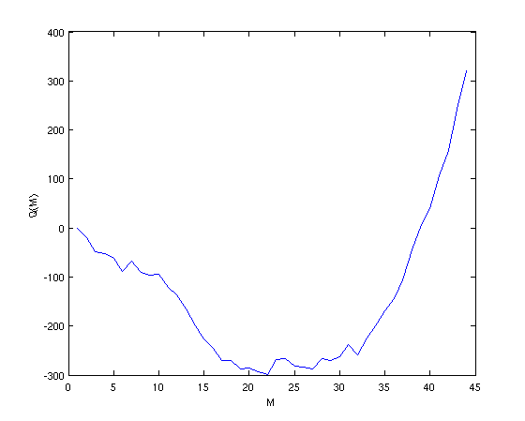
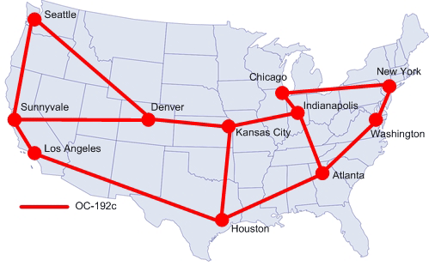
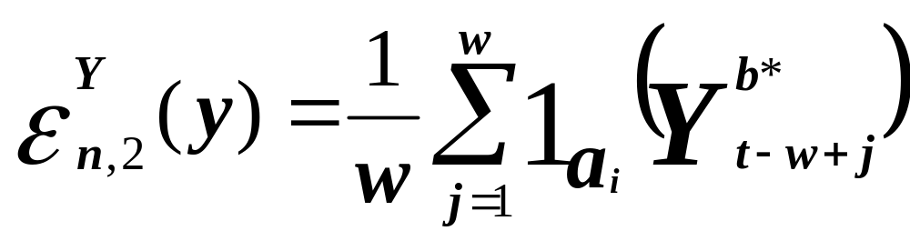

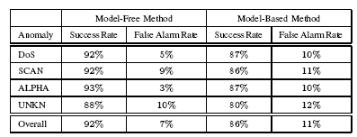

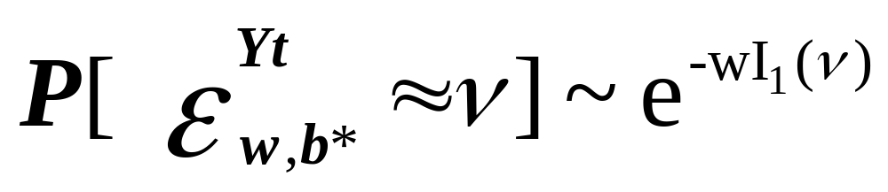


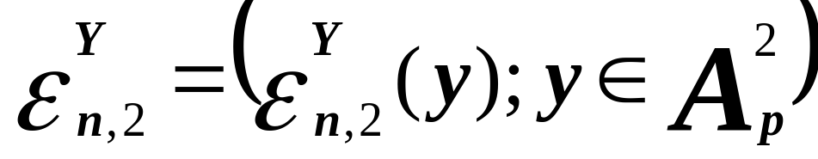
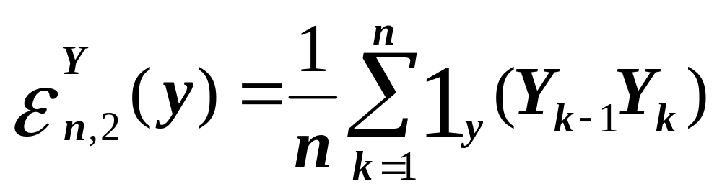
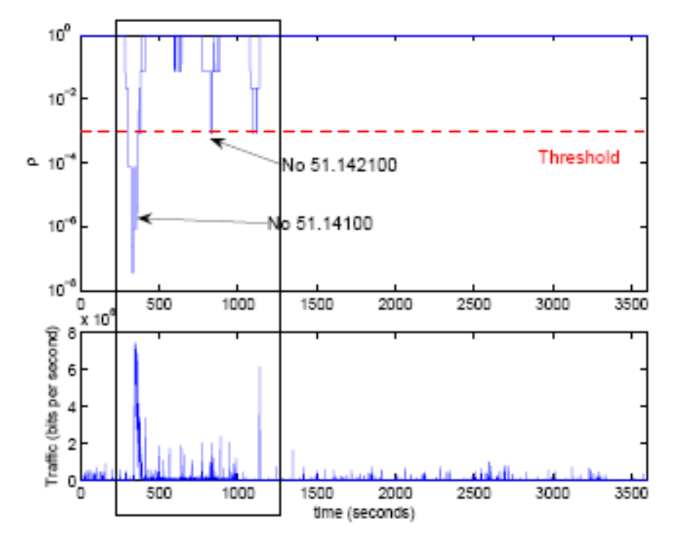
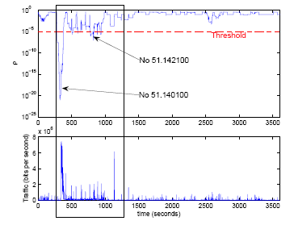
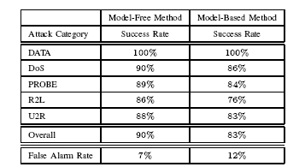


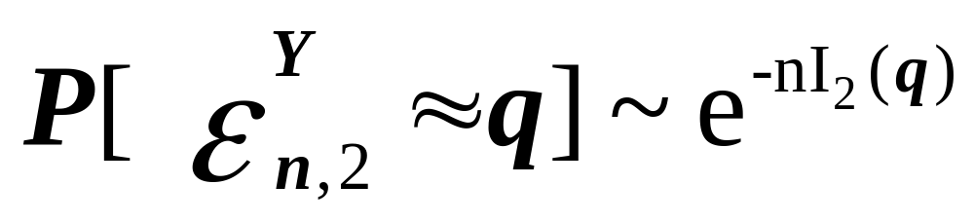
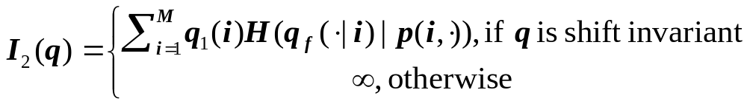
A Large Deviations Approach to
Statistical Traffic Anomaly Detection
Ioannis Ch. Paschalidis and Georgios Smaragdakis
http://ionia.bu.edu
Overview
We introduce an Internet traffic anomaly detection mechanism based on large deviations asymptotic results. Using past traffic traces we characterize network traffic during various time-of-day intervals, assuming that it is anomaly-free. We present two different approaches to characterize traffic: (i) a model-free approach based on the method of types and Sanov's theorem, and (ii) a model-based approach modeling traffic using a Markov modulated process. Using these characterizations as a reference we continuously monitor traffic and employ large deviations results to compute the probability that the monitored traffic is “consistent'' with the corresponding reference characterization. Low values of this probability identify, in real-time, traffic anomalies. Our experimental results show that applying our methodology (even short-lived) anomalies are identified within a small number of observations. Throughout, we compare the two approaches presenting their advantages and disadvantages. We validate our techniques by analyzing real traffic traces with time-stamped anomalies.
Methodology
Advantages: 1.General, as it detects all types of anomalies, easily adapted to identify anomalies in any trace traffic representations (e.g., bytes/packets/flows) or system activity (e.g., system calls).
2. Prompt, as it can on line detect the anomalies within a small number of observations.
3. Independent of traffic volume moments – our method compares subtle distributional differences between the reference traffic characterization and observed traffic.
4. Easily deployed, a simple infrastructure is required – bit counter (single link) but advanced technologies like netflow can also be used (for the whole internet).
Traffic Realization
:observation
window
Reliable
Model &
Threshold
Estimation
Y₁,Y₂,…,Y_{n}
Traffic Characterization
Large Deviations Theory
Reference Traffic
Attack Detection
Traffic Characterization
Evaluation
1. Model-Free Approach
1. The Abilene Dataset
Method of types
Aggregate Traffic
(iid partial sums)
Akaike’s Information Criterion
where
{a₁,a₂,..,a_{N}}
DoS (Model-Free)
DoS (Model-Based)
Training Traffic
Optimal size
of Alphabet (N)
(Symbol, Range,
Probability of appearance)
X₁,X₂,…,X_{n}
: anomaly free frequency measure
- 11 Point of Presence (PoPs)
- 121 origin-destination flows
- 3 traffic representations
- 4 anomaly types
: realization frequency measure
Detection
according to:
, where
2. Model-Based Approach
2. The DARPA Evaluation Dataset
Disjoint Markov Modulated Process
- Border router activity
- 5 anomaly types
, where
Akaike’s Information Criterion
1
2
…
K
K+1
…
N
Training Traffic
Optimal #
of states (N)
(State,Range),
Transition Probabilities
: anomaly free probability measure
X₁,X₂,…,X_{n}
: realization probability measure
Detection
according to:
, where
Model-Free Approach
Model-Based Approach

