Slide 1
Selfish Neighbor Selection:
Formulation, Analysis, and Implications for Overlay Routing and P2P File Sharing
Intel Research, 25 Apr. 2007 – Berkeley, CA
Nikolaos Laoutaris
Postdoc Fellow
Harvard University
Email: nlaout@eecs.harvard.edu
Homepage: http://www.eecs.harvard.edu/~nlaout/
Notes:
-- rather abstract definition of the problem
-- analytic followed by experimental results to demonstrate the performance of different neighbor selection policies
-- then I’ll discuss how we can apply these results in two different applications (1),(2) – FINISH WITH RESEARCH OVERVIEW

Slide 2



Joint work with:
Azer Bestavros
John Byers
Georgios Smaragdakis
Shang-Hua Teng
Ravi Sundaram
Rajmohan Rajaraman
Mema Roussopoulos
Documented in:
-- Implications of Selfish Neighbor Selection in Overlay Networks
to appear in IEEE INFOCOM 2007
-- A bounded-degree network formation game
arXiv-CoRR cs.GT/0701071
-- Improving the Performance of Overlay Routing and P2P File Sharing using Selfish Neighbor Selection
submitted

Slide 3
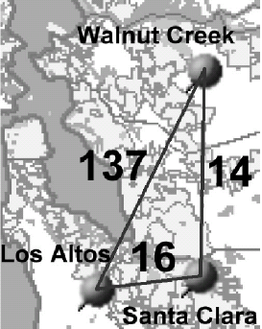


Neighbor Selection in Overlay Networks
O₂
overlay
node
Assumed overlay network model:
no predefined structure
nodes & weighted dirctd overlay links
  weight ~ physical dist.
shortest-path routing @ overlay
overlay
link
O₁
O₃
R₃
Neighbor selection: choose overlay nodes for the establishment of direct links
R₁
R₂
R₄
physical
link
Applications:
overlay routing nets (traffic)
unstructured P2P file sharing (queries)
physical node (e.g., end-systems, router or AS)
Notes:
-- we’re considering an overlay network without pre-defined structure
-- in which routing at the overlay layer is shortest-path
-- and links are directed and carry weights that relate to the underlying distance
-- since there’s no predefined structure, we have to devise neighbor selection policies to be able to fold new nodes in the network and also cope with changes in traffic and node participation

Slide 4
2 key elements of our study of neighbor selection
  selfish nodes
    … select neighbors to optimize the connection quality of the local users
  bounded node degrees
    overlay routing ➔ overlay link-state O(nk) as opposed to O(n²)
    Unstructured P2P ➔ many neighbors would flood the network (even with scoped flooding in place)
* Previous Network Creation Games more appropriate for physical telecom. networks
Notes:
-- we’re considering neighbor selection under a new setting
-- BOUNDED DEGREE: (1) LINK-STATE O-ROUTING PROTOCOL; (2) FLOODING

Slide 5
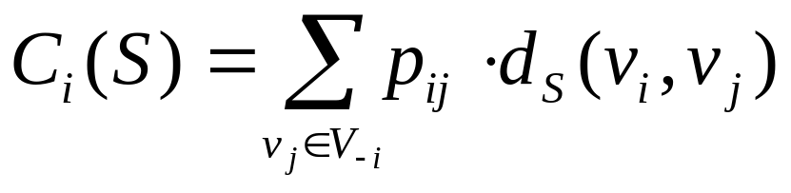
The objective of a selfish node
v_{i}’s preference for v_{j}
v_{i} wants to minimize:
w
over all s_{i}∈S_{i}
v_{i}
u
individual wiring
s_{i}={u,w}
G_{-i}=(V_{-i},S_{-i})
global wiring
S=S_{-i}+{s_{i}}
v_{i}’s residual wiring
v_{i}’s residual network
residual wiring
Notes:
-- imagine that a new node wants to connect to an existing network (we call it residual)
-- Pij IS TRAFFIC MATRIX FOR O-ROUTING OR REPUTATION FOR P2P
-- say again about SHORTEST PATH – SAY THA DELAY →(implicitly) BANDWIDTH

Slide 6
An initial set of questions we pose
What is the best way to connect to a given residual wiring?
How does it compare to empirical connection strategies?
Do pure Nash equilibrium wirings always exist ?
What about their structure and performance?
Notes:
Granted the previous description what the network is and what every node wants to do

Slide 7
The Selfish Neighbor Selection (SNS) game
Players: the set of overlay nodes V={v₁,…,v_{n}}
Strategies: a strategy s_{i}∈S_{i} for node v_{i} amounts to a selection of direct outgoing overlay links (therefore |S_{i}|=(n-1 choose k_{i}))
Outcome: S={s₁,…,s_{n}} is the global wiring composed of the individual wirings s_{i}
Cost functions: C_{i}(S) the communication cost for v_{i} under the global wiring S, i.e.:
symmetric strategy sets
Notes:
-- to answer these questions we model the situation as a strategic game in normal form

Slide 8
What is a Best-Response wiring?
residual network
It is the optimal neighbor selection for the deciding node undr a given residual graph (utilizes fully the link structure of the residual graph)
  k-Random does not use any link information
  k-Closest uses only local information
Under uniform overlay link weights (hop-count distance):
  best-response wiring ⬄ asymmetric k-median on the reversed distance function of the residual graph G_{-i} :
Consequently:
  Best-response is NP-hard
  Const. factor approx for metric k-median don’t apply here
  O(1)-approx with O(logn) blow-up in # medians (Lin and Vitter,’92)
  Most likely the best we can do (Archer, 2000)
1
2
2
w
w
wrong
3
right
3
1
cheap
4
expensive
d(1,3)=2
u
u
since these
cost the same
d(3,1)=1
w,u can be
obtained from
2-median on
reversed distances
d₁₂<d₁₃<d₁₄
Notes:
-- In this slide I’ll try to build some intuition on what a best response is and what it looks like
-- this is the key differentiating factor with the empiricals
-- map the preference into the demand in the k-median formulation

Slide 9
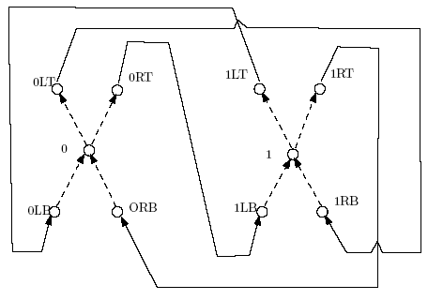
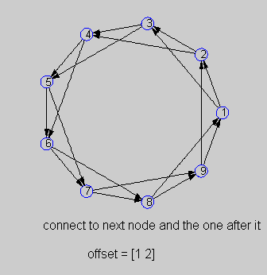
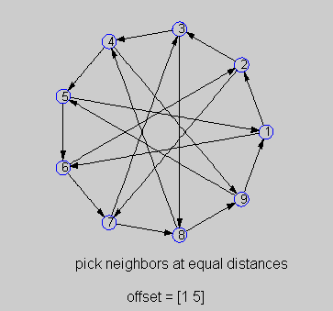
Existence of pure Nash equilibria and performance
t=n-n_{k,h}
t’=t+1 mod k
k
t’
…
…
utopian
…
t
…
…
  uniform game → uniform preference, link budget (k), and link weights (1)
  Theorem: All (n,k)-uniform games have pure Nash equilibria.
  Theorem: There exist non-uniform games with no pure Nash equilibria.
    there exist asymmetric non-uniform games that have no pure Nash (we “implemented” on a graph the cost-structure of the matching-pennies game)
    there exists an equivalent symmetric non-uniform game for each one of them
  Lemma: In any stable graph for the (n, k)-uniform game, the cost of any node is at most 2 + 1/k + o(1) times the cost of any other node.
  Lemma: The diameter of any stable graph for an (n, k)-uniform game is O(sqrt(n log_{k}n)). [don’t know if it is tight]
  Theorem: For any k ≥ 2, no Abelian Cayley graph with degree k and n nodes is stable, for n ≥ c2^{k}, for a suitably large constant c.
. . .
unstable for large n
. . .
1
2
3
4
5
k-1
h
h
6
7
8
9
…
…
. . .
. . .
disconnection
k
Social Cost(ourEQ) < 2 * Social Cost(SO)
. . .
. . .
…
…
…
…
…
…
k
k
utopian+1
disconnection
gets either k roots
or the k hubs
gets t’ roots
and k-t’ heaviest hubs
Notes:
-- a pure Nash equilibrium wiring is when nodes use BR WIRINGS CONCURRRENTY

Slide 10
Performance under non-uniform overlay links (1/2)
Benefits for an individual “newcomer” node on a fixed residual graph:
  9 different residual graphs = [wiring of existing] X [overlay weight model]
  overlay weight model: BRITE, PlanetLab, AS-level maps
  different link densities, preference profiles
Summary:
  BR substantial performance benefits for the individual in most scenarios
    gain increasing in sparse graphs (and obviously with skewed profiles)
  no empirical generally good enough (nor constant ranking among them)
  … but they do well on stable graphs
  … maybe then we should try to apply BR in practice [coming in 2 slides]
naive cheating???
Notes:
-- by combining 3 choices for the policy that the existing nodes have followed
-- SAY ABOUT STABLE THRU ILP IN THIS CASE
-- SAY ABOUT CHEATING IN P2P

Slide 11
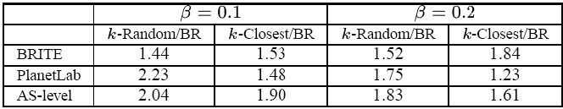
Performance under non-uniform overlay links (2/2)
Benefits for the social cost of the network:
  social cost = sum individual node costs
  SC(random graph)/SC(stable) and SC(closest graph)/SC(stable)
    under different link weight models
    and different link densities
stable graphs can half the social cost compared empirical graphs
nearly as good as socially OPT graphs

Slide 12
But can we use Best-Response in practice?
Candidate applications:
  Overlay routing (RON, QRON, Detour, OverQoS, SON, etc.)
  Unstructured P2P file sharing (KaZaA, Gnutella, etc.)
To give an answer, we have to examine:
  how natural is the mapping from the abstract SNS to the app?
  are the SNS pre-requisites in place?
    information to compute Best-Response: d_{ij} and d_{G-I}
    computational complexity
    shortest path routing on the weighted overlay graph
  true performance benefits (factoring-in node churn, dynamic delays, bandwidth, etc.)
Notes:
-- to answer it, we will examine specific applications
-- and for each one we will have to answer

Slide 13

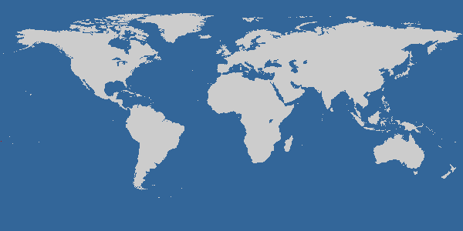

EGOIST:
Our prototype overlay
routing system for
n7
n8
n3
n2
n1
n10
n4
n5
n9
Connecting a newcomer node v_{i}
bootstrap
listen to overlay link-state protocol to get d_{G-i}
get d_{ij}’s through active (ping) or passive measurmnt (Pyxida,pathChirp)
wire according to (hybrid) Best-Response
monitor and announce your links
n6
n11
50 nodes around the world using the infrastructure of
Notes:
FOR OVERLAY ROUTING OUR ANSWER IS ON THE POSITIVE SIDE

Slide 14
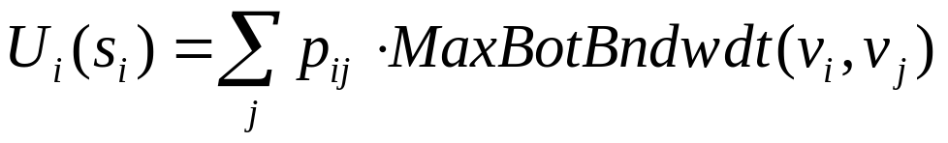
EGOIST: Features
supported metrics:
  delay (active/passive monitoring with ping/Pyxida)
  available bandwidth (monitoring with pathChirp)
  node load (monitoring with loadavg)
supported wiring strategies:
  k-Random
  k-Closest
  k-Regular
  Best-Response (delay and AvailBw formulations)
  Hybrid Best-Response
residual network
immediate
neighbors
MaxBotBndwdthPath(v_{i},v_{j})
a destination
v_{i}
v_{j}
Notes:
ELABORATE ON HYBRID

Slide 15
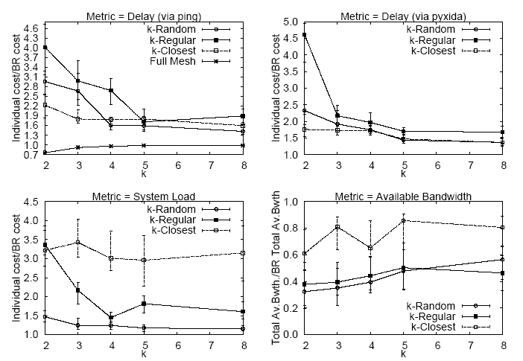
EGOIST: Performance and scalability
as good as Full Mesh but with O(nk) instead of O(n²) monitoring overhead
further scalability boost through sampling
Notes:
-- BR does actually better than simulation and analysis
-- cause the heuristics are LAZY (except k-Closest)

Slide 16
Is Best-Response applicable to unstructured P2P file sharing
?
queries are for files (wherever they may reside) and not for nodes
you don’t have the residual graph (cause you don’t have overlay link-state protocol as in overlay routing)
you don’t have shortest-path routing (instead you have scoped-flooding and random-walk forwarding of queries)
P2P net several orders of magnitude larger than an overlay routing net (so you definitely have to use sampling)
… common sense …
  instead of new P2P …
  new BR for the existing P2P with scoped-flooding

Slide 17
Current unstructured P2P file sharing apps
Gnutella and other P2P systems choose their neighbors (SNs) using locality and/or random selection
2
Bootstrap
Server
1
3
4
if the TTL of scoped flooding is 2
randomly
this wiring will give you access to 4 nodes

Slide 18
Our Best-Response for unstructured P2P file sharing
IDEA: we select neighbors to maximize the
foothold of our scoped flooding
4
Bootstrap
Server
1
6
3
5
2
for each candidate we compute the number
of distinct nodes we can reach with TTL 2
connect to those candidates that maximize the overall sum of uniques
this wiring gives us access to 6 nodes
Notes:
Best-Response is again NP-hard (vertex cover)
Greedy heuristic
MENTION SIMULATION EXPERIMENTS ON GNUTELLA TOPOLOGY -- ADD SLIDE WITH P2P EXPERIMENTS

Slide 19
The next step (ongoing actually)
an interesting application: n × n broadcasting
  n nodes, each broadcasting its own LARGE file
  e.g., scientific computing, distributed database sync, distributed anomaly/intrusion detection
our approach: swarming (BitTorrent like) on top of EGOIST
  EGOIST to construct a common overlay
  swarming to exchange chunks over it
many interesting questions:
  EGOIST-related: which formulation, how often to rewire?
  Swarming-related: multiple torrents fighting for bandwidth
    download / upload scheduling of chunks
    free-riding
  Can we beat n torrents, or n Bullets, or n Split-Streams ?????

Slide 20
Summary & conclusions
neighbor selection with selfish nodes & bounded degrees
optimal neighbor selection vs empiricals
existence & performance of stable (pure Nash) graphs
Best Response ➔ yes for overlay routing networks
➔ probably no for unstructured P2P
for the later, we reformulated Best Response to optimize the search performance under scoped-flooding

Slide 21
Overview of my “small-world” research graph
SELFISHNESS
CACHING
Selfish
Neighbor
Selection
LRU Analysis
& Cache
Interconnection
Distributed
Facility
Location
Distributed
Selfish
Replication
Distributed
Selfish
Caching
The Cache
Inference
Problem
Storage Capacity
Allocation for
Content Networks
VPNs
Fault
Detect.
Embed.
Systems
Playout Scheduling
Video Caching
Live MPEG Apps
FACILITY
LOCATION
STREAMING
OTHERS

Slide 22
Thank you
Q ?

