Slide 1

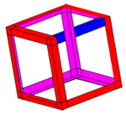



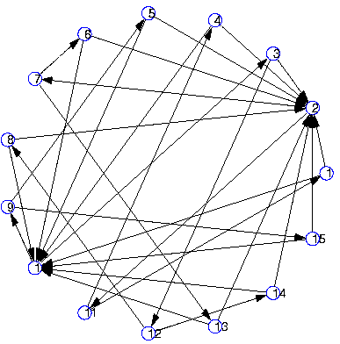
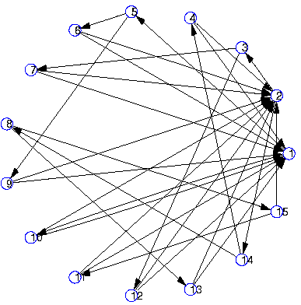
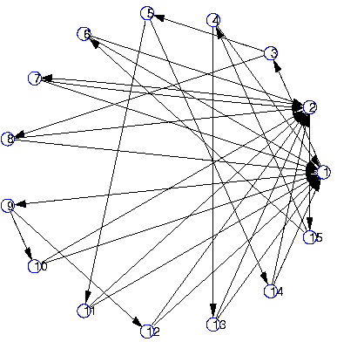
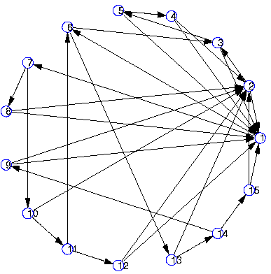
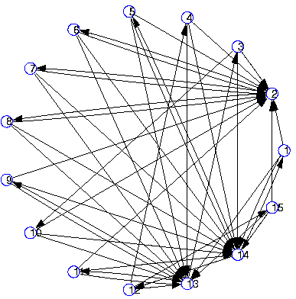
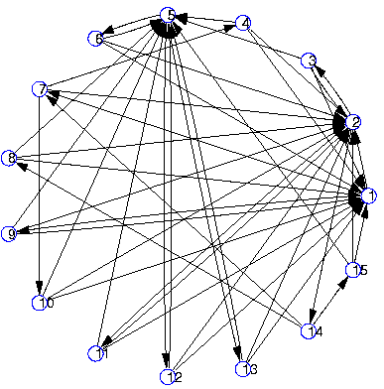
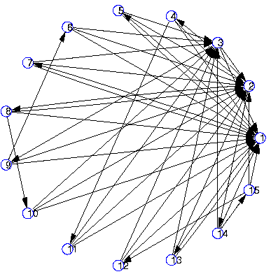
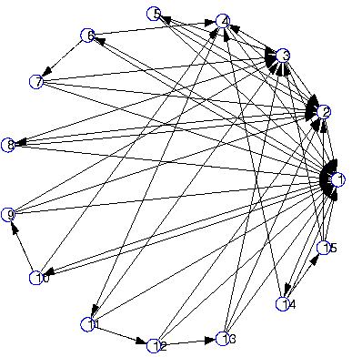
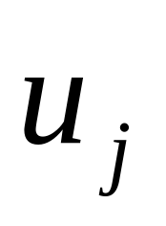
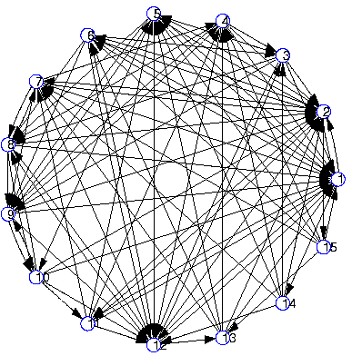
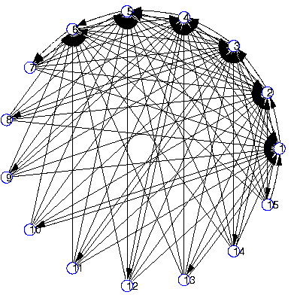
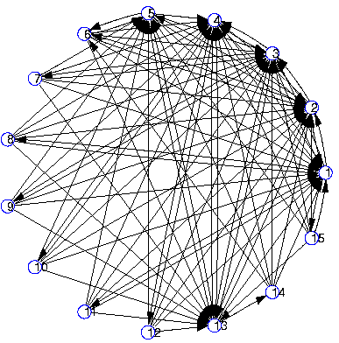
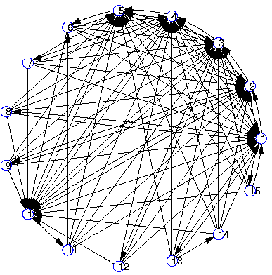
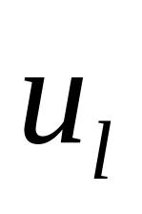
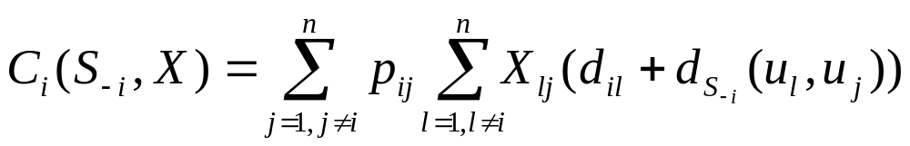
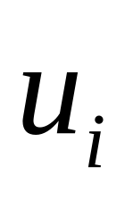
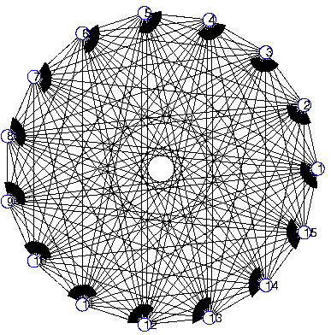
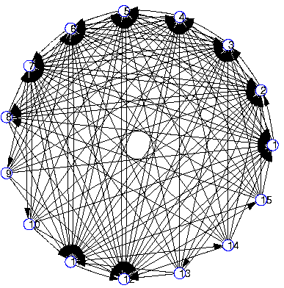

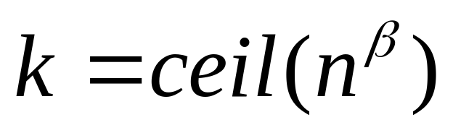
The Selfish Neighbor Selection Problem
In Overlay Networks
SNS
Georgios Smaragdakis, Nikolaos Laoutaris, Azer Bestavros,
John W. Byers and Mema Roussopoulos
http://csr.bu.edu/sns
Overview
We re-examine the problem of Overlay Network Creation, taking into consideration the existence of selfish overlay nodes. We develop a general Game-Theoretic framework that provides a unified approach to modeling Selfish Neighbor Selection (SNS) procedures, "wiring" for brevity, on behalf of such nodes. The model is general enough to take into consideration costs reflecting network latency and node preference profiles, the inherent directionality in overlay maintenance protocols and the limited recourses of each node in terms of bounded out- and in-degrees. Within this framework we formalize the notion of node's "best response" wiring strategy as a k-median problem on asymmetric distance, and use this formulation to obtain pure Nash equilibria. We show that selfish nodes can reap substantial performance benefits when connecting (following a "best response" wiring) to any overlay network, especially those composed of non-selfish nodes. Turning our attention to the performance of overlay networks that are dominating by selfish nodes, we experimentally examine the properties of such stable wirings on synthetic topologies, as well as on real topologies and maps constructed from PlanetLab and AS-level Internet measurements. To capitalize on the substantial performance improvement of best response wirings for individual nodes and the emergent stable global wirings we design and deploy, EGOIST, an SNS-inspired prototype overlay routing network for PlanetLab. We show that best response is significantly more efficient than previous heuristic strategies, under multiple performance metrics, including delay and available bandwidth --- while at the same time achieving superior scalability and nearly as good performance as full-mesh based approaches. We also demonstrate how SNS yields multi-fold improvement of search performance compared to existing unstructured peer-to-peer file sharing systems.
Towards A Realistic Model of Overlay Networks
1. Bounded in- and out-degrees
2. Directed Edges
3. Non-uniform preference vectors
4. Realistic models of Physical Distance
Characterization of Stable Wirings
alpha=0
alpha=0.4
alpha=0.6
alpha=0.9
beta=0.2
beta=0.4
Deriving Stable Wirings
- Best Response Wiring:
minimize
or solve the k-median problem on asymmetric distances
(if link weights are uniform)
- Equilibrium Wirings:
Through Iterative Best Response
beta=0.6
beta=0.8
An overlay node applying Best Response
wiring policy to the residual overlay graph
Skewness: , distribution: Zipf( )
Oudegree:

