Slide 1
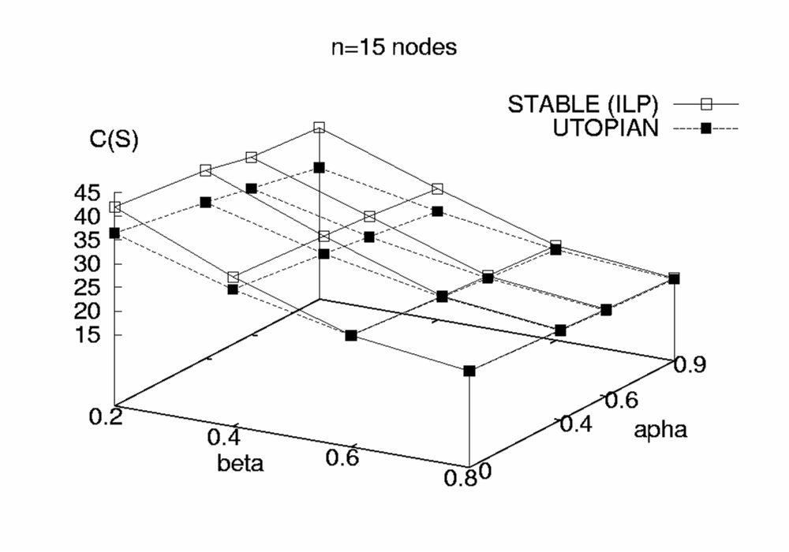
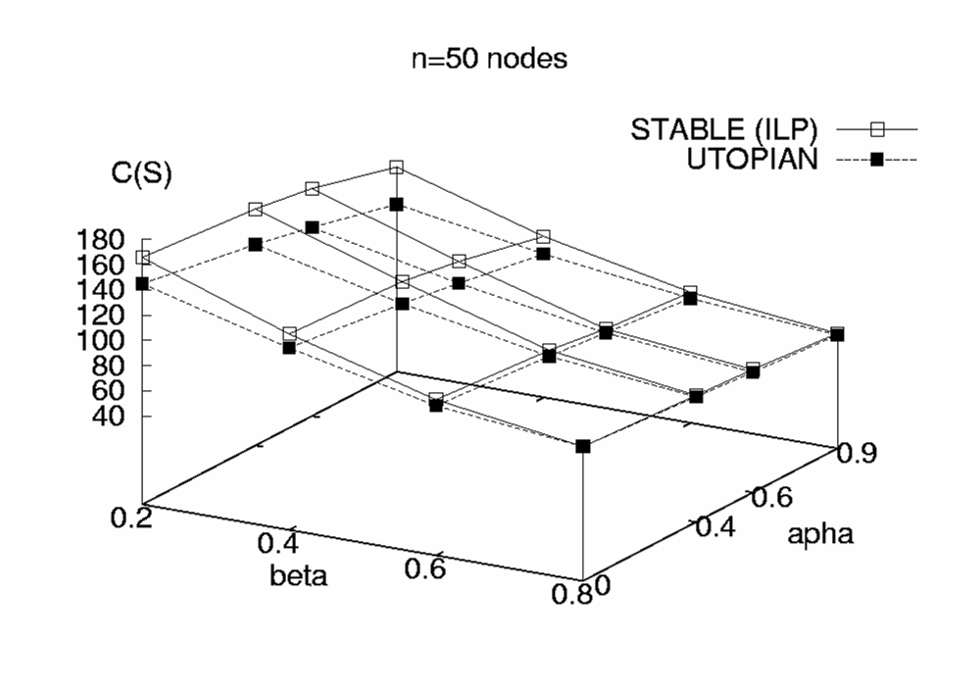
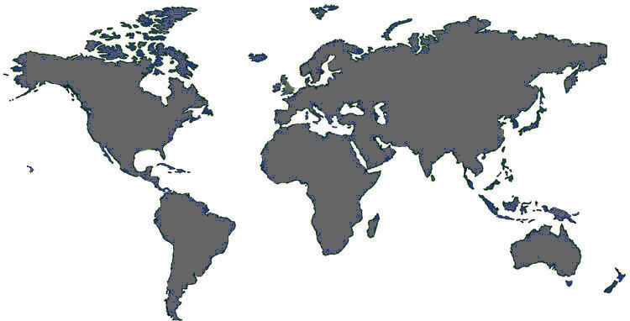
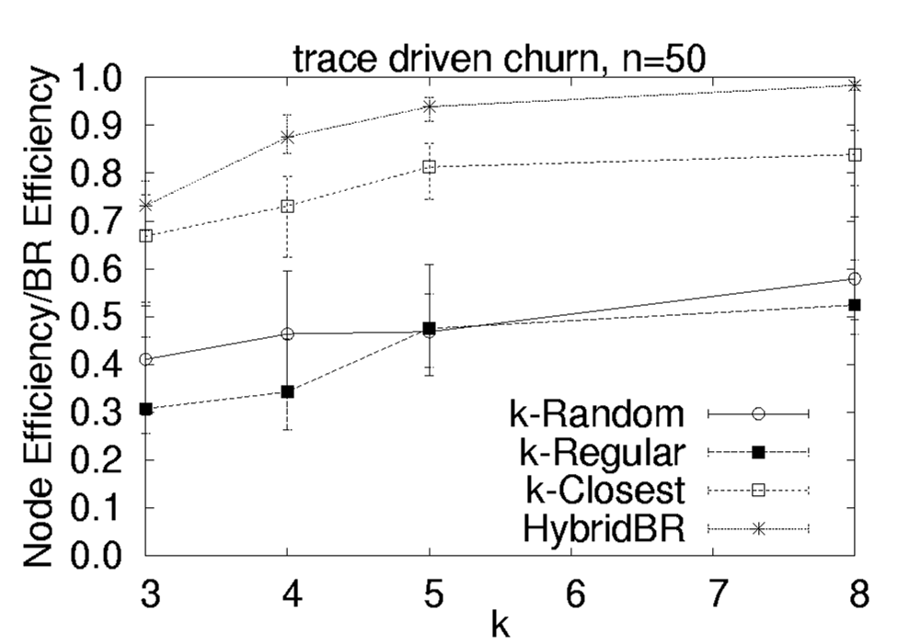
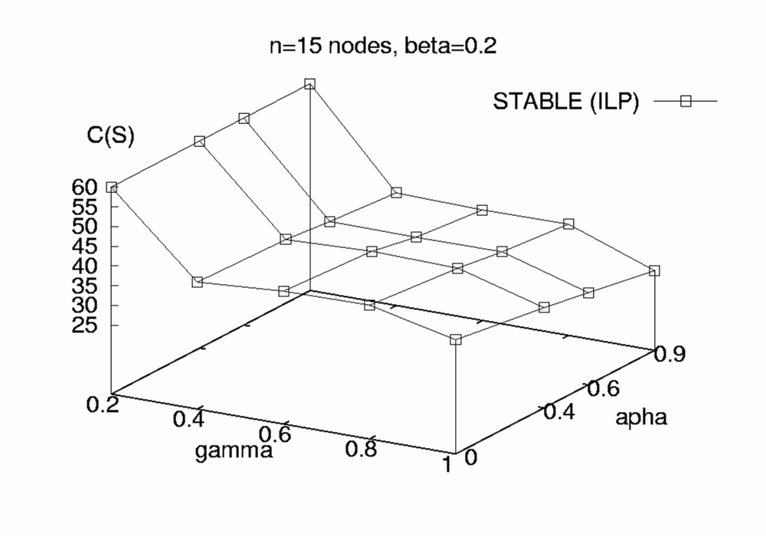
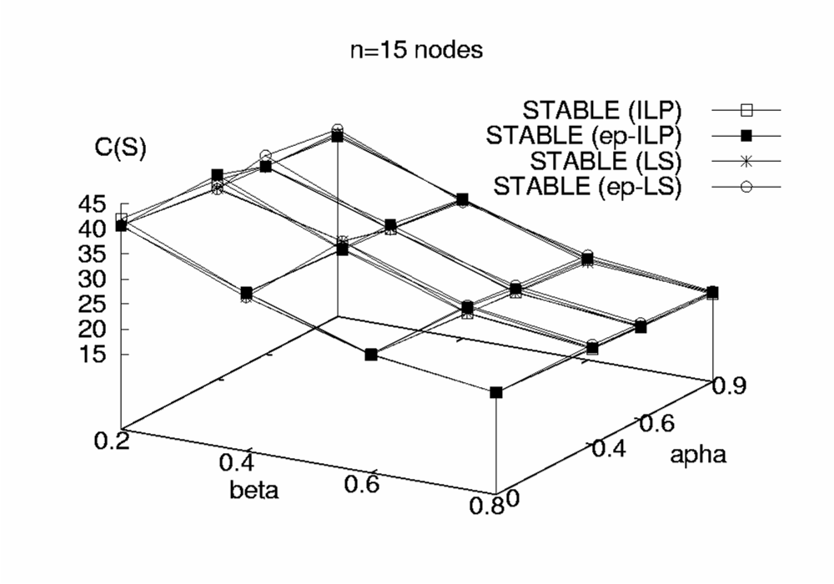
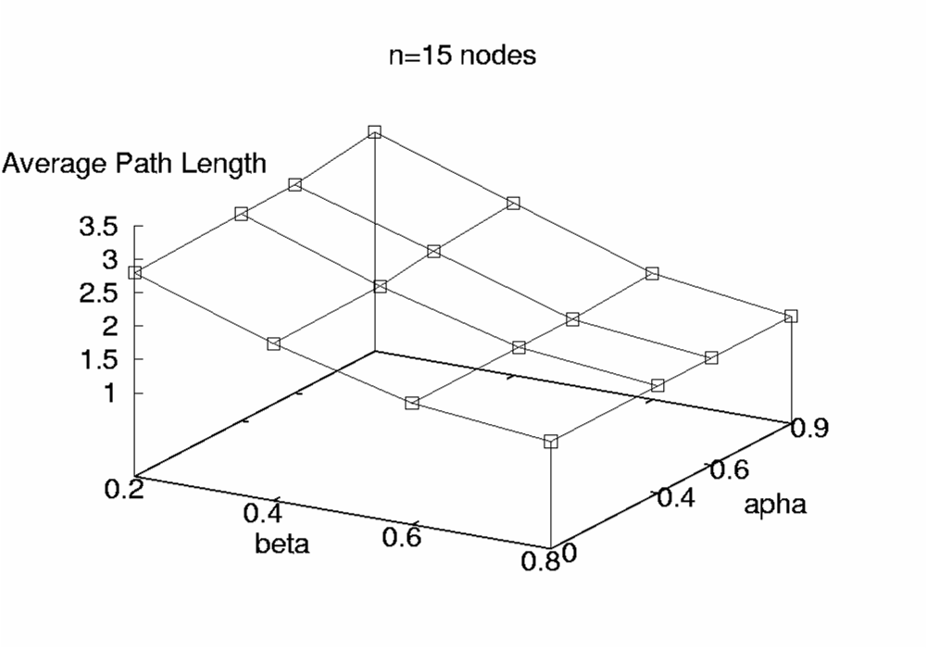
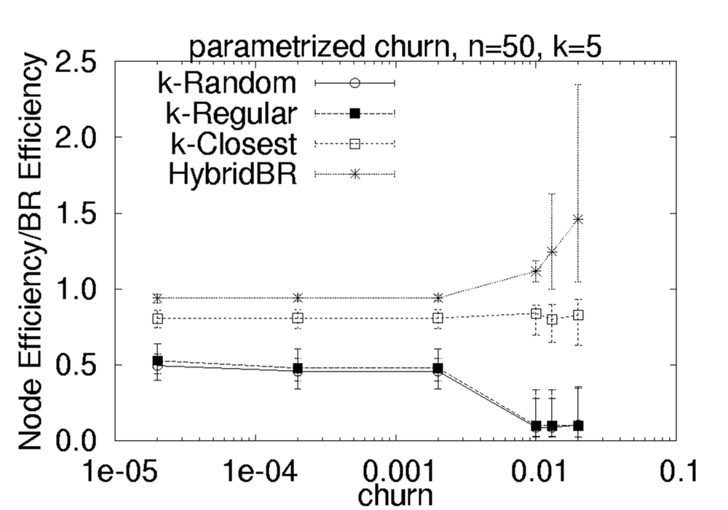
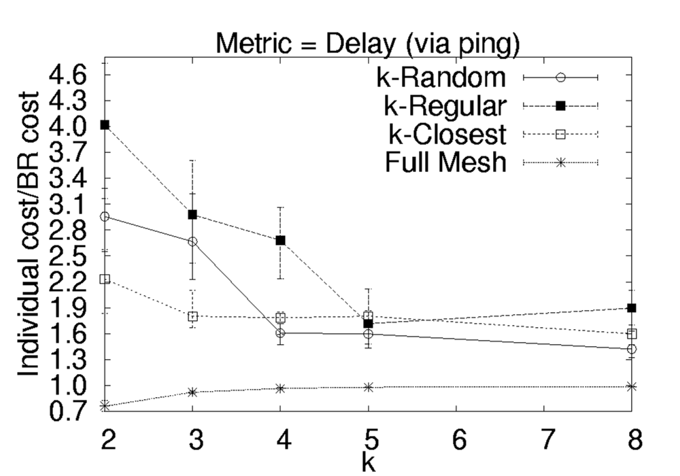
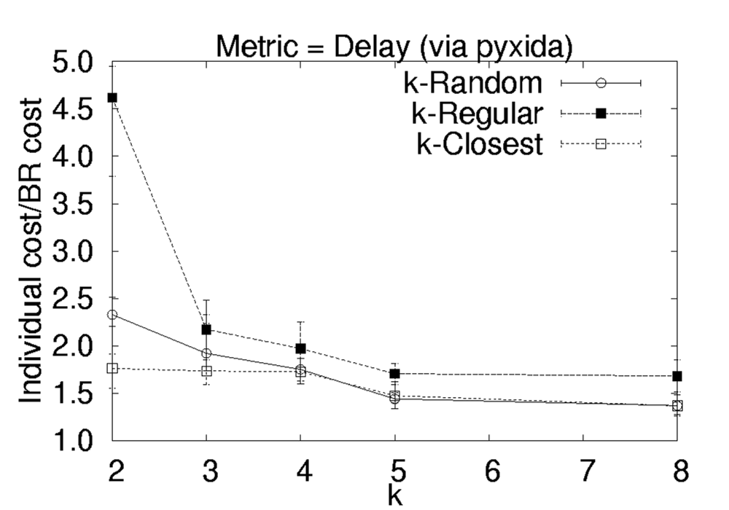
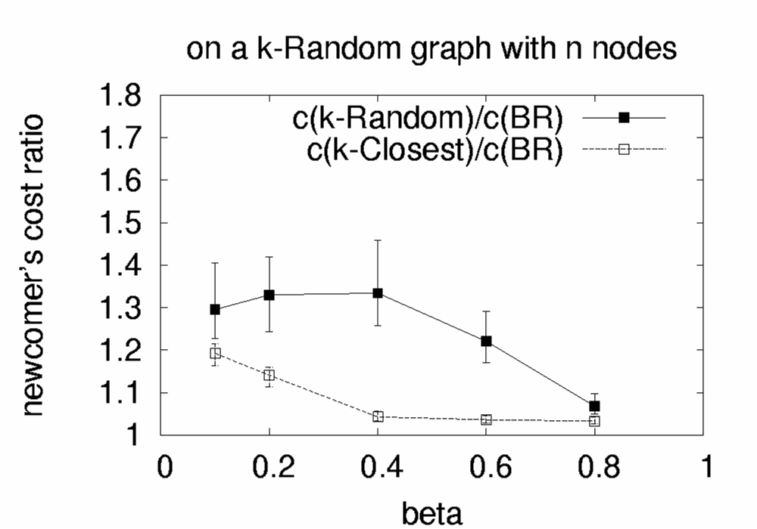
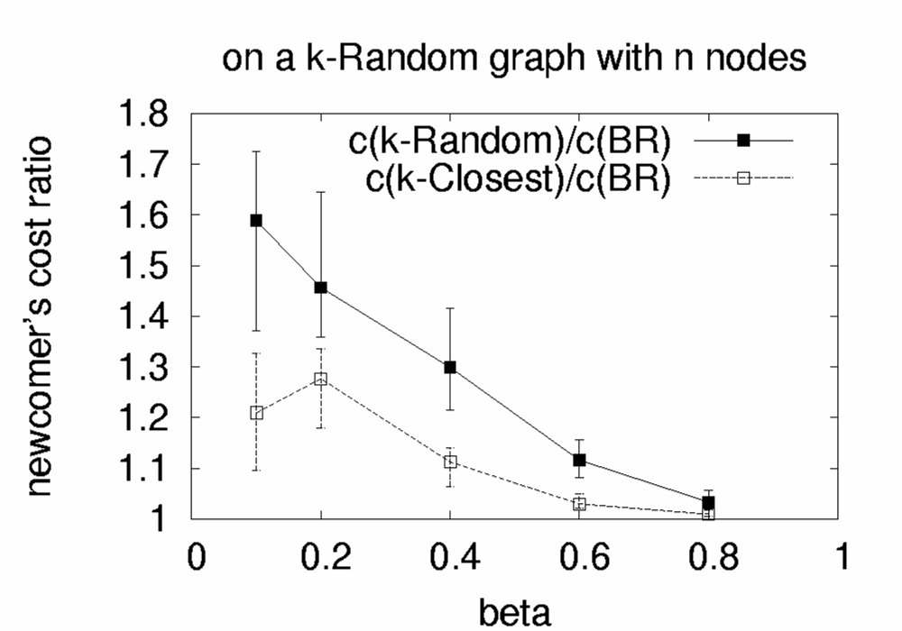
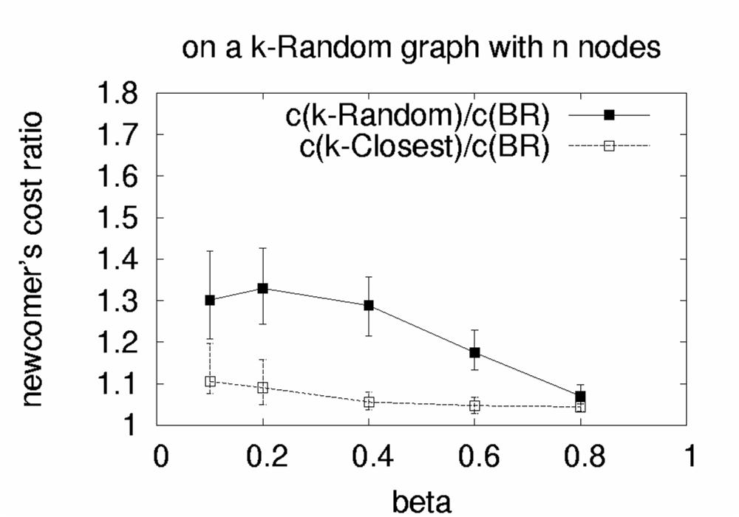
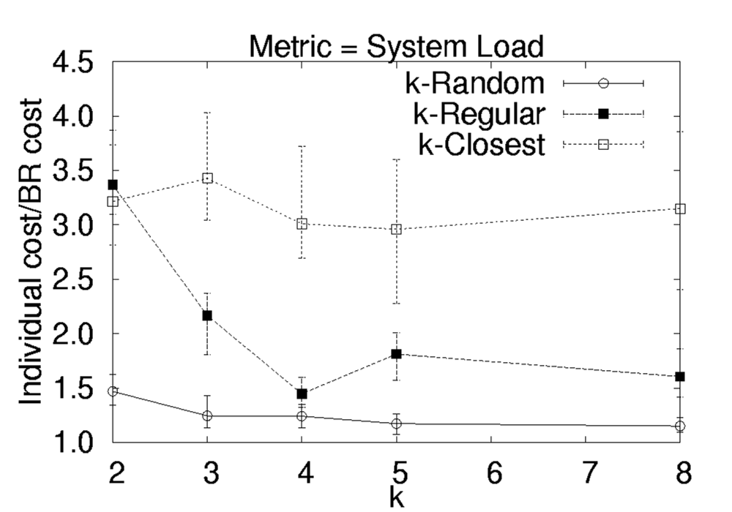
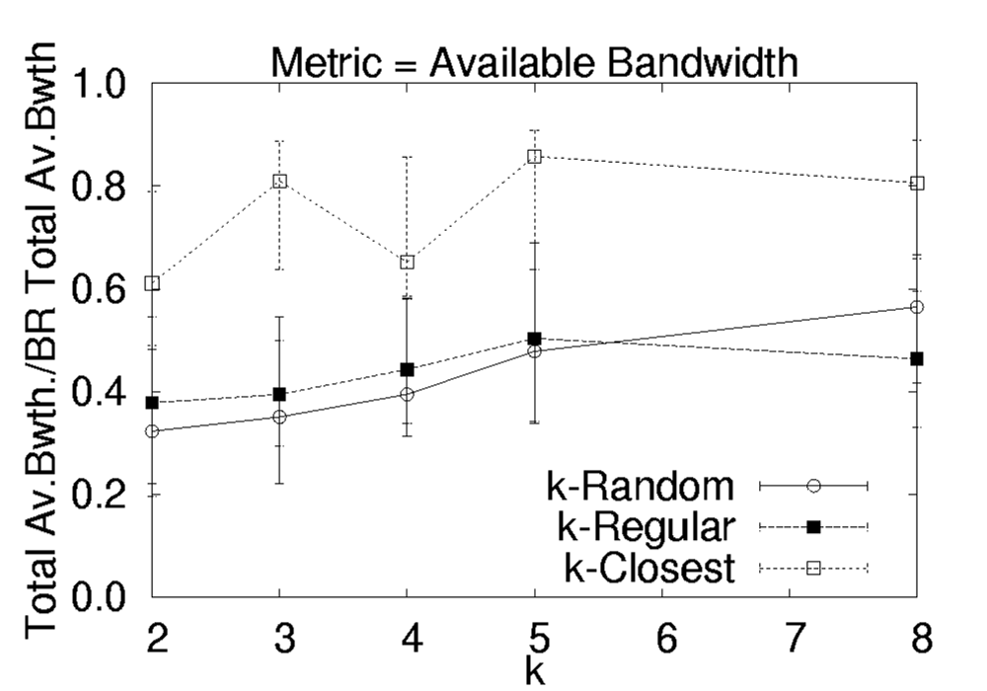
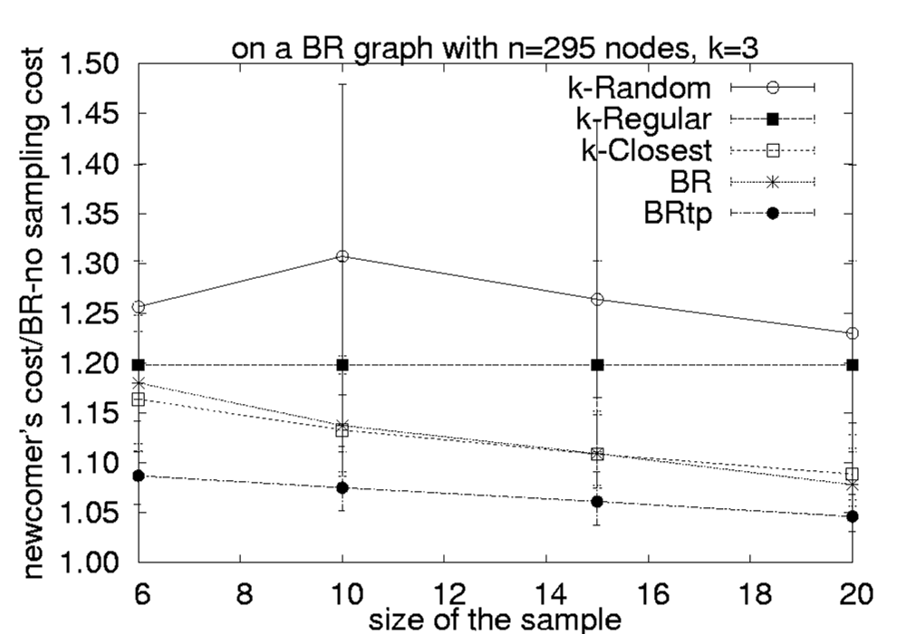

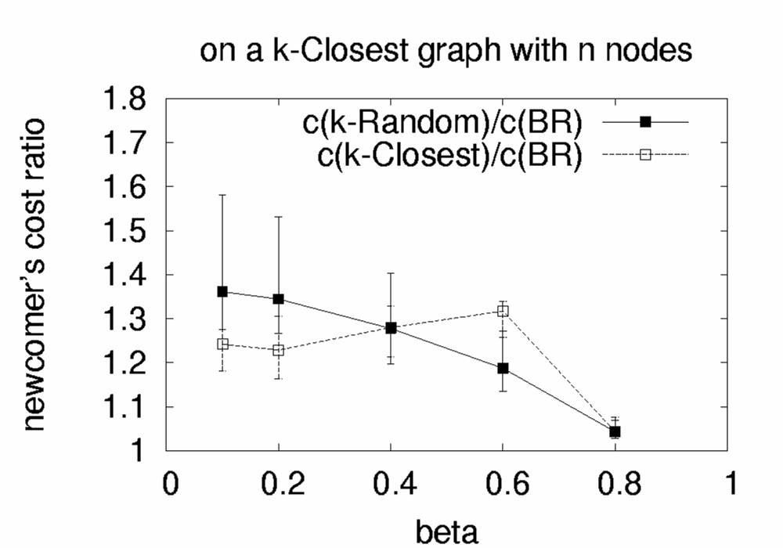
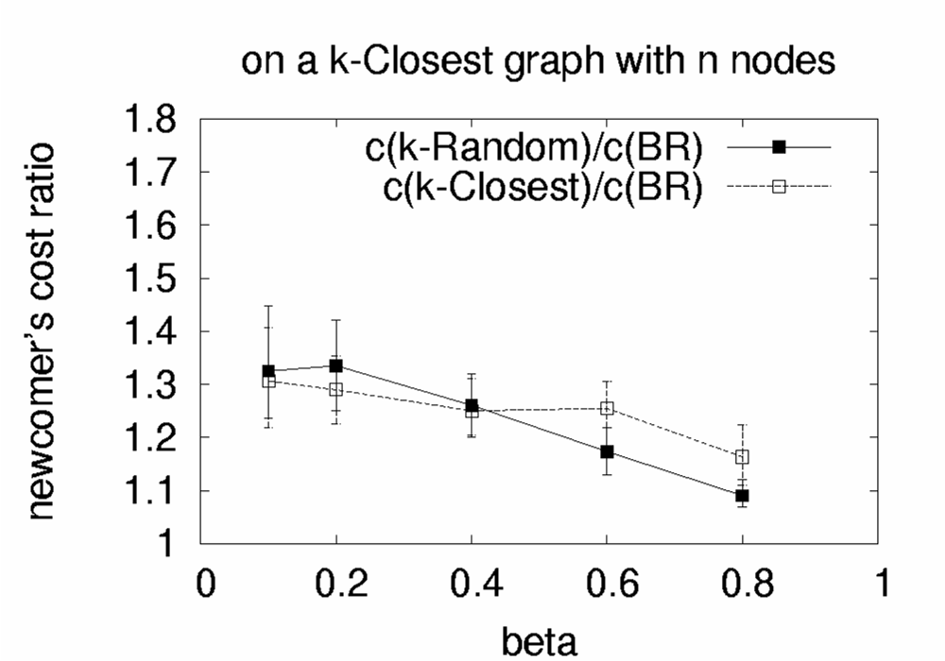
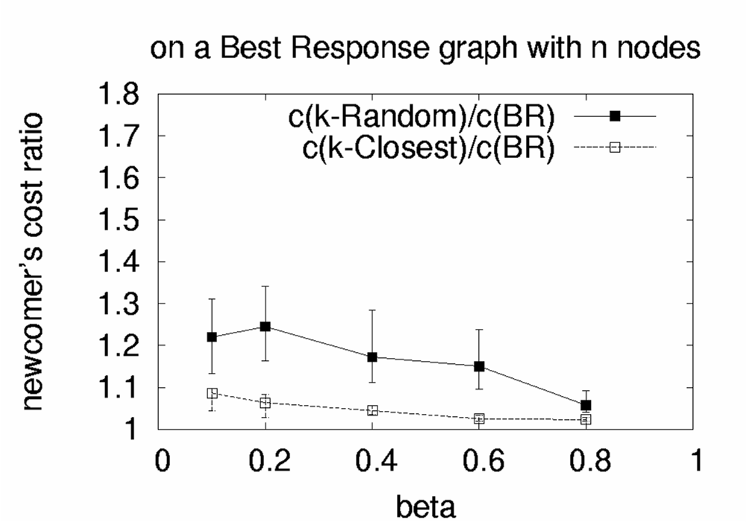
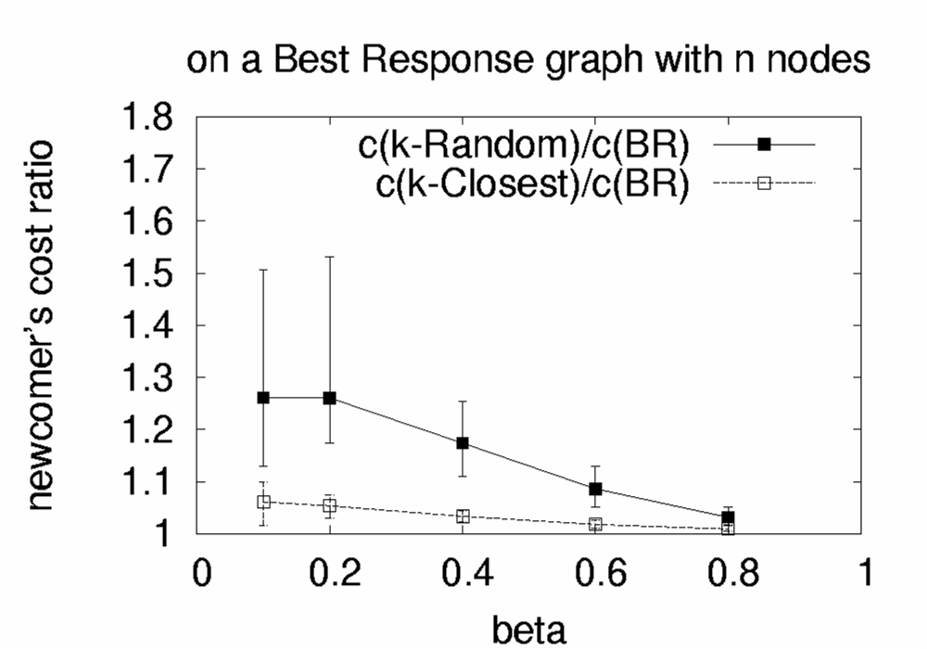

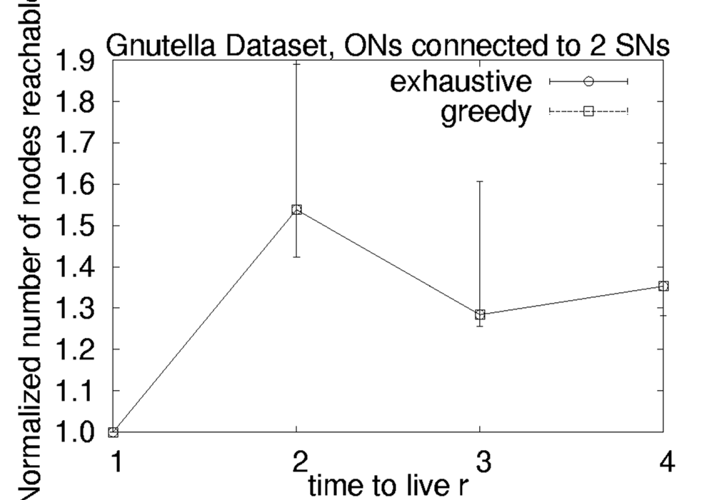
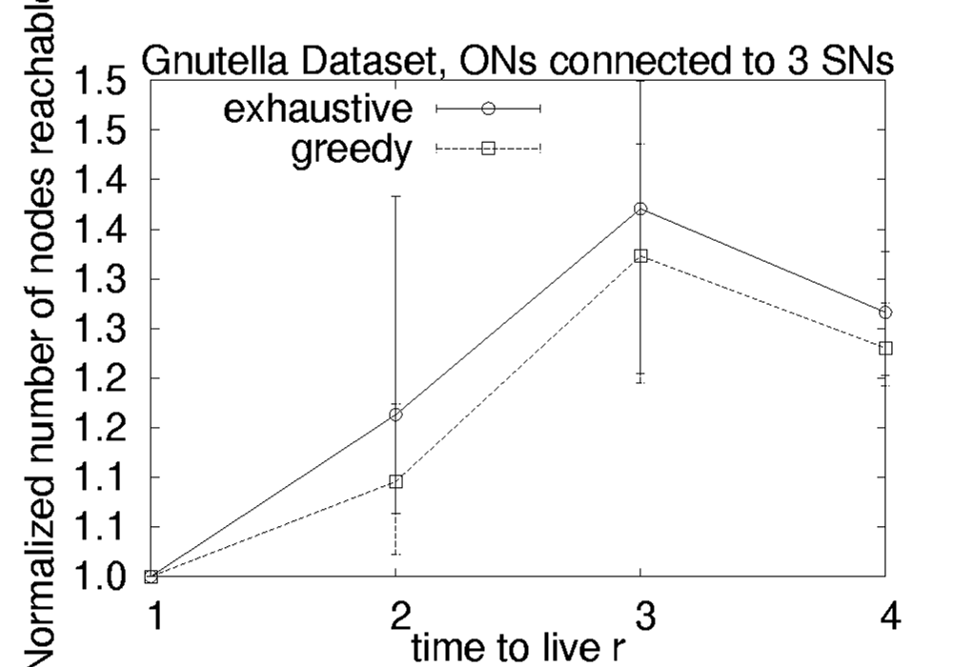
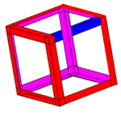
Social Cost of Stable Wirings
EGOIST : A scalable SNS-inspired System
Single Capacitated
Under Churn
Double Capacitated
Active Probing
Network Coordinates
Experiments and Implications
 | beta=0.1 |  | beta=0.2 |  | beta=0.4 |  | beta=0.6 |  | beta=0.8
 | k-Random/BR | k-Closest/BR | k-Random/BR | k-Closest/BR | k-Random/BR | k-Closest/BR | k-Random/BR | k-Closest/BR | k-Random/BR | k-Closest/BR
BRITE | 1.44 | 1.53 | 1.52 | 1.84 | 1.38 | 2.07 | 1.28 | 1.46 | 1.09 | 1.16
PlanetLab | 2.23 | 1.48 | 1.75 | 1.23 | 1.37 | 1.13 | 1.09 | 1.16 | 1.04 | 1.06
AS-level | 2.04 | 1.9 | 1.83 | 1.61 | 1.58 | 1.39 | 1.24 | 1.23 | 1.12 | 1.16
System Load
Available Bandwidth
With Incomplete Information
BRITE
PlanetLab
AS-level
Improving Search performance in Unstructured P2P systems
Publications:
[1] “Implications of Selfish Neighbor Selection in Overlay Networks”
Nikolaos Laoutaris, Georgios Smaragdakis, Azer Bestavros and John W. Byers.
IEEE INFOCOM 2007.
References:
[2] “Improving the Performance of Overlay Routing and P2P File Sharing
using Neighbor Selection”
Georgios Smaragdakis, Nikolaos Laoutaris, Azer Bestavros, John W. Byers and Mema Roussopoulos. Under Submission.
[3] ”A bounded-degree network formation game”
Nikolaos Laoutaris, Rajmohan Rajaraman, Ravi Sundaram, Shang-Hua Teng.
arXiv-CoRR cs.GT/0701071.
Bootstrap
Server
?
?
?
?
?
SNS

