Slide 1
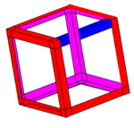



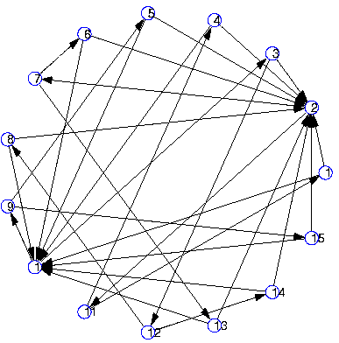
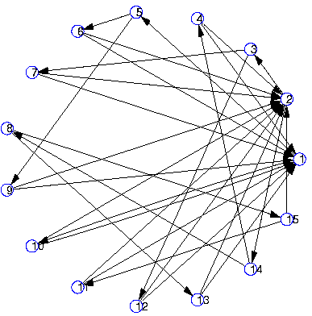
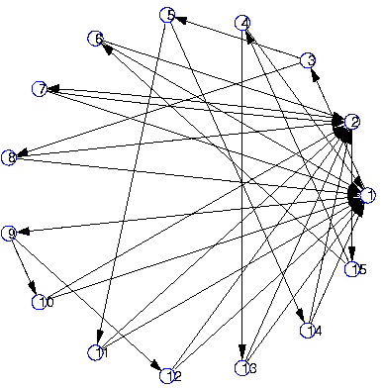
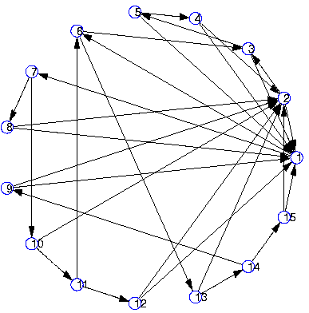
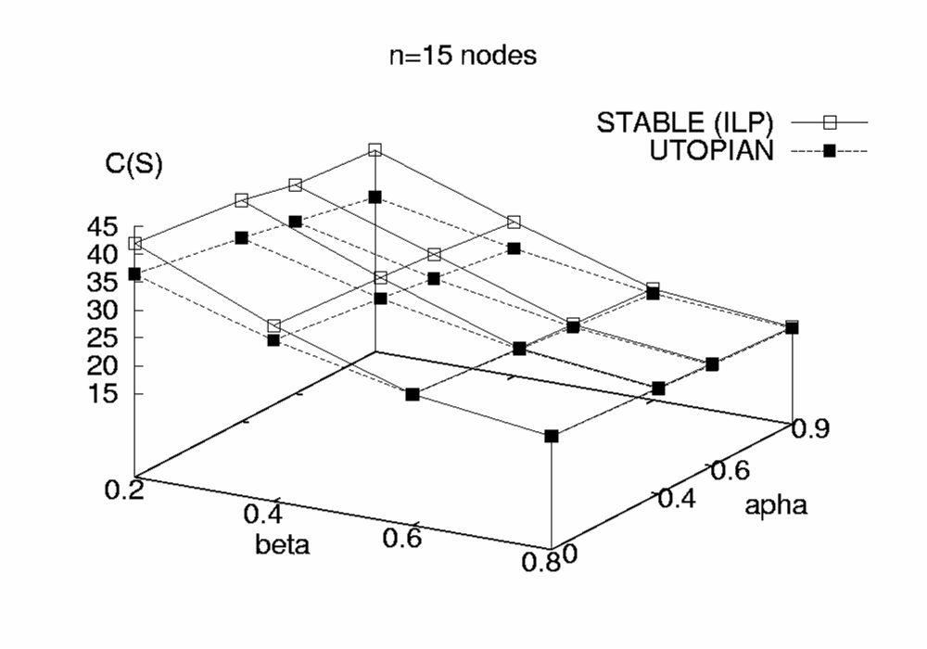
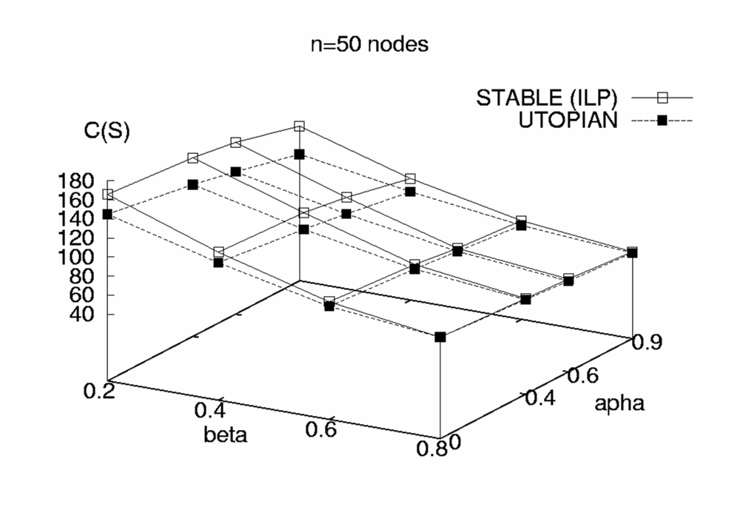
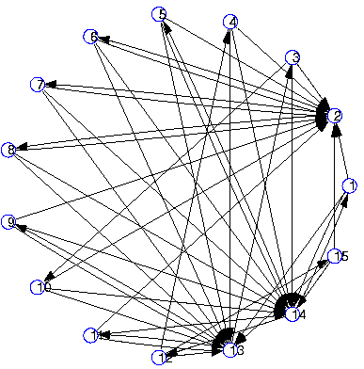
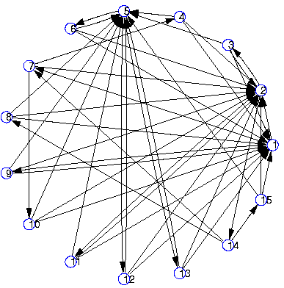
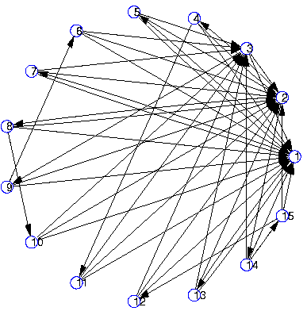
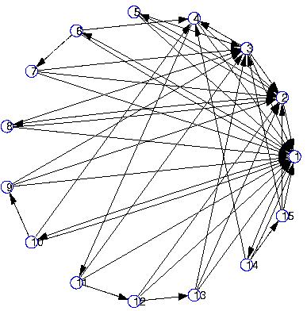
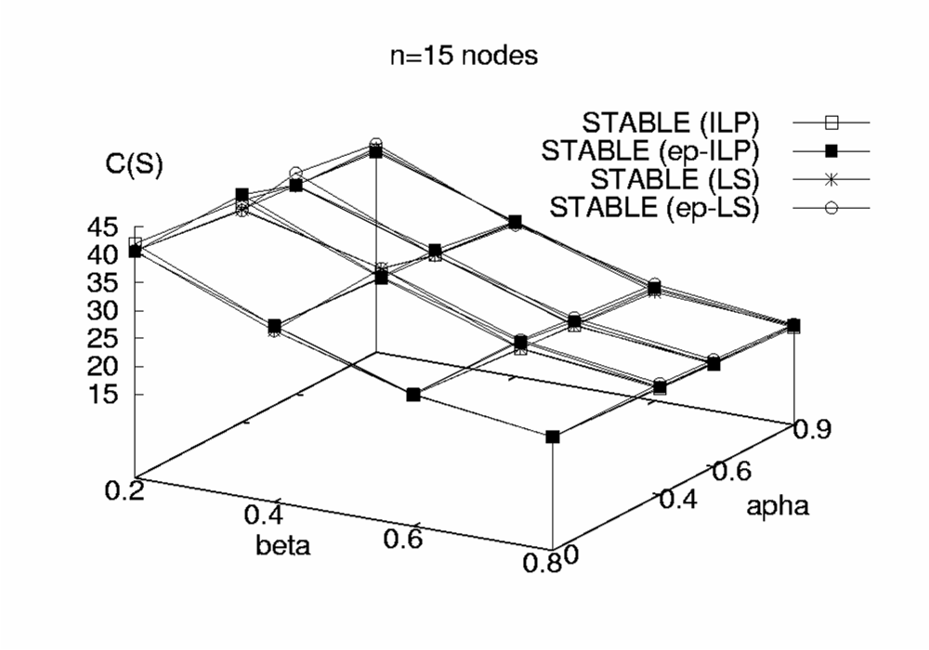
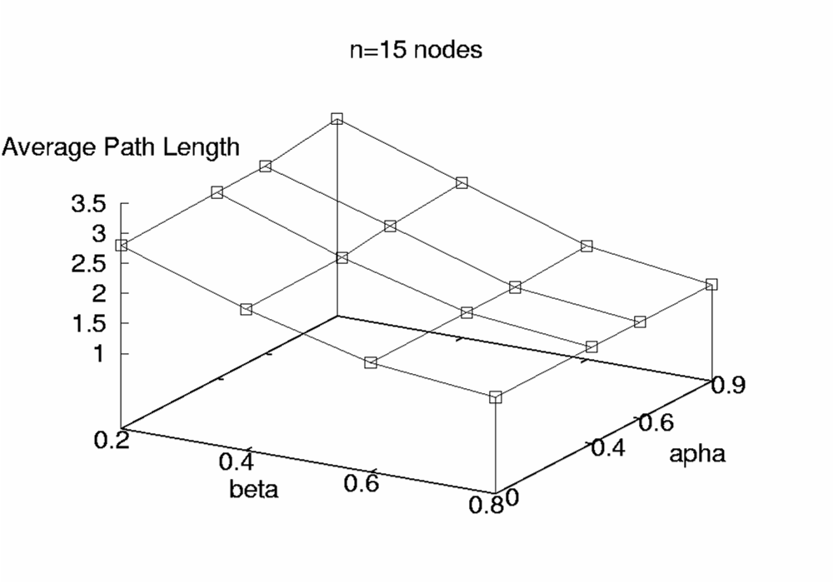
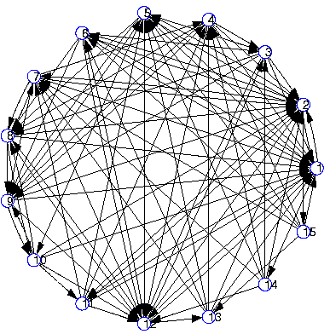
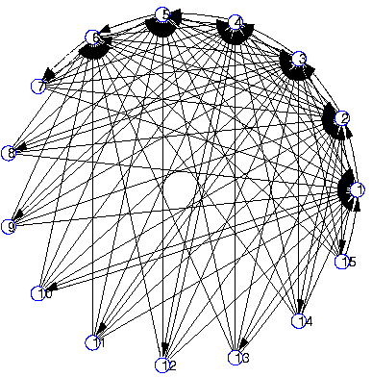
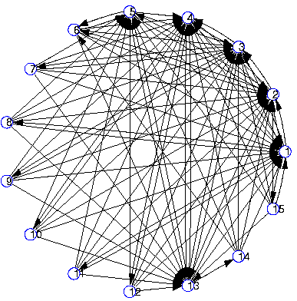
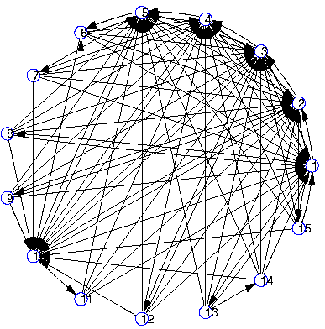
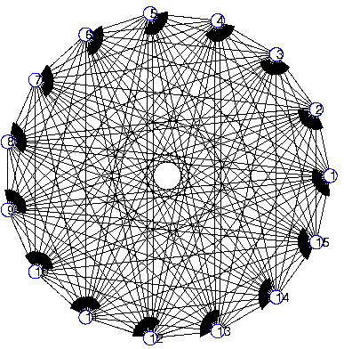
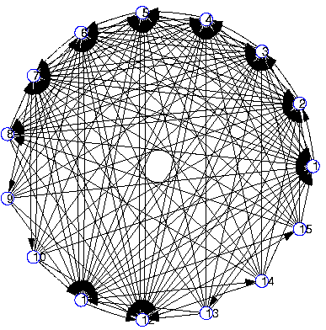
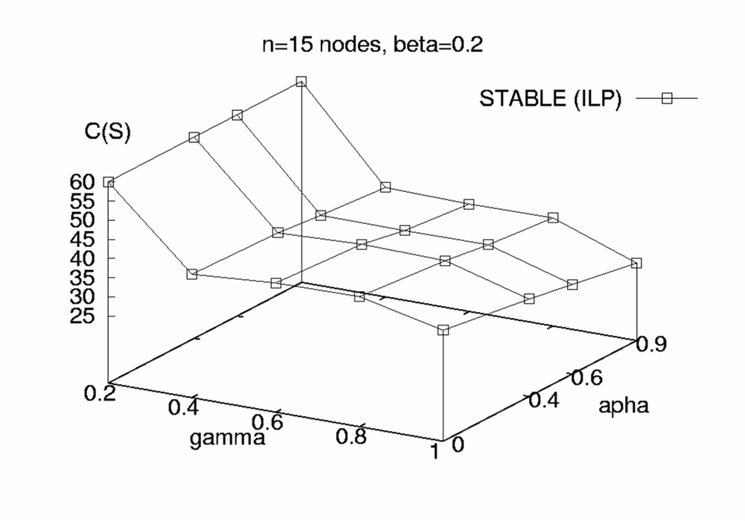
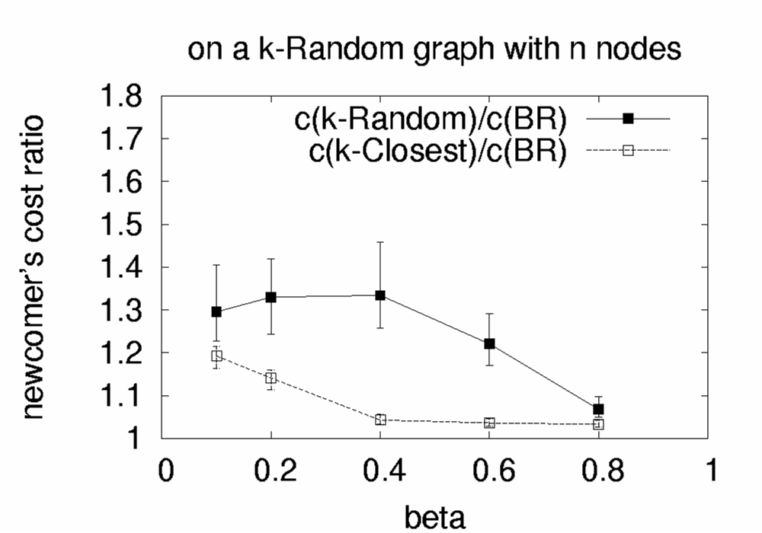
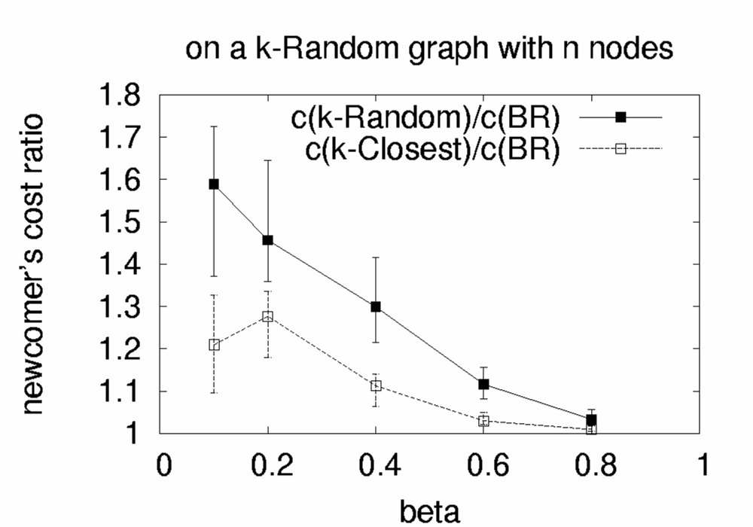
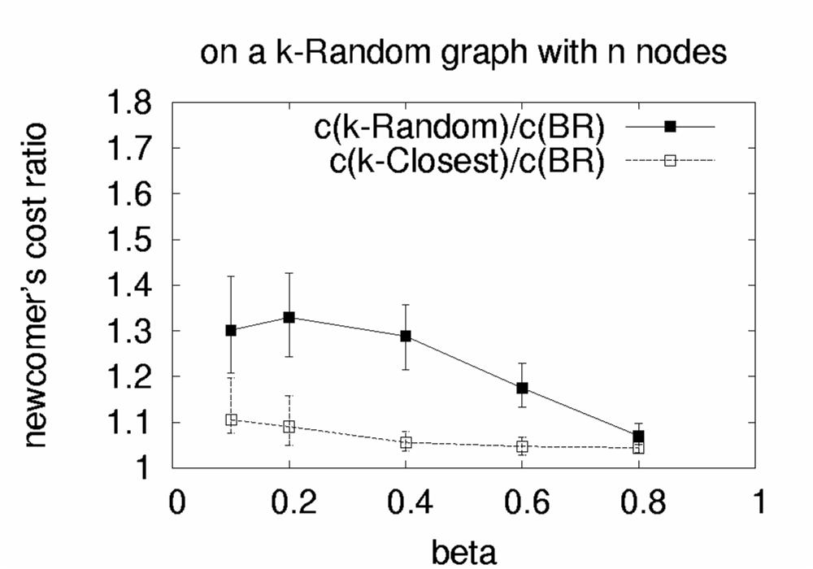

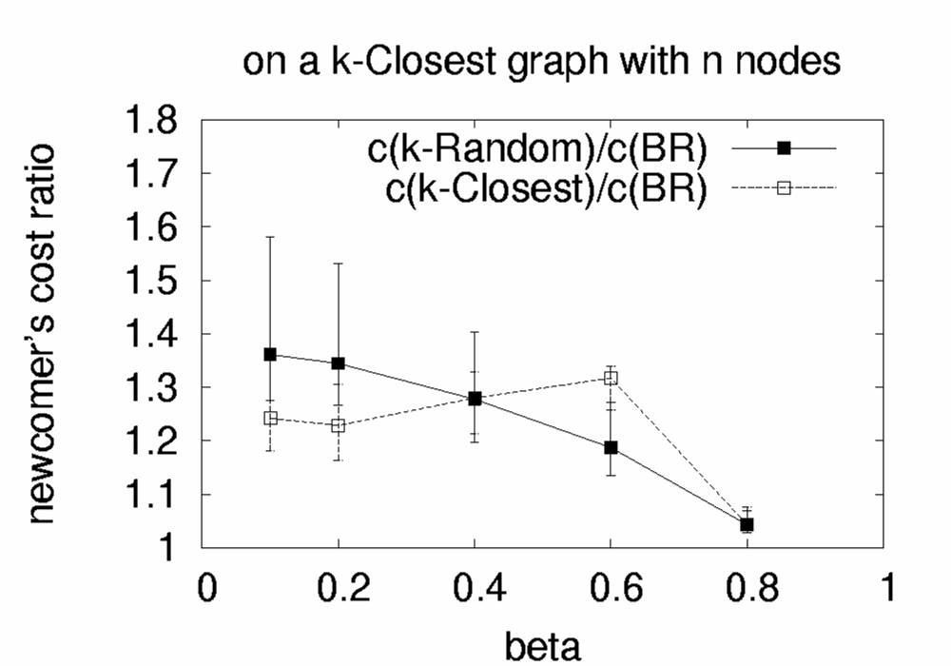
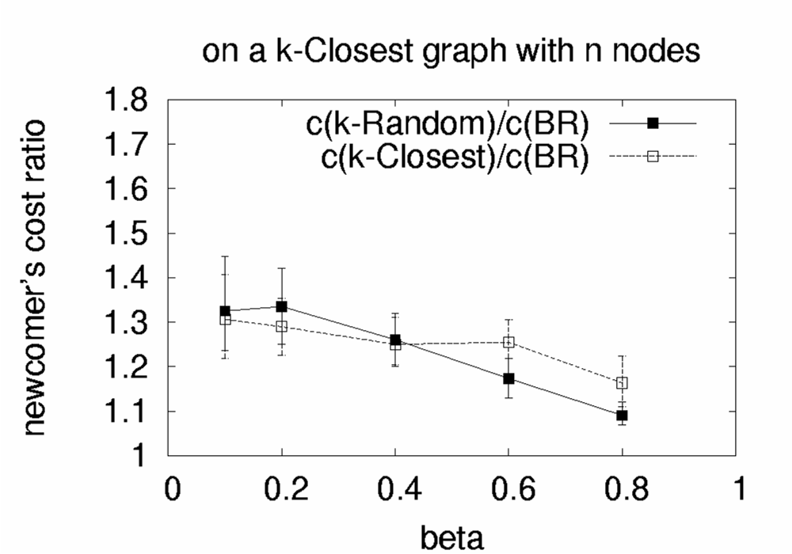
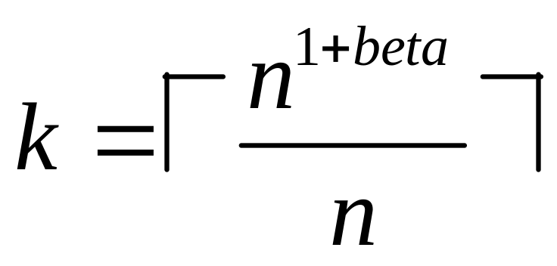
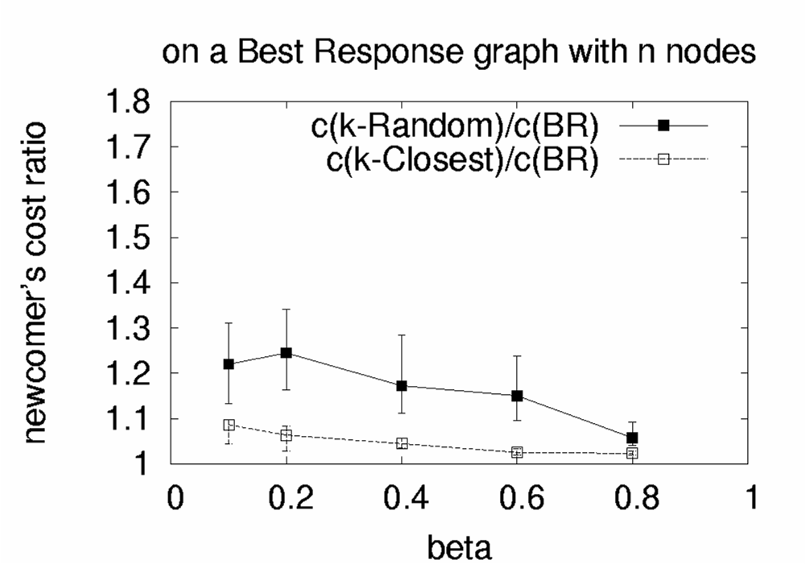
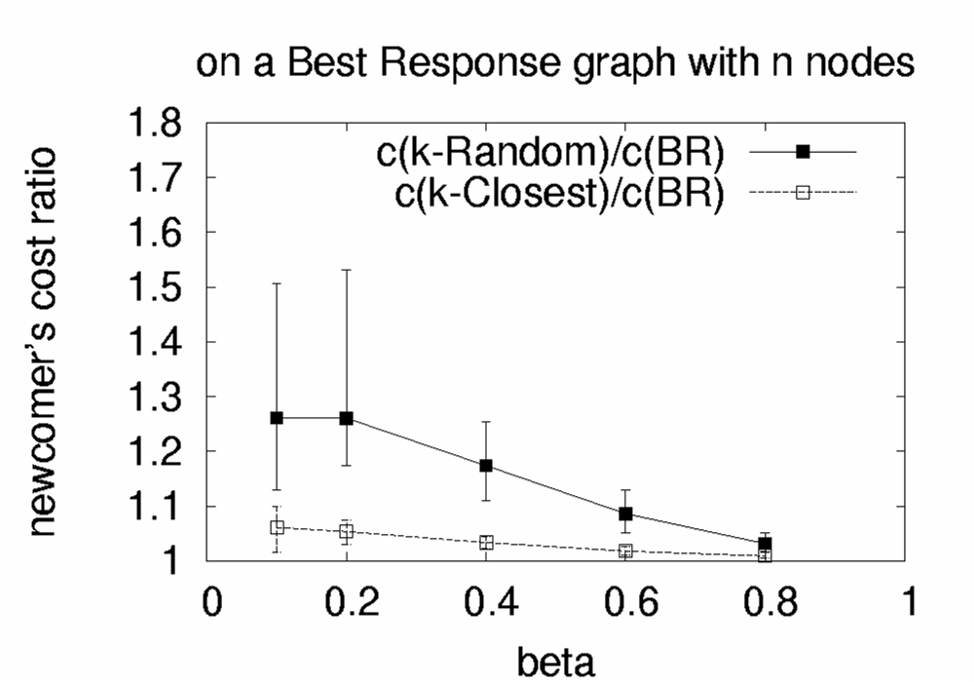

The Selfish Neighbor Selection Problem
In Overlay Networks
SNS
Georgios Smaragdakis, Nikolaos Laoutaris, Azer Bestavros and John W. Byers
http://csr.bu.edu/sns
Overview
In a typical overlay network for routing or content sharing, each node must select a fixed number of immediate overlay neighbors for routing traffic or content queries. A selfish node entering such a network would select neighbors so as to minimize the weighted sum of expected access costs to all its destinations. Previous work on selfish neighbor selection has built intuition with simple models where edges are undirected, access costs are modeled by hop-counts, and nodes have potentially unbounded degrees. However, in practice, important constraints not captured by these models lead to richer games with substantively and fundamentally different outcomes. Our results indicate that selfish nodes can reap substantial performance benefits when connecting to overlay networks composed of non-selfish nodes. On the other hand, in overlays that are dominated by selfish nodes, the resulting stable wirings are optimized to such great extent that even non-selfish newcomers can extract near-optimal performance through naive wiring strategies.
Characterization of Stable Wirings
Social Cost of Stable Wirings
Towards A Realistic Model of Overlay Networks
1. Bounded in- and out-degrees
2. Directed Edges
3. Non-uniform preference vectors
4. Realistic models of Physical Distance
alpha=0
alpha=0.4
alpha=0.6
alpha=0.9
beta=0.2
beta=0.4
Deriving Stable Wirings
- Best Response Wiring:
By solving an Asymmetric k-median problem
- Equilibrium Wirings:
Through Iterative Best Response
beta=0.6
beta=0.9
Double Capacitated
Experiments
 | beta=0.1 |  | beta=0.2 |  | beta=0.4 |  | beta=0.6 |  | beta=0.8
 | k-Random/BR | k-Closest/BR | k-Random/BR | k-Closest/BR | k-Random/BR | k-Closest/BR | k-Random/BR | k-Closest/BR | k-Random/BR | k-Closest/BR
BRITE | 1.44 | 1.53 | 1.52 | 1.84 | 1.38 | 2.07 | 1.28 | 1.46 | 1.09 | 1.16
PlanetLab | 2.23 | 1.48 | 1.75 | 1.23 | 1.37 | 1.13 | 1.09 | 1.16 | 1.04 | 1.06
AS-level | 2.04 | 1.9 | 1.83 | 1.61 | 1.58 | 1.39 | 1.24 | 1.23 | 1.12 | 1.16
BRITE
PlanetLab
AS-level
An overlay node
applying Best Response
wiring policy to the residual
overlay graph
Skewness: alpha, Zipf(alpha)
Oudegree:

