Slide 1


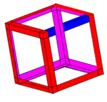

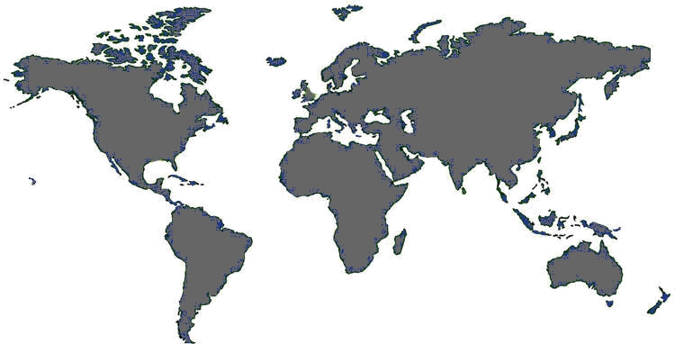
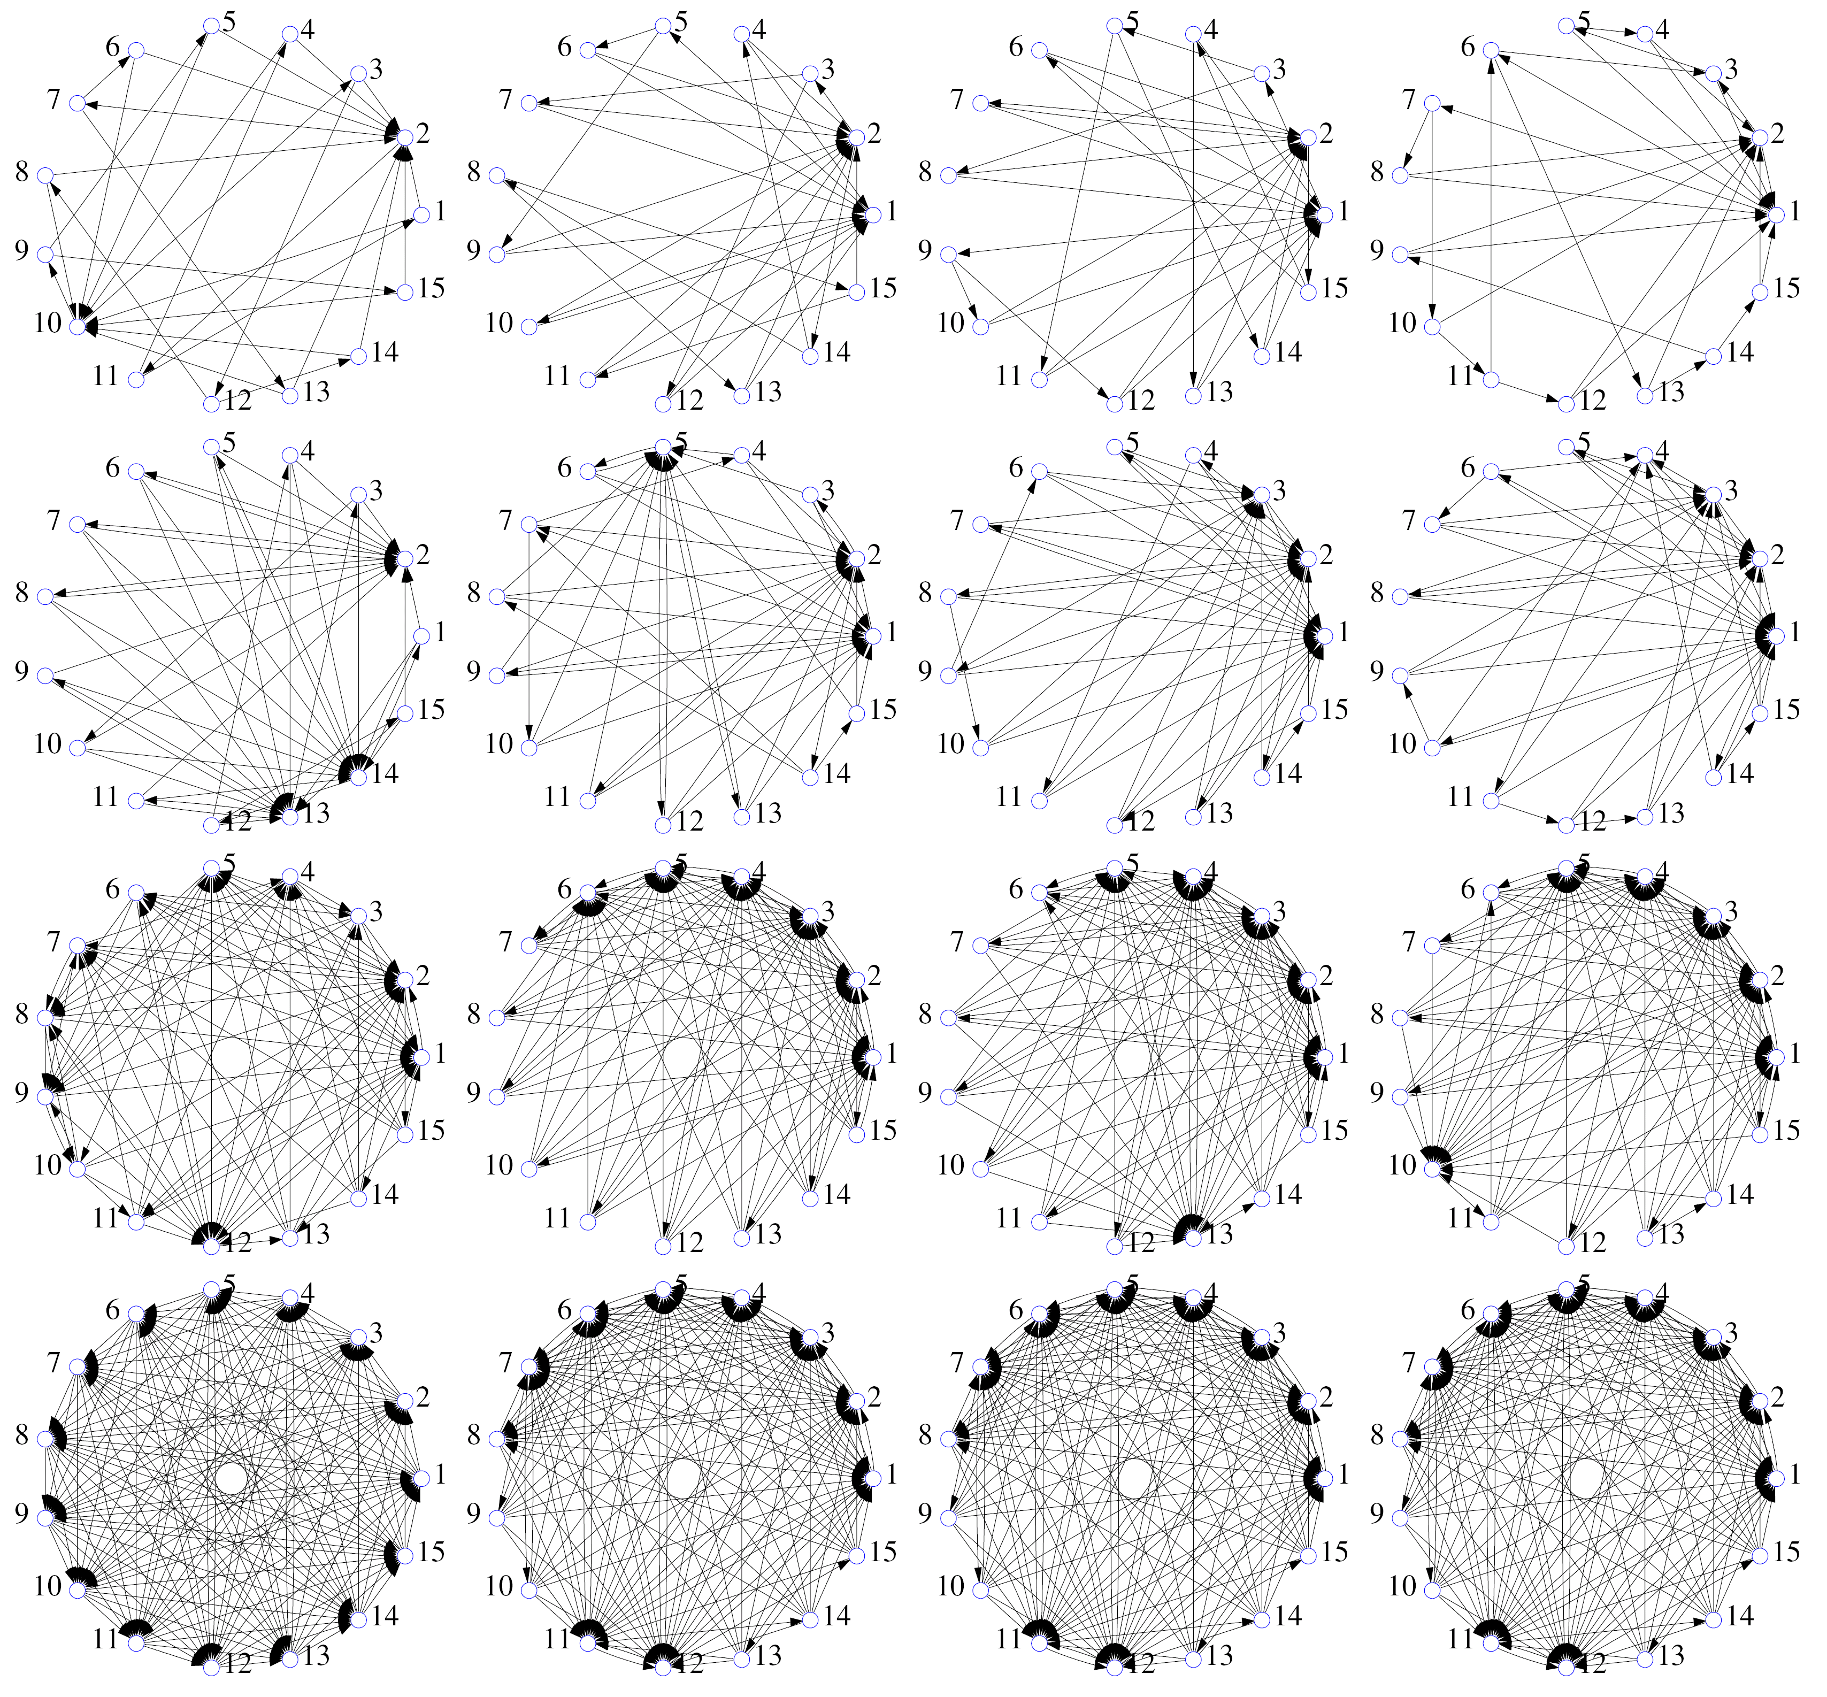

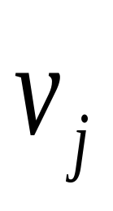
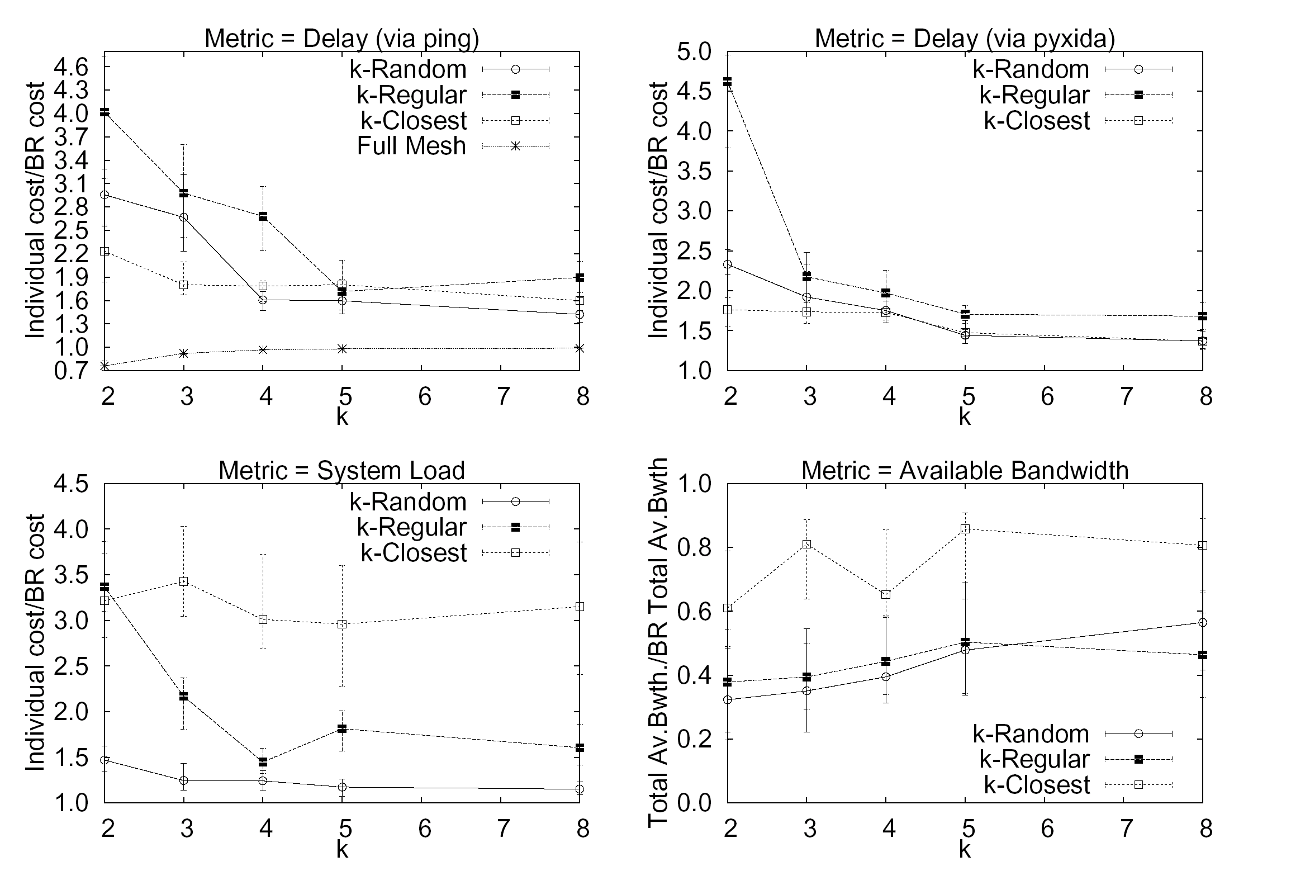
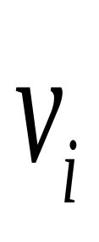
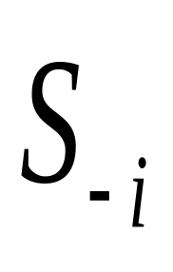

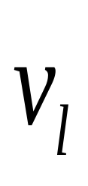

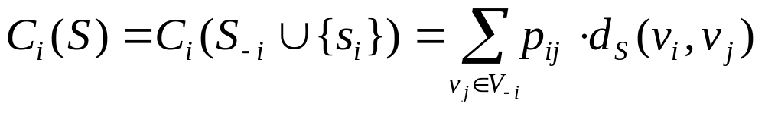
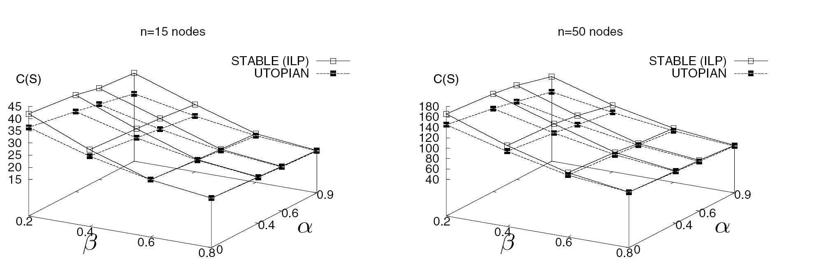
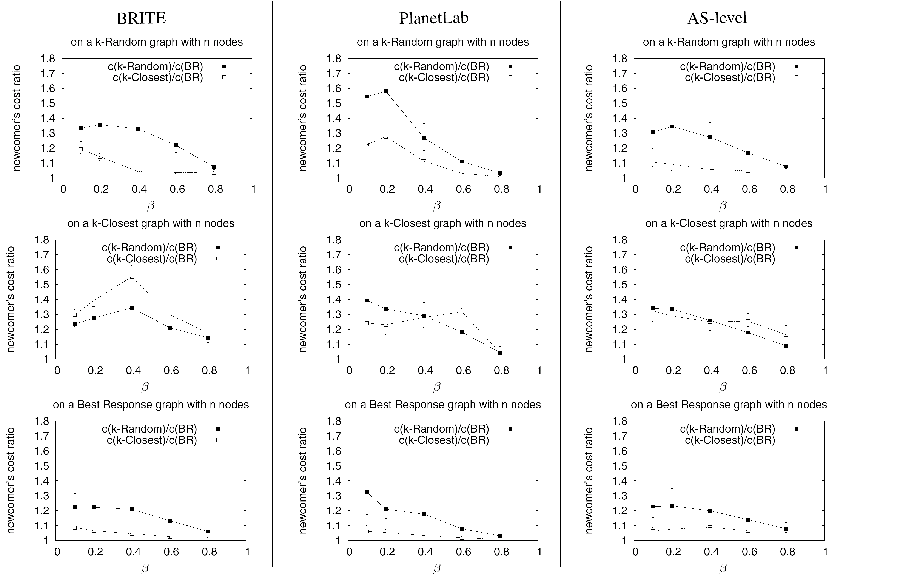
Selfish Neighbor Selection and Implications on the Design and Performance of Overlay Network Protocols
Georgios Smaragdakis (BU), Nikolaos Laoutaris (Telefonica), Azer Bestavros (BU),
John W. Byers (BU), Mema Roussopoulos (Harvard), and Pietro Michiardi (Eurocom)
SNS
http://csr.bu.edu/sns
SNS as a Game Among Overlay Nodes
Results and Implications
EGOIST: A PlanetLab Prototype
Given an established overlay network
A node v_{i} evaluates the advantage (if any) from picking a different set of neighbors
If warranted, v_{i} changes its (outbound) neighbors
This rewiring may trigger more rewiring by others
Node Popularity Skew
Novel contributions
Directed edges with bounded node degrees
Non-uniform node popularity and link costs
Formulated for different metrics and objectives
Node Out Degree Neighbors
Best Response SNS Strategy
Characteristics of Stable Wirings
Publications
v_{i}’s Best Response (BR) is a wiring s_{i} that minimizes
where p_{ij} is the preference of v_{i} for v_{j} and d_{S}(v_{i},v_{j}) is the cost of routing from v_{i} to v_{j} in global wiring S.
Finding BR for uniform link costs requires solving the NP-hard k-median problem; approximation possible
Implications of Selfish Neighbor Selection in Overlay Networks, IEEE INFOCOM 2007.
EGOIST: Overlay Routing using Selfish Neighbor Selection, BUCS-TR-2007-006.
Swarming on Optimized Graphs for n-way Broadcast, BUCS-TR-2007-009.
n = 15
n = 50
Selfish nodes achieve close to utopian cost
BRITE (n=50)
PlanetLab (n=50)
AS-Level (n=50)
BRITE (n=50)
PlanetLab (n=50)
AS-Level (n=50)
BRITE (n=50)
PlanetLab (n=50)
AS-Level (n=50)
If your neighbors are naïve, it pays to be selfish…
If your neighbors are greedy, it pays to be selfish…
If your neighbors are selfish, it’s OK to be naïve!

