Slide 1

The Selfish Neighbor Selection Problem
In Overlay Networks
Georgios Smaragdakis (Boston University)
Joint work with Nikos Laoutaris (Harvard U.), Azer Bestavros (Boston U.),
John W. Byers (Boston U.) and Mema Roussopoulos (Harvard U.)
UoA, July 19 2007

Slide 2
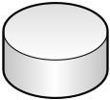
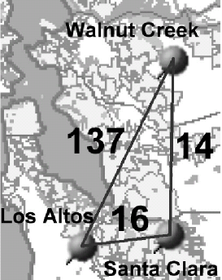

Neighbor Selection in Overlay Networks
O₂
overlay
node
Assumed overlay network model:
no predefined structure
shortest-path routing @ overlay
nodes & weighted directed
overlay links
  weight ~ physical dist.
overlay
link
O₁
O₃
R₃
Neighbor selection Problem: choose overlay nodes for the establishment of direct links
R₁
R₂
R₄
physical
link
Applications:
overlay routing nets (traffic)
unstructured P2P file sharing (queries)
physical node (e.g., end-systems, router or AS)

Slide 3
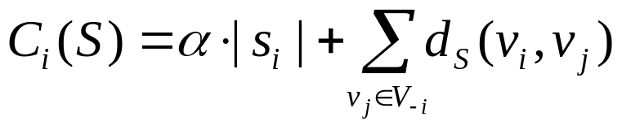
Main differences with previous
Network Creation Games
they assume undirected links, and
unbounded degrees
  e.g., in Fabrikant et al., 2003: node v_{i} can “buy” as many undirected links as it wants, each at cost “α”, so as to minimize:
  Chun et al., 2004: study experimentally the case of non-uniform link costs “α_{ij}”
  Appropriate for physical telecommunication networks
purchase cost
access cost

Slide 4
Key elements of our study of neighbor selection
  selfish nodes
    … select neighbors to optimize the connection quality of the local users
  bounded node out-degrees
    overlay routing ➔ overlay link-state O(nk) as opposed to O(n²)
    Unstructured P2P ➔ many neighbors would flood the network (even with scoped flooding in place)
    Upload link stress, OS issues etc.
  directional links
    don’t want degree-based preferential attachment phenomena
    Pricing issues
N. Laoutaris, G. Smaragdakis, A. Bestavros and J.W. Byers, INFOCOM 2007

Slide 5
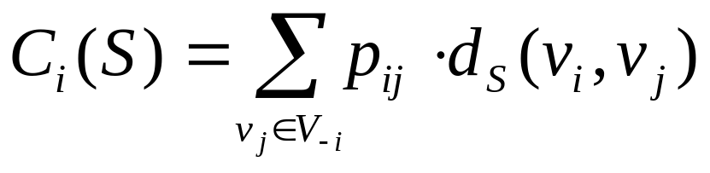
Here comes the selfish node
v_{i}’s preference for v_{j}
v_{i} wants to minimize:
w
over all s_{i}∈S_{i}
v_{i}
u
individual wiring
s_{i}={u,w}
G_{-i}=(V_{-i},S_{-i})
global wiring
S=S_{-i}+{s_{i}}
v_{i}’s residual wiring
v_{i}’s residual network
residual wiring

Slide 6
An initial set of questions we pose
What is the best way to connect to a given residual wiring?
How does it compare to empirical connection strategies?
Do pure Nash equilibrium wirings always exist ?
What about their structure and performance?

Slide 7
The Selfish Neighbor Selection (SNS) game
Players: the set of overlay nodes V={v₁,…,v_{n}}
Strategies: a strategy s_{i}∈S_{i} for node v_{i} amounts to a selection of direct outgoing overlay links (therefore |S_{i}|=(n-1 choose k_{i}))
Outcome: S={s₁,…,s_{n}} is the global wiring composed of the individual wirings s_{i}
Cost functions: C_{i}(S) the communication cost for v_{i} under the global wiring S, i.e.:
symmetric strategy sets

Slide 8
What is a Best-Response wiring?
It is the optimal neighbor selection for the deciding node under a given residual graph (utilizes fully the link structure of the residual graph)
  k-Random does not use any link information
  k-Closest uses only local information
The case of uniform game, i.e. uniform preference, link budget (k), and
link weights (1):
Under uniform overlay link weights (hop-count distance):
  best-response wiring ⬄ asymmetric k-median on the reversed distance function of the residual graph G_{-i} :
Theoretical Results (Laoutaris et.al. asXiv GT/070207):
  All (n,k)-uniform games have pure Nash equilibria.
  There exist non-uniform games with no pure Nash equilibria.
2
w
w
wrong
right
3
1
cheap
4
expensive
u
u
since these
cost the same
w,u can be
obtained from
2-median on
reversed distances
d₁₂<d₁₃<d₁₄

Slide 9
Experimental results under unit distance for direct overlay links
Stable wirings obtained through iterative best-response (BR) using ILP and local-search for BR (asymmetric k-median).
SC(stable) close to SC(soc-opt), gap closing with:
  density of links
  skewness of preference
Doubly-constrained overlay: constraining the in-degree increases the social cost by creating longer paths

Slide 10
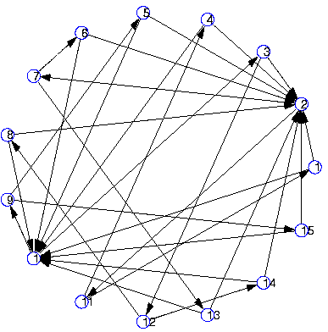
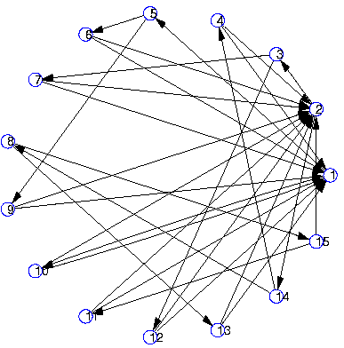
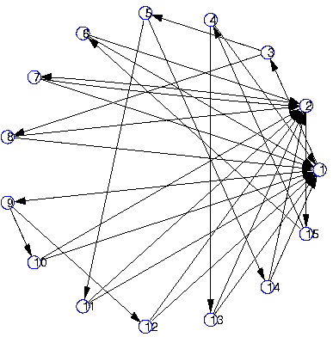
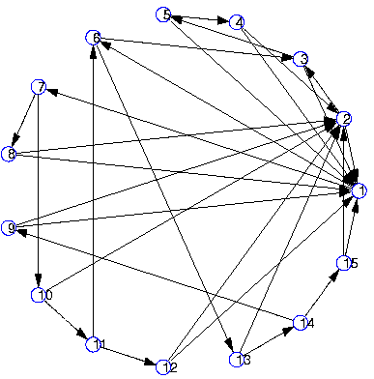
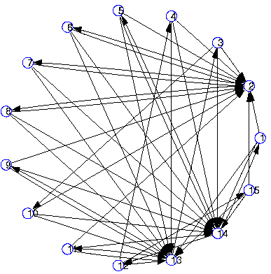
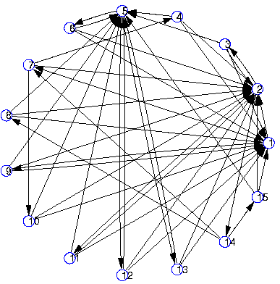
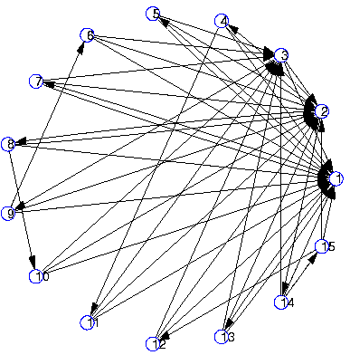
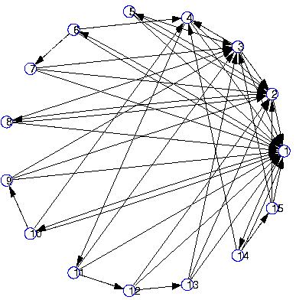
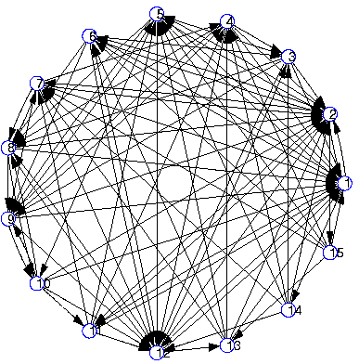
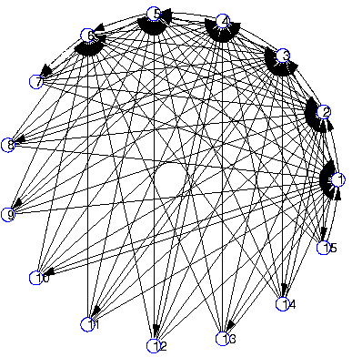
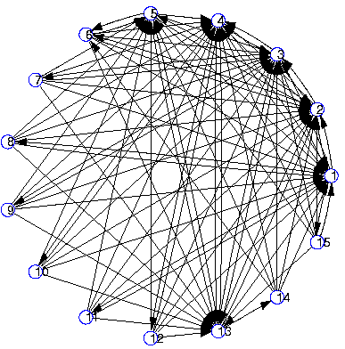
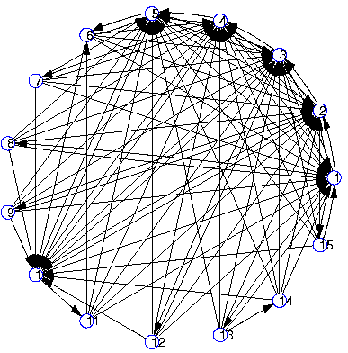
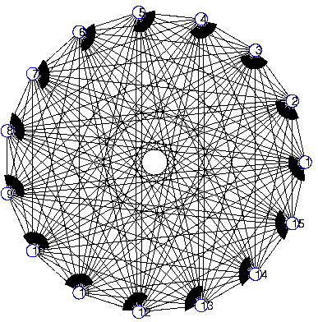
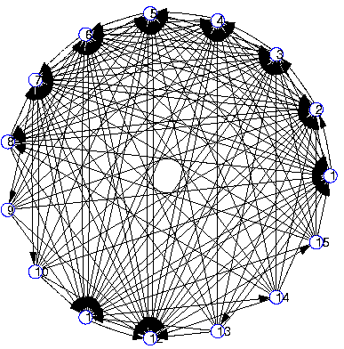
Structure of Stable Graphs
Uniform Preference Skewness of preference
in-degrees of stable are highly skewed even under uniform preference !
- seems it is quality-based “preferential attachment”
k (outgoing links)

Slide 11
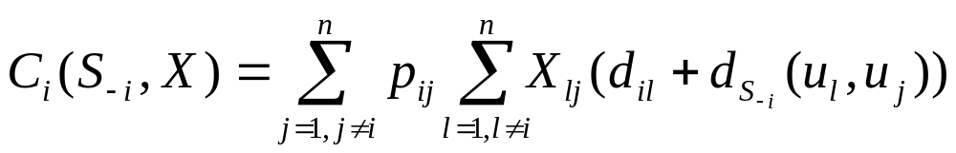
Experimental results under realistic physical distance
instead of 1-weighted direct links, weights obtained from:
Main goal: Best-response vs. empirical wirings
  k-Random
  K-Closest
Stable wirings from iterative BR method using an ILP formulation of BR
what most P2P protocols due when a new node joins (bootstap)
what a “cheating” P2P node can do using pings (Local greedy)
minimize

Slide 12
Experimental results under realistic physical distance
  Data Sets:
  BRITE topology generator
    Barabasi-Albert growth model
    nodes placed on a surface according to a heavy-tail model
    Euclidean distances
  “all-pairs” ping traces from PlanetLab sites (300 sites)
  AS-level map of the actual Internet topology
    from Dec. 2001, obtained using the “Rocket-Fuel” methodology
    used the #hops between u, w at the AS-level as the weight of a direct link at the overlay layer

Slide 13
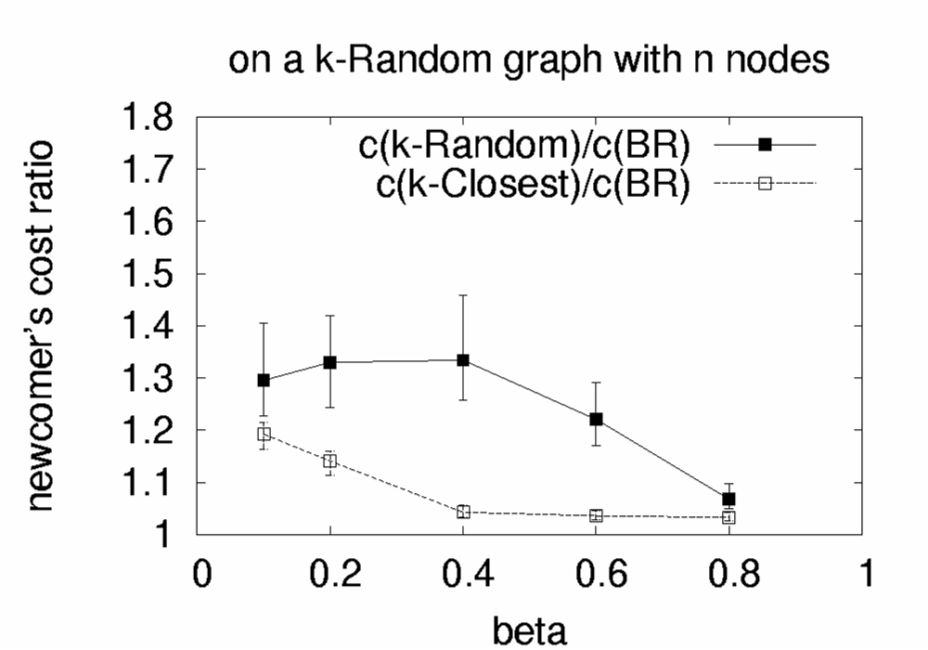
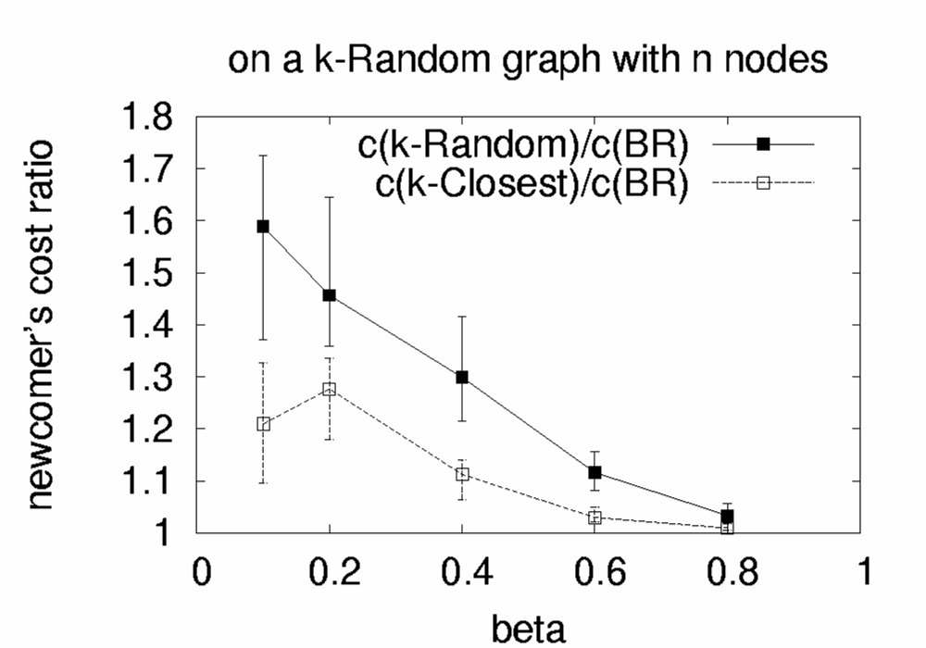
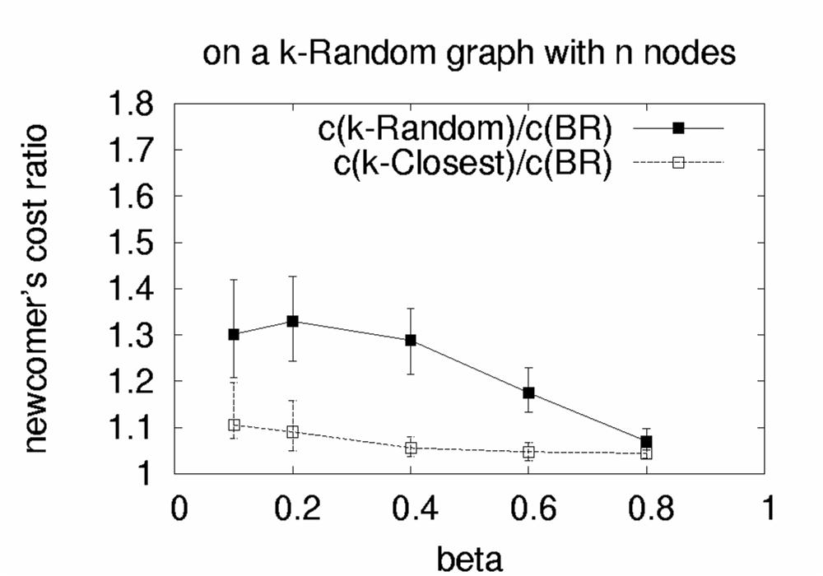
Summary of results
on a k-Random graph:
  BR yields large cost reduction compared to k-Random
  k-Closest has generally good performance
BRITE
PlanetLab
AS-level
k-Random/BR
k-Random/BR
k-Random/BR
k-Closest/BR
k-Closest/BR
k-Closest/BR
A “newcomer” connecting to k-Random graph with 50 nodes

Slide 14
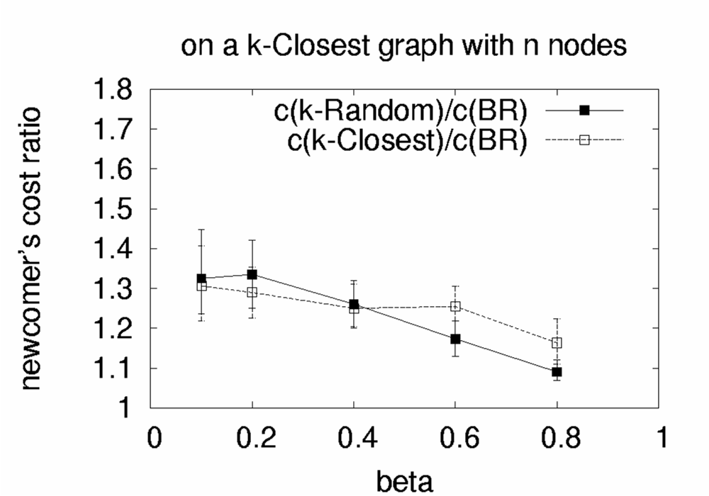

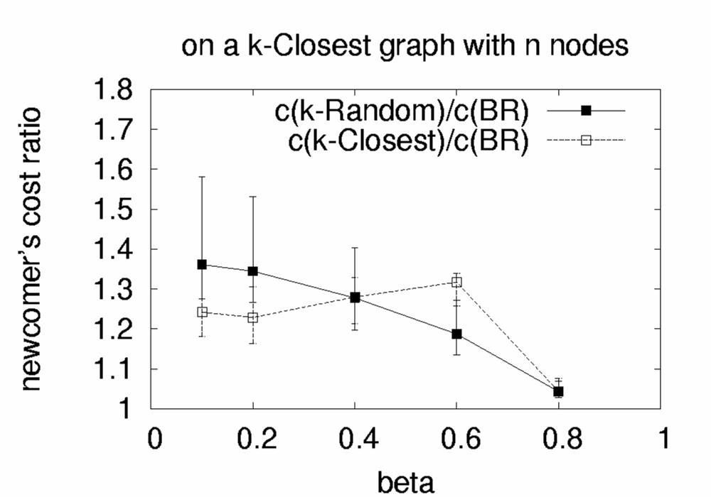
Summary of results
on a k-Closest graph:
  doing k-Closest wiring might be risky
  even k-Random can be much better
BRITE
PlanetLab
AS-level
k-Random/BR
k-Random/BR
k-Random/BR
k-Closest/BR
k-Closest/BR
k-Closest/BR
A “newcomer” connecting to k-Closest graph with 50 nodes

Slide 15
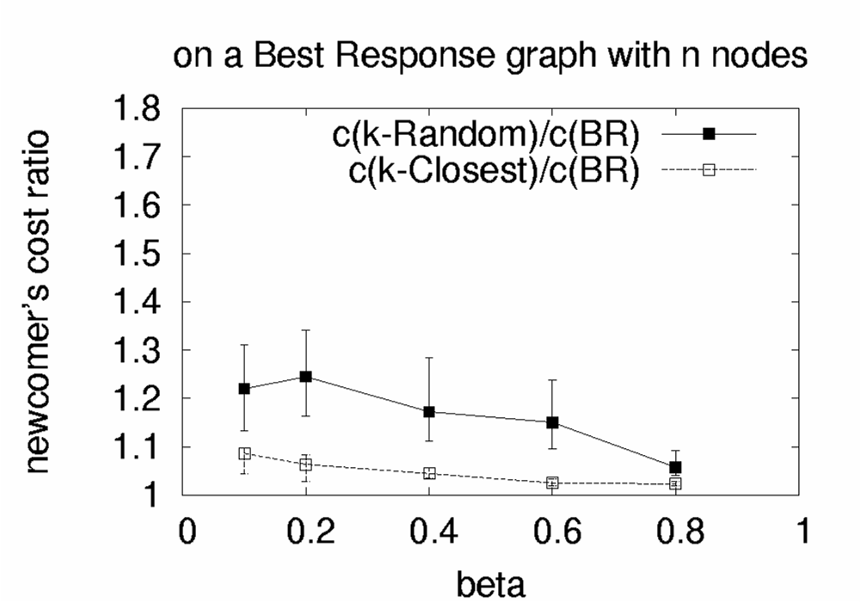

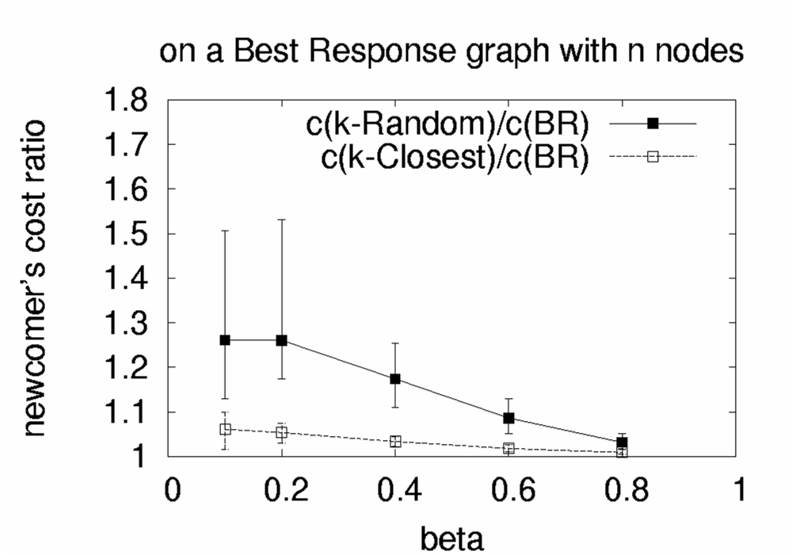
Summary of results
on a BR graph:
  even the empirical wirings do well
  the BR graph is highly optimized
BRITE
PlanetLab
AS-level
k-Random/BR
k-Random/BR
k-Random/BR
k-Closest/BR
k-Closest/BR
k-Closest/BR
A “newcomer” connecting to BR graph with 50 nodes

Slide 16
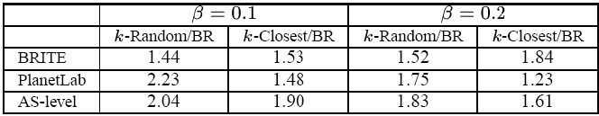
Summary of results
Social Cost(X) / Social Cost(BR), X∈{k-Random, k-Closest}
The BR graph can
half the social cost compared to k-Random and k-Closest

Slide 17
But can we use Best-Response in practice?
Candidate applications:
  Overlay routing (RON, QRON, Detour, OverQoS, SON, etc.)
  Unstructured P2P file sharing (KaZaA, Gnutella, etc.)
To give an answer, we have to examine:
  how natural is the mapping from the abstract SNS to the app?
  are the SNS pre-requisites in place?
    information to compute Best-Response: d_{ij} and d_{G-I}
    computational complexity
    shortest path routing on the weighted overlay graph
  true performance benefits (factoring-in node churn, dynamic delays, bandwidth, etc.)
G. Smaragdakis, N. Laoutaris, A. Bestavros, J.W. Byers and M. Roussopoulos BUCS-TR-2007-006

Slide 18

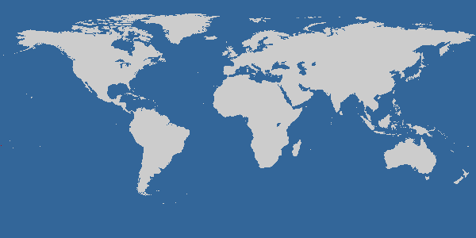

EGOIST:
Our prototype overlay
routing system for
n7
n8
n3
n2
n1
n10
n4
n5
n9
Connecting a newcomer node v_{i}
bootstrap
listen to overlay link-state protocol to get d_{G-i}
get d_{ij}’s through active (ping) or passive measurmnt (Pyxida,pathChirp)
wire according to (hybrid) Best-Response
monitor and announce your links
n6
n11
50 nodes around the world using the infrastructure of

Slide 19
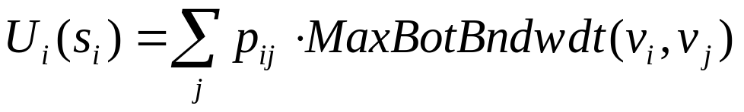
EGOIST: Features
supported metrics:
  delay (active/passive monitoring with ping/Pyxida)
  available bandwidth (monitoring with pathChirp)
  node load (monitoring with loadavg)
supported wiring strategies:
  k-Random
  k-Closest
  k-Regular
  Best-Response (delay and AvailBw formulations)
  Hybrid Best-Response
BR-computation based on
  the full residual graph
  or just samples of it
residual network
immediate
neighbors
MaxBotBndwdthPath(v_{i},v_{j})
a destination
v_{i}
v_{j}

Slide 20
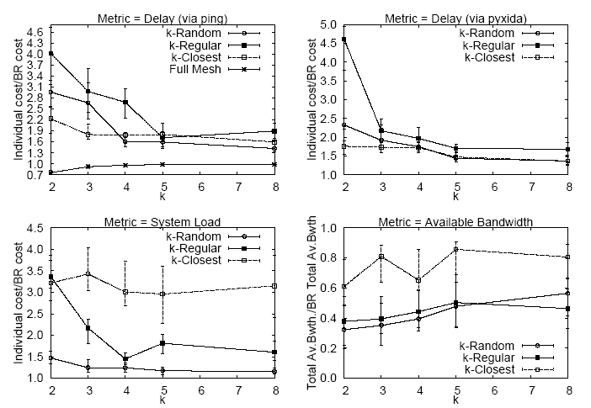
EGOIST: Performance and scalability
as good as Full Mesh but with O(nk) instead of O(n²) monitoring overhead
BR every
T seconds

Slide 21
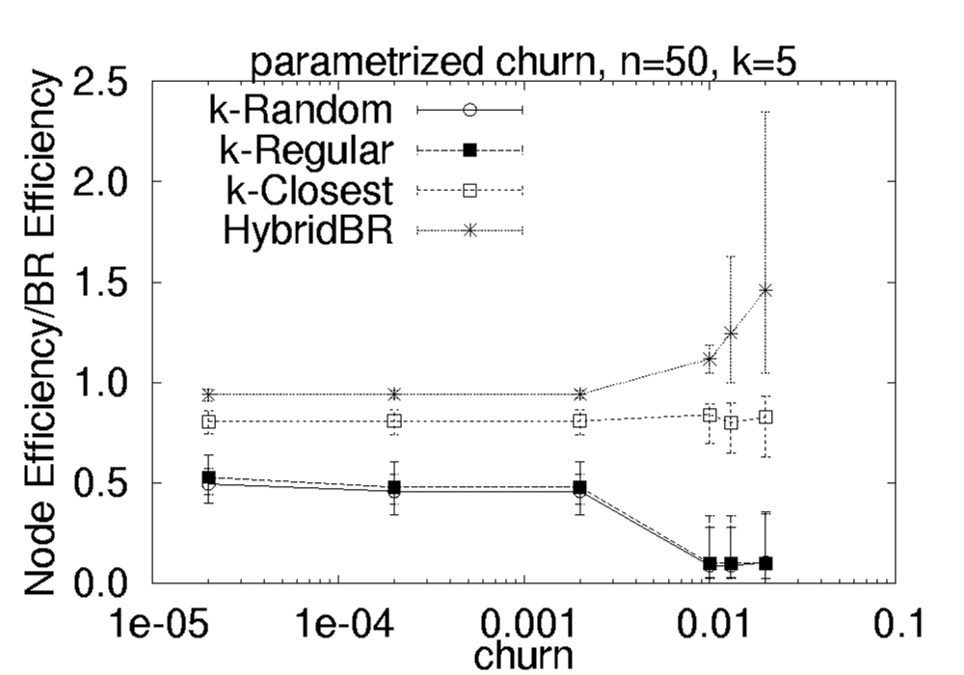
EGOIST: Performance Under Churn
BR resilient to churn for moderate Churn.
The graph becomes connected after
O(T/n)
Hybrid BR has been proposed for
guaranteed connectivity. It requires
a number of links to be dedicated.
Efficiency of a node:
e_{i} = 1/(n-1) Sum 1/d_{ij}

Slide 22
Is Best-Response applicable to unstructured P2P file sharing
?
queries are for files (wherever they may reside) and not for nodes
you don’t have the residual graph (cause you don’t have overlay link-state protocol as in overlay routing)
you don’t have shortest-path routing (instead you have scoped-flooding and random-walk forwarding of queries)
P2P net several orders of magnitude larger than an overlay routing net (so you definitely have to use sampling)
… common sense …
  instead of new P2P …
  new BR for the existing P2P with scoped-flooding
  GOAL: optimize search performance

Slide 23
Current unstructured P2P file sharing apps
Gnutella and other P2P systems choose their neighbors (SNs) using locality and/or random selection
2
Bootstrap
Server
1
3
4
if the TTL of scoped flooding is 2
randomly
this wiring will give you access to 4 nodes

Slide 24
Our Best-Response for unstructured P2P file sharing
IDEA: we select neighbors to maximize the
foothold of our scoped flooding
4
Bootstrap
Server
1
6
3
5
2
for each candidate we compute the number
of distinct nodes we can reach with TTL 2
connect to those candidates that maximize the overall sum of uniques
this wiring gives us access to 6 nodes

Slide 25
Wrap up
neighbor selection with selfish nodes & bounded degrees
optimal neighbor selection vs empiricals
performance of stable (pure Nash) graphs
Best Response ➔ yes for overlay routing networks
➔ probably no for unstructured P2P
for the later, we reformulated Best Response to optimize the search performance under scoped-flooding

Slide 26
FAQs
SNS is Selfish Routing?
  In SNS the routing protocol is given; the objective is to construct the graph .
  In Selfish Routing the graph is given; the objective is to design the (source) routing.
Why Not DHTs?
  Local Greedy Routing can be suboptimal (e.g. in terms of delay)
The nodes belong to an enterprise network, thus are not selfish?
  The SNS framework can also be seen as a distributed optimization framework.

Slide 27
SNS in concept
Service Deployment Problem (a.k.a Distributed Facility Location, DFL):
  Selection of nodes for service installation.
  Migration of Service.
Selfish Neighbor Selection Problem (SNS):
  Connect the nodes,
  Route node’s traffic or requests.
n-way broadcast Application
  Peer Set Selection for fast content dissemination.

Slide 28
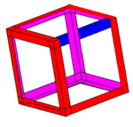
SNS

Slide 29
The Service Deployment Problem
The deployment of large scale services requires
  Selection of the Locations of Service Facilities
  Estimation of the Number of Service Facilities
  to better satisfy the demand of clients
The current approach:
A single entity deploy the application.
A fresh view toward a client-oriented service model:
Let the client’s demand deploy the service!
N. Laoutaris, G. Smaragdakis, K. Oikonomou, I. Stavrakakis, and A. Bestavros, INFOCOM 2007

Slide 30

A setting for dynamic service deployment
Generic
Service
Host
Service
Facility
Flash
Crowd

Slide 31
Key challenges
The Deployment of such applications must be:
Scalable
Distributed
Oblivious to network topology
Unaware (a-priori) of the client demand
Easily reconfigurable

Slide 32
Related Work
Uncapacitated k-median (UKM): Choose k facilities so as to minimize the distance between users to the closest facility.
Uncapacitated Facility location (UFL): In addition to UKM, estimate the number of facilities (the cost of open/maintain facilities part of the input).
Both approaches are inherently limited:
  They are Centralized and not Scalable
  Require Complete Information for both Topology and Client demand
  Any change in the setting requires full re-estimation

Slide 33
Migration: A Limited Horizon Distributed Approach
Main Idea:
Local Re-locations: Solve the UKM (or UFL) problem in an r-hop neighborhood (r-ball), where both topology and client demand are easily captured.
Improve the solution until you converge to a stable set of facilities.

Slide 34
Processing a facility
“ring” nodes
const # facilities → 1-median in r-ball
var # facilities → UFL in r-ball
but there is a PROBLEM
  nodes outside the r-ball
  … are totally neglected
and a SOLUTION to it
  map ring demand on the “skin” of the r-ball
r-ball
(r=2)
r-ball
(r=1)

Slide 35
Properties
Convergence:
Allowing migration only if the cost of facilitating the demand decreases at least be a%, leads to convergence in
O(log_{1+a} n) steps
We can control the speed of convergence by tuning a
The decision of the value for r regulates the trade-off between Scalability and Performance
  Good performance even for r=1, 2.

Slide 36
THANK YOU!!

