Slide 1
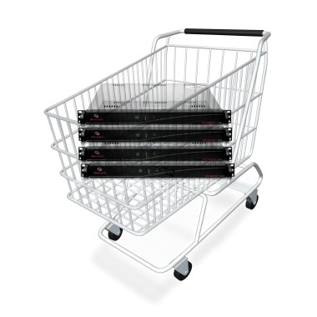



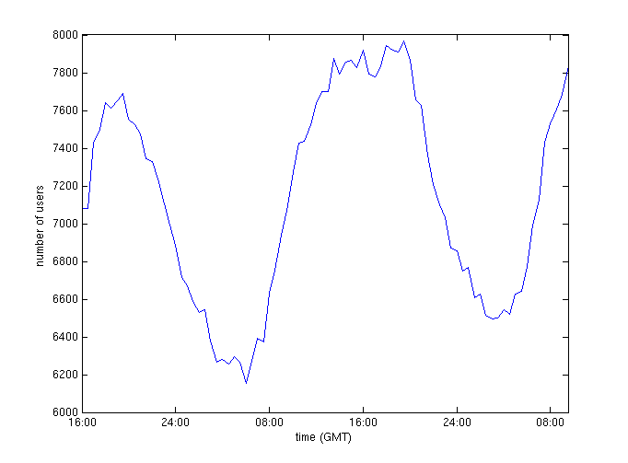

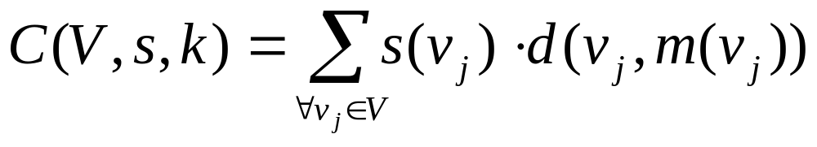
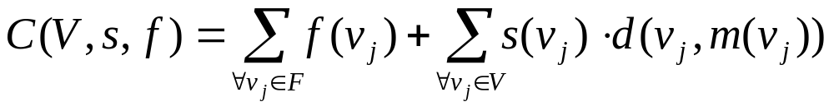
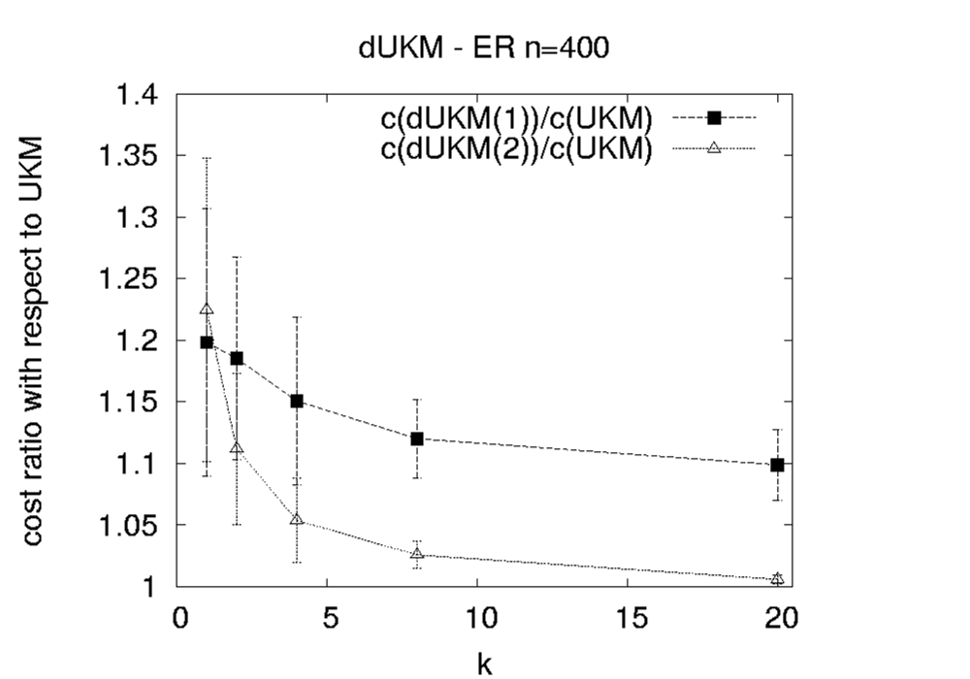
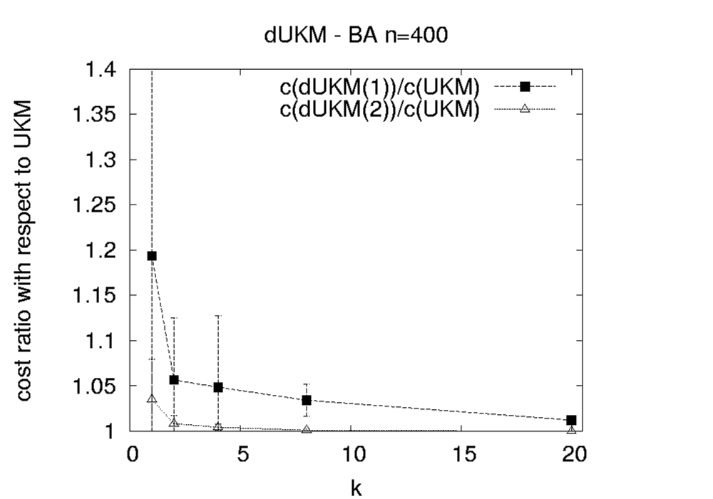
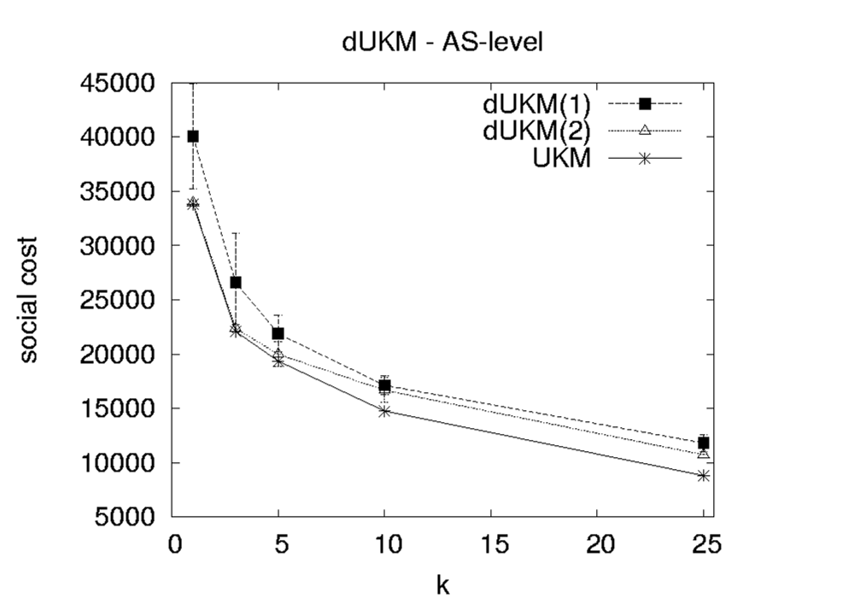
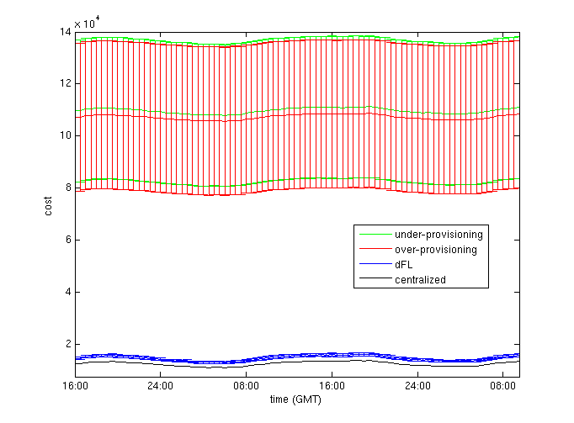
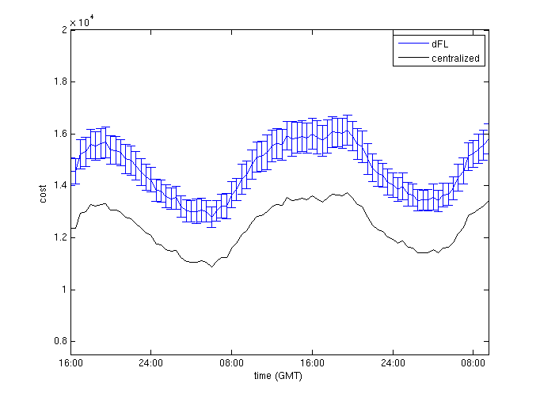
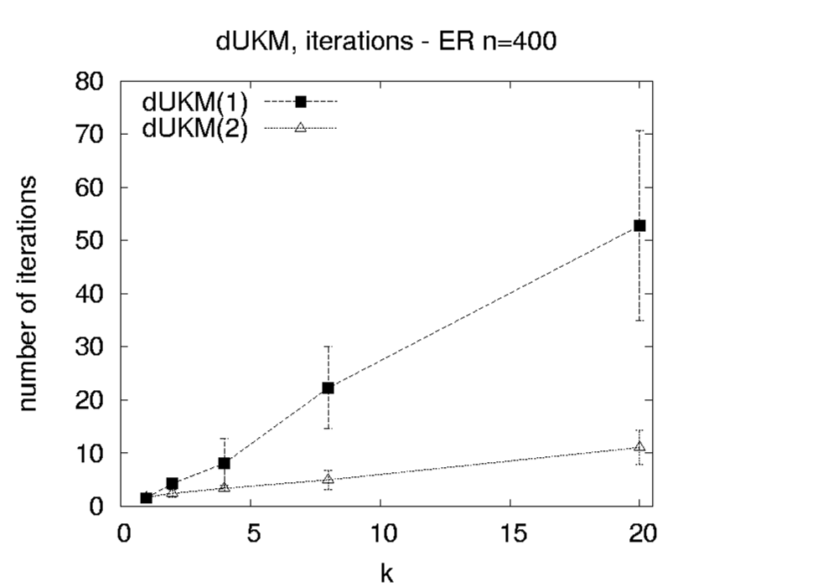
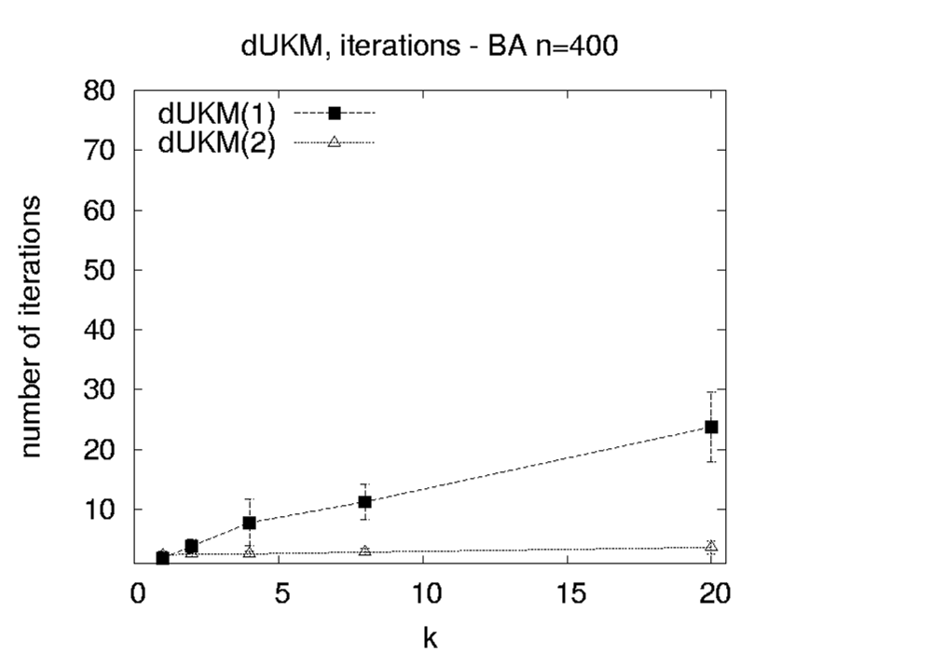
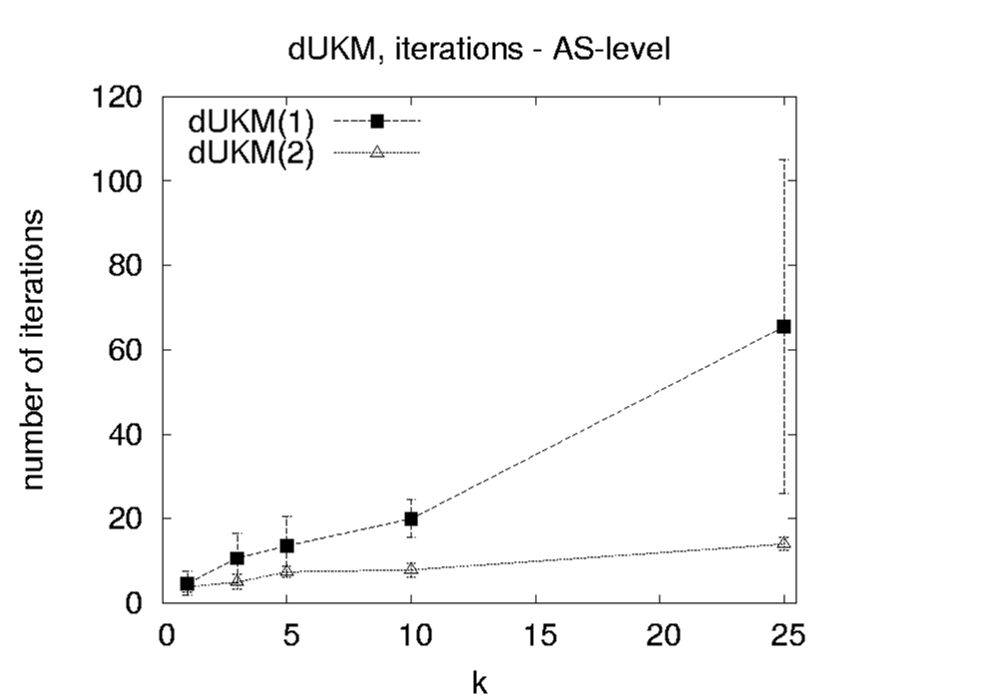
Distributed Placement of Service Facilities in Large-Scale Networks
Georgios Smaragdakis, Nikolaos Laoutaris, Azer Bestavros,
Konstantinos Oikonomou and Ioannis Stavrakakis
http://csr.bu.edu/dfl
Overview
“How can we determine in a distributed and scalable manner the number and location of service facilities?” We propose an innovative approach in which topology and demand information is limited to neighborhoods, or balls of small radius around selected facilities, whereas demand information is captured implicitly for the remaining (remote) clients outside these neighborhoods, by mapping them to clients on the edge of the neighborhood. Through an iterative local reoptimization of the location and the number of facilities within such balls, our distributed approach achieves performance that is comparable to that of optimal, centralized approaches requiring full topology and demand information. We demonstrate the efficiency and scalability of our framework under various synthetic and real Internet topologies.
Background : Centralized Service Deployment
Problem: Estimate the number and location
of servers for an application
- Uncapacitated k-median:
min
- Uncapacitated Facility Location::
min
Toward Dynamic Service Deployment
Key applications:
- Distribution of software updates and patches
- Pay-per-revenue applications
- Replication and Management in Distributed Data Centers
Key Challenges
An ideal deployment should be:
- Scalable
- Distributed
- Oblivious to Network Topology
- Unaware (a-priori) of the client demand
- Easily Reconfigurable
Generic Service
Host
users
Service Facility
Flash Crowd
time
A Limited Horizon Approach to
Distributed Facility Location
Dynamic vs. Static Deployment
ER topology
BA topology
AS-level topology
“ring” nodes
Cost
Cost
Cost
r-ball
(r=2)
.01 0.05 0.1
#facilities: % of nodes
r-ball
(r=1)
.01 0.05 0.1
#facilities: % of nodes
.01 0.05 0.1
#facilities: % of nodes
Iterations
Iterations
Iterations
Properties:
1. Convergence in O(log_{1+a} n) steps
.01 0.05 0.1
#facilities: % of nodes
.01 0.05 0.1
#facilities: % of nodes
.01 0.05 0.1
#facilities: % of nodes
2.
The decision of the value for radius r regulates the trade-off between Scalability and Performance
Publications:
[1] “Distributed Placement of Service Facilities in Large-Scale Networks“
Nikolaos Laoutaris, Georgios Smaragdakis, Konstantinos Oikonomou,
Ioannis Stavrakakis and Azer Bestavros. IEEE INFOCOM 2007

