Slide 1
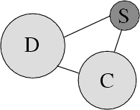
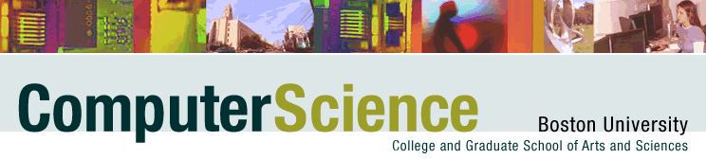



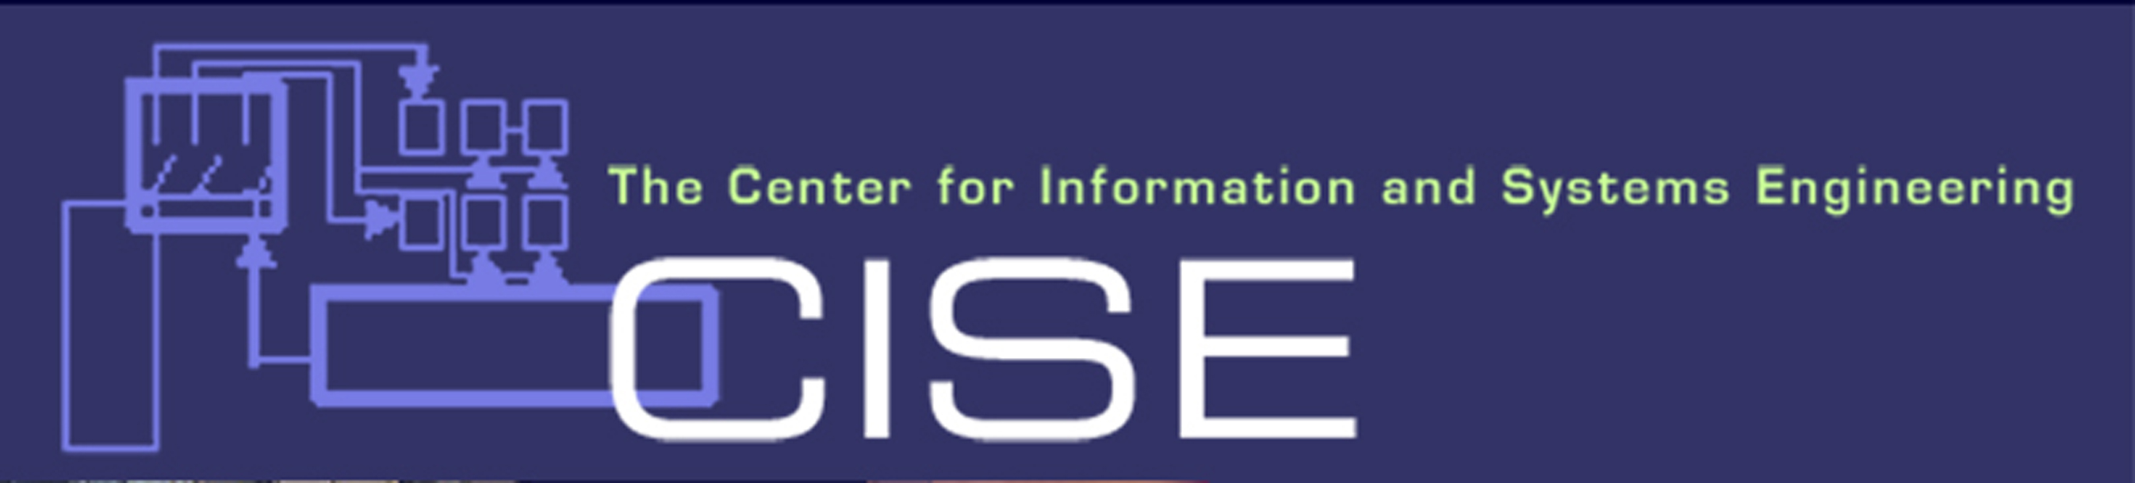

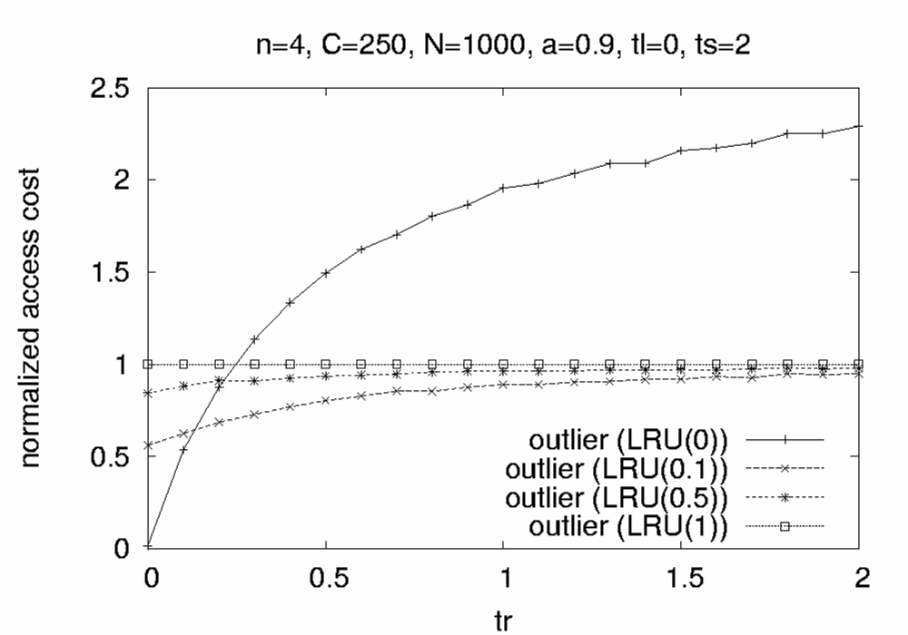
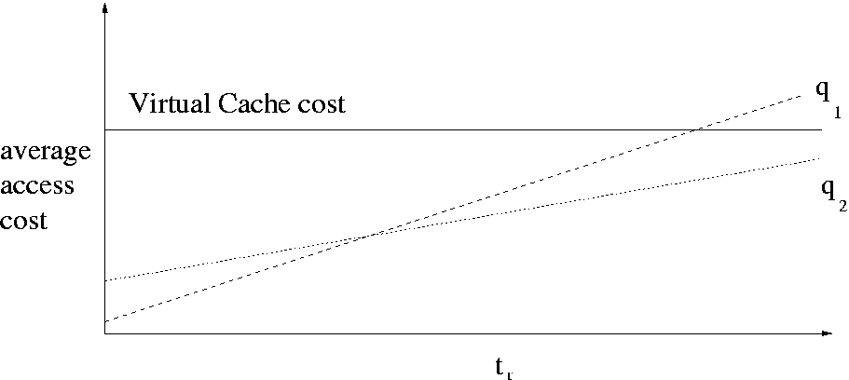
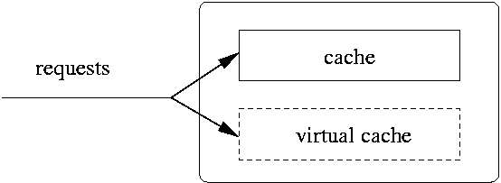
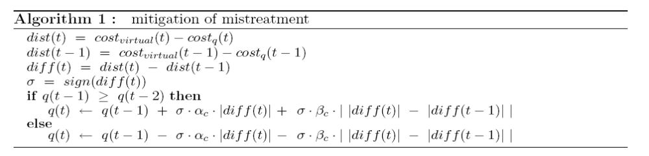
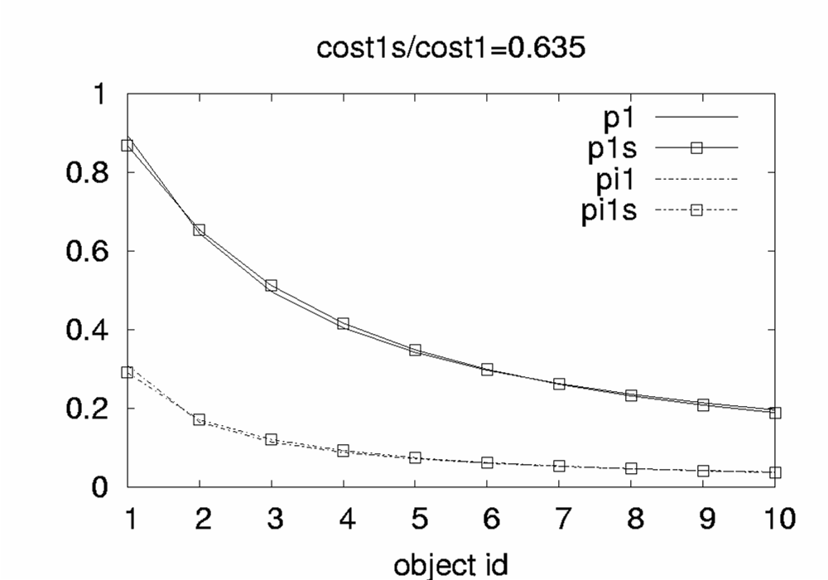
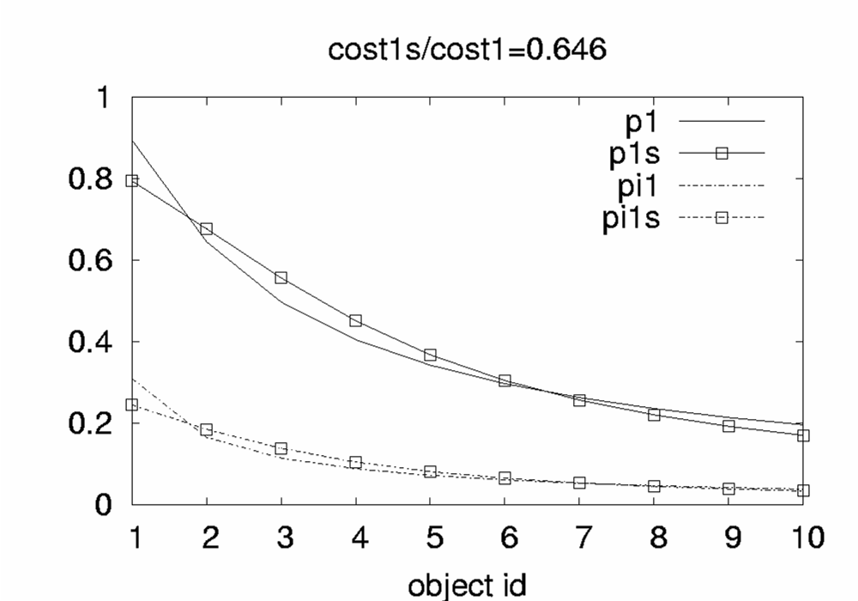
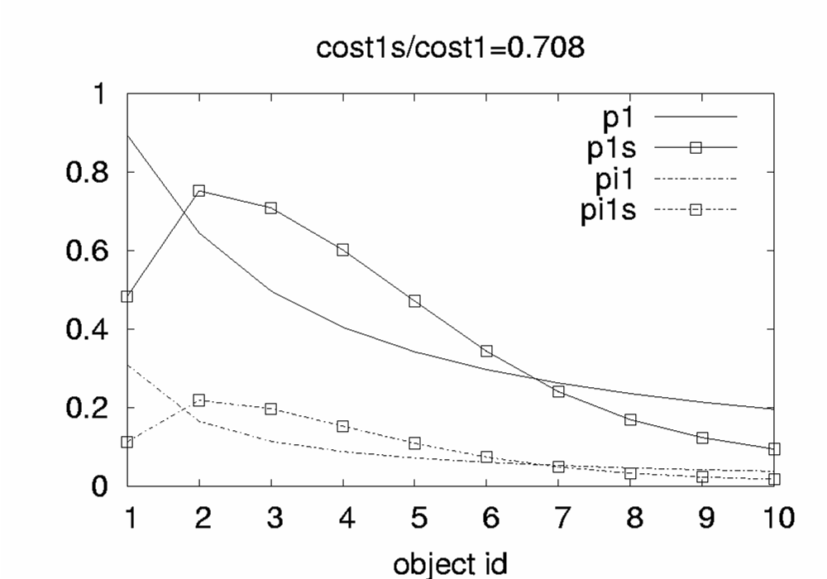
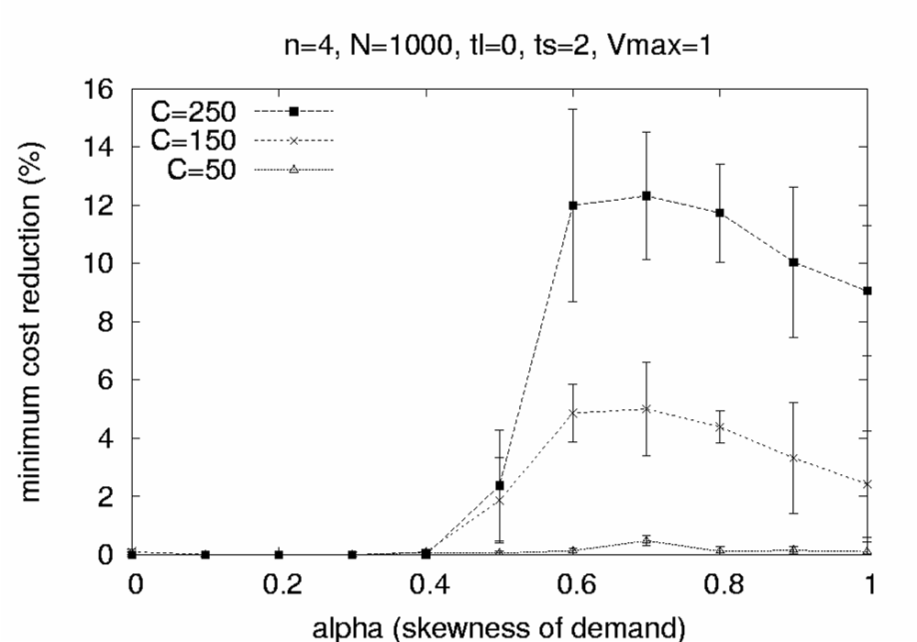
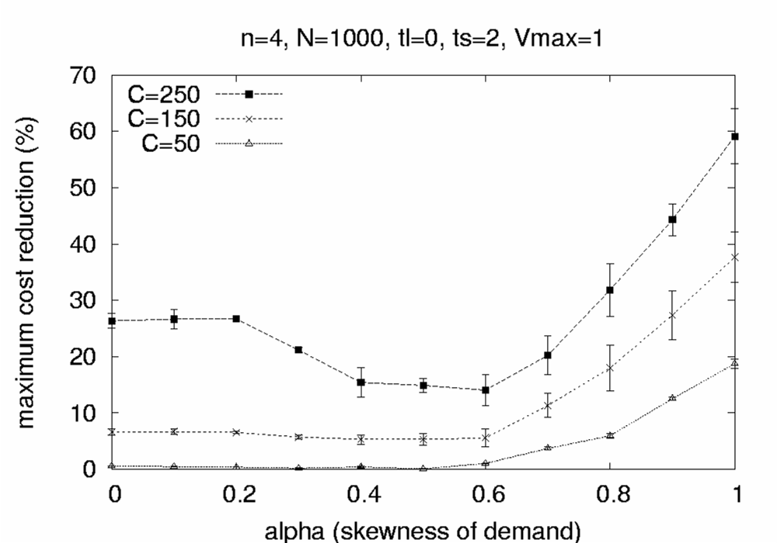
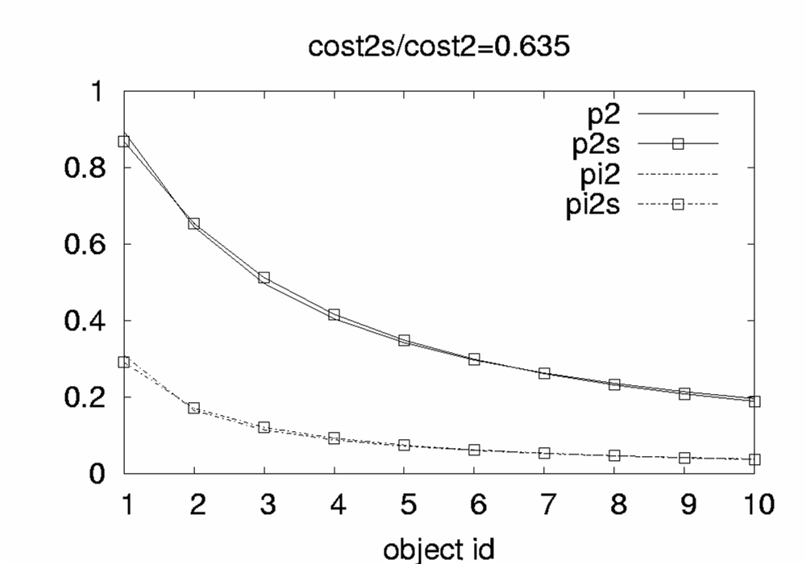
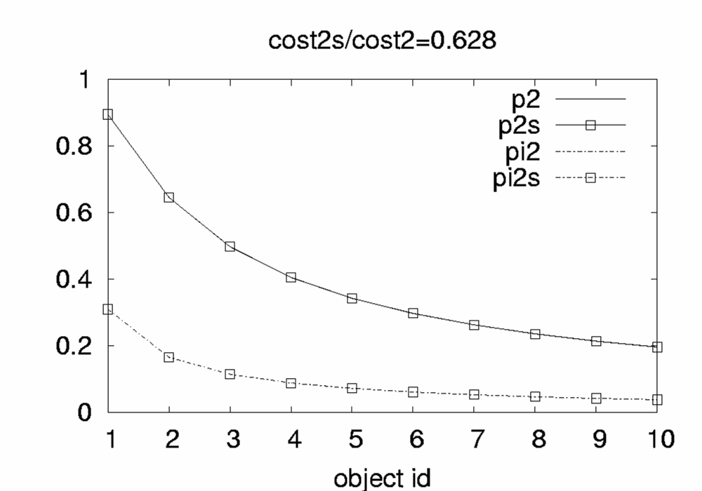
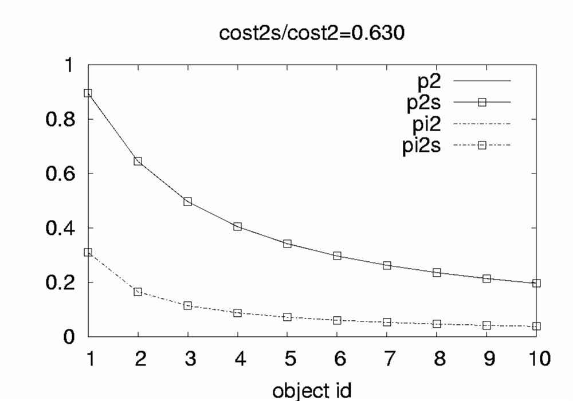
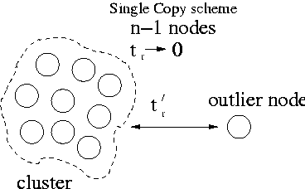
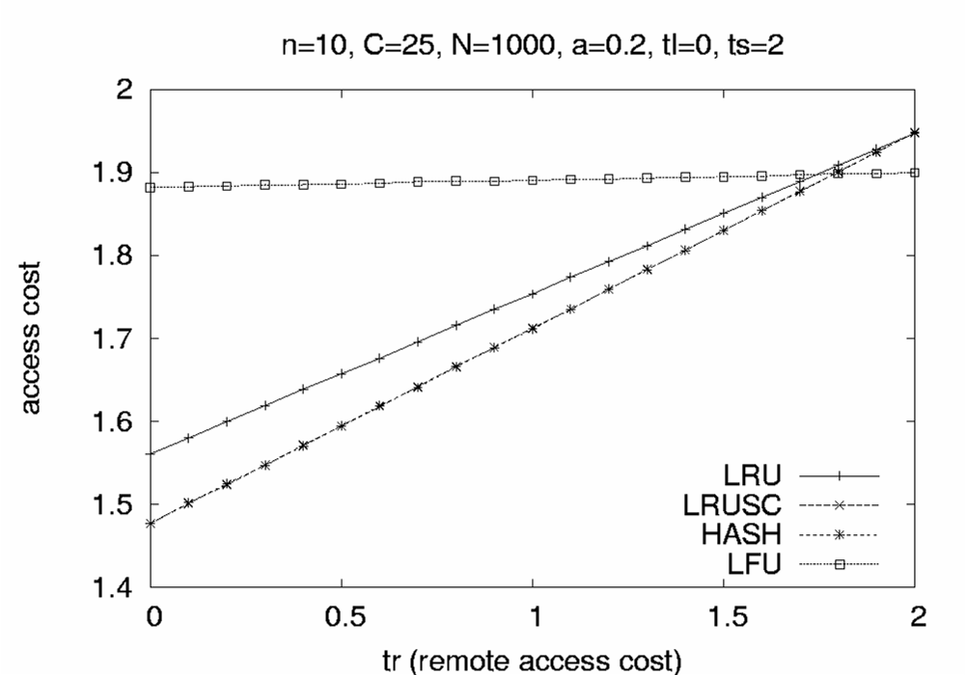
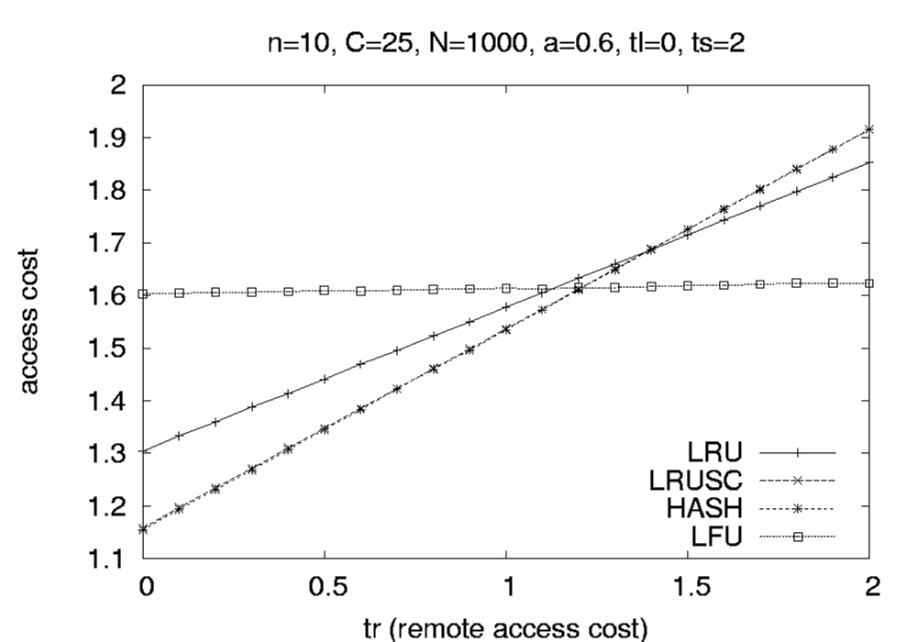
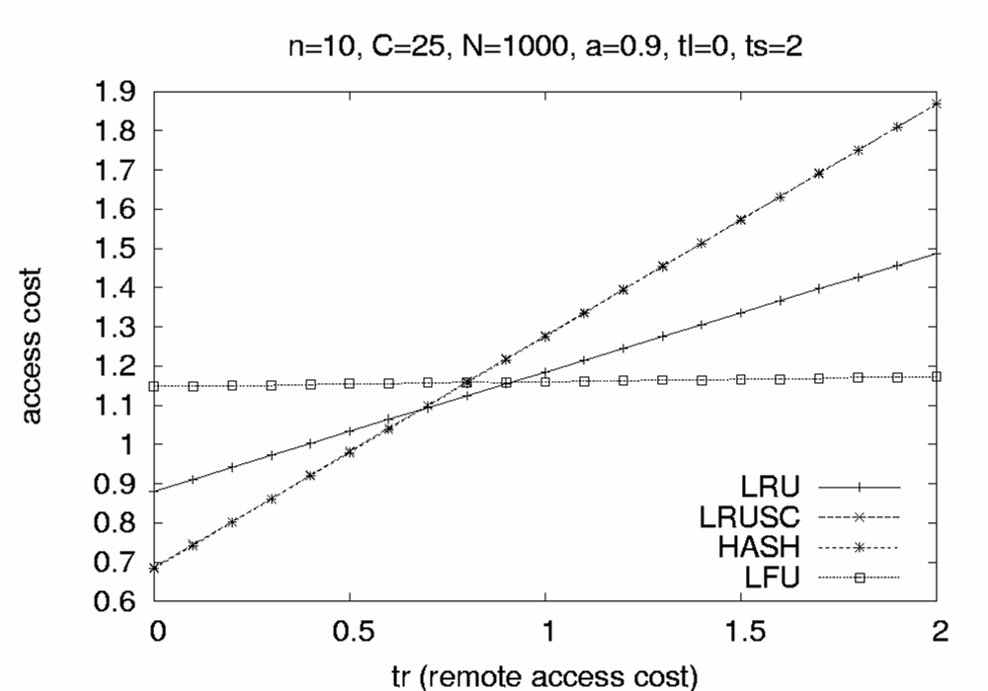
Distributed Selfish Caching
Georgios Smaragdakis, Nikolaos Laoutaris, Azer Bestavros,
Ibrahim Matta and Ioannis Stavrakakis
http://csr.bu.edu/dsc
Overview
Although cooperation generally increases the amount of resources available to a community of nodes, thus improving individual and collective performance, it also allows for the appearance of potential mistreatment problems (i.e., a node's access cost for fetching information objects becoming worse with cooperation than without) through the exposition of one node's resources to others. We study such concerns by considering a group of independent, rational, self-aware nodes that cooperate using on-line caching algorithms, where the exposed resource is the storage at each node. Motivated by content networking applications -- including web caching, CDNs, and P2P -- in this project we extend previous work on the on-line version of the problem [4], which was conducted under a game-theoretic framework, and limited to object replication.
Towards Mistreatment-Resilient Caching
Our solution: A virtual Cache and an Adaptive Caching Scheme
Mistreatment in Distributed Caching Groups
1. Cache state Interactions due to the cooperative servicing of requests
Simulation
Results:
2. The adoption of a Common Scheme for cache management policies
Publications:
[1] “Mistreatment in Distributed Caching Groups: Causes and Implications”
Nikolaos Laoutaris, Georgios Smaragdakis, Azer Bestavros and Ioannis Stavrakakis.
IEEE INFOCOM 2006.
[2] “A Feedback Control Approach to Mitigating Mistreatment in Distributed
Caching Groups ”
Georgios Smaragdakis, Nikolaos Laoutaris, Ibrahim Matta, Azer Bestavros and
Ioannis Stavrakakis. IFIP Networking 2006.
[3] “Distributed Selfish Caching”
Nikolaos Laoutaris, Georgios Smaragdakis, Azer Bestavros, Ibrahim Matta and
Ioannis Stavrakakis. BUCS-TR-2006-003. Submitted for Journal publication.
References:
[4] “Distributed Selfish Replication”
Nikolaos Laoutaris, Orestis Telelis, Vassilios Zissimopoulos and Ioannis Stavrakakis.
To appear in IEEE Transactions on Parallel and Distributed Systems, 2006.
r₄ /r₁=1
r₄ /r₁=10
r₄ /r₁=100
Scenario: An outlier
Mistreatment under Single Copy and Multiple Copy Schemes:

