Slide 1
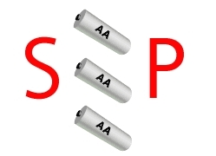
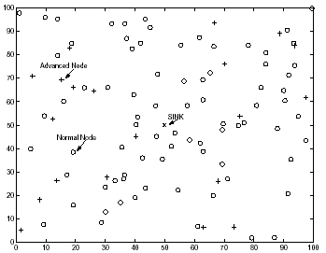
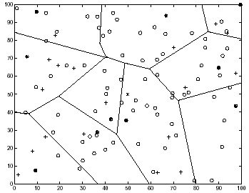
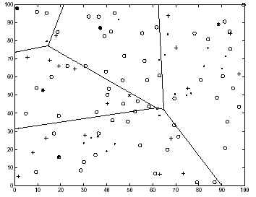
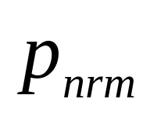
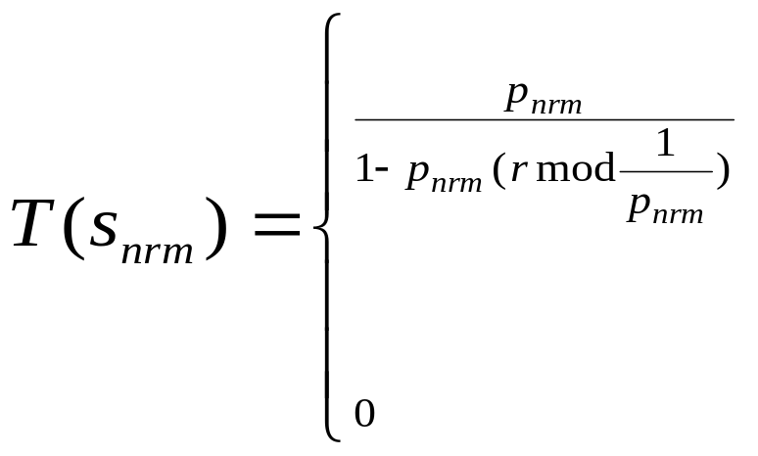
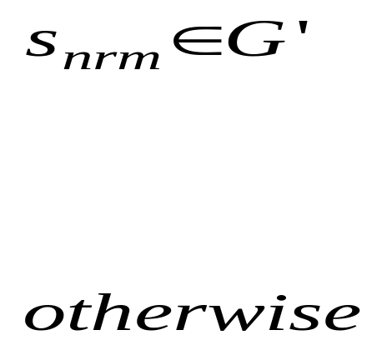
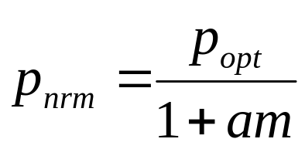
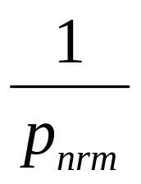
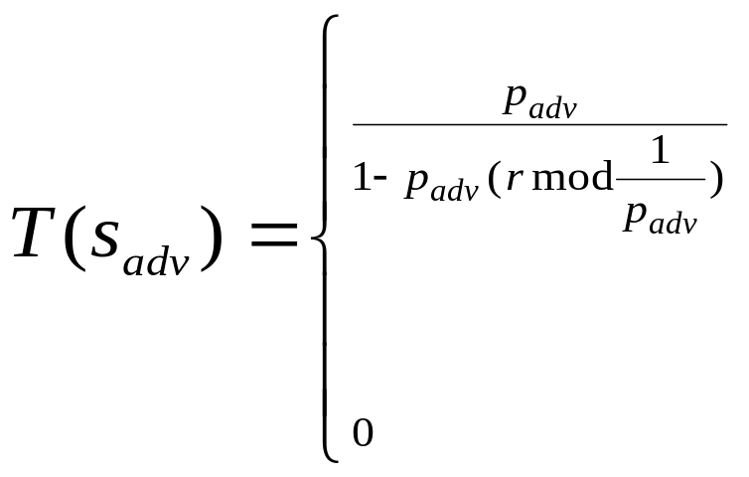
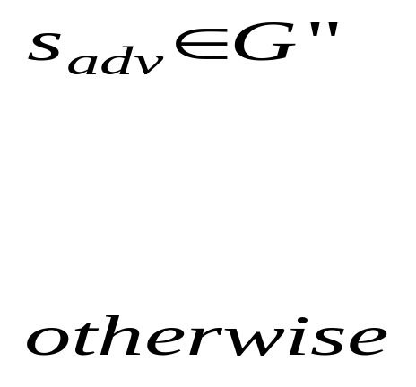
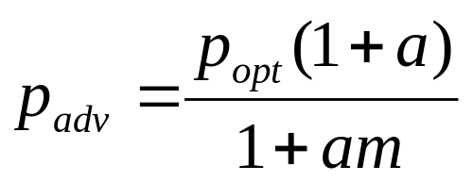

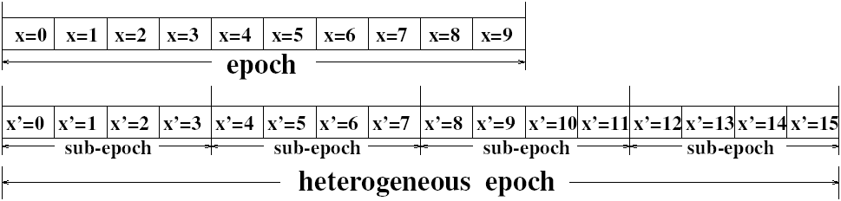
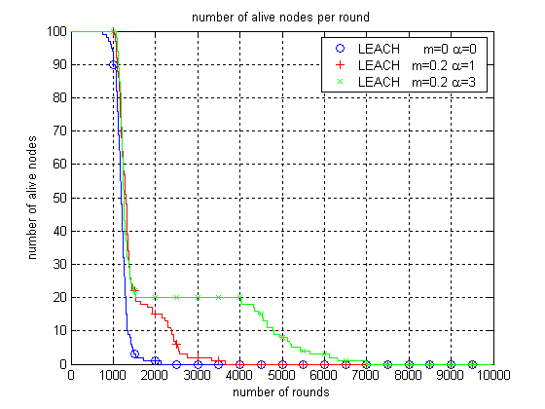
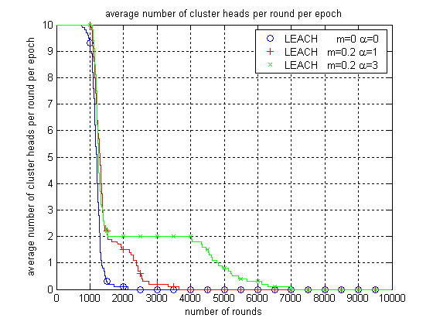
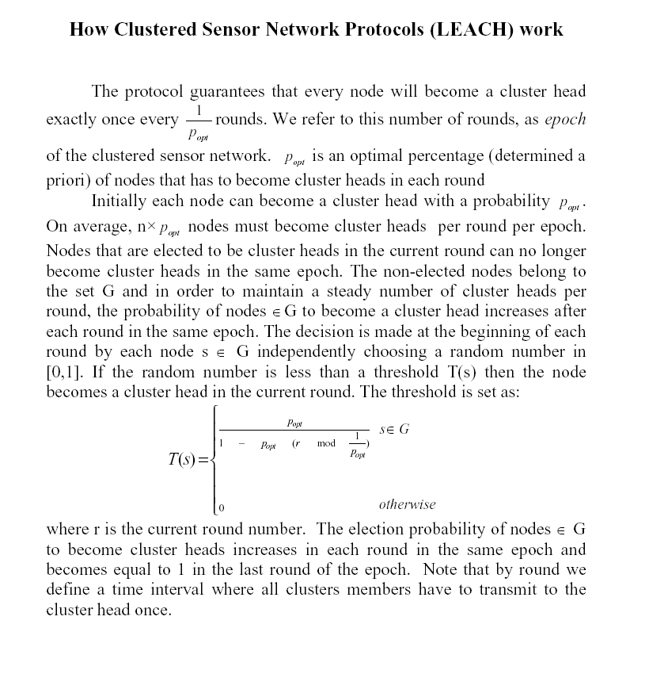
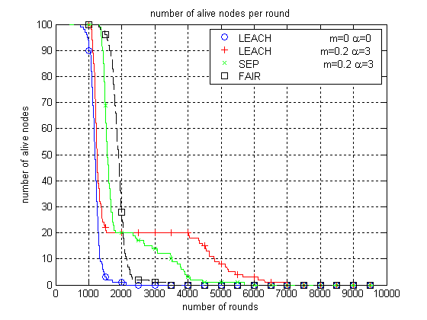
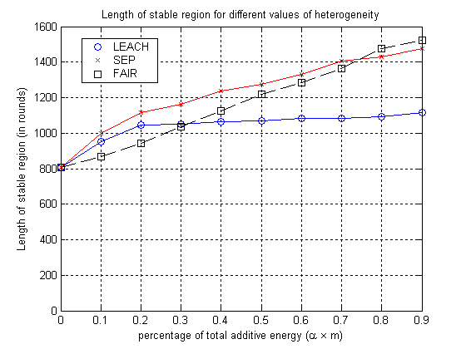
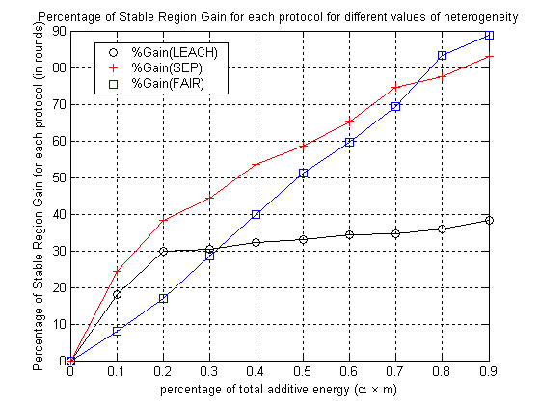
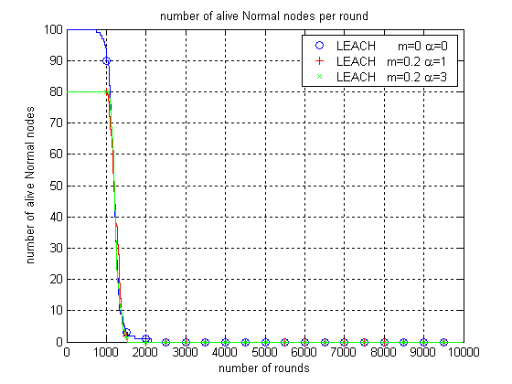
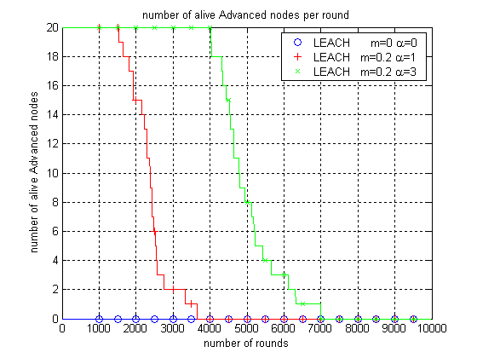
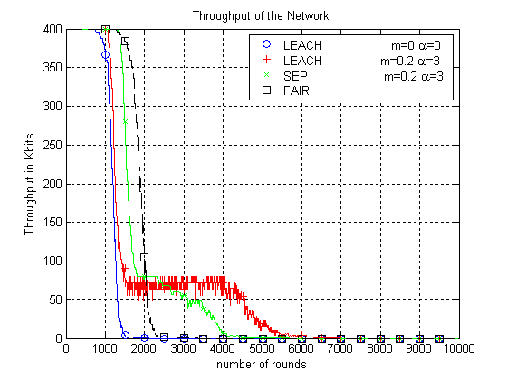
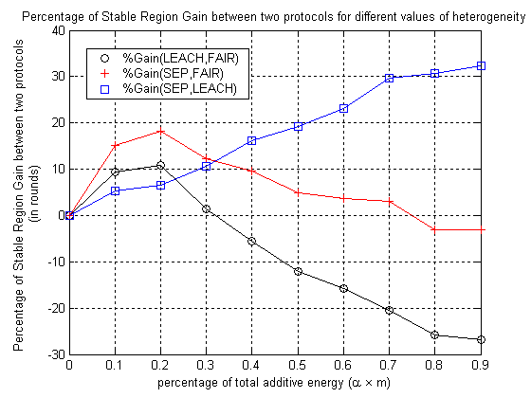


SEP: A Stable Election Protocol for clustered heterogeneous wireless sensor networks
Georgios Smaragdakis, Ibrahim Matta and Azer Bestavros – Computer Science Department, Boston University
Introduction
We study the impact of heterogeneity of nodes, in terms of their energy, in wireless sensor networks that are hierarchically clustered. In these networks some of the nodes become cluster heads, aggregate the data of their cluster members and transmit it to the sink. We assume that a percentage of the population of sensor nodes is equipped with additional energy resources - this is a source of heterogeneity which may result from the initial setting or as the operation of the network evolves. We show that the behavior of such sensor networks becomes very unstable once the first node dies, especially in the presence of node heterogeneity.
n nodes, m% of nodes are equipped before the first node dies after the death of some nodes
with a% more energy
Related Work
Classical clustering protocols assume that all the nodes are equipped with the same amount of energy and as a result, they cannot take full advantage of the presence of node heterogeneity.
Our Protocol
We propose SEP, a heterogeneous-aware protocol to prolong the time interval before the death of the first node (we refer to as stability period), which is crucial for many applications where the feedback from the sensor network must be reliable. SEP is based on weighted election probabilities of each node to become cluster head according to the remaining energy in each node.
Analysis
In the heterogeneous scenario the average number of cluster heads per round per epoch is equal to n(1+am) (because each virtual node has the initial energy of a normal node). The new thresholds for normal and advanced nodes are respectively:
where is the weighted probability for normal nodes,
r is the current round and G’ is the set of normal nodes that have not
become cluster heads the last rounds of the epoch.
where is the weighted probability for normal nodes,
r is the current round and G’’ is the set of normal nodes that have
not become cluster heads the last rounds of the epoch.
Thus the average total number of cluster heads per round per heterogeneous epoch is np_{opt} .
Main Results
- Our SEP protocol successfully extends the stable region.
- Due to extended stability, the throughput of SEP is higher.
- The performance of SEP is observed to be close to that of an ideal upper bound
SEP is more resilient than LEACH in judiciously consuming the extra energy of advanced nodes
- yields longer stability region for higher values of extra energy.
- SEP is light and scalable for large and small networks (it is not GPS based solution).
Sensitivity Study
http://csr.bu.edu/sep

