Slide 1

The Selfish Neighbor Selection Problem
In Overlay Networks
George,
Joint work with Nikos, Azer and John
NRG Work-In-Progress Meeting, Oct 30 2006

Slide 2


Overlay Networks & Neighbor Selection
overlay
node
Overlay networks: “logical” or “virtual” networks build on-top of actual “physical” networks
overlay
link
Neighbor selection: selection of overlay nodes for the establishment of direct overlay links
physical
link
upon node joins (bootstrap)
leaves, malfunctions, etc. (maintenance)
physical node (e.g., end-systems, router or AS)
Notes:
Overlay networks are logical, virtual networks built ontop of actual physical networks
They consist of nodes, which are typically processes running at the application layer
and links, which are logical associations between overlay nodes
Neighbor selection amounts to choosing a subset of overlay nodes for establishing direct links and is a central component of the creation and and maintenance of such networks
For example in BitTorrent, upon joining, a node has to select up to 35 first hop neighbors from a larger list of potential neighbors provided by the “tracker”-node for a certain file

Slide 3
We study Neighbor Selection issues
in overlay networks for routing or content dissemination in view of:
  selfish nodes
  general (node) preference profiles
  directional overlay links
  bounded out- and in-degrees
  (limited resource allocation problem)
Notes:
We consider settings in which:
Nodes are selfish, meaning that they only for their own communication quality with the network
They employ general preference profiles for the other destinations
Directional overlay links
Bounded out- and in degree degrees
See this a limited resource allocation problem

Slide 4
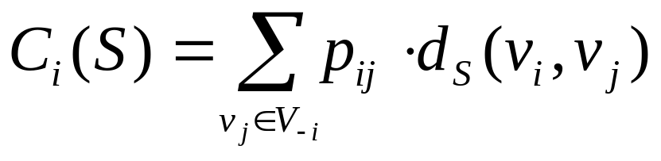
Example: connecting to a residual wiring
v_{i}’s preference for v_{j}
v_{i} wants to minimize:
w
over all s_{i}∈S_{i}
v_{i}
u
individual wiring
s_{i}={u,w}
G_{-i}=(V_{-i},S_{-i})
global wiring
S=S_{-i}+{s_{i}}
v_{i}’s residual wiring
v_{i}’s residual network
residual wiring
Notes:
Say that vi wants to connect to u, w, then its individual wiring is a set containing these two nodes
Vi wants to minimize its cost in the context of a global wiring where the cost is a weighted summation of distances to all other nodes

Slide 5
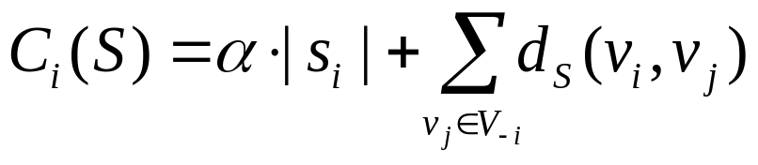
Main differences with previous
Network Creation Games
they assume undirected links, and
unbounded degrees
  e.g., in Fabrikant et al., 2003: node v_{i} can “buy” as many undirected links as it wants, each at cost “α”, so as to minimize:
  Chun et al., 2004: study experimentally the case of non-uniform link costs “α_{ij}”
Instead, we impose explicit bounds on the degrees of nodes
  For an analogy → think of UFL and UKM
Motivation for our choice of setting:
  Directed links, bounded degree -> better for overlay networks
  vs. Undirected links, unbounded degree -> better for physical networks
purchase cost
access cost
Notes:
We believe that the combination of directed links and bounded degree represents more faithfully the constraints imposed by the protocols used to implement such networks. All such protocols (KaZaA, Gnutella, BitTorrent) include explicitly the notions of directionality and bounded degree

Slide 6
Questions that we pose:
What is the best way to connect to a given residual wiring?
How does it compare to empirical connection strategies?
In view of selfishness, do stable global wirings always exist ?
Structure and performance?
Notes:
Granted this setting, we ask the following questions:

Slide 7
The Selfish Neighbor Selection (SNS) game
Players: the set of overlay nodes V={v₁,…,v_{n}}
Strategies: a strategy s_{i}∈S_{i} for node v_{i} amounts to a selection of direct outgoing overlay links (therefore |S_{i}|=(n-1 choose k_{i}))
Outcome: S={s₁,…,s_{n}} is the global wiring composed of the individual wirings s_{i}
Cost functions: C_{i}(S) the communication cost for v_{i} under the global wiring S, i.e.:

Slide 8
Summary of analytic results
The following hold true when all overlay links have the same weight (e.g., under hop-count distance)
v_{i}’s best-response to G_{-i} → a k-median with asymmetric distance:
  node set: V_{-i}
  number of medians: k_{i}
  “demand” from v_{j} taken from v_{i}’s preference for that node: w_{j}=p_{ij} , v_{j}∈V_{-i}
  distance function: by reversing d_{S-i} (i.e., d(u,w)=d_{S-i}(w,u), for all u,w ∈V_{-i})
w
w
u
u
since these
cost the same
w,u can be
obtained from
2-median on
reversed distances
More General: best-response to G-i → a UKM with asymmetric distance,
by assigning an additional cost to reach the associated
nodes by connecting to a median (physical distance).
Notes:
In the k-median problem you are given a set of nodes, a weight for each node representing its demand for some service, and a positive integer k, and you have to select k nodes to act as medians so as to minimize the weighted summation of distances from each node to its closest median
Lets say that vi’s optimal wiring is to connect to w, u
These nodes are such that from them you can access all other destinations efficiently
Since all direct overlay links cost the same, we don’t need to consider them
We just need to find 2 nodes which minimize the weighted distance to all other destinations
NOTES:
Consequently:
Best-response is NP-hard
O(1) additive approximation with O(logn) blow-up in median budget (Lin and Vitter, 1992)
Most likely the best we can do (Archer, 2000)

Slide 9
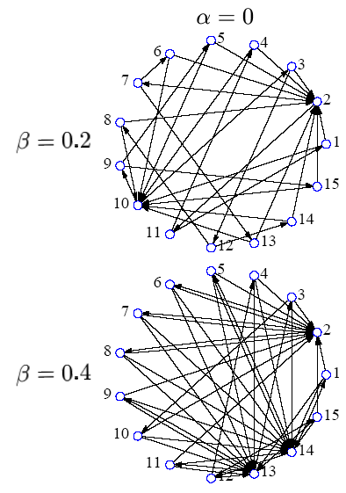

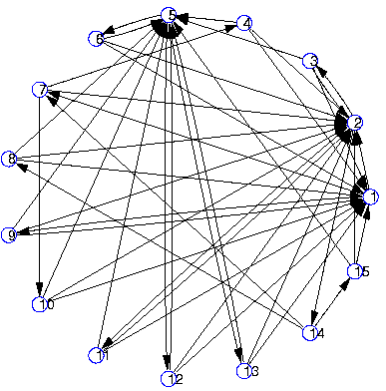
Simple experimental results under unit distance for direct overlay links
Stable wirings obtained through iterative best-response (BR) using ILP and local-search for BR (asymmetric k-median)
SC(stable) close to SC(soc-opt), gap closing with:
  density of links
  skewness of preference
in-degrees of stable are highly skewed even under uniform preference !
  given the directionality of links, this cannot be due to degree-based “preferential attachment”
  not an artifact due to bias in “tie-breaking” in computing best-response
  seems it is quality-based “preferential attachment”
Doubly-constrained overlay: constraining the in-degree increases the social cost by creating longer paths
Notes:
If the links were undirected, then any node with an initial head-start in degree, would attract many more links because it can provide short routes to many destinations because of its large degree
Having made sure that this is not an artifact due to tie-breaking
We attribute the fact to “quality”-based preferential attachment. Meaning that some nodes place their k outgoing links in a way that is not only beneficial to the local node but to others as well, useful bridges

Slide 10
Experimental results under realistic physical distance
instead of 1-weighted direct links, weights obtained from:
  BRITE topology generator
    Barabasi-Albert growth model
    nodes placed on a surface according to a heavy-tail model
    Euclidean distances
  “all-pairs” ping traces from PlanetLab sites (300 sites)
  AS-level map of the actual Internet topology
    from Dec. 2001, obtained using the “Rocket-Fuel” methodology
    used the #hops between u, w at the AS-level as the weight of a direct link at the overlay layer
Main goal: Best-response vs. empirical wirings
  k-Random
  K-Closest
Stable wirings from iterative BR method using an ILP formulation of BR
what most P2P protocols due when a new node joins (bootstap)
what a “cheating” P2P node can do using pings

Slide 11
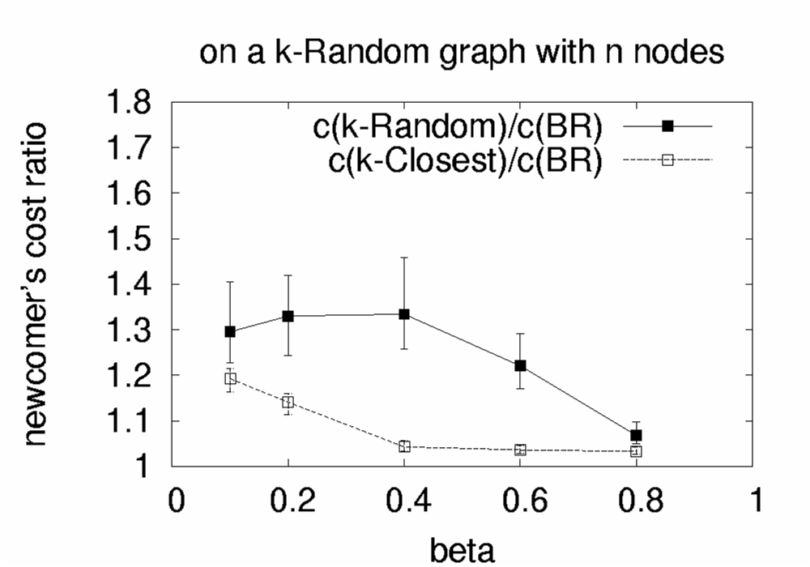
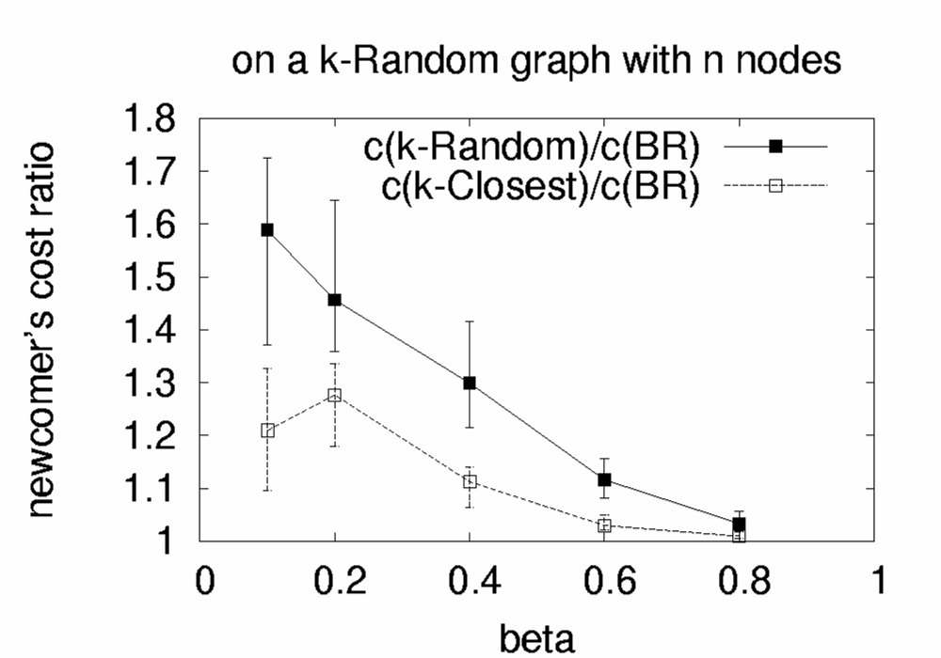
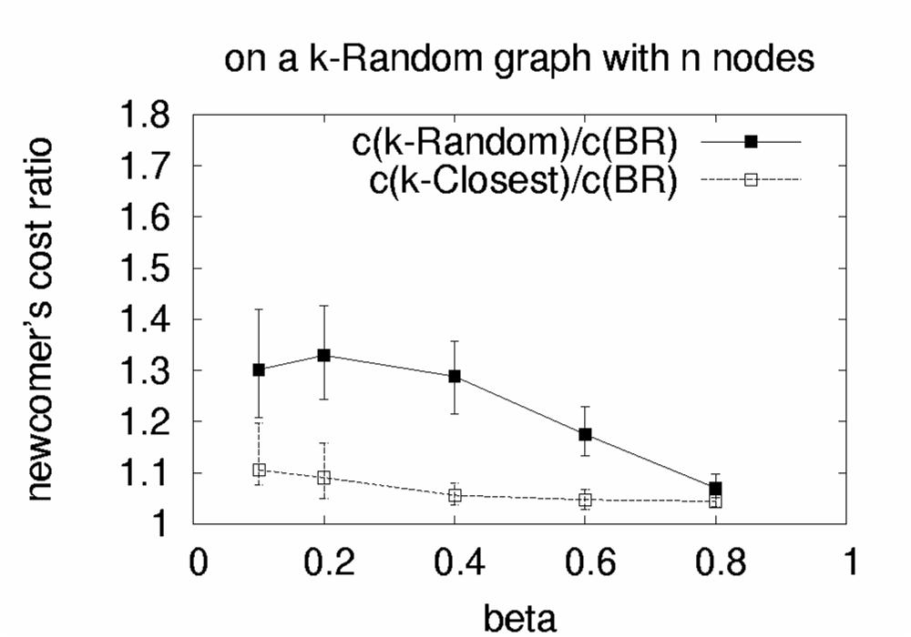
Summary of results
on a k-Random graph:
  BR yields large cost reduction compared to k-Random
  k-Closest has generally good performance
BRITE
PlanetLab
AS-level
k-Random/BR
k-Random/BR
k-Random/BR
k-Closest/BR
k-Closest/BR
k-Closest/BR
A “newcomer” connecting to k-Random graph with 50 nodes

Slide 12
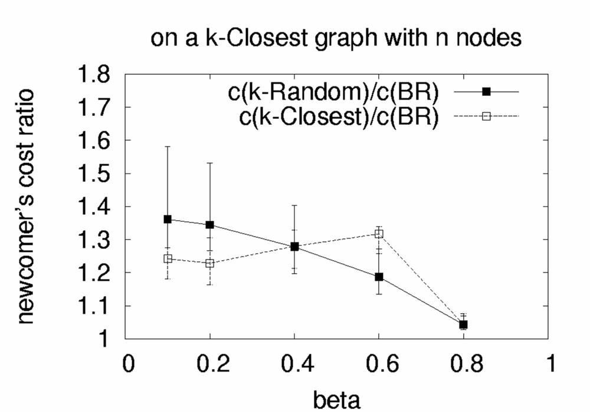
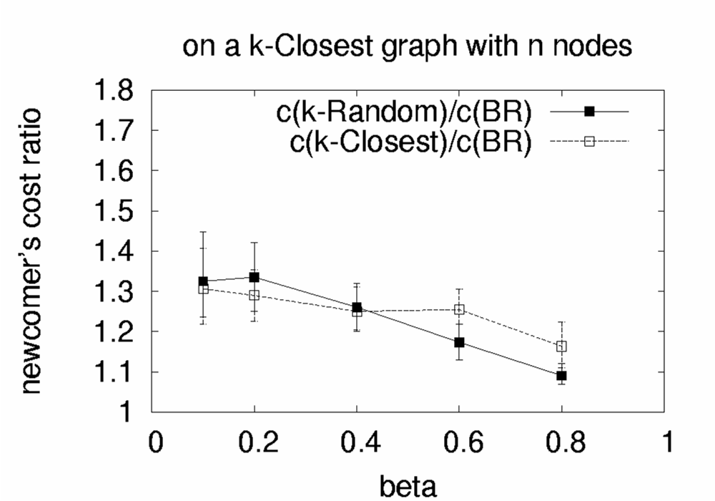

Summary of results
on a k-Closest graph:
  doing k-Closest wiring might be risky
  even k-Random can be much better
BRITE
PlanetLab
AS-level
k-Random/BR
k-Random/BR
k-Random/BR
k-Closest/BR
k-Closest/BR
k-Closest/BR
A “newcomer” connecting to k-Closest graph with 50 nodes

Slide 13
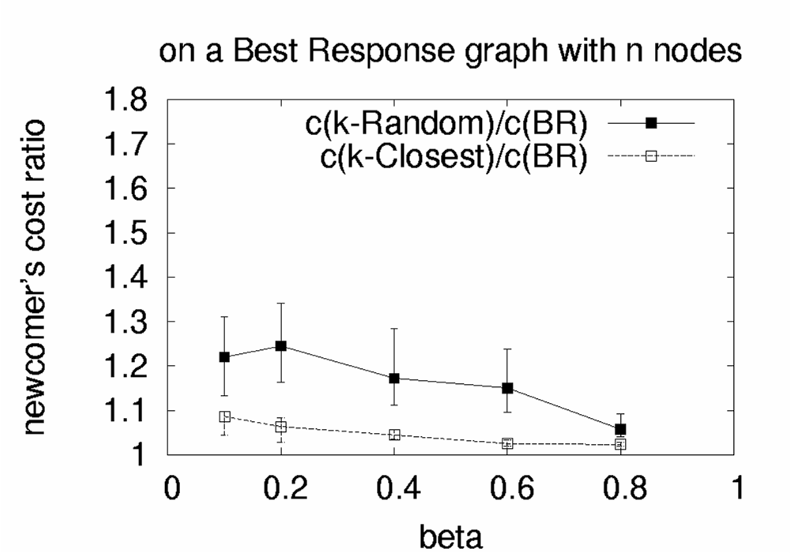
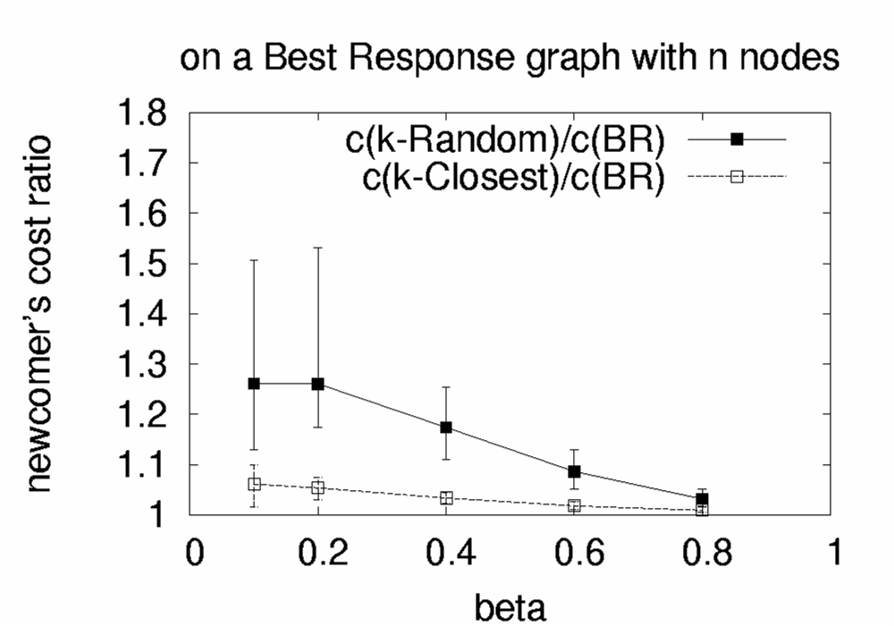

Summary of results
on a BR graph:
  even the empirical wirings do well
  the BR graph is highly optimized
BRITE
PlanetLab
AS-level
k-Random/BR
k-Random/BR
k-Random/BR
k-Closest/BR
k-Closest/BR
k-Closest/BR
A “newcomer” connecting to BR graph with 50 nodes

Slide 14
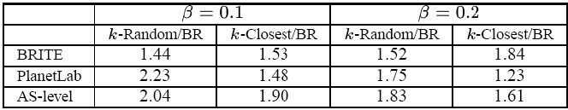
Summary of results
Social Cost(X) / Social Cost(BR), X∈{k-Random, k-Closest}
The BR graph can
half the social cost compared to k-Random and k-Closest

Slide 15

Ongoing Work
Demployment of -ist: An SNS service
A Decentralized Approach:
  Every node register its 1-hop neighbors
  Periodically request its BR neighbors
A Distributed Approach:
  Through Resource Discovery Techniques,
    Overlay Traceroute and Ping
    Using Network Tools like Vivaldi and Meridian

Slide 16
Ongoing Work
Performance Evaluation of BR wiring under Different Bootstraping Architectures
  Size of Bootstrap list
  Sampling quality of Boostrap process
  Structure of evolving BR graphs
Performance Evaluation of BR wiring in a Dynamic Environment
  Sensitivity to arrival/departure/failure of nodes
  SNS game in different levels

Slide 17
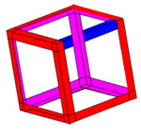
SNS

Slide 18
Ongoing Work (extra slides)
Inference for the underline graph based on BR wiring cost
Incentives to provide true 1-hop neighbors
Full explanation for preferential attachment
Robust optimization?

