Slide 1
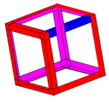
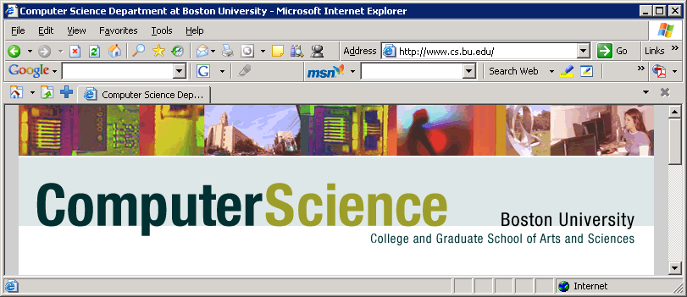



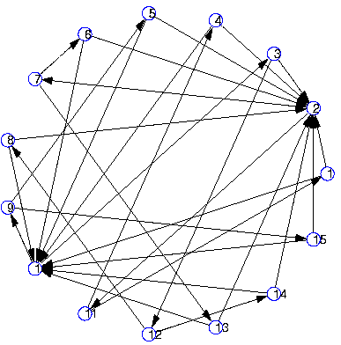
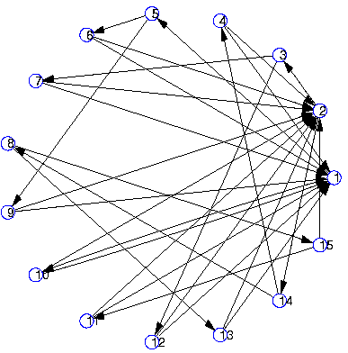
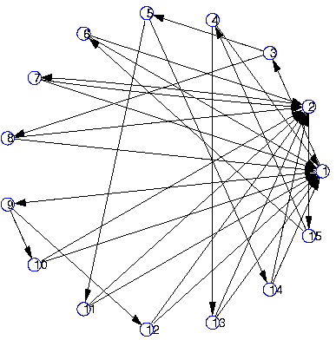
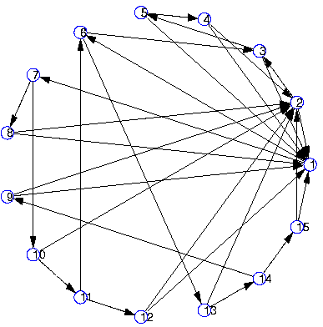
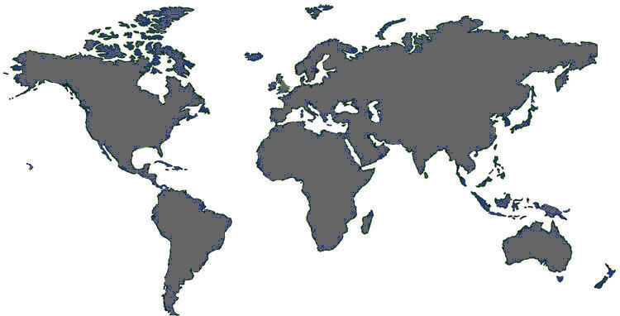
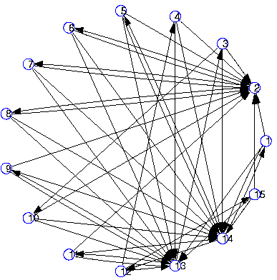
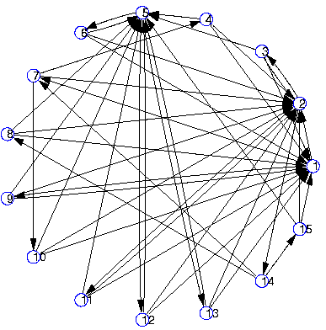
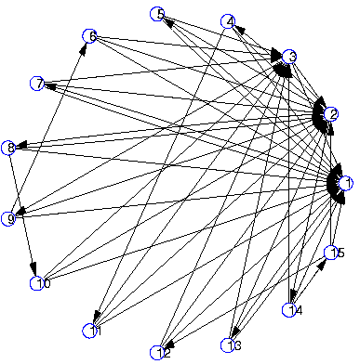
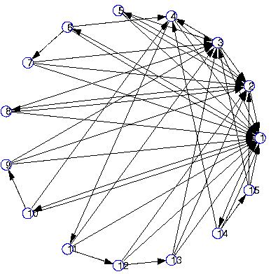
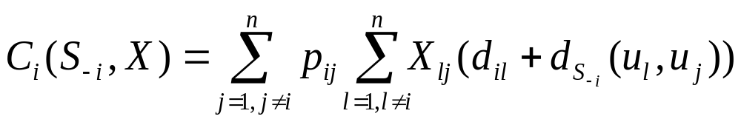
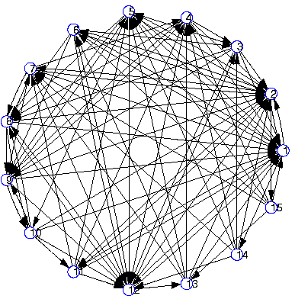
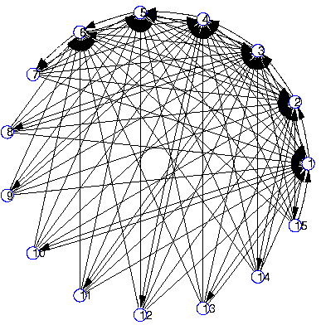
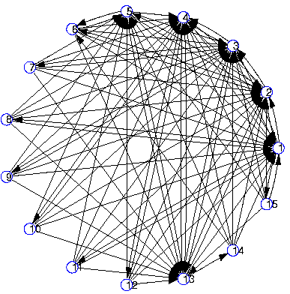
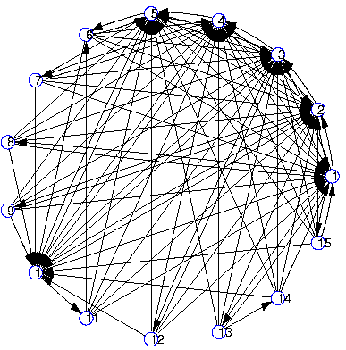
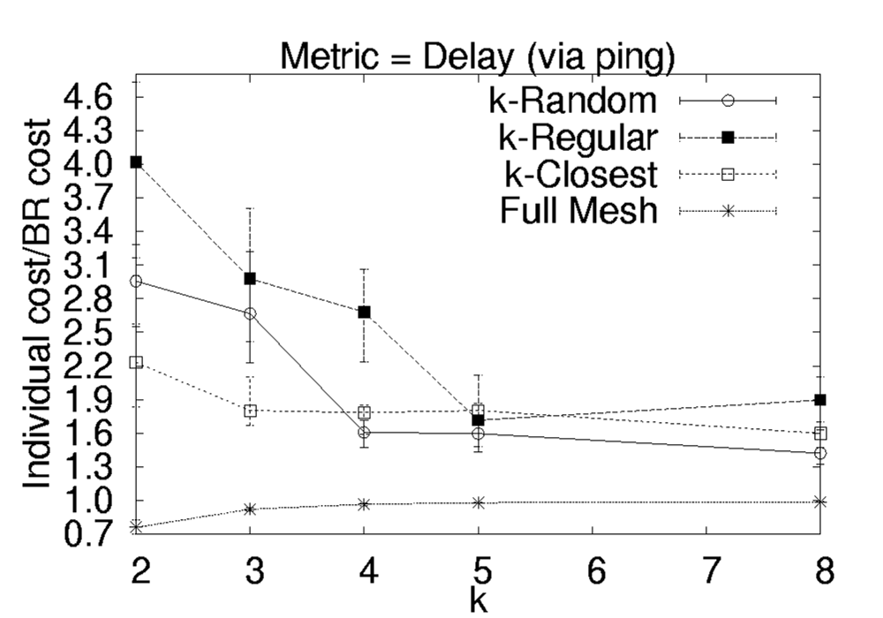
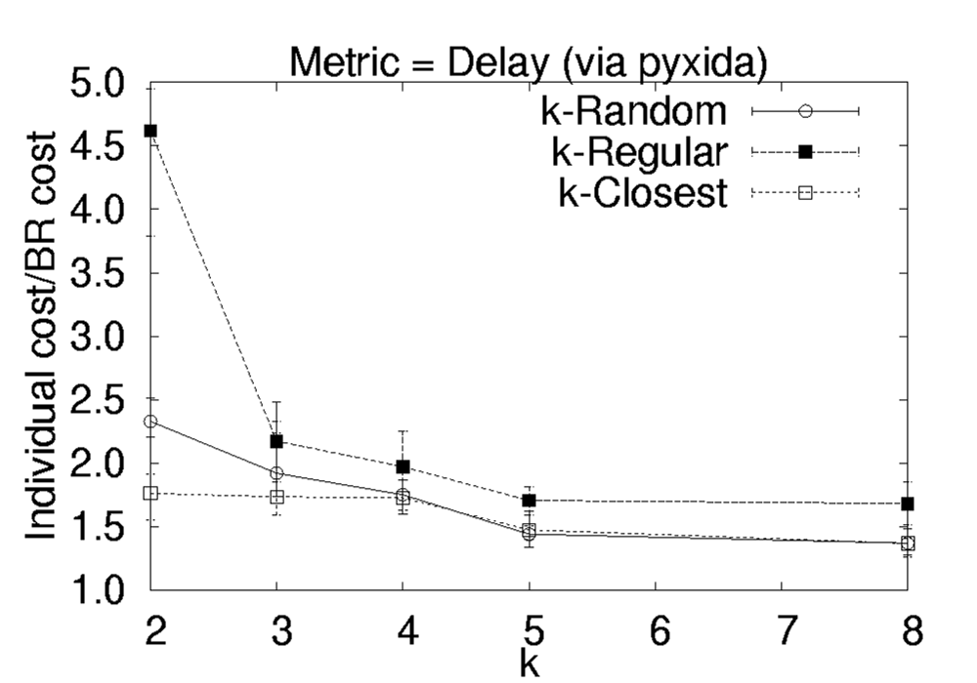
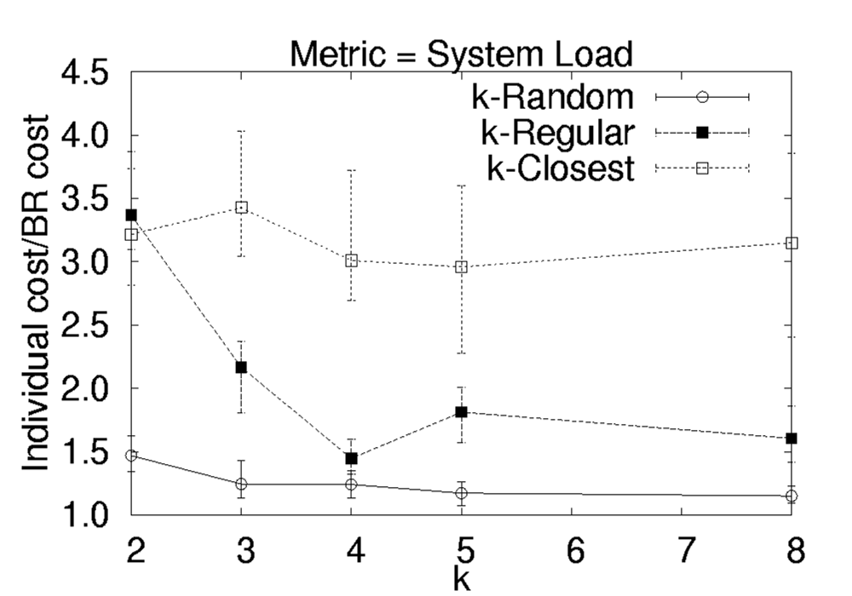
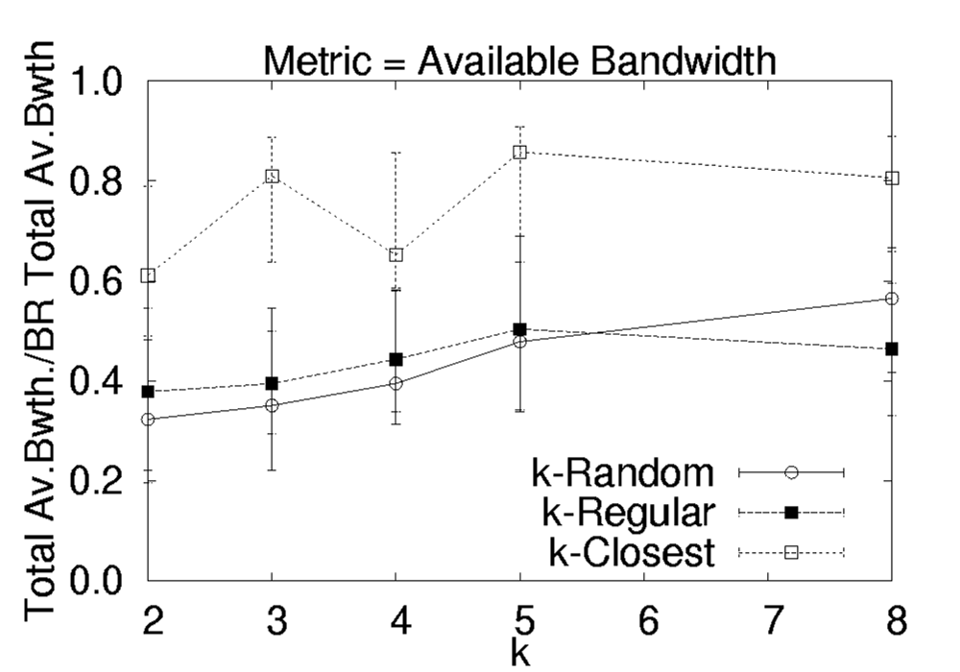
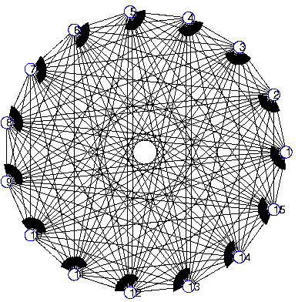
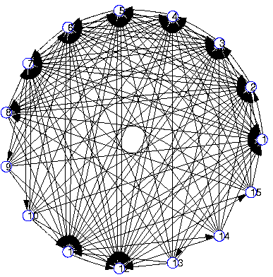

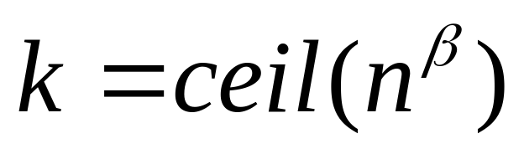
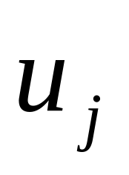
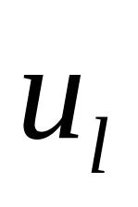
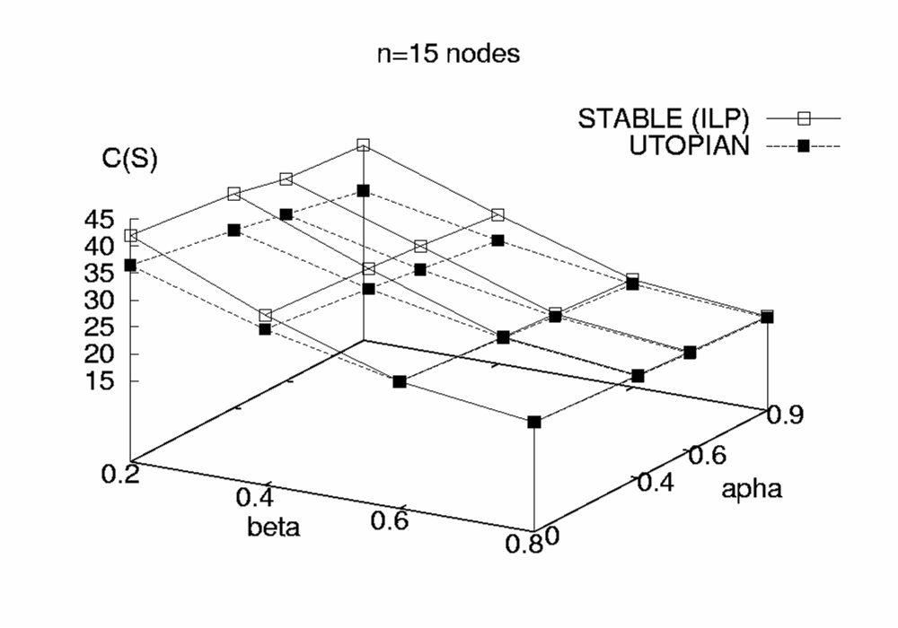
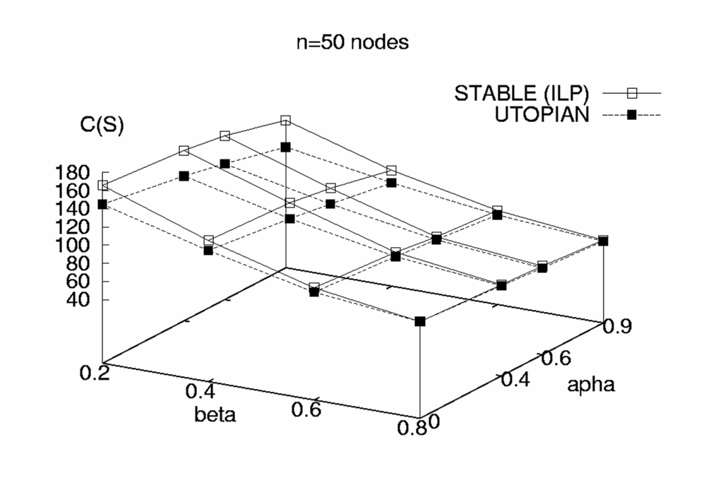
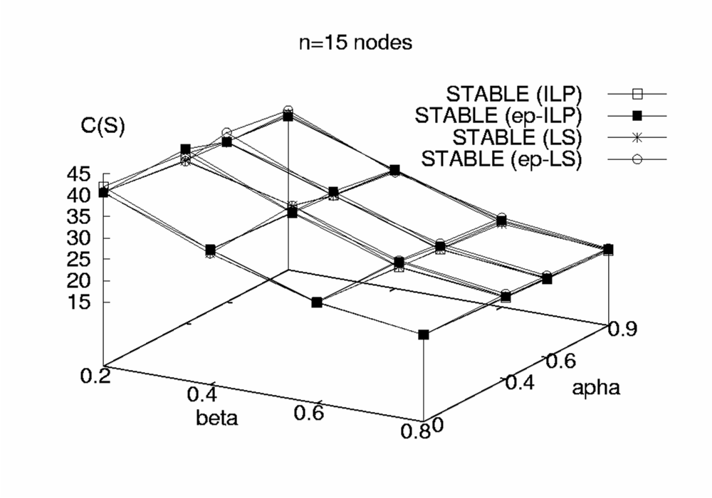
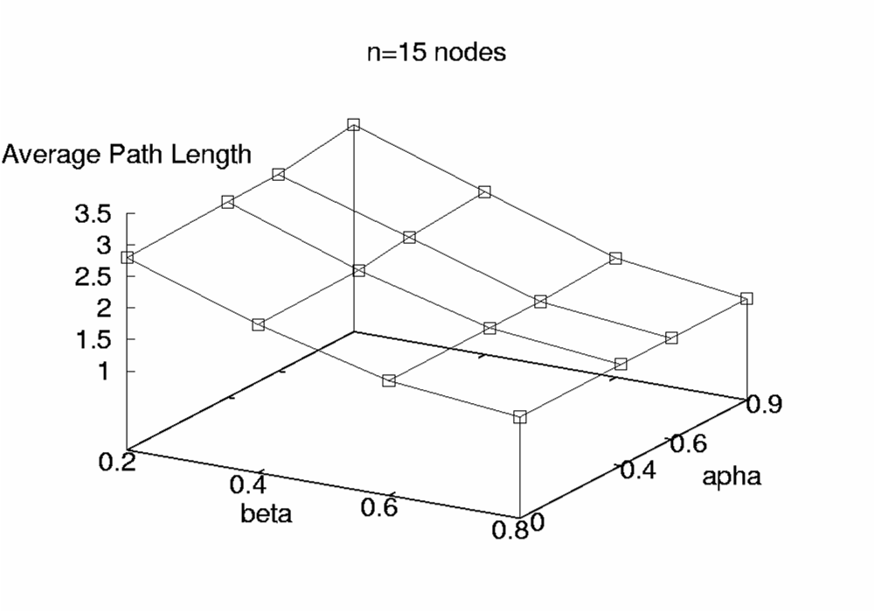

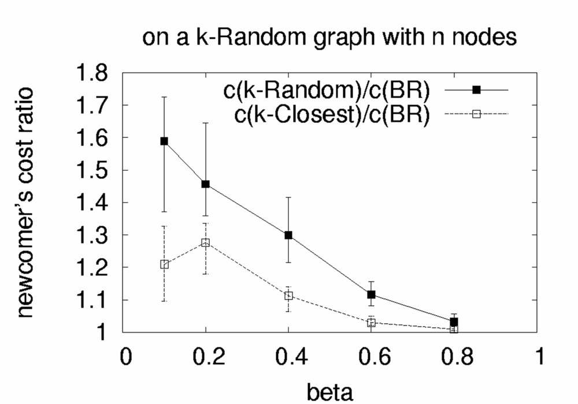
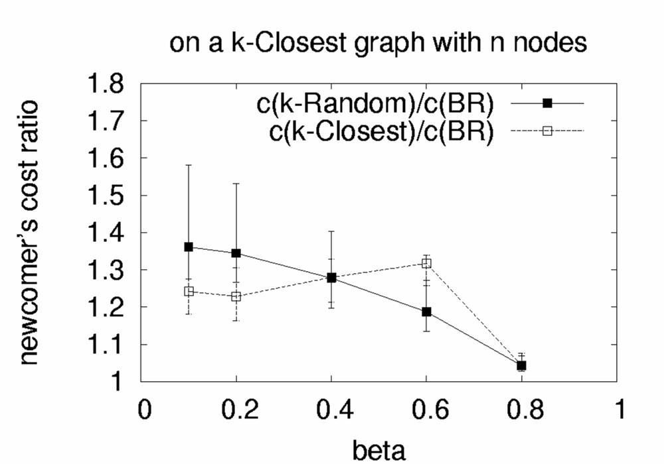
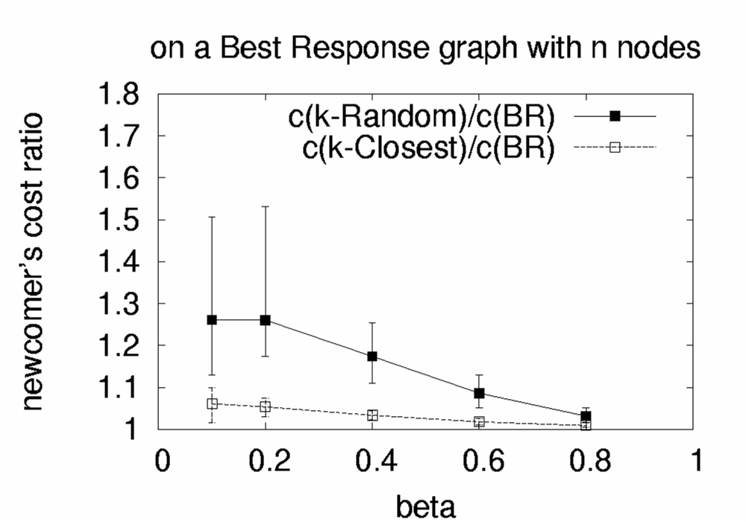
The Selfish Neighbor Selection Problem
In Overlay Networks
SNS
Georgios Smaragdakis, Nikolaos Laoutaris, Azer Bestavros,
John W. Byers, Mema Roussopoulos and Pietro Michiardi
http://csr.bu.edu/sns
Towards A Realistic Model of Overlay Networks
1. Bounded in- and out-degrees
2. Directed Edges
3. Non-uniform preference vectors
4. Realistic models of Physical Distance
Characterization of Stable Wirings
EGOIST :
An SNS-inspired System
alpha=0
alpha=0.4
alpha=0.6
alpha=0.9
beta=0.2
Deriving Stable Wirings
- Best Response Wiring:
minimize
or solve the k-median problem
on asymmetric distances
(if link weights are uniform)
- Equilibrium Wirings:
Through Iterative Best Response
beta=0.4
beta=0.6
beta=0.8
Multiple Performance Metrics
- Delay (active and passive estimation)
- System Load
- Available Bandwidth
Key Properties
- Close to optimal Performance
- Scalable and Reconfigurable
- Effective under Churn
- Robust to Free Riding
Skewness: , distribution: Zipf( )
Oudegree:
Properties of Stable Wirings
An overlay node applying Best Response
wiring policy to the residual overlay graph
Experiments and Implications
Publications:
[1] “Implications of Selfish Neighbor Selection in Overlay Networks” INFOCOM 2007,
Nikolaos Laoutaris, Georgios Smaragdakis, Azer Bestavros and John W. Byers.
References:
[2] “Improving the Performance of Overlay Routing and P2P File Sharing
using Neighbor Selection”, Under Submission
Georgios Smaragdakis, Nikolaos Laoutaris, Azer Bestavros, John W. Byers and Mema Roussopoulos.
[3] “Swarming on Optimized Graphs for n-way Broadcast”, Under Submission
Georgios Smaragdakis, Nikolaos Laoutaris, Pietro Michiardi, Azer Bestavros,
John W. Byers and Mema Roussopoulos.
[4] “A bounded-degree network formation game”, arXiv-CoRR cs.GT/0701071,
Nikolaos Laoutaris, Rajmohan Rajaraman, Ravi Sundaram, Shang-Hua Teng.
Applications Beyond Overlay Routing
- n-way Broadcast
- Optimal Search in Unstructured
P2P Networks
Sponsors: The SNS project is supported partially by a number of National Science Foundation grants, including CISE/CSR Award #0720604, ENG/EFRI Award #0735974, CISE/CNS Award #0524477, CNS/NeTS Award #0520166, CNS/ITR Award #0205294, and CISE/EIA RI Award #0202067.
Disclaimer: Any opinions, findings, conclusions, or recommendations expressed in materials available from this site are those of their author(s) and do not necessarily reflect the views of Boston University or of the National Science Foundation.

