Slide 1

P2P File Searching with Selfish Users
Georgios Smaragdakis

Slide 2
Approaches
Structured (DHT-based):
+ Small message load
+ Content discovery is guaranteed
- Predetermined structure
- Not optimized for any network metric, and client profile
- Rich queries are not supported
Unstructured:
  Random walks
  + Good performance in clustered networks
  - High Performance variance
  Scoped Flooding
  + Flexible neighbor selection procedure
  + Rich query support
  - Loose guarantees for content discovery
  - High message load

Slide 3
P2P & Selfish Users
A selfish node, caters strictly to satisfy its own utility.
Seeks for
  minimal and flexible resource allocation
  highest service quality possible
  ignoring social welfare
  → File Searching using Scoped Flooding is a candidate application
Notes:
-- re-estimates

Slide 4
Bootstrapping
Bootstrap
Server
2
1
3
4
v_{j}
randomly
TTL of scoped flooding is 2
Notes:
-- DHT not well incentivized
--

Slide 5
Bootstrapping & Selfish Users
Best Response Wiring:
max the #nodes reached
4
Bootstrap
Server
1
6
3
5
v_{j}
2
selfishly
TTL of scoped flooding is 2
→ Maximum Coverage Problem
Notes:
-- Reduced to the maximum set cover problem,

Slide 6
The Maximum Coverage Problem
Given a universal set U={e₁,e₂,…,e_{n}},
where each element e_{i} has profit p_{i}>0,
a collection of subsets of U, S₁,S₂,…,S_{l}
and an integer k, pick k sets so that to
maximize the total profit of elements
covered.
  p_{i}=r_{ji}/d_{ji} , r_{ji} : preference, d_{ij} : delay
  NP-complete

Slide 7


Approximations
(Local-Greedy,k)
1. C ← Ø
2.While |C|≤k do
Pick S_{i} s.t. i = arg max_{j} |C U S_{j}|
Set C ← C U S_{i}
3. Output C
  Approximation factor:
  1 – ( 1 - )^{k} > 1 – 1/e
  If p_{i}=1, for k=2 is OPT

Slide 8
The Generalized
Maximum Coverage Problem
Given a universal set U={e₁,e₂,…,e_{n}},
where each element e_{i} has profit p_{i}>0,
a collection of subsets of U, S₁,S₂,…,S_{l},
where each subset has cost C_{i}, and an
integer k, pick a collection S’ ob subsets
so that to maximize the total profit of
elements covered, and the total cost of
the sets in S’ does not exceed k.

Slide 9
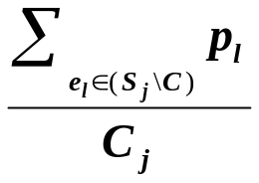
Approximations
(Greedy-Set-Cover,k)
1. C ← Ø
2.While |C|≤k do
Pick S_{i} s.t. i = arg max_{j}
Set C ← C U S_{i}
3. Output C
  Approximation factor: H(max_{i}(|S_{i}|))
  If C_{i}≤εk, Appr.factor: 1 – 1/e - ε
  - There is an (1 - 1/e)-approximation based on
  LP-approximation
Notes:
-- Harmonic -> in the worst case inapproximable
-- LP: rounding?

Slide 10
Selecting k
If k is not fixed
→ prize collection problem
i.e. minimize the cost of selecting a collection of subsets, and the profit of uncovered elements.
Approximations:
  (4/3 + ε)H(max_{i}(|S_{i}|))
  (4/3 + ε)f , where f is the frequency of the most frequent element (LP-approximation).
Notes:
-- Primal dual

Slide 11
The Game
The bounded out-degree Maximum Coverage game (<V,W,P>,k,r):
V: the set of players (nodes)
{W_{i}}: the wiring strategies of v_{i},
i.e. choose to connect to m out of k
{P_{i}}: set of utilities, i.e. profit by
flooding in max r hops.
Outcome: A graph
A stable graph is a pure Nash Equilibrium

Slide 12
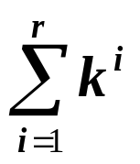
Existence of Pure Nash Equilibrium
The Uniform-profit bounded out-degree Maximum Coverage game
The Utopian Tree:
node v_{i} reaches
T_{k,r}=
unique nodes.
v_{i}
…
. . .
r
…
. . .
…
…
. . .
…
k

Slide 13
Existence of Pure Nash Equilibrium
Existence of Utopian Tree for each node is sufficient condition for Nash Equilibrium
Node fanout is maximized
The social fanout is also maximized
- PoS = 1
(Iterative BR may loop)
. . .
…
r
. . .
…
…
…
. . .
…
k
. . .
…
r
. . .
…
…
…
. . .
…
k
Notes:
-- PoA bad with bad bootstrapping

Slide 14
Mechanism
Each leaf must connect to k trees where each node is unique.
. . .
…
r
. . .
…
…
…
. . .
…
k
. . .
. . .
. . .
…
. . .
…
. . .
…
. . .
r
. . .
. . .
. . .
…
…
…
…
…
…
…
…
…
…
…
…
k
k
k

Slide 15
Non Existence of Nash Equilibrium
The non Uniform-profit bounded out-degree Maximum Coverage game may not have pure NE.
Profits for A:
B: 1/2
C: 2
D: 1+ε
G: 1/2
Profits for B:
A: 1/2
C: 1+ε
E: 2
G: 1/2
ε<1/2
A
B
G
C
E
D
r=3, k=2

Slide 16
Approximate Nash Equilibria
NP-hard to determine if there exists one
(a,β)-approximate equilibria;
  Nodes do not rewire if they do not improve their coverage by a factor a
  The total coverage is not more than β worse than the social optimal.
Notes:
-- reduction to 3-SAT
-- A Utopian Tree is still a sufficient condition
→ Refinements of equilibria, and implications to the boostrap design.

Slide 17
A Conjecture
For every set cover game, with cost sharing, it has been proved that:
  An (f,1)-approximate NE always exist.
  An (f,f)-approximate NE can be computed in polynomial time.
Experimentally we verified this for maximum coverage games, but we still lack concrete proof.
Notes:
-- Maybe we have to use re-bootstrapping (Mechanism Design), optimal stopping theory?

Slide 18
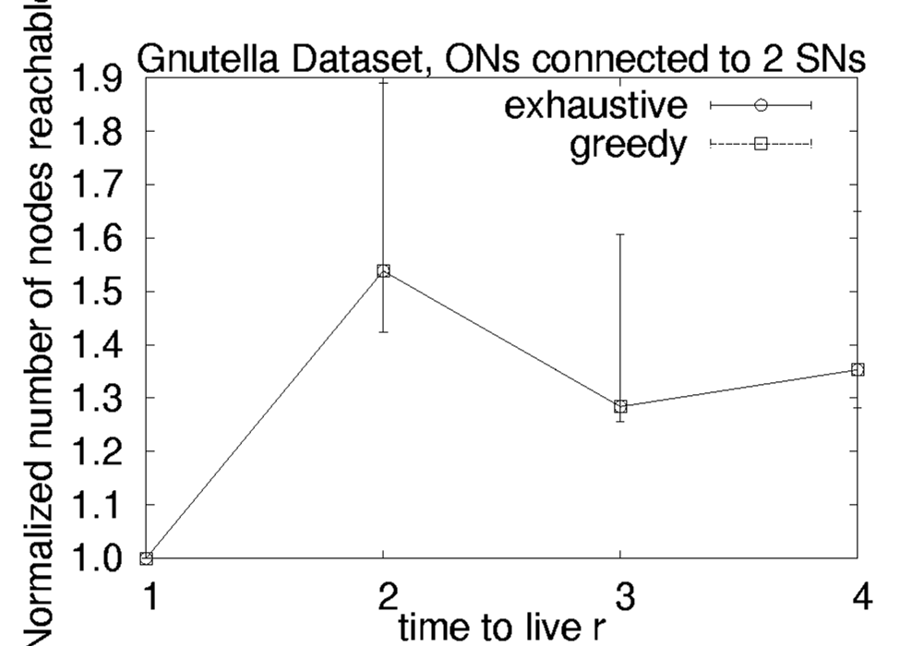
Performance in the Wild
Dealing with Heterogeneity of out-degree in the network.
Setting: Gnutella topology with over 305,000 Ordinary and Super nodes.
k=2
Search Improvement

Slide 19
Thank you!

Slide 21
Non Existence of Nash Equilibrium
The non Uniform-profit bounded out-degree Maximum Coverage game may not have pure NE.
Profits for A:
B: 1/2
C: 2
D: 1+ε
F: 1/2
Profits for B:
A: 1/2
C: 1+ε
E: 2
G: 1/2
ε<1/2
F
A
B
G
C
E
D
r=3, k=2

