Slide 1
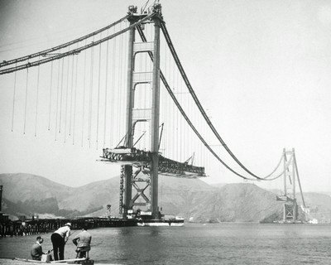
Selfish Overlay Network Formation:
Resource Allocation Strategies & Implications to Protocol Design
Georgios Smaragdakis
Committee members: Azer Bestavros,
Nikolaos Laoutaris,
John Byers
Notes:
Network Formation from the Networking point of view::focusing on Services that networks can offer.
Results working with friends and colleagues from BU and around the world.
Results that constitutes a potential thesis (still under construction).

Slide 2



Overlay Networks
overlay
plane
O₂
process
overlay node
router, AS
O₁
O₃
physical
plane
R₃
R₁
R₂
R₄
Notes:
→ overlay networks are virtual networks that are built on top of physical networks, that typical run an
Process running on the application layer.
Those networks are multipurpose and they have been used for traffic routing, congestion avoidance,
and content distribution
It is a successful alternative to add expensive bandwidth and more complexity in the internet routing.
Still this is too tightly connected to the technological aspects (motivated by)
As a successful alternative to add more expensive bandwidth and routing complexity to the I-net.

Slide 3
Overlay Economics
Market:
Investment:
Flat Resource Allocation
internet
overlay
replicas
overlay links
overlay
storage
transit ISP
transit ISP
$?
$?
$?
access ISP
access ISP
access ISP
Notes:
Lately a lot of attention has been paid to analyze such networks wearing economic lens.
It is not the first time that such models are used to analyze networks, but I-net models can not be directly applied to the set of overlay networks, 1) overlays are deployed in a very small time scale
2) Is able to bypass expensive and slow agreements of ISPs.
In this setting, individual users value the benefit they have by building such networks and invest.
The related CS problem is the problem of resource allocation. And I call this flat resources allocation.
They can allocate quite divirse set of resources like
MARKET::Bypass pricing …BUT Increases Access Demand!
Essentially, a FLAT Resource Allocation Problem (not single authority does not scale, do nor trust)
::HOW VALUABLE IS THE SERVICE FOR the overlay, ESSENTIALLY a resource allocation problem/MAX RETURN
- Lately overlays
→Bypass policies [more flexible than strict agreements], obstacles, BID for service etc. → in an opportunistic way!
→Search for data etc.
→and at the same time increases demands!
Still resources have to be allocated, namely
1.
2. / bwth, delay, etc.
3.

Slide 4
Challenges
Opportunities
Network Heterogeneity:
pair wise delay or available bandwidth,
storage, cpu cycles, budget…
Load Variability:
diurnal variation of traffic, dynamic routing or pricing, node churn…
Diversity of users:
different prospective, conflicting objectives
Notes:
→ To deploy such applications is really challenging:
1) Network Heterogeneity
2)Traffic Dynamics
3)Diversity of users
→ Solutions in the literature can be generally grouped in two categories:
i) light heuristics that work good in practice
ii) Abstract models (not capturing all the power of overlays) that are easy to analyze.
In this talk I am going to propose a general framework that bridges the two approaches,
in such a way that I will turn all the aforementioned challenges into opportunities for nodes that participate
In the network.
Amalgam of different of multiple independent authorities, with different prospectives and possible conflicting objectives→ entities not only overlay users but also entities of the setting.
Previous work..
In this work we will turn all the above challenges into opportunities
XXXXX Challenges.

Slide 5
Strategic Resource Allocation
Natural to be selfish
Our Methodology:
Responses that are easily realizable by a
continuous distributed optimization process
Effect on the quality of service users receive
Implications to protocol design
Notes:
→ I am going to do that along the lines of flat but strategic resource allocation.
Well, in this setting it is natural for users (nodes) to be selfish, ie cater only to satisfy their
Individual utility ignoring the social welfare. By allocating the min #resources while achiving the
Best quality from the overlay.
→ I am going to study this in a methodological way.
→ By the end of talk I will try to convince you that the framework is general enough to analyze and
Improve a very diverse set of compononents of overlay networks, namely::
We explore → strategic users, s.t. (distributed optimization process). Along the lines of Strategic Resource Allocation
→Flat Resource allocations
Satisfied Individual overlay users
At the same time the overlay provides them with high quality of service
→What is the right strategy, what a protocol should support ()
→Implications to Protocol design
→ Be careful what you are asking for

Slide 6
Neighbor Selection
Node Selection
Peer Selection
Storage Sharing
Notes:
Roadmap
Clockwise
Components/Blocks closely related to each other share a side
Building Blocks can be independent, can be also monolithic

Slide 7
Neighbor Selection
Node Selection
Peer Selection
Storage Sharing
Notes:
The effectiveness of service provisioning in many large-scale applications is based on the # and
Location of service facilities.
-- The effectiveness of service provisioning in large-scale networks depends heavily on the
Number and location of service facilities deployed.

Slide 8
the Game
Game with rational players:
  Clients
  Service Providers
Objectives:
  Clients: min the cost to receive service
  Service Providers:
  min Installation and Maintenance cost + distance to users.
Outcome:
  The overlay and a client assignment map
Notes:
And let me sketch the game that underpins such a service deployment.
It’s a game with rational users, namely
By minimizing to increase its revenue.
A fix service deployment is not able to give a lot of power to the service provider.
GAME: !!!!!!
*Clients want good service-> go to the closest facility
*operators want to satisfy the largest target group with the minimum cost (this gives them revenue)→strategic placement of resources ()
-- Improve proximity of client-to-service
-- A lot of attention has been given focusing on the Economically Efficiency
-- Large Time scale for Network provisioning

Slide 9

Dynamic Service Deployment
Generic
Service
Host
Service
Facility
Demand Change
Eg. Flash Crowd,
time-of-day
effect
Notes:
Ideally, a service provider would like to migrate its service facilities in order to increase its revenue
-- CONFIGURATION, TIMELY DISTRIBUTED FILES
--Distribution of software updates and patches (e.g., Windows Update)
Real time distribution of virus definition files
--Fixed deployment Dynamic deployment time-of-day effects flash crowds
--Being able to adjust the number and the location of service facilities dynamically should be more economic than fixed over-provisioning…
Nomeglateur:::Crazy map of Internet
We have: a network (let’s think AS-level granularity) & a demand (# downloads from each AS)
We want: [the number of service facilities] their location
→A competitive setting where:: DFL: users want the best service, operator wants the best service, but..
→Think the service as a piece of software that migrates
-- different granularity from akamai (we don’t migrate with every request)
→Feasible economic model

Slide 10
Ideal Solution : Requirements
Economically Efficient
Distributed
Scalable
Oblivious to physical topology
A-priori unaware of client demand
Easily reconfigurable
Notes:
→ Let me summarize the requirements for a ideal solution.
-- Improve proximity of client-to-service
-- A lot of attention has been given focusing on the Economically Efficiency
-- Large Time scale for Network provisioning

Slide 11
Facility Location
Toward more realistic economic models:
F: set of (potential) facilities,
f_{i}: cost to open+maintain facility,
C: set of clients,
c_{ij}: cost connecting client j → facility i
Uncapacitated Facility Location (UFL):
Find a subset I of F and a function σ:C→I
to min ( Σ_{i} f_{i} + Σ_{i,j} c_{ij} )
Uncapacitated k-median (UKM): if |I| ≤ k
NP-hard
Notes:
- Mention the UKM problem

Slide 12
Is UFL Ideal?
UFL
V
x
x
x
x
x
Economically Efficient
Distributed
Scalable
Oblivious to physical topology
A-priori unaware of client demand
Easily reconfigurable
Notes:
-- UFL::Focusing on Large Time scale for Network provisioning

Slide 13
Local Search
LS and FL: Define a neighborhood structure B(S)
  UFL: open, delete or swap a facility
  UKM : swap facilities
  Good approximations in practice
Algorithm (Local Search):
1. Set S any arbitrary feasible solution
2. While exists S’ in B(S) : cost(S’)<cost(S)
S’ ← S
3. Return S
Notes:
Local Search is a (meta)-heuristic; it describes any algorithm that “explores” sequentially the space of possible solutions, moving one step from a current solution to a “neighboring” one.
- heuristic: tries to optimize a solution based on one metric.
- A metaheuristic is a heuristic method for solving a very general class of computational problems by combining user given black-box procedures — usually heuristics themselves — in a hopefully efficient way. The name combines the Greek prefix "meta" ("beyond", here in the sense of "higher level") and "heuristic" (from ευρισκειν, heuriskein, "to find").

Slide 14
Is LS Ideal ?
UFL
V
x
x
x
x
x
LS
V
x
V
x
x
V
Economically Efficient
Distributed
Scalable
Oblivious to physical topology
A-priori unaware of client demand
Easily reconfigurable

Slide 15
Our Approach : dFL
[LSOSB’07]
Solve UFL in r-ball
..BUT nodes outside the r-ball are totally neglected
“ring” nodes
r-ball
(r=2)
when r-balls intersect
→ merge them
Notes:
-- each client shortest path to the facility
-- 2 or more copies in “duplication”
-- don’t want to know the topology of the ring and certainly not want to solve UKM in the ring
-- bad local minima
--loops

Slide 16
Properties
Convergence:
Migration only if the cost of facilitating the demand decreases at least be a%, converges in O(log_{1+a} n) steps
  We can control the speed of convergence by tuning a
Limited Horizon View Requirement:
  r regulates the trade-off between Scalability and Performance
Notes:
-- Let’s continue the discussion of flat resource allocation
→ Single parameter that captures the tradeoff between establishing a link and routing cost
--Single shot game, unrealistic.
--A great first model but..
→Bilateral

Slide 17
dFL is Ideal !
UFL
V
x
x
x
x
x
LS
V
x
V
x
x
V
dFL
V
V
V
V
V
V
Economically Efficient
Distributed
Scalable
Oblivious to physical topology
A-priori unaware of client demand
Easily reconfigurable

Slide 18
Neighbor Selection
Node Selection
Peer Selection
Storage Sharing
Notes:
→ One of the fundamental issues underline many network applications, is this of connectivity management, folding new arrivals into the existing overlay and rewire to cope with changing network conditions. In a typical overlay network, a node has to select a number of immediate neighbors to route traffic or requests.
Even when node have been selected, they have somehow to communicate, needless to say that in many cases, there is no provisioning for the deployment of applications.
--In most of the case though applications, have to deal with unpredictable arrivals, departures (no control on that)
--Or somehow the facilities have to be connected
--Single path
--Refinements of Equilibria, Iterative Games (not on distribution of strategies)

Slide 19
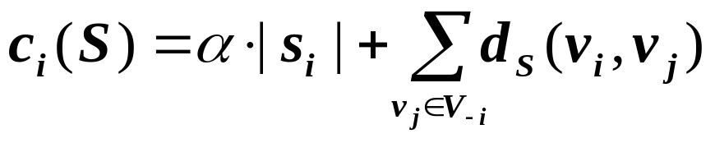
Game-Theoretic Network Formation
Local Connection Game <V,{s_{i}},{C_{i}}> [Fabrikant et al’03,…]
  V: set of n players (nodes)
  {s_{i}}: strategies available to v_{i} (wirings)
  {C_{i}}: set of utilities for v_{i} (cost)
  Outcome: S is the global wiring
Undirected links and unbounded degrees
  model:
    Equilibria (stable graphs) always exist
    Small Price of Anarchy
purchase cost
access cost
Notes:
-- Let’s continue the discussion of flat resource allocation →LOCAL CONNECTION GAMES!
<NON COOPERATIVE GAMES>
→ SINGLE STAGE GAME
→ Single parameter that captures the tradeoff between establishing a link and routing cost
--!!!!Single shot game!!!!, unrealistic. → surprisingly, PoA is moderate!
--A great first model but..
→ Chun et al., 2004: study experimentally the case of non-uniform link costs “α_{ij}”
Appropriate for physical telecommunication networks
→Bilateral➔ COST SHARING CAN BE BAD!!➔NOT SELFISH ROUTING!!!!
Good FIRST MODEL for the physical telecommunication networks.

Slide 20
Selfish Neighbor Selection (SNS) [LSBB’07]
Towards a Realistic model for Overlay Networks:
  Directed Links
  Bounded out- and in-degree
  Non-uniform preference vectors
  Realistic models of physical distance
Towards a Richer Game, easily realizable via a network protocol.
Notes:
Towards Realistic models:
Local connection game ← SNS JOURNAL
Not Selfish Routing!!! ← SNS JOURNAL
Always connected graphs←

Slide 21
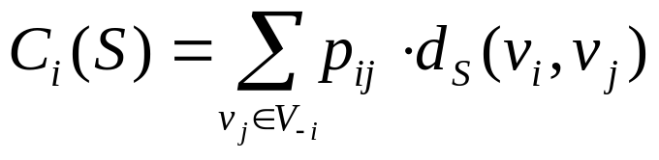
SNS : Best Response
v_{i}, minimize:
v_{i}’s residual network
w
over all s_{i}∈S_{i}
v_{i}
u
individual wiring
s_{i}={u,w}
G_{-i}=(V_{-i},S_{-i})
global wiring
S=S_{-i}+{s_{i}}
residual wiring
Notes:
Towards Realistic models:
Local connection game
Not Selfish Routing!!!

Slide 22
SNS Best Response & Facility Location
Uniform link weights, and uniform preference
→ k-median on asymmetric distances
or Local Search
w
w
v
Non Uniform link weights, and uniform
preference:
ILP formulation or Local Search
u
u
since these
cost the same
w,u can be
obtained from
k-median on
reversed distances
Notes:
-- uniform case
-- non uniform case
NIKY RIGA

Slide 23
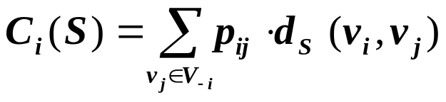
SNS : the Game
It is not Selfish (Source) Routing!
Local Connection Game <V,{s_{i}},{C_{i}}>
V: set of n players (nodes)
{s_{i}}: strategies available to v_{i} (wirings),
choose k out of n to connect
{C_{i}}: set of utilities for v_{i}
  min
Outcome: S, the global wiring
  A stable wiring is a pure Nash Equilibium.
  Using iterative Best response.
Notes:
==Not congestion game <-> Not Potential game (Shapley’96,…)
BEYOND POTENTIAL GAMES ← SNS JOURNAL, smooth analysis
Refinement of Games, leads to richer equilibria, Iterative best response
Responses

Slide 24
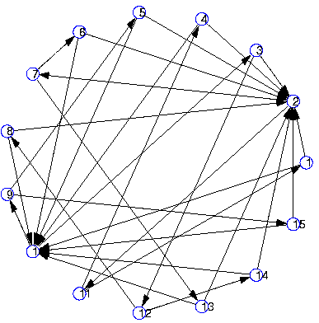
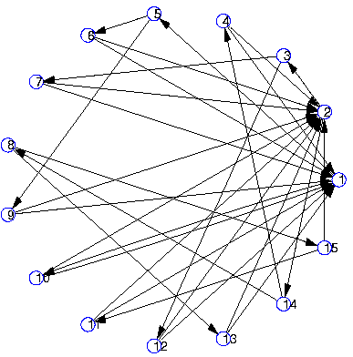
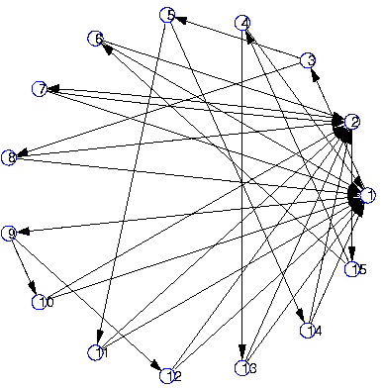
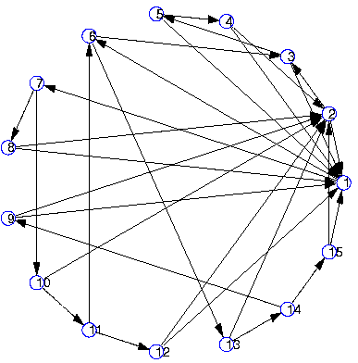
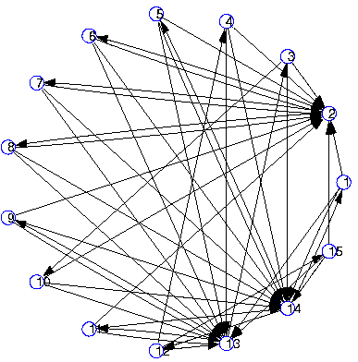
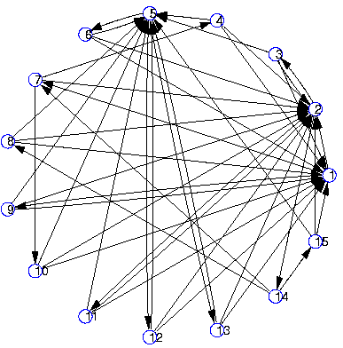
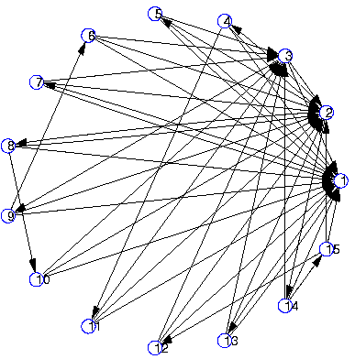
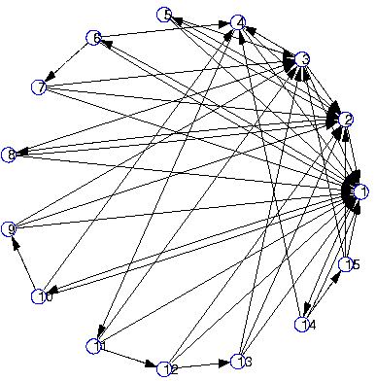
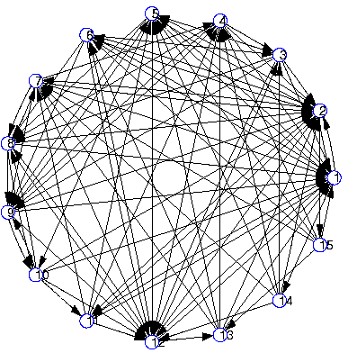
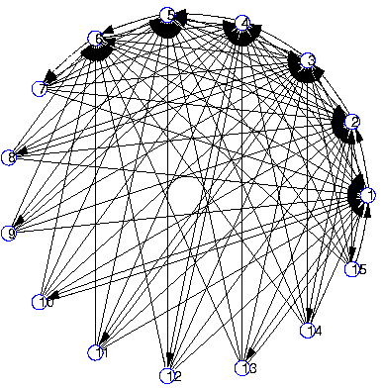
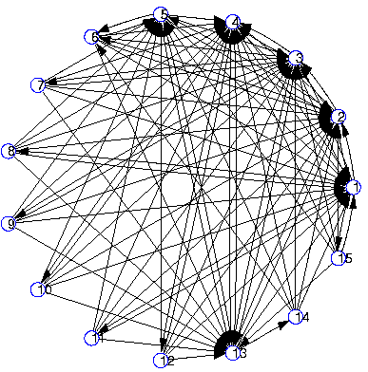
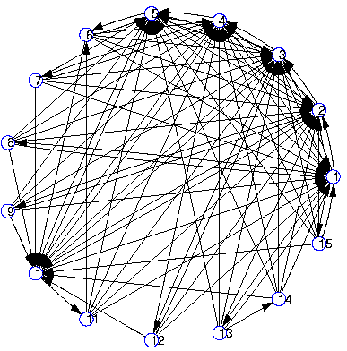
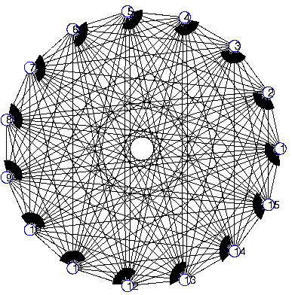
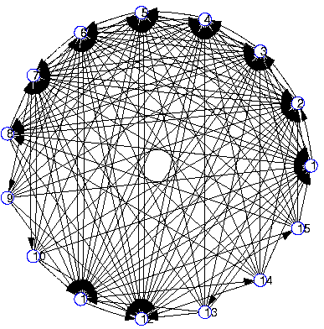
SNS : Equilibria
Uniform Preference Skewness of preference
n=15 k=2
k=3
k=8
k=11
in-degrees are highly skewed even under uniform preference !
→ quality-based “preferential attachment”
k (outgoing links)
Notes:
-- Regular graphs are not equilibria (degree distributions are not uniform)
IMPLICATIONS TO GAME LEARNING!!!! ← SNS JOURNAL
NIKY ->k

Slide 25
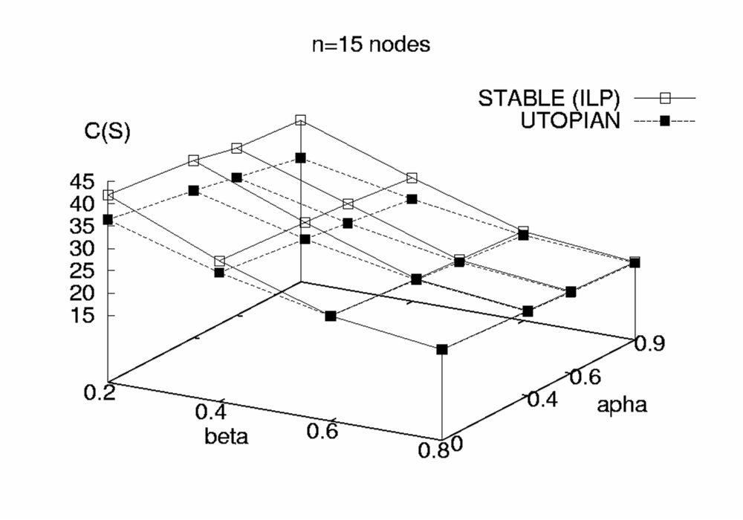
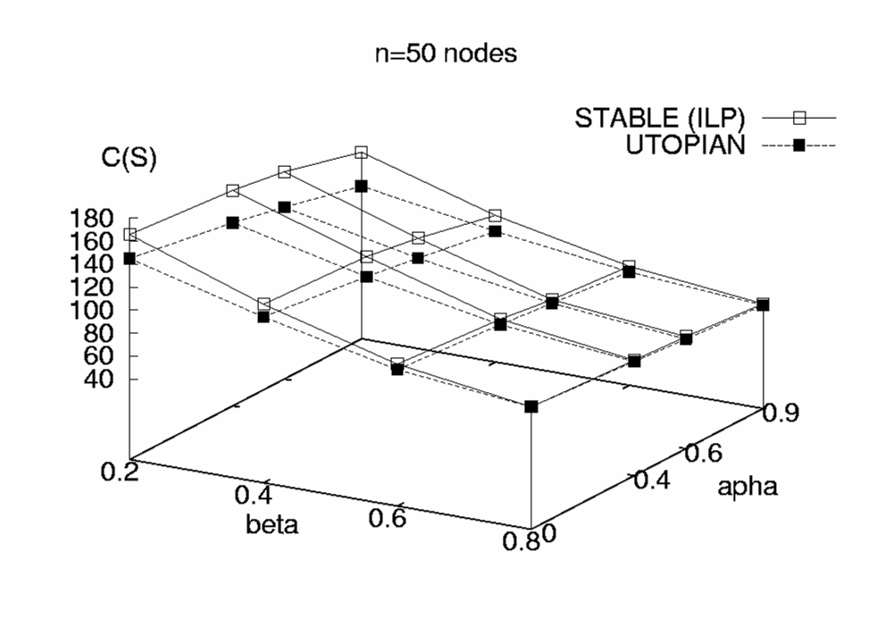
SNS : Efficiency
Performance close to Utopian!
Theoretical Results [Laoutaris et al’07] :
  Uniform link weight and preference:
  A stable graph ALWAYS exists, s.t.
    The cost of any node is at most 2 + k ⁻¹ + o(1) that of any other node.
    Stable graphs with small diameter.
  Non-Uniform link weight and preference:
    Not always a stable graph exists.
Skewness of preference
Outgoing links
Skewness of preference
Outgoing links
Notes:
INDEPENDENT OF SIZE!!, EVEN APPROXIMATIONS ARE GOOD ENOUGH!!!
As computer scientist still we do not have good tools to analyze the PoA, PoS, convergence to Equilibria.|||| PRICE OF STABILITY → Benefit of a protocol
PRICE OF STABILITY::THE BENEFIT BY DEPLOYING A (communication) PROTOCOL!!!!
NIKOS THEORY WORK

Slide 26
SNS : Trace-Driven Games
Link cost generation:
  Synthetically using BRITE
  Empirically from PlanetLab
  Empirically from AS-level maps
Neighbor Selection Strategies:
  k-Random heuristic
  k-Closest heuristic
  k-Best Response
Control parameter:
  Bound on out-degree k (link density)
Notes:
4 slides

Slide 27
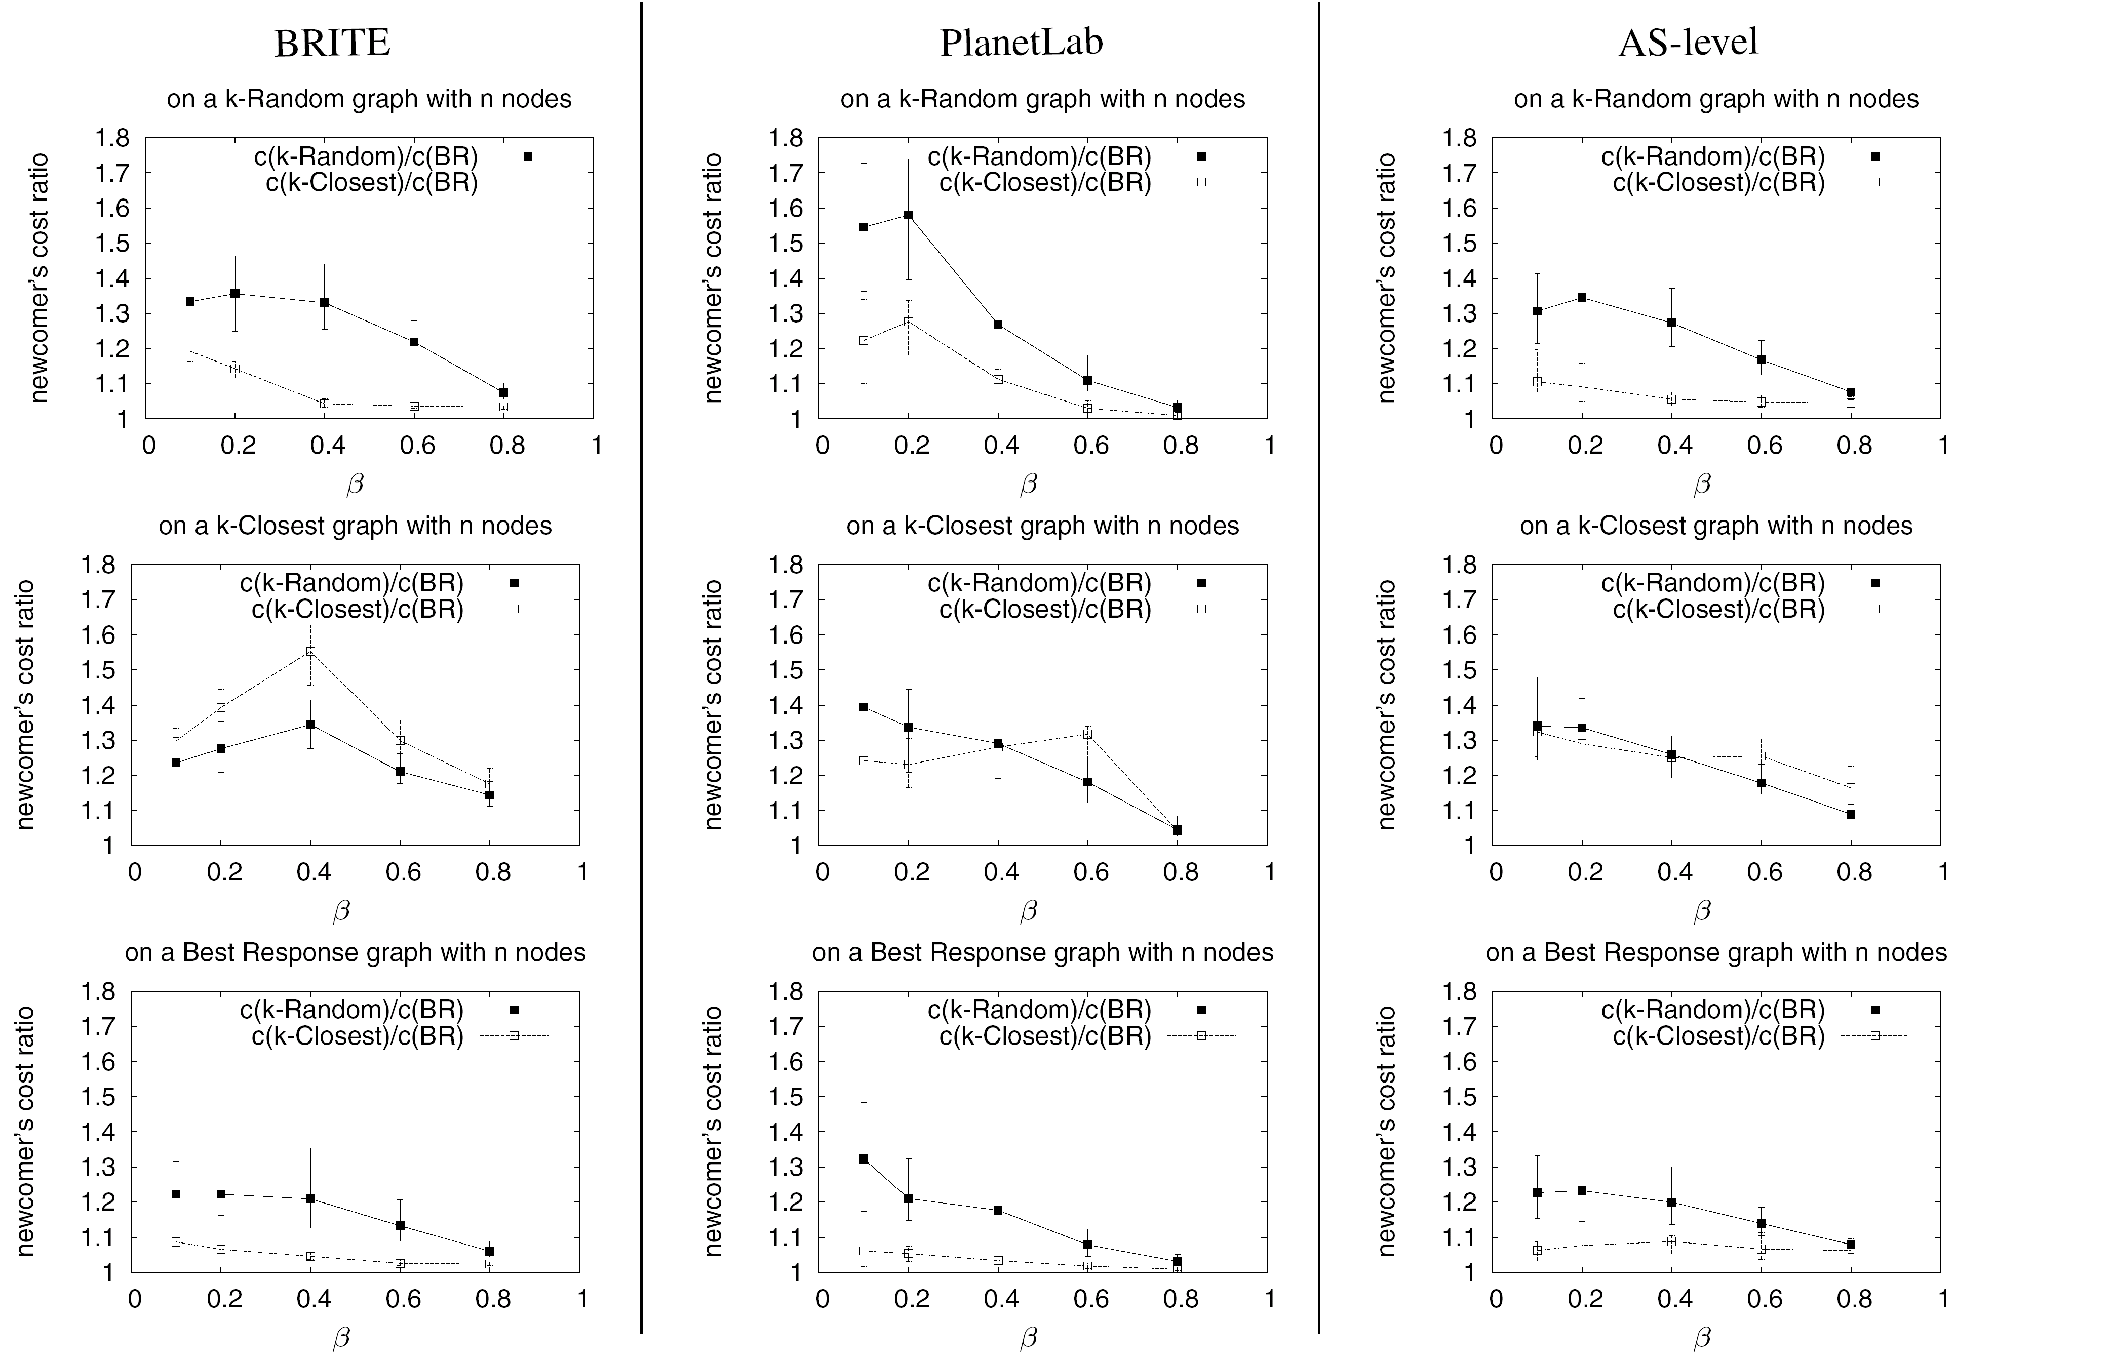
SNS : Implications
On a k-Random graph
BRITE (n=50)
PlanetLab (n=50)
AS-Level (n=50)
0 2 3 5 11 22
Link density
0 2 3 5 11 22
Link density
0 2 3 5 11 22
Link density
Link density
If your neighbors are naïve, it pays to be selfish!
Notes:
→ let’s see what is the performance of such wiring strategies on different graphs.
BR good, but there are not a lot to optimize

Slide 28
SNS : Implications
On a k-Closest graph
“Greed is not good”
BRITE (n=50)
PlanetLab (n=50)
AS-Level (n=50)
0 2 3 5 11 22
Link density
0 2 3 5 11 22
Link density
0 2 3 5 11 22
Link density
Link density
Link density
Link density
Link density
If your neighbors are greedy, it pays to be selfish!
Notes:
IN A GREEDY WAY too small steps ← SNS JOURNAL

Slide 29
SNS : Implications
On a stable Best-Response graph
The graph is highly optimized
BRITE (n=50)
PlanetLab (n=50)
AS-Level (n=50)
0 2 3 5 11 22
Link density
0 2 3 5 11 22
Link density
0 2 3 5 11 22
Link density
Link density
If your neighbors are selfish, it is OK to be naïve!
Notes:
Every node is a portal to optimal service (portals)!! ← SNS Journal,
Newcomer ← SNS Journal

Slide 30
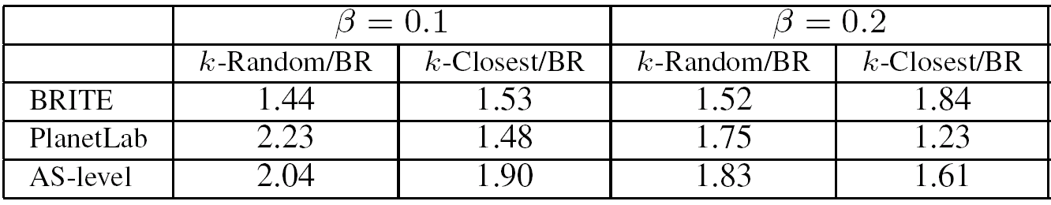
SNS : Implications
Macroscopic view:
Focusing on the Social Welfare
k=2 k=3
The network is better off with selfish nodes!
Notes:
4 slides

Slide 31
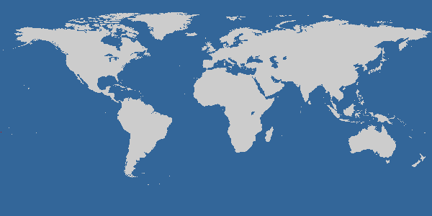

EGOIST : SNS in the wild
[SLBBR’07a]
EGOIST Demo at: http://csr.bu.edu/sns
Notes:
3- FOLD:: 3x ← SNS JOURNAL (ALL OF THEM)
1)To capitalize--Live Laboratory
!!!!!!!!→ If it takes too much time, why should computers even reach them? →Is it enough to have BRs?
2)Beyond Equilibria, In general graphs we do not know how many iterations are needed to reach equilibria,
*) The protocol, real traces break the tights!!!!
If reached, How about studying the performance study?
3)Available to the community

Slide 32
EGOIST : Link State Protocol
Protocol for EGOIST overlay node v_{i}
  Bootstraps by connecting to arbitrary neighbors
  Joins link-state protocol to get residual graph
  Measures cost to candidate neighbors
  Wires according to chosen strategy
  Monitors and announces overlay links

Slide 33
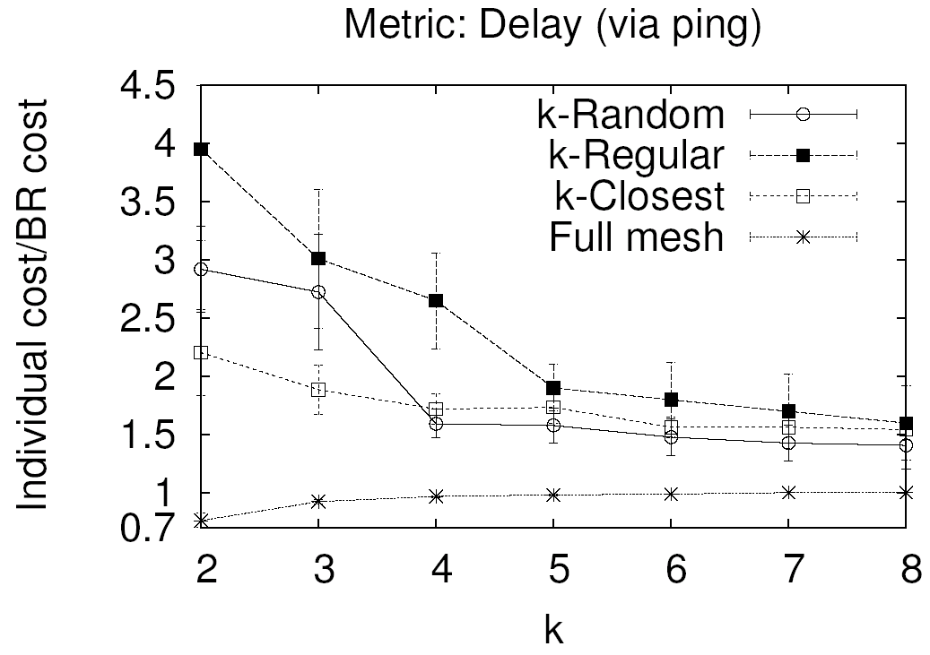
EGOIST : Performance
BR
n=50 overlay nodes
Notes:
-- Marginal gain for large k

Slide 34
EGOIST : Performance
BR strategy outperform heuristics
  Delay (active or passive measurements)
  Available Bandwidth
  Node load
Effective under Churn
Robust to Cheating
Effective even with partial knowledge
Minimal overhead
Small number of rewirings
Notes:
-- different variations of the BR.
→ Huge Combinatorial space, and ONLINE PROBLEM!!! ← SNS Journal

Slide 35
P2P File Sharing & Scoped Flooding
Bootstrap
Server
2
1
3
4
randomly
TTL of scoped flooding is 2
Notes:
-- DHT not well incentivized
--

Slide 36
SNS and P2P File Sharing [SLBBR’07b]
Best Response: max #nodes reached
4
Bootstrap
Server
1
6
3
5
2
selfishly
TTL of scoped flooding is 2
→ Maximum Coverage Problem
Notes:
-- Reduced to the maximum set cover problem,
-- We have derived the BR, and equilibria

Slide 37
Neighbor Selection
Node Selection
Peer Selection
Storage Sharing
Notes:
→ In many overlay networks, the routing is explicit. It is not any more 1-1 but 1-many, Such networks
Are typically content distribution networks. A node in such network has to establish peering relationiships
With a small number of other nodes that participate in the overlay and exchange data.
--anypath, focusing on data exchange applications, data dissemination,
-- NO ROUTING (1-many, many-to-many) [[not 1-1 routing like shortest path]] → ASK NIKOS PPT.!!

Slide 38
BT 101
Broadcast Problem
Swarming
Peer selection
  - Protect Upload Capacity
  - Based on Reciprocation
Piece Selection
- Rarest First
– Speed-up Dissemination
Network flow problem [Massoulie et al’07]
internet
Notes:
→-RECIPROCATION AND COST SHARING --- ****PROTECT THE UPLOAD CAPACITY ****
--not any more single path, but ******STILL LOCAL CONNECTIVITY GAMES ****!!
E2e performance! Think this as a flow!, ←swarming! ---- FLOW!!!
****Scale****, but 1 torrent
Less scale, many and demanding torrents!
Mention 1-way broadcast (for all the purposes nodes can leave the system) ->find min-cut and send a random useful piece, LOCAL RAREST FIRST!
→& BitMax! Be smart by exchanging information and have the upload highly utilized, with the right pieces.
→Limited by the topology! SCALE

Slide 39
n-way Broadcast
[SLMBBR’08]
How about all-to-all?
  - Many candidate applications
n-overlays increase stress on physical links!
How about creating one topology?
Bwth measurement is needed.
internet
Notes:
-- How about having different colors? – ALL-to-ALL ::volumnios applications
<COOPERATIVE GAMES??>
--Protect the upload capacity of each overlay node!
--NP-hard, Be careful of what you are asking for!!
-- ONE TOPOLOGY THAT COMBINES ALL COLOR → MULTICOLOR

Slide 40
n-way Broadcast : Formation
Distributed Network Formation
  Network flow problem
  Keep swarming, and local scheduling
Objective 1: Minimize the average download time
→The flow objective (Max-Sum) for node v_{i}:
max Σ MaxFlow(v_{i}, v_{j}), for all v_{j} in the network
Objective 2: Minimize the total download time
→The flow objective (Max-Min) for node v_{i}:
max min MaxFlow(v_{i}, v_{j}), for all v_{j} in the network
Scalable and Efficient solution: Local Search
Notes:
→ CENTRALIZED FORMATION IS INTRACTABLE
→Two objectives → two formations
-- How about having different colors?
→ Solve a flow problem!!

Slide 41
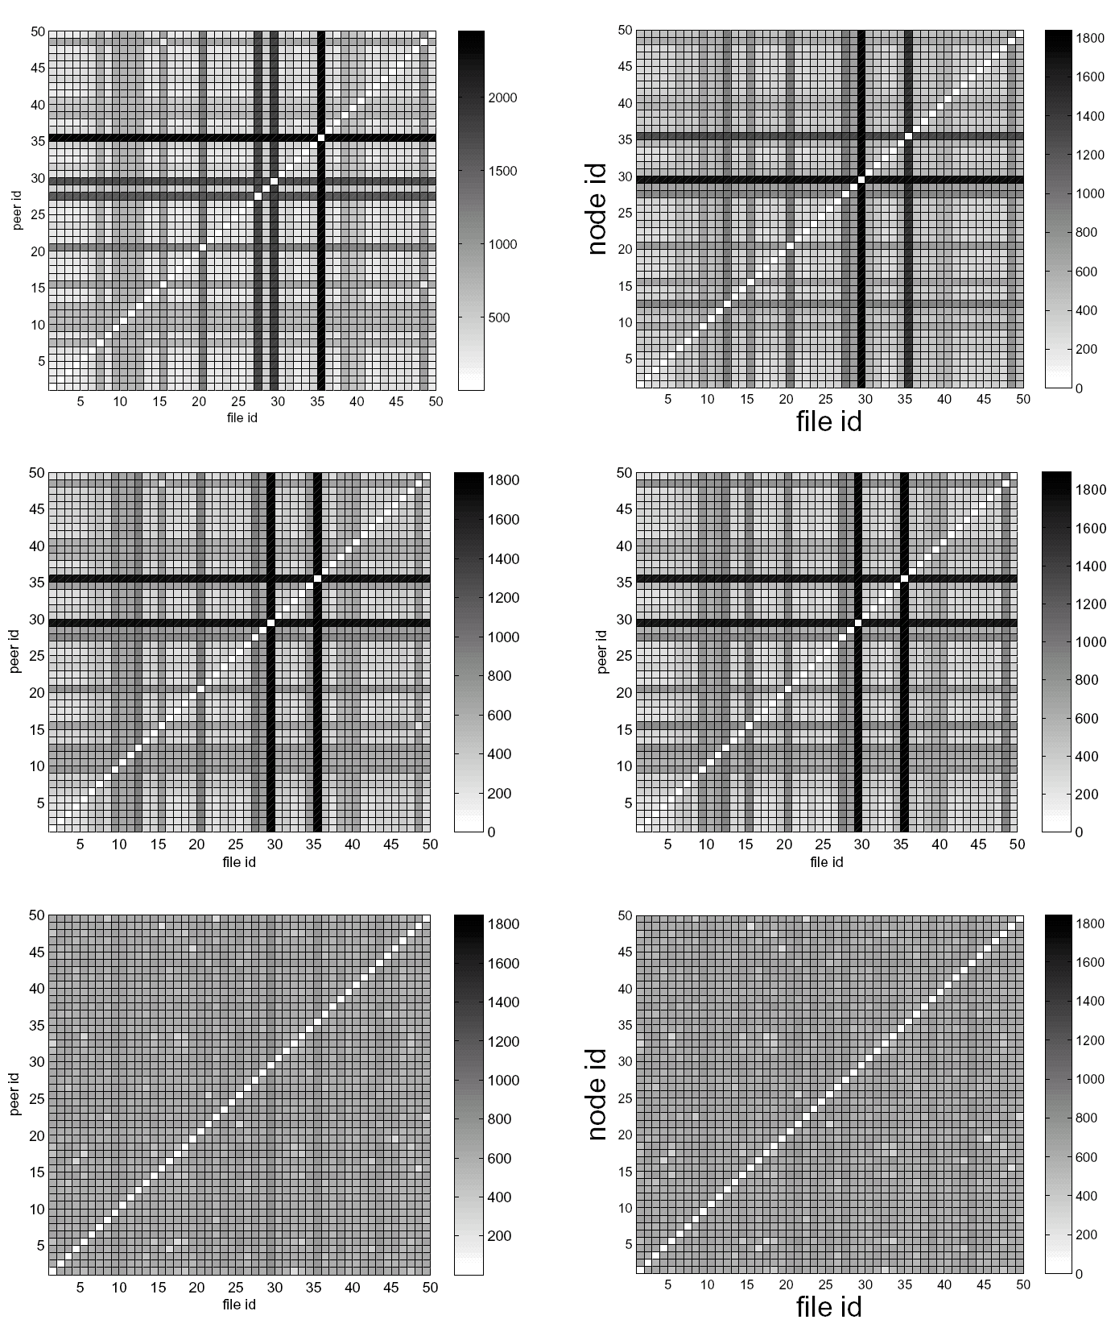
n-way Broadcast : Efficiency
Random, Greedy
Max-Sum
Max-Min
Node ID
Delivery Time
File ID
Min average download time objective:
  Easily satisfied with Max-Sum, Max-Min, even with Heuristics
Min total download time objective:
  Max-Min is dominant
  synchronization is guaranteed!
Notes:
-- How about having different colors?
→
--with selfish users--scheduling? → Robust to selfish scheduling!
→ SYNCHRONIZATION IS A REQUIREMENT FOR A LOT OF APPLICATIONS->

Slide 42
Neighbor Selection
Node Selection
Peer Selection
Storage Sharing
Notes:
How about if a node does not have the power to select neighbors, is there any way to choose if he
Wants to participate in the network or not. This is still a network formation problem, as nodes may join, leave, or the capacities of the vertices change over time.
-- How about if the selection procedure is slower than the changes (migh be expensive), are there
Ways to make safe the resources?
Mistreatment. Exposure of common resources

Slide 43
Distributed Caching
Origin
Server
Distributed Caching
→ online replacement algorithms
→ serve each other request
Cooperation improves individual and collective performance [Korupolu et al ‘99]
...BUT individual nodes can be mistreated
t_{s}
t_{r}
Storage allocated to application
Storage allocated to application
Notes:
→ Users form storage networks to serve each other requests, and in each cache online replacement algorithms take place.
→ Mistreatment is the situation where a node’s performance worsens while participating in the network
→ Mistreated through the exposition of its resources to the others
-- Canonical example, no coordination and
--Abstraction for Content Distribution Applications (including )
--AVOID MISTREATMENT

Slide 44
Mistreatment : Causes
[LSBS’06, LSBMS’07a]
Cause 1: Cache State Interaction due to the cooperative servicing of requests
  e.g. existence of an overactive node
Cause 2: Adoption of the Common Scheme of cache management
  e.g. existence of an outlier node
Notes:
→ Mistreatement is observed when
→ Mistreated through the exposition of its resources to the others
-- Canonical example, no coordination and
--Abstraction for Content Distribution Applications (including )
--AVOID MISTREATMENT

Slide 45
Distributed Selfish Caching
[SLBMS’07b,SLBMS’07c]
Towards Mistreatment-Resilient Distributed Caching:
Detection Mechanism : Identify
Virtual Cache:
Mitigation Mechanism : React
  Randomized Replacement(p)
  p: interaction or reliance parameter
Control Mechanism : Optimize
  Update the control parameter toward the direction that
  the individual cost is decreased
holds objects identifiers
virtual cache
request stream
cache
holds actual objects
Notes:
-- OBLIVIOUS TO WIRING, no power to do any of the above!
→ Performance tight to the
-- Randomized Replacement Algorithms: Break Mistreatment with Randomization!
--Requirements, unaware of the profile of other caches
--MISTREATMENT!!!

Slide 46
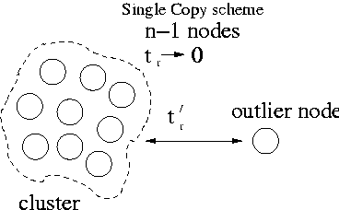
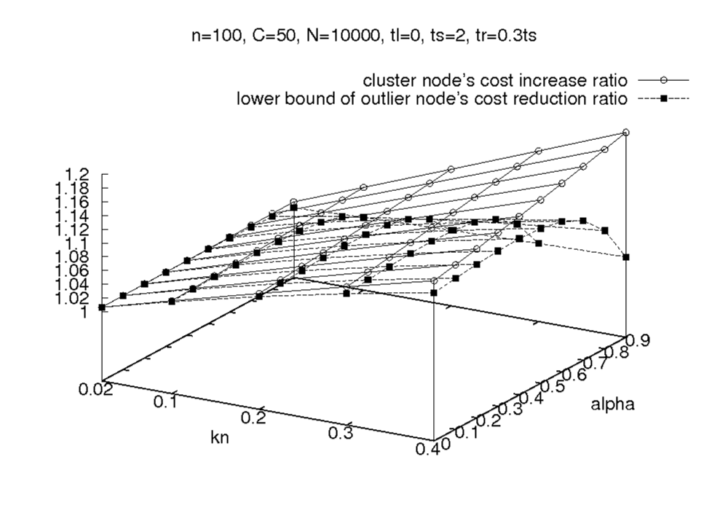
Distributed Selfish Caching : Efficiency
cluster nodes
outliers
Skewness of preference
Percentage of outlier nodes
Selfishness mitigates mistreatment & the degradation
of the overall performance is minimal
Notes:
-- Virtual Cache

Slide 47
Conclusions
Overlay Network Formation
→ Flat Resource allocation
→ Strategic Resource Allocation
Flattens the Internet
Notes:
→ OPTIMIZED FOR BOTH INDIVIDUAL USERS AND NETWOK
-- While much of the attention has been drawn to the harmful downsides of selfish behavior, our results advocate that strategic resource allocation primitives significantly outperform existing ones, providing
a promising alternative to distributed overlay network formation.
-- Maybe a direction to follow for Network Formation?
Flatens the Internet (ADOPTING SIMILAR STRATEGIES, OR BY HOSTING SUCH NETWORKS)
--> by adopting such strategies, or hosting selfish overlays

Slide 48
Chapter 2
Neighbor Selection
Chapters 3,4
Node Selection
Chapter 5
Peer Selection
Chapter 6
Storage Sharing
Notes:
Roadmap

Slide 49
Table of Contents
Introduction (Chapter 1)
Node Selection (Chapter 2)
  dFL Algorithm VVVVV
  dFL Performance VVVVx
  dFL & Pricing Models VVVVx
Neighbor Selection (Chapters 3,4)
  SNS Best Responses VVVVV
  Stable Graph Characterization VVVVV
  Implications to Protocol Design VVVVV
  EGOIST: SNS & Overlay Routing VVVVx
  SNS & P2P File Sharing VVVVx

Slide 50
Table of Contents
Peer Selection (Chapter 5)
  BRs for n-way Broadcast VVVVV
  Swarming over Optimized Graphs VVVVV
  Dealing with Selfish Scheduling VVVxx
Storage Sharing (Chapter 6)
  Mistreatment: Causes VVVVV
  Mistreatment: Implications VVVVV
  Mistreatment-resilient Design VVVVV
  Mistreatment-resilient Efficiency VVVVV
Conclusions (Chapter 7)

Slide 51
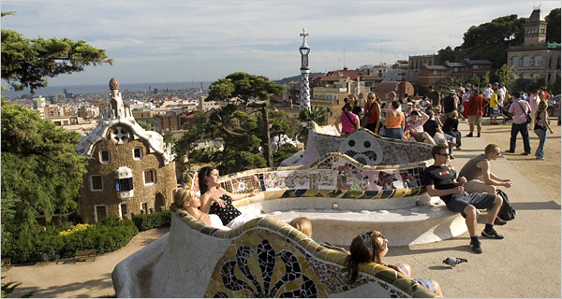



Timeline

Slide 52
Thank You!
Links:
csr.bu.edu/dfl
csr.bu.edu/sns
csr.bu.edu/dsc
List of Co-authors:
  Azer Bestavros, John Byers, Nikolaos Laoutaris,
  Ibrahim Matta, Pietro Michiardi, Konstantinos Oikonomou,
  Mema Roussopoulos, Ioannis Stavrakakis.

Slide 54
Selfish Neighbor Selection :
Tractable Analysis
utopian
…
. . .
k-1
h=log_{k}n
…
. . .
disconnection
k
Social Cost(ourEQ) < 2 * Social Cost(SO)
…
…
. . .
…
k
utopian+1
disconnection
Notes:
In a consequence work of ours.The authors try to analyze this strange structure
-> see the geometric properties of this graph and try to draw it without moving your pen::TREE (unfold it!)
Touch the two high in-degree nodes..

Slide 55
Overlay Networks
O₂
overlay
plane
O₁
O₃
R₃
physical
plane
R₁
R₂
R₄

Slide 56
Overlay Economics
Market:
Bid:
(Resource Allocation)
internet
overlay
replicas
overlay links
overlay
storage
transit ISP
transit ISP
$?
$?
$?
access ISP
access ISP
access ISP
Notes:
Bypass pricing …BUT Increases Access Demand!
Essentially, a FLAT Resource Allocation Problem (not single authority does not scale, do nor trust)
- Lately overlays
→Bypass policies [more flexible than strict agreements], obstacles, BID for service etc. → in an opportunistic way!
→Search for data etc.
→and at the same time increases demands!
Still resources have to be allocated, namely
1.
2. / bwth, delay, etc.
3.

Slide 57
Publications Related to the Thesis
Node Selection (Chapter 2)
  “Distributed Placement of Service Facilities in Large-Scale Networks”, LSOSB, INFOCOM’07.
  Ongoing: extensions for Journal publication.
Neighbor Selection (Chapters 3 & 4)
  “Implications of Selfish Neighbor Selection in Overlay Networks”, LSBB, INFOCOM’07.
  “EGOIST:Overlay Routing using Selfish Neighbor Selection”, SLBBR, BUCS-TR’07.
  Ongoing: extensions for Journal publication, P2P File Sharing equilibria.
Peer Selection (Chapter 5)
  “Swarming on Optimized Graphs for n-way Broadcast”, SLMBBR, INFOCOM’08.
  Ongoing: extensions for Journal publication.
Storage Sharing (Chapter 6)
  “Distributed Selfish Caching”, LSBMS, TPDS’07.
  “Mistreatment in Distributed Caching Groups”, LSBS, INFOCOM’06.
  “Mistreatment-resilient Distributed Caching”,SLBMS, Computer Networks’07.
  “A Feedback Control approach to Mitigating Mistreatment in Distributed Caching Groups”, SLBMS, Networking’07.

Slide 58
Selfish Neighbor Selection : Best Response
v_{i}’s preference for v_{j}
v_{i}, minimize:
v_{i}’s residual network
w
over all s_{i}∈S_{i}
v_{i}
u
individual wiring
s_{i}={u,w}
G_{-i}=(V_{-i},S_{-i})
global wiring
S=S_{-i}+{s_{i}}
residual wiring
Notes:
Towards Realistic models:
Local connection game
Not Selfish Routing!!!

Slide 59
SNS and P2P File Sharing
BR: max the nodes reached
4
Bootstrap
Server
1
6
3
5
2
TTL of scoped flooding is 2
→ Maximum Set Cover Problem
Notes:
-- Reduced to the maximum set cover problem,

Slide 60
SNS : Trace-Driven Games
Link cost generation:
  Synthetically using BRITE:
    Barabasi-Albert (BA) model with heavy-tailed 2D placement
    Euclidean distance used to derive cost of overlay links
  Empirically from PlanetLab:
    300-node PlanetLab topology
    All-pair ping traces used to derive cost of overlay links
  Empirically from AS-level maps
    2001 data of the AS-level topology
    AS relationships from vantage points
Neighbor Selection Strategies:
  k-Random heuristic
  k-Closest heuristic
  k-Best Response
Control parameter:
  Bound on out-degree k (link density)
Notes:
4 slides

Slide 61
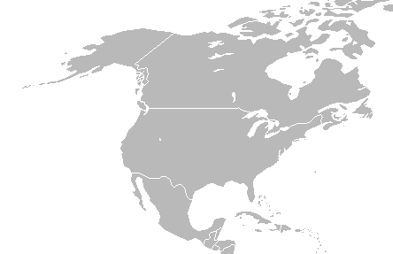
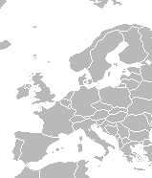
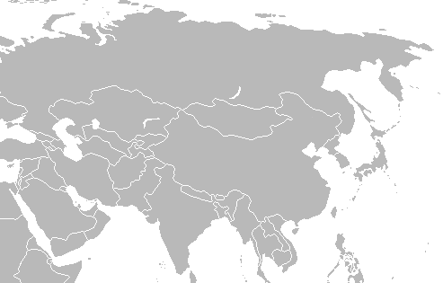
Service Deployment & Migration
Potential
Market:
software updates, patches, virus description files, limited-budget deployment.
Generic
Service
Host
Service
Facility
Demand Change
Eg. Flash Crowd,
time-of-day
effect
Notes:
-- CONFIGURATION, TIMELY DISTRIBUTED FILES
--Distribution of software updates and patches (e.g., Windows Update)
Real time distribution of virus definition files
--Fixed deployment Dynamic deployment time-of-day effects flash crowds
--Being able to adjust the number and the location of service facilities dynamically should be more economic than fixed over-provisioning…
Nomeglateur:::Crazy map of Internet
We have: a network (let’s think AS-level granularity) & a demand (# downloads from each AS)
We want: [the number of service facilities] their location
→A competitive setting where:: DFL: users want the best service, operator wants the best service, but..
→Think the service as a piece of software that migrates
-- different granularity from akamai (we don’t migrate with every request)
→Feasible economic model

Slide 62
the Game
Game with rational players!
Set of players:
  Clients
  Service Providers
Strategies:
  Clients: min the cost to receive service
  Service Providers: min Installation and Maintenance cost + closer to large target of users.
Cost function:
  Clients: cost to closer service facility
  Service Providers: cost to deploy service
Outcome:
  The overlay and a client assignment map
Notes:
GAME: !!!!!!
*Clients want good service-> go to the closest facility
*operators want to satisfy the largest target group with the minimum cost (this gives them revenue)→strategic placement of resources ()
-- Improve proximity of client-to-service
-- A lot of attention has been given focusing on the Economically Efficiency
-- Large Time scale for Network provisioning

