Slide 1


Delay Tolerant Bulk Data Transfers on the Internet
Nikolaos Laoutaris (Telefonica Research)
based on joint work with:
Georgios Smaragdakis (DT-Labs), Pablo Rodriguez (Telefonica), Ravi Sundaram (Northeastern)
© 2007 Telefónica Investigación y Desarrollo, S.A. Unipersonal

Slide 2
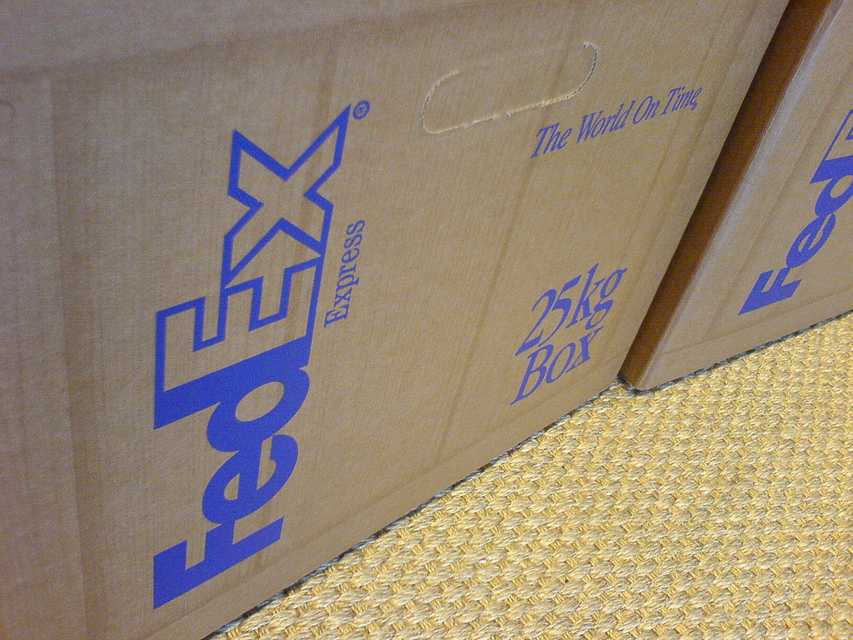
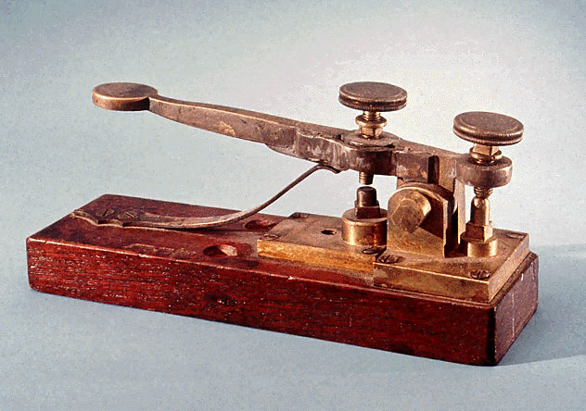
This talk is about rethinking of the Internet
from a communication network for delay intolerant data
into a cargo network for delay tolerant bulk data

Slide 3
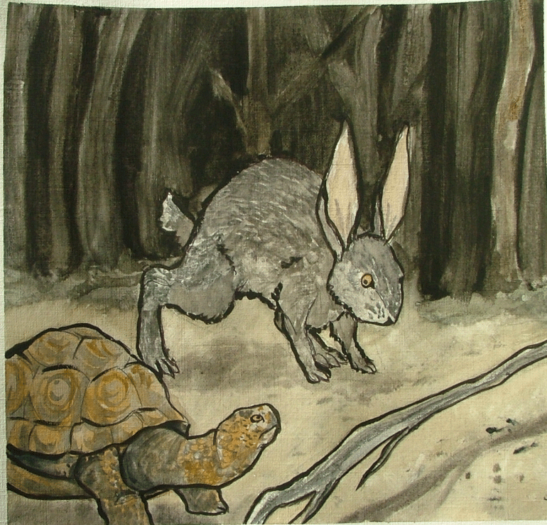

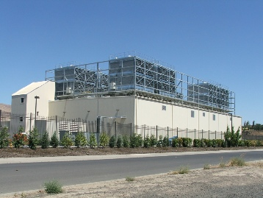

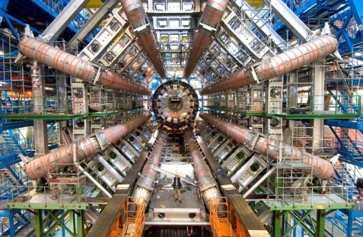
Delay Tolerant Bulk (DTB) data
Definition:
  Delay tolerance ~ few hours to few days
  Volume ~ terabytes to petabytes
Several examples:
  Scientific datasets
  Data center synchronization, accounting, data-mining traffic
  Distributed production of movies
  High resolution images

Slide 4
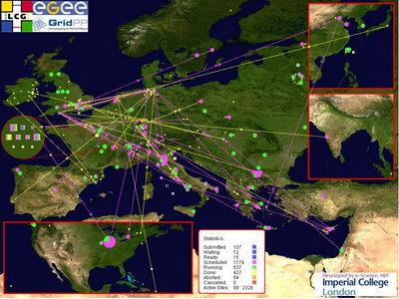

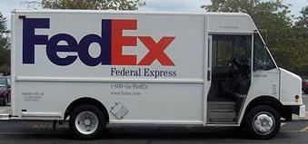
Current situation
DTB data are served by:
Expensive dedicated networks
  LHC Computing Grid
Postal system in hard disks & DVDs
Our objective is:
Utilize leftover capacity from commercial ISPs to send DTB data
Can Telco’s compete with ?

Slide 5


Case study: Sending CERN LHC data
Push 27 Tbytes/day
LHC@CERN
Fermilab
(A) with a dedicated line
  27 Tbytes/day = ~ 2.5 Gbps
  $30K/Gbps/month (Europe/N. America)
  $90K/Gbps/month (Asia/S. America)
  $200K-$500K / month
(B) with FedEx International priority
  54 Tbytes every 2 days
  ~70 Kgr using 1 Tbyte disks (1.2 Kgr)
  $1.2K / shipment → $18K / month

Slide 6
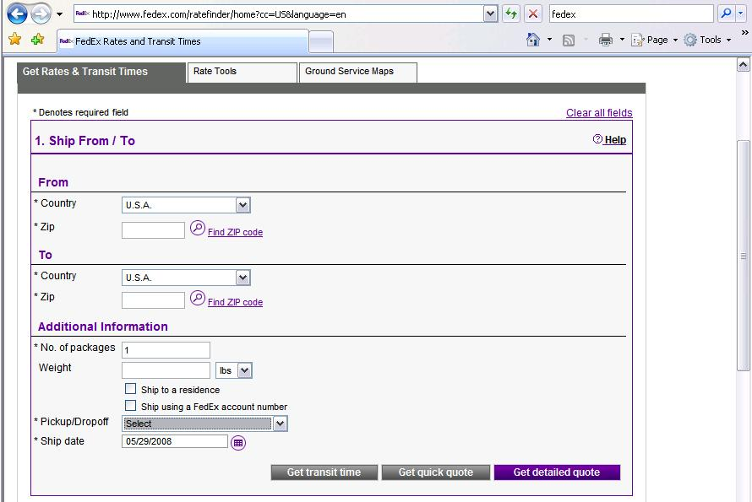
Our approach: (C) Use commercial ISPs

Slide 7
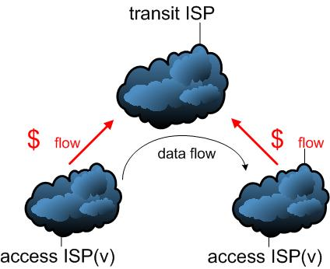

How would it work?
95-percentile pricing
X(t) volume sent at t (5-minute slots)
X vector over a month
q₉₅(X)
c() concave pricing function
c(q₉₅(X)) monthly charge
$
$
initially here
backgound
need to get there
How can we mininize the
cost for ISP(v) and ISP(u)?
DTB data

Slide 8
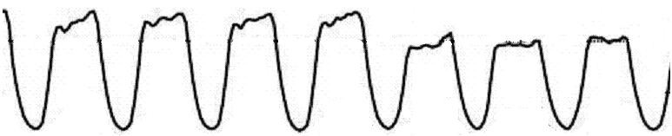
Simplest mixing: E2E-CBR
B=27 Tbytes, T=1 day → CBR rate B/T=2.5 Gbps
traffic
ISP(v)→ TR
95-percentile
background
background
+
DTB
DTB rate
B/T
day of week
E2E-CBR as expensive as a dedicated line!

Slide 9

E2E-Sched
Take advantage of Delay Tolerance
Regulate source rate and send DTB only during load valleys
traffic
ISP(v)→ TR
valley
(already paid for bandwidth)
95-percentile
background
day of week

Slide 10
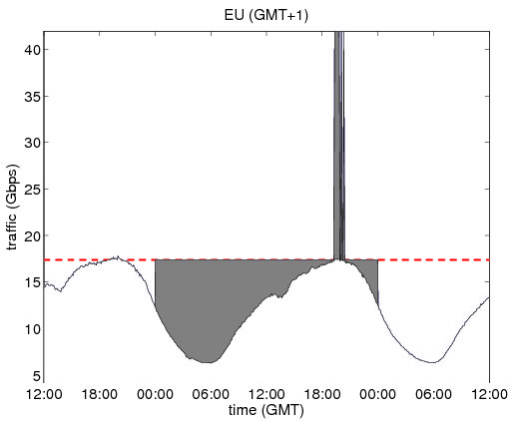
The details of source scheduling
“Water-filling” for sending F(q₉₅(x),x,t₀,T) of DTB for free!
  If x(t) < q₉₅(x) add q₉₅(x) -x(t)-ε DTB data
  If x(t) ≥ q₉₅(x) add C-q₉₅(x)-Δ DTB data
Similarly, for q>q₉₅(x)
we can send F(q,x,t₀,T)
at cost c(q)-c(q₉₅(x))
T
q
t
0
q₉₅(x)
FREE!
x(t)

Slide 11
Is this the whole story?
No (please don’t try it at home ☺ )
Remember there are at least 2 charged links
Their valleys are generally non-coinciding

Slide 12
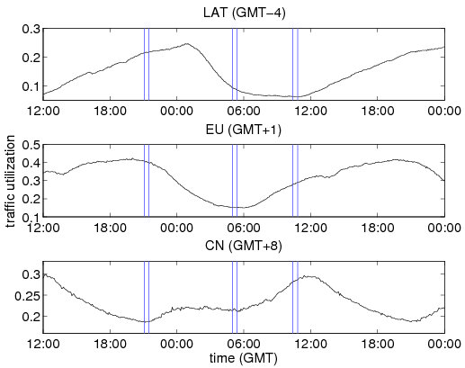
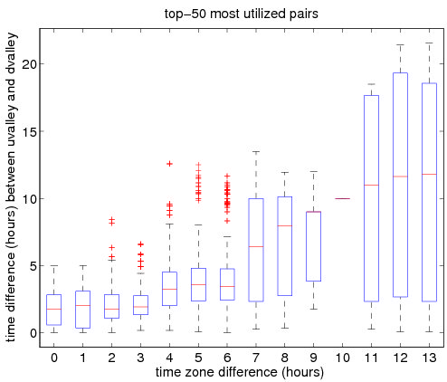
Non-coinciding valleys at sender-receiver
Load time-series from 280 interconnection points of a large transit provider
Sender in LAT Receiver in EU or China
Aggregate results from TR
uvalley(LAT)
8am
1pm
8pm

Slide 13


What about Store n’ Forward?
To recap ...
E2E-CBR
SnF
E2E-Sched

Slide 14
E2E-Sched vs. SnF (1/5)
METHODOLOGY
200 links from a large ISP with global presence
For every pair ISP(v), ISP(u) in our dataset
We calculate F(E2E-Sched) and F(SnF)
  Amount of data that can be sent for free between ISP(v) and ISP(u) in 24 hours
  Water-filing: independent (SnF), constrained by min (E2E-Sched)
We report median values for a working week

Slide 15
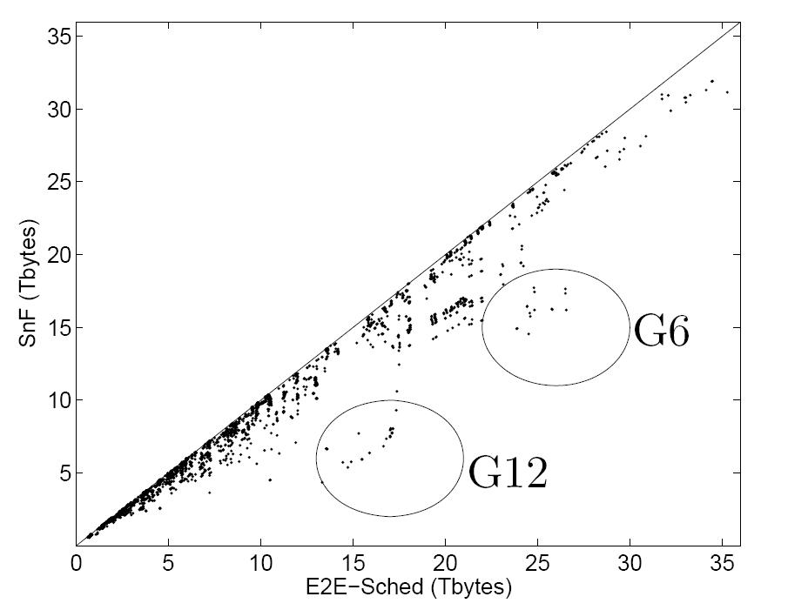
E2E-Sched vs. SnF (2/5)
T=1 day
E2E-Sched (Tbytes)
E2E-Sched
SnF
SnF (Tbytes)

Slide 16
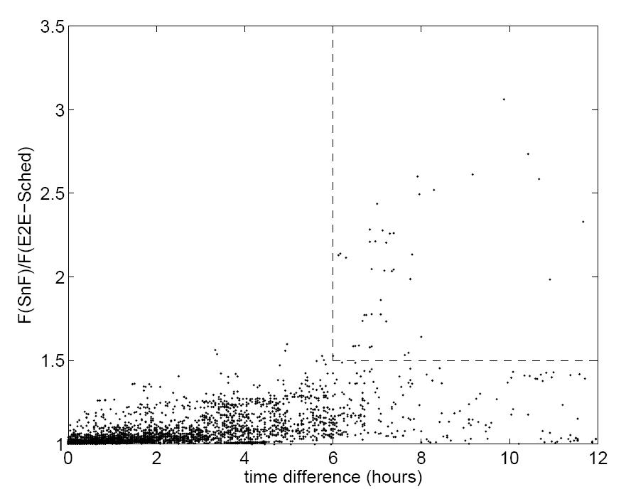
E2E-Sched vs. SnF (3/5)

Slide 17
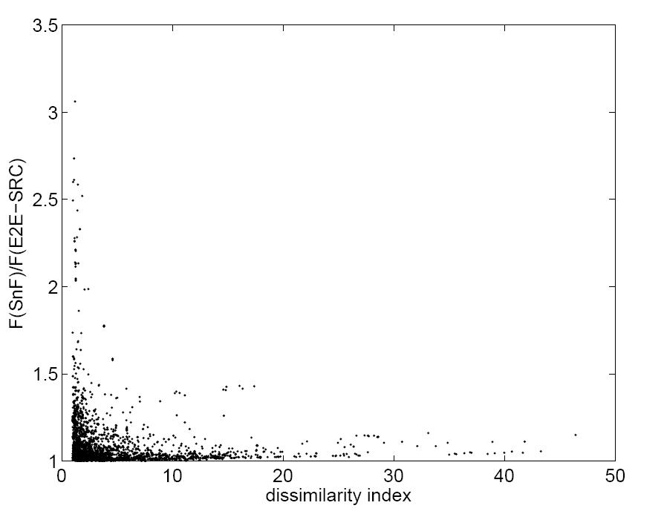
E2E-Sched vs. SnF (4/5)

Slide 18
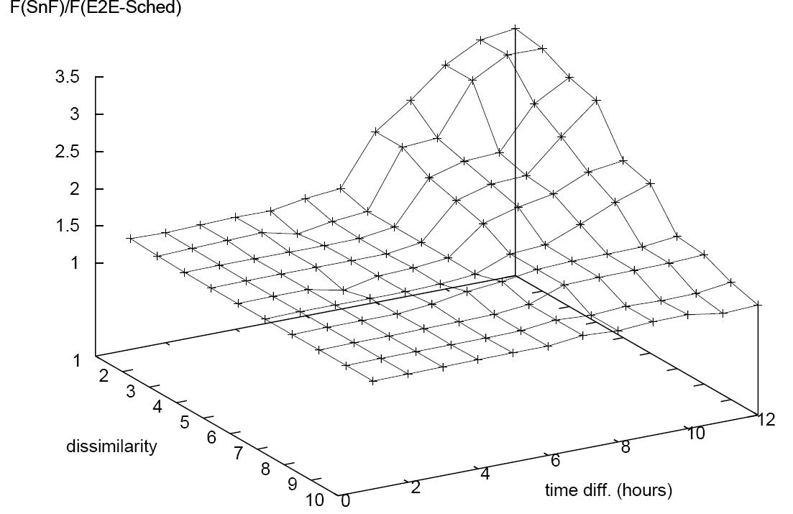
E2E-Sched vs. SnF (5/5)

Slide 19
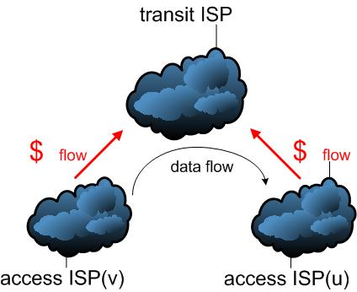
The cost of meeting deadlines
What if we want to send more than what fits for free?
To meet the deadline
  we need to send faster than what water-filling based on q₉₅(x_{v}), q₉₅(x_{u}) allows
  will have to pay extra cost
Min cost for sending volume B in [t₀,t₀+T) under policy P:
  Find q_{v}> q₉₅(x_{v}) and q_{u}>q₉₅(x_{u})
  To minimize c(q_{v})+c(q_{u})-c(q₉₅(x_{v})) -c(q₉₅(x_{u}))
  Subject to F(P,q_{v},q_{u},t₀,T)=B
q₉₅(x_{v})
q₉₅(x_{u})

Slide 20
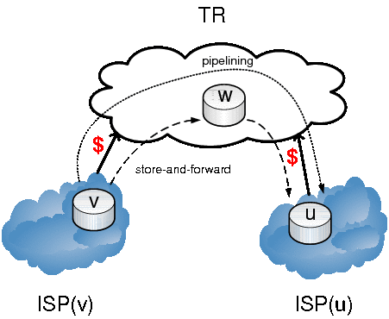
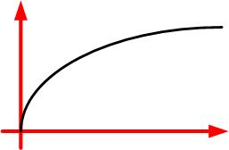

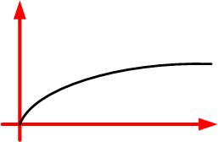
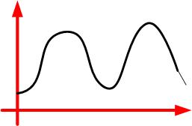
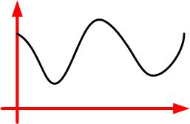
Things that affect the minimum cost
C(q)
Delay Tolerance: T
C(q)
q
q
bandwidth price
ISP(v) → TR
Data: B
bandwidth price
TR → ISP(u)
load ISP(v) → TR
load TR → ISP(u)

Slide 21
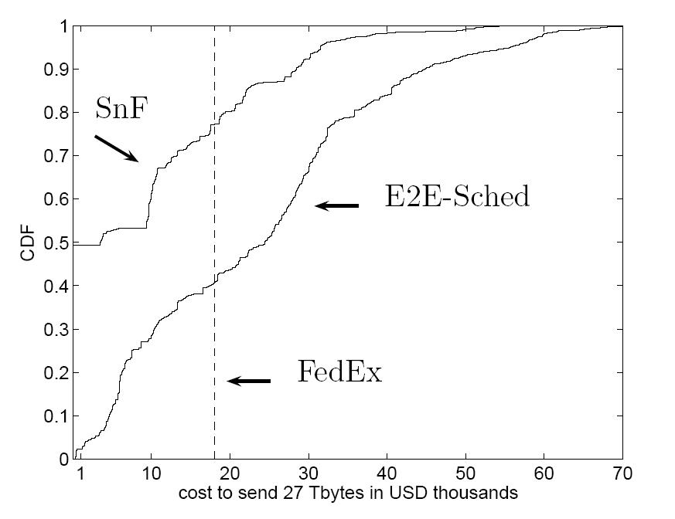
E2E-Sched vs. SnF vs. FedEx for CERN

Slide 22
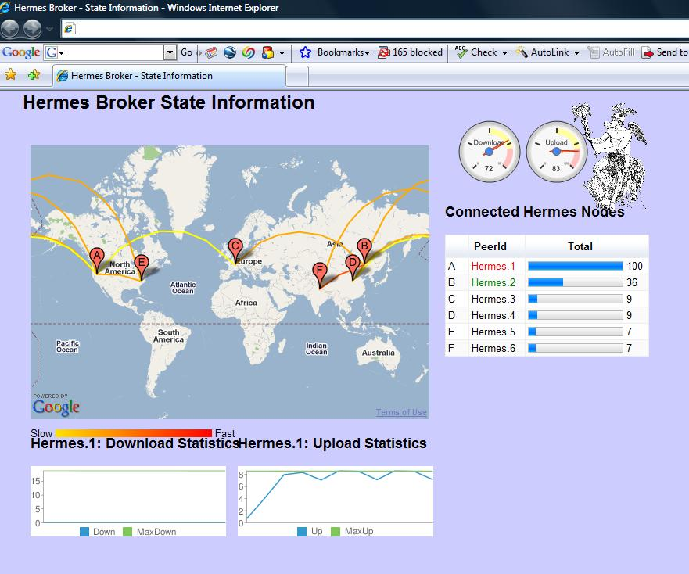
Ongoing work

Slide 23
Summary
E2E-CBR not cheaper than a dedicated link
if B<F(E2E-Sched) →send with E2E-Sched at 0 cost
If F(E2E-Sched)<B<F(SnF) →send with SnF at 0 cost
If B>F(SnF) →send with SnF at minimum transit cost
FedEx is cheaper for single shipments but not for flows

Slide 24
A more general take home message
Internet = communications →
max delay ~ msec – min →
scheduling = congestion avoidance
Internet = bulk data dissemination →
max delay ~ hours – days →
scheduling = network efficiency

Slide 25

More info at: http://research.tid.es/nikos/

Slide 26
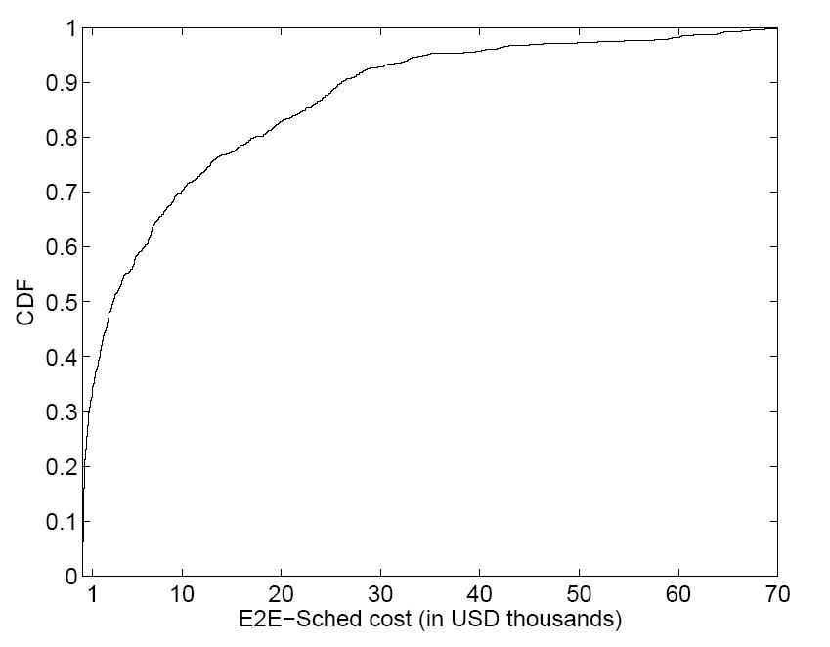
Cost for E2E-Sched for matching F(SnF)

