Slide 1
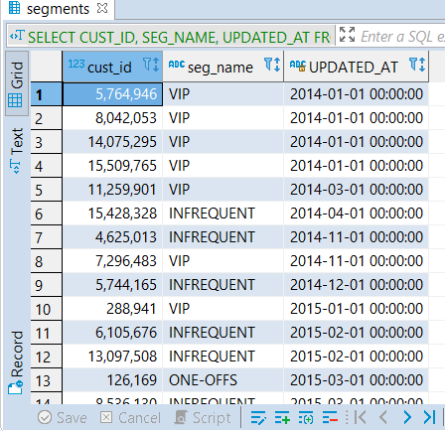
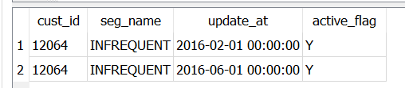

PROBLEM 1: Finding the current active segment for each customer sorted by the segment update date
Answer:
Since we have more than one active segment(active_flag=‘Y’) record showing for a cust_id and seg_name combination, a straight-forward WHERE ACTIVE_FLAG=‘Y’ ORDER BY UPDATE_AT will fetch records for customer where there are two dates active for a segment.
For example :
    SELECT * FROM SEGMENTS WHERE CUST_ID='12064' AND ACTIVE_FLAG=‘Y’;
To account for this, I have modified the query as below
    SELECT
    CUST_ID,
    SEG_NAME,
    UPDATED_AT
    FROM
    (
    SELECT
    cust_id, seg_name, update_at AS UPDATED_AT, ROW_NUMBER() OVER (PARTITION BY CUST_ID
    ORDER BY
    UPDATE_AT DESC) AS LATEST
    FROM
    SEGMENTS
    WHERE
    ACTIVE_FLAG = 'Y' ) LATEST_SEG
    WHERE
    LATEST = 1
    ORDER BY
    UPDATED_AT ASC;
Result:

Slide 2
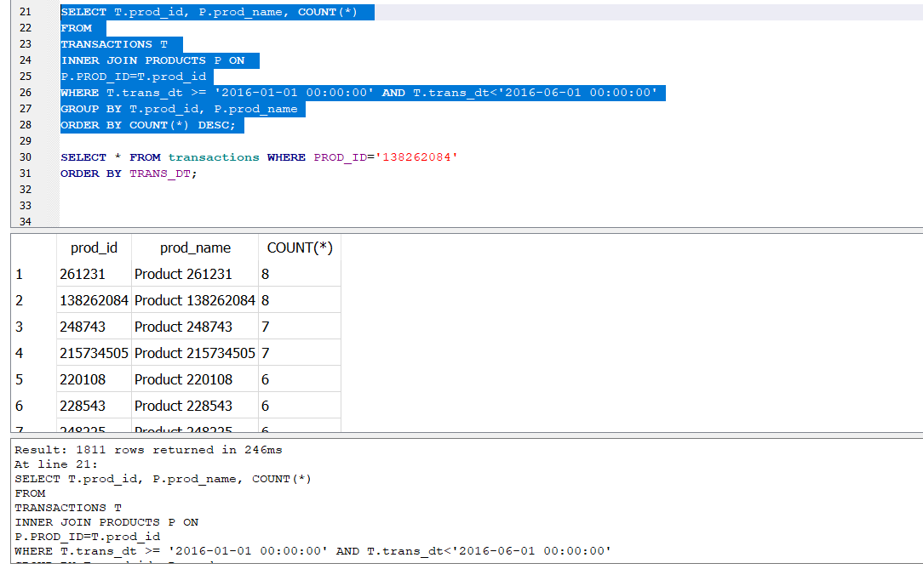
PROBLEM 2: Find number of distinct transactions per product between Jan 01 2016 and May 31 2016
Answer:
Here the query to get the no of transactions per product
  SELECT T.prod_id, P.prod_name,
  COUNT(*)
  FROM
  TRANSACTIONS T
  INNER JOIN PRODUCTS P ON
  P.PROD_ID=T.prod_id
  WHERE
  T.trans_dt >= '2016-01-01 00:00:00' AND
  T.trans_dt<'2016-06-01 00:00:00'
  GROUP BY T.prod_id, P.prod_name
  ORDER BY COUNT(*) DESC;
Or
  SELECT T.prod_id, P.prod_name,
  COUNT(distinct trans_id)
  FROM
  TRANSACTIONS T
  INNER JOIN PRODUCTS P ON
  P.PROD_ID=T.prod_id
  WHERE T.trans_dt >= '2016-01-01 00:00:00’
  AND T.trans_dt<'2016-06-01 00:00:00'
  GROUP BY T.prod_id, P.prod_name
  ORDER BY COUNT(distinct trans_id) DESC;

Slide 3
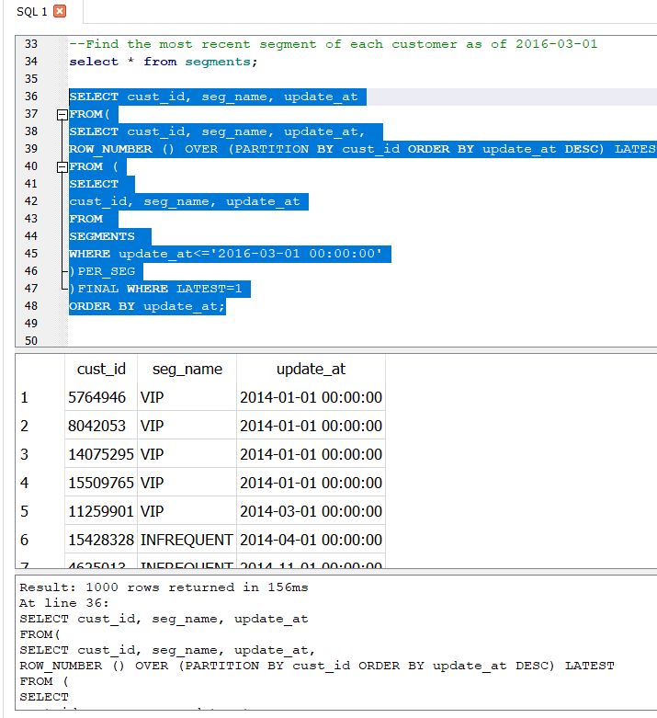
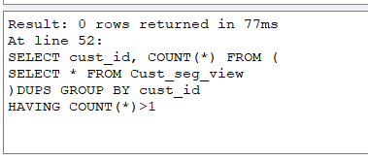
PROBLEM 3: Find the most recent segment of each customer as of 2016-03-01
Answer:
  SELECT cust_id, seg_name, update_at
  FROM(
  SELECT cust_id, seg_name, update_at,
  ROW_NUMBER () OVER (PARTITION BY cust_id
  ORDER BY update_at DESC)
  LATEST
  FROM (
  SELECT
  cust_id, seg_name, update_at
  FROM
  SEGMENTS
  WHERE update_at<='2016-03-01 00:00:00'
  )PER_SEG
  )FINAL WHERE LATEST=1
  ORDER BY update_at;
The Other Part of the question : “should have at most one row per customer”
To verify this
  SELECT cust_id, COUNT(*) FROM (
  SELECT * FROM Cust_seg_view
  )DUPS GROUP BY cust_id
  HAVING COUNT(*)>1

Slide 4
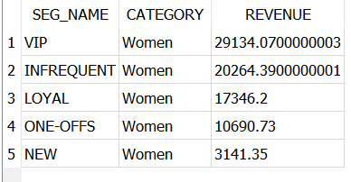
PROBLEM 4: FIND MOST POPULAR CATEGORY FOR EACH ACTIVE SEGMENT. **READ AS MOST REVENUE PRODUCING WHERE REVENUE IS item_qty* item_price
Answer:
  SELECT SEG_NAME, category, REVENUE FROM
  (
  SELECT SEG_NAME, CATEGORY, REVENUE,
  RANK() OVER(PARTITION BY
  SEG_NAME
  ORDER BY REVENUE DESC)
  AS MOST_POP
  FROM
  (
  SELECT
  S.seg_name,
  P.category,
  SUM(T.item_price * T.item_qty) AS REVENUE
  FROM
  TRANSACTIONS T
  INNER JOIN products P ON
  P.prod_id=T.prod_id
  INNER JOIN segments S ON
  S.CUST_ID =T.cust_id
  WHERE S.ACTIVE_FLAG='Y'
  GROUP BY S.seg_name, P.category
  --ORDER BY REVENUE DESC;
  )MOST_POP
  )FINAL WHERE MOST_POP=1
  ORDER BY REVENUE DESC;

