Slide 1
FINAL PROJECT
Vehicle Maintenance Service
Booking System
A database-driven web application for a small vehicle service center
Student:
Student ID:
Amer Alawadhi
3087

Slide 2
INTRODUCTION
Project Overview
A small vehicle service center needs a web application to manage customer vehicles, maintenance bookings, and service records — helping staff track service requests and update service status.
6
3
Web Pages
Database Tables
Actors / Users
• Service center admin / staff — manage bookings, update statuses, view reports
• Mechanic — updates booking status as work progresses
• Customer — registers a profile, registers vehicles, books services, reviews history
23
4
Stored Procedures
Reports
Vehicle Maintenance Service Booking System — Amer Alawadhi (ID: 3087)
2

Slide 3
ARCHITECTURE
Technology Stack
Back End
C# / ASP.NET Core MVC (.NET 8)
Front End
Razor views (HTML5), external CSS3, vanilla JavaScript (ES6)
Database
Microsoft SQL Server 2022 (containerized via Docker)
Data Access
ADO.NET (Microsoft.Data.SqlClient) with parameterized stored procedures
Dev Tools
Visual Studio Code, .NET CLI, Docker / Colima
ASP.NET Core MVC was used instead of Web Forms — an option explicitly permitted by the assignment — so it could be built, run, and verified end-to-end on macOS.
Vehicle Maintenance Service Booking System — Amer Alawadhi (ID: 3087)
3

Slide 4
DATA MODEL
Database Design
Customers
Vehicles
ServiceBookings
• CustomerID (PK)
• FullName
• Email (UNIQUE)
• Phone
• CreatedDate
• VehicleID (PK)
• CustomerID (FK)
• PlateNumber
• Brand / Model
• Year
• CreatedDate
• BookingID (PK)
• VehicleID (FK)
• ServiceType
• BookingDate
• Status
• Notes
1 : many
1 : many
All foreign keys cascade on delete — removing a customer removes their vehicles and bookings.
23 stored procedures cover full CRUD + search + 4 reports — all SQL access is parameterized (no string concatenation).
Vehicle Maintenance Service Booking System — Amer Alawadhi (ID: 3087)
4

Slide 5
FUNCTIONALITY
CRUD Operations & Validation
CRUD Operations
Validation Rules
Create
Add customers, vehicles, and bookings
• Email — regular expression, client + server
• Plate number — regex ^[A-Za-z]{1,3}[\s-]?\d{1,6}$
• Vehicle year — 1980 to (current year + 1)
• Booking status — fixed set, DB CHECK constraint
• Server-side validation is authoritative
Read
Display all records with owner/vehicle joins
Update
Inline-editable table rows on every page
Delete
Cascading delete with confirm() dialogs
Vehicle Maintenance Service Booking System — Amer Alawadhi (ID: 3087)
5

Slide 6
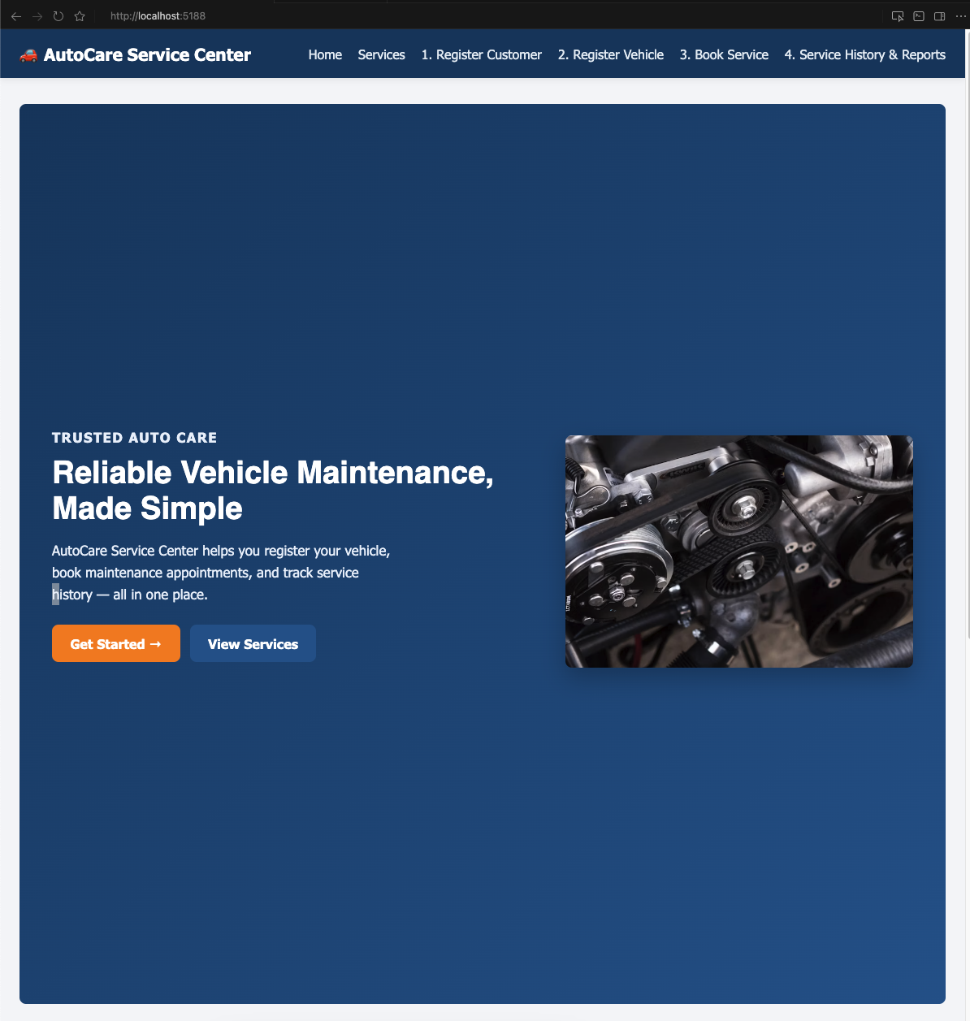
WALKTHROUGH — STEP 0
Home Page
• Hero section introduces the service center and its value proposition
• “Get Started” button leads directly into the booking workflow
• Full-bleed responsive hero built with Flexbox
Vehicle Maintenance Service Booking System — Amer Alawadhi (ID: 3087)
6

Slide 7
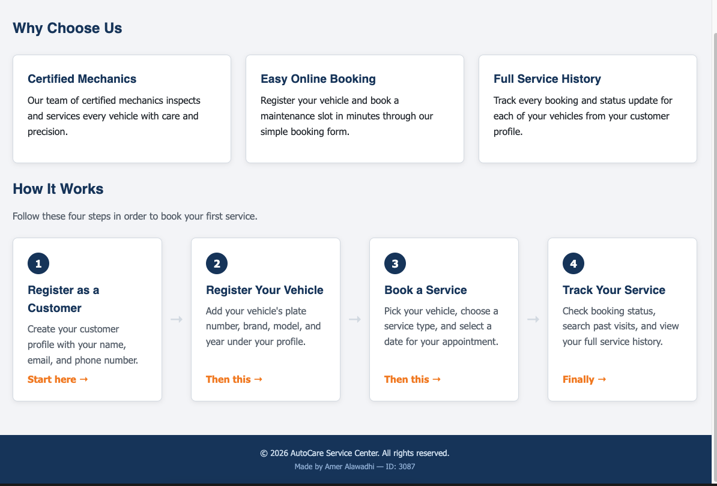
WALKTHROUGH — STEP 0
Home Page — Guided Workflow
• “Why Choose Us” cards use a CSS Grid layout
• Numbered “How It Works” guide walks first-time visitors through all 4 steps
• Designed so a new user always knows what to do next
Vehicle Maintenance Service Booking System — Amer Alawadhi (ID: 3087)
7

Slide 8
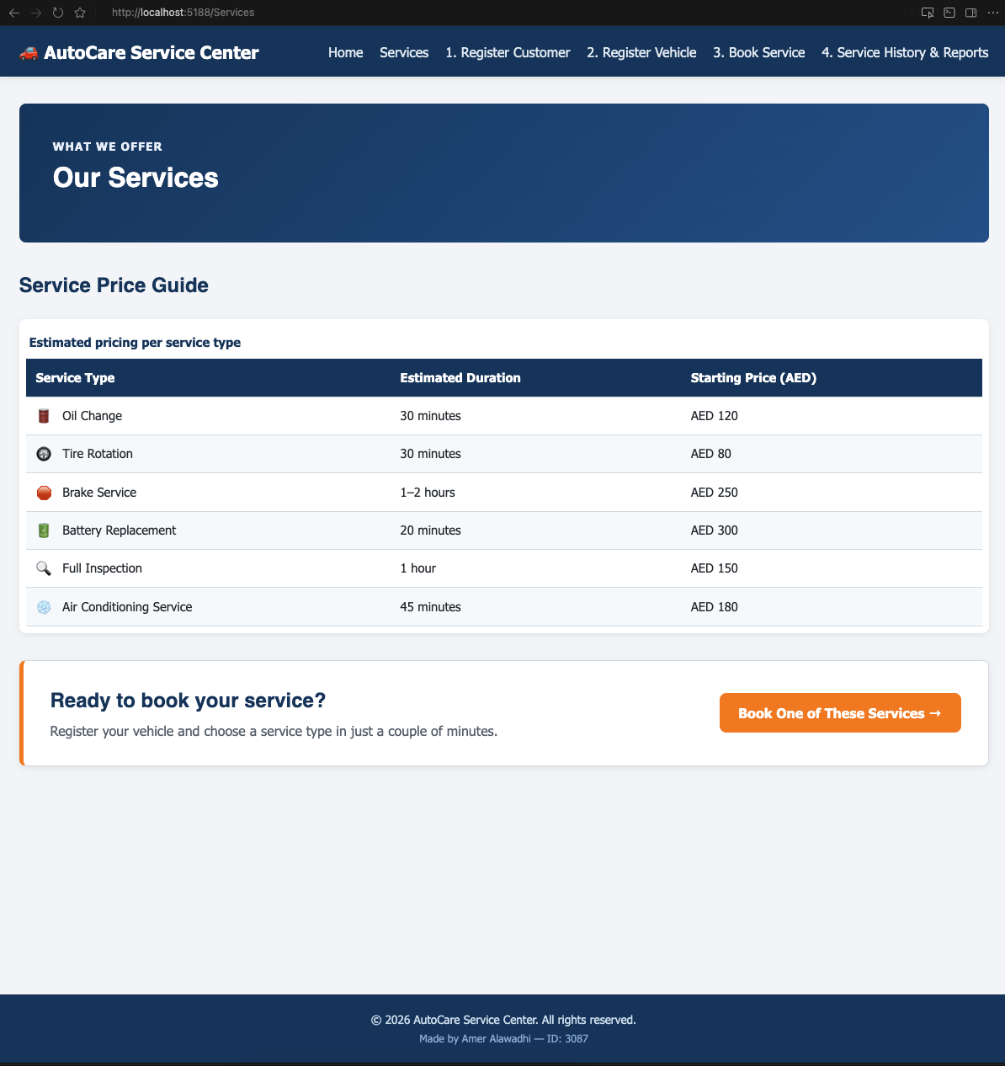
WALKTHROUGH — SERVICES
Services & Price Guide
• Six service types with estimated duration and starting price
• Data table demonstrates semantic HTML table markup
• Call-to-action banner links straight into the booking page
Vehicle Maintenance Service Booking System — Amer Alawadhi (ID: 3087)
8

Slide 9
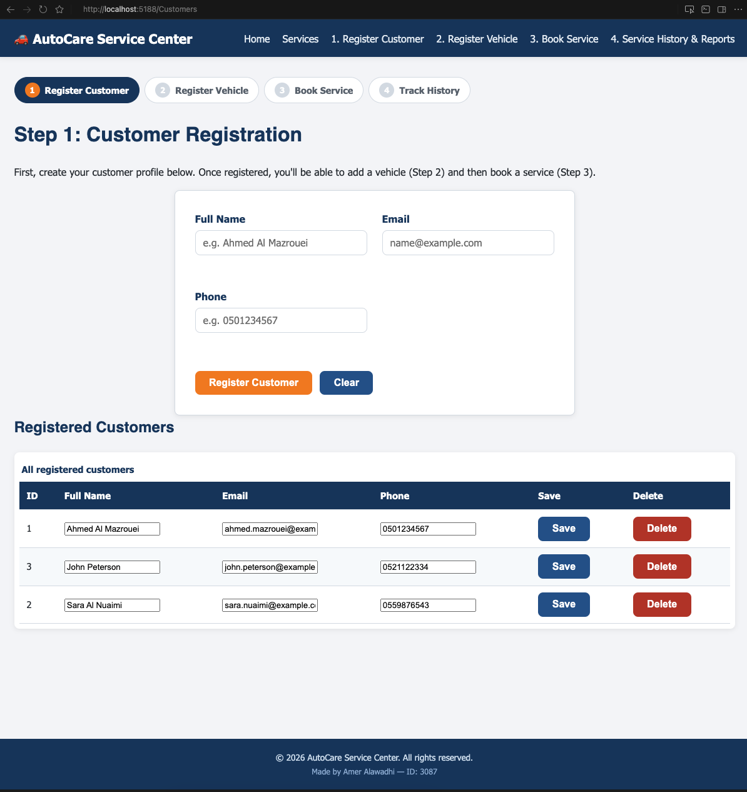
WALKTHROUGH — STEP 1
Customer Registration
• Step indicator shows progress through the 4-step workflow
• Create form + live table of all registered customers
• Inline edit (Save) and Delete with confirmation, backed by stored procedures
Vehicle Maintenance Service Booking System — Amer Alawadhi (ID: 3087)
9

Slide 10
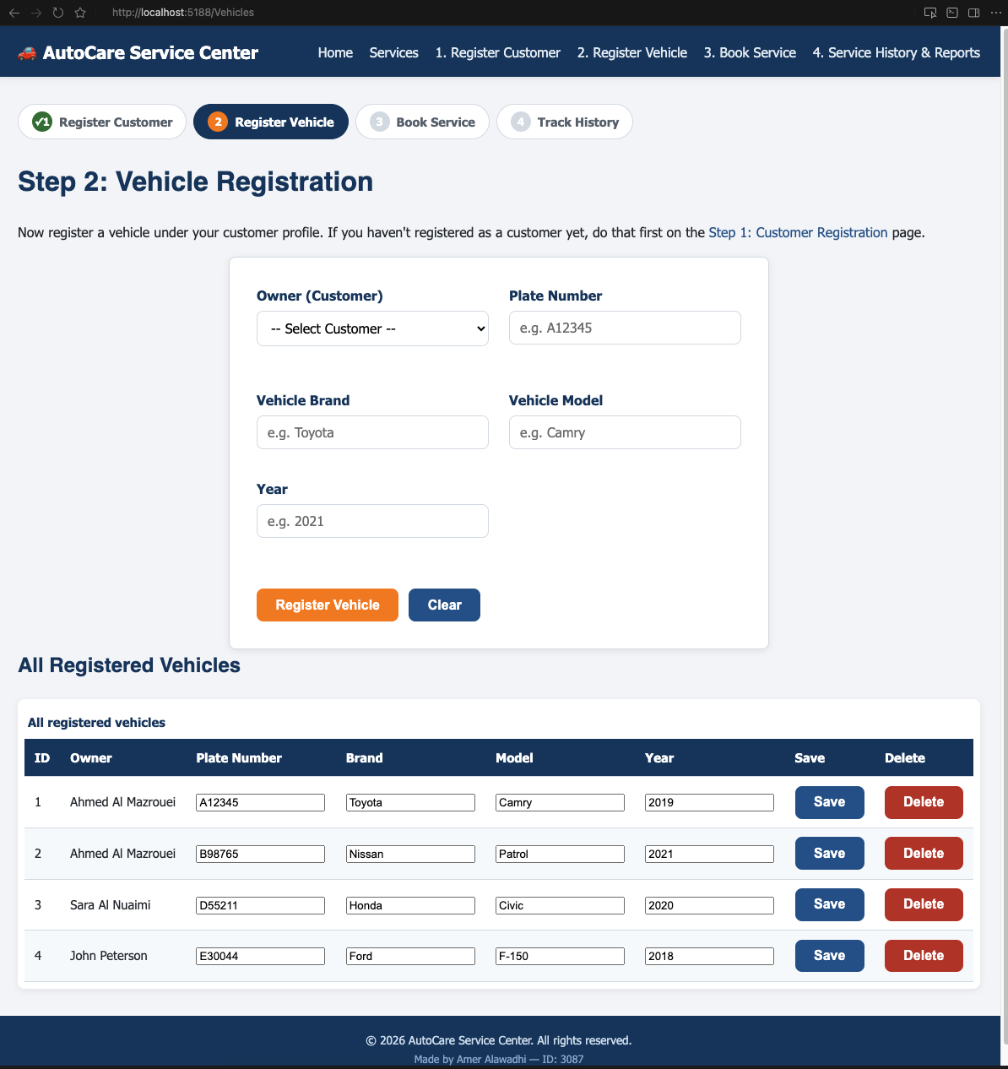
WALKTHROUGH — STEP 2
Vehicle Registration
• Vehicle linked to an existing customer via a dropdown (foreign key)
• Plate number and year validated client-side and server-side
• All registered vehicles shown with owner name via SQL join
Vehicle Maintenance Service Booking System — Amer Alawadhi (ID: 3087)
10

Slide 11
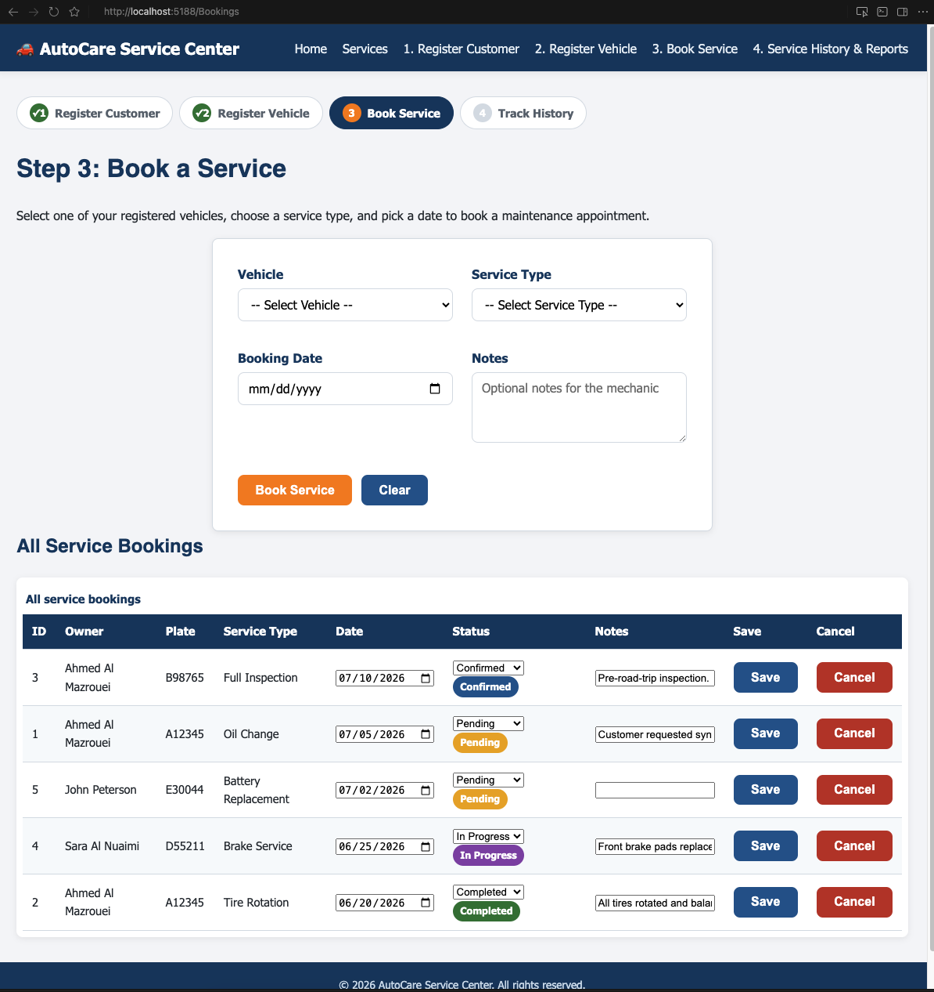
WALKTHROUGH — STEP 3
Service Booking
• Select vehicle, service type, and date to create a booking
• Status badges (Pending / Confirmed / In Progress / Completed) color-coded
• Booking status editable inline; Cancel guarded by a confirm() dialog
Vehicle Maintenance Service Booking System — Amer Alawadhi (ID: 3087)
11

Slide 12
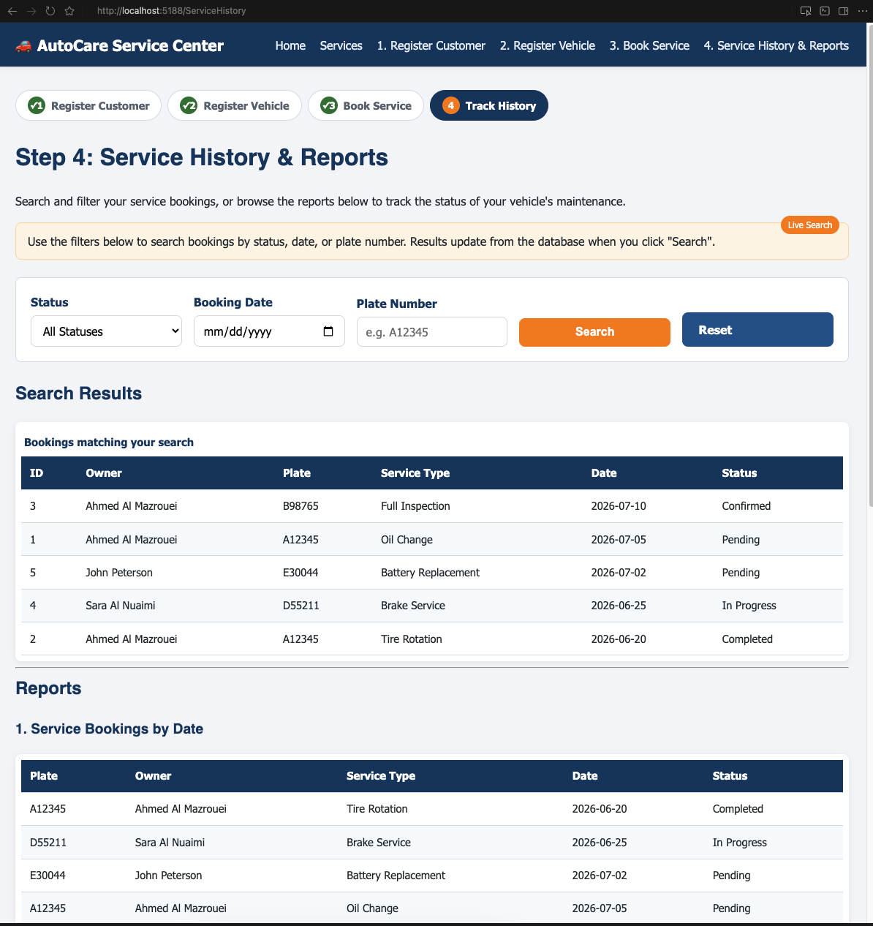
WALKTHROUGH — STEP 4
Service History & Reports (1/2)
• Live search/filter by status, date, and plate number
• Report 1: Service Bookings by Date — queried via a dedicated stored procedure
• Results and reports are database-driven, not hardcoded
Vehicle Maintenance Service Booking System — Amer Alawadhi (ID: 3087)
12

Slide 13
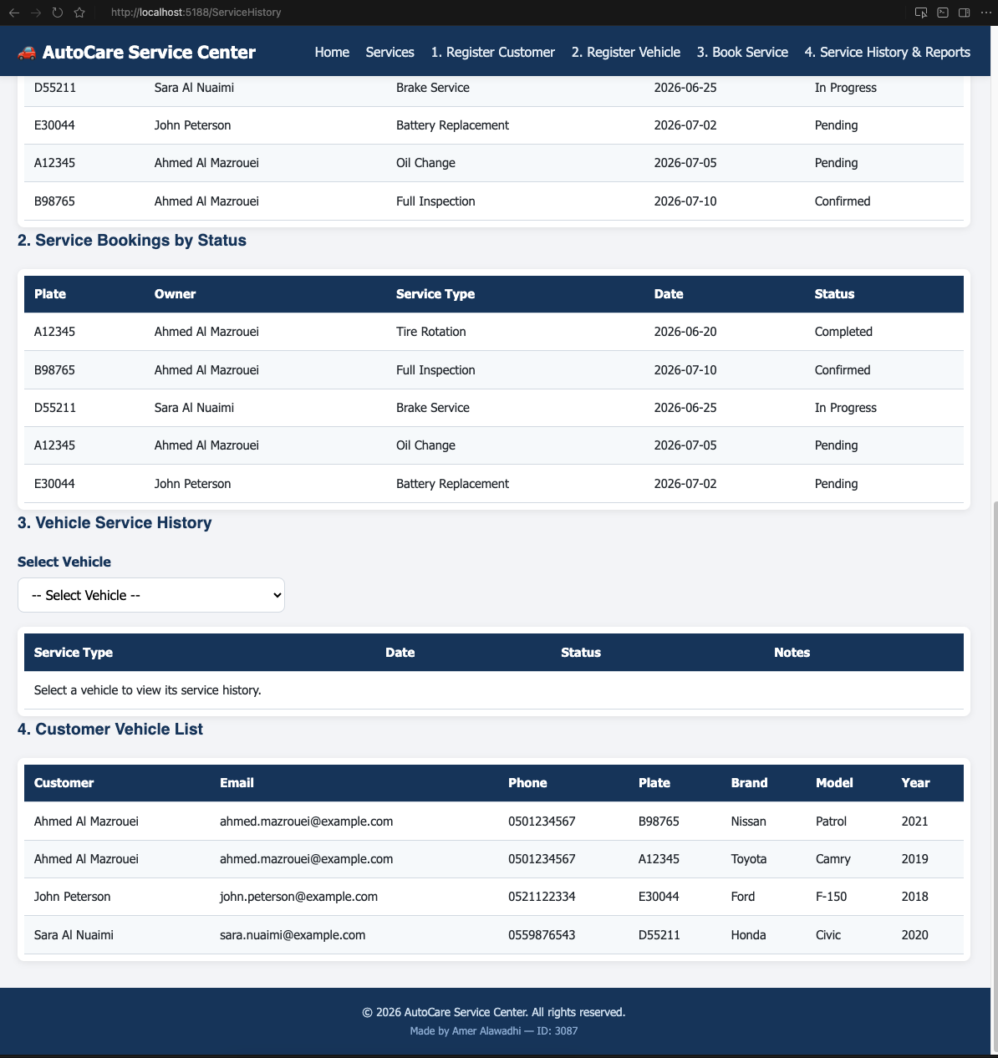
WALKTHROUGH — STEP 4
Service History & Reports (2/2)
• Report 2: Bookings by Status • Report 3: Vehicle Service History
• Report 4: Customer Vehicle List — full customer-to-vehicle join
• Four distinct reports satisfy the assignment's reporting requirement
Vehicle Maintenance Service Booking System — Amer Alawadhi (ID: 3087)
13

Slide 14
FRONT END
JavaScript Features
• DOM access via getElementById() and querySelectorAll()
• Event handling via addEventListener() (input, blur, click)
• Regular expressions for email, plate number, and year validation
• Selection statements (if/else) and loop statements (for)
• DOM manipulation via innerHTML and textContent for live field errors
• confirm() dialogs before every destructive action (delete / cancel)
Vehicle Maintenance Service Booking System — Amer Alawadhi (ID: 3087)
14

Slide 15
FRONT END
CSS & Responsive Design
• Typography & box model — CSS custom properties (:root variables) for a consistent theme
• Flexbox — header/nav, hero section, step-by-step guide, filter bar
• CSS Grid — service cards, “Why Choose Us” cards, multi-column forms
• Float & position — utility classes demonstrated per assignment requirement
• Media queries — two breakpoints (768px, 480px) for tablet/mobile layouts
Vehicle Maintenance Service Booking System — Amer Alawadhi (ID: 3087)
15

Slide 16
QUALITY ASSURANCE
Testing & Verification
• dotnet build completes with 0 warnings, 0 errors
• database_script.sql executed against a live SQL Server 2022 container via sqlcmd — verified no errors
• All 6 pages tested via HTTP requests — confirmed 200 OK, correct static assets (CSS/JS/images)
• Live Create → verify-in-database → Delete round trip performed against the Customers table
• Search/filter feature verified to return correctly scoped results
Vehicle Maintenance Service Booking System — Amer Alawadhi (ID: 3087)
16

Slide 17
REFLECTION
Challenges & Key Decisions
• Framework choice — switched from ASP.NET Web Forms to ASP.NET Core MVC to build and test the app directly on macOS, without needing Windows or Visual Studio
• Local SQL Server — ran SQL Server 2022 in a Docker container (via Colima) since native SQL Server isn't available on macOS
• One-command setup — built start.sh to auto-detect and install missing dependencies (Homebrew, Docker, .NET SDK) so the project runs on a fresh machine with a single command
• Security — every database call uses parameterized stored procedures; no SQL string concatenation anywhere in the codebase
Vehicle Maintenance Service Booking System — Amer Alawadhi (ID: 3087)
17

Slide 18
CONCLUSION
A Complete, Verified Solution
• Three related database tables with proper keys and constraints
• Full CRUD operations backed exclusively by parameterized stored procedures
• A multi-page responsive front end built with semantic HTML, CSS, and JavaScript
• Client- and server-side validation on every form
• Verified to run correctly end-to-end, not just reviewed as static code
Thank you.

